Slide 1

LIBRARY MANAGEMENT SYSTEM

Slide 2
INTRODUCTION
The project “ Library Management System ” developed in java using Hibernate Framework. It is a Console Based Application. It perform some basic operations in library like adding new members, new books and updating new information, searching books and members and facility to borrow books and return books.
The project has six modules which is Member, MemberReport, Book, Category, Librarian, Authentication. The Library Management System stores the details like name, Librarian_ID of librarians working in the library and Members who visit to library. The details of books like book name, book_ID, author, year of publication that are present in the library.

Slide 3
OBJECTIVES
Improve user interaction with the library through intuitive interfaces and streamlined processes.
Automate routine tasks such as book data entry, and maintenance of records.
Provide role-based access control for different users (member , librarian, ).
Generate various reports, such as daily transactions, late returns, and user activity.
Manage library members, including visitors and librarians.

Slide 4
PURPOSE
Help library administrators monitor usage, improve services, and make informed decisions based on data.
Enhance user experience by enabling quick access to desired materials based on author, title, subject .
Keep track of user details, membership status, and their borrowing history, outstanding items.
Ensure all library resources are properly indexed, categorized, and searchable by members and library staff.

Slide 5
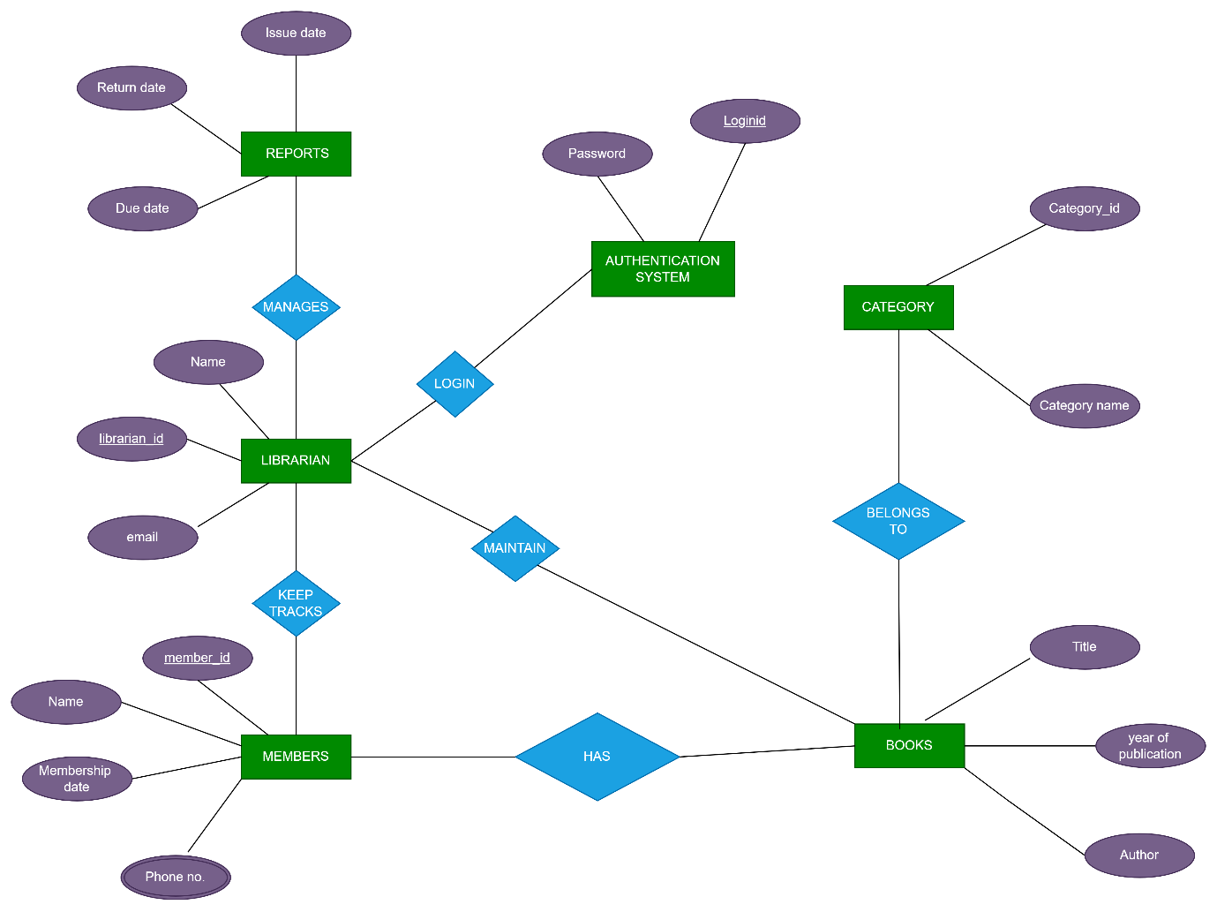
ER DIAGRAM

Slide 6
TECHNOLOGY
Software Requirements :-
Java is the core language for the project, and the JDK includes the Java compiler, runtime environment, and necessary libraries.
Eclipse is the Integrated Development Environment (IDE) where we will write, test, and debug our Java code. It also supports plugins for Hibernate and MySQL.
Hibernate is an Object-Relational Mapping (ORM) framework that will manage database interactions. It simplifies database access and reduces the need for complex SQL queries by mapping Java objects to database tables. You’ll need to include Hibernate libraries and configure the Hibernate configuration file (hibernate.cfg.xml) .
MySQL will store the library's data such as books, users, and transactions. You'll need to set up a database to store all your entities.

Slide 7
TECHNOLOGY
Hardware Requirements :-
intel core i5 processor.
Keyboard
Mouse

Slide 8
Proposed System
The proposed system contains the following features:
The members will register them through Online.
Individually each member will have his account through which he can access the information he needs.
Book details like authors, number of copies totally maintained by library, present available number of books, reference books, non-reference books etc. all this information can be made handy.
Regarding the members designation, number of books was issued.
Issue dates and returns of each member is maintained separately .
Librarian can add, update , delete the books.
Time consuming is low, gives accurate results, reliability can be improved with the help of security.

Slide 9
Conclusion:- This website provides a computerized version of library management system which will benefit the members as well as the librarian of the library. It makes entire process online where members can search books, librarian can generate reports and do book transactions. It also has a facility for members login where members can login and can see status of books issued as well request for book or give some suggestions.

Slide 10
Thank You !

