Slide 1
LIBRARY MANAGEMENT SYSTEM

Slide 2
INTRODUCTION
The project “ Library Management System ” developed in java using Hibernate Framework. It is a Console Based Application. It perform some basic operations in library like adding new members, new books and updating new information, searching books and members and facility to borrow books and return books.
The project has six modules which is Member, MemberReport, Book, Category, Librarian, Authentication. The Library Management System stores the details like name, Librarian_ID of librarians working in the library and Members who visit to library. The details of books like book name, book_ID, author, year of publication , the total number of books that are present in the library.

Slide 3
TECHNOLOGY
Tool Used :-
Eclipse IDE
MYSQL for Database
JAVA Programming Language
Hibernate Framework

Slide 4
Eclipse IDE
Eclipse is an Integrated Development Environment (IDE) used in computer programming. It contains a base workspace and an extensible plug-in system for customizing the environment. It had been the most popular IDE for Java development Kit.
The Eclipse Software Development Kit (SDK) is free and open-source software, released under the terms of the Eclipse Public License.

Slide 5
MySQL Workbench
MySQL Workbench is a visual database design tool that integrates SQL development, administration, database design, creation and maintenance into a single integrated development environment for the MySQL database system.
The MySQL GUI Tools Bundle is a cross-platform open-source suite of desktop applications for the administration of MySQL database servers, and for building and manipulating the data within MySQL databases.
It was developed by MySQL AB and later by Sun Microsystems and released under the GPL.

Slide 6
JAVA Programming Language
Java is a high-level, class-based, object-oriented programming language that is designed to have as few implementation dependencies as possible. It is a general-purpose programming language intended to let programmers write once, run anywhere (WORA), meaning that compiled Java code can run on all platforms that support Java without the need to recompile.
Java was originally developed by James Gosling at Sun Microsystems. It was released in May 1995 as a core component of Sun's Java platform.

Slide 7
Hibernate Framework
Hibernate ORM (or simply Hibernate) is an object–relational mapping tool for the Java programming language. It provides a framework for mapping an object-oriented domain model to a relational database. Hibernate handles persistent database accesses with high-level object handling functions. Hibernate is free software that is distributed under the GNU Lesser General Public License 2.1. Hibernate's primary feature is mapping from Java classes to database tables, and mapping from Java data types to SQL data types. The mapping of Java classes to database tables is implemented by the configuration of an XML file or by using Java Annotations.
There are provided facilities to arrange one-to-many and many-to-many relationships between classes. Hibernate can use the XML file or the Java annotations to maintain the database schema.

Slide 8
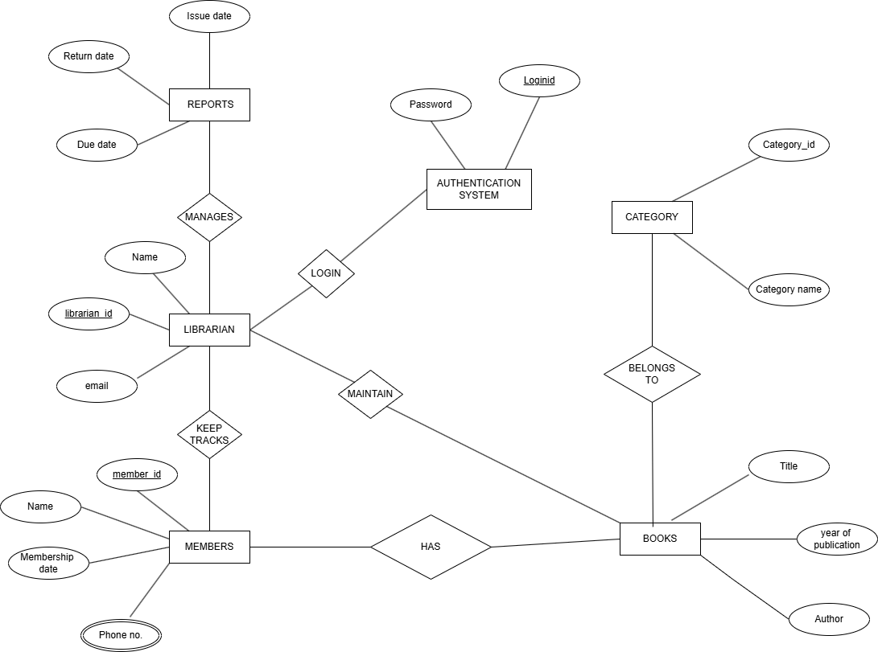
ER DIAGRAM

Slide 9
DATABASE DESIGN
Table Design :-
1.Book :-
Column Name | Data Types | Constraints
ID | INT | Primary Key
Title | VARCHAR (100) | NOT NULL
Author | VARCHAR (50) | NOT NULL
YearOfPublication | INT | NOT NULL
MembershipDate | DATE | NOT NULL

Slide 10
DATABASE DESIGN
2.Category :-
Column Name | Data Types | Constraints
Category_id | INT | Primary Key
Category_Name | VARCHAR (50) | NOT NULL

Slide 11
DATABASE DESIGN
3.Members :-
Column Name | Data Types | Constraints
Member_id | INT | Primary Key
Name | VARCHAR (20) | NOT NULL
Email | VARCHAR | NOT NULL, Unique Key
Password | VARCHAR | NOT NULL, Unique Key
MembershipDate | DATE | NOT NULL
Phone Number | INT | NOT NULL

Slide 12
DATABASE DESIGN
4.Member Report :-
Column Name | Data Types | Constraints
ID | INT | Primary Key
Issue_Date | DATE | NOT NULL
Return_Date | DATE | NOT NULL
Due_Date | DATE | NOT NULL

Slide 13
DATABASE DESIGN
4.Librarian :-
Column Name | Data Types | Constraints
Librarian_id
Name
Email
Password

