Slide 1
E-retail factors for customer activation and retention: A case study from Indian e-commerce customers
Submitted by: Vrushal Ghanate

Slide 2
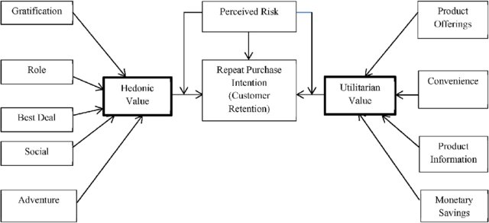

Conceptual Background of the Domain Problem
Problem Statement: Analyse the Features affecting Customer Satisfaction & retention and test if brand preference depends on factors like age and gender.
The combination of both utilitarian value and hedonistic values are needed to affect the repeat purchase intention (loyalty) positively.
The data is collected from the Indian online shoppers. Results indicate the e-retail success factors, which are very much critical for customer satisfaction.

Slide 3
Analytical Problem Framing
Data Scientists must apply their analytical skills to give findings and conclusions in detailed data analysis written in Jupiter notebook.
Only data analysis is required.

Slide 4
Data sources and info
There are two sheets (one is detailed) and second is encoded in the excel file.
Using df.shape(), we get dimensions i.e. 269 rows and 71 columns.
Using df.head() we display the first five rows of the dataset.
Using df.info(), we get info of the features of the dataset and we get 70 “object” type features and 1 “int64” type feature.

Slide 5
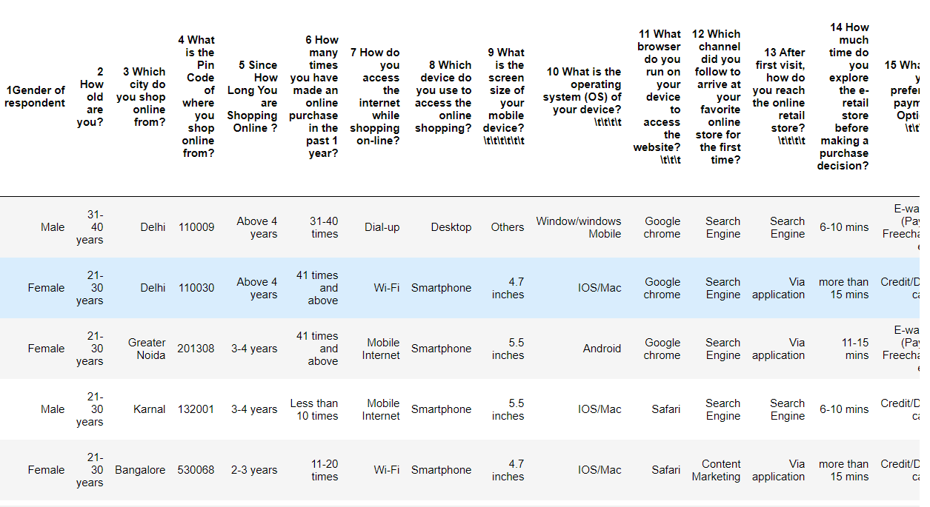

Slide 6
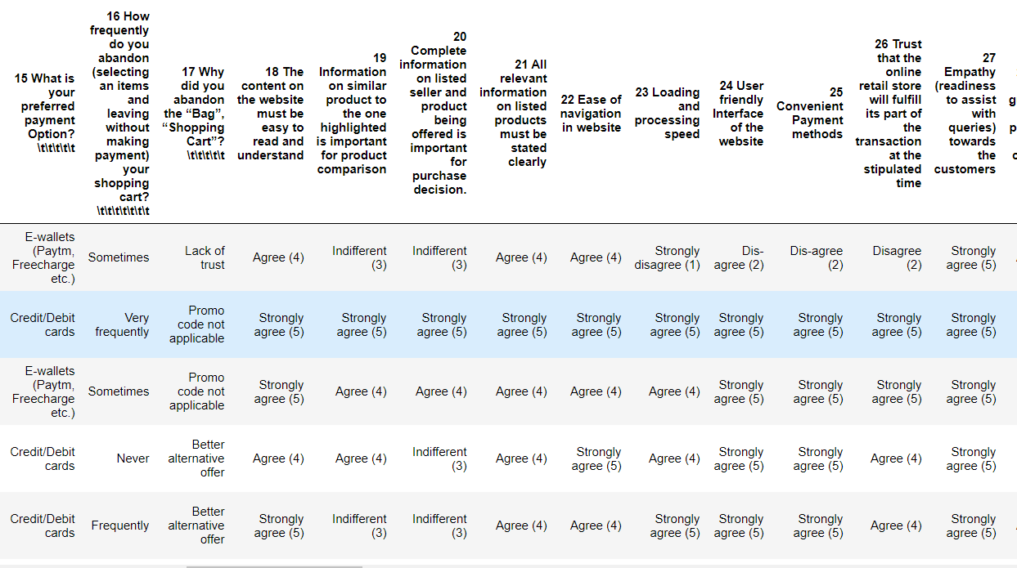

Slide 7
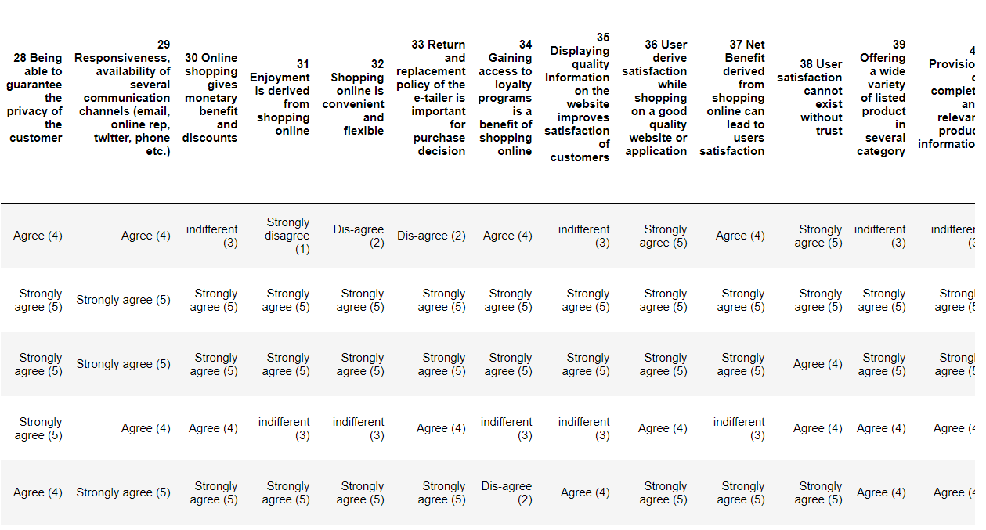

Slide 8
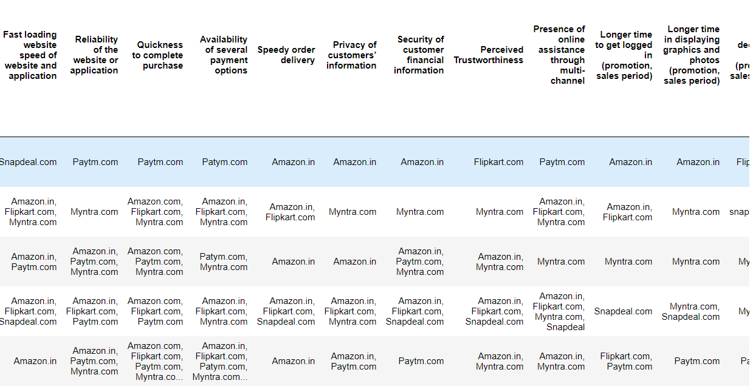

Slide 9
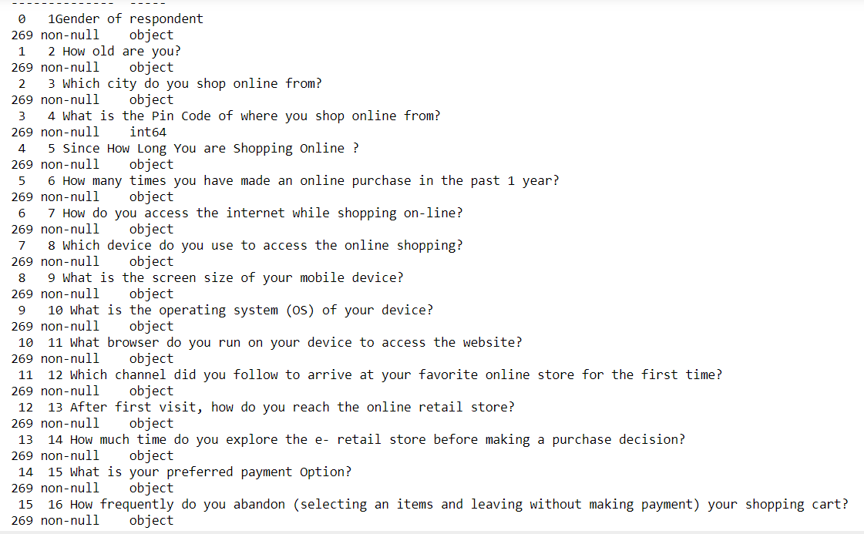
Dataset info: (269 rows and 71 columns)

Slide 10
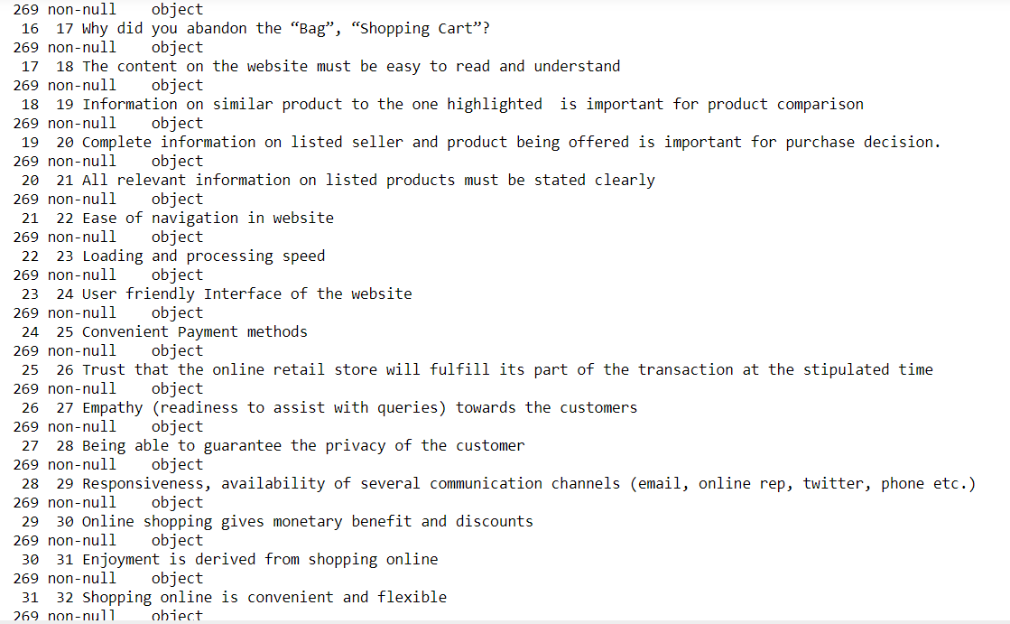

Slide 11
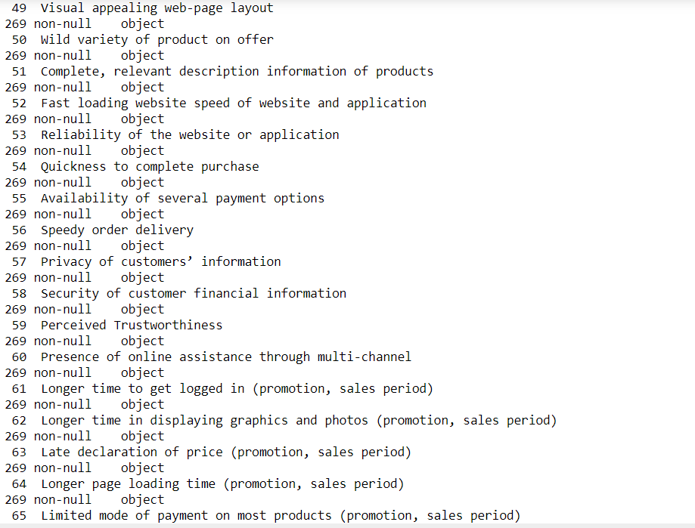

Slide 12
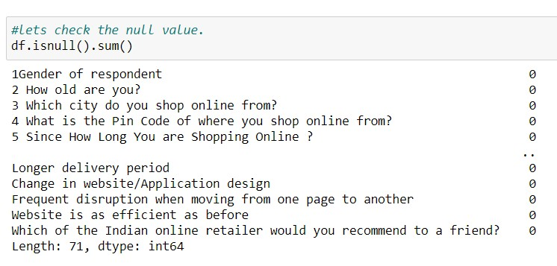
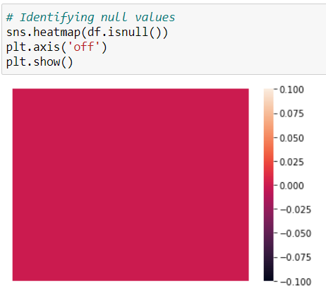
Checking for the null values: sns.heatmap(df.isnull().sum())
From the plot we can see that there are no null values present in the dataset.

Slide 13
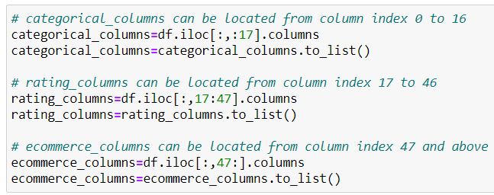
As there are a huge number of features, it makes sense to divide the data into these categories:
categorical_columns = This will contain demographic features and other person specific features like age, gender, browser]
rating_columns = This will contain all questions which have answers in the form of (Agree, Strongly Agree, Indifferent etc.)
ecommerce_columns = This will contain all questions which have answers in the form of (amazon, flipkart, Myntra etc.)

Slide 14
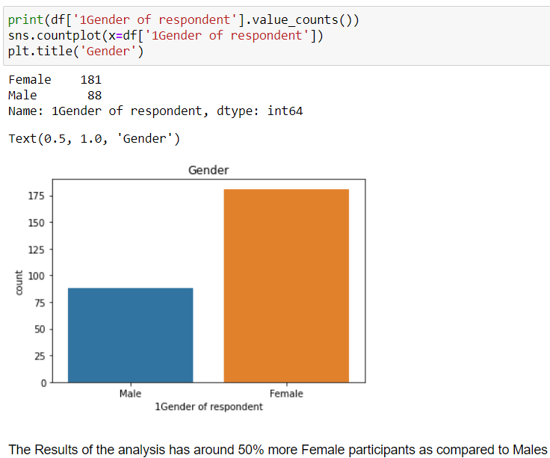
Data visualization:
From the plot we can see Female online buyer (181) are more than Male online buyer (88)

Slide 15
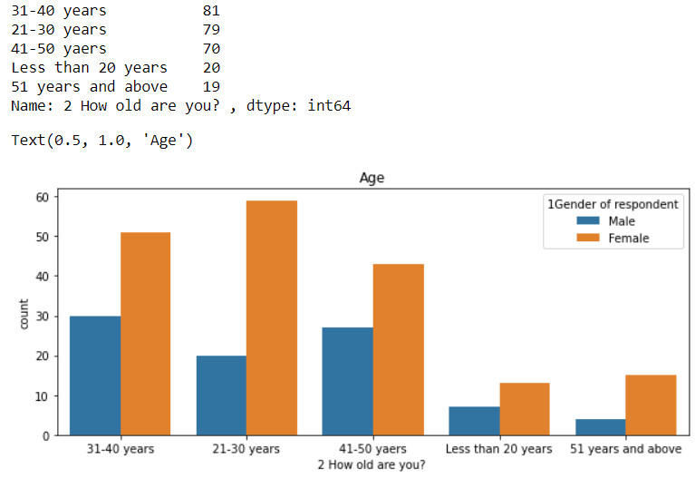
From the plot we can see Female online buyer are more than Male online buyer in all ages.

Slide 16
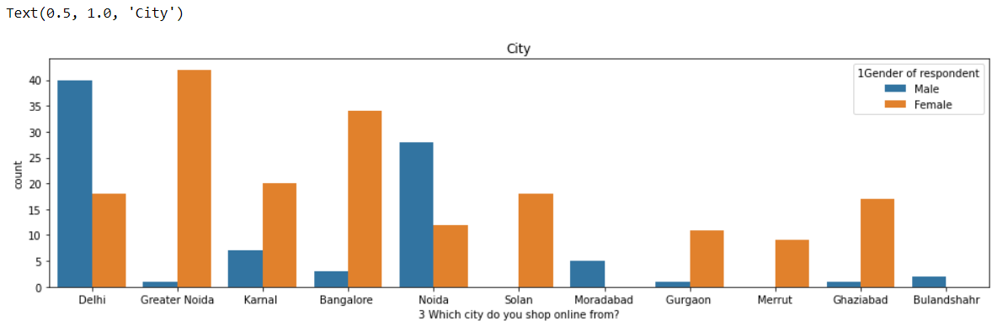
from the plot we can say that cities like Delhi , Noida, Moradabad, Bulandshahr has more male customers and cities like greater Noida, Karnal, Bangalore, Solan, Gurgaon, Merrut & Ghaziabad has more female customers.

Slide 17
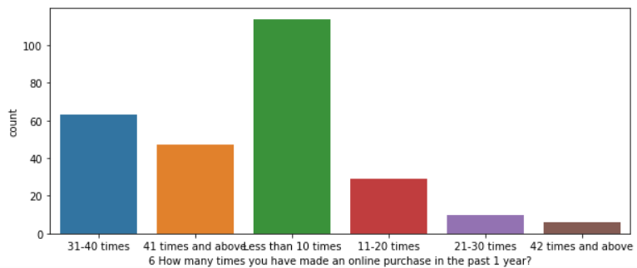
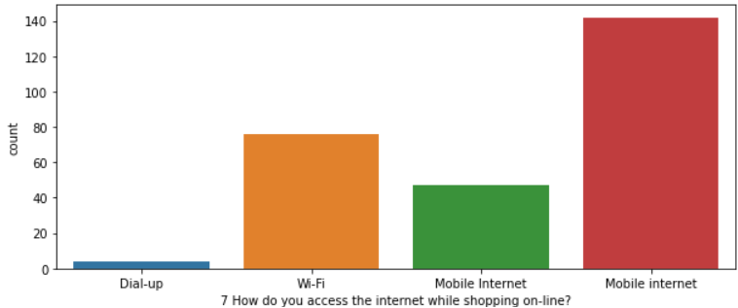
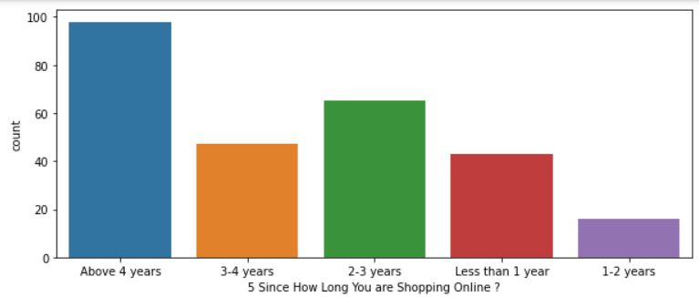
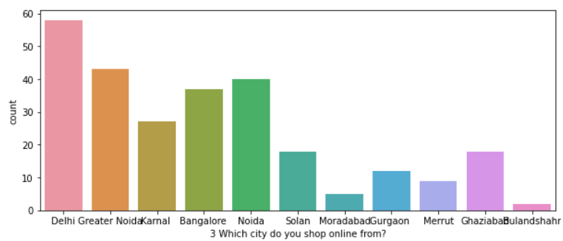
Univariate analysis:
Univariate analysis:

Slide 18
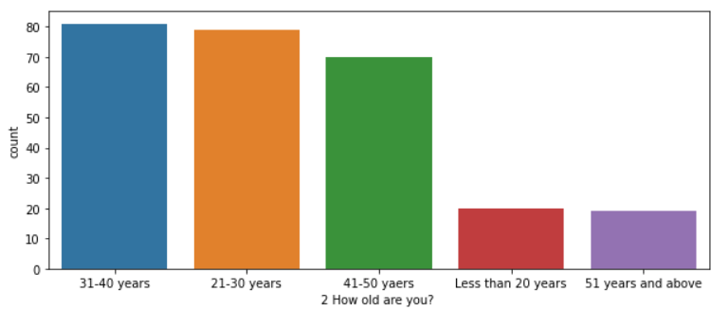
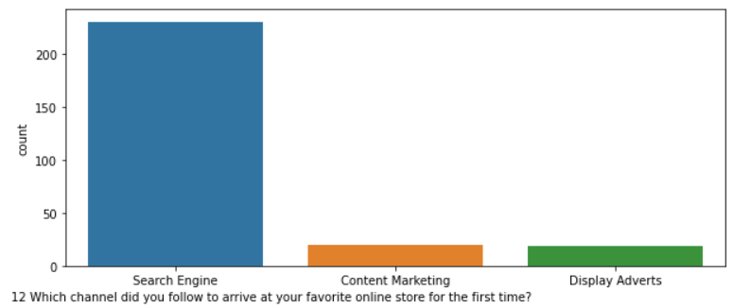
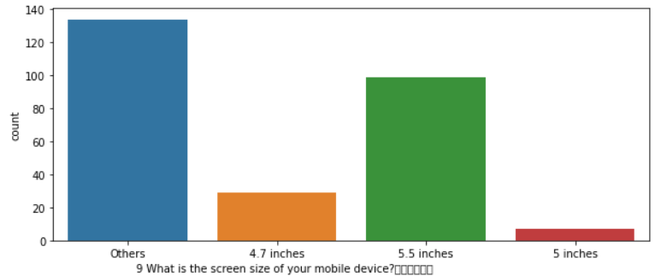
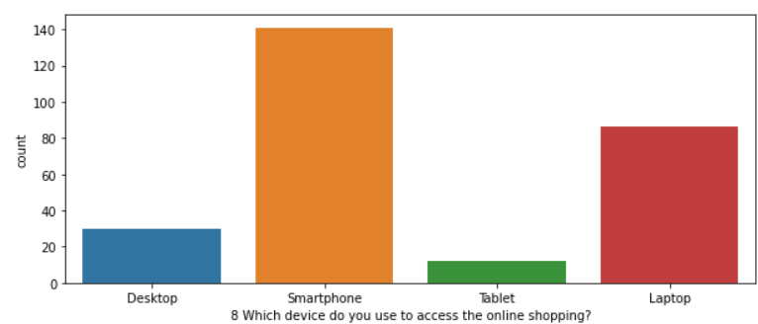

Slide 19
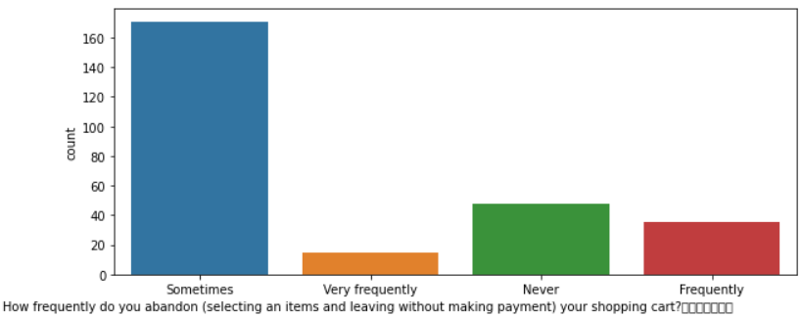
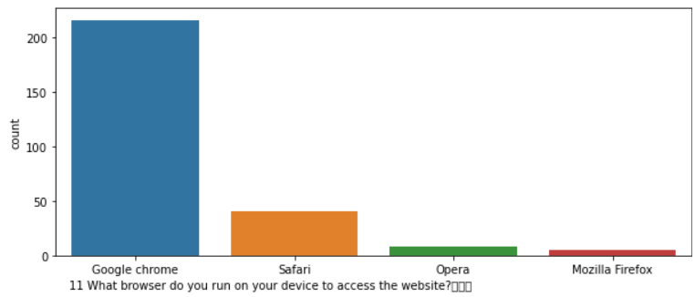
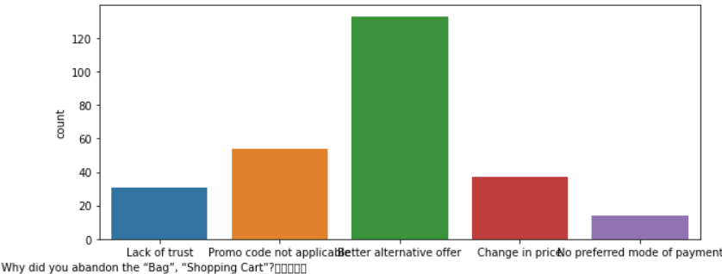
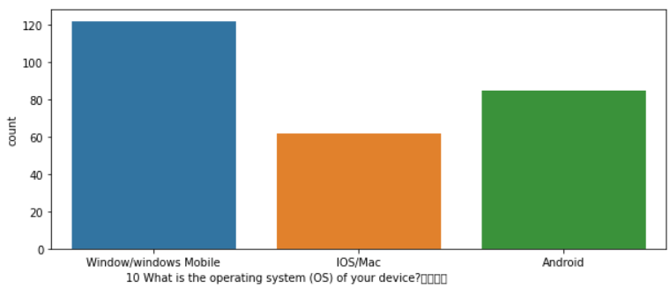

Slide 20
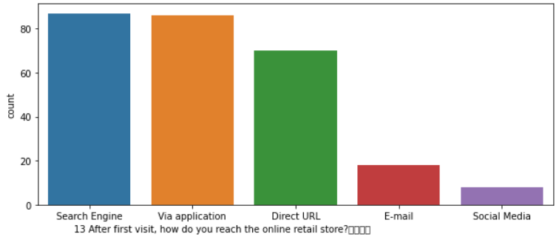
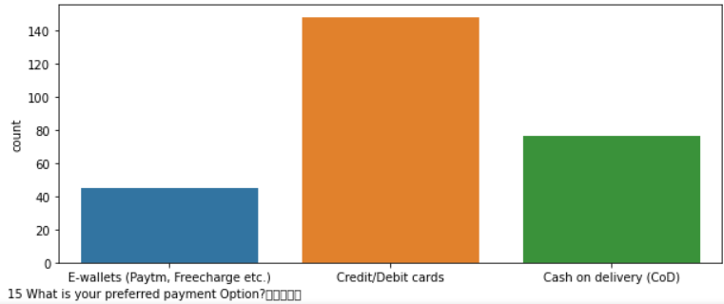
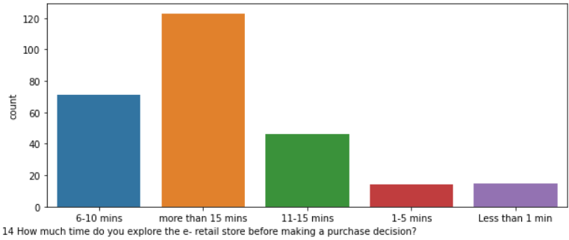

Slide 21
Observations:
1) Majority online buyer are Females as compare to males.
2) Approx. 80% of female online buyer between the age group of 21-50 years.
3) Majority online buyer are from Delhi, Greater Noida, Bangalore and Noida.
4) Majority of buyers doing online shopping for than 4 years.
5) Online purchase in last 1 year is less than 10 times(114) as compared to 31-40(63) times and 41 times and above(47).
6) Majority of customer prefer mobile internet for online shopping because its more handy and comfortable any time any where.
7) Majority of customer prefer smartphone because of its compactable and single hand use.
8) Most of customer screen size is in other size and later also 5.5 inches screen.
9) Most of customer using windows mobile for shopping
10) Consumer find Google chrome browser more user friendly for browsing and online shopping.
11) Consumer find search engine channel to visit there favorite online store for first time.
12) After the first visit, most of customer use search engine because its store in your history and also recommend with notifications.
13) Consumer do spend more than 15 min(123) before making any purchase decision.
14) Majority time consumer use Credit/Debit cards for online purchase because they get good cashback & rewards points offers.
15) Maximum people abandon the shopping cart are "Sometimes" as compare to "Never" & "Frequently".
16) Maximum people abandon the "Bag", "Shopping Cart" is because they get "Better alternative offer"(133).

Slide 22
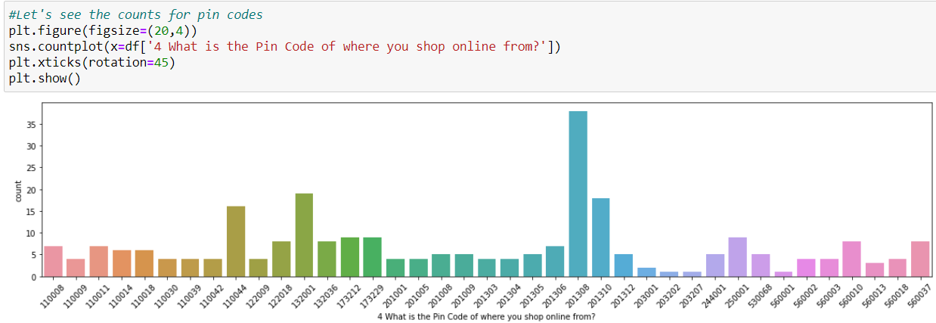
value_counts for “pincode” column:
from the plot we can see that Pin Code “201308" has majority online buyers as compare to pincode 132001, 201310 and 110044.

Slide 23
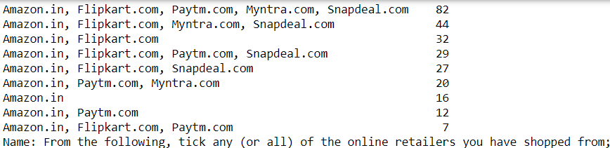
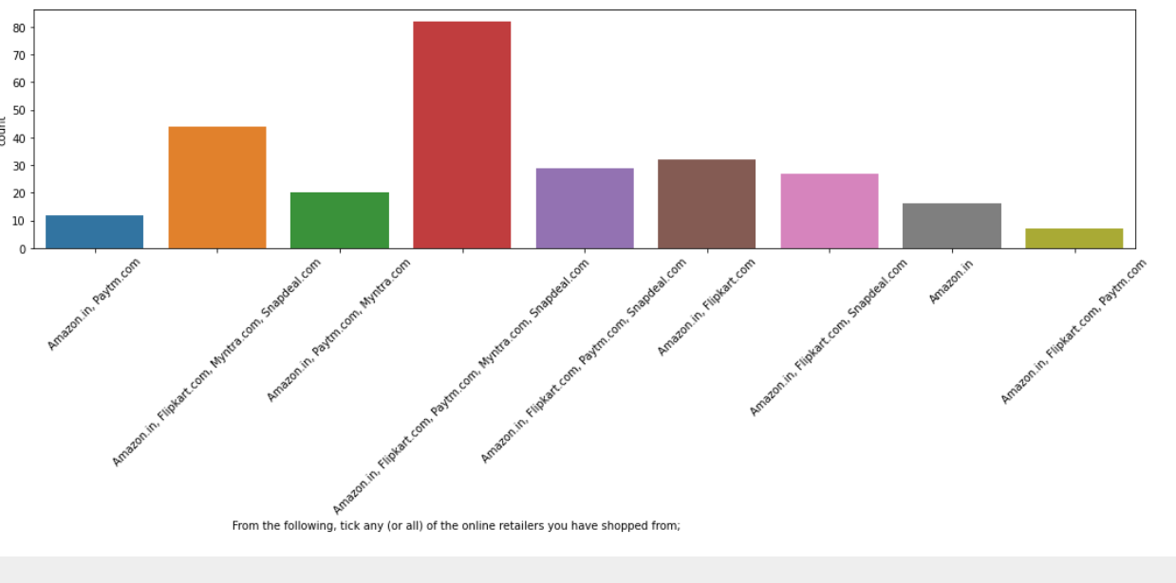
other categorical columns:

Slide 24
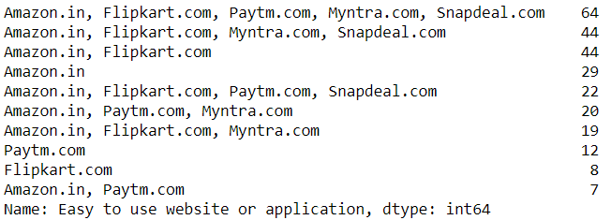
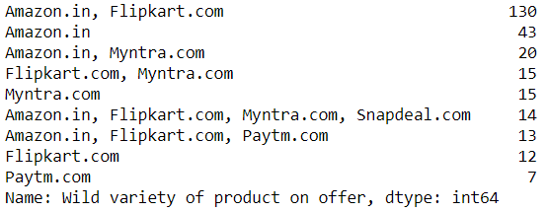
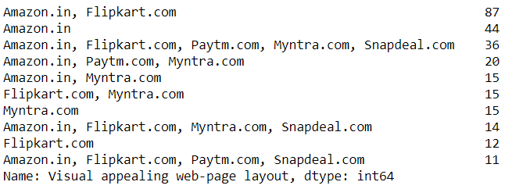
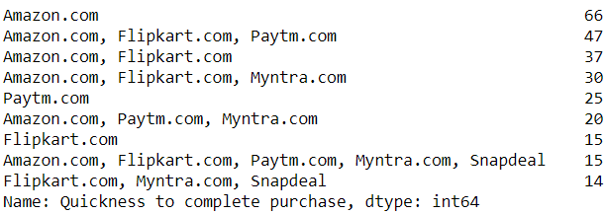
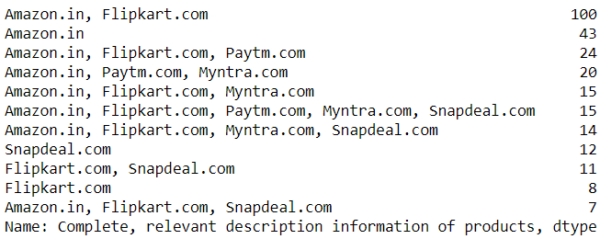
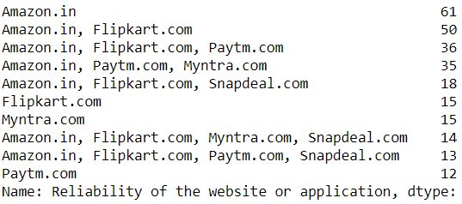

Slide 25
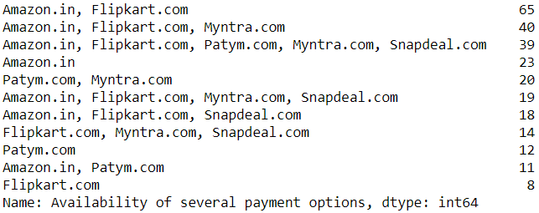
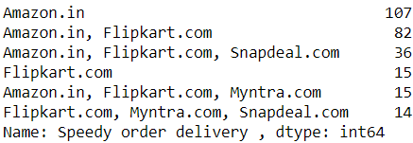
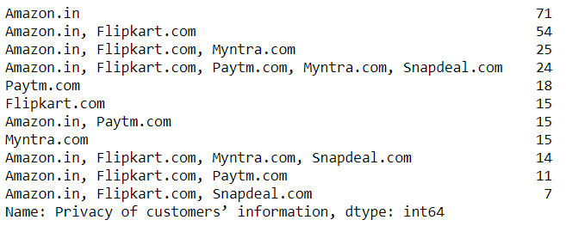
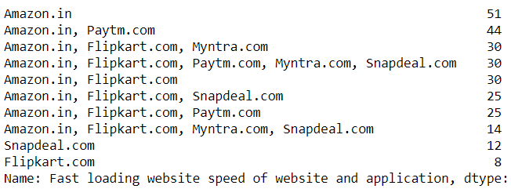
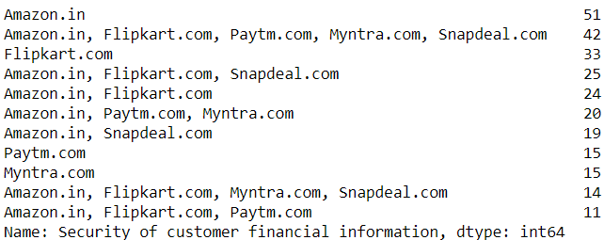
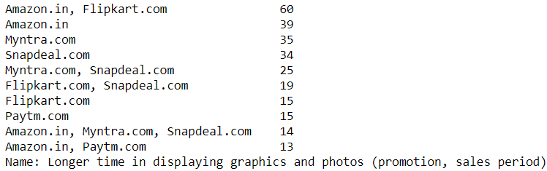

Slide 26
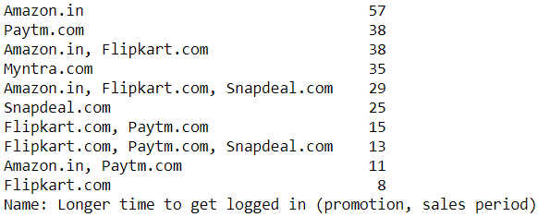
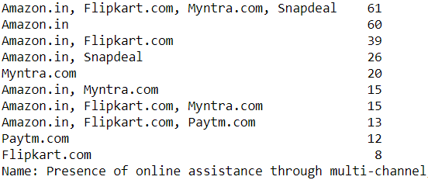
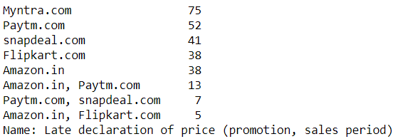
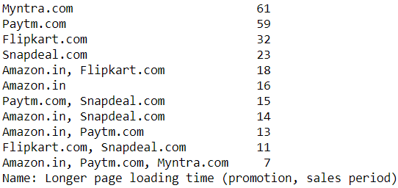
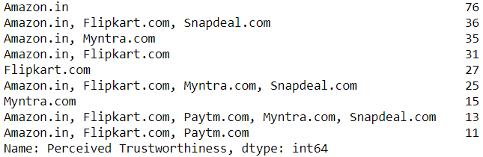
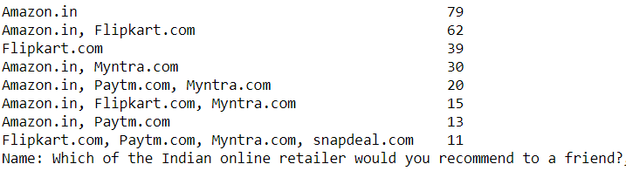

Slide 27





Slide 28



Slide 29



Slide 30



Slide 31



Slide 32
Observations:
1. Majority people like to do shopping from Amazon.in, Flipkart.com, Paytm.com, Myntra.com, Snapdeal.com.
2. Majority people find Easy to use website or application are - Amazon.in, Flipkart.com, Paytm.com, Myntra.com, Snapdeal.com
3. For Visual appealing web-page layout Amazon.in and Flipkart.com are the best choices..
4. For Wide variety of product on offer is Amazon.in and Flipkart.com.
5. Complete, relevant description information of products is Amazon.in and Flipkart.com.
6. Fast loading website speed of website and application Amazon.in is best among others.
7. Reliability of the website or application is Amazon.in.
8. Quickness to complete purchase is Amazon.in.
9. Quickness to complete purchase is Amazon.in
10. Speedy order delivery: Amazon.in is best option.

Slide 33
Observations:
11. Privacy of customers’ information Amazon.in is one we can trust more and later is Flipkart.com
12. Security of customer financial information Amazon.in is leading one even Flipkart, Paytm.com, Myntra.com, Snapdeal.com are also good to trust.
13. Perceived Trustworthiness: Amazon.in lead again and Flipkart, Snapdeal are can 2nd choice.
14. Presence of online assistance through multi-channel: Amazon.in, Flipkart.com, Myntra.com, Snapdeal are lead one.
15. Longer time to get logged in (promotion, sales period): Amazon, paytm.
16. Longer time in displaying graphics and photos (promotion, sales period): Amazon.in, Flipkart.com
17. Late declaration of price: Myntra, Paytm, Snapdeal. May be one of the reason consumer choose other online website. Need to work to improve this.
18. Longer page loading time (promotion, sales period): Myntra and Paytm have bad feedback on this. Flipkart should also have a look into it, as it is at the 3rd place.
19. Limited mode of payment on most products (promotion, sales period): Snapdeal.com need to provide more option.
20. Longer delivery period: Paytm and Snapdeal need to shorten their delivery time by adopting other delivery partners.
21. Change in website/Application design is Amazon.in
22. Frequent disruption when moving from one page to another: Amazon.in.
23. Website is as efficient as before: Amazon.in
24. Which of the Indian online retailer would you recommend to a friend?: Amazon.in

Slide 34
Conclusion:
As per above datasets we found 80% of Female like to do online shopping from their mobile smartphone. Especially from Noida region and they trust to purchase things from Amazon.in.
Looking at the Customer’s and the Company's performance based on report we can conclude that the Companies likely to have
High Customer Satisfaction and Retention:
1. Amazon.com
2. Flipkart.com
High Risk of Customer Churn:
1. Myntra.com
2. Snapdeal.com

