Slide 1


Empowering Social Buzz: Scaling Big Data and Navigating IPO Success"

Slide 2


Today's agenda
Project recap
Problem
The Analytics team
Process
Insights
Summary

Slide 3

Client Overview:
Name: Social Buzz
Industry: Social Media & Content Creation
Established: 2010
HQ: San Francisco
Employees: 250 (200 technical staff)
Users: 500M+ monthly active
Background:
Founded by former engineers from a large social media conglomerate.
Focus on anonymous content with diverse user reactions.
Rapid growth with significant unstructured data challenges.
Project Recap

Slide 4


Problem
1] IPO Preparation: Need guidance for a smooth IPO next year.
2] Resource Limitations: Require experienced practice for current scale.
3] earning Best Practices: Desire to adopt big data practices from large corporations.

Slide 5



Andrew Fleming
(Chief Technical Architect)
The Analytics team
Marcus Rompton
(Senior Principle)
Vrushal More
(Data Analyst)

Slide 6
Process
1
Data Understanding
2
Data cleaning
3
Data modelling
4
Data analysis
5
Uncovering Insights

Slide 7
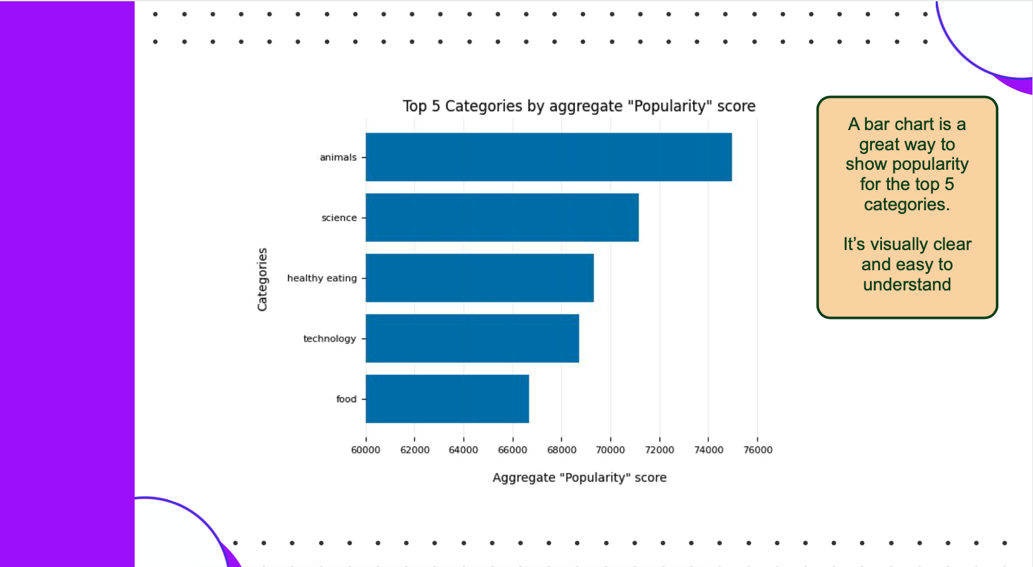

Slide 8
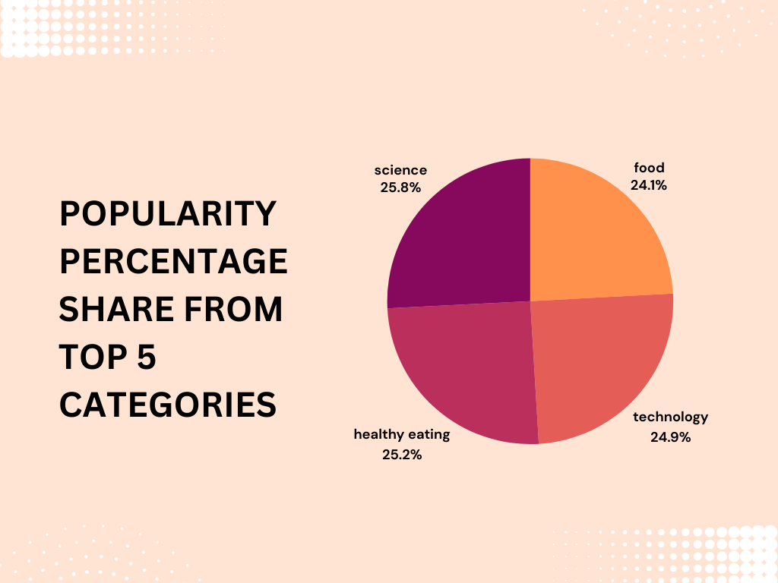

Slide 9

Thank you!
ANY QUESTIONS?

