Slide 1

Sant Dnyaneshwar Shikshan Sanstha's
ANNASAHEB DANGE COLLEGE OF ENGINEERING & TECHNOLOGY,ASHTA
Tal.-Walwa, Dist.-Sangli, Maharashtra (India) 416 301
Department of Computer science and Engineering
Academic Year 2021-22

Slide 2
Detection of Tomato Leaf Diseases Using Deep Learning Approach
Presented By: Dhanashri Thorat (412) Vrushali Patil (441) Pratik Patil (456) Shradha Babar (467)
Guided By: Mr. S. P. Patil

Slide 3
Contents
Abstract
Problem statement
Literature survey
Objectives
Methodology
Conclusion
References

Slide 4
Abstract
deep learning ->crop disease detection and classification.
Through this project, we hope to accomplish: I) Easy way to choose the appropriate pesticides for plants. II) System will help farmers about preventative measures about diseases.

Slide 5
Problem Statement
To design and develop a system for detection of diseases on Tomato leaf using Deep Learning approch .

Slide 6
Literature Survey
Thair A. Salih, et al.[1] use CNN. CNN method depends on feature extraction (such as color, leaves edge, etc.) from an input image and on this basis, the decision of classification is done. A Matlab m-file has been used to build the CNN structure. A dataset obtained from plant village has been used for training the network (CNN). The suggested neural network has been applied to classify six types of tomato leaves situation (one healthy and five types of leave plant diseases). The results show that the convolution neural network (CNN) has achieved a classification accuracy of 96.43%.
Iftikhar Ahmad, et al.[2] consider four CNN architectures, namely, VGG-16, VGG-19, ResNet, and Inception V3, and use feature extraction and parameter-tuning to identify and classify tomato leaf diseases. They test the underlying models on two datasets, a laboratorybased dataset and self-collected data from the field. They observe that all architectures perform better on the laboratory-based dataset than on field-based data, with performance on various metrics showing variance in the range of 10%– 15%. Inception V3 is identified as the best performing algorithm on both datasets.

Slide 7
Objectives
To collect a dataset of tomato leaves from Kaggle.
To train the deep learning model for disease detection of tomato leaf and test the same.
To analyze the performance of the model and improve the same by tuning the trainable parameters.
To design and develop a web application to incorporate the model for disease detection.
To recommend the appropriate pesticides according to disease.

Slide 8
Methodology
Capturing images of disordered tomato plant’s leaf is taken as an input and it is pre-processed for the improvement to remove the unwanted distortion for feature processing
In the feature extraction the shape, color and texture of tomato leaf is identified.
Database consists of many images with healthy and unhealthy leaves of tomato plant and images are trained to identify the model from the database.
In Neural Network(NN) classification, the part of plant is recognized whether it is normal or abnormal.
If it is abnormal, the defected region is classified.
The affected area and type of bacteria, virus, etc. are identified in the result.
According to the disease, the system will provide the appropriate pesticides.

Slide 9
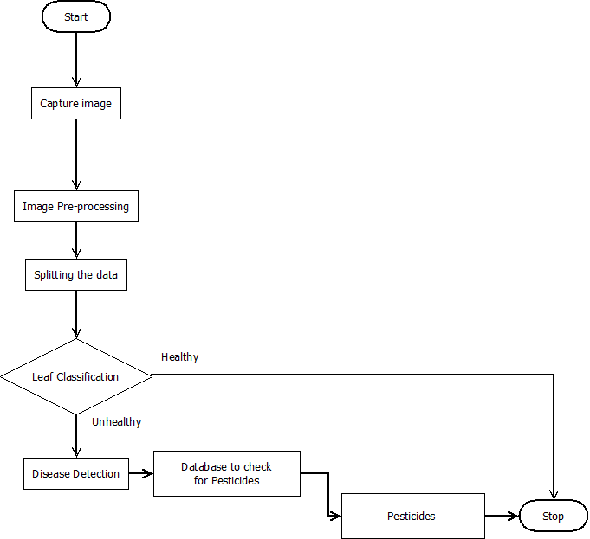
Working
Data Flow Diagram

Slide 10
Conclusion
Deep learning techniques like CNN algorithm is used to detect the disordered leaf.
This system helps the farmers to easily choose the appropriate pesticides for the plants.

Slide 11
References
[1] Salih, T.A., Ali, A.J. and Ahmed, M.N. (2020), ”Deep Learning Convolution Neural Network to Detect and Classify Tomato Plant Leaf Diseases”, Open Access Library Journal, 7.[2] S. R. Maniyath et al., “Plant disease detection using machine learning,” Proc. - 2018 Int. Conf. Des. Innov. 3Cs Comput. Commun. Control. ICDI3C 2018.
[2] Iftikhar Ahmad, Muhammad Hamid, Suhail Yousaf, Syed Tanveer Shah, and Muhammad Ovais Ahmad, “Optimizing Pretrained Convolutional Neural Networks for Tomato Leaf Disease Detection”, Hindawi Complexity Volume 2020.
[3] Rangarajan, A.K., Purushothaman, R.,Ramesh, A., 2018, ”Tomato crop disease classification using pre-trained deep learning algorithm”, Procedia computer science 133, 1040-1047.
[4] https://www.kaggle.com/emmarex/plantdisease

Slide 12
Thank you!

