Slide 1
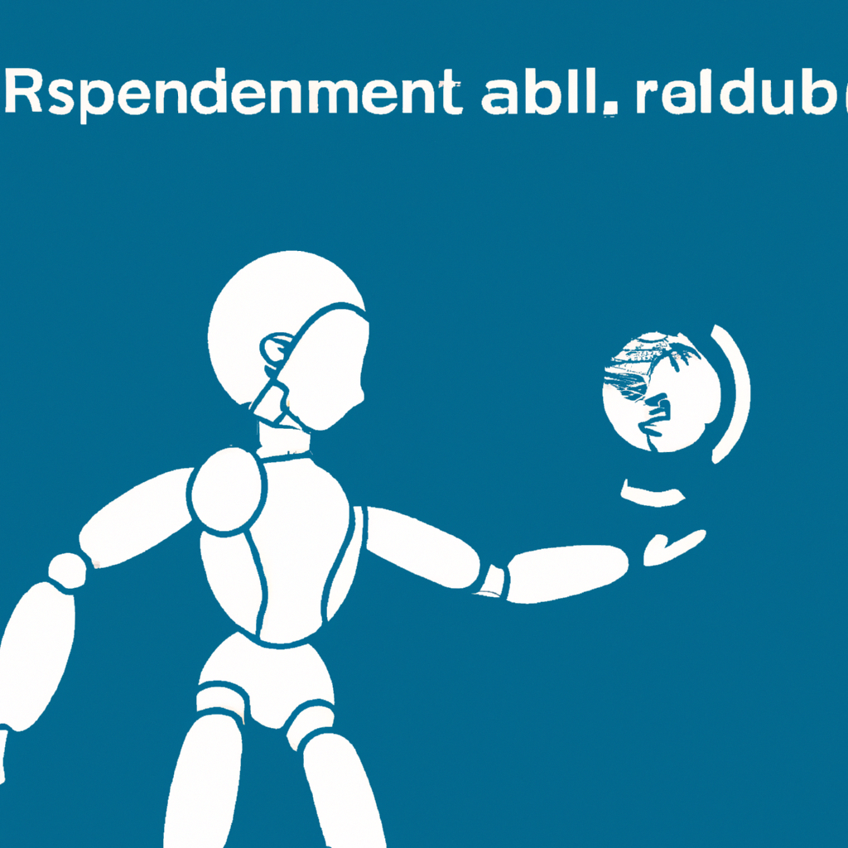
In healthcare, AI has been used to improve diagnostic accuracy, assist in drug development, and personalize treatment plans. In finance, AI has been utilized for fraud detection, risk assessment, and algorithmic trading. In technology, AI has powered virtual assistants, recommendation systems, and autonomous drones.
The future of AI holds endless possibilities, from enhancing precision medicine to creating more efficient energy systems. However, the rapid development of AI also raises ethical and societal concerns, such as job displacement, privacy invasion, and biased decision-making.
As AI continues to reshape industries and revolutionize the way we live and work, it is essential to address these issues and ensure that AI technologies are developed responsibly and for the benefit of humanity. With careful consideration and collaboration, we can

