Slide 1
Authorship Attribution

Slide 2
Group info
B42 – Dipal Shah
B50 – Vrushika Shah
B54 – Khushi Sharma
B80 – Drashti Varaiya

Slide 3
Introduction
Authorship attribution is a natural language processing task that involves identifying the author of a given text based on various linguistic features.
The goal of authorship attribution is to determine who wrote a particular text, even when the author's identity is not immediately apparent or is intentionally concealed.
Authorship attribution has a wide range of applications, including forensics, plagiarism detection, and literary analysis.

Slide 4
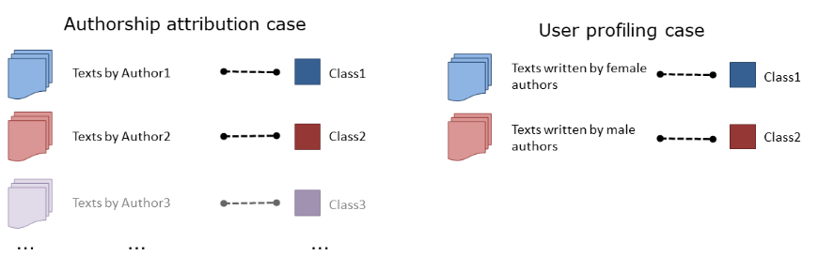
Machine learning algorithms can be trained on a dataset of texts written by different authors, with various linguistic features used as input data.
Once trained, the machine learning algorithm can analyze the linguistic features of a new text and use them to predict the author's identity.
This is done by comparing the linguistic patterns of the new text to those of the texts in the training dataset, and identifying the author whose writing style is the most similar.
Overall, authorship attribution is an important application of machine learning and natural language processing, and it has many potential practical applications in fields such as forensics, security, and literary analysis.

Slide 5
N-grams

Slide 6
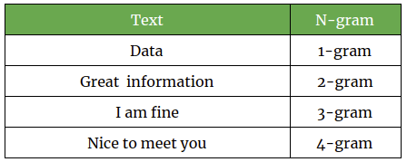
This approach involves analyzing the frequency and distribution of words or characters in a text.
Machine learning algorithms can be trained on a dataset of texts written by different authors, with the n-grams used as input data. The algorithm learns to recognize patterns in the n-grams that are unique to each author, and uses these patterns to predict the authorship of new texts.

Slide 7
In machine learning, an n-gram is a contiguous sequence of n items, typically words or characters, in a text.
N-grams are often used in natural language processing tasks such as language modeling, machine translation, and sentiment analysis, among others.
By analyzing the frequency and distribution of n-grams in a text, machine learning algorithms can learn to recognize patterns and make predictions about the text's meaning or authorship.
N-grams are generated by sliding a window of size n over the text and extracting each contiguous sequence of n items.
For example, a 2-gram (also called a bigram) would consist of every pair of adjacent words in a text, while a 3-gram (also called a trigram) would consist of every set of three adjacent words.

Slide 8
REFERENCES
1)https://www.researchgate.net/publication/2375544_N-Gram-Based_Text_Categorization
2) https://iopscience.iop.org/article/10.1088/1757-899X/1031/1/012048
3) https://web.stanford.edu/~jurafsky/slp3/3.pdf

Slide 9
THANK YOU

