Slide 1
Effective Presentations Skills

Slide 2
Agenda
Introduction
Planning Your Presentation
The Presentation Sequence
Creating Effective Visual Aids
resentation Techniques
Practice

Slide 3
Why Give A Presentation?
Two Main Purposes
Inform
Persuade
Educate

Slide 4
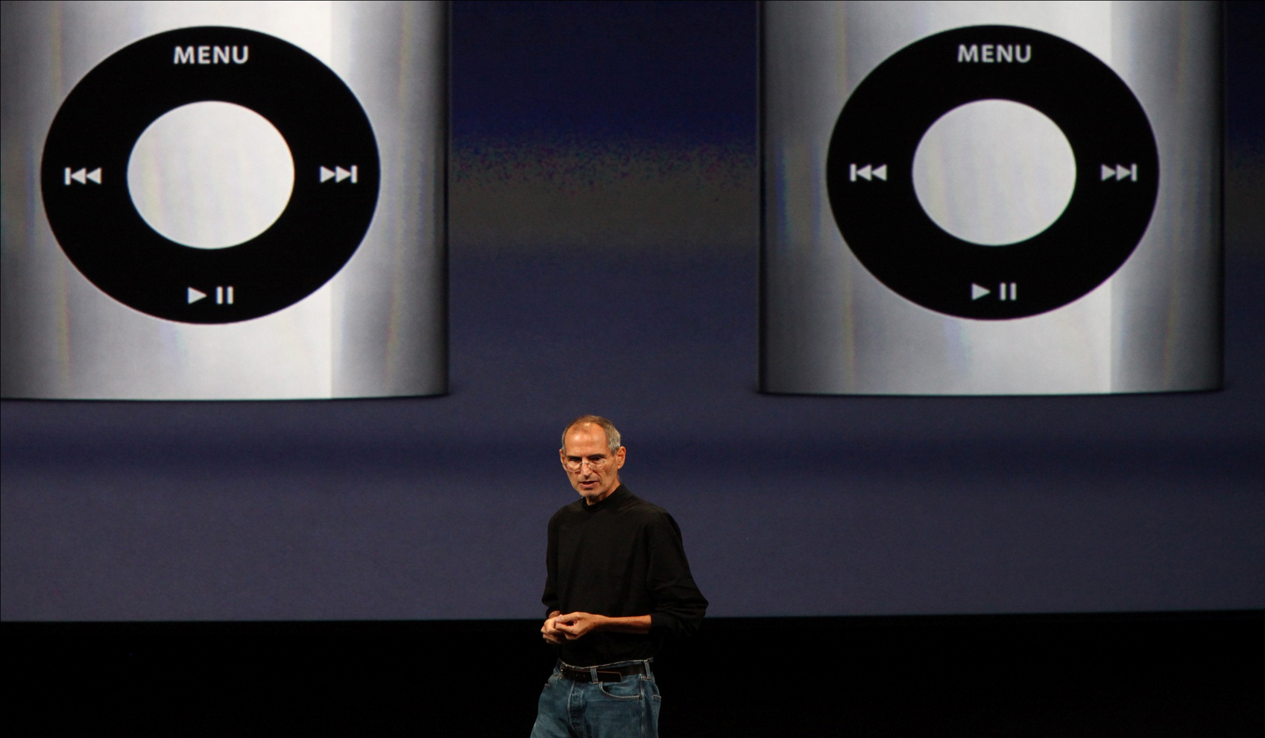
“Presentation is the ‘Killer Skill’ we take into the real world. It’s almost an unfair advantage.”
Ethan Rasiel & Paul N. Friga, ‘The McKinsey Mind’ N. Friga, ‘The McKinsey Mind’
Notes:
Boring less you present in person, hit the highlights, and beware the bullets
Opportunity for doodling and daydreaming
More distractions than ever before

Slide 5
“Great speakers aren’t born, they are trained.”

Slide 6
#1 Fear
Fear of the Unknown OR Loss of Control
Feared More Than Death!
No Backup Plan
No Enthusiasm For Subject
Focus of Attention

Slide 7
Effective Presentations
Control Anxiety – Don’t Fight It
Audience Centered
Accomplishes Objective
Fun For Audience
Fun For You
Conducted Within Time Frame

Slide 8
Planning Your Presentation

Slide 9

Steps in Giving Presentation
Plan
2. Prepare
3. Practice
4. Present
Notes:
Importance of a process (4 steps)

Slide 10

1. Planning

Slide 11
Questions?
Who is your audience?
Why are they there?
What is your goal?
How long will it be?
Where will it take place?
Notes:
Before you even open up PowerPoint, sit down and really think about the day of your presentation. What is the real purpose of your talk? Why is it that you were ask to speak? What does the audience expect? In your opinion, what are the most important parts of your topic for the audience to take away from your, say, 50-minute presentation? Remember, even if you've been asked to share information, rarely is the mere transfer of information a satisfactory objective from the point of view of the audience. After all, the audience could always just read your book (or article, handout, etc.) if information transfer were the only purpose of the meeting, seminar, or formal presentation.

Slide 12
Planning A Presentation
Plan Space
Number of Seats
Seating Arrangement
Audio/Visual Equipment
Distracters
What Day and Time?
Any Day!
Morning

Slide 13
#2: Opening Your Presentation
Introduce Yourself – Why Should They Listen
Get Attention, Build More Rapport, Introduce Topic
Humor
Short Story
Starling Statistic
Make Audience Think
Invite Participation
Get Audience Response

Slide 14
#2…Completing the Opening
Clearly Defining Topic
If Informative…
Clear parameters for content within time
If Persuasive…
What’s the problem
Who cares
What’s the solution
Overview

Slide 15
#4: Concluding Your Presentation
Goal
Inform audience that you’re about to close
Summarize main points
Something to remember or call-to-action
Answer questions
“Tell ’em What You Told ‘em.”

Slide 16
Presentation Style
3 Elements
Vocal Techniques
Loudness
Pitch
Rate
Pause
Deviations From the Norm for Emphasis

Slide 17
Presentation Style (con’t)
3 Elements
Body Language
Eye Contact, Gestures, Posture
Use of Space
Can Everyone See You?
Movement

Slide 18
Common Problems
Verbal fillers
“Um”, “uh”, “like”
Any unrelated word or phrase
Swaying, rocking, and pacing
Hands in pockets
Lip smacking
Fidgeting
Failure to be audience-centered

Slide 19
5 Presentation Tips
Smile
Breathe
Water
Notes
Finish On Or Under Time

Slide 20
Visual Aids - Examples
PowerPoint Slides
Overhead Trans
Graphs/Charts
Pictures
Films/Video
Flip Charts
Sketches

Slide 21
Thank You

