Slide 1
Predictive Modeling of Income Levels

Slide 2
Overview
Objective: Identify factors influencing higher income.
Importance: Understand socio-economic and job-related aspects linked to income.
Goal: Develop a model predicting income levels.
This slide highlights our aim to pinpoint what drives higher income, emphasizing the significance of socio-economic and job-related factors, ultimately aiming to create a predictive model for income classification.

Slide 3
Dataset Overview
Source of Data: Unknown (from a census, socio-economic study, or similar data collection).
Types of Variables:
Numerical: Age, Education-num, Capital-gain, Capital-loss, Hours-per-week.
Categorical/Nominal: Profession Class, Education, Marital-status, Occupation, Relationship, Race, Gender, Country, Income.
Ordinal: Final_census.
Size and Structure of the Dataset:
Size: 32561 rows and 16 columns.
Structure: The dataset contains multiple columns representing different attributes of individuals (e.g., age, education, occupation, etc.), for analysis or classification tasks.

Slide 4
Age | Profession Class | Final_census | Education | Education-num | marital-status | occupation | relationship | race | Gender | capital-gain | capital-loss | hours-per-week | country | income
39 | State-gov | 77516 | Bachelors | 13 | Never-married | Adm-clerical | Not-in-family | White | Male | 2174 | 0 | 40 | United-States | <=50K
50 | Self-emp-not-inc | 83311 | Bachelors | 13 | Married-civ-spouse | Exec-managerial | Husband | White | Male | 0 | 0 | 13 | United-States | <=50K
38 | Private | 215646 | HS-grad | 9 | Divorced | Handlers-cleaners | Not-in-family | White | Male | 0 | 0 | 40 | United-States | <=50K
53 | Private | 234721 | 11th | 7 | Married-civ-spouse | Handlers-cleaners | Husband | Black | Male | 0 | 0 | 40 | United-States | <=50K
28 | Private | 338409 | Bachelors | 13 | Married-civ-spouse | Prof-specialty | Wife | Black | Female | 0 | 0 | 40 | Cuba | <=50K
37 | Private | 284582 | Masters | 14 | Married-civ-spouse | Exec-managerial | Wife | White | Female | 0 | 0 | 40 | United-States | <=50K
49 | Private | 160187 | 9th | 5 | Married-spouse-absent | Other-service | Not-in-family | Black | Female | 0 | 0 | 16 | Jamaica | <=50K
52 | Self-emp-not-inc | 209642 | HS-grad | 9 | Married-civ-spouse | Exec-managerial | Husband | White | Male | 0 | 0 | 45 | United-States | >50K
31 | Private | 45781 | Masters | 14 | Never-married | Prof-specialty | Not-in-family | White | Female | 14084 | 0 | 50 | United-States | >50K
42 | Private | 159449 | Bachelors | 13 | Married-civ-spouse | Exec-managerial | Husband | White | Male | 5178 | 0 | 40 | United-States | >50K

Slide 5
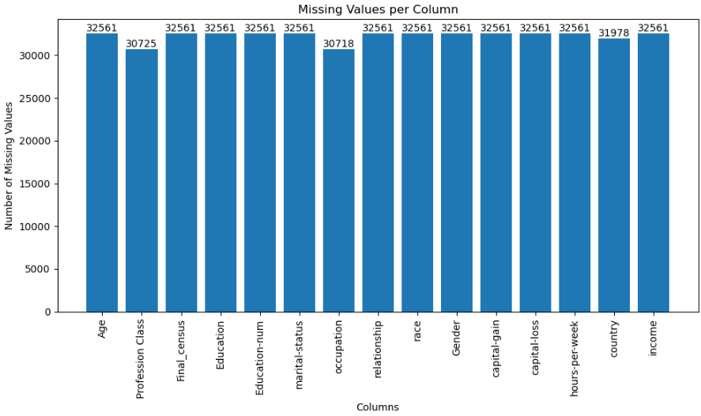
Data Cleaning
Removing Spaces in Column Names.
Removing 'Unnamed: 15' Column.
checking for missing values (marked as '?').
Handling Missing Values:
Handling "?" Values: Replacing '?' with NaN: The code replaces '?' values with NaN using ‘replace’.
Filling Missing Values with Mode: Imputing Missing Values: Missing values are imputed using the mode for categorical columns with missing values.

Slide 6
Exploratory Data Analysis (EDA)

Slide 7
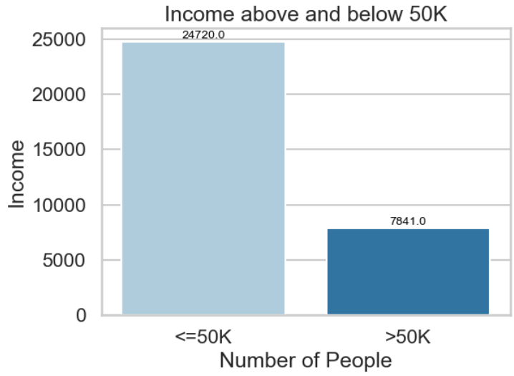
Class Imbalance Check: Visualizes the class distribution of the 'income' feature to identify potential class imbalances using ‘sns.countplot()’.
As We can see in the graph the data is Imbalanced.

Slide 8
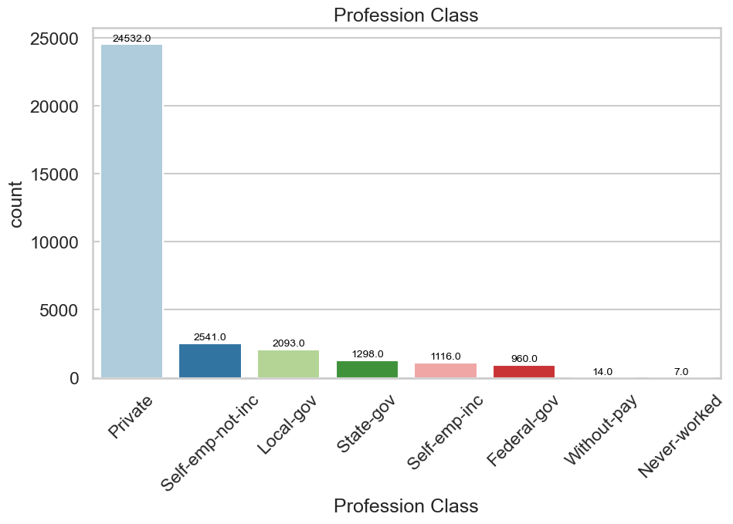
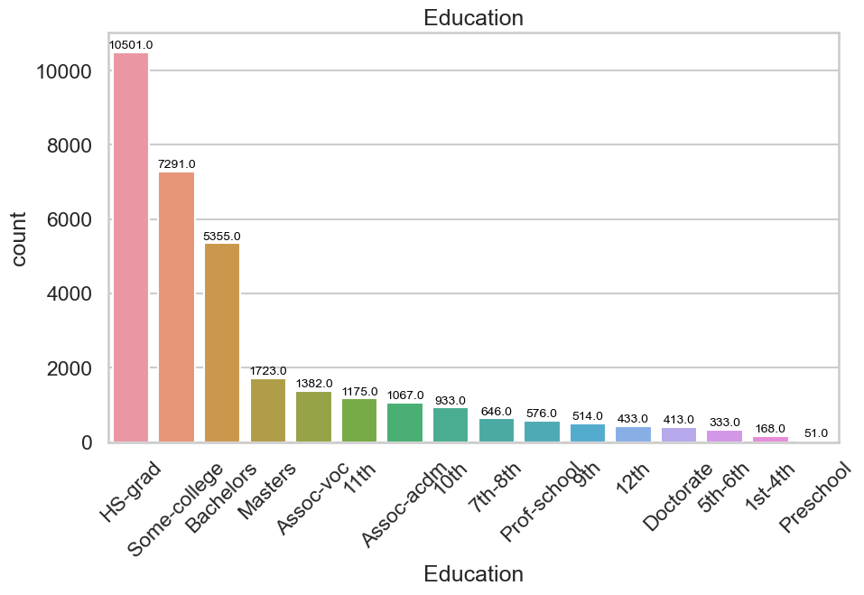
Distribution Plots: Utilizes histograms (‘sns.histplot()’) to display distributions of Profession Class, Education, Education-num, marital-status, occupation, relationship, race, Gender.

Slide 9
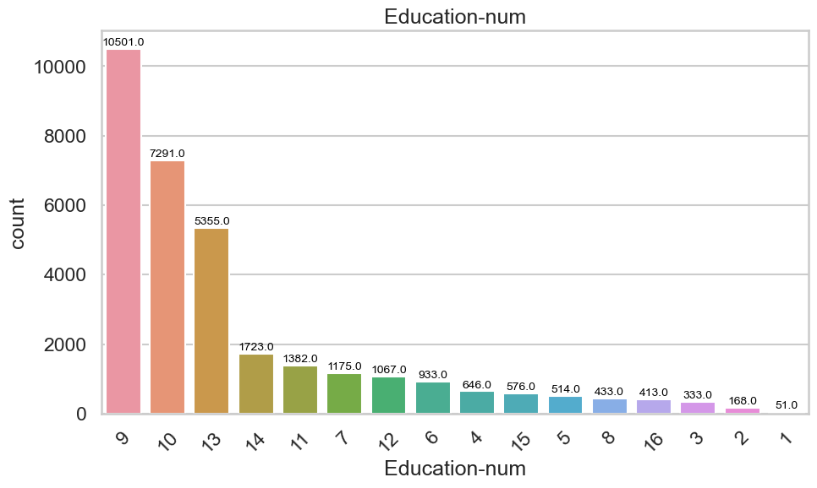
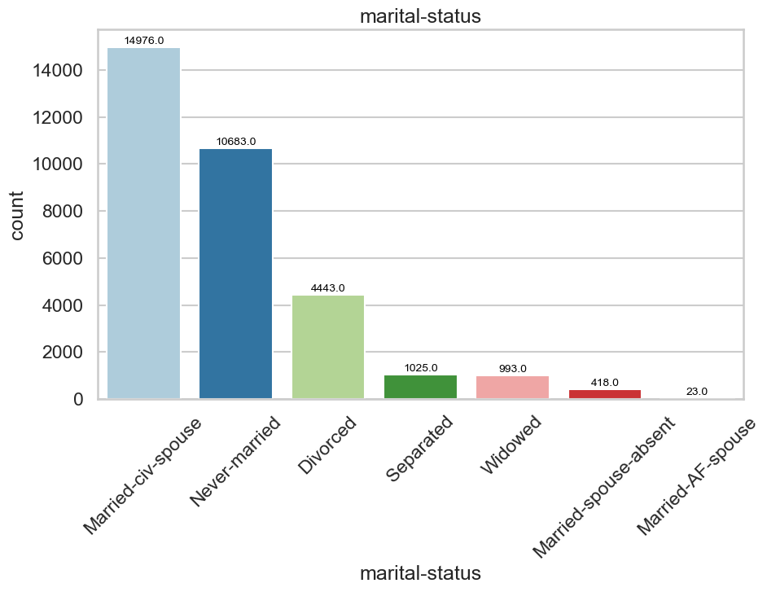
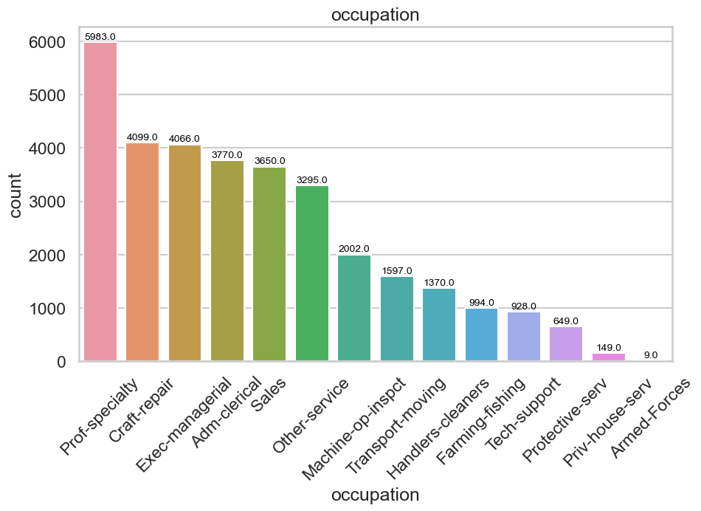
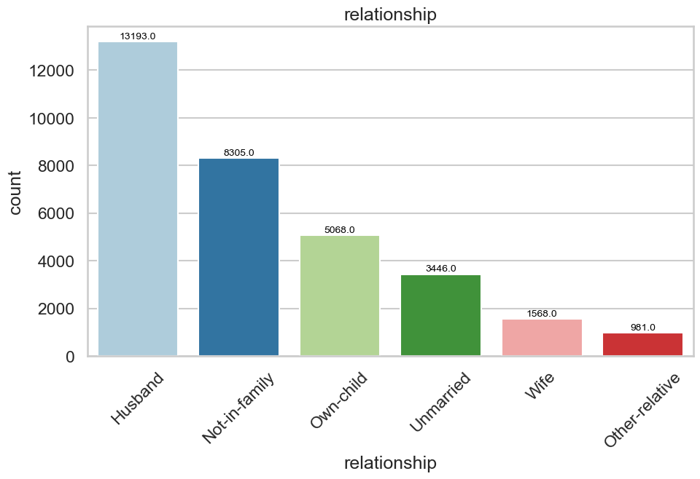

Slide 10
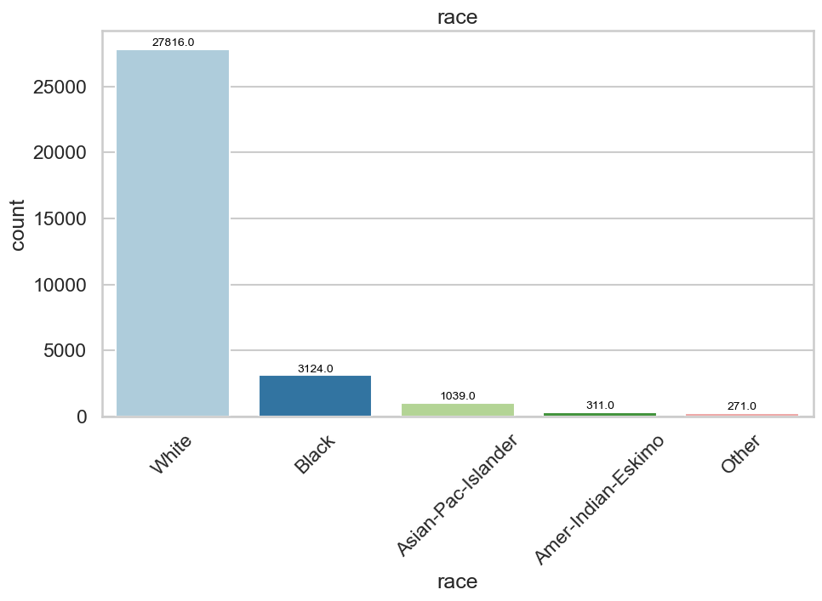
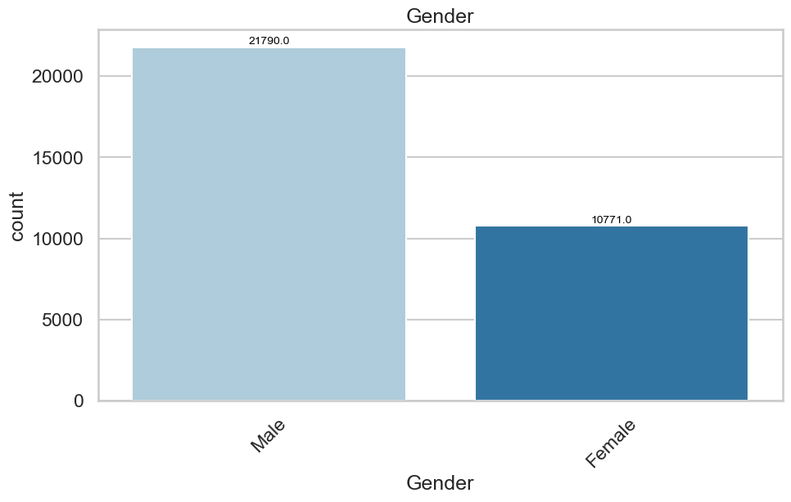

Slide 11
This dataset consists nearly 70 percent of men.
This dataset consists of white race people mostly.
The majority of people in the dataset have jobs in the private sector. This suggests that the private sector is the largest employer in the economy. Government jobs are less common, but still represent a significant portion of the workforce.
The majority of people are married or in a relationship.
There is a significant number of unmarried people and not-in-family.
There is a small number of people who are other relatives.
I notice that the Education column related with EducationNum column Where:
HS-grad = 9 years of education completed.
Some-college = 10
Bachelors = 13
Masters = 14
Assoc-voc = 11 And So On..
We will drop Education column.

Slide 12
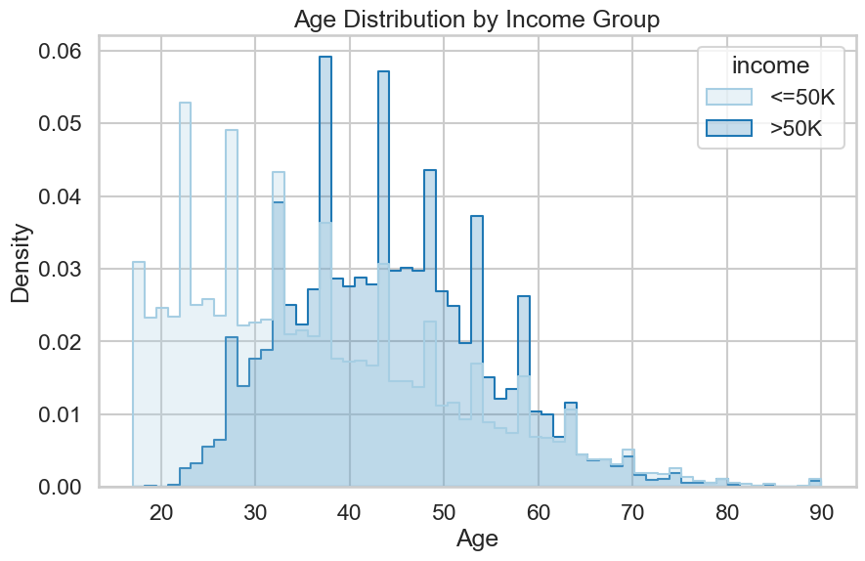
Categorical Columns Visualization with income: Iteratively creates count plots ‘sns.countplot()’ for categorical columns against the 'income' feature to discern income distribution within various categories.
The median age for individuals earning >50K is notably higher, reflecting a potential relationship between age and income level.

Slide 13
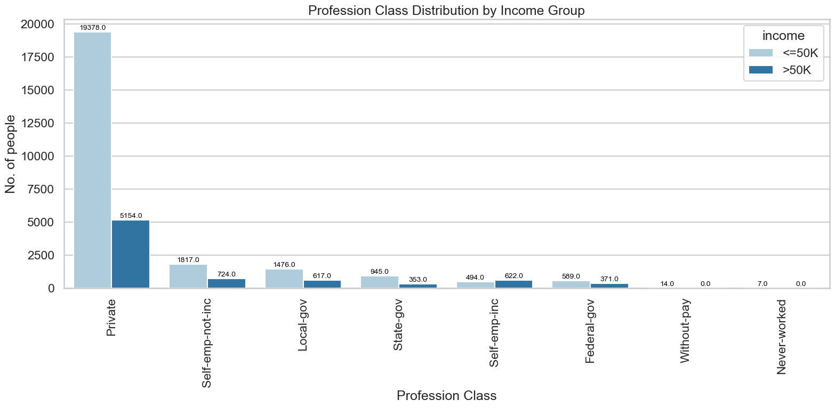
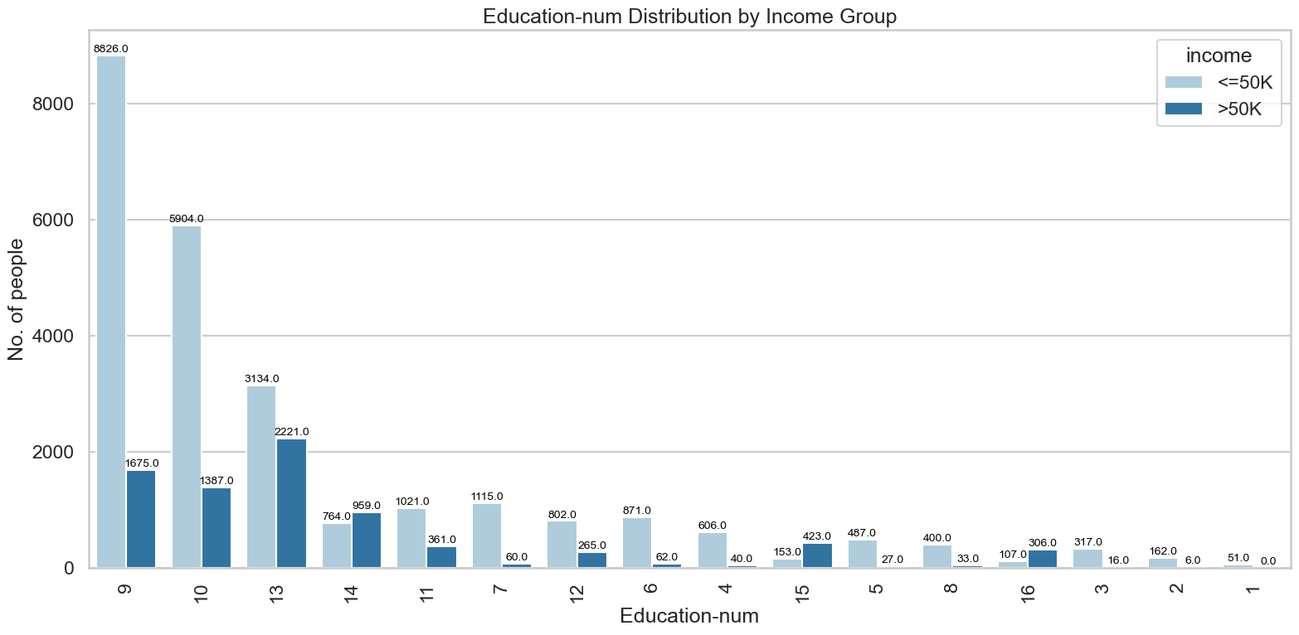

Slide 14
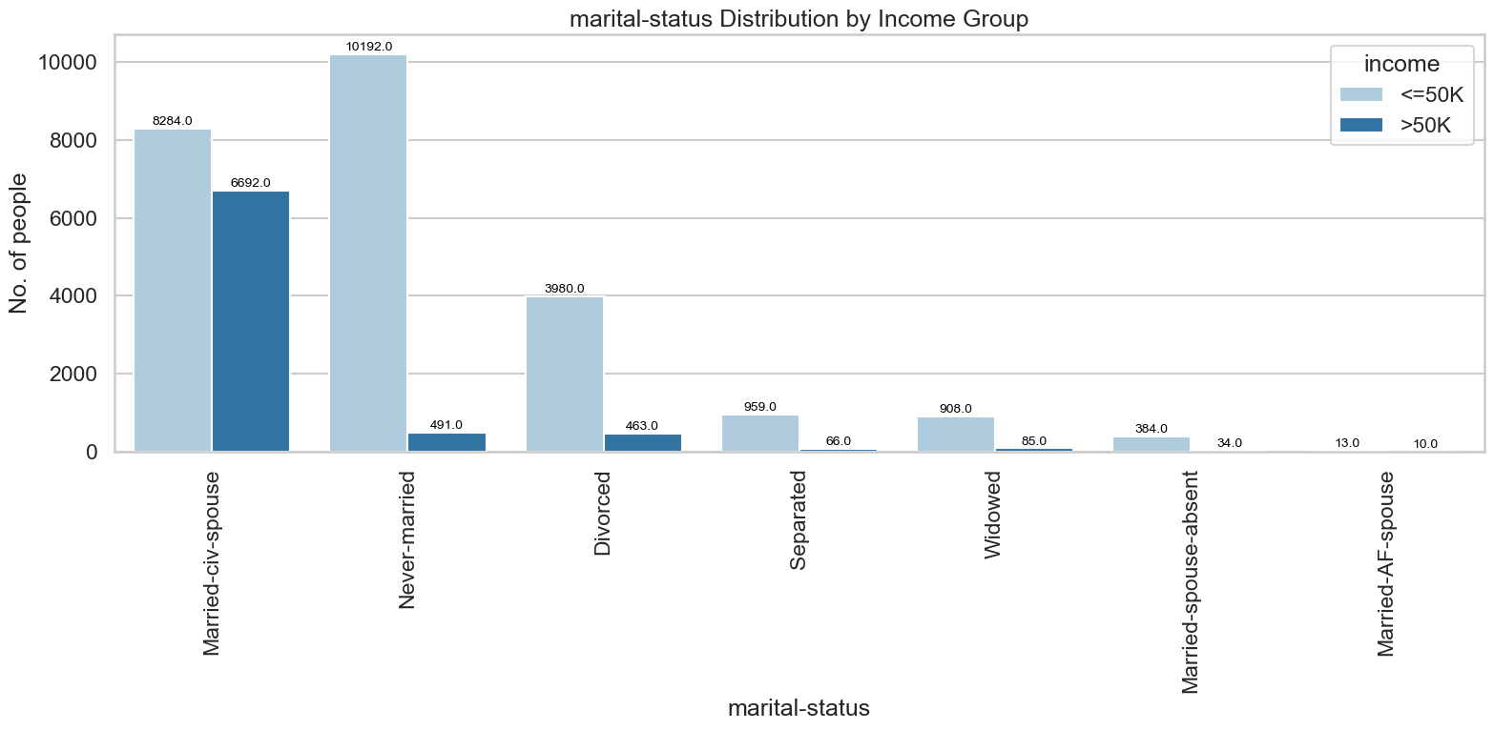
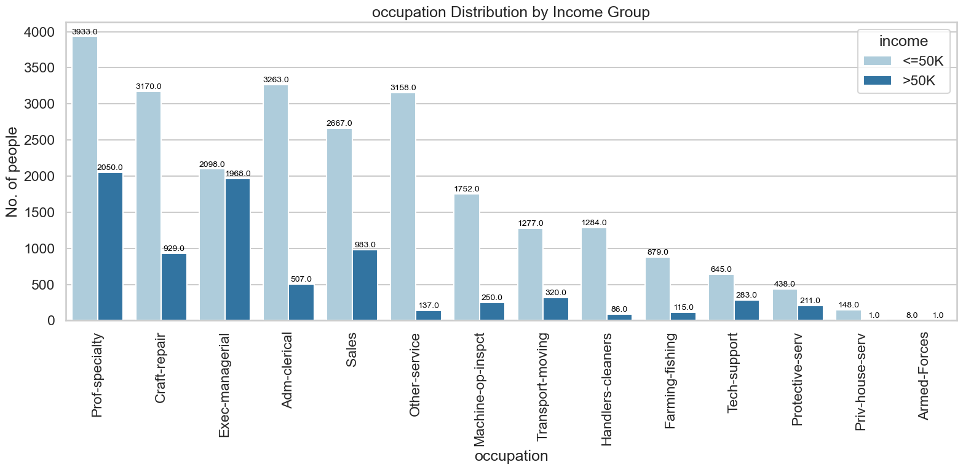

Slide 15
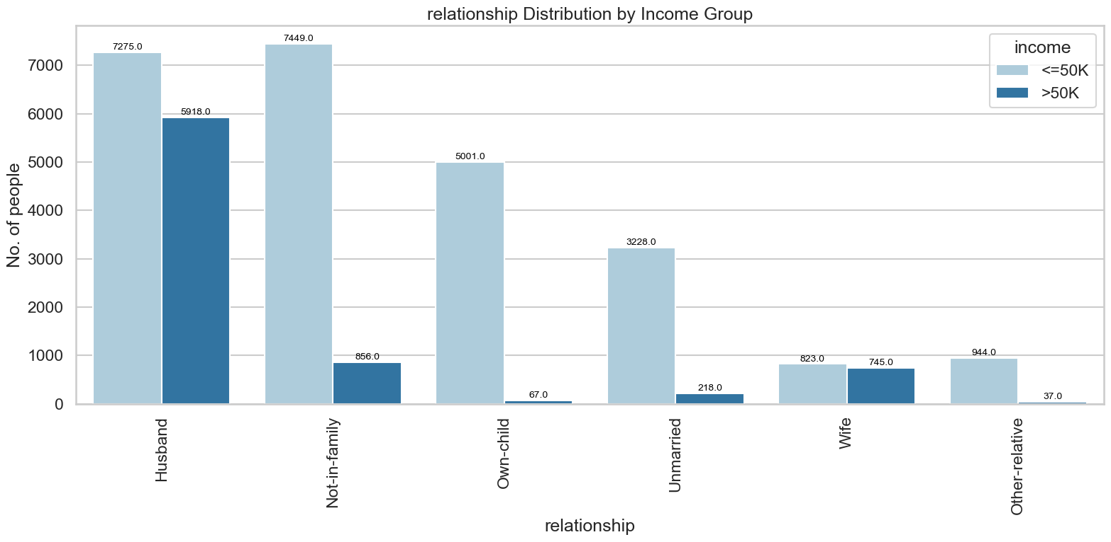
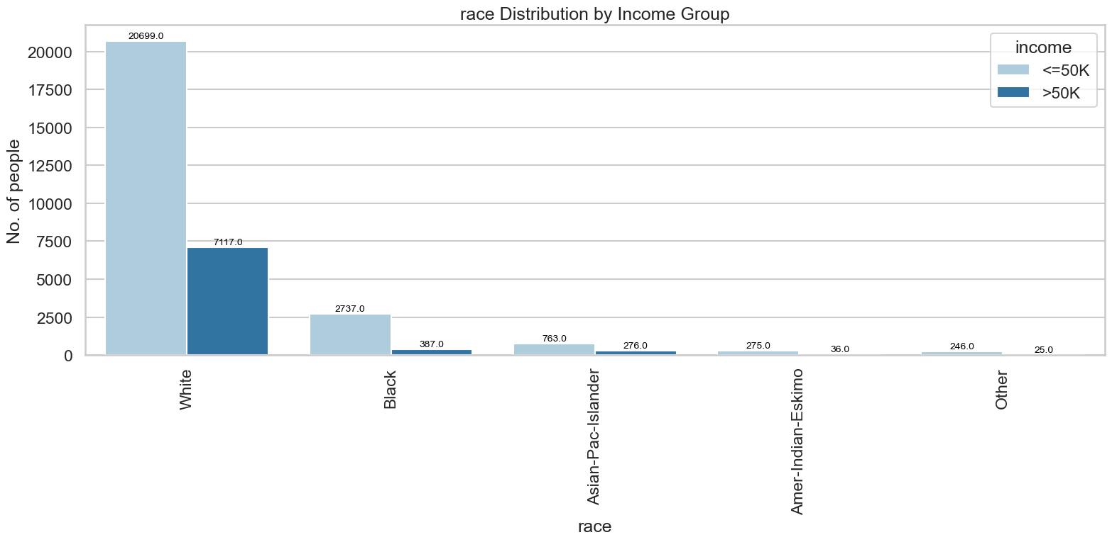

Slide 16
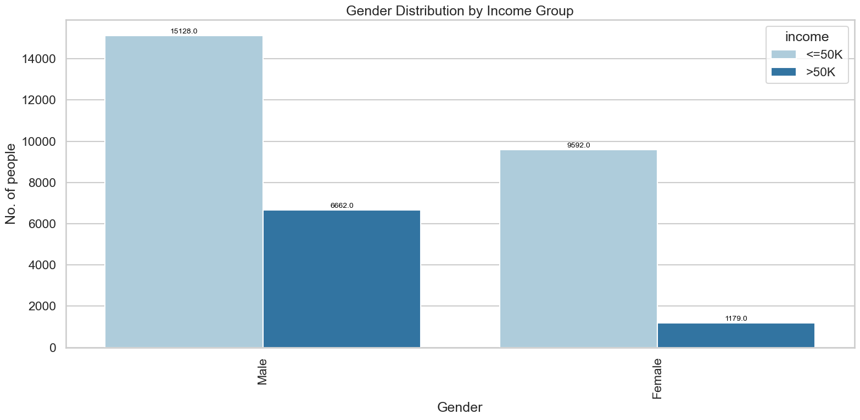
From above comparison graphs, we can understand that
In most of the occupations, the number of peoples having income<=50k is three times higher than number of peoples having income>50k.
Self employed workclass have more people of income >50k than people of <=50k.
People who are husbands, wives have almost equal ratio in income earned of >50k and <=50k. And the relation and marital-status bar charts are similar.
People who have education Bachelors, have more count of earning >50k.
Male have high no.of people of earning income>50k.
White race people have high count of earning income>50k.

Slide 17
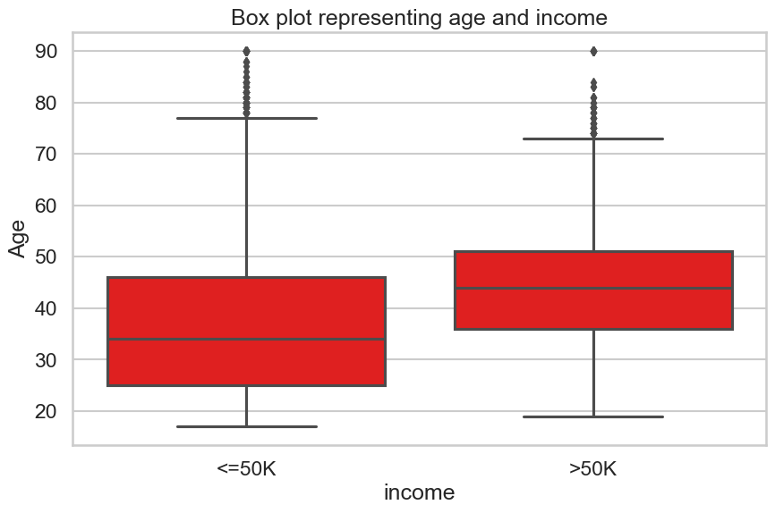
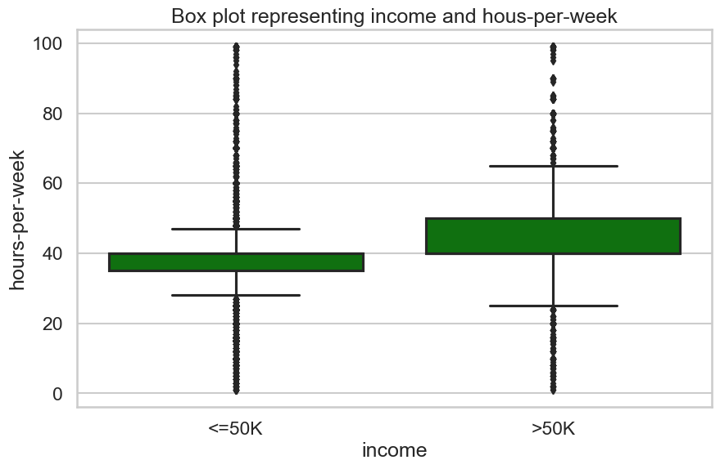
Box Plots: Uses box plots (‘sns.boxplot()’) to compare distributions of 'Age' and 'hours-per-week' concerning income levels.
As we can see in the Box Plot, the median age of people earning less than 50,000 is around 34 years and that of people earling more than 50,000 is around 45 years.
From above box plot we can conclude that, Most of them having income<=50k working 40 hours per week. Most of them having income>50k working more that 40 hours per week.

Slide 18
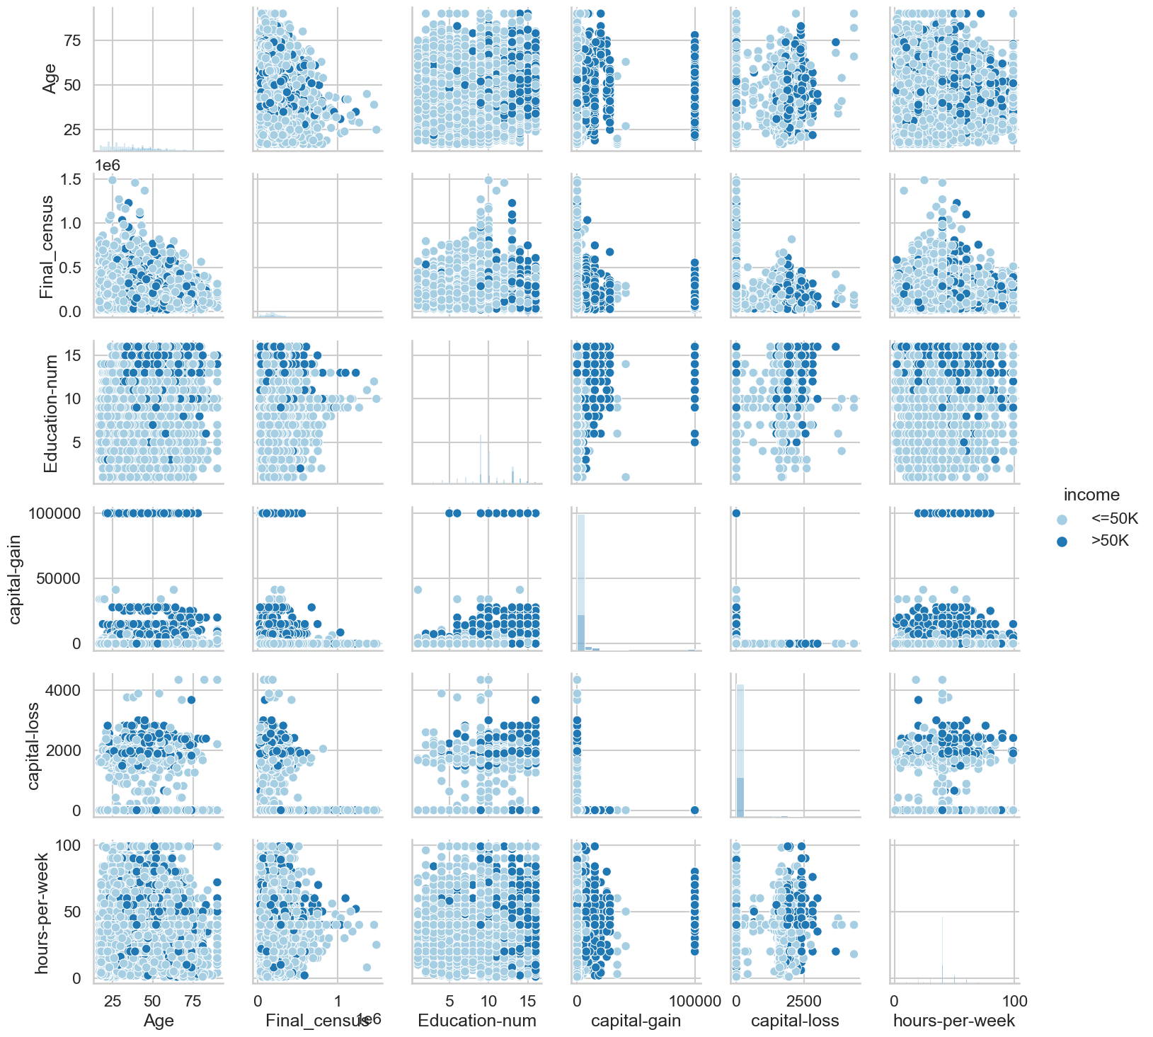
Scatter Plot: Presents a scatter plot (‘sns.pairplot()’) with histograms along the diagonal, showcasing pairwise relationships across numerical variables, colored by income groups.

Slide 19
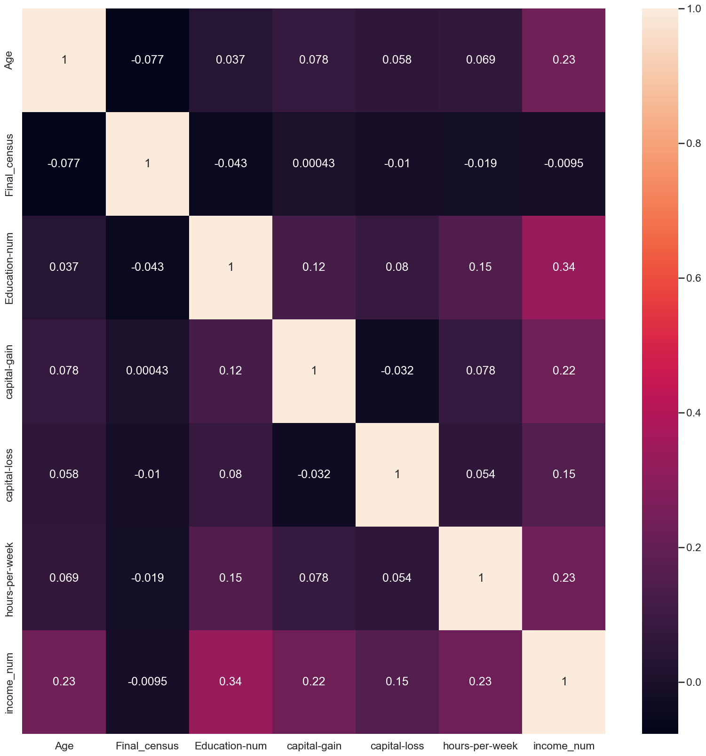
Heatmap: Displays the correlation matrix (‘sns.heatmap()’) to examine the correlation between features and the target variable.

Slide 20
From above correlation matrix, we found that the all correlation co-efficients are near to 0. So we can conclude that all the relationship between quantitative columns are very weakly correlated. Final_census and income_num is very weakly correlated.
So We will remove:
Income column is removed because we added income_num column instead of it.
Final_census is removed because of it is weakly co-related with target variable.
marital-status and relationship are almost same

Slide 21
Conclusion
Occupations: Certain occupations exhibit a distinct skew, with significantly more individuals earning <=50K than >50K.
Work Classes: Observations on work classes like 'self-employed' indicating a higher ratio of individuals earning >50K.
Marital Status & Relationships: Analysis reflects a similar income distribution between married and relationship-based statuses.
Education Level: Higher education levels, specifically 'Bachelors,' seem to correspond with higher counts of individuals earning >50K.
Gender & Race: Demographic details show that males and individuals of the 'White' race tend to have higher counts in the >50K income bracket.

Slide 22
Feature Engineering

Slide 23
Feature Engineering Techniques Used:
Handling Categorical Data: Utilizing one-hot encoding through (‘pd.get_dummies()’) to convert categorical columns like 'Profession Class', 'marital-status', 'occupation', 'race', 'Gender', 'country' into numerical values. This method transforms categorical variables into binary vectors.
Creation of Target Variable: Creating a binary target variable 'income_num' based on the original 'income' column. Mapping the values '<=50K' to 0 and '>50K' to 1 using (‘map()’).
Creation of New Variables
Target Variable Creation: Generating 'income_num' as a binary representation of income levels, replacing the original 'income' column.
Feature Selection Methods
Dropping Irrelevant Columns: Removing 'income' column since it's replaced by 'income_num'.
Eliminating 'Final_census' due to its weak correlation with the target variable.
Dropping 'relationship' as it's similar to 'marital-status'.

Slide 24
Data Splitting & Balancing: Splitting data into train and test sets, addressing class imbalance using SMOTE oversampling technique to balance the target variable's distribution.
Scaling: Applying standard scaling on the training data.
The process involves understanding the dataset's structure, cleaning it by handling missing values, conducting extensive exploratory data analysis to uncover patterns and relationships, analyzing income-related aspects, and finally, preparing the data for modeling through feature engineering and preprocessing steps.

Slide 25
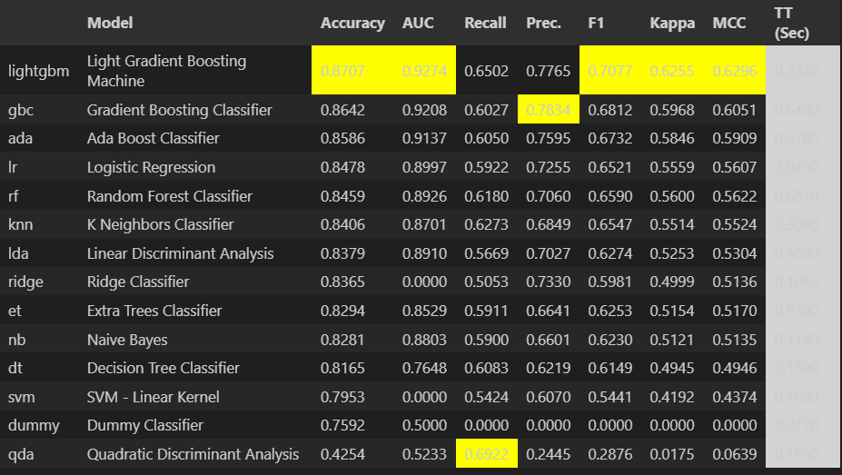
Model
Model Selection: Utilized a range of classifiers including LightGBM, Gradient Boosting, AdaBoost, Logistic Regression, Random Forest, and more.

Slide 26
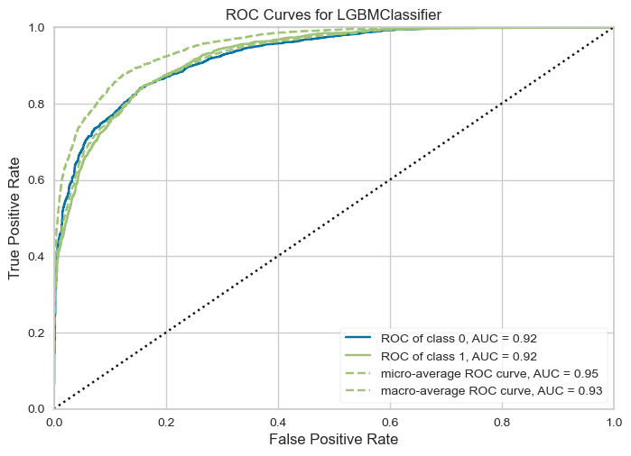
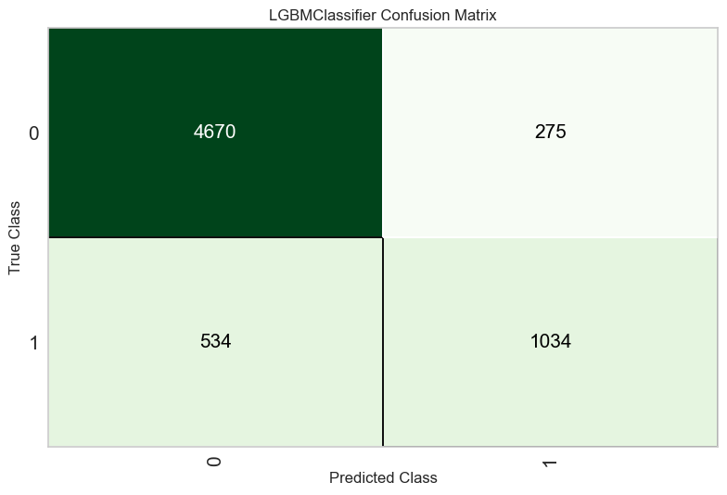
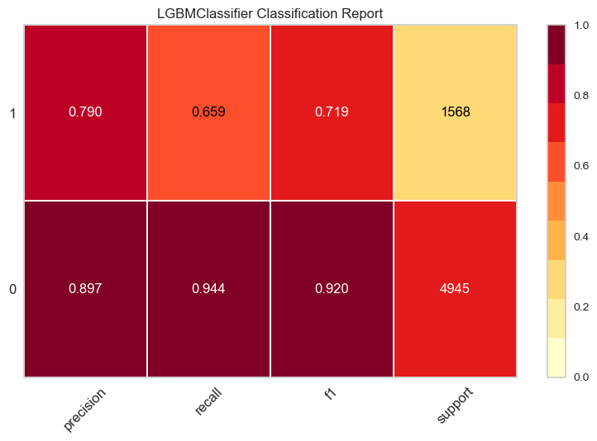
Evaluation Metrics: Assessed model performance using various evaluation metrics like Accuracy, AUC-ROC, Recall, Precision, F1-score.

Slide 27
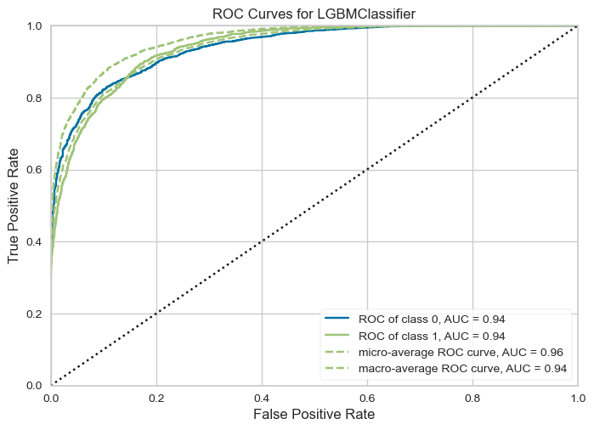
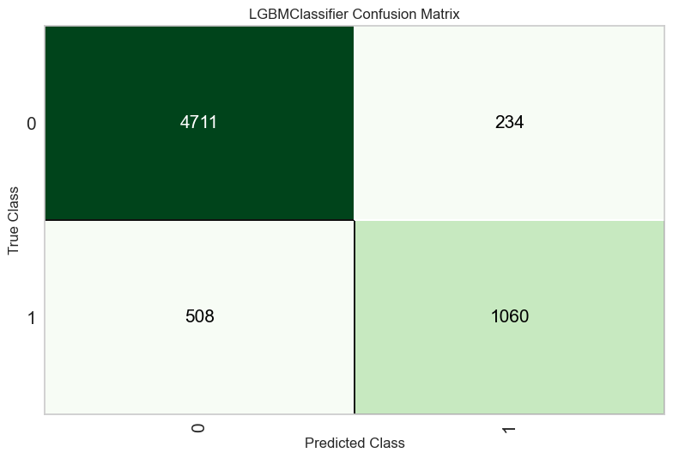
Hyperparameter Tuning: For LGBMClassifier.

Slide 28
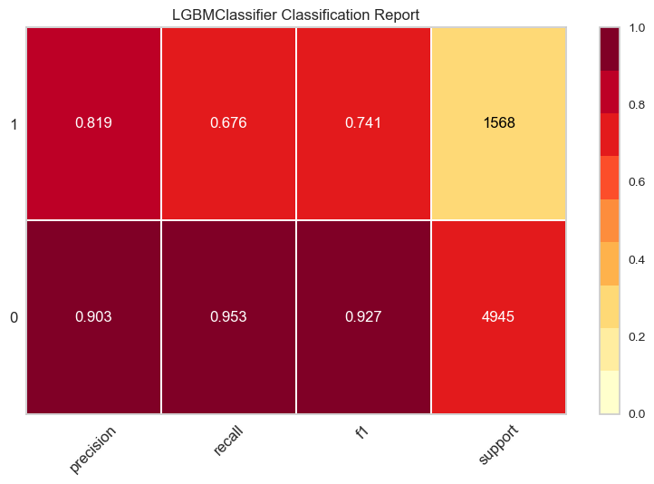
Model Selection and Outcome: Among the models assessed, the original LightGBM classifier seems to perform the best based on the provided evaluation metrics.

Slide 29
Thankyou

