Slide 1

P-184 NLP Emails
Group no. 1
Dipali Patil, Rutuja Deshmukh, Kalyani Fulpagare, Aniket Patil, Shubham Nagpure,Vishal Sathe
Mentored By
Mr. Varun (EXCELR)
Group no 1

Slide 2
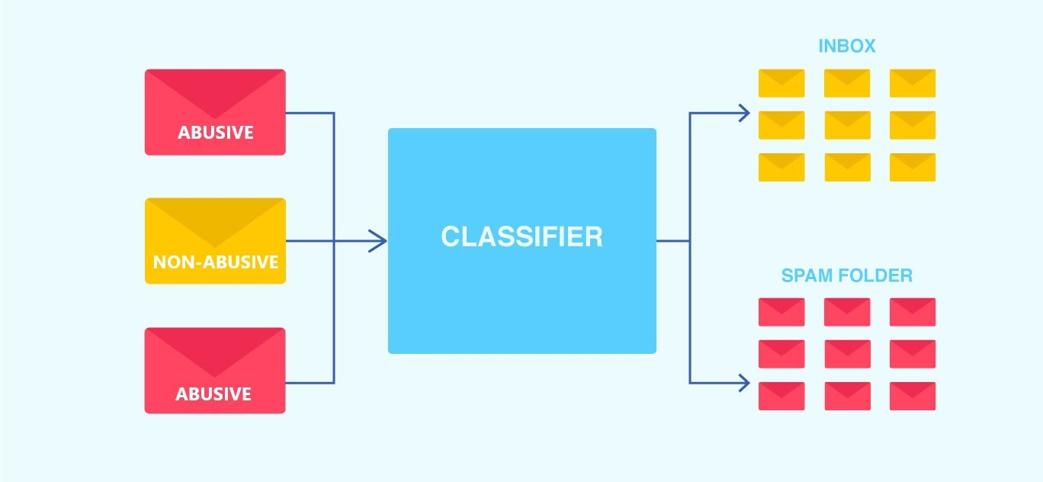
Business Problem
Inappropriate emails tend to demotivate and spoil the positive environment that would lead to more attrition rate and low productivity
Inappropriate emails could be in form of bullying, racism, sexual favouritism and hate in the gender or culture
In today's world, so dominated by email, no organization is immune to these hate emails
Objective
The goal of the project is to identify such emails on a given day based on the above inappropriate content and classify them as Abusive or Non-Abusive emails.
Group no 1

Slide 3
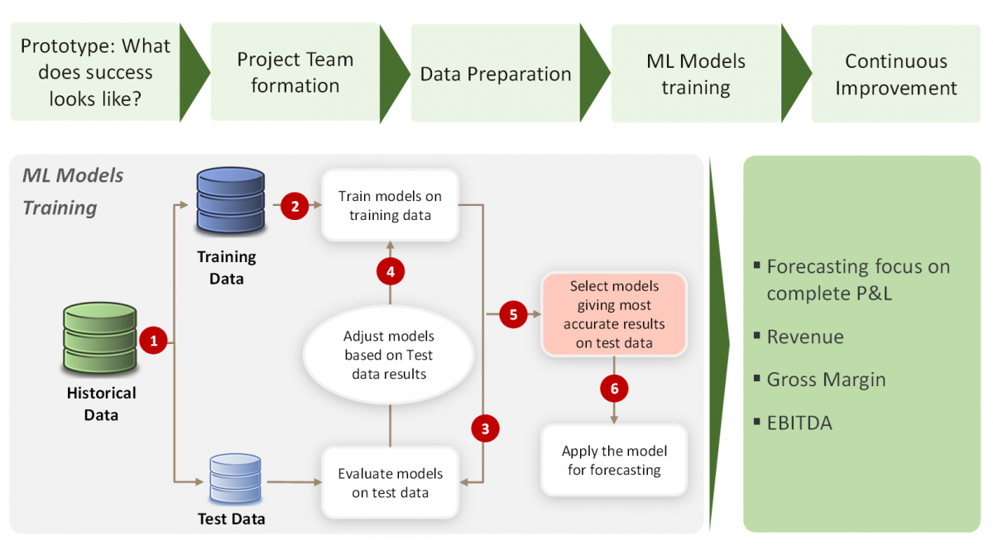
Project Architecture / Project Flow
Model deployment and classification of Emails as Abusive or Non-Abusive
for classification
Group no 1

Slide 4
Exploratory Data Analysis (EDA) and
Feature Engineering
Group no 1

Slide 5
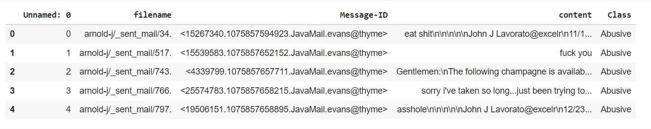
Dataset Details
Emails dataset contains 5 Columns and 48076 Rows
Group no 1

Slide 6
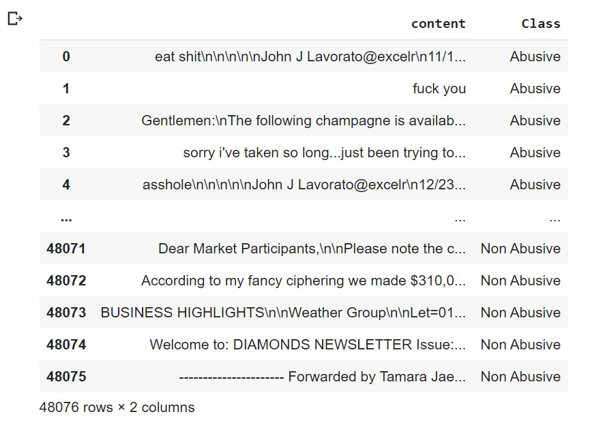
Dataset Details
Only two attributes “Content” and “Class” are considered as carrying relevant information
Group no 1

Slide 7
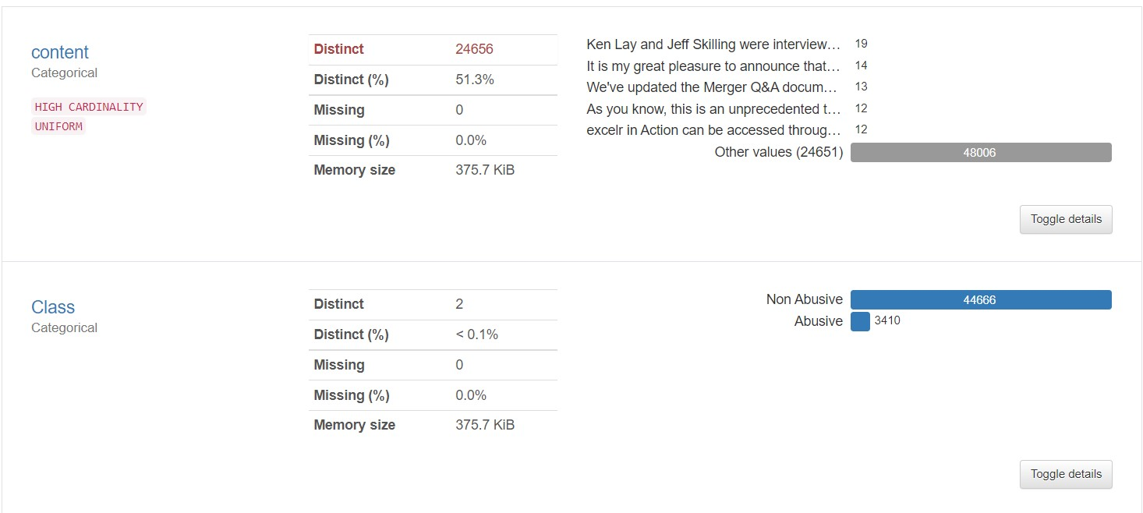
EDA
Auto EDA using Pandas Profiling
Group no 1

Slide 8
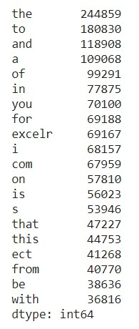
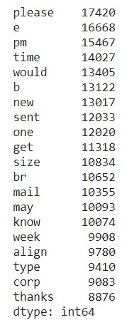
Manual EDA
Data cleaning and applying Stopwords
Word frequency before removal of stopwords
Word frequency after removal of
stopwords
Group no 1

Slide 9
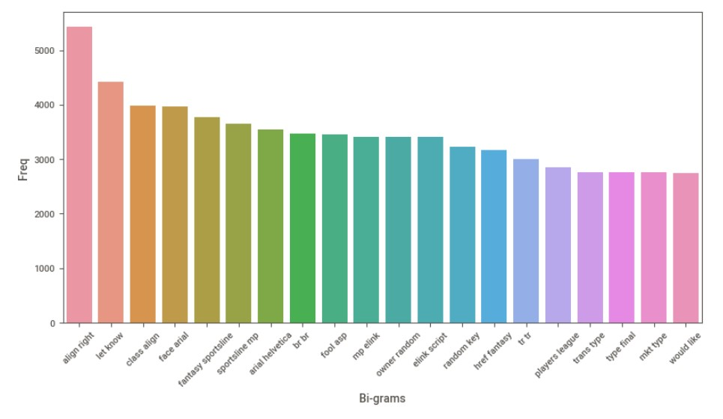
Feature Extraction
Bi-gram Using N-Gram Vectorizer
Group no 1

Slide 10
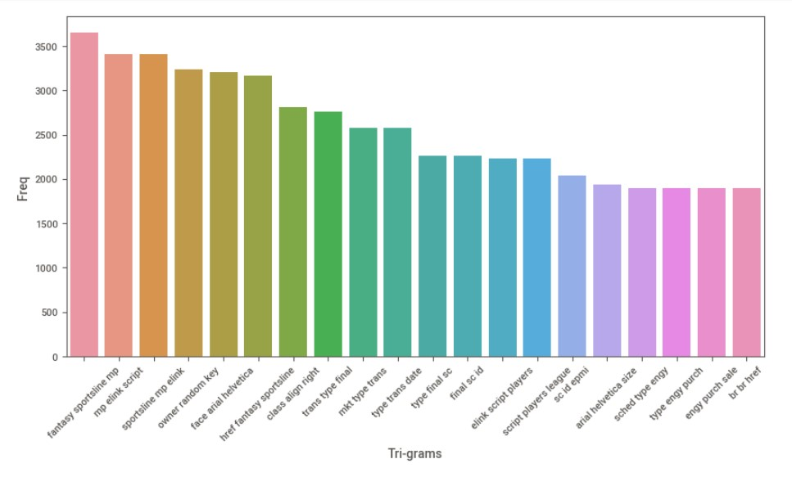
Feature Extraction
Tri-gram Using N-Gram Vectorizer
Group no 1

Slide 11
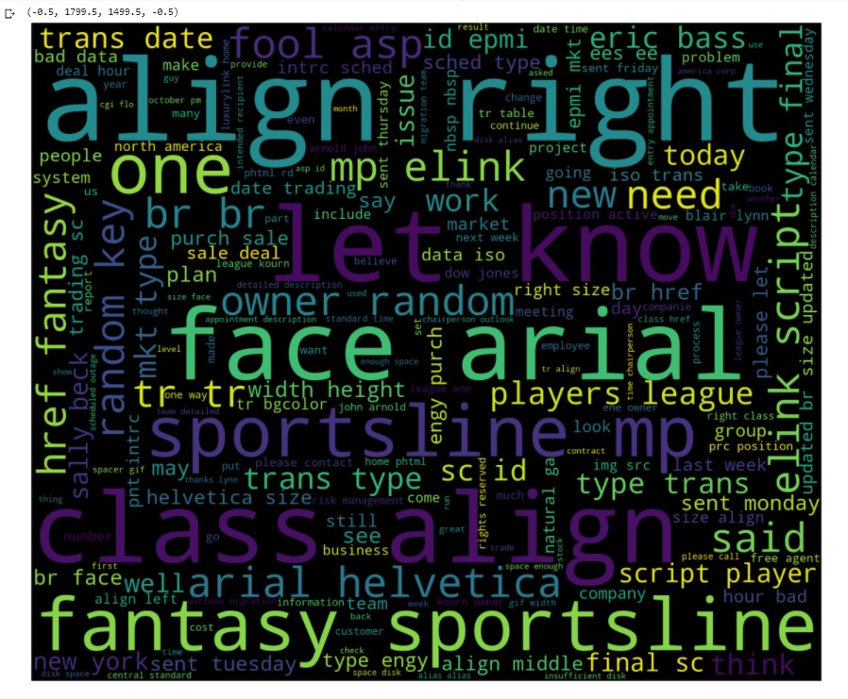
Word Cloud
Word cloud is generated for entire corpus based on words frequency
Group no 1

Slide 12
Model Building
Group no 1

Slide 13
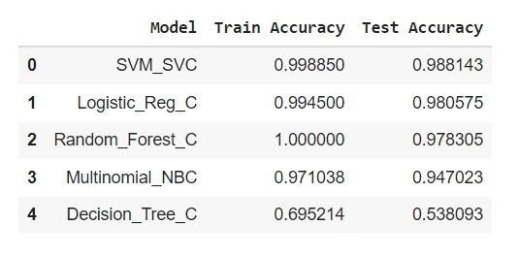
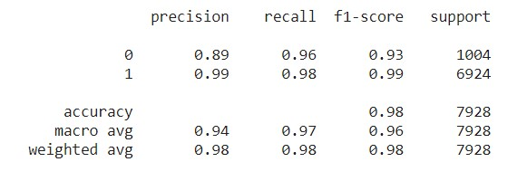
Model Building
Comparison of various models with Train and Test accuracies
Model | Parameters
Logistic Regression Classifier (BOW-TFIDF)
Group no 1

Slide 14
Model Deployment
Group no 1

Slide 15
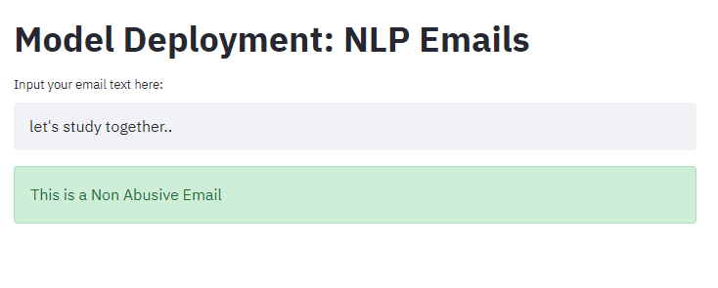
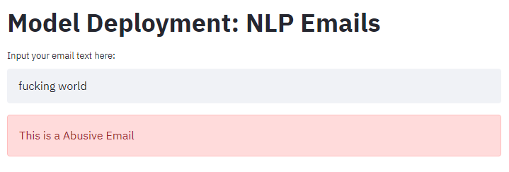
Model Deployment
Deployed model using Streamlit
Group no 1

Slide 16
Challenges faced?
1. Data balancing of imbalance data
2. Loading of dataset file while deploying
3. Model execution time in deployment
1. Cleaning unseen data in deployment
How did you overcome?
1. Overcame data imbalance using SMOTE over-sampling and under-sampling
2. Reduced the dataset file size by exporting the file after removing duplicate content
3. Though SVM model gave better train-test accuracy than other models, it has high
runtime. Comparatively, Logistic Regression model with approx same accuracy
as SVM performed well in execution and deployment.
1. Performed all cleaning steps of model on unseen data
Group no 1

Slide 17
Thank you
Group no 1

