Slide 1


Madanapalle Institute of Technology & Science, Madanapalle UGC-AUTONOMOUS INSTITUTION Affiliated to JNTUA, Ananthapuramu & Approved by AICTE, New Delhi
M I T S
Department of Computer Science and Technology
Final Review
Interactive Intelligence-Driven Feedback Interpretation and Insight Generation System for Enhanced Decision-Making
Presenting by:
22691A28G2 - V. SATHEESH
22691A28H1 - G. SOMU SHEKAR
22691A28H3 - R. SREEPATHI REDDY

Slide 2
CONTENTS :
OBJECTIVE
ABSTRACT
EXISTING SYSTEM
DISADVANTAGES
PROPOSED SYSTEM
ADVANTAGES
RESEARCH GAP
TENTATIVE METHODOLOGY
CONCLUSION

Slide 3
OBJECTIVE
To automate the extraction of key themes and topics from large volumes of open-ended feedback using Natural Language Processing (NLP).
To implement an intelligent clustering pipeline using algorithms like K-Means or DBSCAN to group semantically similar user responses.
To integrate cross-platform data acquisition by fetching real-time feedback directly from Google Sheets and Google Forms via API.
To generate actionable summaries and insights by synthesizing clustered data with large language models like Gemini 1.5 Flash.
To develop an interactive visualization dashboard using React to present data-driven insights and theme distributions for faster decision-making.To evaluate the efficiency of keyword extraction by comparing techniques such as TF-IDF and KeyBERT across various feedback datasets.

Slide 4
ABSTRACT
Smart Feedback AI is an intelligent platform that leverages NLP to analyze open-ended feedback from sources like Google Forms and Sheets. It identifies key themes, extracts actionable insights to support faster, data-driven decision-making.
The platform reduces the time spent on manual analysis, enhances responses to real user experiences, and can structure unorganized textual data into actionable formats.
Additionally, ensuring consistent and accurate analysis across large datasets. It also presents insights through clear visualizations, helping organizations quickly understand trends and improve actions.

Slide 5
EXISTING SYSTEM
Current systems used for feedback analysis have several limitations.
General AI models sometimes give unexpected or incorrect answers, and their responses can change depending on how the question is asked. They usually provide only basic summaries and do not clearly show which keywords or feedback points were used to create those summaries. This makes the results hard to trust or verify.
Traditional feedback systems mostly depend on manual work, such as tagging feedback by hand, using simple sentiment checks (positive/negative), and managing data in spreadsheets. These methods are slow, repetitive, and difficult to manage when large amounts of feedback are involved. Also, existing systems:
Cannot automatically group similar feedback together
Do not understand the full meaning or context of user comments

Slide 6
DISADVANTAGES
Lack of Explainability Insights are generated without clear reasoning or traceability to the original feedback.
Inconsistent Outputs Results vary based on prompt wording, leading to unreliable and unstable analysis.
Manual Dependency Heavy reliance on human effort for categorization and sorting increases time and error rates.
No Semantic Clustering Similar feedback is not automatically grouped, missing meaningful patterns.
Limited Context Understanding Systems fail to capture deeper meaning, intent, or relationships between feedback.
Basic Sentiment Analysis Only surface‑level positive/negative sentiment is identified, ignoring nuances.
Poor Scalability Struggles to handle large volumes of feedback efficiently.

Slide 7
PROPOSED SYSTEM
The proposed system follows a hybrid architecture designed to provide accurate, explainable, and scalable feedback analysis. The process begins with feedback collection from sources such as Google Sheets using APIs to ensure seamless data ingestion.
The collected feedback is then passed through a preprocessing stage, where the text is cleaned and converted into semantic embeddings for better contextual understanding. Next, the system performs keyword extraction using techniques like TF‑IDF, RAKE, and KeyBERT to identify important terms from the feedback.In parallel, clustering algorithms such as K‑Means or HDBSCAN are applied to group semantically similar feedback, enabling the discovery of hidden patterns and related issues. Once clusters are formed, cluster‑wise summarization is carried out using models like the Gemini Flash API to generate meaningful summaries for each group.
Finally, these summaries are combined in a final aggregation step to produce clear themes and an overall summary, providing actionable insights with improved consistency, explainability, and minimal manual effort.

Slide 8
ADVANTAGES
Automated Feedback Collection Using Google Sheets API enables easy, real‑time data collection without manual intervention.
Improved Data Quality through Preprocessing Text cleaning and embedding generation reduce noise and improve accuracy in downstream analysis.
Context‑Aware Keyword Extraction Combining TF‑IDF, RAKE, and KeyBERT extracts meaningful and relevant keywords, improving explainability.
Effective Semantic Clustering K‑Means and HDBSCAN group similar feedback automatically, uncovering hidden patterns and trends.
Dual‑Path Analysis for Deeper Insights Parallel keyword extraction and clustering ensure both surface‑level and semantic‑level understanding.
Cluster‑Wise Summarization Summarizing each cluster separately produces concise, focused insights rather than generic summaries. End‑to‑end automation significantly reduces human effort and processing time.

Slide 9
RESEARCH GAP
Lack of Explainable Feedback Analysis Existing systems generate summaries without clearly linking insights to extracted keywords, clusters, or original feedback.
Over‑reliance on Manual and Basic Methods Most traditional approaches depend on manual categorization and basic sentiment analysis, limiting scalability and accuracy.
Single‑Stage Analysis Focus Many existing solutions focus only on either keyword extraction or sentiment analysis, lacking a unified multi‑stage pipeline.
Inconsistent Insight Quality AI‑generated summaries vary with prompts and models, and this inconsistency is rarely measured or controlled.
Absence of Semantic Clustering Integration Semantic clustering methods like K‑Means or HDBSCAN are not systematically combined with embedding‑based representations.

Slide 10
TENTATIVE METHODOLOGY
Data Collection & Preprocessing
Collect user feedback data from Google Sheets using the Google Sheets API.
Perform text preprocessing including noise removal, punctuation cleaning, and basic normalization.
Keyword Extraction
Apply TF‑IDF to identify frequently occurring and important terms.
Use KeyBERT to extract context‑aware semantic keywords from feedback text.
Feedback Clustering
Convert preprocessed text into embeddings for semantic representation.
Apply K‑Means and DBSCAN clustering algorithms to group similar feedback automatically.
Insight Generation (AI‑Based Synthesis)
Perform cluster‑wise summarization using Gemini 2.5 Flash to generate meaningful insights from grouped feedback.
Reduce hallucinations by grounding summaries on clustered feedback data.
Final Aggregation & Visualization
Aggregate cluster‑level insights into overall themes and summaries.
Present results through an interactive React‑based dashboard for clear visualization and analysis.

Slide 11
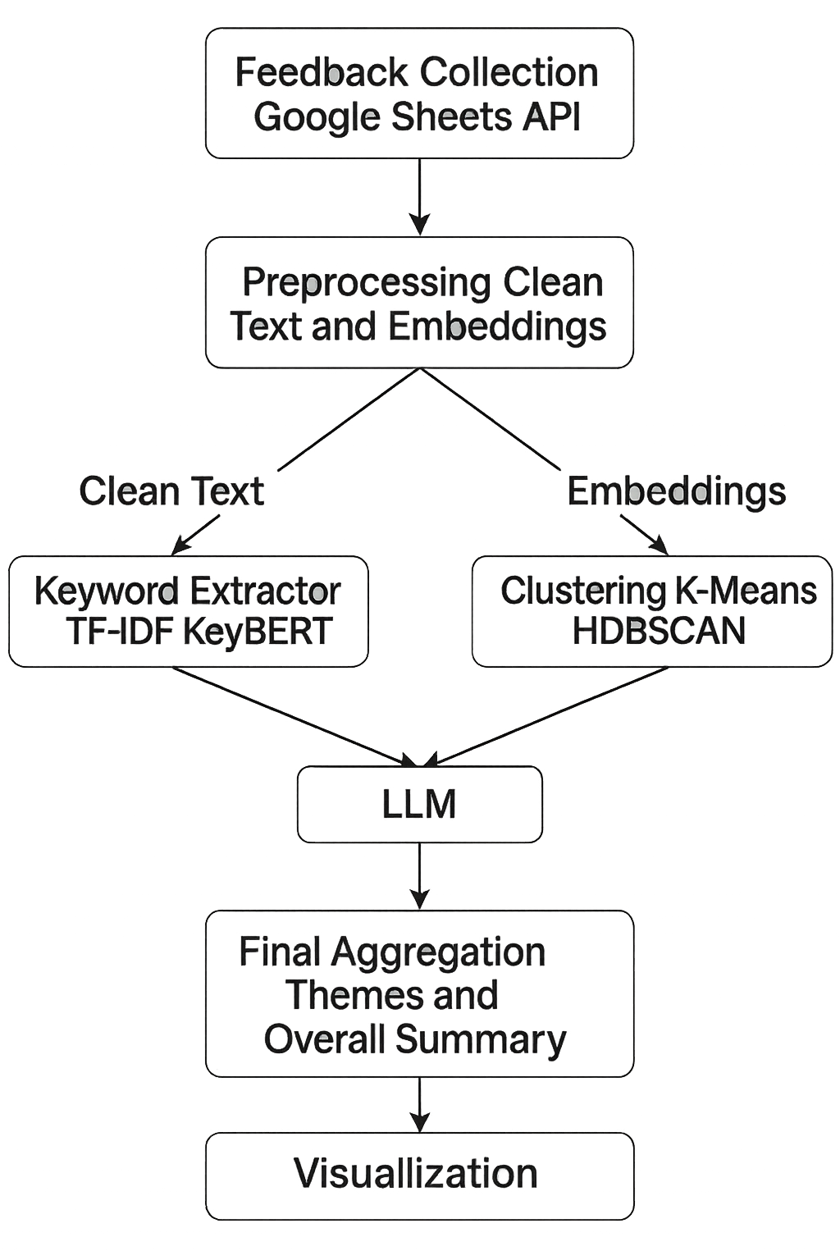
ARCHITECTURE DIAGRAM for AI - Powered Feedback Interpretation System

Slide 12
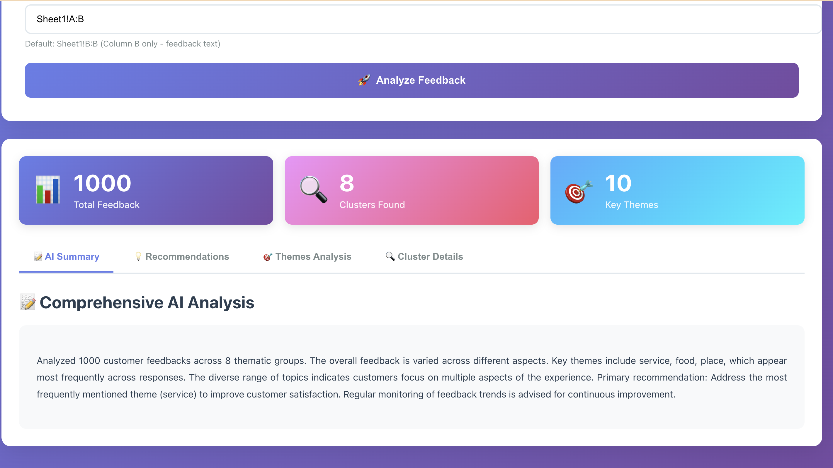
EXPECTED OUTPUT

Slide 13
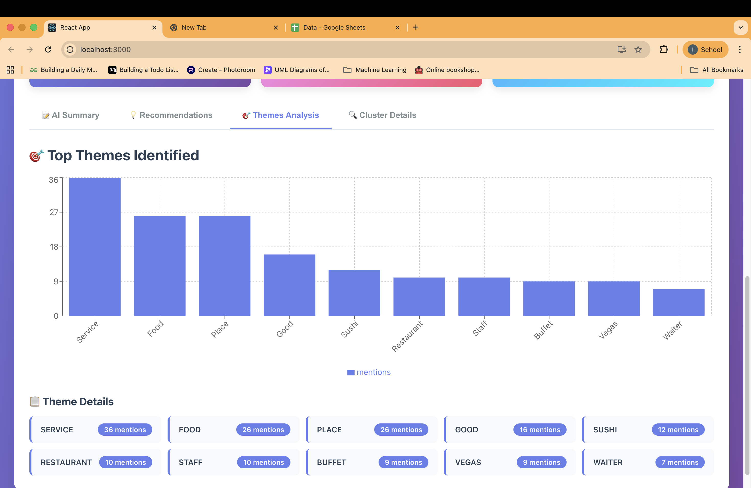

Slide 14
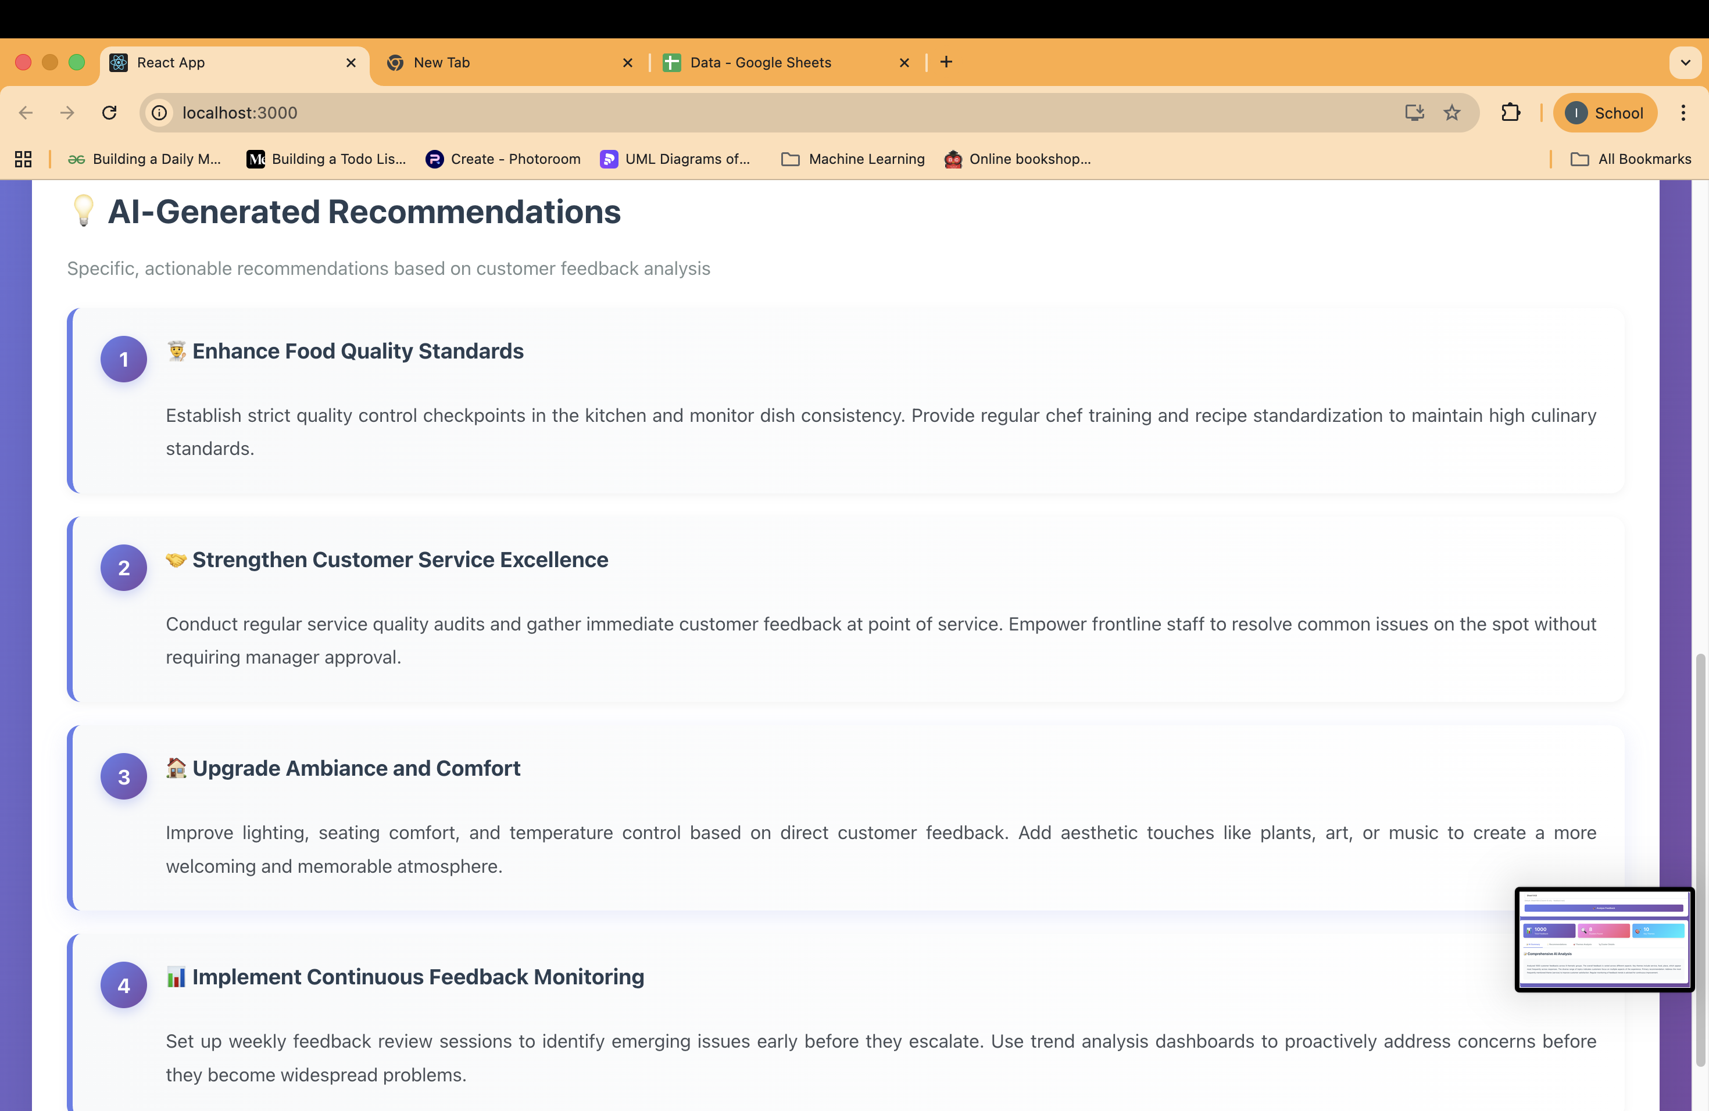

Slide 15
CONCLUSION :
Smart Feedback AI effectively automates the process of analyzing large volumes of open-ended feedback using Natural Language Processing and deep learning techniques. The system converts unstructured textual data into meaningful insights by extracting keywords, identifying themes, and clustering similar responses. This automation significantly reduces manual effort, minimizes human bias, and saves time. By presenting insights through clear visualizations, the system improves decision-making for organizations. The solution is highly suitable for both educational institutions and organizations to continuously improve services based on real user feedback.
Transforms raw feedback into insights using NLP and visualization.
Supports better decision-making by highlighting key themes and

Slide 16


