Slide 1
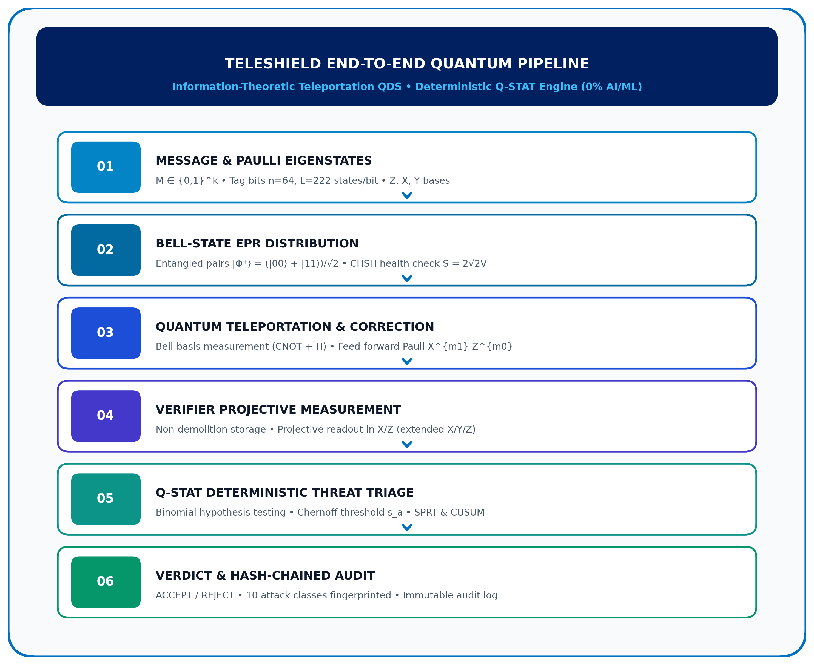

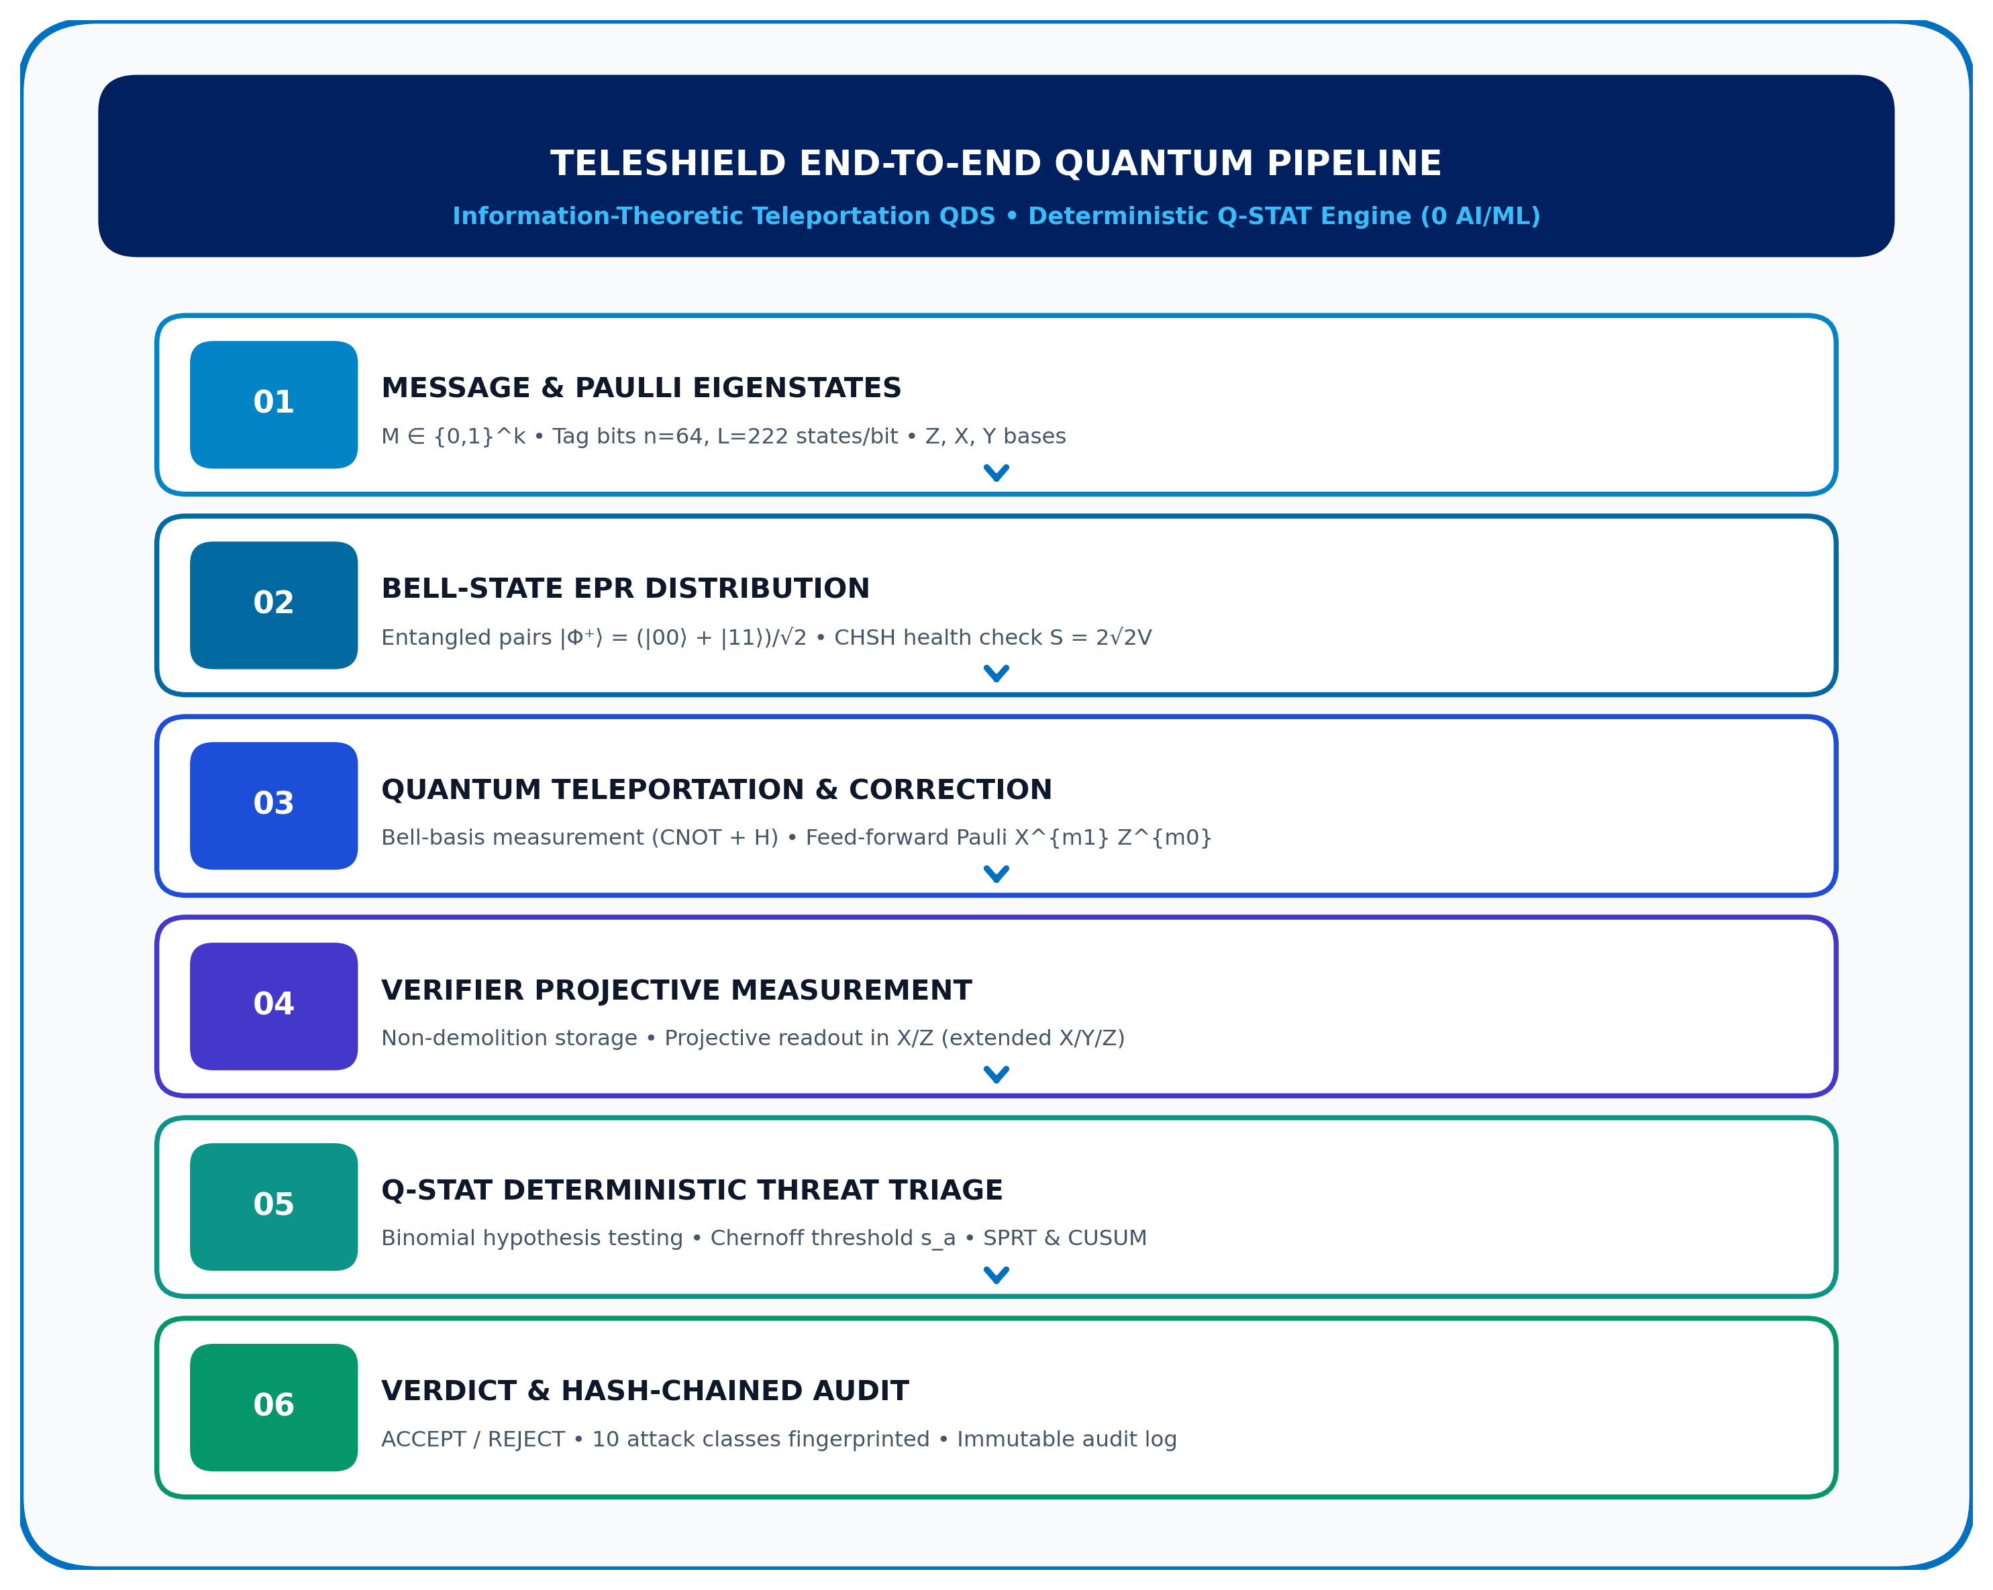
SMART INDIA HACKATHON 2026
TITLE PAGE • INNOVATION PITCH
Problem Statement ID – 26141
Problem Statement Title – Quantum-Inspired Cyber Threat Detection Framework for Teleportation-Based Quantum Digital Signatures
Theme – Blockchain & Cybersecurity (Quantum Security)
PS Category – Software
Team ID – [INSERT TEAM ID]
Team Name – TeleShield / HexaCore (Registered on portal)
Solution Pitch: Full-stack teleportation QDS framework with deterministic Q-STAT threat engine, Hoeffding/Chernoff statistical bounds, 10 attack classes & dual hardware profiles (0% AI/ML).

Slide 2
IDEA TITLE: TELESHIELD
Quantum-Inspired Cyber Threat Detection for Teleportation-Based QDS
TeleShield
PROBLEM-TO-SOLUTION TRAJECTORY: [RSA/ECC Cryptosystems] ➔ [Active Adversarial Tampering] ➔ [Teleportation-Based QDS] ➔ [TeleShield Q-STAT Engine] ➔ [Tamper-Proof Verdict]
PROPOSED SOLUTION & HOW IT ADDRESSES THE PROBLEM (THREAT TAXONOMY)
INNOVATION & UNIQUENESS OF THE SOLUTION (4 CORE PILLARS)
• FORGERY ATTACKS: Random state injection & splice tampering detected via non-orthogonal projection mismatch exceeding Chernoff threshold s_a; random guessing bound P_FA ≤ exp(-2L(p_f - s_a)^2).
• IMPERSONATION: Man-in-the-Middle spoofing signer identity blocked without pre-shared Bell pairs; orthogonal basis collapse prevents authentic verification.
• REPLAY & FRESHNESS: Stale quantum signatures intercepted and replayed rejected via sequential nonces, session timestamps, and quantum state collapse.
• CHANNEL MANIPULATION: Bit-flip (X), dephasing (Z), depolarizing noise & intercept-resend detected via Bell-state fidelity decay and CHSH violation tracking (S = 2√2V).
1. Quantum-Native Measurement Analysis: Direct Pauli projective statistics (X/Z, extended X/Y/Z) without full state tomography. O(1) state complexity vs O(2^n) tomography overhead.
2. Zero AI / Zero ML (100% Deterministic): No opaque black-box neural networks, no training bias, no false confidence, and zero hallucination risk. 100% explainable mathematical proof.
3. Mathematically Derived Statistical Thresholds: Analytical acceptance threshold s_a from Hoeffding/Chernoff bounds: P_FR ≤ exp(-2L(s_a - ε)^2), P_FA ≤ exp(-2L(p_f - s_a)^2). Zero hardcoded cutoffs.
4. Hardware-Aware Dual-Profile Architecture: Calibrated simulation profiles for Ion-Trap (Qiskit Aer depolarizing/dephasing) and Rydberg/Neutral-Atom (Pulser Hamiltonian) with Clifford scaling via Stim.
DETAILED EXPLANATION: END-TO-END TELEPORTATION QDS ARCHITECTURE & WORKING MECHANISM
1. MESSAGE
M ∈ {0,1}^k
Classical text
2. QDS STATES
Pauli eigenstates
X, Z (ext. Y)
3. EPR SOURCE
|Φ⁺⟩ = (|00⟩+|11⟩)/√2
Bell distribution
4. TELEPORT
CNOT + H
Bell measurement
5. CORRECTION
Pauli feed-forward
X^{m1} Z^{m0}
6. VERIFIER
Quantum memory
Storage of states
7. READOUT
Projective basis
Π_Z, Π_X readout
8. Q-STAT
Statistical triage
Binomial / SPRT
9. VERDICT
ACCEPT / REJECT
Hash-chained log
Configurable Demo Baseline: n = 64 tag bits, L = 222 states/bit, 10,000 shots (simulation parameters, not claimed hardware limits). Strict 0% AI/ML statistical decision.

Slide 3
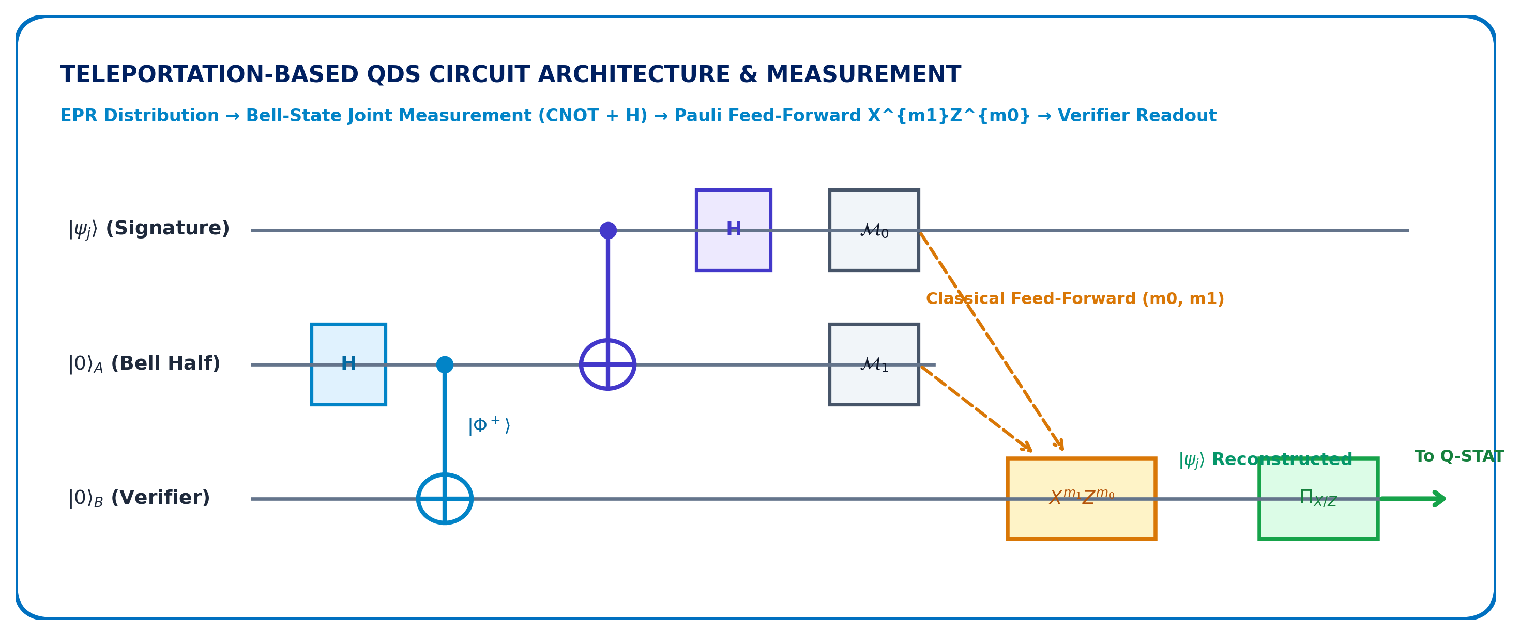
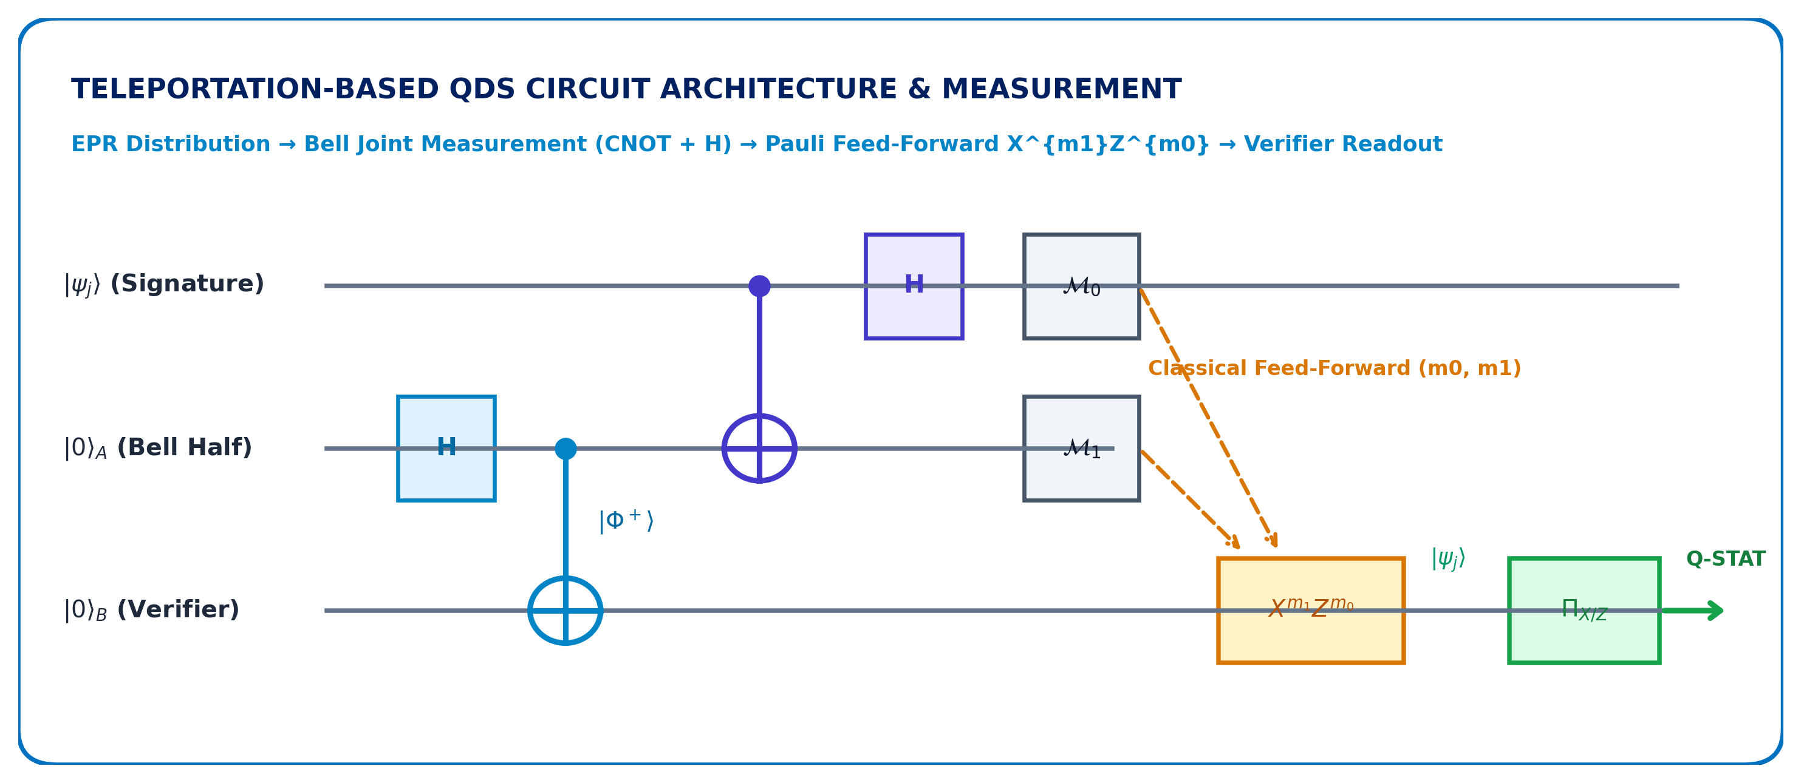
TECHNICAL APPROACH
Technology Stack, Mathematical Model & 9-Stage Q-STAT Detection Pipeline
TeleShield
TECHNOLOGIES & QUANTUM SOFTWARE STACK (POINTER 1)
MATHEMATICAL FORMULATION & HOEFFDING/CHERNOFF ERROR BOUNDS
• Core & Reference Backend: Python 3.11+, NumPy, SciPy (Reference exact numerical state-vector engine; 100% deterministic baseline).
• Primary Simulation Engine: Qiskit 1.0+ & Qiskit Aer (Emulates quantum circuits, Bell pairs, Kraus operators & noisy quantum channels).
• Clifford & Neutral-Atom Engines: Stim (Ultra-fast O(N) Clifford simulation for 10^5+ shots) + Pulser (Neutral-atom Hamiltonian pulse simulation).
• Hardware Profile Alignment: Trapped-Ion simulation profile (dephasing/heating noise) & Rydberg neutral-atom hardware-aware profile.
• API & Triage Dashboard: FastAPI (Async REST API service) + Streamlit & Plotly (Real-time explainable Q-STAT visual triage dashboard).
• Binomial Statistical Model: Per-block mismatch X_j ~ Binomial(L, p), observed mismatch rate m_j = X_j / L against analytical threshold s_a.
• False Rejection Bound (Honest): P_FR ≤ exp(-2L(s_a - ε)^2); across n blocks: P_FR,total ≤ n exp(-2L(s_a - ε)^2) (guaranteed < 10^-6).
• Forgery Acceptance Bound (Attacker): Random guessing p_f = 1/2 implies strict forgery bound P_FA ≤ exp(-2L(p_f - s_a)^2) (guaranteed < 10^-9).
• CHSH Entanglement Test: Werner state parameterization S = 2√2 V; S > 2 confirms non-locality; S ≤ 2 triggers channel intercept alarm.
• Sequential & Session Drift: SPRT early-exit verification (Wald's bounds) + CUSUM cumulative sum tracking for slow adversarial drift.
METHODOLOGY: Q-STAT 9-STAGE THREAT TRIAGE PIPELINE
1. Envelope Check: JSON schema validation, parameter bounding & payload integrity.
2. Freshness Check: Timestamp, sequence number, and nonce check against replay.
3. Authorization Check: Signer public key identity and registry authorization verification.
4. Message Integrity: Classical cryptographic hash comparison across signer and verifier.
5. Quantum Measurement: Projective measurement on verifier's teleported qubits in X/Z bases.
6. Binomial / SPRT Decision: Sequential hypothesis testing against calculated s_a (0 AI/ML).
7. Attack Fingerprinting: Classifies signature vector across 10 distinct attack/noise classes.
8. CHSH / CUSUM Check: Entanglement visibility verification (S = 2√2V) & cumulative drift.
9. Verdict & Audit Log: ACCEPT / REJECT verdict with SHA-256 hash-chained immutable log.

Slide 4
FEASIBILITY AND VIABILITY
Rigorous Feasibility Analysis, Threat Risks & Engineering Mitigation Strategies
TeleShield
1. ANALYSIS OF FEASIBILITY (POINTER 1)
2. POTENTIAL CHALLENGES & RISKS (POINTER 2)
3. STRATEGIES & MITIGATIONS (POINTER 3)
• Software Feasibility: Built entirely on standard Python 3.11+, Qiskit 1.0+, Stim, and SciPy. Zero proprietary runtime requirements; fully containerized via Docker.
• Computational Feasibility: Clifford-dominated teleportation circuits simulate in polynomial time O(N) using Stim, enabling 10^5+ Monte Carlo shots in seconds without clusters.
• Hardware Feasibility: Decoupled backend architecture models physical NISQ systems (depolarizing, thermal relaxation, gate crosstalk) via calibrated Qiskit Aer & Pulser profiles.
• Measurement Scalability: Projective measurements evaluate in O(1) time per shot via fast binomial statistics and SPRT early-stopping; avoids exponential tomography.
• Reproducibility & Standards: Open architecture with explicit YAML configuration schemas, automated pytest suites (32+ tests passing), and deterministic seeds.
• Simulation Complexity: Exponential state-vector memory explosion (2^N) in full density matrix simulators when scaling multi-party quantum signatures.
• Noise vs. Attack Ambiguity: Physical thermal relaxation and gate infidelity resembling low-rate adversarial eavesdropping or intercept-resend attacks.
• False Rejection Risk: Strict acceptance thresholds rejecting valid honest signatures under unexpected physical channel jitter or environmental drift.
• Sub-Threshold Stealth Attacks: Sophisticated adversaries injecting errors just below detection limits (threshold-aware attackers evading static bounds).
• Hardware Profile Discrepancies: Trapped-ion shuttling delays vs. Rydberg neutral-atom blockade leakage creating divergent physical error signatures.
• Multi-Engine Abstraction: Exact backend for mathematical ground truth; Stim for 10^5+ shot volumes; Aer for realistic NISQ noise emulation.
• Per-Basis & Per-Block Diagnostics: Differentiates isotropic physical noise (uniform across X/Z) from targeted adversarial tampering (asymmetric X/Z or single block).
• Analytical Chernoff Thresholds: Mathematically derived acceptance cutoff s_a guarantees provable error bounds (P_FR < 10^-6, P_FA < 10^-9); zero hardcoded limits.
• Continuous Entanglement & Drift Checks: Werner-state CHSH test (S = 2√2V) detects channel loss; CUSUM cumulative sum tests expose creeping sub-threshold attacks.
• Modular Hardware Profiles: Ion-trap and Rydberg profiles configure independent T1, T2, gate crosstalk, and readout errors without claiming proprietary hardware.
VERIFICATION & REPRODUCIBILITY LIFECYCLE: [SIMULATION: Exact / Aer / Stim / Pulser] ➔ [NOISE CALIBRATION: T1/T2 & Kraus Operators] ➔ [STATISTICAL ANALYSIS: Binomial & Chernoff s_a] ➔ [ATTACK EVALUATION: 10 Adversarial Vectors] ➔ [REPRODUCIBLE RESULTS: SHA-256 Hash-Chained Audit]

Slide 5
IMPACT AND BENEFITS
Target Audience Impact, Societal Benefits & Measurable Deliverables
TeleShield
QUANTUM-READY CYBER DEFENCE: UNCONDITIONAL INTEGRITY FOR POST-RSA CRITICAL INFRASTRUCTURE
FIVE BENEFIT SECTORS & TARGET AUDIENCE (POINTERS 1 & 2)
CRITICAL REAL-WORLD APPLICATION DOMAINS
1. Digital Security & Sovereign Identity
Tamper-proof non-repudiation protects national e-governance, digital passports, legal contracts, and sovereign credentials against quantum forgery and impersonation.
2. Quantum Cybersecurity Research
Provides an open, standardized benchmark framework for researchers to evaluate teleportation protocols, Kraus noise models, and active quantum attack strategies.
3. Hardware Readiness & Industry Transition
Offers hardware manufacturers a standardized, low-friction application-layer testing sandbox to benchmark real NISQ trapped-ion and neutral-atom processors.
4. Explainable & Legally Auditable Security
100% deterministic mathematical telemetry eliminates opaque neural network black-boxes, fulfilling strict regulatory compliance and evidentiary legal standards.
5. Future Quantum Networks & Repeaters
Establishes the algorithmic foundation for the Quantum Internet, quantum repeater authentication, and multi-party quantum signature distribution networks.
• Defense & National Security: High-assurance command-and-control messaging with mathematically provable zero eavesdropping tolerance.
• Financial Systems & CBDC: High-value cross-border settlements, central bank digital currencies, and fraud-proof cryptographic bonds.
• Critical National Infrastructure: Power grids, nuclear command networks, and telecommunication backbones shielded from post-RSA compromise.
MEASURABLE ARCHITECTURAL CHARACTERISTICS & PROJECT METRICS
0 AI / ML Models
100% Deterministic & Provable Decision Logic
3 Core Simulators
Exact NumPy, Qiskit Aer, Stim Clifford
2 Hardware Profiles
Ion-Trap Aligned & Rydberg Aware
3 Measurement Bases
Primary X/Z, Extended Six-State X/Y/Z
10 Threat Classes
Comprehensive Adversarial Attack Matrix
100% Audit Trail
Cryptographic SHA-256 Hash-Chained Log
* Architectural parameters and simulation profiles; zero unverified hardware claims.

Slide 6
RESEARCH AND REFERENCES
Scientific Foundations, Hardware Profile Alignment & Open Deliverables
TeleShield
QUANTUM DIGITAL SIGNATURES (QDS) THEORETICAL FOUNDATIONS
QUANTUM TELEPORTATION & ENTANGLEMENT VERIFICATION
• D. Gottesman and I. Chuang: "Quantum Digital Signatures", arXiv:quant-ph/0105032 (2001). Foundational information-theoretic protocol establishing quantum public keys, unconditional non-repudiation, and non-forgeability.
• E. Andersson, M. Curty, I. Jex: "Practical Quantum Digital Signatures without Quantum Memory", Phys. Rev. Lett. 96, 170501. Breakthrough enabling optical and multiport verifications.
• V. Dunjko, P. Wallden, E. Andersson: "Quantum Digital Signatures without Quantum Memory: Protocols and Security", Phys. Rev. A 89, 062327. Security bounds against collective coherent attacks.
• C. H. Bennett et al.: "Teleporting an Unknown Quantum State via Dual Classical and Einstein-Podolsky-Rosen Channels", Phys. Rev. Lett. 70, 1895 (1993). Foundational quantum teleportation mechanism.
• J. F. Clauser, M. A. Horne, A. Shimony, R. A. Holt: "Proposed Experiment to Test Local Hidden-Variable Theories (CHSH)", Phys. Rev. Lett. 23, 880 (1969). Bell inequality framework utilized in TeleShield.
• R. F. Werner: "Quantum States with Einstein-Podolsky-Rosen Correlations Admitting a Hidden-Variable Model", Phys. Rev. A 40, 4277 (1989). Parameterization for isotropic quantum channel degradation.
QUANTUM SOFTWARE, SIMULATION ENGINES & STATISTICAL TOOLS
HARDWARE PROFILE CONTEXT & OPEN REPOSITORY DELIVERABLES
• Qiskit & Qiskit Aer: IBM Quantum open-source SDK for circuit synthesis, gate decomposition, density matrix emulation & Kraus channel noise modeling (https://qiskit.org).
• Stim (C. Gidney): "Stim: a fast stabilizer circuit simulator", Quantum 5, 497 (2021). Enables O(N) Clifford simulation scaling for 10^5+ shots in TeleShield's high-throughput mode.
• Pulser (Pasqal): "Pulser: An open-source package for the simulation of neutral-atom architectures", Quantum 6, 629 (2022). Used for neutral-atom Hamiltonian dynamics.
• SciPy & NumPy: Provides exact binomial distribution, Sequential Probability Ratio Tests (SPRT), and Cumulative Sum (CUSUM) drift detection functions.
• Hardware Profile Alignment: Trapped-ion aligned simulation profile (calibrated Raman gate dephasing, ion shuttling) and Rydberg/neutral-atom hardware-aware profile (Rydberg blockade, optical tweezers).
• Public Industry Landscape Awareness: Informed by emerging neutral-atom platforms including public context from Egreen Quanta (https://www.egreenquanta.com/). Simulation profiles align with public architectural modalities; no proprietary hardware claims made.
• TeleShield GitHub Repository: Complete open-source framework, documentation, test suites & simulation engine: https://github.com/Vshal-Kumar/QDS_for_Photonic
END-TO-END THEORETICAL & APPLIED RESEARCH SYNTHESIS: [QDS THEORY] ➔ [TELEPORTATION] ➔ [MEASUREMENT] ➔ [STATISTICS] ➔ [ATTACK MODELLING] ➔ [HARDWARE SIMULATION] ➔ [TELESHIELD]

