Slide 1
क
PROJECT DEMO · PYTORCH + OPENCV
Devanagari
Handwritten OCR
Photograph a page of handwriting — get back Devanagari Unicode text.
क
ख
ग
८
ज्ञ
९
Trained on DHCD — 92,000 handwritten glyphs, 46 classes
Runs on Apple Silicon (MPS) · CUDA · CPU
Notes:
Hook: photograph any page of Devanagari handwriting and the engine returns the text. Everything on this deck was measured on real runs.

Slide 2
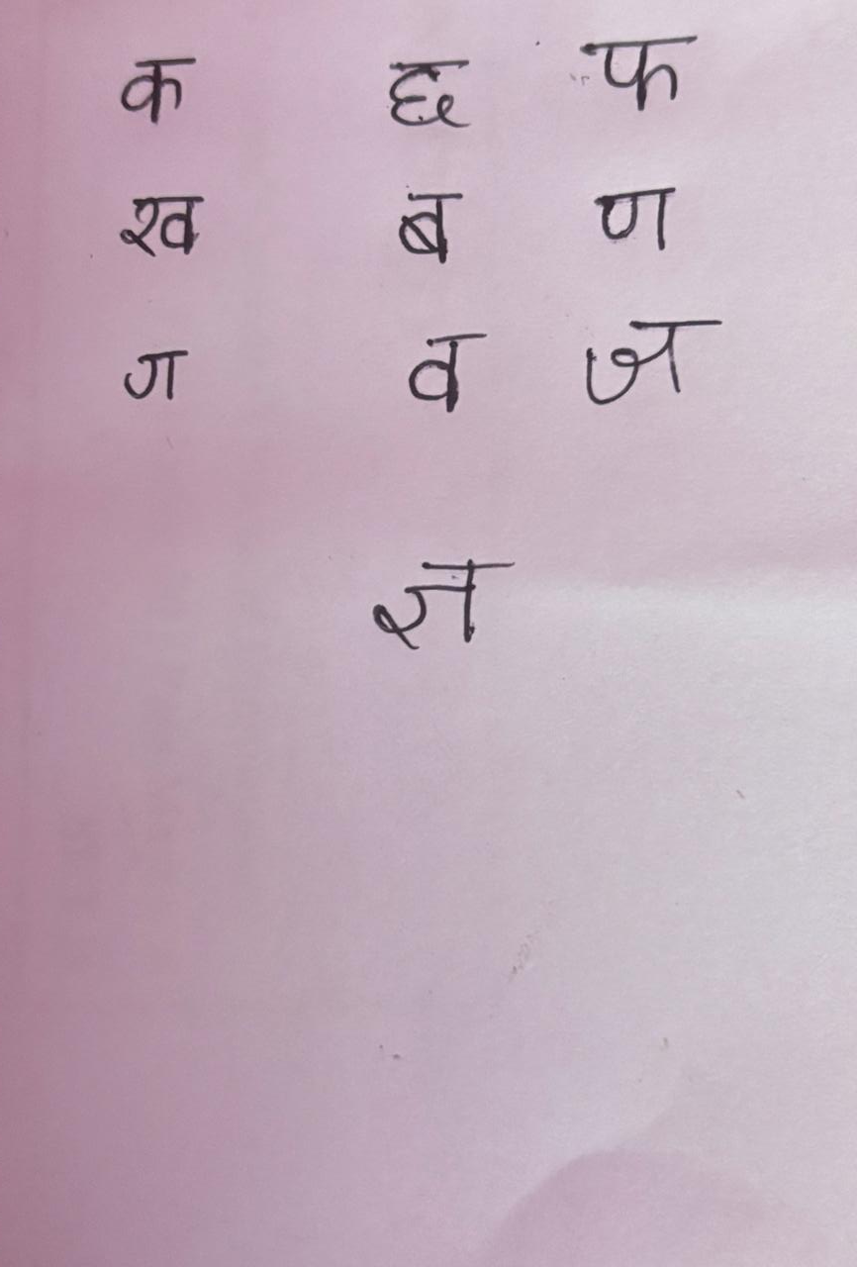
THE PROBLEM
Why handwritten Devanagari is hard
46 visually similar classes
36 consonants + 10 digits — many pairs differ by a single stroke or dot.
The shirorekha fuses words
The headline bar connects every character into one ink blob; it must be cut before characters can be counted.
Every writer is a new font
Stroke width, slant and loop size change from person to person — and pen to pen.
Photos fight back
Real demo input — a phone photo on shadowed pink paper
Shadows, ruled lines, margin bars, paper folds and faint pencil all corrupt the ink.
02
Notes:
Set up the two hard parts the pipeline solves: the shirorekha (segmentation) and 46 similar classes (the CNN).

Slide 3
PIPELINE
One photograph, five stages
01
02
03
04
05
Preprocess
Find lines
Find characters
Classify
Assemble
→
→
→
→
Shadows lifted, page deskewed, contrast normalized, ruled lines erased
Horizontal projection profiles on the cleaned ink binary
Strip the shirorekha, then vertical projection per line
CNN softmax over 46 classes on each 32×32 crop
Group by row, sort left → right, write text + overlay
One engine does it all — device auto-detected: Apple Silicon GPU (MPS), CUDA, or CPU.
03
Notes:
Walk left to right. Stages 2–4 are where the interesting engineering lives; the next slides zoom into each.

Slide 4
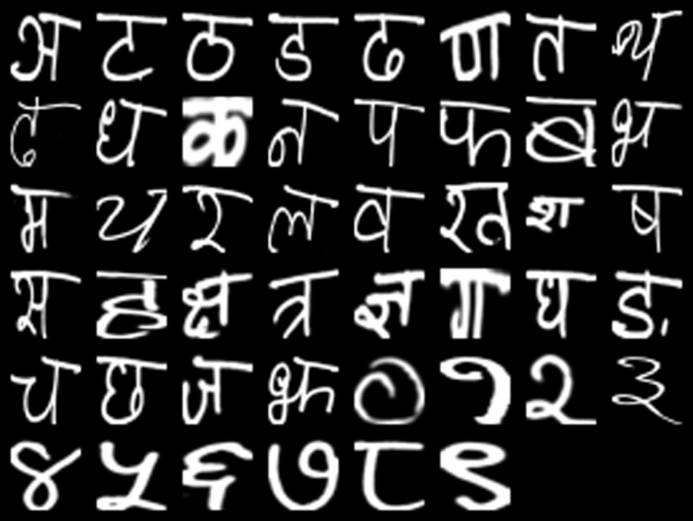
DATASET
DHCD — 92,000 handwritten glyphs
92,000
handwritten glyph images from 2,000 writers
46 classes
36 consonants (क … ज्ञ) + 10 digits (० … ९)
78,200 / 13,800
train / held-out test — the Test folder is used once, at the very end
32×32 px
native crop size the CNN consumes; class order baked into the checkpoint
One sample per class — white ink on black, 32×32 px
Source: UCI Machine Learning Repository — Devanagari Handwritten Character Dataset
04
Notes:
46-way classification is the model's whole world; folder names map to Unicode via DHCD_LABEL_MAP.

Slide 5
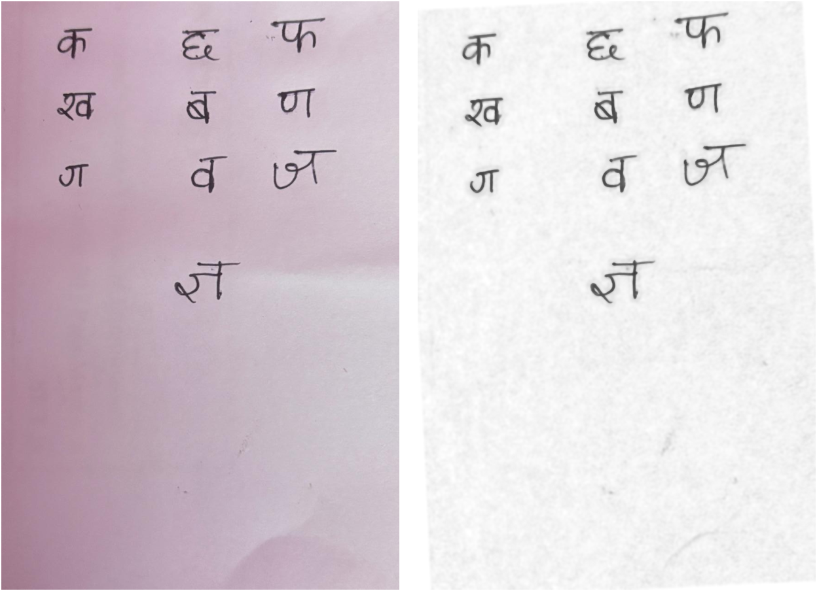
STAGE 1 · PREPROCESSING
Make the photo look like training data
01
Shadow removal
each pixel divided by the estimated paper brightness — shadows lift, ink stays
02
Deskew
page tilt rotated flat via minAreaRect over all ink pixels
03
CLAHE + bilateral filter
faint strokes up, paper texture down, stroke edges stay sharp
04
Ruled & margin lines erased
morphological opening for rules; column statistics for margin bars
05
Text-scale guard
Phone photo · after the enhancement chain
upscale until the median text row ≈ 52 px — thin strokes vanish below that
05
Notes:
Goal: make a photographed page resemble the clean DHCD rendering. Highlight divide-by-background shadow removal and the margin-line eraser.

Slide 6
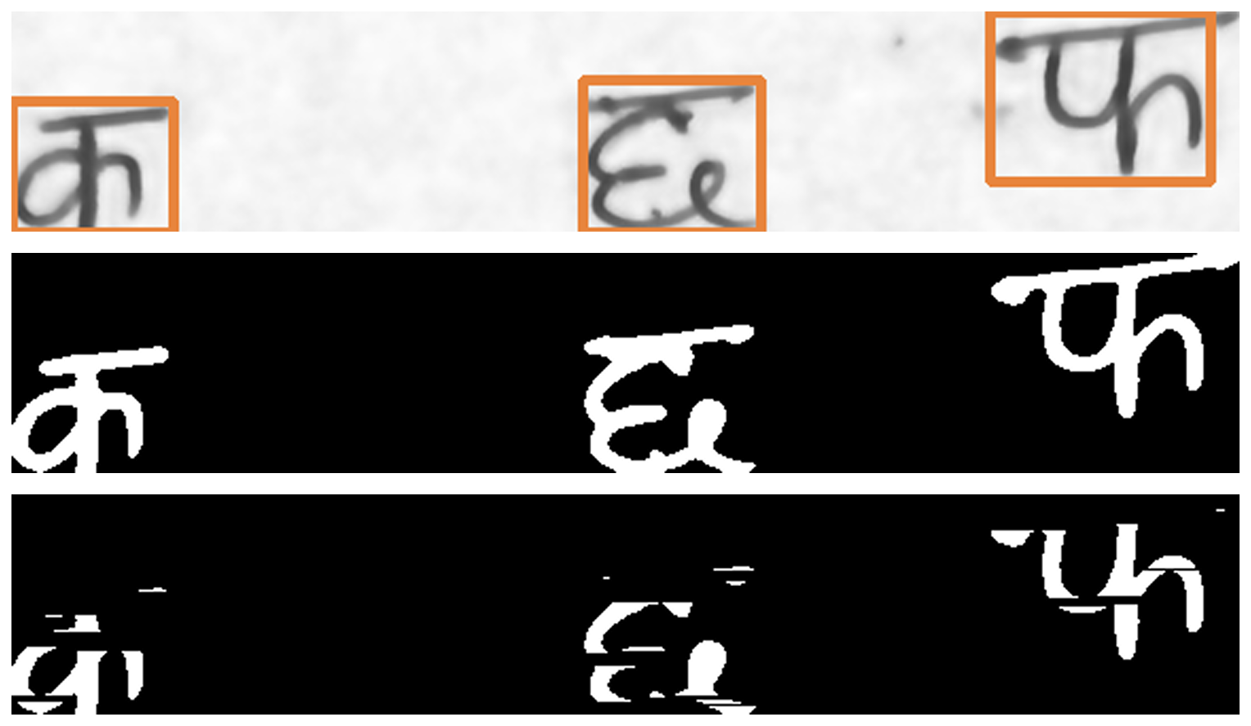
STAGE 2 & 3 · SEGMENTATION
Find lines, then cut characters apart
1
Line detection
Rows of ink found by horizontal projection profiles; dust and crease valleys drop out.
2
Binarize
Otsu for pen ink — fold shadows stay out; adaptive thresholding for faint pencil.
3
Cut characters
A long horizontal kernel strips only the shirorekha. Column gaps appear → vertical projection finds each glyph; final boxes are re-measured on the original binary so the headline stays in the crop, matching DHCD framing.
Line crop with found boxes · ink binary · shirorekha stripped
06
Notes:
The shirorekha is the reason characters can't simply be contour-counted. Boxes go back on the ORIGINAL binary so crops match how DHCD glyphs are framed.

Slide 7
STAGE 4 · CLASSIFIER
A compact CNN for 32×32 glyphs
Input 1 × 32 × 32
grayscale glyph
TRAINING RECIPE
AdamW
Conv 32 → BN → LeakyReLU (×2) → MaxPool
16 × 16
lr 1e-3, weight decay 1e-4 — ReduceLROnPlateau halves the lr on plateaus
Conv 64 → BN → LeakyReLU (×2) → MaxPool
8 × 8
Augmentation
Conv 128 → BN → LeakyReLU (×2) → MaxPool
4 × 4
±10° rotation, ±8% translation, 0.92–1.08 scale
Flatten 2048 → Dropout 0.4
Stratified 90/10 split
validation keeps every class's ratio; Test folder never seen in training
FC 256 → BN → LeakyReLU
Best-checkpoint saving
FC 46 → softmax
one class per glyph
highest validation accuracy each epoch wins — 99.53% at epoch 13/15
≈ 12 minutes
15 epochs, batch 128, on Apple Silicon MPS — no data-center hardware
07
Notes:
BatchNorm after every conv, LeakyReLU(0.1) to avoid dead neurons on ink-sparse inputs, dropout 0.4 around the classifier head. A CRNN for line-level reading ships in the repo but is unused.

Slide 8
RESULTS
Held-out test accuracy
99.36%
99.95%
99.53%
12 / 46
Top-1 accuracy
Top-3 accuracy
Best validation
classes at 100%
13,800 DHCD test images
correct class in the top 3 guesses
epoch 13 of 15
perfect on a quarter of all classes
Hardest class — ढ (dhaa): still 97.0% correct
residual confusion sits in visually similar pairs
Cheap to retrain
≈ 12 minutes end-to-end on Apple Silicon MPS — evaluate_accuracy.py reports the held-out split once, at the end
Source: evaluate_accuracy.py — single final pass on the DHCD Test split
08
Notes:
Top-1 99.36% on 13,800 images the model never saw during training. No leakage: Test/ touched exactly once.

Slide 9
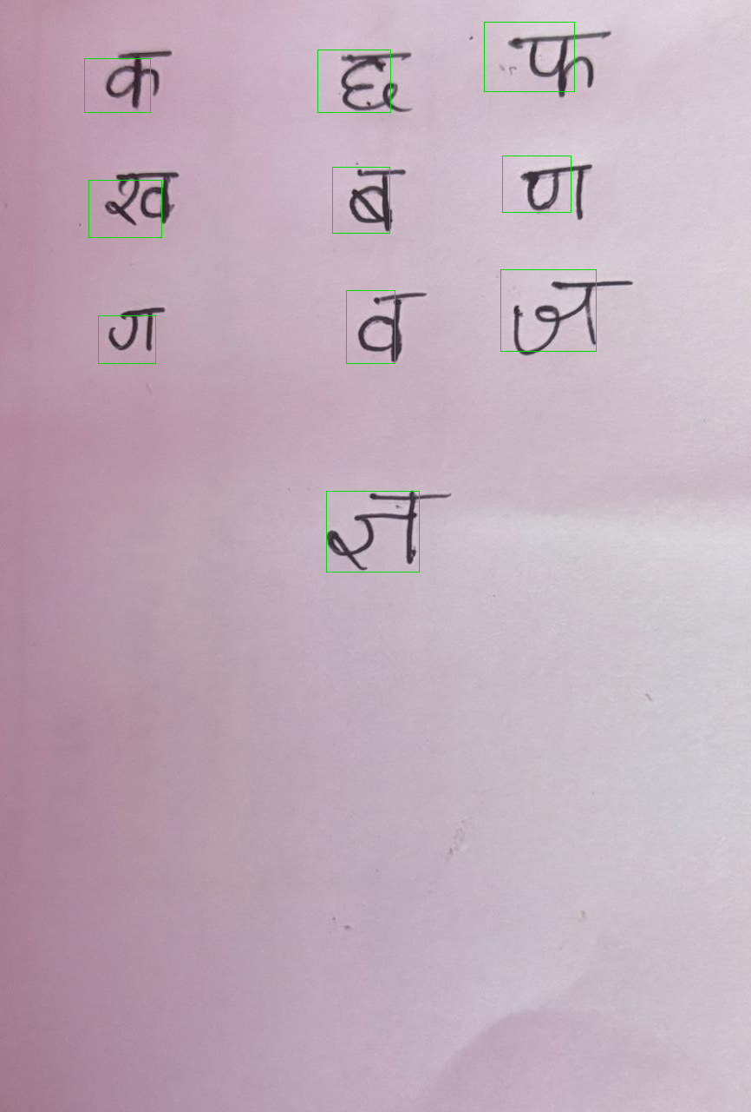
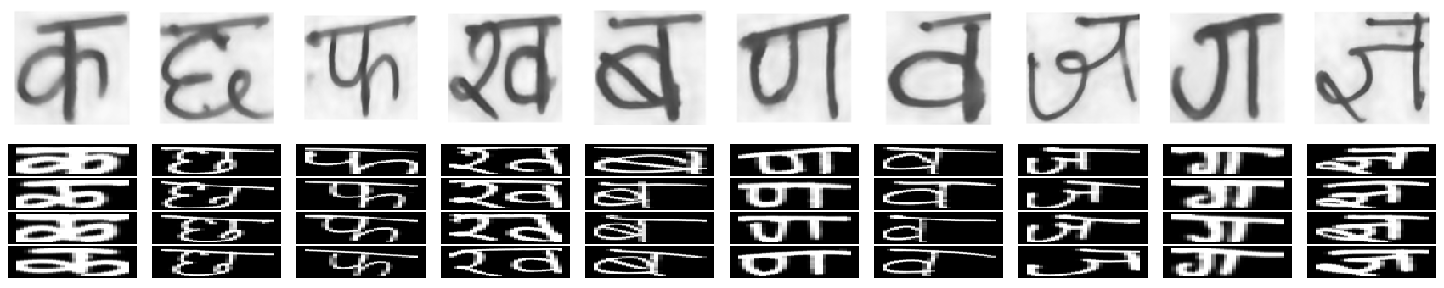
LIVE DEMO
One phone photo → ten glyphs, one pass
RECOGNIZED TEXT
CONFIDENCE CODE
कछफ
खबण
गवज
ज्ञ
above 0.8
0.5 – 0.8
below 0.5
all ten landed green
10 / 10 glyphs · confidence 0.99–1.00
Input — shadowed pink paper
Output — boxes by confidence
Verification sheet
Each segmented crop (top row) next to real DHCD samples of its predicted class — per-glyph checking of free handwriting at a glance.
09
Notes:
All ten predictions at 0.99–1.00 confidence. The verification sheet makes per-glyph correctness checkable without re-running anything.

Slide 10
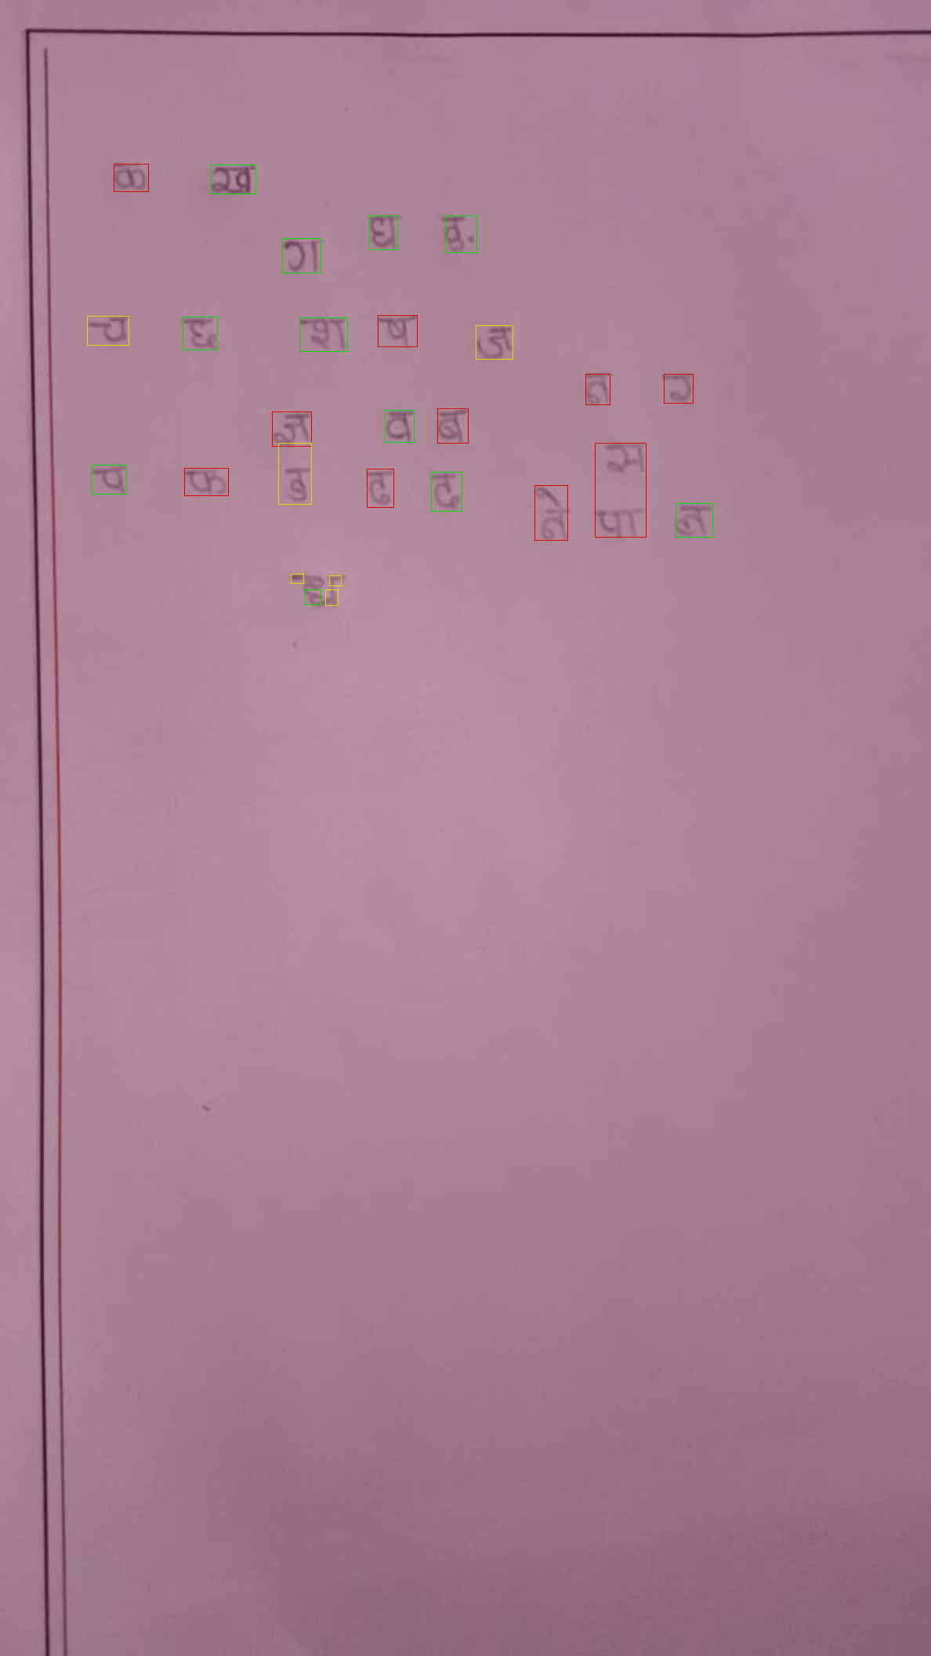
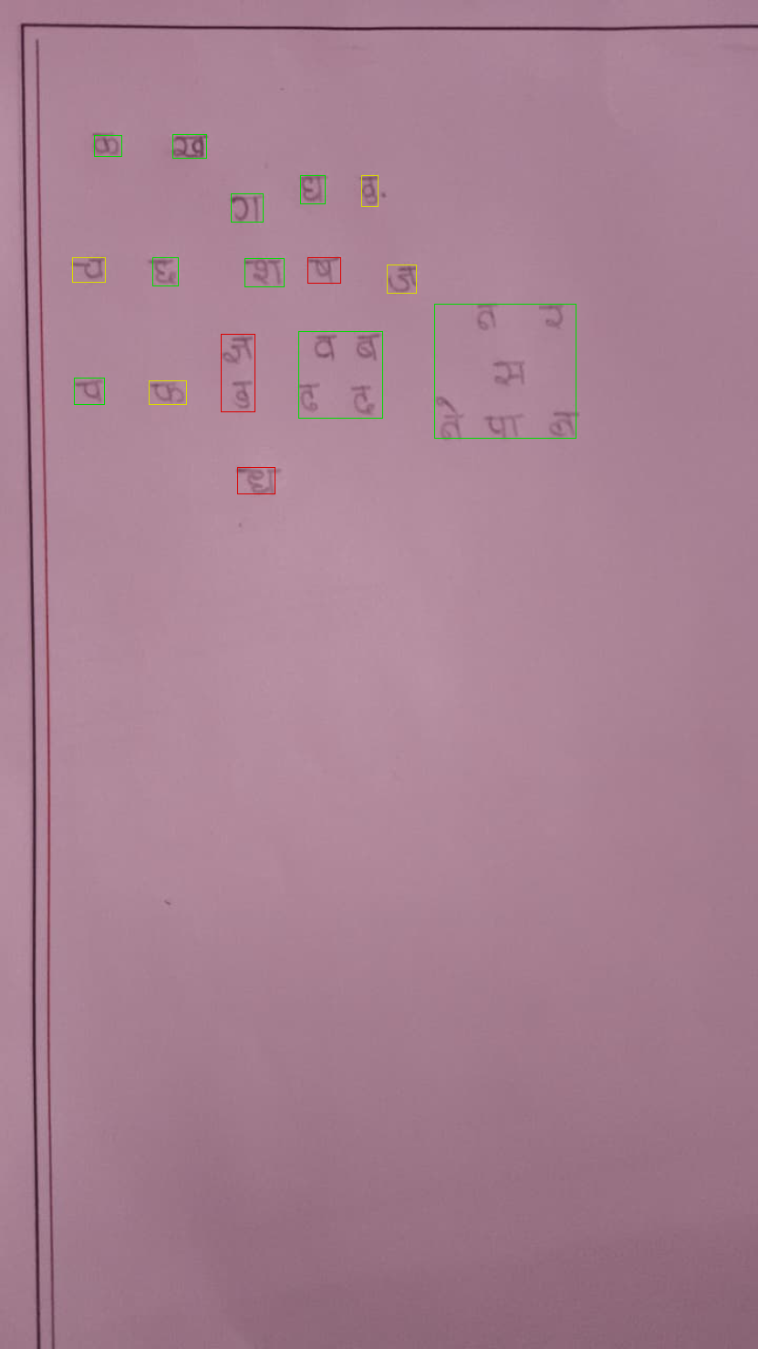
ROBUSTNESS
Stress tests — when the page is not friendly
Faint pencil on ruled paper
Pen on crumpled paper
Vertical margin bar erased by column statistics
Adaptive binarization follows faint strokes
Text-scale upscale before thresholding
Otsu keeps fold shadows out of the ink mask
Dust components removed before profiling
Line profiles split at crease valleys
→ All rows detected; per-character accuracy tracks stroke contrast
→ All glyphs located despite folds and creases
faint pencil, ruled paper
pen, crumpled paper
Detection stays robust; recognition accuracy follows ink contrast — pen beats pencil.
10
Notes:
Two deliberately hostile pages. The binarizer is chosen per page by measured ink contrast — dark ink gets Otsu, faint pencil gets adaptive.

Slide 11
FIELD NOTES
What makes a good capture
१
२
३
४
Pen beats pencil
Fill the frame
Even light
Leave clear gaps
Stroke contrast must clear the paper's own texture level.
Shoot close and straight-on so rows stay large and horizontal.
Avoid shadows and paper folds crossing the writing area.
Separate characters, or words with normal spacing.
The model was trained on dark-ink felt-pen samples (DHCD) — capture quality dominates page-level accuracy.
11
Notes:
Honest limits slide: the model reads what it was trained to see. Good capture habits fix most real-world failures.

Slide 12
TRY IT
Three commands, start to finish
UNDER THE HOOD
$ python devanagari_ocr.py --mode train --epochs 15
PyTorch
trains on DHCD · saves devanagari_cnn.pth (best validation epoch)
CNN, training loop, MPS / CUDA / CPU auto-device
OpenCV
$ python evaluate_accuracy.py
preprocessing, binarization, segmentation
Top-1 / Top-3 and per-class report on the held-out Test split
NumPy · Pillow
projection profiles, dataset loading
$ python devanagari_ocr.py --mode infer --image my_handwriting.jpeg
writes extracted_devanagari.txt + ocr_output_visual.png
Outputs
UTF-8 text · annotated photo · glyph verification sheet
Same code path everywhere — the device is detected at startup, never configured.
12
Notes:
Offer to run inference live on any page the audience writes.

Slide 13
क
धन्यवाद।
Thank you — questions?
WHAT'S NEXT
Whole-line CRNN
Words & conjuncts
Beyond the notebook
already implemented in the repo — reads a line without segmenting it
matras, half-letters and compound glyphs like क्ष त्र
package the engine as an app or API
Devanagari Handwritten OCR · PyTorch + OpenCV · DHCD
Notes:
Close with the roadmap; invite someone to hand-write a character and run it live.

