Slide 1
Sinhgad College of Engineering,
Department of Computer Engineering,Pune-411041
2020-21
MINI PROJECT
ON
“APPLICATION OF FUZZY LOGIC FOR EVALUATION OF ACADEMIC PERFORMANCE OF STUDENTS”
Subject - Human Computer Interface
(B.E Computer Engineering)
Presented By-
Akshay Shekade (B150234372)
Amit Wakade (B150234412)
Vishal Tayade (B150234402)
Shubham Makar (B150234310)
SINHGAD COLLEGE OF ENGINEERING, DEPARTMENT OF COMP. ENGINEERING, 2020-21

Slide 2
Problem Statement
Application of Fuzzy logic for performance evaluation of academic students using different attributes like internal marks , External marks, Attendance etc. Using Mamdani technique.
SINHGAD COLLEGE OF ENGINEERING, DEPARTMENT OF COMP. ENGINEERING, STCL 2020-21.
2

Slide 3
INTRODUCTION
Students’ academic success is evaluated by their performance in exams conducted by the institutes or Universities.
Considering the high demand of IT professionals and the gap between academia and IT Industry it is important that we must explore the possibilities of automated system which can effectively evaluate the performance of students in computer science and IT related courses.
In educational institutions the success is measured by academic performance, or how well a student meets standards set out by governmental educational policies and/or the institutional rules and regulations. This model proposes a new performance evaluation method based on fuzzy logic systems.
In our method, we consider three characteristics for one academic course that involves exam1, theoretical exam2 and practical exam3. Then with using fuzzy logic based on Mamdani technique we get a new approach for evaluating students.
SINHGAD COLLEGE OF ENGINEERING, DEPARTMENT OF COMP. ENGINEERING, STCL 2020-21.
2

Slide 4
MOTIVATION
In educational institutions the success is measured by academic performance, or how well a student meets standards set out by governmental educational policies and/or the institutional rules and regulations. As career competition growing ever fiercer day by day the importance of students doing well in all sectors including academic institutes has caught the attention of parents, legislators and government education departments.
The aim of this proposed method is not to replace the current classical method of evaluation, instead it will help the present system by providing additional information to be used to decision making by educational institutes.
SINHGAD COLLEGE OF ENGINEERING, DEPARTMENT OF COMP. ENGINEERING, STCL 2020-21.

Slide 5
OBJECTIVES
1. To apply fuzzy logic for performance evaluation of students.
2.To take proper input variables for proper execution of model.
3. Reducing the complexities of the classical evaluation method.
4. Re-design the learning content in a way that it is interesting for the target group.
SINHGAD COLLEGE OF ENGINEERING, DEPARTMENT OF COMP. ENGINEERING, STCL 2020-21.

Slide 6
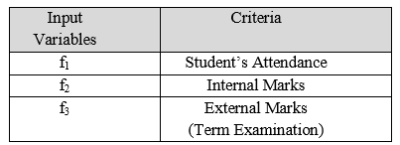
METHODOLOGY
The fuzzy logic model comprises of following stages:
A. Crisp Value (Data):-
The values for input variables may be collected from the records of the students’ end term result with internal assessment (f1), external Assessment (f2) and overall attendance of the Semester (f3) shown in Table I.
TABLE I.INPUT VARIABLES (ELEMENTS) OF THE PROPOSED EVALUATION MODEL
SINHGAD COLLEGE OF ENGINEERING, DEPARTMENT OF COMP. ENGINEERING, STCL 2020-21.

Slide 7

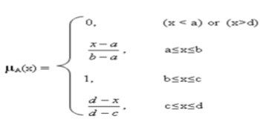
B. Fuzzification (Fuzzy Input Value):-
Fuzzification of three input variables (elements) is done by using variable which are similar to verbal human language such as average, good, very good, excellent etc.. Then each input variable is assigned a trapezoidal Membership function, defined by a lower limit ‘a’, an upper limit ‘d’, a lower support limit ‘b’, and an upper support limit ‘c’, where a < b < c < d, for the degree of association for respective linguistic variables is represented in eqn.(1).
SINHGAD COLLEGE OF ENGINEERING, DEPARTMENT OF COMP. ENGINEERING, STCL 2020-21.

Slide 8
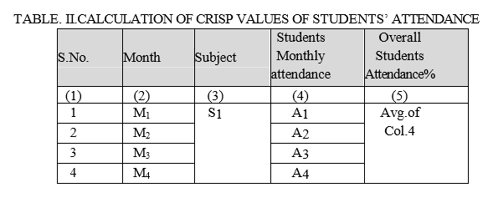
The process of fuzzification of the three input variable is as follows
Fuzzification of Input Variable Students 'Attendance: The Students’ attendance in the subject Linux was taken every day in each lecture. The percentage of attendance is calculated from the number of classes attended by the students in the subject throughout one term of four months
SINHGAD COLLEGE OF ENGINEERING, DEPARTMENT OF COMP. ENGINEERING, STCL 2020-21.

Slide 9
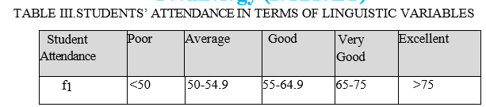
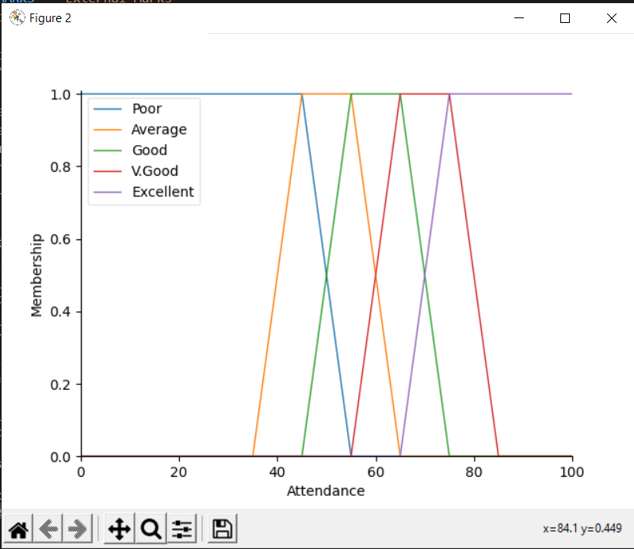
Membership Function of the input variable Students Attendance (f1) is shown in Fig.1.
SINHGAD COLLEGE OF ENGINEERING, DEPARTMENT OF COMP. ENGINEERING, STCL 2020-21.

Slide 10
C. Development of Fuzzy Rule and Inference Mechanism:-
To relate the inputs and output membership functions, fuzzy inference rules are used in inference process. These linguistics rules use “IF-THEN” statements. These rule are flexible and can be formulated depending upon the importance to be given to a particular input with the discussion with the academic experts
SINHGAD COLLEGE OF ENGINEERING, DEPARTMENT OF COMP. ENGINEERING, STCL 2020-21.

Slide 11
Attendance
Internal Marks
Result
External Marks
Fig. FIS System with input and output
Fuzzy inference Rules
(Mamdani)
SINHGAD COLLEGE OF ENGINEERING, DEPARTMENT OF COMP. ENGINEERING, STCL 2020-21.

Slide 12
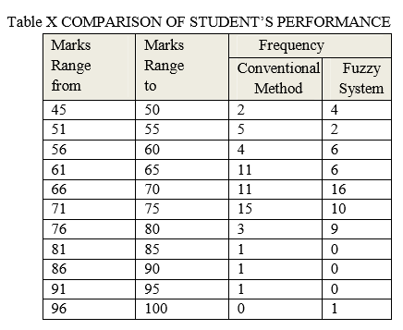
RESULTS
In this system, we have used MATLAB for implementing proposed fuzzy system for student s’ academic performance evaluation. The proposed Fuzzy Expert system was tested with 54 Student’s term attendance, internal marks and external marks in the subject Linux for one term. The result from the fuzzy expert system along with the final result from conventional method of assessment is shown in Table X.
SINHGAD COLLEGE OF ENGINEERING, DEPARTMENT OF COMP. ENGINEERING, STCL 2020-21.

Slide 13
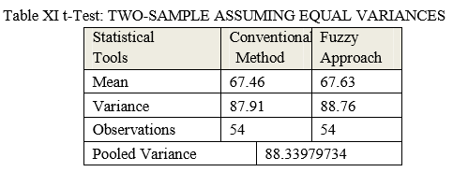
Two sample t-test was also performed on the two results obtained from conventional method and from fuzzy expert system which is shown in Table XI.
SINHGAD COLLEGE OF ENGINEERING, DEPARTMENT OF COMP. ENGINEERING, STCL 2020-21.

Slide 14
CONCLUSION
This shows that the expert system can provide the same results as conventional method. Therefor one can apply computer based Fuzzy System Approach in plane of time consuming conventional method. However, in some cases, the variations in results from fuzzy system have been observed for some students who have same result through conventional method. It was due the difference in their attendance which shows that expert system incorporates input attendance effectively.
SINHGAD COLLEGE OF ENGINEERING, DEPARTMENT OF COMP. ENGINEERING, STCL 2020-21.

Slide 15
REFERENCES
[1]Bakal, Shilpa Ingoley & J.W. 2012, Use of Fuzzy Logic in Evaluating Students’ Learning Achievement, International Journal on Advanced Computer Engineering and Communication Technology (IJACECT), pp. 47-54.
[2] Rajiv Bhatt, Darshana Bhatt., Fuzzy Logic based Student Performance Evaluation Model for Practical Component of Engineering Institution Subjects, International Journal of Technology and Engineering Education , 2017, Vol. 8.
[3] G.Meenakshi. 2015, An Assessment of Final Year project Using Fuzzy Logic, International Journal of Advanced Research in Computer and Communication Engineering Vol. 2, Issue 9, September 2013, pp. 3392-3394.
[4] Faouzi Bouslama, Azzedine Lansari, Akram Al-Rawi. 2017, Fuzzy Rules In Assessing Student Learning Outcomes, American Society for Engineering Education.
[5] McLoone, Séamus C. s.l. : ISSC 2017,On Using Fuzzy Logic for Grading Highly Subjective Assessment Material – a Case Study, NUI Maynooth.
SINHGAD COLLEGE OF ENGINEERING, DEPARTMENT OF COMP. ENGINEERING, STCL 2020-21.

Slide 16
Thank You!
SINHGAD COLLEGE OF ENGINEERING, DEPARTMENT OF COMP. ENGINEERING, STCL 2020-21.
14

