Slide 1

American Express Default Prediction
By: Hanumaiah Chattala & Shruthi Venkataraman

Slide 2
Whether out at a restaurant or buying tickets to a concert, modern life counts on the convenience of a credit card to make daily purchases.
Credit default prediction is central to managing risk in a consumer lending business
Credit default prediction allows lenders to optimize lending decisions
Current models exist to help manage risk but it's possible to create better models that can outperform those currently in use.
This is the motivation behind building a machine learning model for default prediction
The model outputs a probability score of whether the person (customer) will default or not
Background

Slide 3
Proposal of model used
The use of model is focused for the credit card companies
The credit card companies will be able to efficiently identify the defaulters
It will help them to manage risk and increase their profit

Slide 4
Results and Strategy
We grouped the data based on customer id and extracted the last transaction.
The data is pre-processed and cleaned using various methods like handling missing values, normalization, handling outliers, one-hot encoding, etc.
XGBoost and ANN models were used for training the data
The XGBoost model showed AUC ROC score of 0.732, which is comparable to models currently in use
Due to limited computational resources and size of the dataset, the model could not be tuned to high accuracy
The XGBoost model obtained is efficient and light weight
The model can also be deployed on the cloud for real time classification

Slide 5
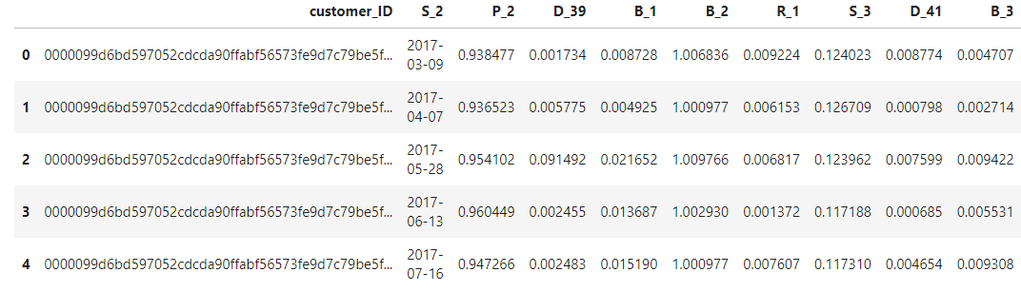
The Dataset
The aim is to is to predict the probability that a customer does not pay back their credit card balance amount in the future based on their monthly customer profile.
The target binary variable is calculated by observing 18 months performance window after the latest credit card statement
Features are anonymized and normalized, and fall into the following general categories:
D_* = Delinquency variable, S_* = Spend variables, P_* = Payment variables, B_* = Balance variables, R_* = Risk variables

Slide 6
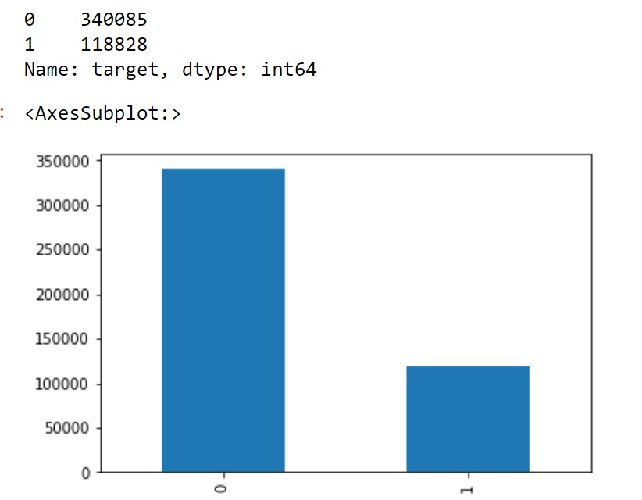
Output Variable
The output is whether customer pay back or not their credit card balance amount
0 – Pay (Non Defaulter)
1 – Don’t Pay (Defaulter)
Distribution of the target variable

Slide 7
Train - Test Split
The train-test split is used to estimate the performance of machine learning algorithms that are applicable for prediction-based algorithms
For training 80% of the data used and rest 20% is preserved for testing
Stratify is used for equal distribution of the target class in train and test split
Data | 0’s | 1’s
Train set | 272,068 | 95,062
Test Set | 68,017 | 23,766
Statistic after splitting :

Slide 8
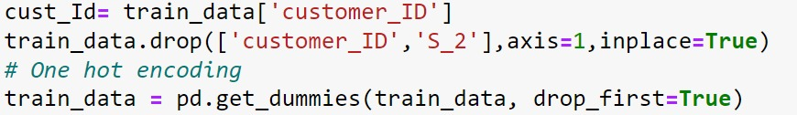
One Hot Encoding
With one-hot, we convert each categorical value into a new categorical column and assign a binary value of 1 or 0 to those columns
Categorical/Object Features are already mentioned which are as follows:
D_63, D_64
The one hot encoding is implemented using pandas inbuild function ‘get_dummies’
The code is :

Slide 9
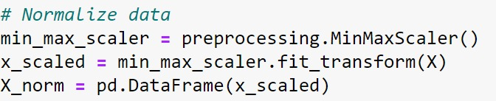
Normalizing the data
The goal of normalization is to change the values of numeric columns in the dataset to use a common scale, without distorting differences in the ranges of values or losing information.
It also improves the performance and accuracy of machine learning models using various techniques and algorithms.
I have implemented MinMax Normalization, in which the data is scaled between [0, 1]
The code is:
Outliers Detection
Generally outliers are detected using Box plot, Z-score, Quantile, etc.
I this case clean data is provided

Slide 10
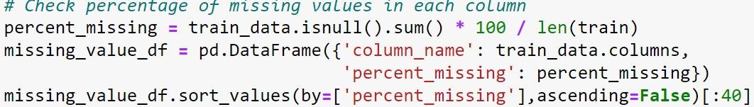
Missing Values
Many models like Decision Tree, Random Forest, etc. are not affected by the missing values, but models like ANN and Linear Models requires missing value free data
We are using back fill and forward fill to handle missing values.
The code is:

Slide 11
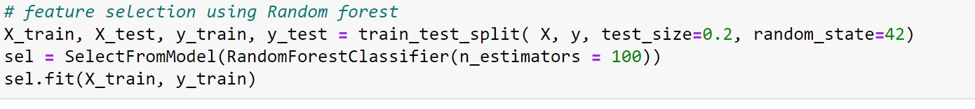
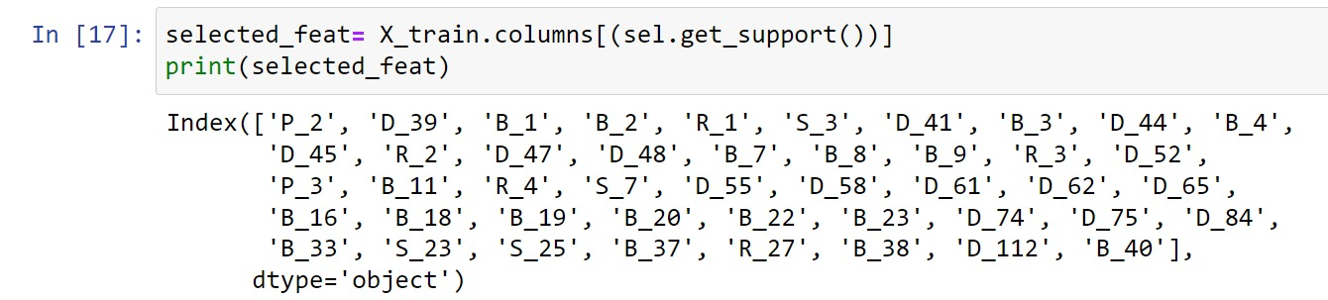
Feature Selection
Use Random Forest Classifier to select the best features
Import feature selection module from Sklearn’s SelectFrom Model
Train this for a train data set to extract the best features

Slide 12
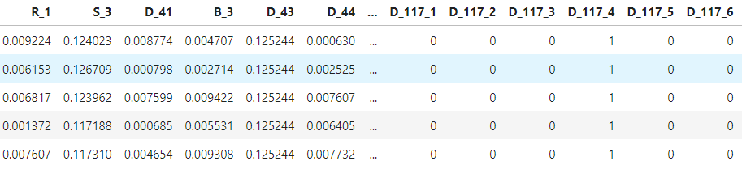
Final Data
After all the preprocessing and data cleaning the data looks like:
Feature engineering is not used as for using it the meaning of each feature should be knows, which is not in this case

Slide 13
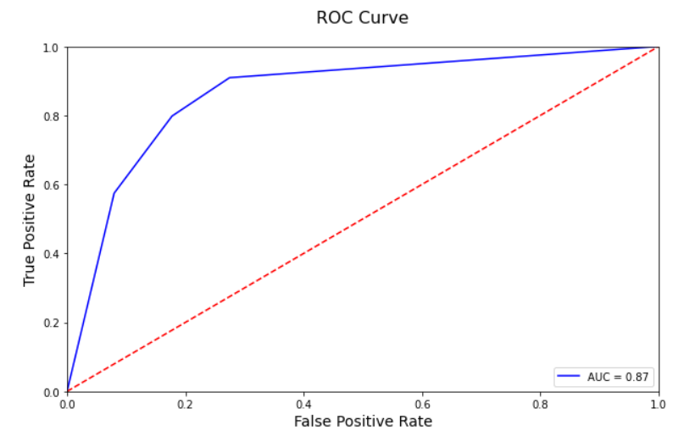
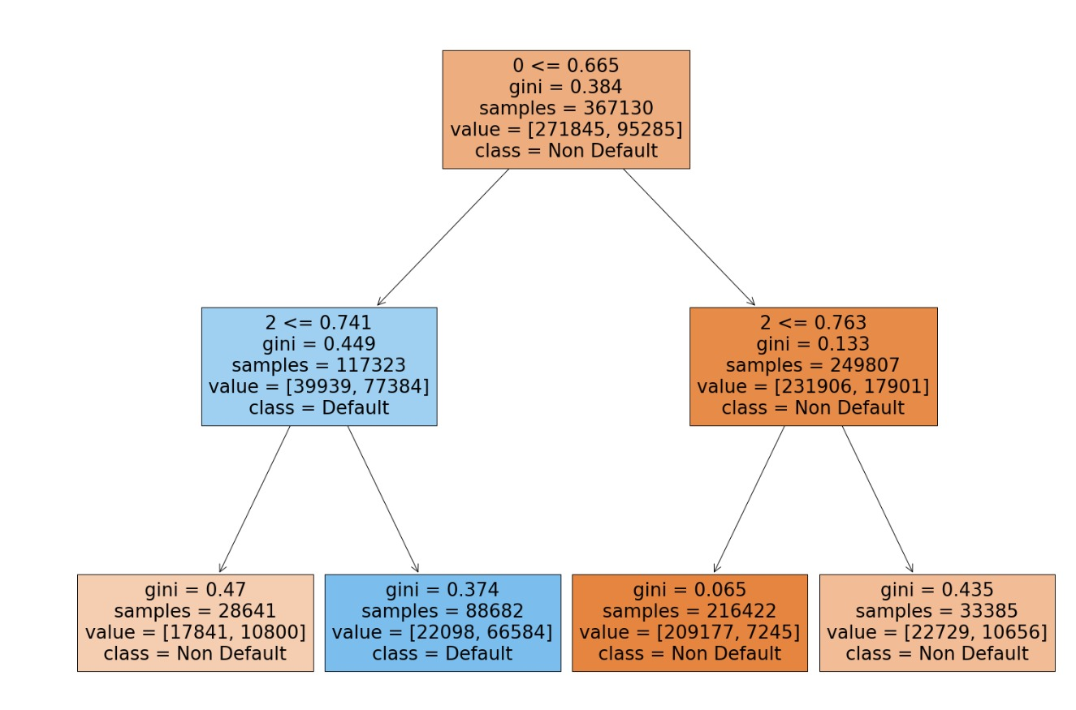
Decision Tree
A decision tree is used for classification and regression
The decision tree is build with four leaf nodes (as required)
The tree is build and plotted using scikit learn library as shown below:

Slide 14
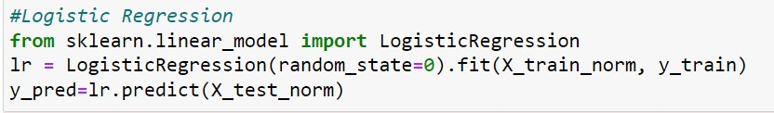
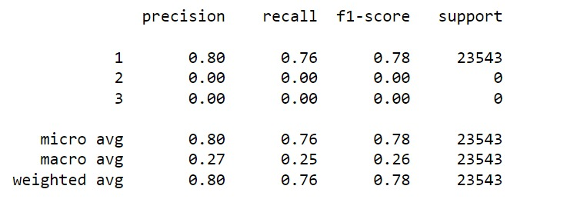
Logistic Regression
Logistic regression is a linear model.
Classification Report

Slide 15
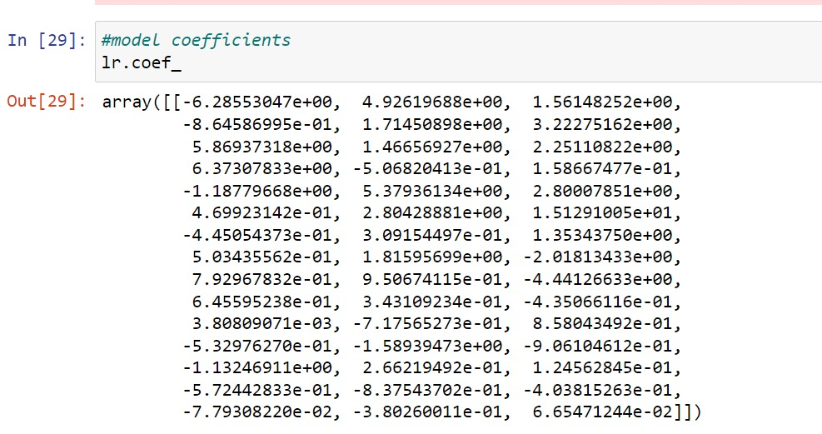
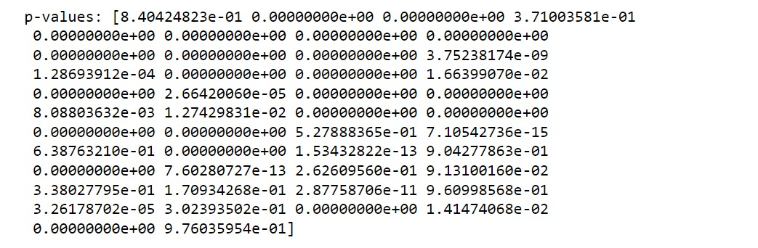
Logistic Regression
Coefficients of Logistic Regression
p-value
A p-value from a t test is the probability that the results from your sample data occurred by chance
p-value for each feature

Slide 16
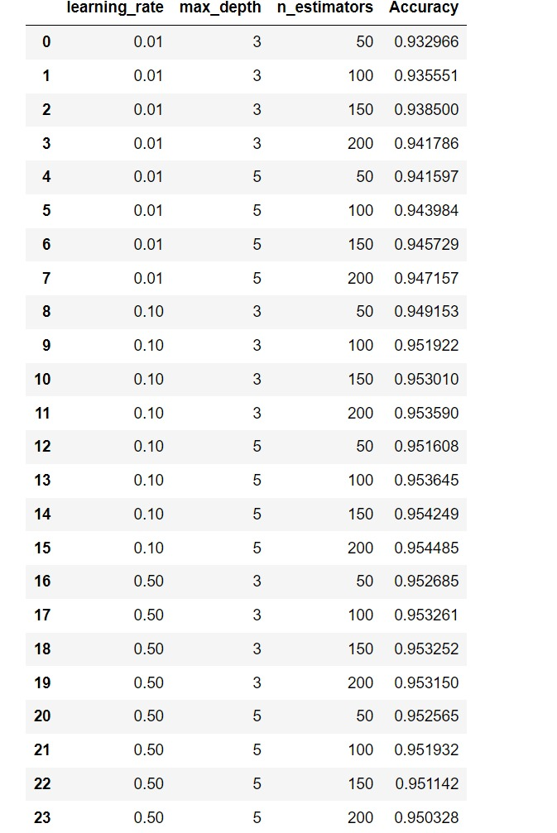
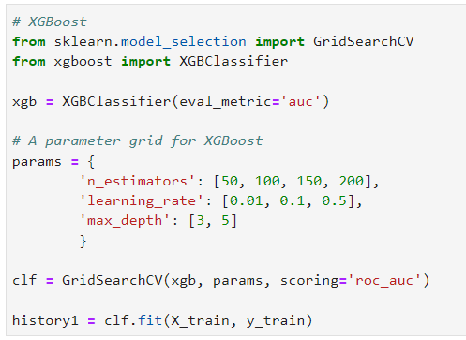
Results
XGBoost Model
The best model is found by grid search over parameters like learning rate, maximum depth and number of estimators
The best model has a accuracy of 95% and AUC ROC score of 0.732
Code

Slide 17
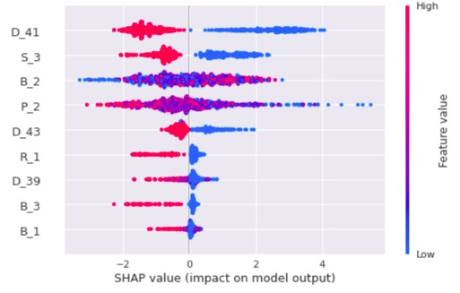
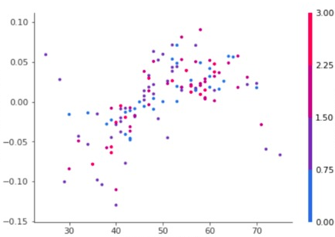
SHAP values
SHAP values (SHapley Additive exPlanations) is a method based on cooperative game theory and used to increase transparency and interpretability of machine learning models.
SHAP Summary Plot
SHAP Dependency Plot

Slide 18
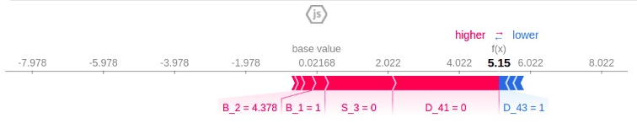
SHAP values
SHAP value plot
It is plotted for observation no. 2
Only top 9 features are taken into consideration for this plot
The model has predicted 5.15, while the base value is 0.02168
Feature values causing increased predictions are in pink, and their visual size shows the magnitude of the feature's effect
Feature values decreasing the prediction are in blue
Feature ‘B_2’ is significantly contributing push the value to the right

Slide 19
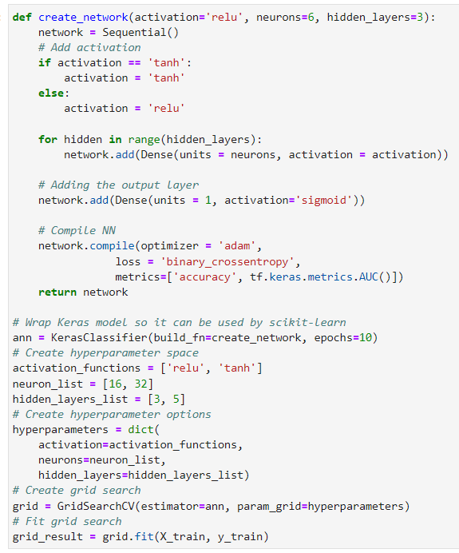
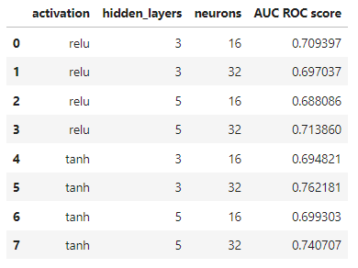
Artificial Neural Network
An ANN is build and grid searched over parameters like number of hidden layers, number of neurons and activation functions
The best model has following parameters :
Activation : ReLU
Neurons : 6
Hidden layers : 3
The results and the code is as shown below:
Results

Slide 20
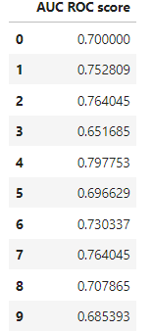
Artificial Neural Network
The best neural network model obtained from the grid search is used for the K fold cross validation
The results shows that, the average AUC ROC score is 0.732

Slide 21
XGBoost Vs Artificial Neural Network
Both of these model performed well
XGBoost showed better results than ANN
The results of ANN also depends on the number of neurons, activation function, hidden layers, learning rate, batch size, etc.
Though grid search is performed on ANN, but the grid was very small and thus actual results may not have appeared
* As the dataset is huge it is not attached in the presentation, the link is : https://www.kaggle.com/datasets/seefun/amex-default-prediction-feather?resource=download

Slide 22
Thank You!

