Slide 1

American Express Default Prediction
By: Hanumaiah Chattala & Shruthi Venkataraman

Slide 2
Project Description
Model’s Output: The model predicts whether a customer will default in the future.
Strategy: We will start by cleaning the data and conducting Exploratory Data Analysis. Based on the analysis we perform feature engineering and feed the data to a Gradient Boosting Classifier model.
Data and Target population: Sample data contains details about delinquency variables, Spend Variables, Payment Variables, Balance variables, and Risk variable. Target population are the customers holding an Amex account.
Data Collection: The Data was Obtained from Kaggle
Target variable: To predict the probability that a customer does not pay back their credit card balance amount in the future based on their monthly customer profile. The target binary variable is calculated by observing 18 months performance window after the latest credit card statement, and if the customer does not pay due amount in 120 days after their latest statement date it is considered a default event.

Slide 3
Sample Size and Features: The Sample has 5531450 observations and 190 features.
Features are anonymized and normalized, and fall into the following general categories:
D_* = Delinquency variables
S_* = Spend variables
P_* = Payment variables
B_* = Balance variables
R_* = Risk variables

Slide 4
Data Preprocessing
To start with, we tried to check how many values were missing in each column. If beyond 80% of the values are missing then it is better to drop the column. From this assumption, we had to remove 23 columns, so now we have a total of 167 columns(features).
The target variable and customer id was a separate dataset so we had to merge the training data set and the data set containing the target variable into one dataset.
We performed correlation with the target variable and removed the columns that had a correlation less than abs(0.3). Which resulted now in a total of 42 columns.

Slide 5
Data Preprocessing
Check the number of null values presented in each column and replace them with the mean value.
Using the seaborn library, we visualize it using box plot for each of the column. Through this we understand the outliers presented.
We found that there were 3 columns with less correlation so we dropped those columns (‘D_41’,’D_78’, ‘S_7’)

Slide 6
Training the Model
Using sklearn, we split the data into two parts: 80% training dataset and 20% testing dataset.
Again using sklearn library, and imported GradientBoostingClassifier, we set parameters
N_estimators = 100
Learning_rate = 1
Max_depth = 1
Random_state = 0

Slide 7
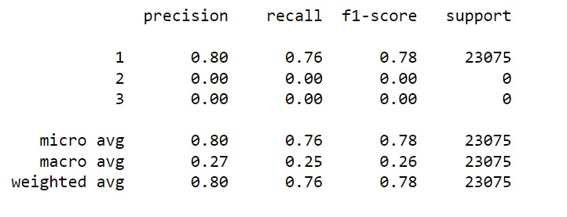
Accuracy of the Model
Using classification_report, we obtain precision, recall, f1-score and support

