Slide 1
Code-Division Multiplexing in UMTS for voice calls and data transimission
Victor SENE
Paul TREHIOU
Geoffrey Glangine
Siyu WANG

Slide 2
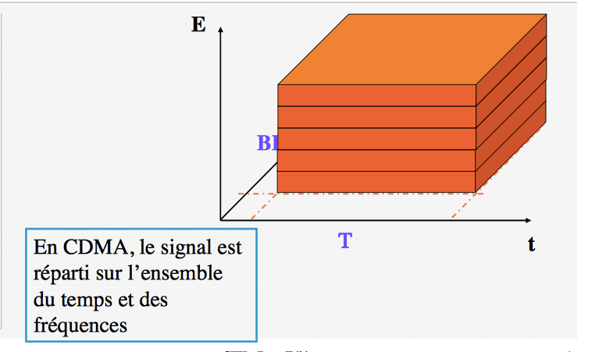
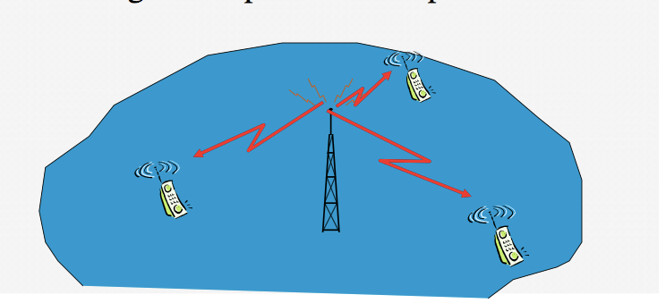
CDMA
CDMA is an example of multiple access.
We can send information simultaneously over a single communication channel.
Several users to shares a band of frequencies.

Slide 3
problem-interference
Interference from other users in the same minicell
Interference from the adjacent cells.
Background noise.
Use of a spread spectrum form of modulation to encode a signal. ( ovsf code )

Slide 4
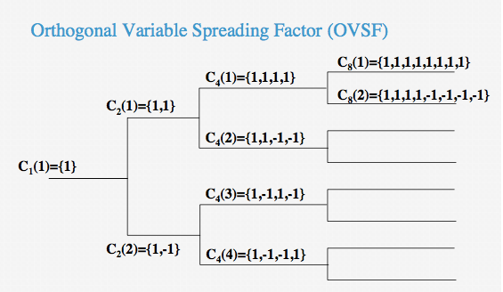
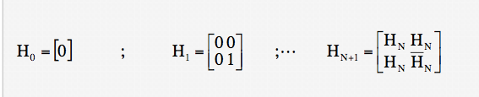
Generation of OVSF code
One antenna transmit messages to many mobiles (system synchoronise)
There are two way to generate OVSF Code.
walsh code/Hadamard code

Slide 5
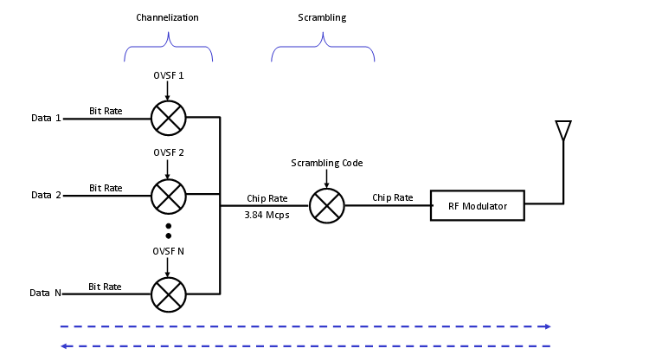
Gold-Code( scrambling code )
Many antennas transmit messages to one or many mobiles.
With scambling code, NodeB can sepafate signals coming simultaneuously from different UES, and UEs can separate signals coming from many diferent NodeB.
Our projet just have one antenna.

Slide 6
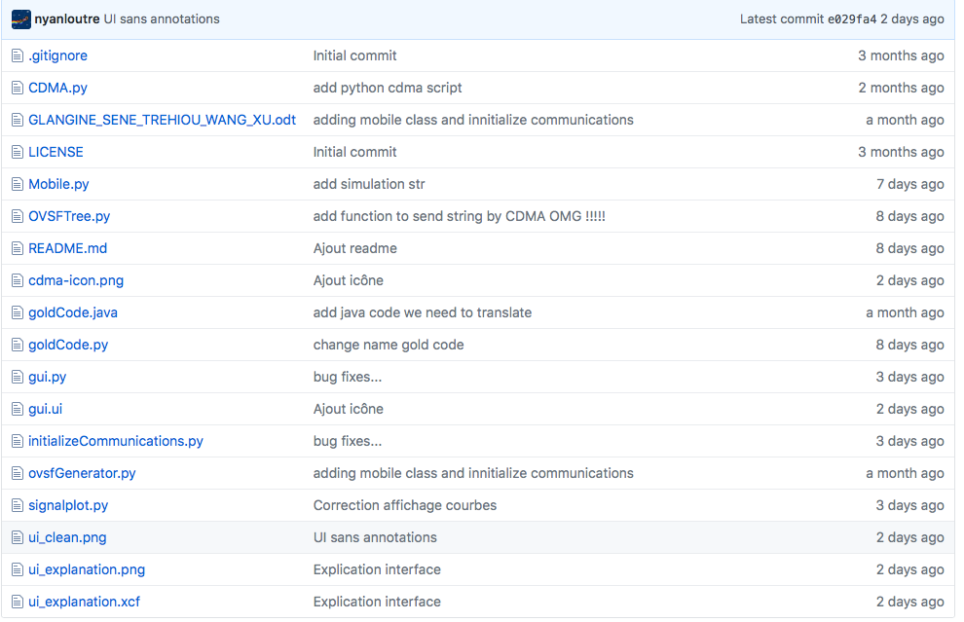
program
use language 'python'

Slide 7
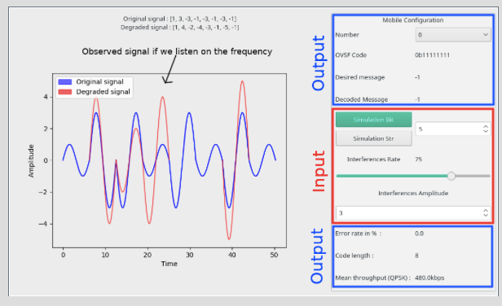
Explication interface

Slide 8
Personal feedback
请在此输入您的文本。请在此输入您的文本。请在此输入您的文本。请在此输入您的文本。请在此输入您的文本。
请在此输入您的文本。请在此输入您的文本。请在此输入您的文本。请在此输入您的文本。请在此输入您的文本。
请在此输入您的文本。请在此输入您的文本。请在此输入您的文本。请在此输入您的文本。请在此输入您的文本。
请在此输入您的文本。请在此输入您的文本。请在此输入您的文本。请在此输入您的文本。请在此输入您的文本。
请在此输入您的文本。请在此输入您的文本。请在此输入您的文本。请在此输入您的文本。请在此输入您的文本。

Slide 9
THANKS
请在此输入您的副标题

