Slide 1
FIGHTER
GO
How to Play
Credits
Quit

Slide 2
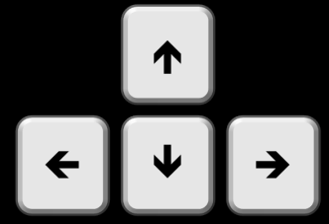
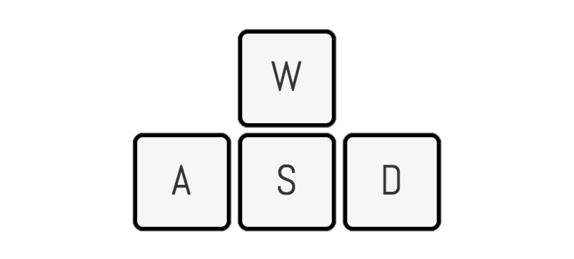


How to Play
Actions | Player 1 | Player 2
Move Forward:
Move Backward:
Jump:
Shoot:
Back

Slide 3
Credits
Programmed by: Vrajang Parikh
Player Sprites: https://www.gameart2d.com/freebies.html
Background music: https://www.youtube.com/watch?v=2CYDgezeQas
Background image: http://massivegalaxy.com/img/titlescreen2x.gif
Back

Slide 4
FIGHTER
Please Choose the game Mode
Infinite
Normal
Back

Slide 5
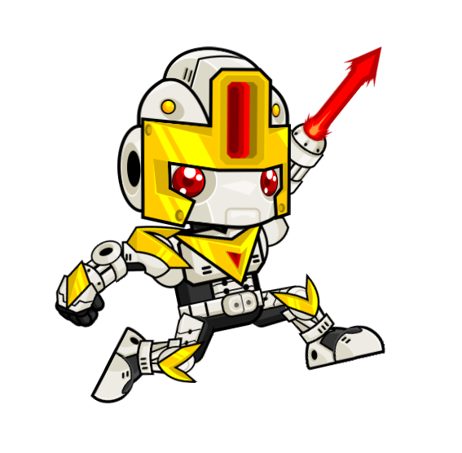
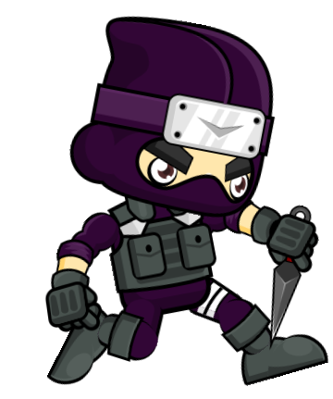
Player 1 Wins!
Thank You for Playing the Game
Play Again
Credits
Quit

Slide 6
Player 2 Wins!
Thank You for Playing the Game
Play Again
Credits
Quit

Slide 7
Tie Game!
Thank You for Playing the Game
Play Again
Credits
Quit

Slide 8
FIGHTER
GO
How to Play
Credits

