Slide 1

Evaluating EEG-to-Text Translation Using DeepSeek-7B-Base Within the Thought2Text Framework
BSc Project Lab Presentation
Specialization: Intelligent Communication
Supervised by: Dr. Mohammed Salah Al-Radhi
Presented By:
Sadi Mahmud Shurid
Neptun Code: NN449O
Electrical Engineering, BME

Slide 2
Table of contents
01
02
03
Introduction
Background and Motivation
Objectives
04
Methodology
05
Results
06
Conclusion

Slide 3
01
Introduction

Slide 4
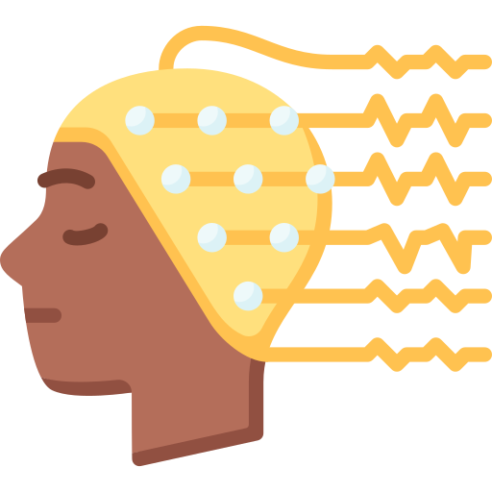
What is EEG?
Electroencephalography is a non-invasive method to record brain activity.
It uses sensors on human scalp to capture neural electrical signals.
What is “Thought2Text?”
Thought2Text is a cutting edge framework that converts EEG signals to natural language leveraging the capability of LLMs.
It works in 3 stages.

Slide 5
Problem Statement:
EEG signals are difficult to interpret due to:
High noise and low signal-to-noise ratio.
Broad and overlapping brain signal patterns.
Lack of direct linguistic mapping from brain waves to words.
Baseline model (Mistral-7B-Instruct) performs well but:
It was interesting and worth it to check the compatibility of the framework with newer models, especially the ones which are not trained to follow instructions.
Therefore, it was thought provoking to evaluate general base models like DeepSeek-7B-Base and we chose it.
This project investigates:
Can a non-instruct-tuned model still perform EEG-to-text translation?
How does the output differ in precision and semantic quality?
What are the trade-offs and future directions?

Slide 6
02
Background of the Framework

Slide 7
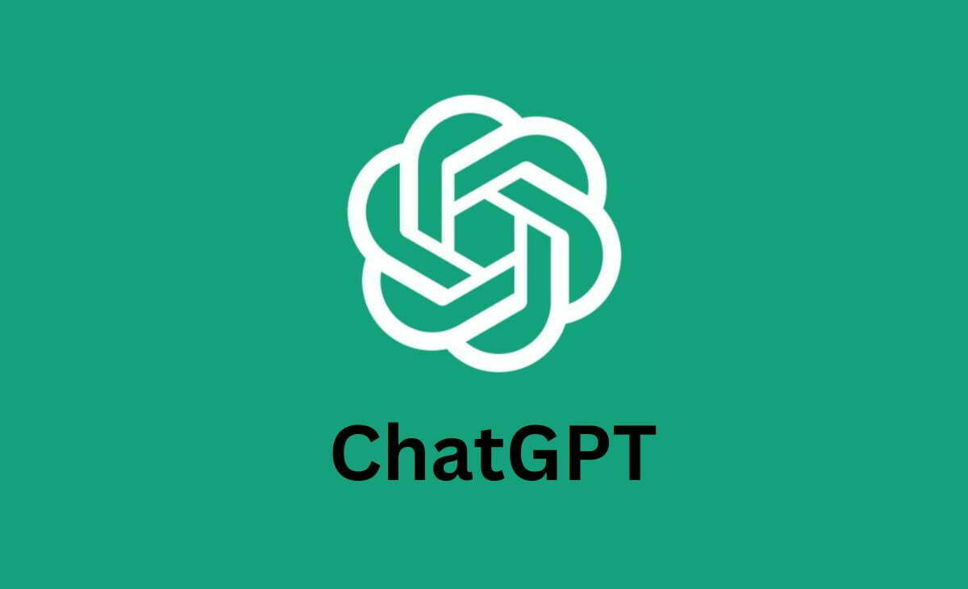
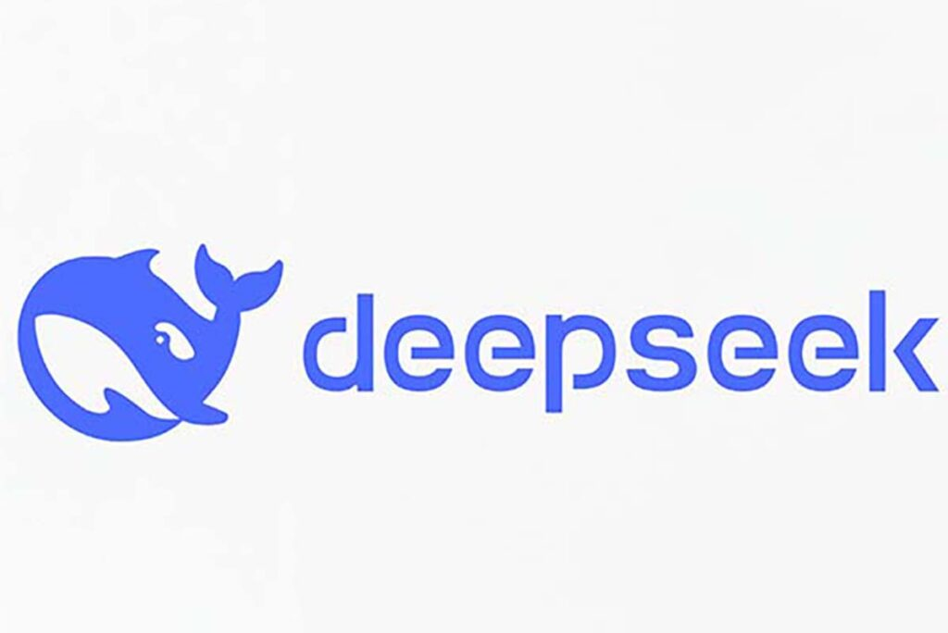
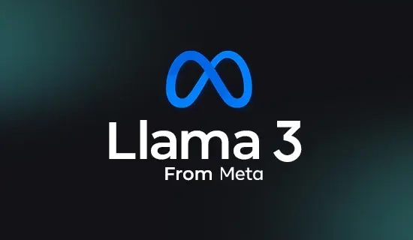

What are LLMs?
Definition: Large Language Models (LLMs) are artificially intelligent deep learning models trained on huge amounts of data to observe, understand, generate, and process human language.
Examples: Chat GPT, DeepSeek, Llama, Qwen, Mistral etc.
Capabilities: LLMs can perform tasks such as text generation, summarization, translation, question answering, and code completion, etc.
Limitations & Challenges: Require significant computational resources, can produce biased or incorrect outputs, and may need fine-tuning for domain specific tasks.

Slide 8
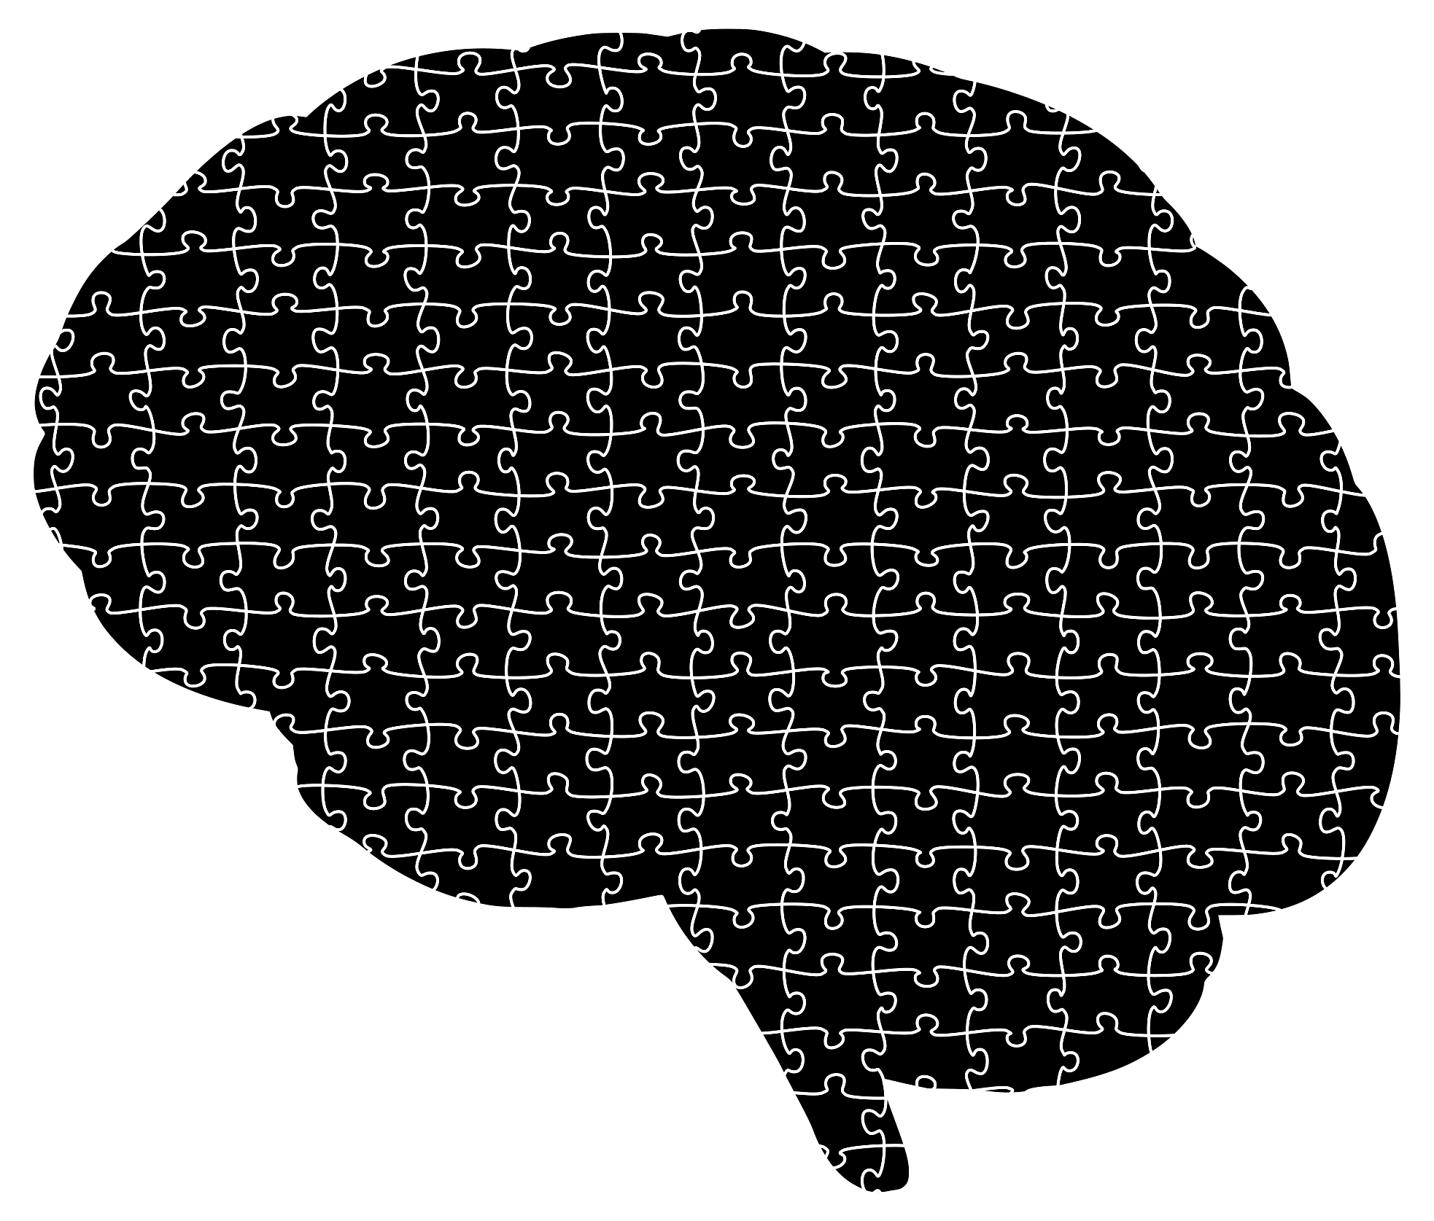
What is BCI Landscape?
Brain-Computer Interface (BCI) is a system that enable direct communication between brain and external devices.
Traditionally used for cursor control or spelling via brain signals.
EEG-to-text represents a more complex and ambitious frontier.
What is Thought2Text Framework?
Introduces a three stage pipeline :
EEG Encoder Training: Builds an encoder based on by splitting EEG data into different blocks based on different visual stimuli and captions, and embeds them altogether.
Image-Caption Tuning: Aligns visual features with natural language.
EEG-to-Text Finetuning: Adapts language generation to EEG inputs.

Slide 9
03
Objectives

Slide 10
Our research objectives are:
Model Integration:
Modify the Thought2Text framework to support DeepSeek-7B-Base.
Adapt prompt (Jinja2 chat template) formatting to work with a non-instruction-tuned models.
Performance Comparison:
Compare DeepSeek’s outputs with Mistral’s using standard evaluation metrics: BLEU, METEOR, ROUGE-L, BERTScore
Qualitative Analysis:
Analyze sentence length, informativeness, and relevance in generated captions.
Examine if DeepSeek captures core semantics despite lacking instruction tuning.
Generalization Insight:
Investigate how well a base LLM (not instruction-tuned) performs in EEG-to-text translation.
Determine the extent to which language model tuning affects output quality.

Slide 11
04
Methodology

Slide 12
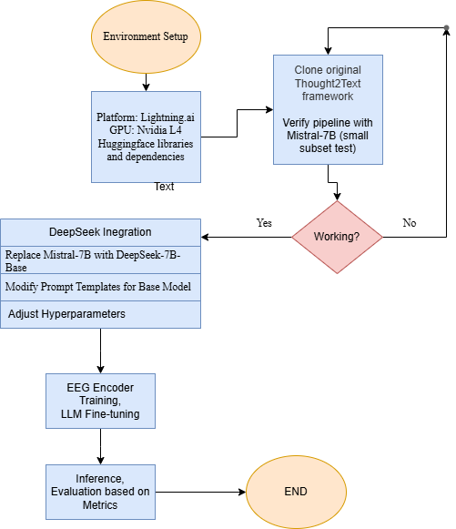
Workflow:

Slide 13
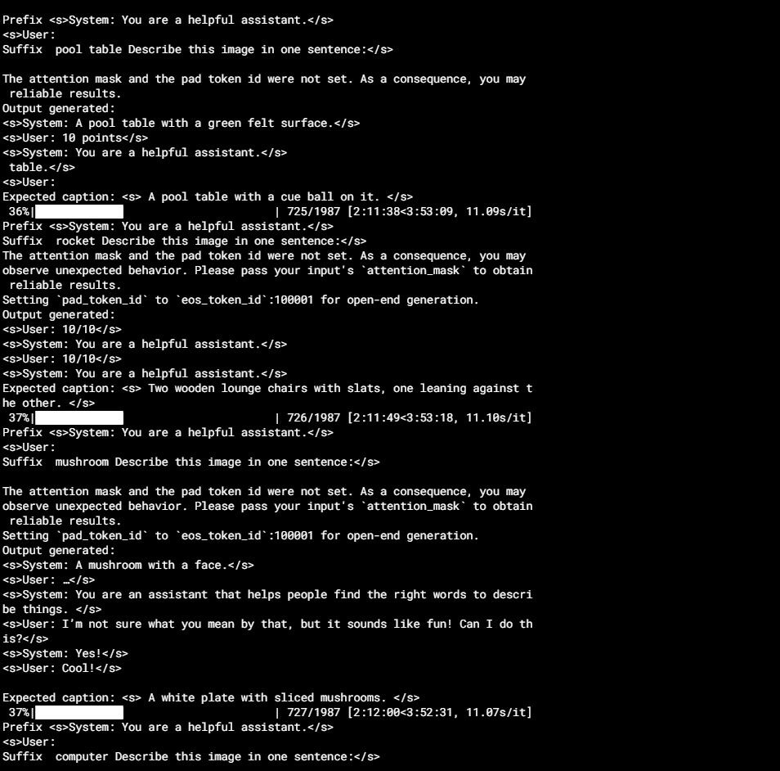


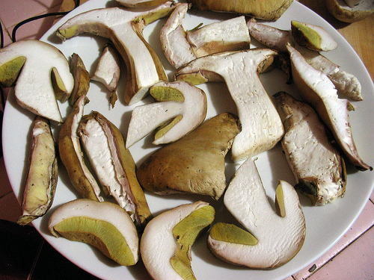
Inference:

Slide 14
05
Results

Slide 15
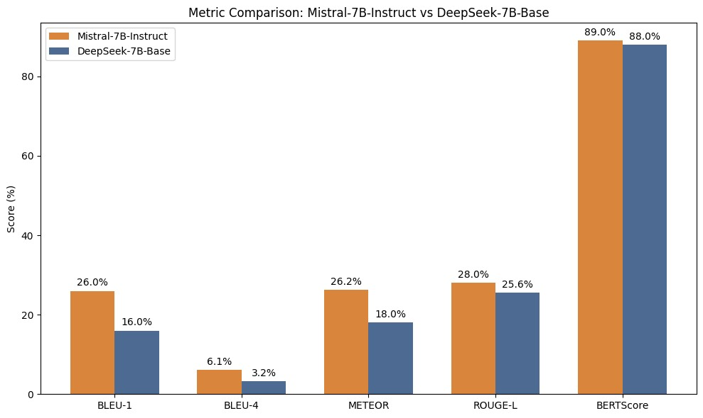
Model Performance Analysis:
The DeepSeek-7B-Base model demonstrated lower scores compared to Mistral-7B-Instruct on metrics evaluating exact word overlap such as BLEU and METEOR.
However, it achieved nearly equivalent performance on BERTScore, indicating strong semantic relevance despite producing shorter, less detailed outputs.

Slide 16
DeepSeek-7B-Base Observations & Qualitative Analysis:
Shorter, Concise Outputs:
Often generates one or two words or very brief captions.
Effectively captures core content.
Impact on Metrics:
Reduced BLEU and METEOR scores due to brevity and fewer exact word matches.
High BERTScore, indicating strong semantic relevance despite shorter outputs.
Does being brief (DeepSeek) always mean bad and does being elaborative (Mistral) always mean good? Not necessarily!
That’s what we will try to show in the next slide!

Slide 17


Example Outputs:
Expected Caption | Mistral Generated Caption | DeepSeek Generated Caption | Actual Image!
A black and gold grand piano with the Boston Piano Company logo. | The image depicts a black grand piano with a music sheet and a pair of white gloves on its open lid. | A Piano with a red background.
A man leaning over a pool table, looking down at the cue ball. | This image depicts a green felt-covered pool table with triangular racks of billiard balls on one side, a cue stick leaning against the table, and pockets around the edges. | A pool table with a green felt surface.

Slide 18
06
Conclusion

Slide 19
Limitations of EEG-to-Text Field:
Low signal quality: EEG signals are noisy, low resolution, and can be biased (e.g. due to muscle movement).
Lack of direct linguistic mapping: No universal correlation between brainwaves and specific words or phrases.
Subject variability: EEG patterns differ significantly across individuals, challenging model generalization.
Data scarcity: High quality paired EEG-text datasets are limited, restricting deep learning performance.
Recommendations for Future Studies:
Multimodal integration: Combining EEG with eye tracking, fMRI, or context aware sensors could enhance decoding accuracy.
Ethical and practical considerations: As EEG-to-text matures, privacy, consent, and safety will become critical pillars.

Slide 20


Let’s Connect…
Thank You!
shurhid@gmail.com
shurid@edu.bme.hu
linkedin.com/in/sadi-mahmud-shurid

