Slide 1
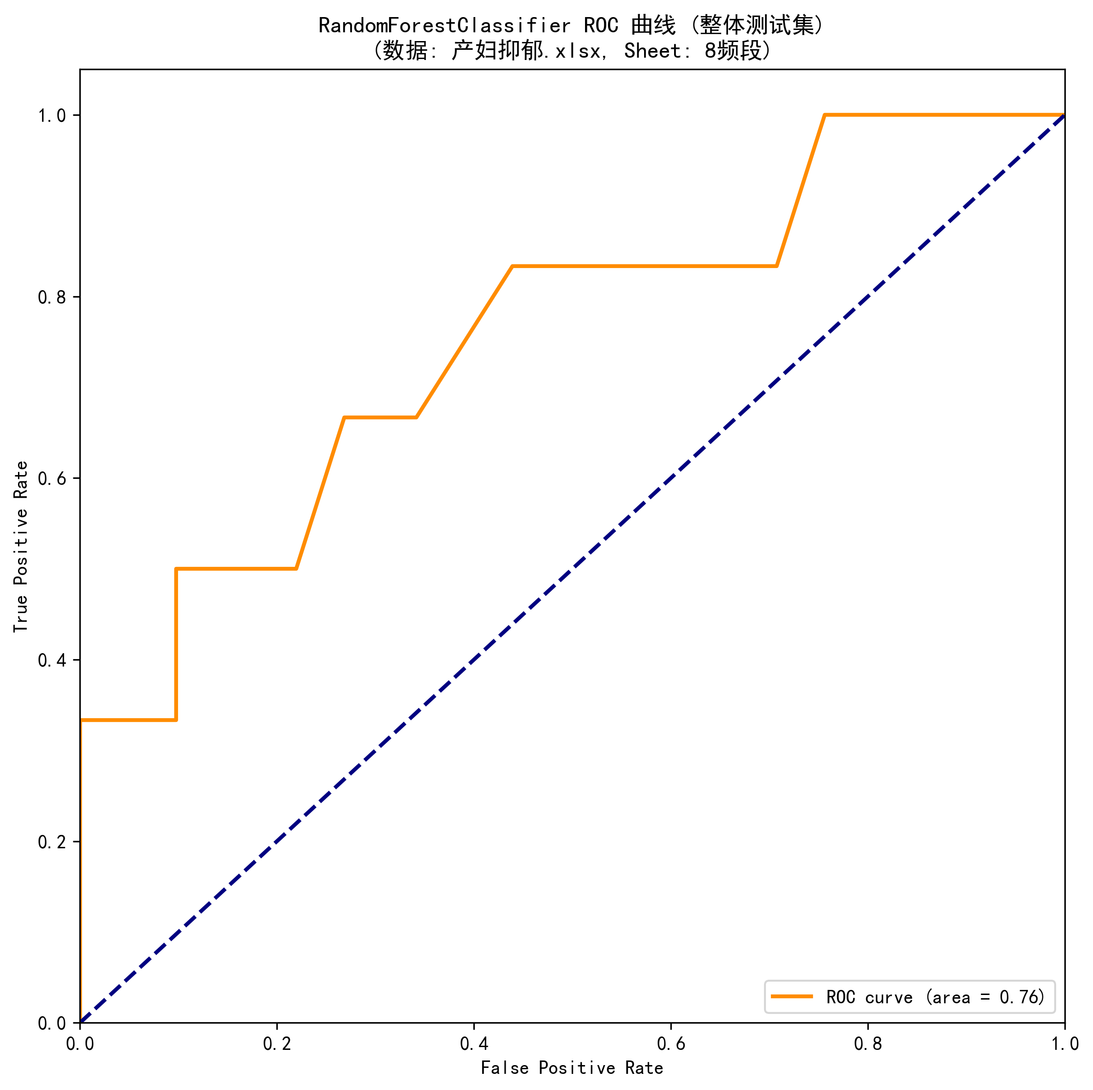
Randomforestclassifier Overall Roc Curve

Slide 2
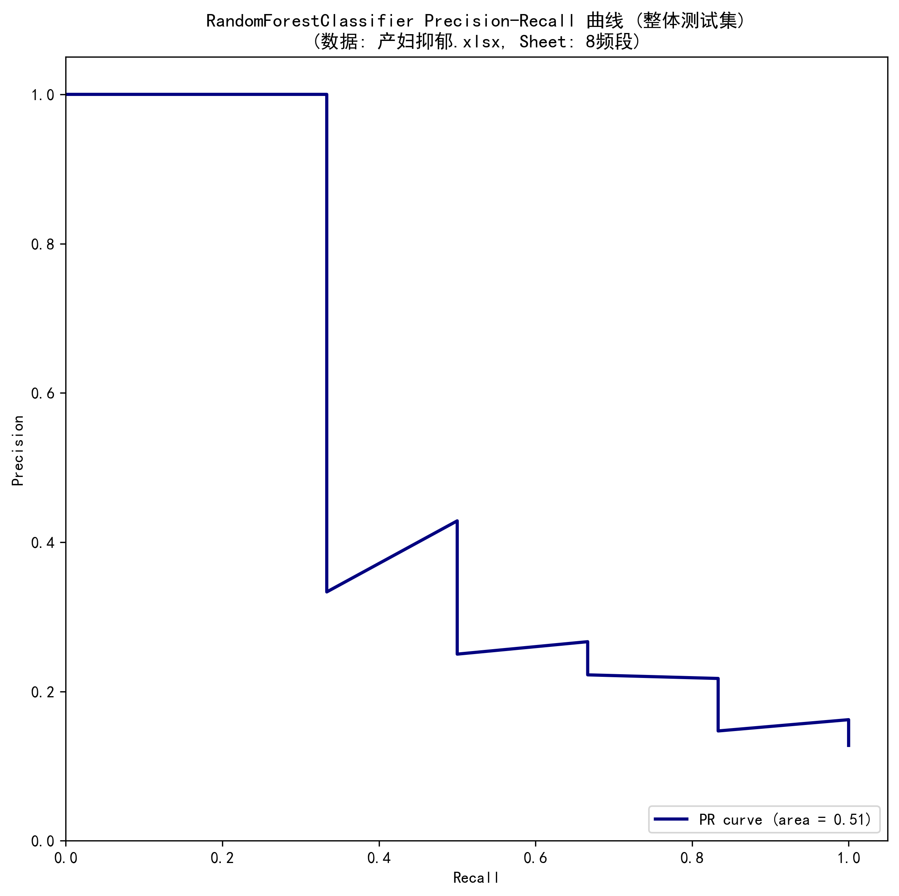
Randomforestclassifier Overall Pr Curve

Slide 3
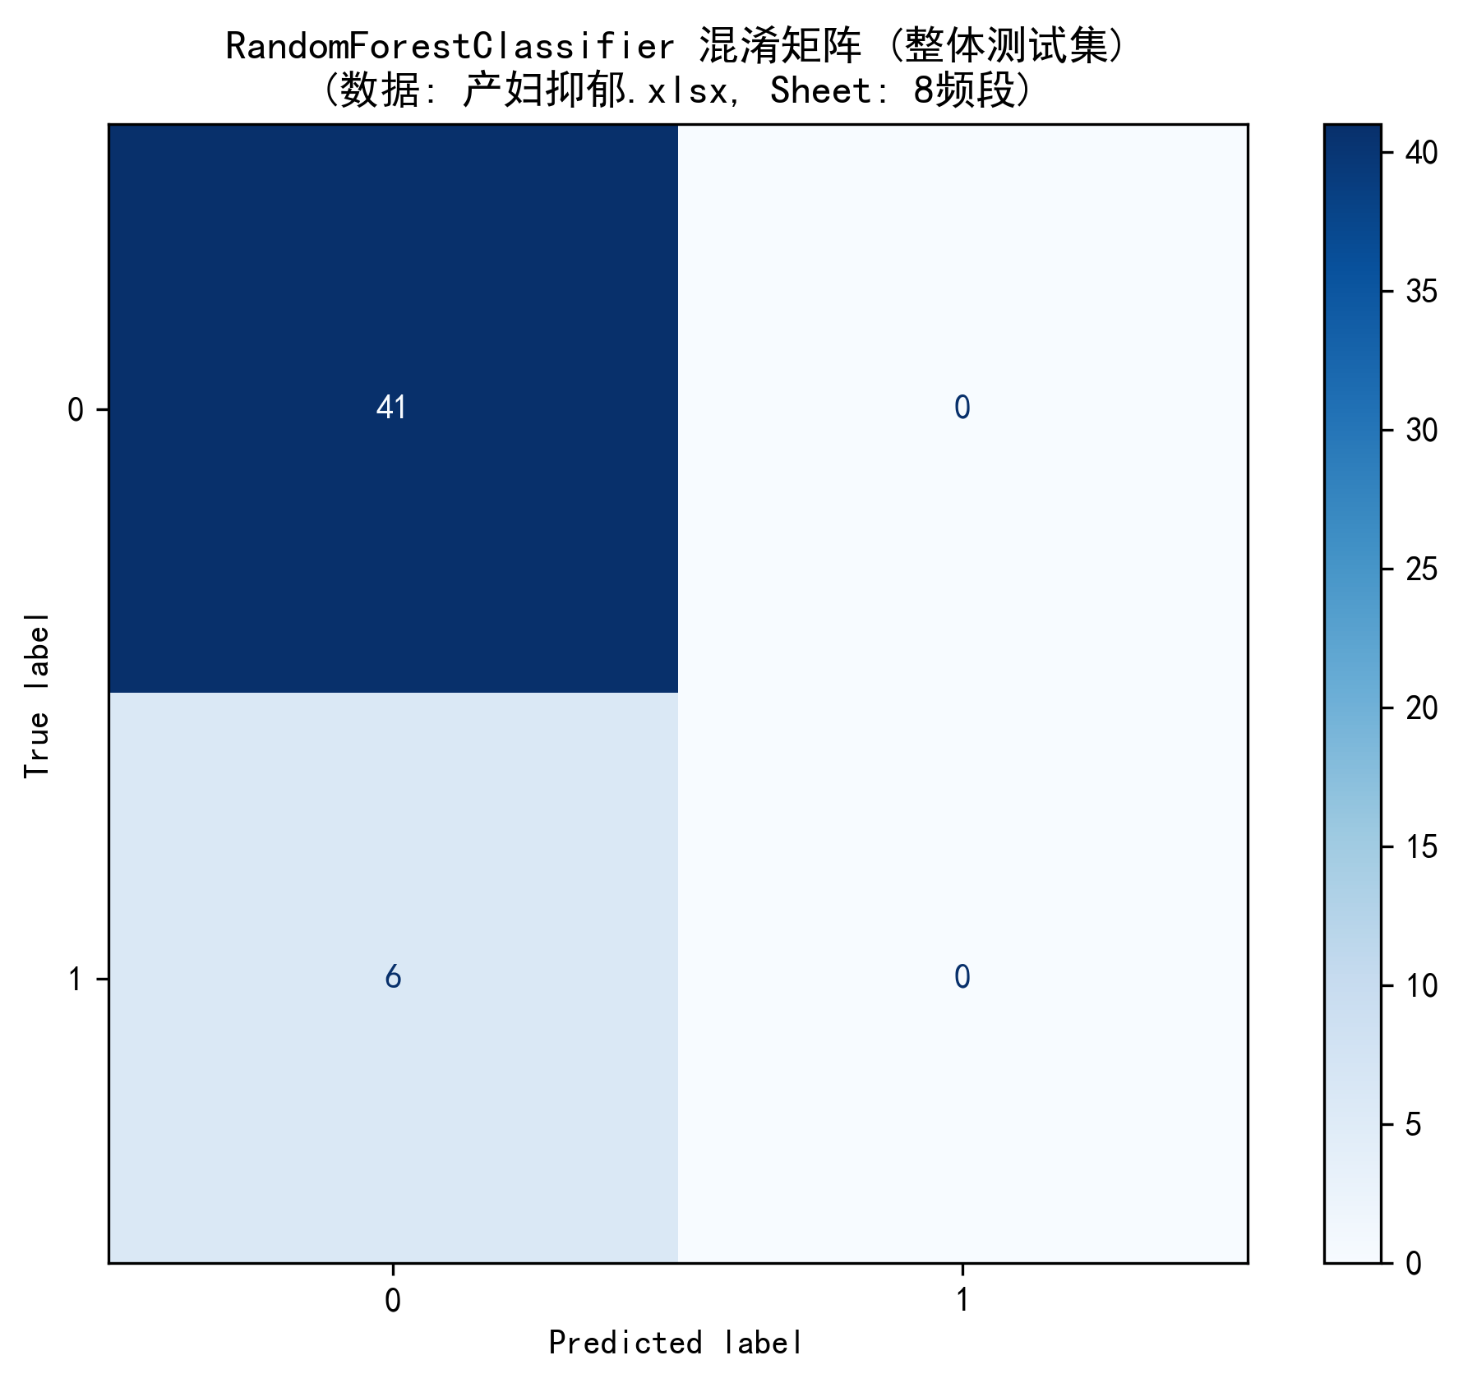
Randomforestclassifier Overall Confusion Matrix

Slide 4
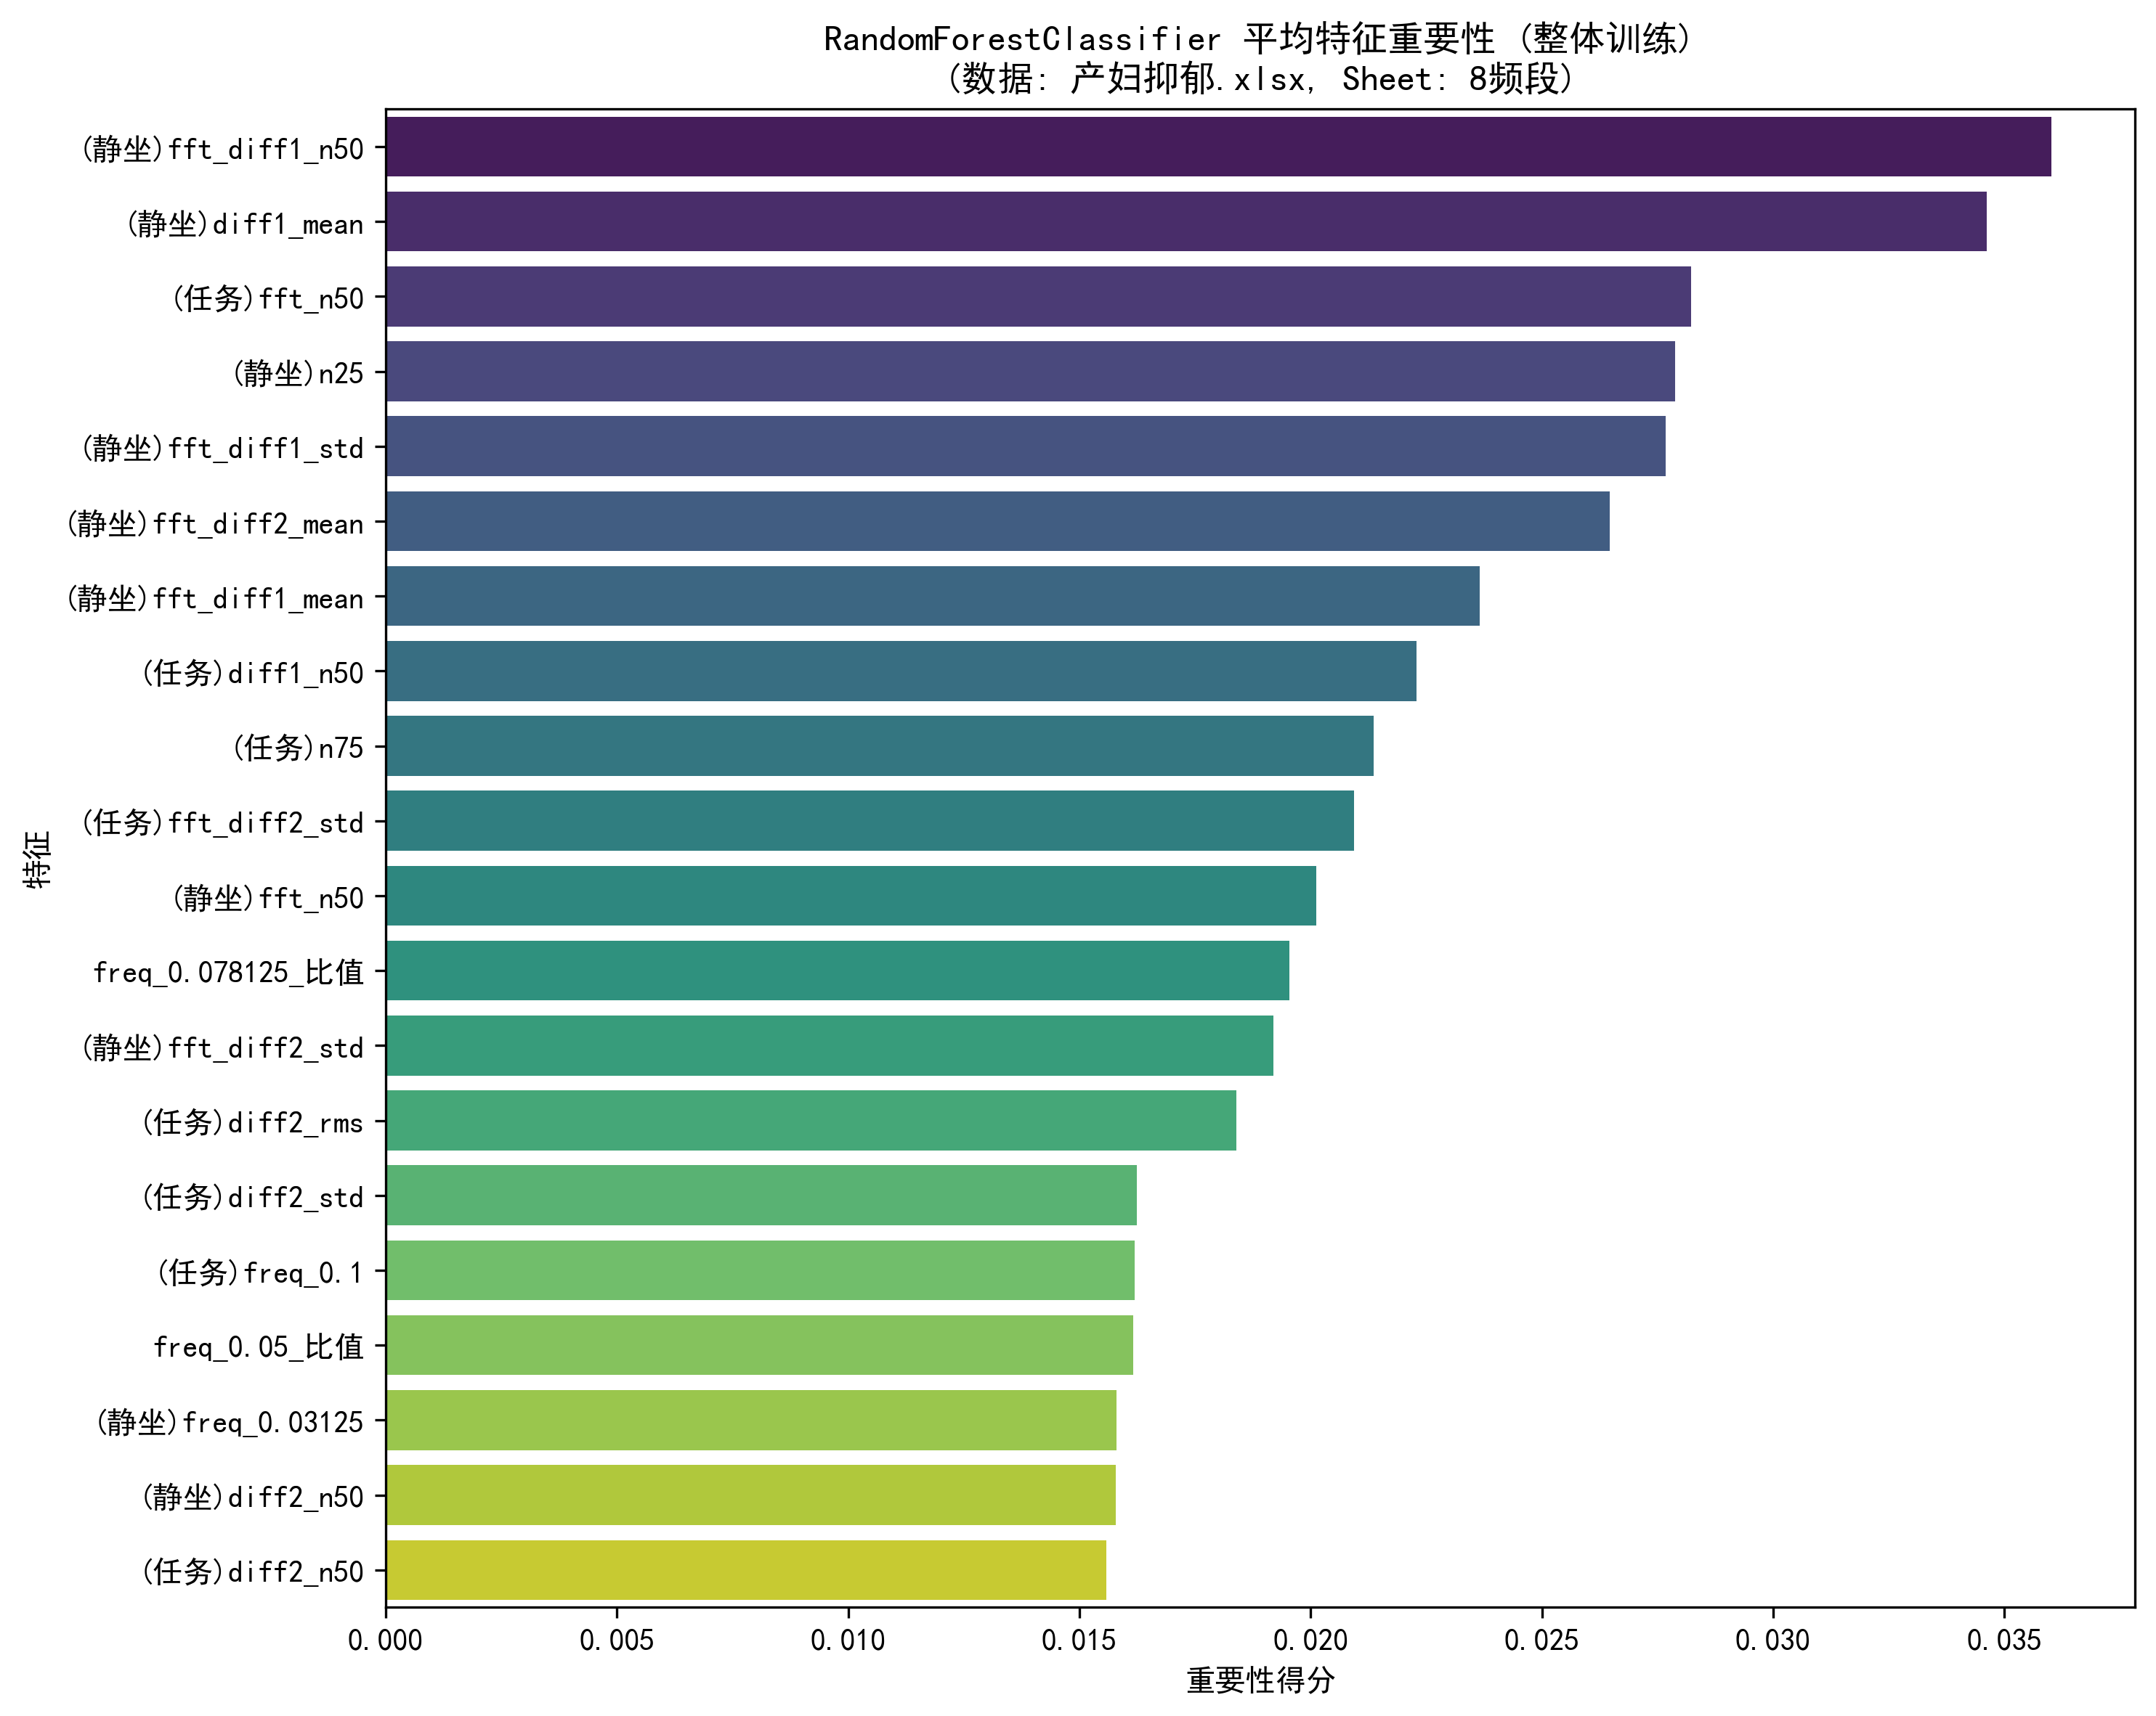
Randomforestclassifier Feature Importance

Slide 5
Randomforestclassifier Shap Bar Summary Overall

Slide 6
Randomforestclassifier Shap Dot Summary Overall

Slide 7
Randomforestclassifier Overall Roc Curve

Slide 8
Randomforestclassifier Overall Pr Curve

Slide 9
Randomforestclassifier Overall Confusion Matrix

Slide 10
Randomforestclassifier Feature Importance

Slide 11
Randomforestclassifier Shap Bar Summary Overall

Slide 12
Randomforestclassifier Shap Dot Summary Overall

