Slide 1
Social media usage/screen time and influence on mental health + Distraction
By:Vhuhwavho Todani

Slide 2
Problem significance and context
Explores reasons for exploring this topic and its importance.

Slide 3
Problem significance
Access to the internet ,social media and technology such as smartphones has drastically increased in the past two decades with newer generations often growing up with said technology. This increase in access has also made it common for people to spend a lot of free time hours on online platforms like youtube, tiktok ,instagram etc. Due to this, there has been a lot of discussion and research that pushes the idea that heavy usage of these platforms may correlate with poor mental health reports. This makes it important to find out how this technology and the social media platforms you can access have an impact on people's mental health and distractibility with consideration to the amount of hours people spend on them.
Social media/screen time hours influence on mental health and distractibility.

Slide 4
Data cleaning and initial analysis approach
Primary dataset survey which aims to gather hours spent on social media and reported scores in areas like sleep issues,distractibility, depressed/down rates
Secondary dataset harvard study of youth screen time and whether or not mental health treatment was needed.

Slide 5
Primary & secondary dataset cleaning
-Column removals: Organization affiliations, platforms commonly used,
-Renaming of columns for easier handling (‘How often do you feel depressed/down= deppression_rate)
-Age range filter applied to secondary data set (10+ years)
-Removal of “treatment not received column” In secondary dataset
-Additional applications such as data type conversions (categorical to numerical associations) for model building.
Social media/screen time hours influence on mental health and distractibility.

Slide 6
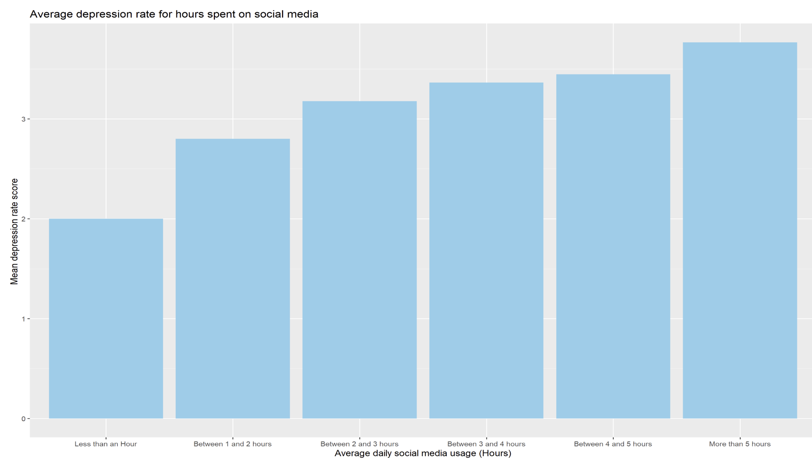
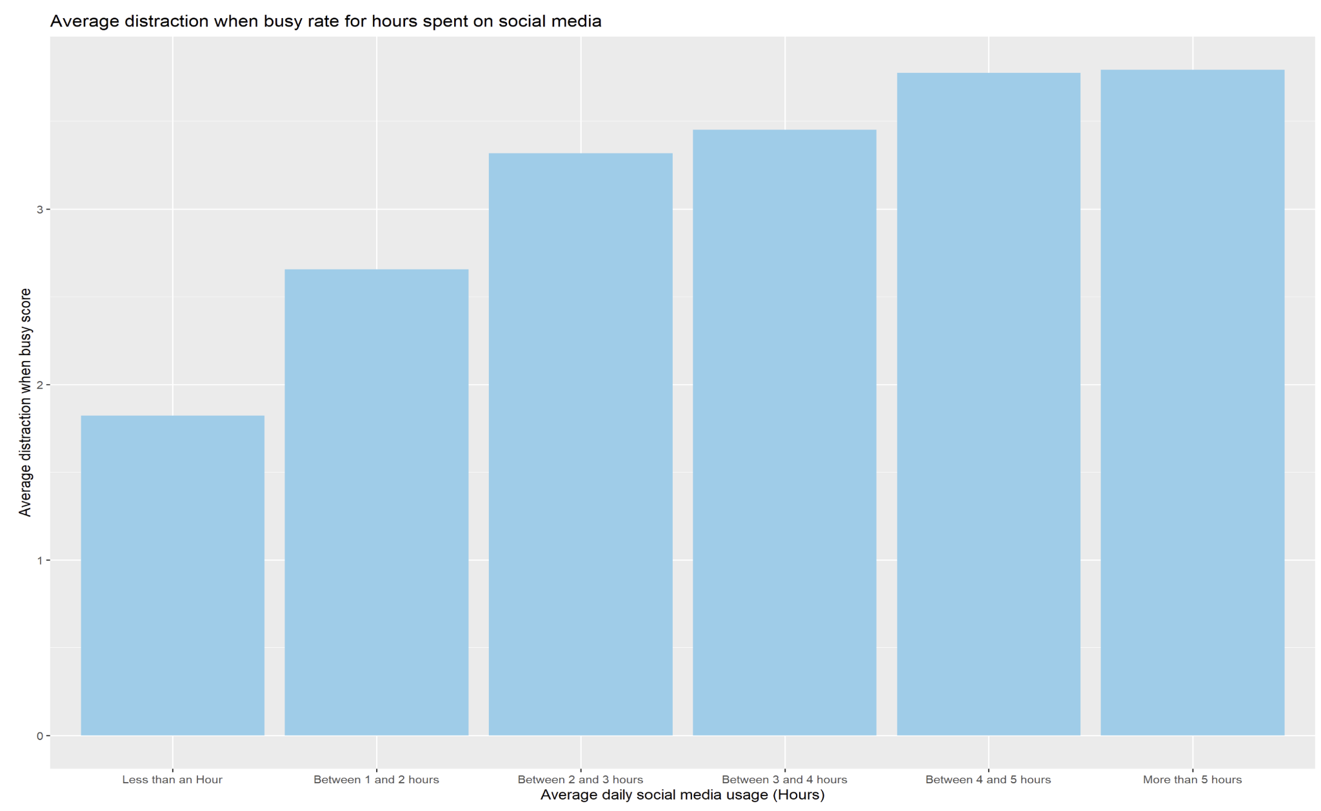
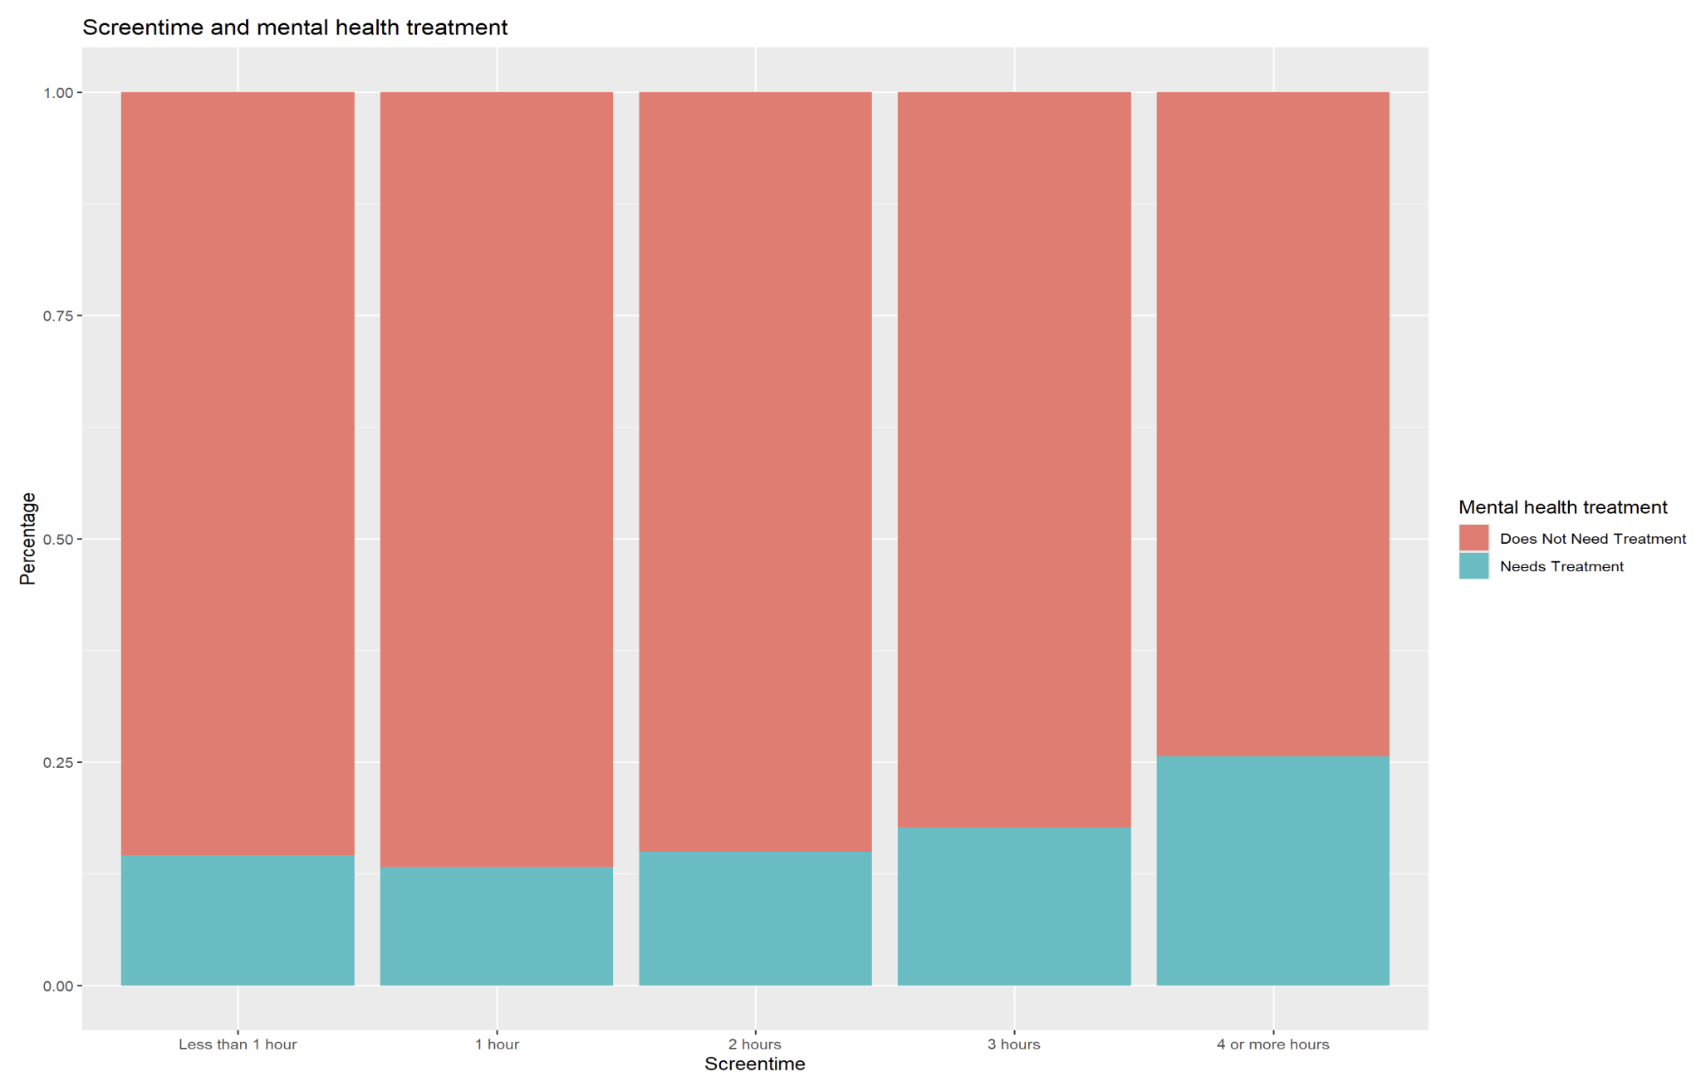
Initial Statistical tests and methods
The ANOVA test (returns p value) with an significance level of 0.05 was the main analysis level as it helped identify if there were notable differences in average score report by different social media hours usage groups In addition to bar plot visualizations. Tests returned significant p values.

Slide 7
Model results and input

Slide 8
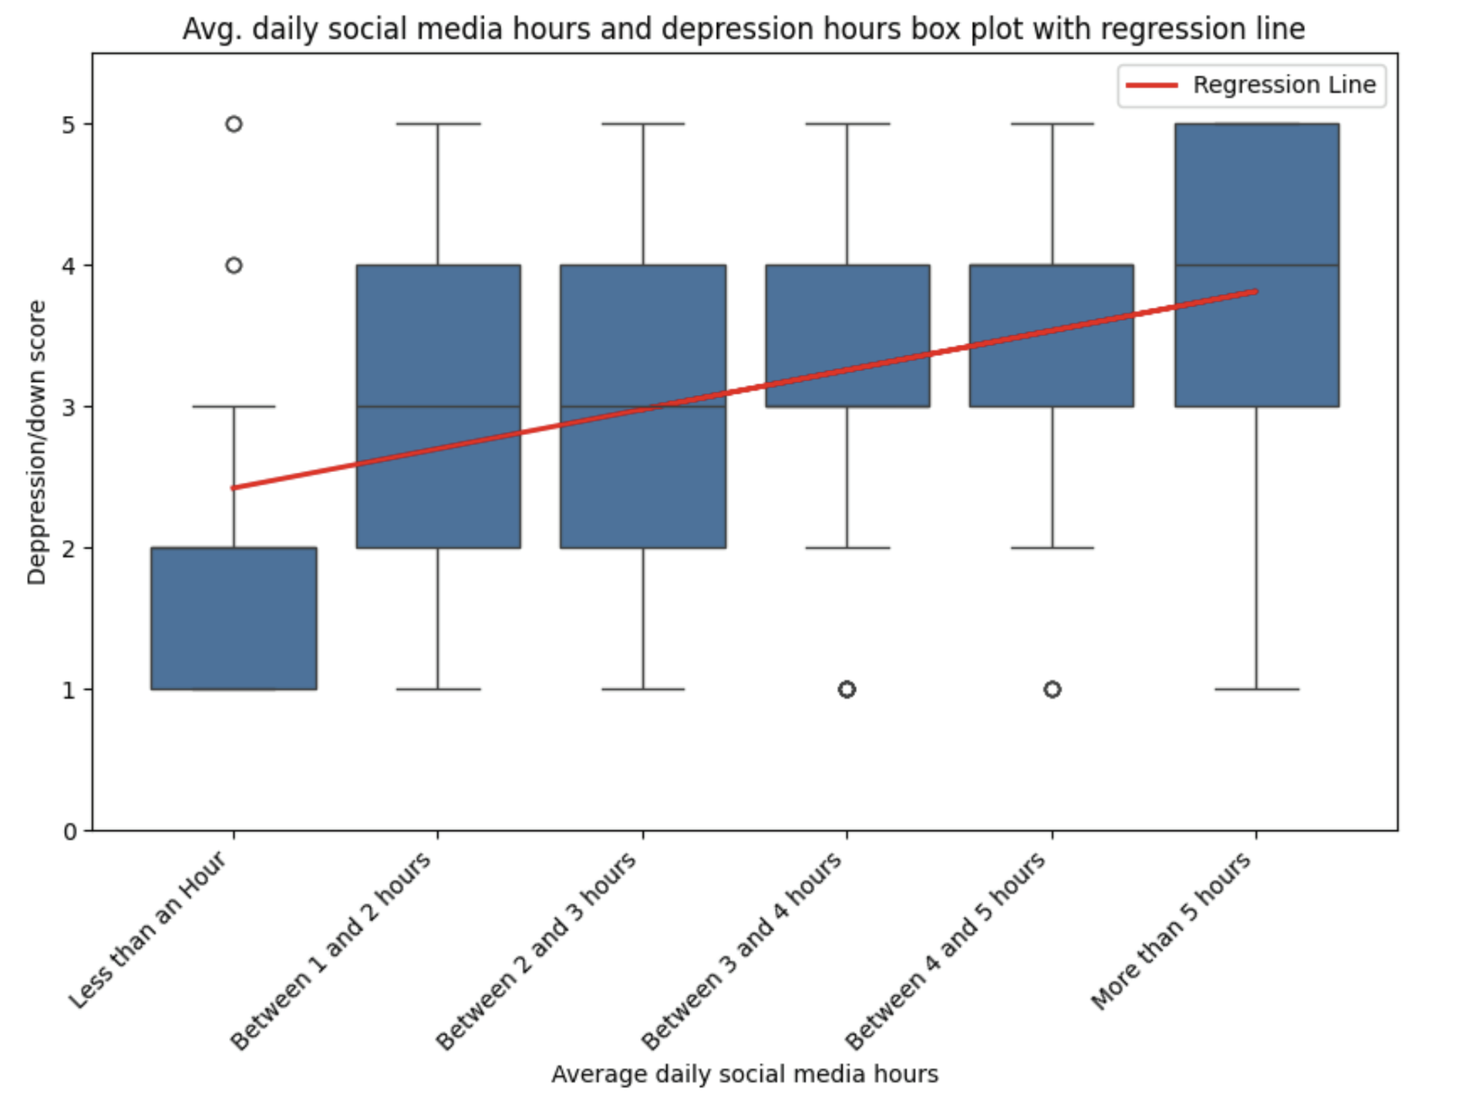
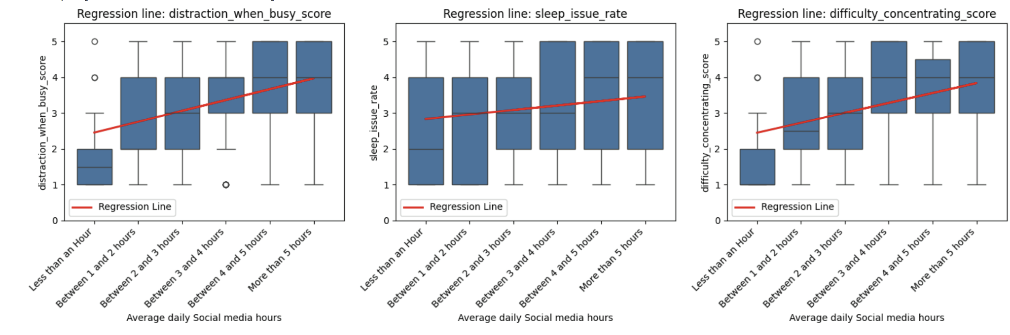
Results
-Overall results indicate that there is an association between hours spent on social media and screen time and poorer reports of mental health and distraction indicators.
-Initial tests such as ANOVA returned significant p values indicating that the usage hour group did have notable differences in reported averages.
-Linear regression models also indicated positive coefficients which indicates that there is a general positive relationship between reported hours and the score in tested indicators such as distractibility and depression/down rate scores. 0.07 and 0.11 r^2 scores
Social media/screen time hours influence on mental health and distractibility.

Slide 9
What do these results indicate and why are they valuable?
The results fall in line with existing information around this topic that indicating that increased time on social media may correlate with worse mental health. This information can be useful to individuals such as parents who may want to monitor how much online time their children spend and individuals who may want to evaluate how much time they spend online or how it may have impacted them.
It can also be valuable to potential stakeholders such as schools who might invest in a mental health related program for their students.
Social media/screen time hours influence on mental health and distractibility.

Slide 10
Setbacks during completion

Slide 11
Notable setback areas
Notable setbacks
-handling data types and considering input style from the survey
-data type issue affected model building approach
-primary data set subgroup sizes did not feel sufficient (e.g) 34 for ‘less than an hour’ social media time group.
-Weak pool of people who reported not making use of social media, limiting how much information could be extracted.
Social media/screen time hours influence on mental health and distractibility.

Slide 12
Reflection
Taking into account setbacks experienced

Slide 13
Areas I would change given setbacks
-May have searched for a different secondary dataset or made use of a third one which could cover different areas.
-Would have placed more consideration in how results were recorded in datasets I would use
-Find more areas to explore within the same dataset
-Properly planned additional areas for research within the same topic/scope
Social media/screen time hours influence on mental health and distractibility.

Slide 14
Thanks for listening!

