Slide 1

Vel Tech Rangarajan Dr. Sagunthala R&D Institute of Science and Technology
School of Computing
Department of Computer Science and Design
10211CS224 / FULL STACK APPLICATION DEVELOPMENT (JAVA)
END SEMESTER PROJECT REVIEW
Date: 06-05-2026
JOB PORTAL MANAGEMENT SYSTEM
SDG: SDG 4 – Quality Education | SDG 8 – Decent Work and Economic Growth
Presented By:
Presented By: V.NIJAMUDDIN SHAH – VTU26592 – Reg.No.23UECS0918
Courses Handling Faculty:
Courses Handling Faculty: Dr. S. HEMAMALINI – Assistant Professor(Senior-Grade)

Slide 2
INTRODUCTION
1
• In today's competitive world, connecting job seekers with suitable employers efficiently is a critical challenge.
• Traditional methods — newspaper ads, physical applications, walk-in interviews — are slow and difficult to track.
• The rapid growth of the internet has enabled online job portals that streamline recruitment processes.
• The Job Portal Management System is a web-based application designed to automate the hiring lifecycle.
2
3
4
5
6
7
8
9

Slide 3
PROBLEM STATEMENT
1
• Existing job recruitment processes in academic institutions rely heavily on manual coordination through emails, notice boards, and physical document submissions.
• This leads to inefficiency in managing large volumes of student applications and employer job postings.
• Students struggle to find relevant opportunities in one place, while employers face difficulty in tracking and filtering applicants.
• There is no centralized, role-based system that allows students to build profiles, upload resumes, and track application statuses in real-time.
• Administrators lack a unified dashboard to monitor platform activity, manage users, and ensure content quality.
• Commercial platforms like LinkedIn and Naukri are subscription-driven and not suitable for institution-level deployment.
• There is a need for a simple, reliable, and automated self-hosted job portal tailored for academic environments.
• This system addresses the gap by offering an open, customizable platform with secure role-based access control.
2
3
4
5
6
7
8
9

Slide 4
OBJECTIVE(S)
1
1. Design and develop a fully functional, role-based Job Portal Management System that allows students to register, manage profiles, upload resumes, and apply for jobs.
2. Enable employers to create company profiles, post job listings, review applicants, and update application statuses (Shortlisted, Hired, Rejected).
3. Provide an admin dashboard for managing all users, jobs, and applications with the ability to enable/disable accounts and remove inappropriate listings.
4. Enforce secure, role-based access control using Spring Security with BCrypt password encoding so each user type sees only relevant features.
2
3
4
5
6
7
8
9

Slide 5
PROPOSED SYSTEM
• A centralized, role-based web platform built with Spring Boot 3.2.3, Thymeleaf, Spring Security, and Spring Data JPA.
• Three distinct user roles: Student, Employer, and Admin — each with dedicated dashboards and secure access.
• Students can register, build profiles, upload resumes, browse/filter job listings, and track application statuses in real-time.
• Employers can post new job openings, manage existing listings, review applicants, and update application statuses.
• Admin panel provides global overview of all users, jobs, and applications with analytics dashboard.
• Authentication enforced through Spring Security with BCrypt password encoding and role-based URL access control.
• Follows MVC architecture ensuring clean separation of concerns across controller, service, repository, and model layers.
• Self-hosted and customizable — suitable for institution-level or department-level deployment without subscription costs.
1
2
3
4
5
6
7
8
9

Slide 6
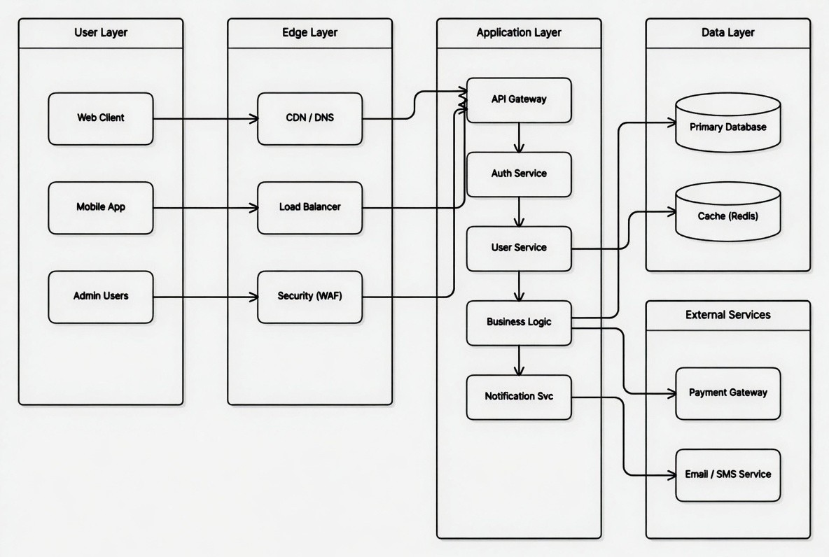
PROPOSED SYSTEM ARCHITECTURE
1
2
3
4
5
6
7
8
9

Slide 7
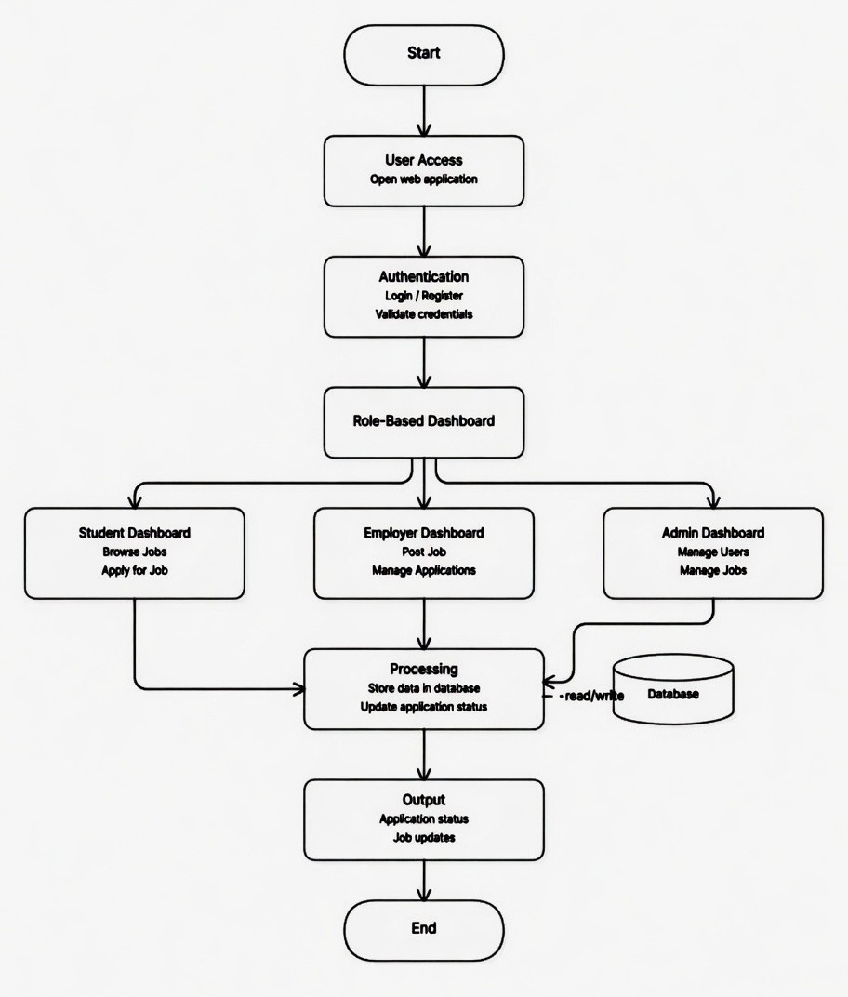
WORKFLOW
1
2
Level 0 DFD: Job Seeker and Employer interact with the Job Portal System. Admin oversees all operations.
Level 1 DFD:
1. Login Module: User submits credentials → Login Process → Authentication Result → Dashboard Redirect.
2. User Registration: User submits registration info → User Registration Process → Student/Employer info stored in Database.
3. Job Management: Employer submits job details → Post Job Process → Job Listings stored in Database → Students browse jobs.
4. Application Module: Student submits application with cover letter → Apply Process → Application Record stored → Employer updates status.
5. Admin Control: Admin sends management request → Manage Users/Jobs Process → Status/Results updated in Database.
3
4
5
6
7
8
9

Slide 8
TECHNOLOGIES USED
1
Frontend:
• Thymeleaf (Server-side Java template engine for rendering dynamic HTML views)
• Bootstrap 5 (Responsive CSS framework for UI components: cards, tables, navbars, buttons)
• HTML5 / CSS3
Backend:
• Spring Boot 3.2.3 (Core backend framework with auto-configuration, embedded Tomcat)
• Spring Security 6 (Authentication with BCrypt encoding, role-based URL access control)
• Spring Data JPA / Hibernate (ORM for database operations, entity mapping, JPQL queries)
• Java 17 (Programming language with LTS support)
Database:
• H2 In-Memory Database (Lightweight relational DB, auto schema creation, web console access)
Third-Party API / Tools:
• Lombok (Reduces boilerplate code: getters, setters, constructors, builders)
• Apache Maven (Build automation and dependency management)
• Spring Mail (SMTP configuration included for future email notifications)
Hardware/Software Requirements:
• JDK 17+, Apache Maven 3.8+, IDE (IntelliJ/Eclipse), Web Browser, 4GB RAM minimum
2
3
4
5
6
7
8
9

Slide 9
MODULE DESCRIPTION
1
Module 1: User Authentication and Registration
Handles user registration (Student/Employer), secure login with BCrypt password encoding, role-based redirection after login, and account enable/disable functionality.
Module 2: Job and Application Management
Employers can create, view, update, and delete job postings. Students can browse, search, and filter jobs by category, location, and experience. Application submission with cover letters and duplicate-application prevention.
Module 3: Admin Control Panel
Provides comprehensive management interface with analytics dashboard showing total students, employers, jobs, and applications. Admin can view all users, toggle account status, and delete inappropriate job listings.
Module 4: Profile Management
Students can update personal details, skills, education, experience, and upload resumes. Employers can update company profiles with name, description, industry, and website.
Module 5: Application Status Tracking
Real-time tracking of application statuses: Applied (system-set), Under Review, Shortlisted, Rejected, Hired (employer-updated). Students view status changes; employers manage applicants with remarks.
2
3
4
5
6
7
8
9

Slide 10
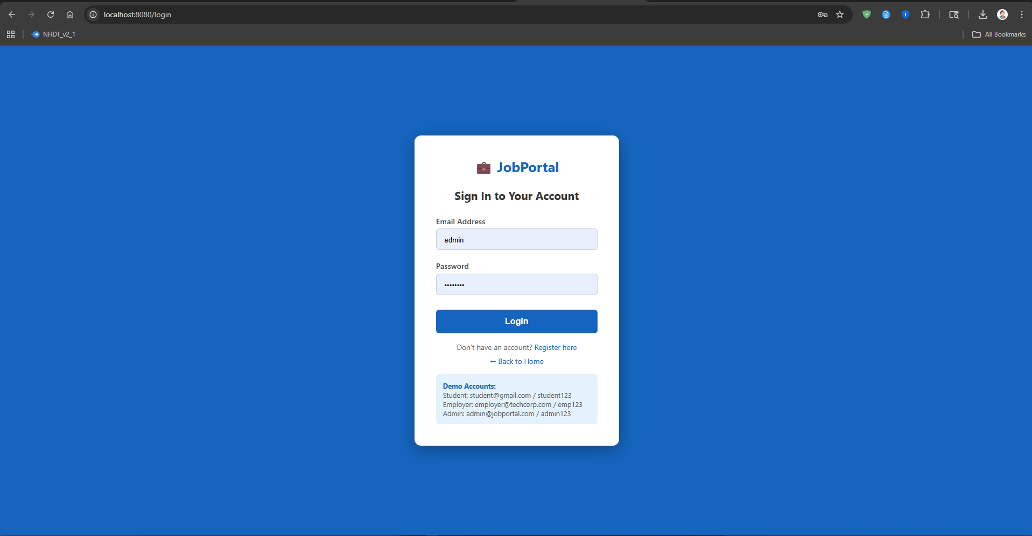
IMPLEMENTATION SCREENSHOTS
1
2
3
4
5
6
7
8
9

Slide 11
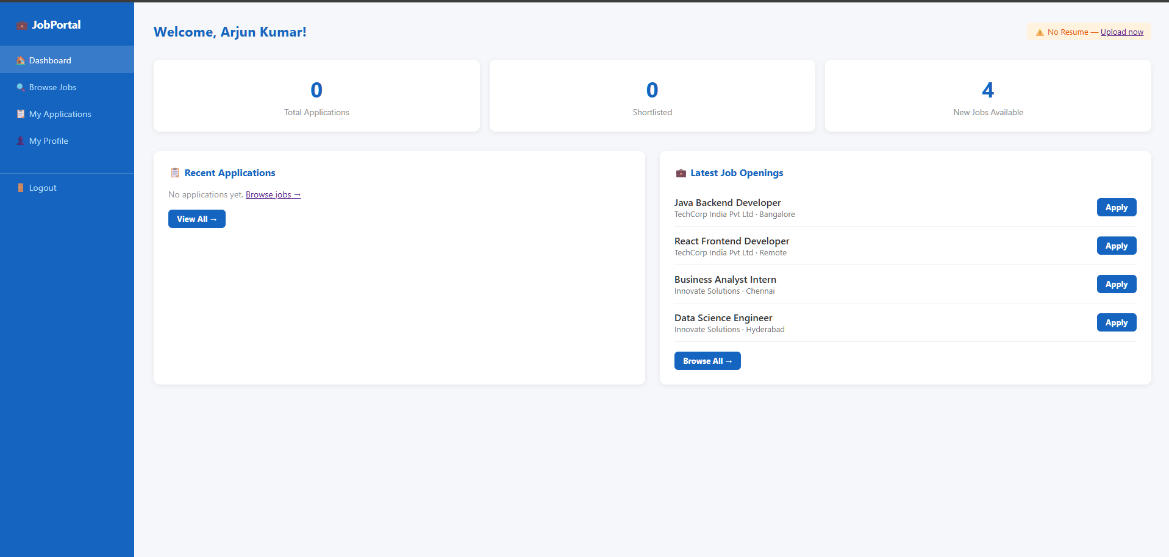
IMPLEMENTATION SCREENSHOTS
1
2
3
4
5
6
7
8(A)
9

Slide 12
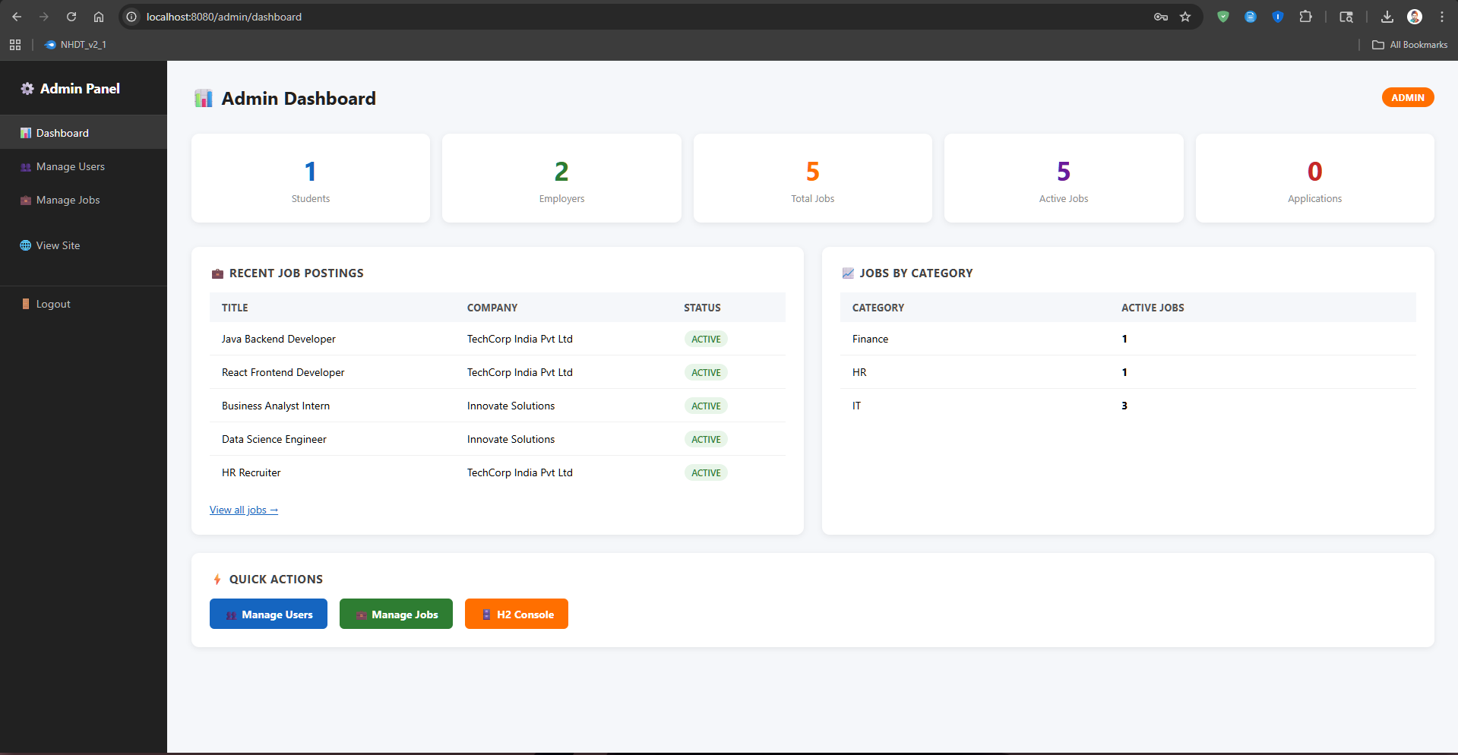
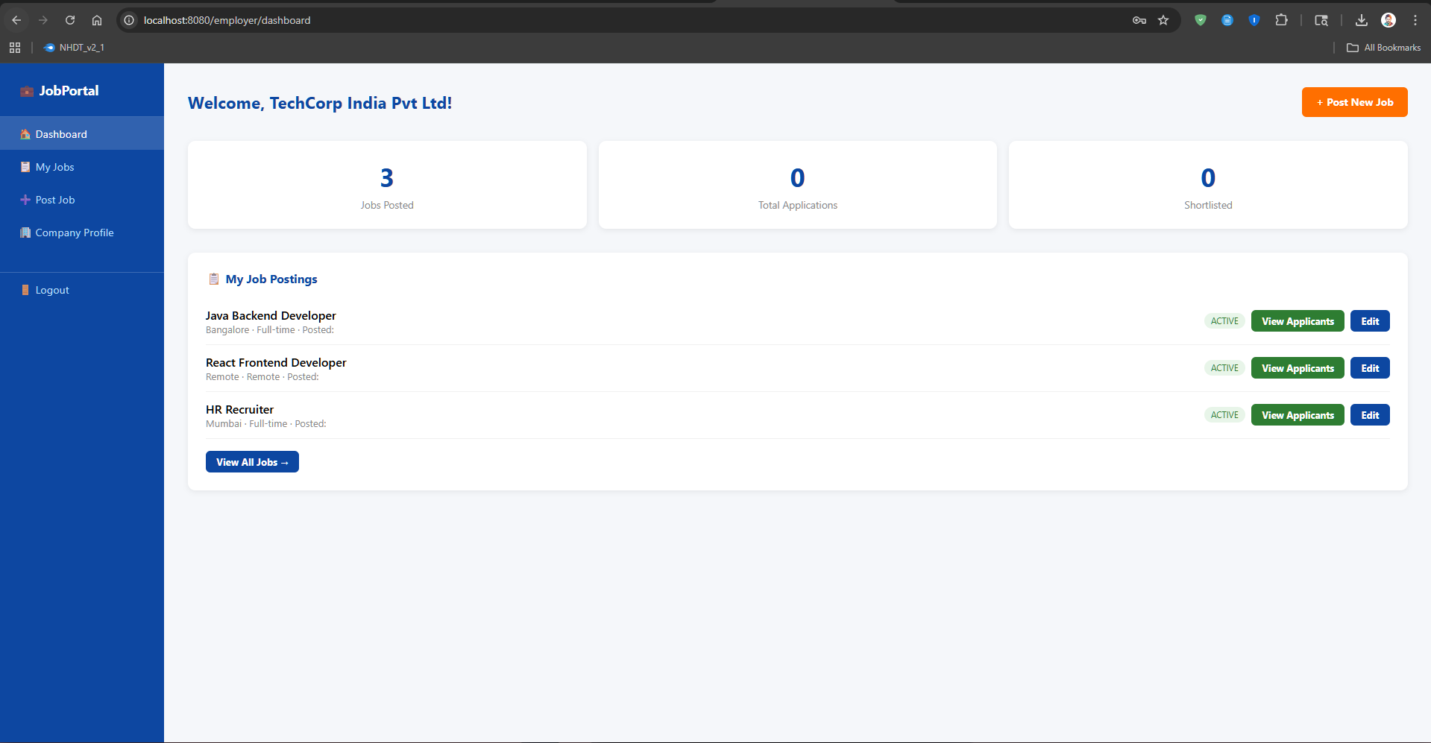
Admin Portal
IMPLEMENTATION SCREENSHOTS
EmPLoyer Portal
1
2
3
4
5
6
7
8(B)
9

Slide 13
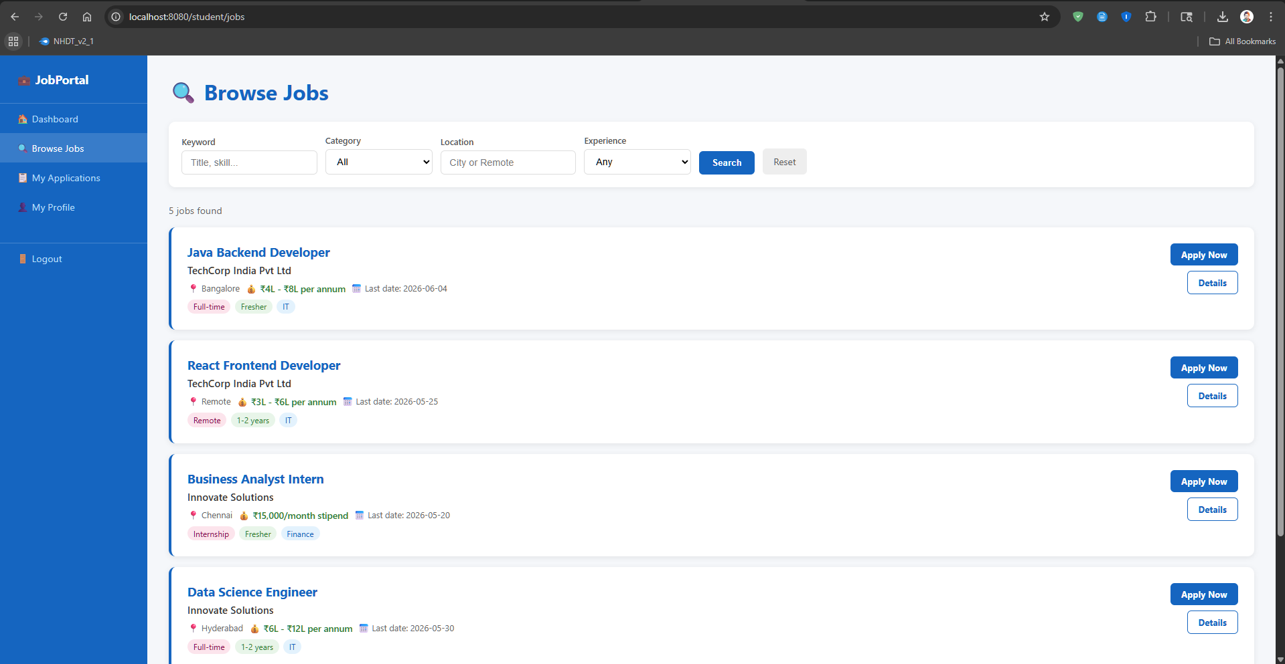
IMPLEMENTATION SCREENSHOTS
1
2
3
4
5
6
7
8(C)
9

Slide 14
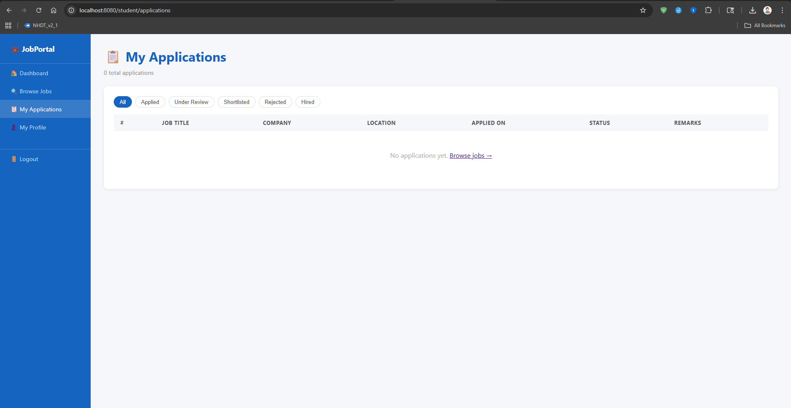
IMPLEMENTATION SCREENSHOTS
1
2
3
4
5
6
7
8(D)
9

Slide 15
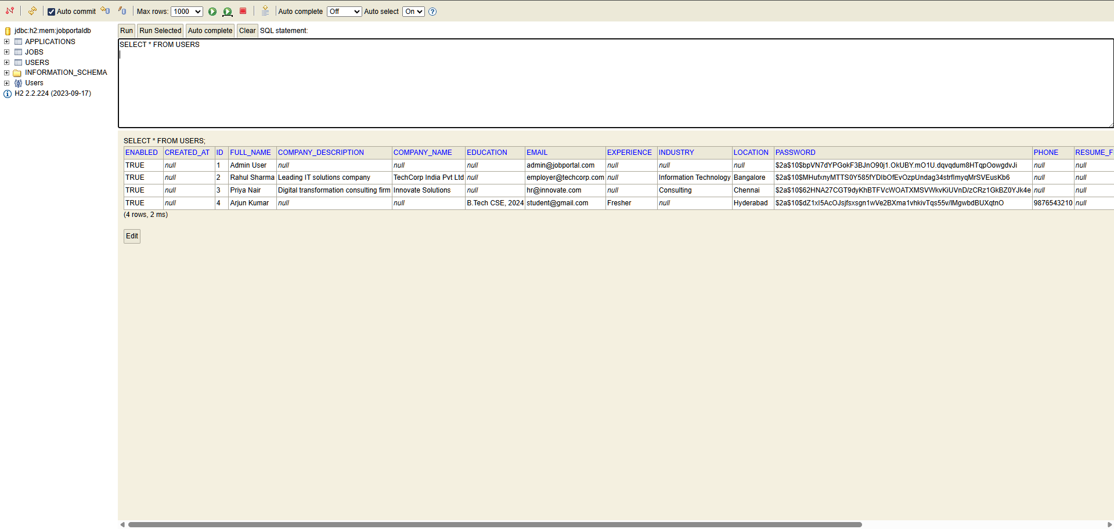
IMPLEMENTATION SCREENSHOTS
1
2
3
4
5
6
7
8(E)
9

Slide 16
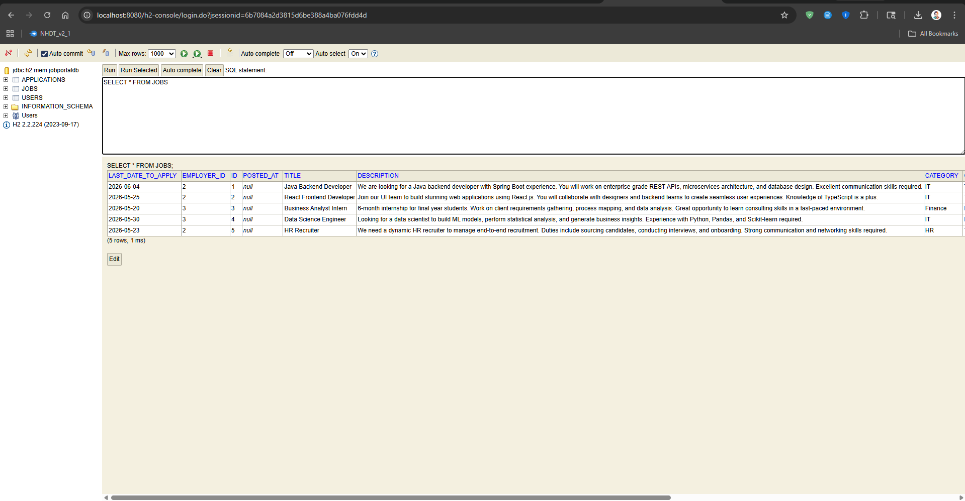
IMPLEMENTATION SCREENSHOTS
1
2
3
4
5
6
7
8(F)
9

Slide 17
ADVANTAGES & LIMITATIONS
1
ADVANTAGES:
a) Centralized Platform: All recruitment activities — job posting, browsing, applying, and status tracking — on a single web platform.
b) Role-Based Access Control: Each user type (Student, Employer, Admin) has a distinct, secure view ensuring data privacy.
c) Resume Management: Students upload and maintain resumes; each application auto-attaches the latest resume.
d) Real-Time Application Tracking: Students track exact status (Applied, Shortlisted, Rejected, Hired); employers get organized applicant lists.
e) Scalable Architecture: Layered MVC with clean separation between controllers, services, and repositories makes the codebase maintainable.
LIMITATIONS:
• In-Memory Database: H2 with create-drop mode means all data is lost on application restart. Production requires MySQL or PostgreSQL.
• No Email Notifications: Spring Mail is configured but automated emails (application confirmation, status updates) are not yet implemented.
• No Pagination: Job listings and application lists load entirely without pagination, affecting performance at scale.
• Single-Server Deployment: Current architecture does not support horizontal scaling or distributed deployment.
2
3
4
5
6
7
8
9

Slide 18
Thank you

