Slide 1
Multi-Model Recommendation Systems In e-Commerce
VU M H TRAN
Arjun kumar
Brandon Beck
Blake Wilson

Slide 2
Why do we need recommendation systems in E-commerce ?
There are millions or even trillions of products
User don’t know what to choose
Recommendation Systems solve this problem by suggesting products that match user preferences
Improve user experience
Increases sales for the business

Slide 3
SO What do our group do ?
Product Content-based Recommendation
K-nearest neighbors variances
KNN with numerical and categorical features model (1)
KNN with text features model (2)
KNN with a combined all features model (3)
User behavior-based Recommendation (AKA Collaborative Filtering )
Matrix Factorization Model (4)
Alternating Least Squares (ALS) Method
Light Graph Convolutional Neural Network (LightGCN) Model (5)

Slide 4
BUT…Why use two types of recommendation ?
Product content Based
Use Behavior Based
Model learns from product’s features (name, category, …)
Recommends based on product features
Powerful when user is not logged in or has less interaction
Normally, under the product section
Trade off
Does not know user preferences
Model learns from user interaction (click, add to cart,…)
Recommends based on user interaction
Powerful when user has interacted to some few products
Normally, located at homepage
Trade off
Does not know product features explicitly

Slide 5
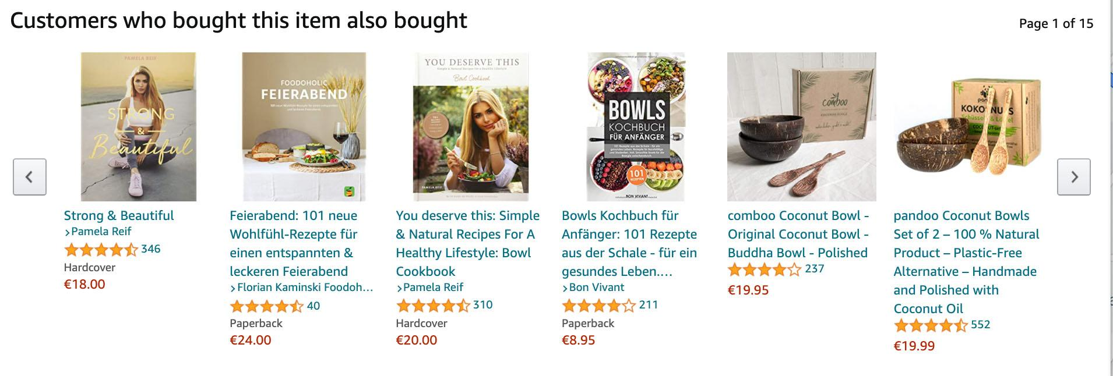
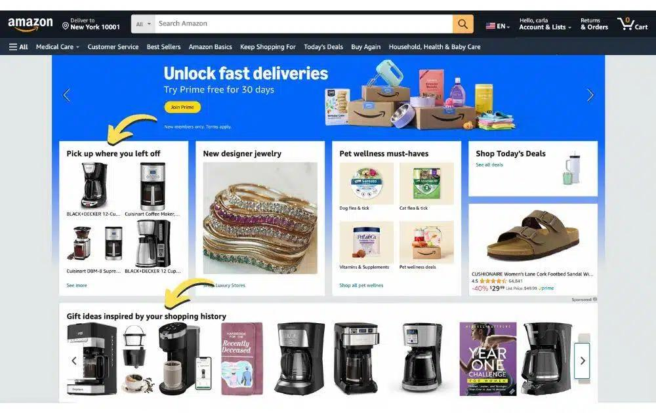
Real Word Example FROM AMAZON MARKETPLACE
PRODUCT CONTENT BASED
USER BEHAVIOR BASED

Slide 6
Let’s start with data (I)
Data is collected from Vu’s e-commerce database
What is inside:
Product Dataset
=> Using for Product content-based recommendation
User Interaction Dataset
=> Using for user behavior-based recommendation

Slide 7
Let’s start with data (Ii)
Product Dataset
User Interaction Dataset
244 Samples
Features:
Product id
Name
Category
Sub-category
Brand
Price
Short description
Long description
10.000 samples
Features:
User id
Product id
Interaction
Add to cart
Add to Wishlist
Rating from 1 to 5
Click

Slide 8
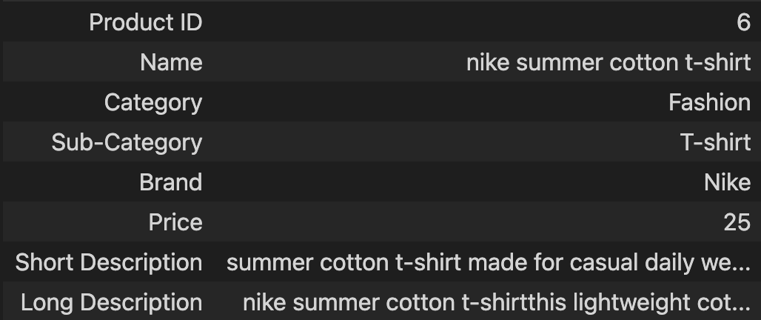
Let’s start with data (Iii)
1 sample from Product Dataset:

Slide 9
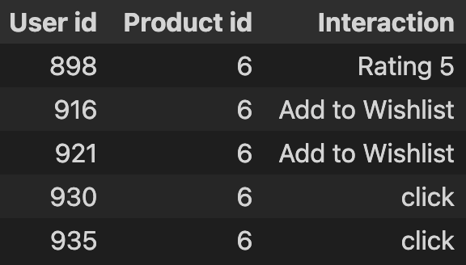
Let’s start with data (IV)
Some samples from User Interaction Dataset:

Slide 10
Product Content-based Recommendation
Feature Engineering
Techniques Used
How recommendation work?

Slide 11
1. Feature Engineering
KNN Variant 1 – Categorical KNN
Category
Sub-category
Brand
Price
KNN Variant II – Text KNN
Name
Short Description
Long Description
KNN Variant III – Combined KNN
Name
Category
Sub-category
Brand
Price
Short Description
Long Description

Slide 12
2. Techniques Used
KNN Variant 1 – Categorical KNN
I. Preprocessing:
Categorical Encode:
One Hot Encoder
Distance Metric
Euclidean
II. Model:
KNN
KNN Variant 2 – Text KNN
I. Preprocessing:
Natural Language Process:
TFIDF
Distance Metric
Cosine Similarity
II. Model:
KNN
KNN Variant 3 – Combined KNN
I. Preprocessing:
Categorical Encode:
One Hot Encoder
Natural Language Process:
TFIDF
Distance Metric:
Cosine Similarity
II. Model:
KNN

Slide 13
3. HOW Recommendation Works
Product dataset
Feature Engineering
Apply Preprocessing
Find K nearest
Compute distance
Return similar Products
[Nike shirt, Fashion, T-shirt, 24,…]
[iPhone 17, Mobile phone, phone, 900,…]
[Adidas shirt, Fashion, T-shirt, 25,…]
[0,1,0,1,1,1,.…]
[1,0,1,0,0,0,…]
[0,1,0,1,1,0,…]
[0,1,0,1,1,1,.…]
[0,1,0,1,1,0,…]
[6, Nike shirt, Fashion, T-shirt, 24,…]
[10, iPhone 17, Mobile phone, phone, 900,…]
[7, Adidas shirt, Fashion, T-shirt, 25,…]
[0, 0.9, 0.0005]
[0.9, 0, 0.9 ]
[0.0005, 0.9, 0]
Nike shirt
Adidas shirt

Slide 14
Time For Visualization !!
You can visit the website anytime at: demo.fashion-shop.uk

Slide 15
THANK YOU FOR YOUR TIME !

