Slide 1
Multi-Model Recommendation Systems In e-Commerce
VU M H TRAN
Arjun kumar
Brandon Beck
Blake Wilson

Slide 2
Why do we need recommendation systems in E-commerce ?
There are millions or even trillions of products
Users don’t know what to choose
Recommendation Systems solve this problem by suggesting products that match user preferences
Improve user experience
Increases sales for the business

Slide 3
SO What do our group do ?
Product Content-based Recommendation
K-nearest neighbors variances
KNN with numerical and categorical features model (1)
KNN with text features model (2)
KNN with a combined all features model (3)
User behavior-based Recommendation (AKA Collaborative Filtering )
Matrix Factorization Model (4)
Light Graph Convolutional Neural Network (LightGCN) Model (5)

Slide 4
BUT…Why use two types of recommendation ?
Product content Based
User Behavior Based
Model learns from product’s features (name, category, …)
Recommends based on product features
Powerful when user is not logged in
Normally, under the product section
Trade off
Does not know user preferences
Model learns from user interaction (click, add to cart,…)
Recommends based on user interaction
Powerful when user is logged in and has interactions
Normally, located at homepage
Trade off
Does not know product features explicitly

Slide 5
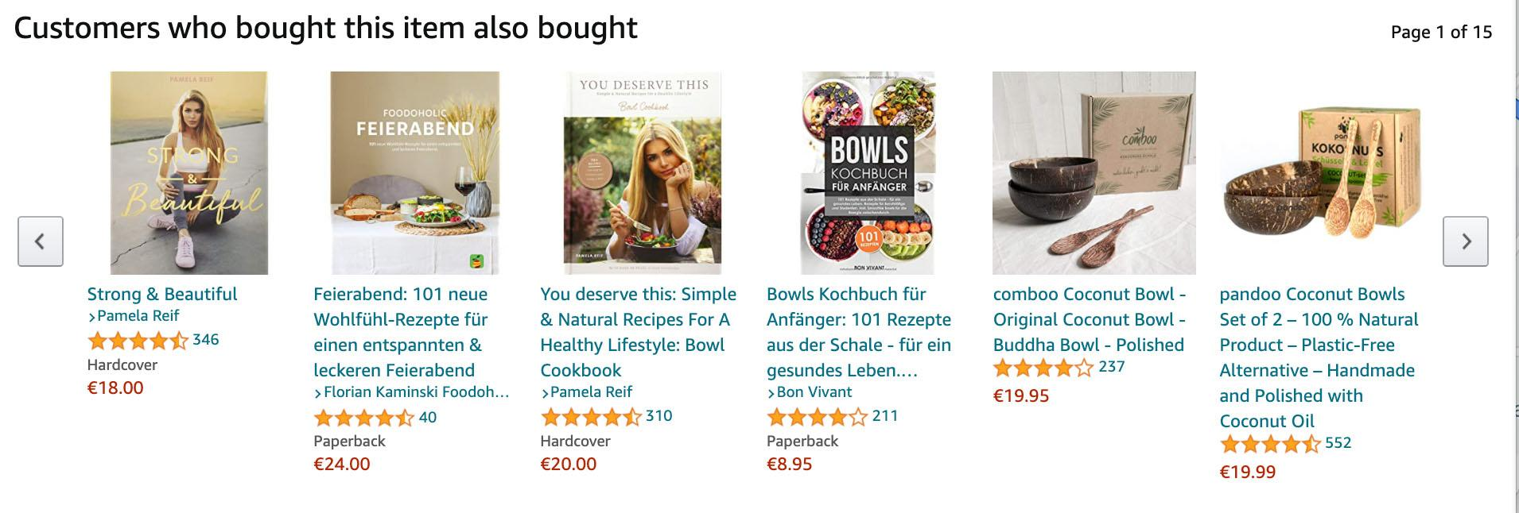
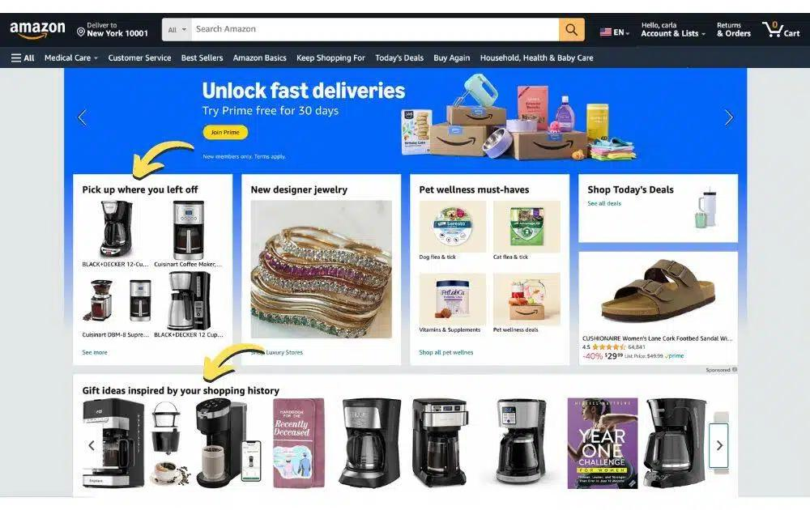
Real Word Example FROM AMAZON MARKETPLACE
PRODUCT CONTENT BASED
USER BEHAVIOR BASED

Slide 6
Let’s start with data (I)
Data is collected from Vu’s e-commerce database
What is inside:
Product Dataset
=>Using for Product content-based recommendation
User-Item Interaction Dataset
Using for User behavior-based recommendation
Note: the words “Item” and “product” are interchangeable

Slide 7
Let’s start with data (Ii)
Product Dataset
User-Item Interaction Dataset
244 Samples
Features:
Product id
Name
Category
Sub-category
Brand
Price
Short description
Long description
10.000 samples
Features:
User id
Product id
Interaction
Add to cart
Add to Wishlist
Rating from 1 to 5
Click
Note: the words “Item” and “product” are interchangeable

Slide 8
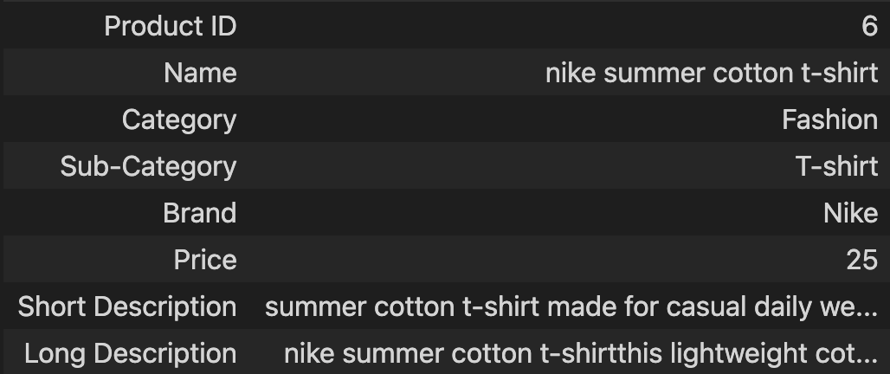
Let’s start with data (Iii)
1 sample from Product Dataset:

Slide 9
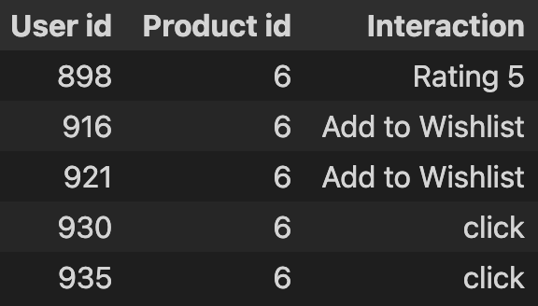
Let’s start with data (IV)
Some samples from User-Item Interaction Dataset:

Slide 10
Product Content-based Recommendation
Feature Engineering
Techniques Used
How recommendation work?
Time for visualization

Slide 11
1. Feature Engineering
KNN Variant 1 – Categorical KNN
Category
Sub-category
Brand
Price
KNN Variant II – Text KNN
Name
Short Description
Long Description
KNN Variant III – Combined KNN
Name
Category
Sub-category
Brand
Price
Short Description
Long Description

Slide 12
2. Techniques Used
KNN Variant 1 – Categorical KNN
I. Preprocessing:
Categorical Encode:
One Hot Encoder
Distance Metric
Euclidean
II. Model:
KNN
KNN Variant 2 – Text KNN
I. Preprocessing:
Natural Language Process:
TFIDF
Distance Metric
Cosine Similarity
II. Model:
KNN
KNN Variant 3 – Combined KNN
I. Preprocessing:
Categorical Encode:
One Hot Encoder
Natural Language Process:
TFIDF
Distance Metric:
Cosine Similarity
II. Model:
KNN

Slide 13
3. HOW Recommendation Works
Product dataset
Feature Engineering
Apply Preprocessing
Find K nearest
Compute distance
Return similar Products
[Nike shirt, Fashion, T-shirt, 24,…]
[iPhone 17, Mobile phone, phone, 900,…]
[Adidas shirt, Fashion, T-shirt, 25,…]
[0,1,0,1,1,1,.…]
[1,0,1,0,0,0,…]
[0,1,0,1,1,0,…]
[0,1,0,1,1,1,.…]
[0,1,0,1,1,0,…]
[6, Nike shirt, Fashion, T-shirt, 24,…]
[10, iPhone 17, Mobile phone, phone, 900,…]
[7, Adidas shirt, Fashion, T-shirt, 25,…]
[0, 0.9, 0.0005]
[0.9, 0, 0.9 ]
[0.0005, 0.9, 0]
Nike shirt
Adidas shirt

Slide 14
4. Time For Visualization !!
You can visit the website anytime at: demo.fashion-shop.uk

Slide 15
User Behavior-based Recommendation – Collaborative Filtering
Matrix Factorization and LightGCN Comparison
Time for visualization

Slide 16
1. Matrix Factorization and LightGCN Comparison
 | Matrix Factorization | LightGCN
Input Structure
Idea
Complexity
Training Speed
Libraries Used
Performance
Weakness
Matrix
Graph
Factorizing a matrix into two smaller matrices: User Factor and Item Factor
Message passing to each node by
forward and backward propagation
Simple
Complex
Faster (1min 40s)
Slower (3min 58s) (Light Neural Network)
Implicit
Pytorch and PyG
Strong for long-term preference learning
Strong for early preference learning
Less effective with complex multi-preference users

Slide 17
2. Time For Visualization !!
You can visit the website anytime at: demo.fashion-shop.uk

Slide 18
Q & A time
Do you have any question for us?

Slide 19
THANK YOU FOR YOUR TIME !

Slide 20
1. Collaborative Filtering, Matrix Factorization and Graph Neural network
What is Collaborative Filtering?
An approach where the model predicts what you will like by seeing other people with similar tastes to you.
What is Matrix Factorization?
A model that break/factorize user-item interaction matrix into 2 smaller matrices, user matrix and item matrix, and then use them to predict what a user may like
Popular methods used in the model: Stochastic Gradient Descent, Singular Value Decomposition, Alternating Least Square, …
What Is Graph Neural Network?
A model that receives a user-item interaction dataset as a graph, where user and item are nodes and interactions are edges, “forcing” nodes to learn mutually and then use all the information that was learned to predict what a node represent for user may like.

Slide 21
2. Alternating Least Square (ALS)
What is ALS ?
A method or a solution used in Matrix Factorization model
Why ALS?
Super fast compared to Stochastic Gradient Descent (SGD)
Works well in case user interaction data is sparse (less interaction information from user) compared to Singular Value Decomposition (SVD)

Slide 22
3. Light Convolutional Neural Network (LightGCN)
What is LightGCN ?
A light version model of Graph Neural Network
Why LightGCN?
Simpler compare to the original Graph Neural Network

Slide 23
4. How recommendation work
Iphone
Iphone
Shirt
Ipad
Shirt
Ipad
MATRIX FACTORIZATION
5 | 1 | 5
5 | 2 | 5
0 | 0 | 0
User1
5 | 1 | 5
5
U1
1 | 0 | 2
0 | 1 | 1
User2
U2
Rating U2_Ipad = 5 * 0 + 5 * 1 + 0 * 1 = 5
Rating U2_Shirt = 1 * 0 + 2 * 1 + 0 * 1= 2

Slide 24
4. How recommendation work
Iphone
U1
Iphone
Ipad
U2
Shirt
U1
1
0
2
0
1
1
5
5
0
1
2
0
5
5
0
LightGCN
Shirt
U2
Ipad
? = 5 * 0 + 5 * 1 + 0 * 1= 5
? = 1* 0 + 2 * 1 + 0 * 1= 2

