Slide 1
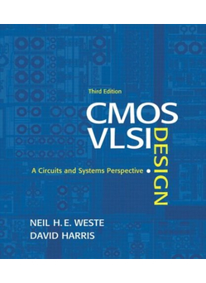
Lecture 0:
Introduction

Slide 2
Course Information
Instructor
  Dr. Lam Duc Khai (khaild@uit.edu.vn )
Text book
  CMOS VLSI Design – A Circuits and System Perspective – Neil H.E. Weste and David Harris – 3rd Edition, 2005.
Other books
  Analysis and Design of Digital Integrated Circuits – In Deep Submicro Technology – David A.Hodges, Horace G. Jackson and Resve A. Saleh – 3rd Edition, 2004.
0: Introduction

Slide 3
Course Evaluation
Grading policy:
  Attendance and Assignments: 25%
  Lab: 25%
  Final term (Project): 50%
No cheating
0: Introduction

Slide 4
Introduction
Integrated circuits: many transistors on one chip.
Very Large Scale Integration (VLSI): bucketloads!
Complementary Metal Oxide Semiconductor
  Fast, cheap, low power transistors
Today: How to build your own simple CMOS chip
  CMOS transistors
  Building logic gates from transistors
  Transistor layout and fabrication
Rest of the course: How to build a good CMOS chip
0: Introduction

Slide 5
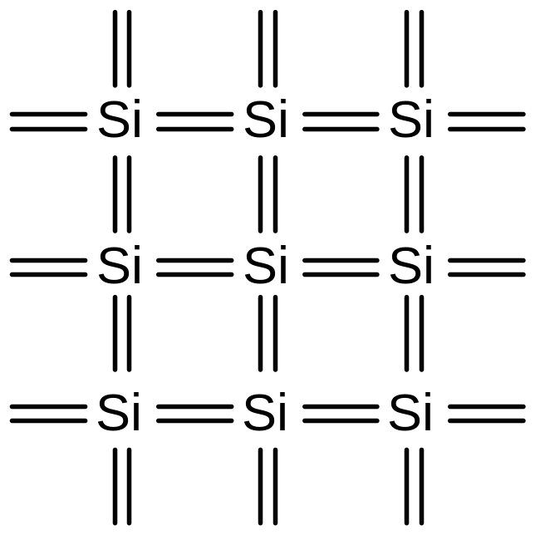
Silicon Lattice
Transistors are built on a silicon substrate
Silicon is a Group IV material
Forms crystal lattice with bonds to four neighbors
0: Introduction

Slide 6
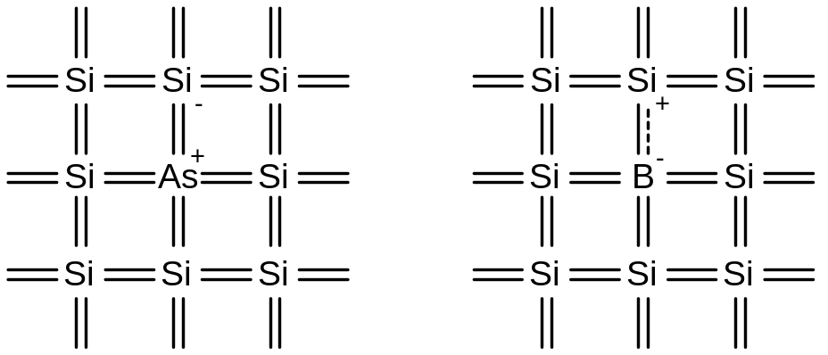
Dopants
Silicon is a semiconductor (Germanium – Ge: similar)
Pure silicon has no free carriers and conducts poorly
Adding dopants increases the conductivity
Group V (Phosphorus, Arsenic): extra electron (n-type)
Group III (Boron, Gallium, Indium): missing electron, called hole (p-type)
0: Introduction

Slide 7
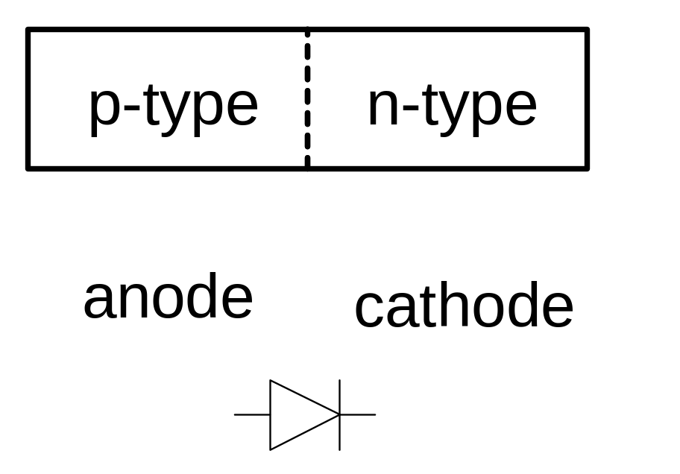
p-n Junctions
A junction between p-type and n-type semiconductor forms a diode.
Current flows only in one direction
0: Introduction

Slide 8
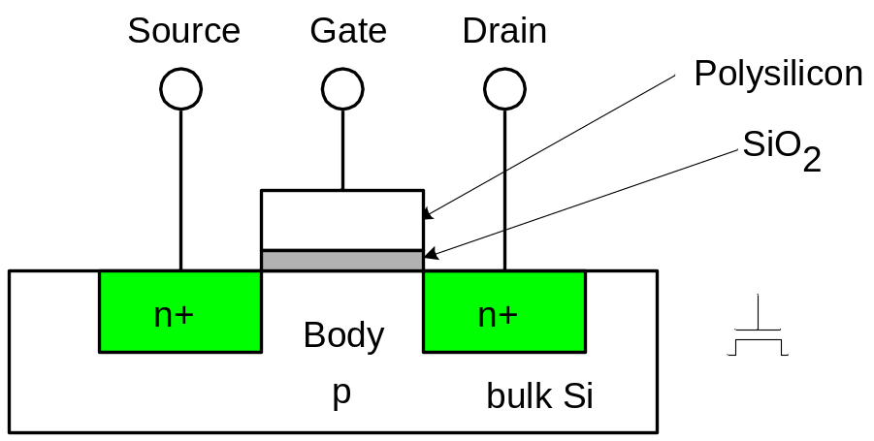
nMOS Transistor
Four terminals: gate, source, drain, body
Gate – oxide – body stack looks like a capacitor
  Gate and body are conductors
  SiO₂ (oxide) is a very good insulator
  Called metal – oxide – semiconductor (MOS) capacitor
  Even though gate is
  no longer made of metal
0: Introduction

Slide 9
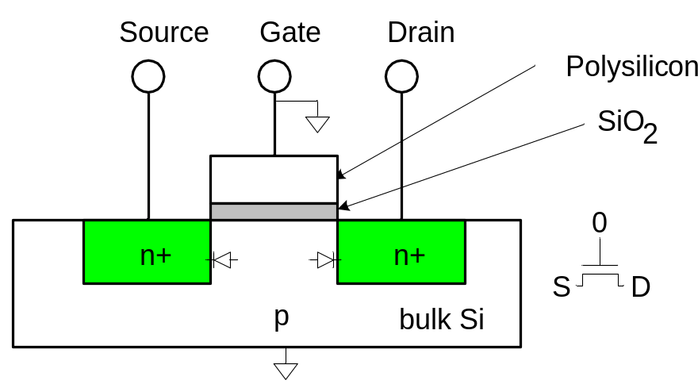
nMOS Operation
Body is usually tied to ground (0 V)
When the gate is at a low voltage:
  P-type body is at low voltage
  Source-body and drain-body diodes are OFF
  No current flows, transistor is OFF
0: Introduction

Slide 10

nMOS Operation Cont.
When the gate is at a high voltage:
  Positive charge on gate of MOS capacitor
  Negative charge attracted to body
  Inverts a channel under gate to n-type
  Now current can flow through n-type silicon from source through channel to drain, transistor is ON
0: Introduction

Slide 11
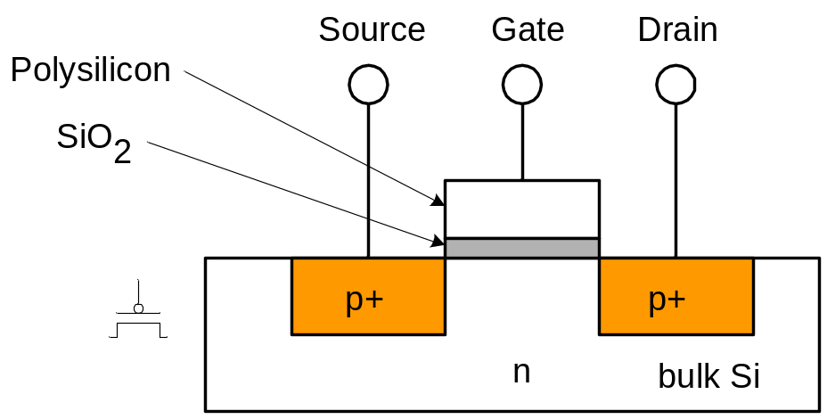
pMOS Transistor
Similar, but doping and voltages reversed
  Body tied to high voltage (V_{DD})
  Gate low: transistor ON
  Gate high: transistor OFF
  Bubble indicates inverted behavior
0: Introduction

Slide 12
Power Supply Voltage
GND = 0 V
In 1980’s, V_{DD} = 5V
V_{DD} has decreased in modern processes
  High V_{DD} would damage modern tiny transistors
  Lower V_{DD} saves power
V_{DD} = 3.3, 2.5, 1.8, 1.5, 1.2, 1.0, …
0: Introduction

Slide 13
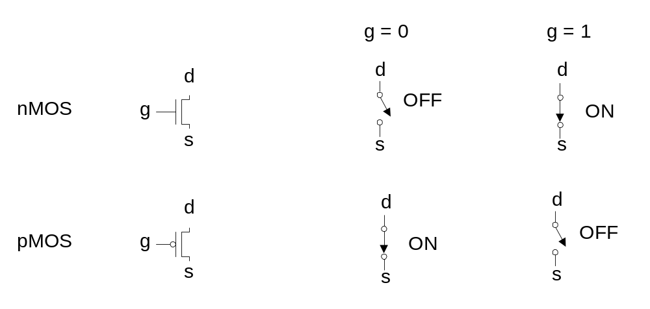
Transistors as Switches
We can view MOS transistors as electrically controlled switches
Voltage at gate controls path from source to drain
0: Introduction

Slide 14
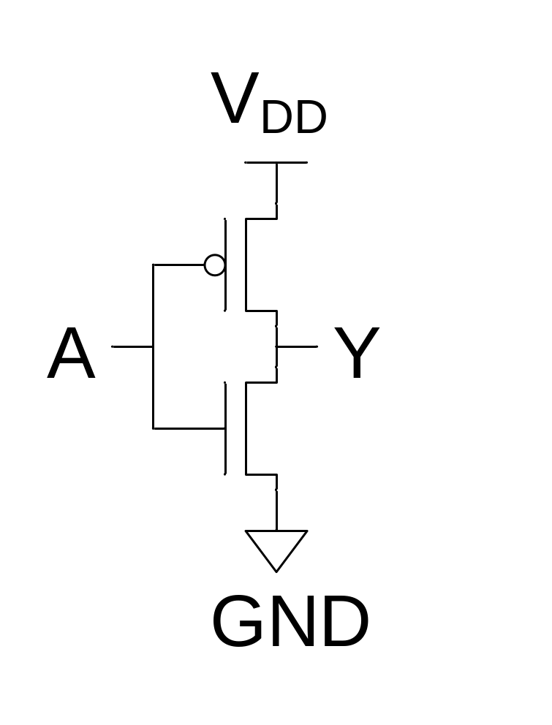
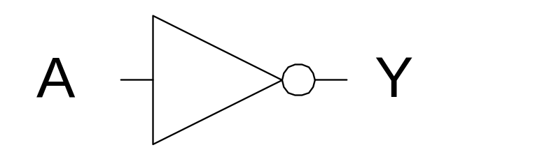
CMOS Inverter
A | Y
0 | 1
1 | 0
OFF
ON
0
1
ON
OFF
0: Introduction

Slide 15
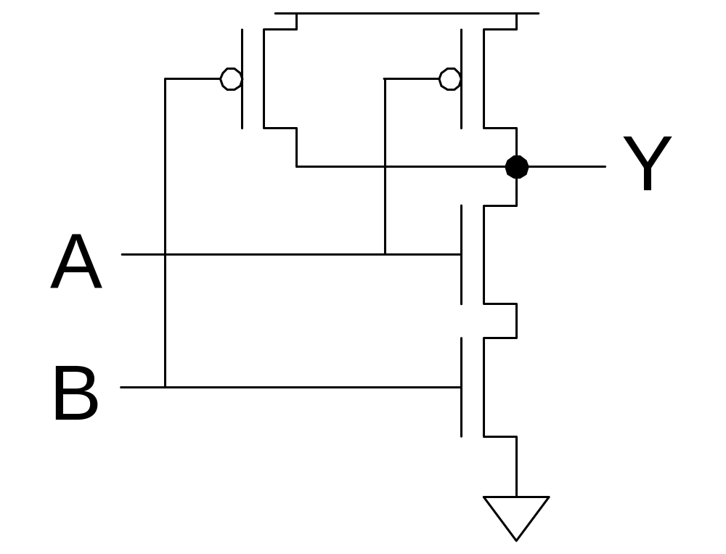
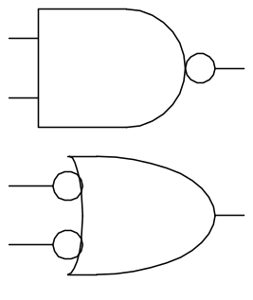
CMOS NAND Gate
A | B | Y
0 | 0 | 1
0 | 1 | 1
1 | 0 | 1
1 | 1 | 0
ON
OFF
OFF
ON
OFF
OFF
ON
ON
1
1
0
0
ON
ON
OFF
OFF
1
0
0
1
ON
OFF
OFF
ON
0: Introduction

Slide 16
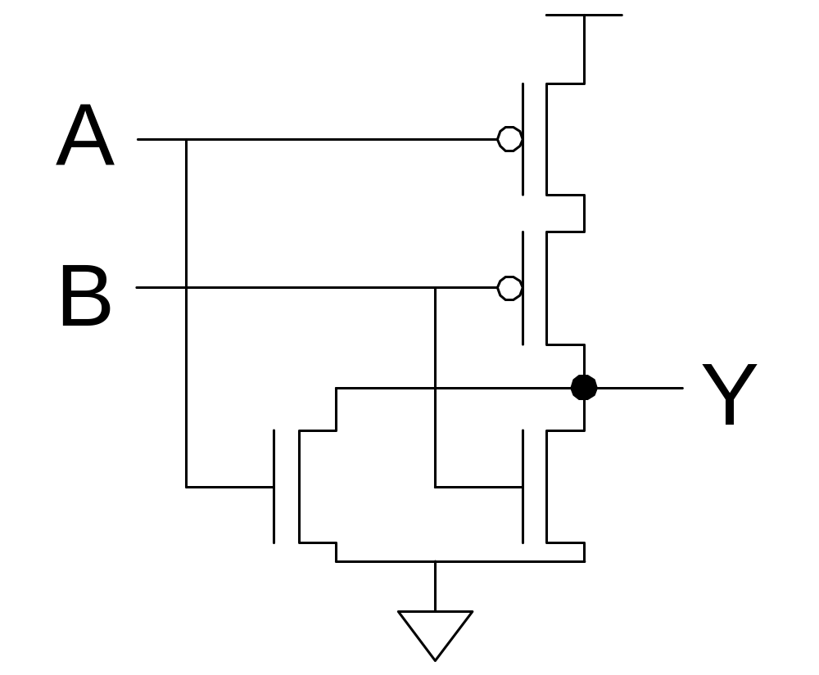
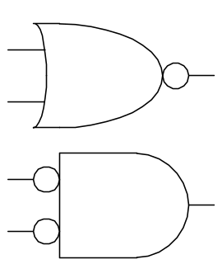
CMOS NOR Gate
A | B | Y
0 | 0 | 1
0 | 1 | 0
1 | 0 | 0
1 | 1 | 0
0: Introduction

Slide 17
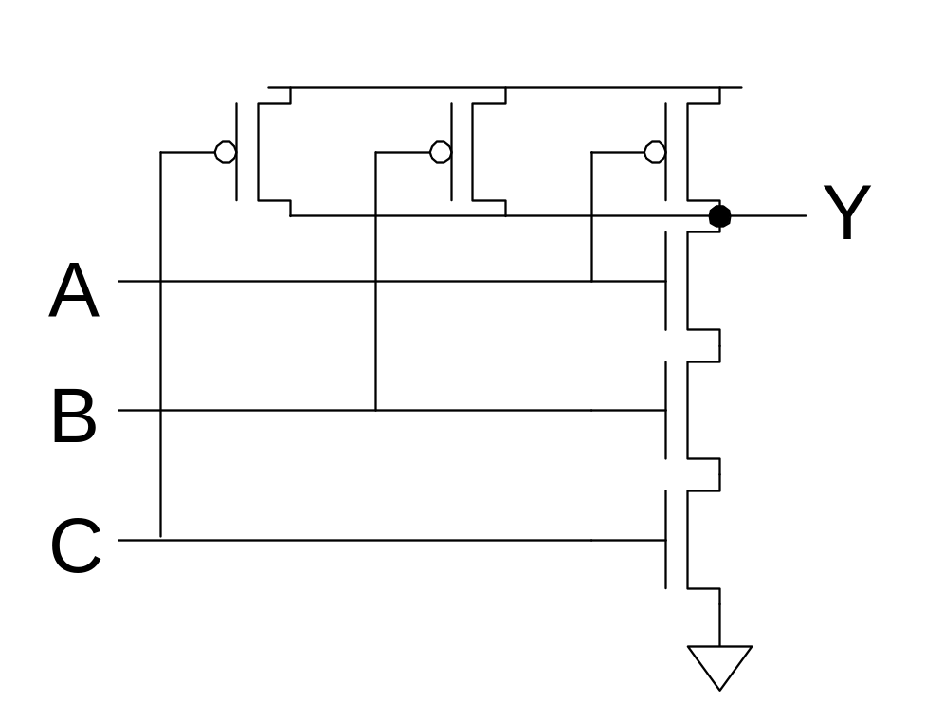
3-input NAND Gate
Y pulls low if ALL inputs are 1
Y pulls high if ANY input is 0
0: Introduction

Slide 18
CMOS Fabrication
CMOS transistors are fabricated on silicon wafer
Lithography process similar to printing press
On each step, different materials are deposited or etched
Easiest to understand by viewing both top and cross-section of wafer in a simplified manufacturing process
0: Introduction

Slide 19
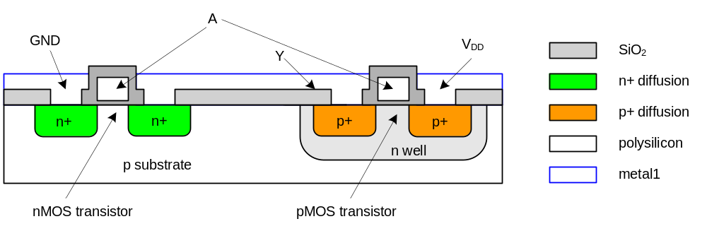
Inverter Cross-section
Typically use p-type substrate for nMOS transistors
Requires n-well for body of pMOS transistors
0: Introduction
Notes:
Reason to use Polysilicon as Gate instead of Metal:
One reason for the initial switch to polysilicon is that fabrication processes after the initial doping required very high temperature annealing. Metal gates would melt under such conditions whereas polysilicon would not. Using polysilicon allowed for a one-step process of etching the gates compared to elaborate multi-steps that we see today in metal-gate processes.
The other reasons is that the threshold voltage of the MOSFET inversion layer is correlated with the work-function difference between the gate and the channel. Using metal would result in a higher Vt compared to polysilicon since a polysilicon gate would be of the same or similar material composition as the bulk silicon channel.
As we reach smaller and smaller scales, the need for a higher Vt has become important again due to problems of leakage. Higher conductivity in the gate has also become important as the oxide dielectric layers cannot be shrunk any further to increase speed. Thus, metal gates with a high-k dielectric are used in modern CMOS transistors

Slide 20
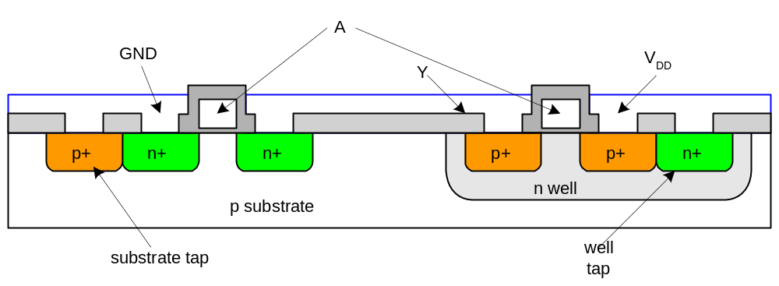
Well and Substrate Taps
Substrate must be tied to GND and n-well to V_{DD}
Metal to lightly-doped semiconductor forms poor connection called Shottky Diode
Use heavily doped well and substrate contacts / taps
0: Introduction
Notes:
Tap cells gives reverse bias to the nwell and p well . This is to avoid latch up, in simple words is , phenominon where the the thyristor, which is formed by adjacent junctions in the substrate, turns on and goes to a high current mode ( thermal run away).
Or, Latch-up, a condition in which the whole chip acts as a thyristor (PNPN) device in order to short Vdd to Vss.
Thyristor hay Chỉnh lưu silic có điều khiển (SCR) là phần tử bán dẫn cấu tạo từ bốn lớp bán dẫn,ví dụ như P-N-P-N, tạo ra ba lớp tiếp giáp P-N: J1,J2,J3. Thyristor có ba cực: anode (A), cathode (K) và cực điều khiển (G) như được biểu diễn trong hình vẽ. Nó được dùng cho chỉnh lưu dòng điện có điều khiển

Slide 21

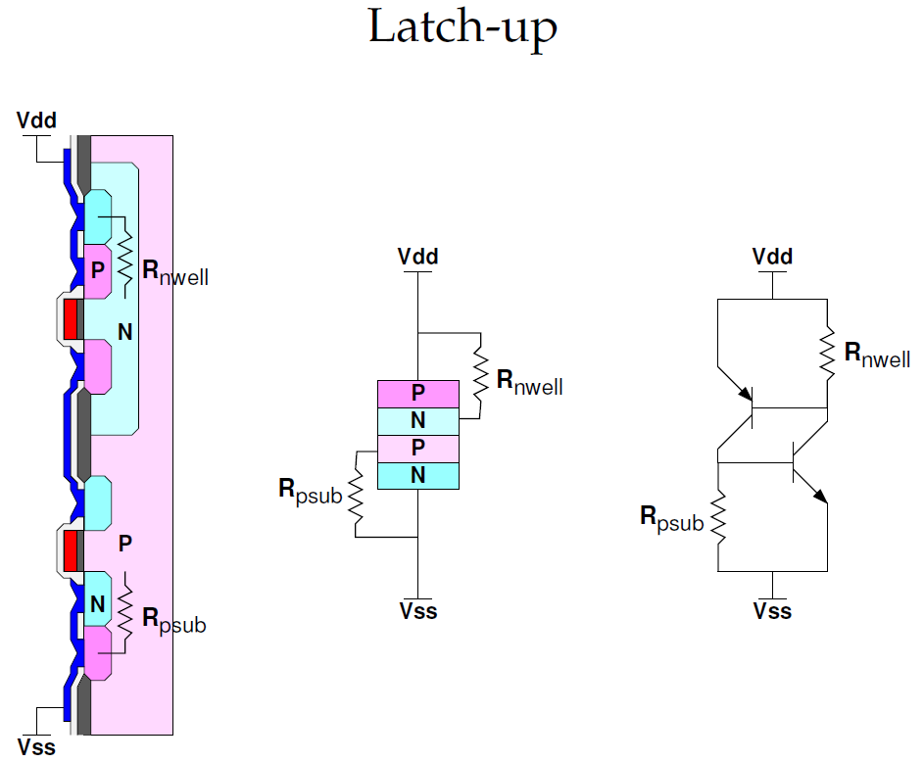
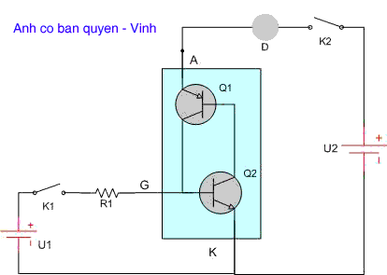
Well and Substrate Taps
Thyristor
0: Introduction
Notes:
Tap cells gives reverse bias to the nwell and p well . This is to avoid latch up, in simple words is , phenominon where the the thyristor, which is formed by adjacent junctions in the substrate, turns on and goes to a high current mode ( thermal run away).
Or, Latch-up, a condition in which the whole chip acts as a thyristor (PNPN) device in order to short Vdd to Vss.
Thyristor hay Chỉnh lưu silic có điều khiển (SCR) là phần tử bán dẫn cấu tạo từ bốn lớp bán dẫn,ví dụ như P-N-P-N, tạo ra ba lớp tiếp giáp P-N: J1,J2,J3. Thyristor có ba cực: anode (A), cathode (K) và cực điều khiển (G) như được biểu diễn trong hình vẽ. Nó được dùng cho chỉnh lưu dòng điện có điều khiển

Slide 22
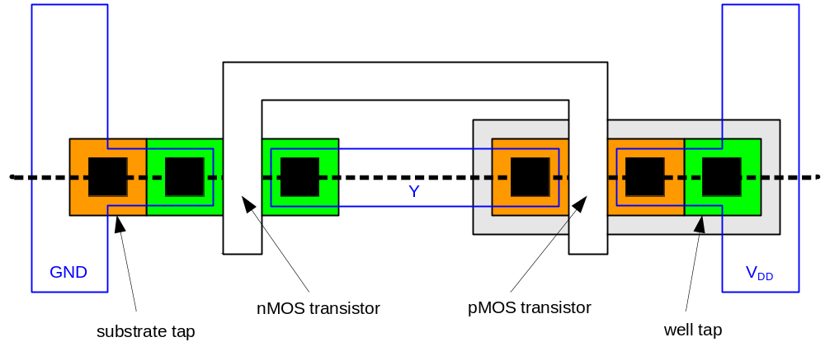
Inverter Mask Set
Transistors and wires are defined by masks
Cross-section taken along dashed line
0: Introduction

Slide 23
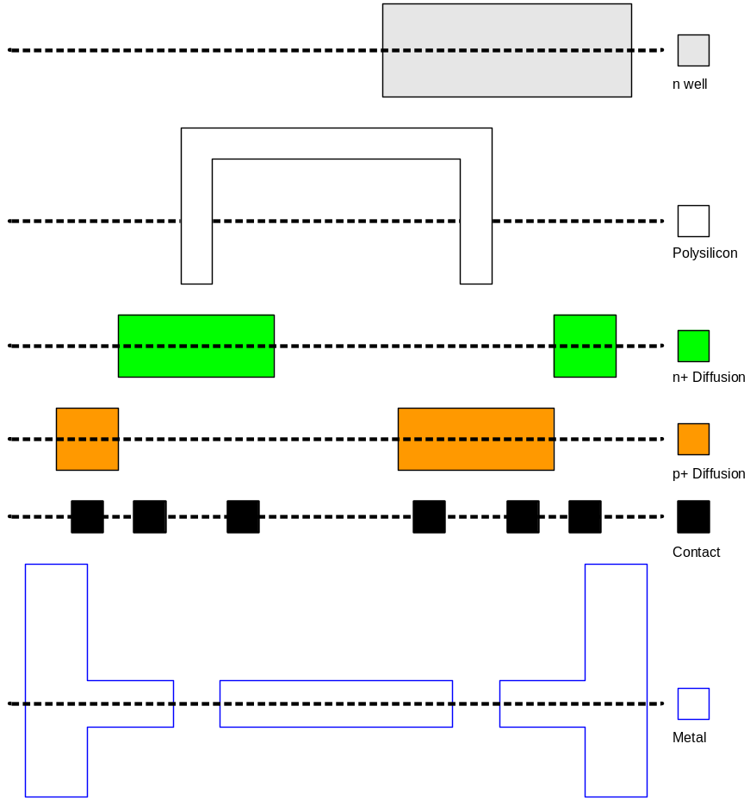
Detailed Mask Views
Six masks
  n-well
  Polysilicon
  n+ diffusion
  p+ diffusion
  Contact
  Metal
0: Introduction

Slide 24
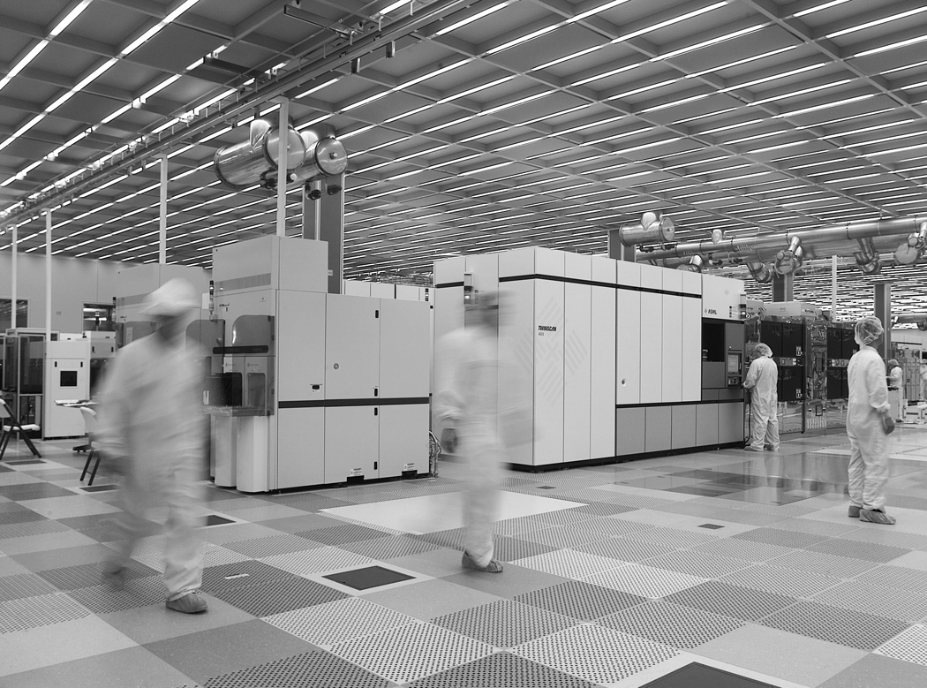
Fabrication
Chips are built in huge factories called fabs
Contain clean rooms as large as football fields
Courtesy of International
Business Machines Corporation.
Unauthorized use not permitted.
0: Introduction

Slide 25
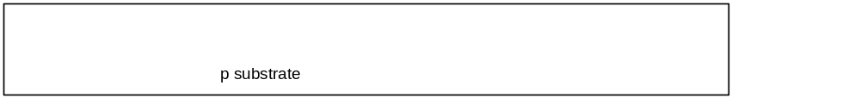
Fabrication Steps
Start with blank wafer
Build inverter from the bottom up
First step will be to form the n-well
  Cover wafer with protective layer of SiO₂ (oxide)
  Remove layer where n-well should be built
  Implant or diffuse n dopants into exposed wafer
  Strip off SiO₂
0: Introduction

Slide 26
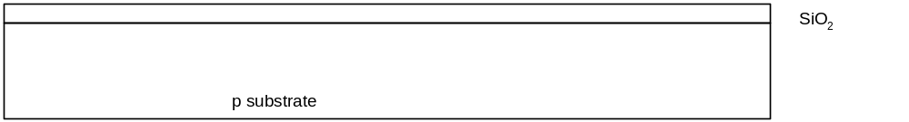
Oxidation
Grow SiO₂ on top of Si wafer
  900 – 1200 C with H₂O or O₂ in oxidation furnace
0: Introduction

Slide 27
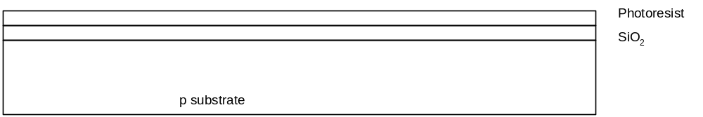
Photoresist
Spin on photoresist
  Photoresist is a light-sensitive organic polymer
  Softens where exposed to light
0: Introduction
Notes:
Exposed to light: được tiếp xúc với ánh sáng

Slide 28
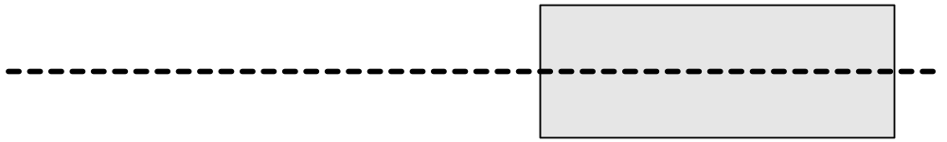
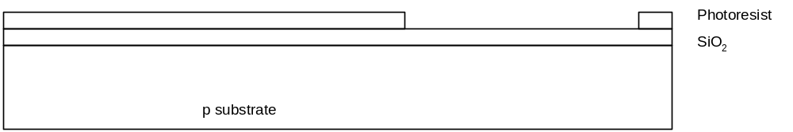
Lithography
Expose photoresist through n-well mask
Strip off exposed photoresist
0: Introduction
Notes:
Strip off: gột rửa, lột ra

Slide 29
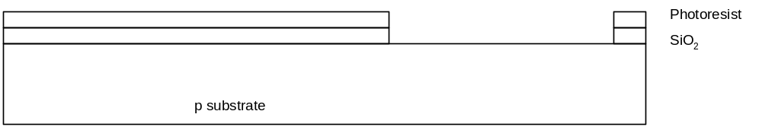
Etch
Etch oxide with hydrofluoric acid (HF)
  Seeps through skin and eats bone; nasty stuff!!!
Only attacks oxide where resist has been exposed
0: Introduction

Slide 30
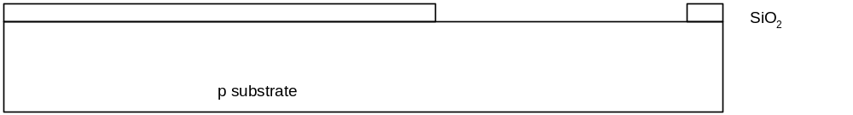
Strip Photoresist
Strip off remaining photoresist
  Use mixture of acids called piranah etch
Necessary so resist doesn’t melt in next step
0: Introduction
Notes:
Strip off: gột rửa, lột rửa

Slide 31
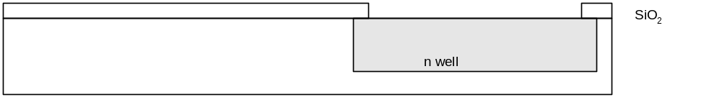
n-well
n-well is formed with diffusion or ion implantation
Diffusion
  Place wafer in furnace with arsenic gas
  Heat until As atoms diffuse into exposed Si
Ion Implanatation
  Blast wafer with beam of As ions
  Ions blocked by SiO₂, only enter exposed Si
0: Introduction

Slide 32
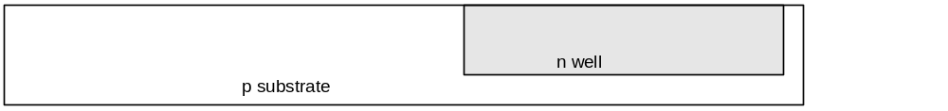
Strip Oxide
Strip off the remaining oxide using HF
Back to bare wafer with n-well
Subsequent steps involve similar series of steps
0: Introduction

Slide 33
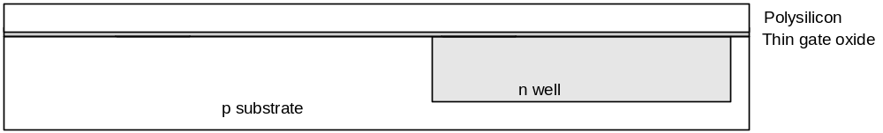
Polysilicon
Deposit very thin layer of gate oxide
  < 20 Å (6-7 atomic layers)
Chemical Vapor Deposition (CVD) of silicon layer
  Place wafer in furnace with Silane gas (SiH₄)
  Forms many small crystals called polysilicon
  Heavily doped to be good conductor
0: Introduction

Slide 34
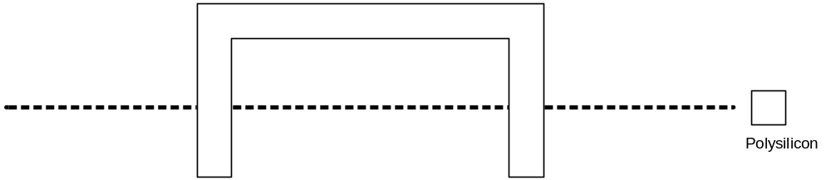
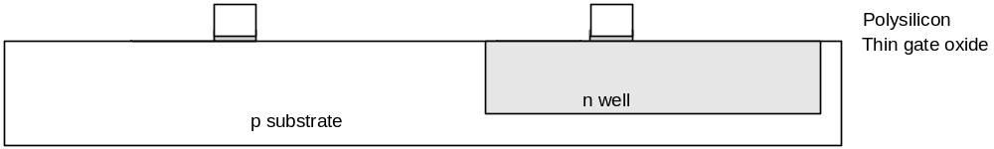
Polysilicon Patterning
Use same lithography process to pattern polysilicon
0: Introduction

Slide 35
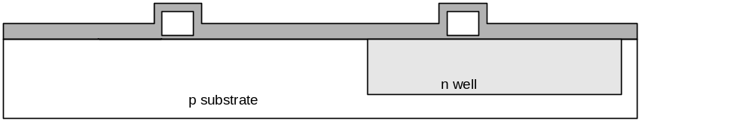
Self-Aligned Process
Use oxide and masking to expose where n+ dopants should be diffused or implanted
N-diffusion forms nMOS source, drain, and n-well contact
0: Introduction

Slide 36
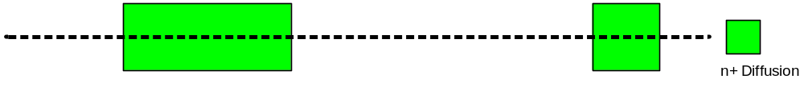
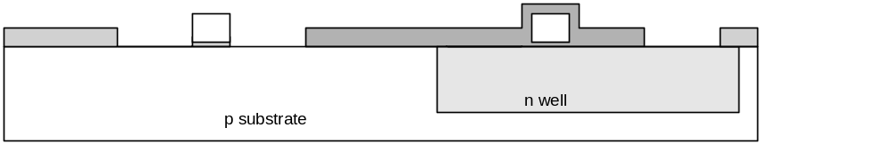
N-diffusion
Pattern oxide and form n+ regions
Self-aligned process where gate blocks diffusion
Polysilicon is better than metal for self-aligned gates because it doesn’t melt during later processing
0: Introduction

Slide 37
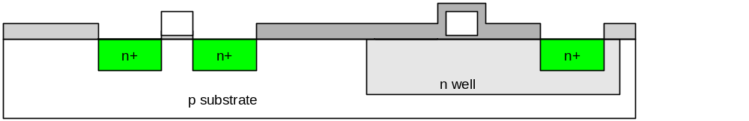
N-diffusion cont.
Historically dopants were diffused
Usually ion implantation today
But regions are still called diffusion
0: Introduction

Slide 38
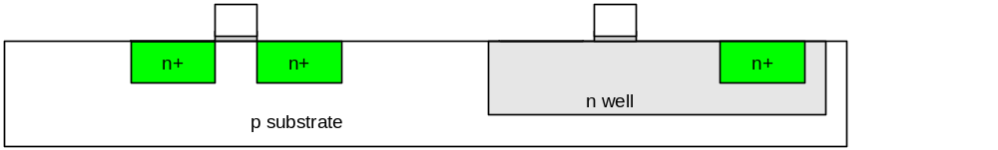
N-diffusion cont.
Strip off oxide to complete patterning step
0: Introduction

Slide 39
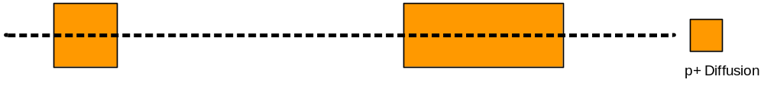
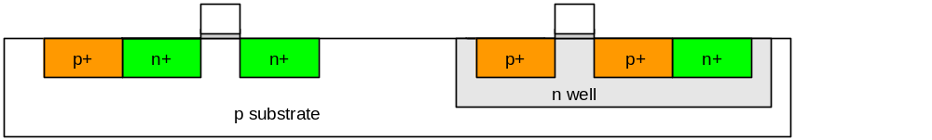
P-Diffusion
Similar set of steps form p+ diffusion regions for pMOS source and drain and substrate contact
0: Introduction

Slide 40
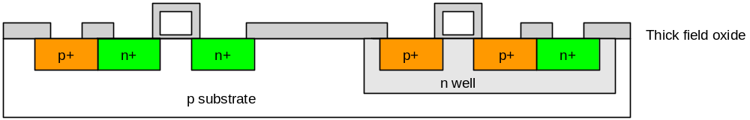
Contacts
Now we need to wire together the devices
Cover chip with thick field oxide
Etch oxide where contact cuts are needed
0: Introduction

Slide 41
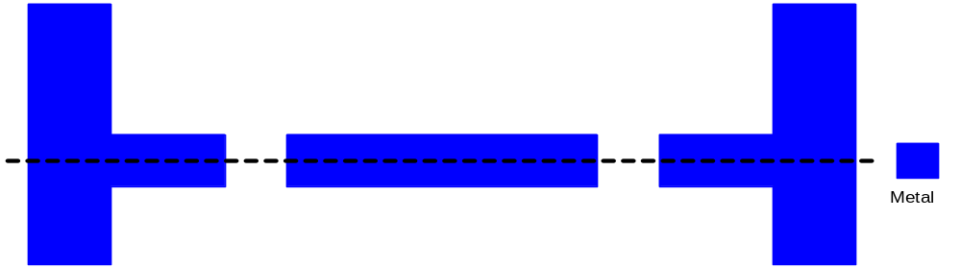
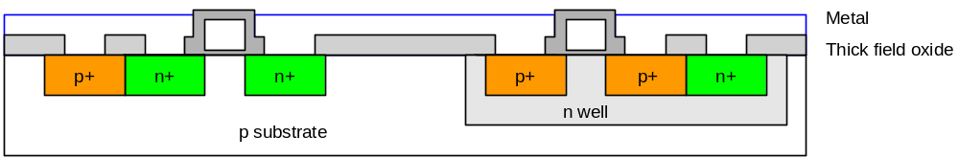
Metalization
Sputter on aluminum over whole wafer
Pattern to remove excess metal, leaving wires
0: Introduction

Slide 42
Layout
Chips are specified with set of masks
Minimum dimensions of masks determine transistor size (and hence speed, cost, and power)
Feature size f = distance between source and drain
  Set by minimum width of polysilicon
Feature size improves 30% every 3 years or so
Normalize for feature size when describing design rules
Express rules in terms of λ = f/2
  E.g. λ = 0.3 μm in 0.6 μm process
0: Introduction

Slide 43
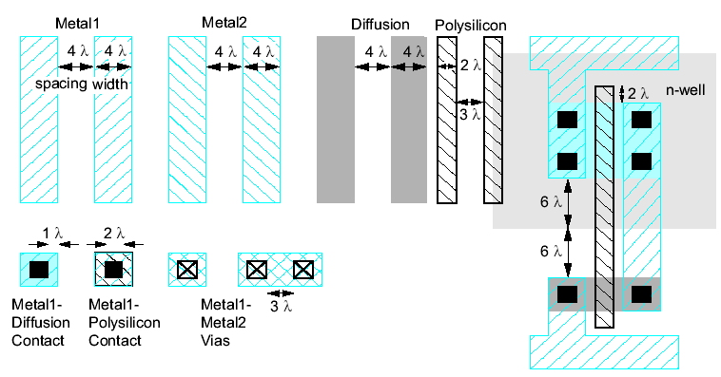
Simplified Design Rules
Conservative rules to get you started
0: Introduction

Slide 44
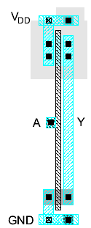
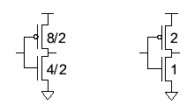
Inverter Layout
Transistor dimensions specified as Width / Length
  Minimum size is 4λ / 2λ, sometimes called 1 unit
  In f = 0.6 μm process, this is 1.2 μm wide, 0.6 μm long
0: Introduction

Slide 45
Summary
MOS transistors are stacks of gate, oxide, silicon
Act as electrically controlled switches
Build logic gates out of switches
Draw masks to specify layout of transistors
Now you know everything necessary to start designing schematics and layout for a simple chip!
0: Introduction

