Slide 1
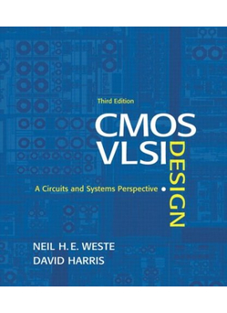
Lecture 1:
Circuits & Layout

Slide 2
Outline
A Brief History
CMOS Gate Design
Pass Transistors
CMOS Latches & Flip-Flops
Standard Cell Layouts
Stick Diagrams
1: Circuits & Layout

Slide 3
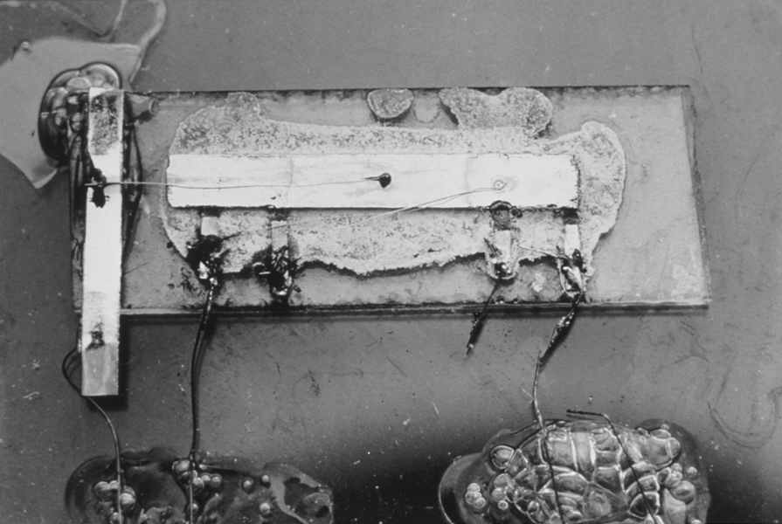
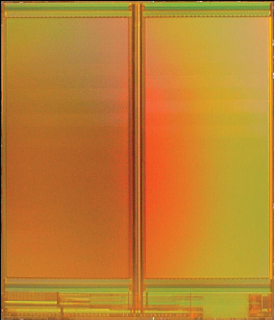
A Brief History
1958: First integrated circuit
  Flip-flop using two transistors
  Built by Jack Kilby at Texas Instruments
2010
  Intel Core i7 μprocessor
    2.3 billion transistors
  64 Gb Flash memory
    > 16 billion transistors
Courtesy Texas Instruments
[Trinh09]
© 2009 IEEE.
1: Circuits & Layout

Slide 4
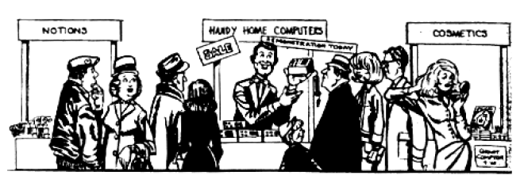
Growth Rate
53% compound annual growth rate over 50 years
  No other technology has grown so fast so long
Driven by miniaturization of transistors
  Smaller is cheaper, faster, lower in power!
  Revolutionary effects on society
[Moore65]
Electronics Magazine
1: Circuits & Layout

Slide 5
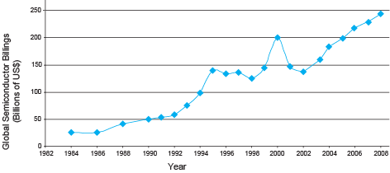
Annual Sales
>10¹⁹ transistors manufactured in 2008
  1 billion for every human on the planet
1: Circuits & Layout

Slide 6
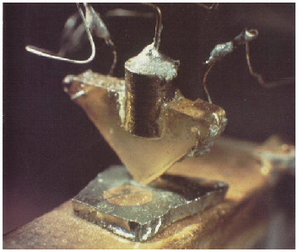
Invention of the Transistor
Vacuum tubes ruled in first half of 20th century Large, expensive, power-hungry, unreliable
1947: first point contact transistor
  John Bardeen and Walter Brattain at Bell Labs
  See Crystal Fire
  by Riordan, Hoddeson
AT&T Archives. Reprinted with permission.
1: Circuits & Layout

Slide 7
Transistor Types
Bipolar transistors
  npn or pnp silicon structure
  Small current into very thin base layer controls large currents between emitter and collector
  Base currents limit integration density
Metal Oxide Semiconductor Field Effect Transistors
  nMOS and pMOS MOSFETS
  Voltage applied to insulated gate controls current between source and drain
  Low power allows very high integration
1: Circuits & Layout

Slide 8
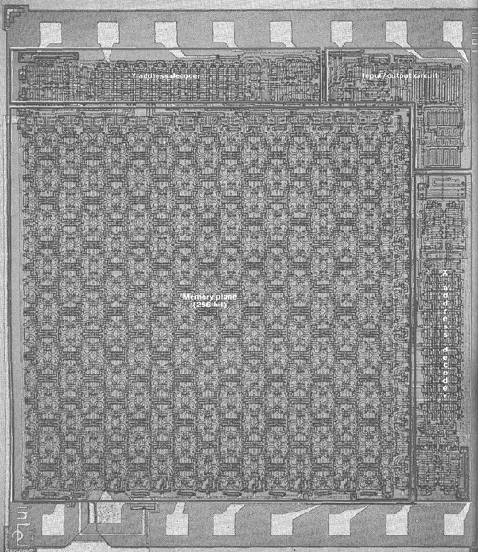
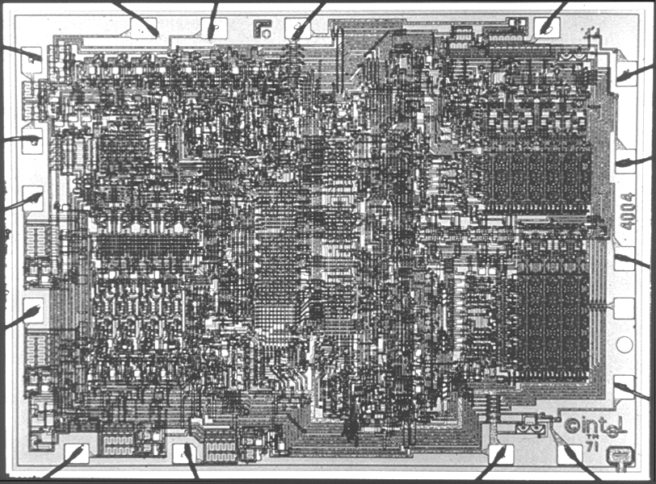
MOS Integrated Circuits
1970’s processes usually had only nMOS transistors
  Inexpensive, but consume power while idle
1980s-present: CMOS processes for low idle power
Intel Museum.
Reprinted with permission.
[Vadasz69]
© 1969 IEEE.
Intel 1101 256-bit SRAM
Intel 4004 4-bit μProc
1: Circuits & Layout

Slide 9
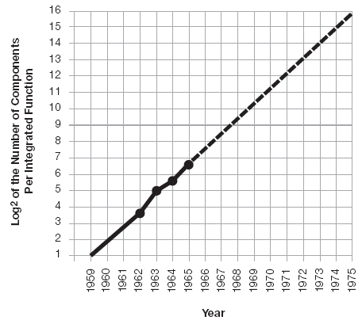
Moore’s Law: Then
1965: Gordon Moore plotted transistor on each chip
  Fit straight line on semilog scale
  Transistor counts have doubled every 26 months
Integration Levels
SSI: 10 gates
MSI: 1000 gates
LSI: 10,000 gates
VLSI: > 10k gates
[Moore65]
Electronics Magazine
1: Circuits & Layout

Slide 10
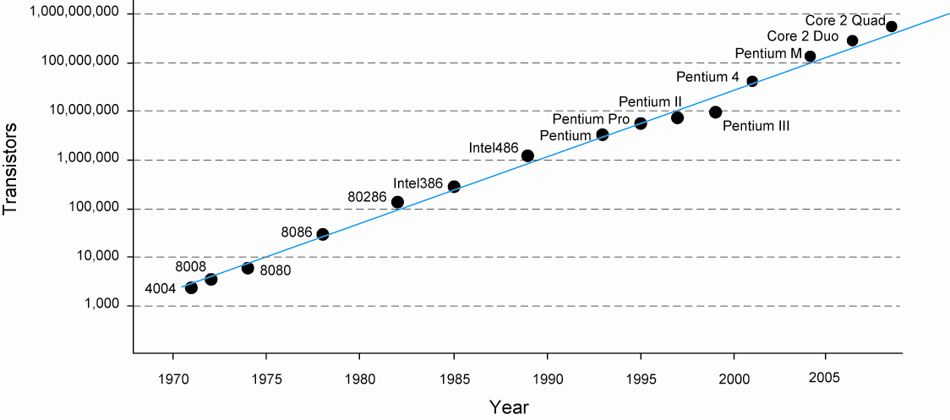
And Now…
1: Circuits & Layout

Slide 11
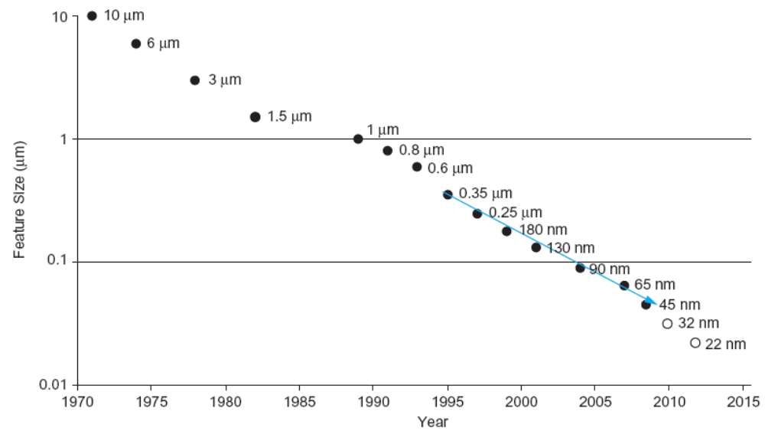
Feature Size
Minimum feature size shrinking 30% every 2-3 years
1: Circuits & Layout

Slide 12
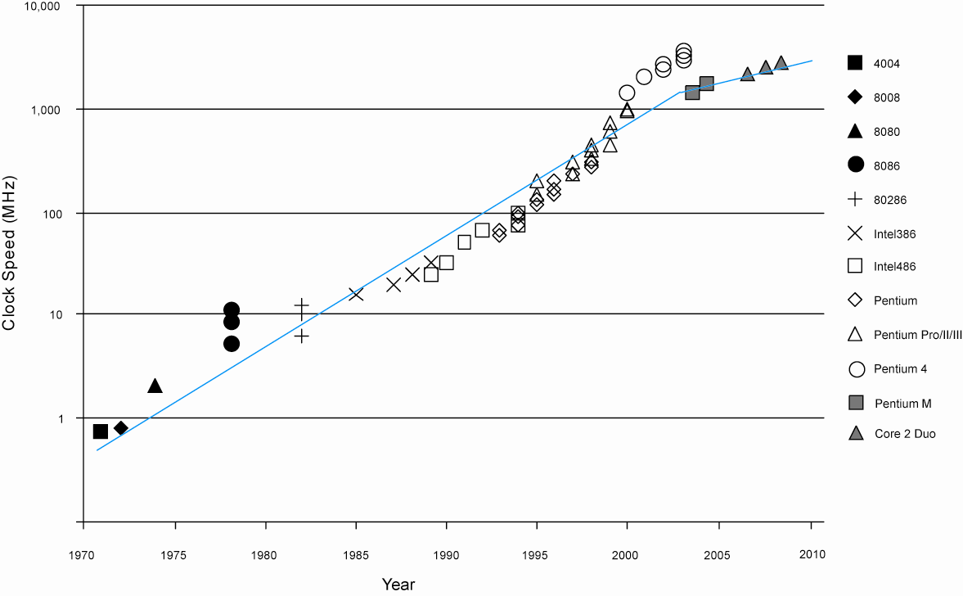
Corollaries
Many other factors grow exponentially
  Ex: clock frequency, processor performance
1: Circuits & Layout

Slide 13
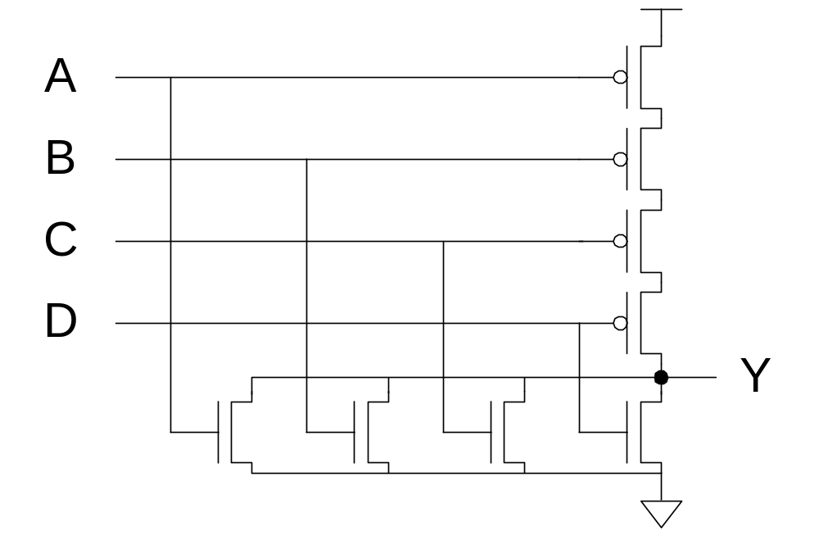
CMOS Gate Design
Activity:
  Sketch a 4-input CMOS NOR gate
1: Circuits & Layout

Slide 14
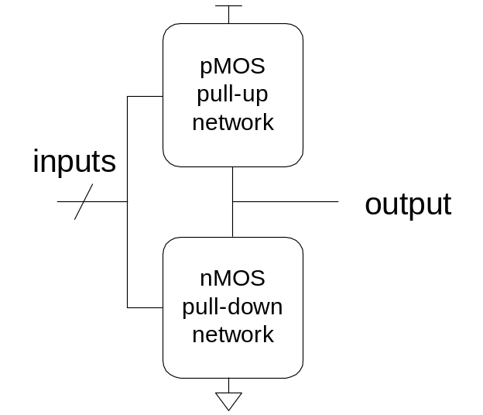
Complementary CMOS
Complementary CMOS logic gates
  nMOS pull-down network
  pMOS pull-up network
  a.k.a. static CMOS
 | Pull-up OFF | Pull-up ON
Pull-down OFF | Z (float) | 1
Pull-down ON | 0 | X (crowbar)
1: Circuits & Layout
Notes:
a.k.a: also known as

Slide 15
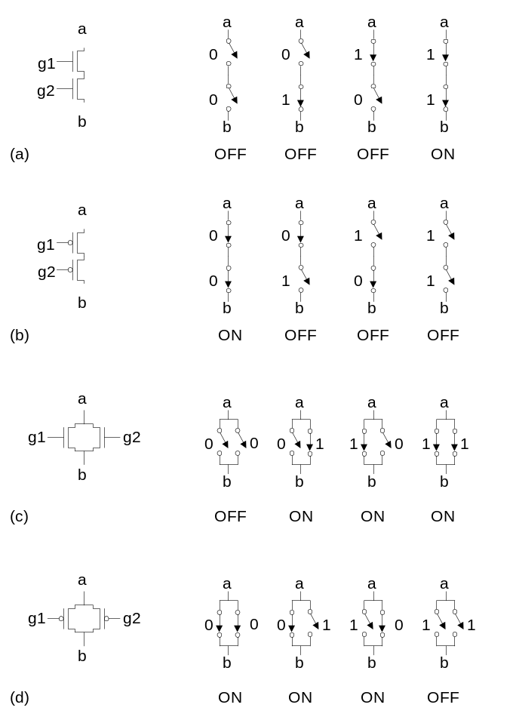
Series and Parallel
nMOS: 1 = ON
pMOS: 0 = ON
Series: both must be ON
Parallel: either can be ON
1: Circuits & Layout

Slide 16
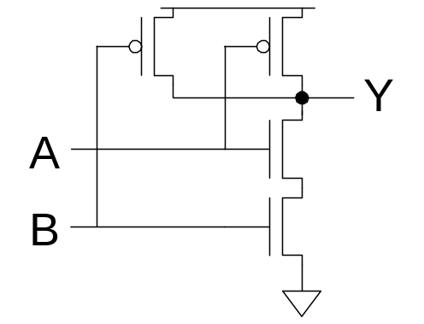
Conduction Complement
Complementary CMOS gates always produce 0 or 1
Ex: NAND gate
  Series nMOS: Y=0 when both inputs are 1
  Thus Y=1 when either input is 0
  Requires parallel pMOS
Rule of Conduction Complements
  Pull-up network is complement of pull-down
  Parallel -> series, series -> parallel
1: Circuits & Layout

Slide 17
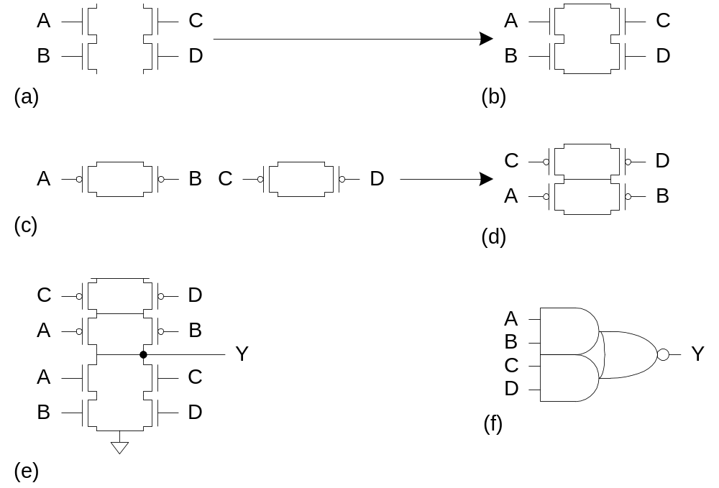
Compound Gates
Compound gates can do any inverting function
Ex:
1: Circuits & Layout

Slide 18
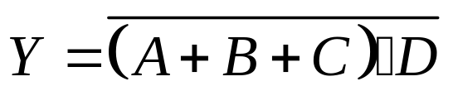
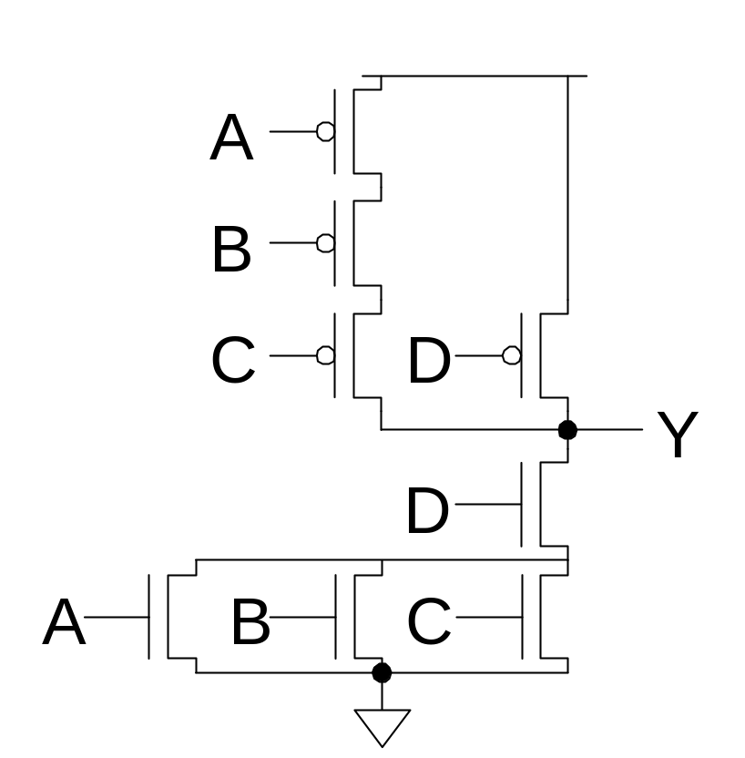
Example: O3AI
1: Circuits & Layout

Slide 19
Signal Strength
Strength of signal
  How close it approximates ideal voltage source
V_{DD} and GND rails are strongest 1 and 0
nMOS pass strong 0
  But degraded or weak 1
pMOS pass strong 1
  But degraded or weak 0
Thus nMOS are best for pull-down network
1: Circuits & Layout

Slide 20
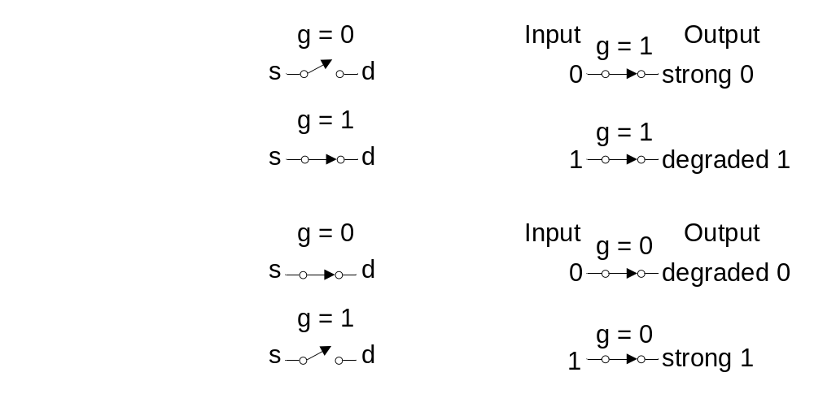
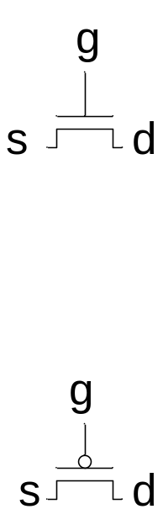
Pass Transistors
Transistors can be used as switches
1: Circuits & Layout

Slide 21
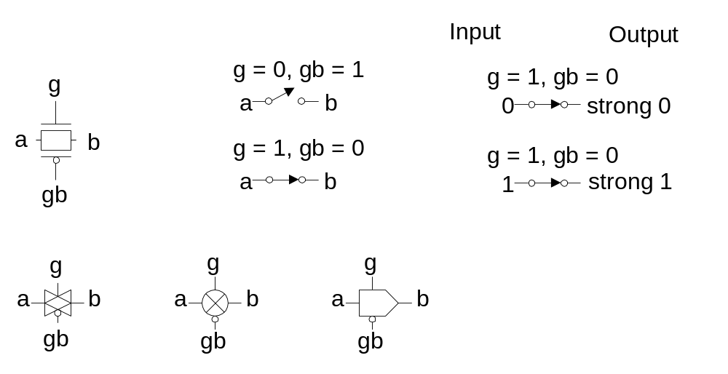
Transmission Gates
Pass transistors produce degraded outputs
Transmission gates pass both 0 and 1 well
1: Circuits & Layout

Slide 22
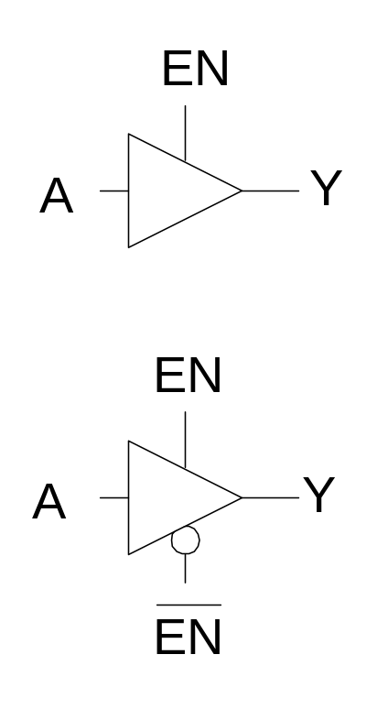
Tristates
Tristate buffer produces Z when not enabled
EN | A | Y
0 | 0 | Z
0 | 1 | Z
1 | 0 | 0
1 | 1 | 1
1: Circuits & Layout

Slide 23
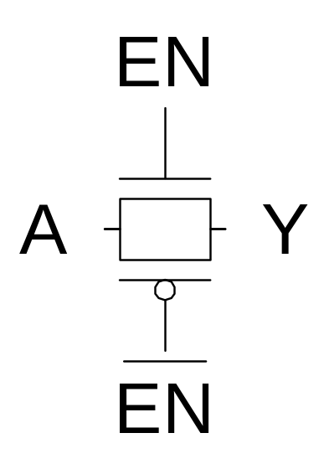
Nonrestoring Tristate
Transmission gate acts as tristate buffer
  Only two transistors
  But nonrestoring
    Noise on A is passed on to Y
1: Circuits & Layout
Notes:
Restore: khôi phục
Với cổng này thì nếu phía bên A có nhiễu làm giảm tín hiệu thì bên Y cũng sẽ nhận tín hiệu bị nhiễu này mà không thể khôi phục lại được (làm strong “0” hoặc strong “1” lại)

Slide 24
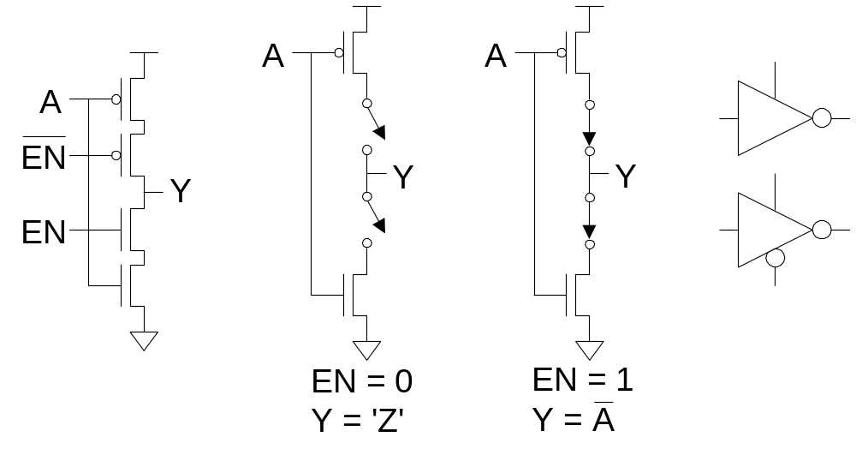
Tristate Inverter
Tristate inverter produces restored output
  Violates conduction complement rule
  Because we want a Z output
1: Circuits & Layout
Notes:
Tristate inverter có khả năng khôi phục lại (làm tín hiệu strong “0” hoặc strong “1” trở lại) được tín hiệu tại ngõ ra.

Slide 25
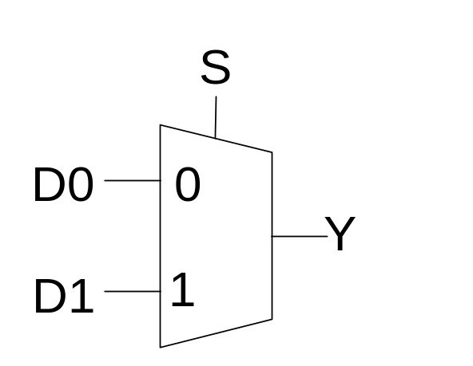
Multiplexers
2:1 multiplexer chooses between two inputs
S | D1 | D0 | Y
0 | X | 0 | 0
0 | X | 1 | 1
1 | 0 | X | 0
1 | 1 | X | 1
1: Circuits & Layout

Slide 26
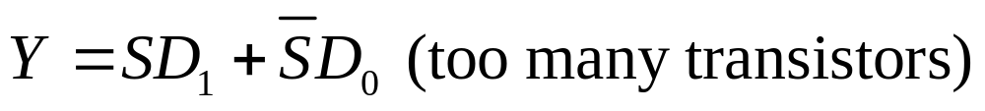
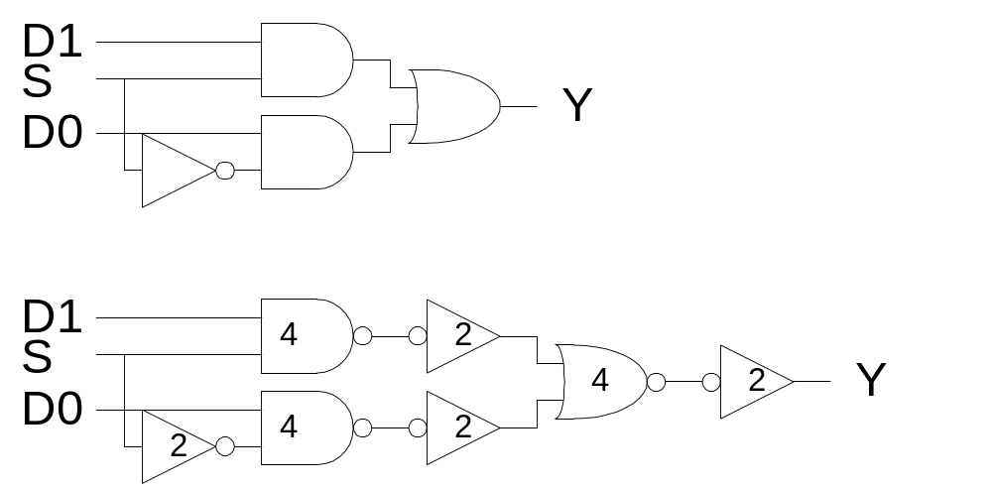
Gate-Level Mux Design
How many transistors are needed? 20
1: Circuits & Layout

Slide 27
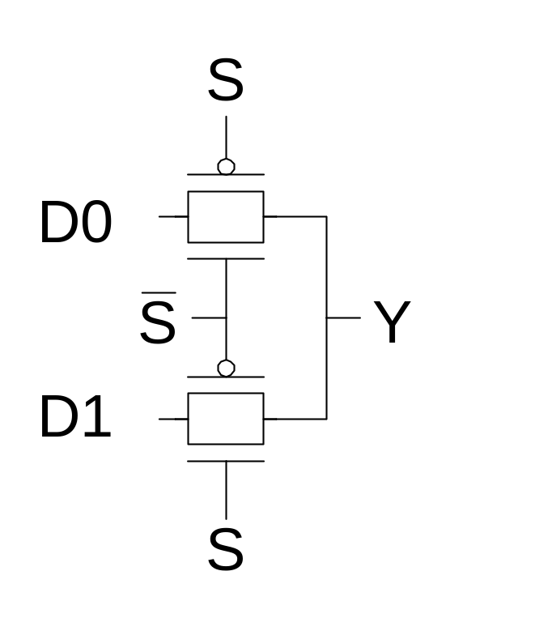
Transmission Gate Mux
Nonrestoring mux uses two transmission gates
  Only 4 transistors
1: Circuits & Layout

Slide 28
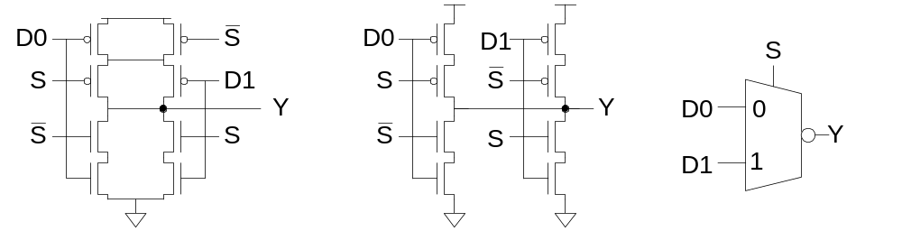
Inverting Mux
Inverting multiplexer
  Use compound AOI22
  Or pair of tristate inverters
  Essentially the same thing
Noninverting multiplexer adds an inverter
1: Circuits & Layout

Slide 29
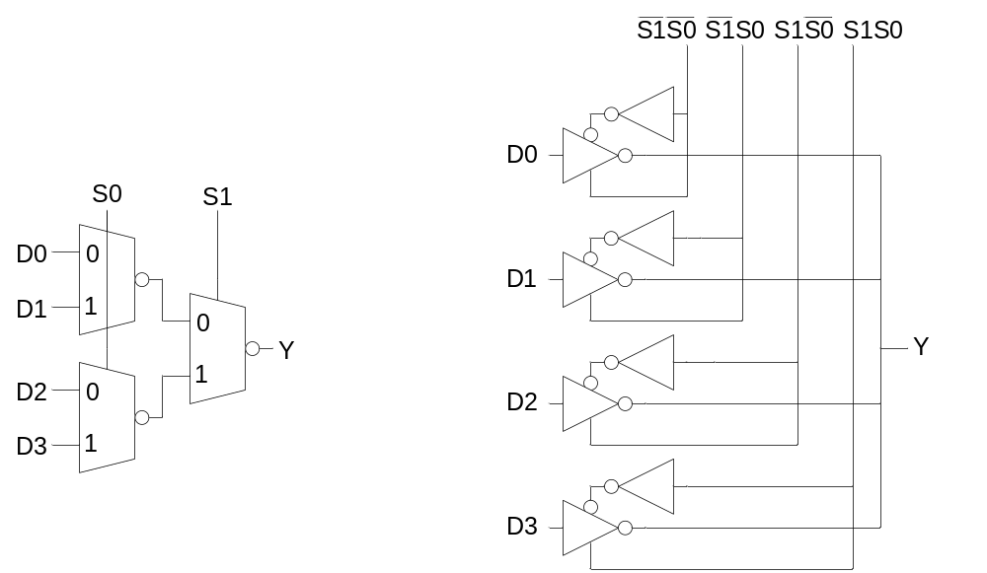
4:1 Multiplexer
4:1 mux chooses one of 4 inputs using two selects
  Two levels of 2:1 muxes
  Or four tristates
1: Circuits & Layout

Slide 30
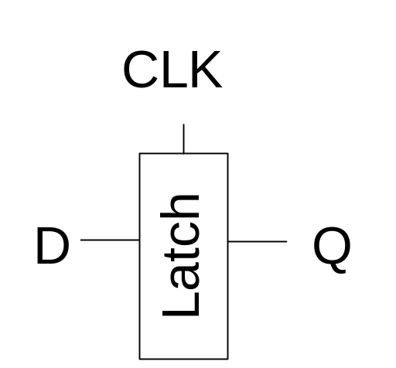
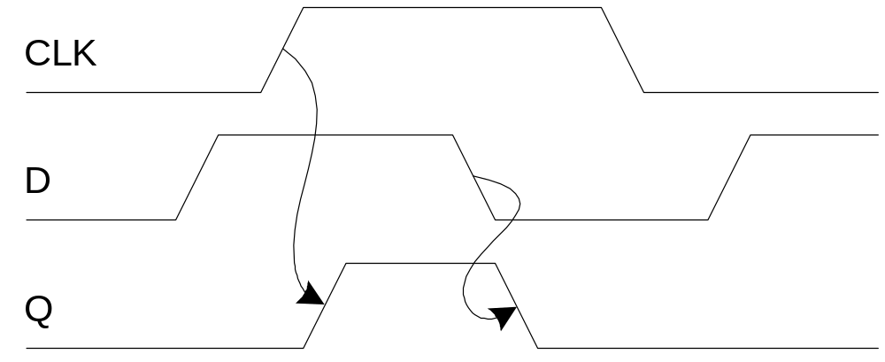
D Latch
When CLK = 1, latch is transparent
  D flows through to Q like a buffer
When CLK = 0, the latch is opaque
  Q holds its old value independent of D
a.k.a. transparent latch or level-sensitive latch
1: Circuits & Layout

Slide 31
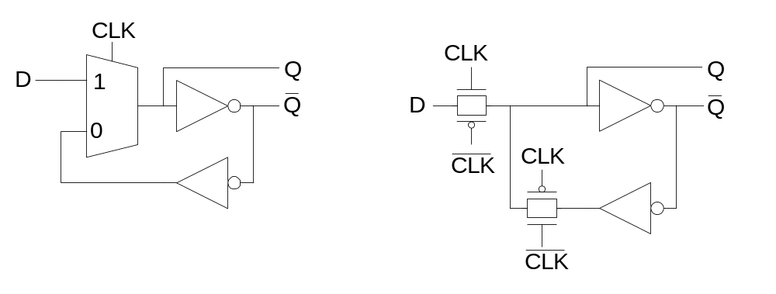
D Latch Design
Multiplexer chooses D or old Q
1: Circuits & Layout

Slide 32
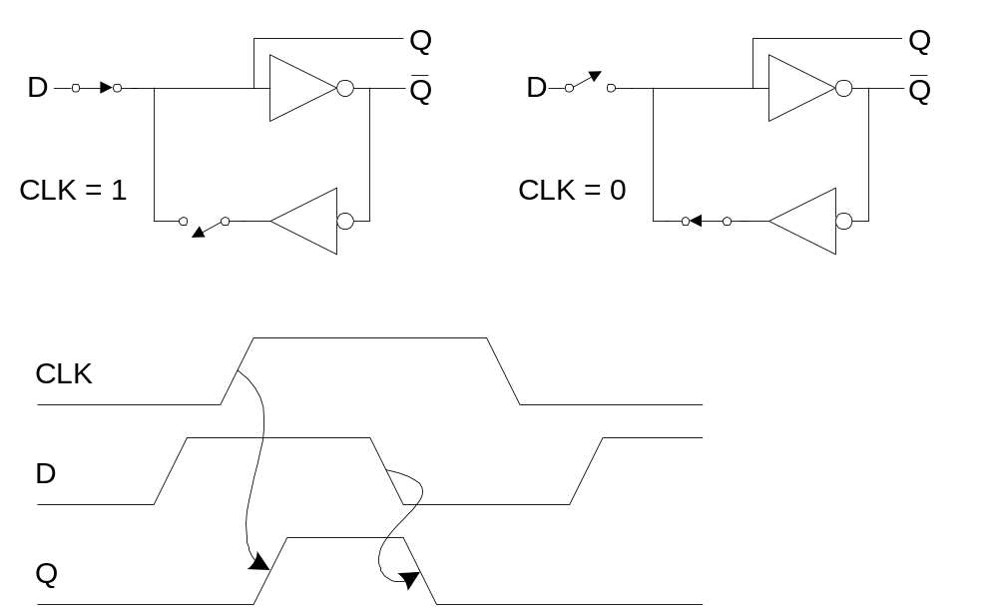
D Latch Operation
1: Circuits & Layout

Slide 33
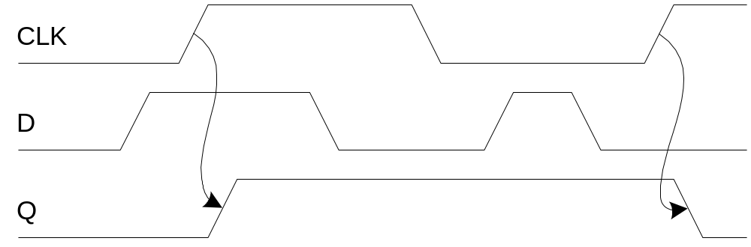
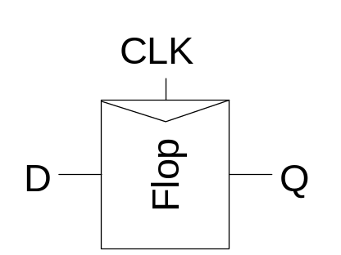
D Flip-flop
When CLK rises, D is copied to Q
At all other times, Q holds its value
a.k.a. positive edge-triggered flip-flop, master-slave flip-flop
1: Circuits & Layout

Slide 34
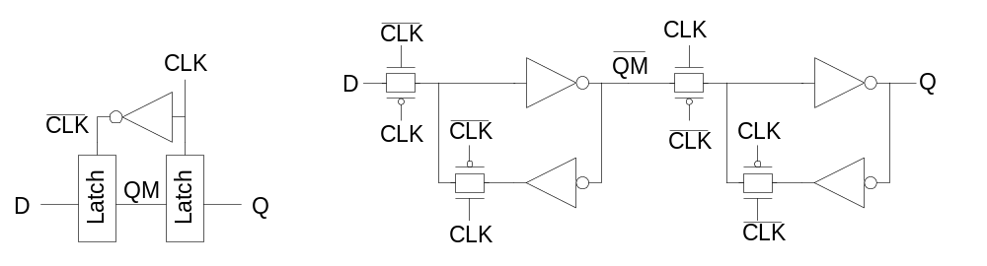
D Flip-flop Design
Built from master and slave D latches
1: Circuits & Layout

Slide 35
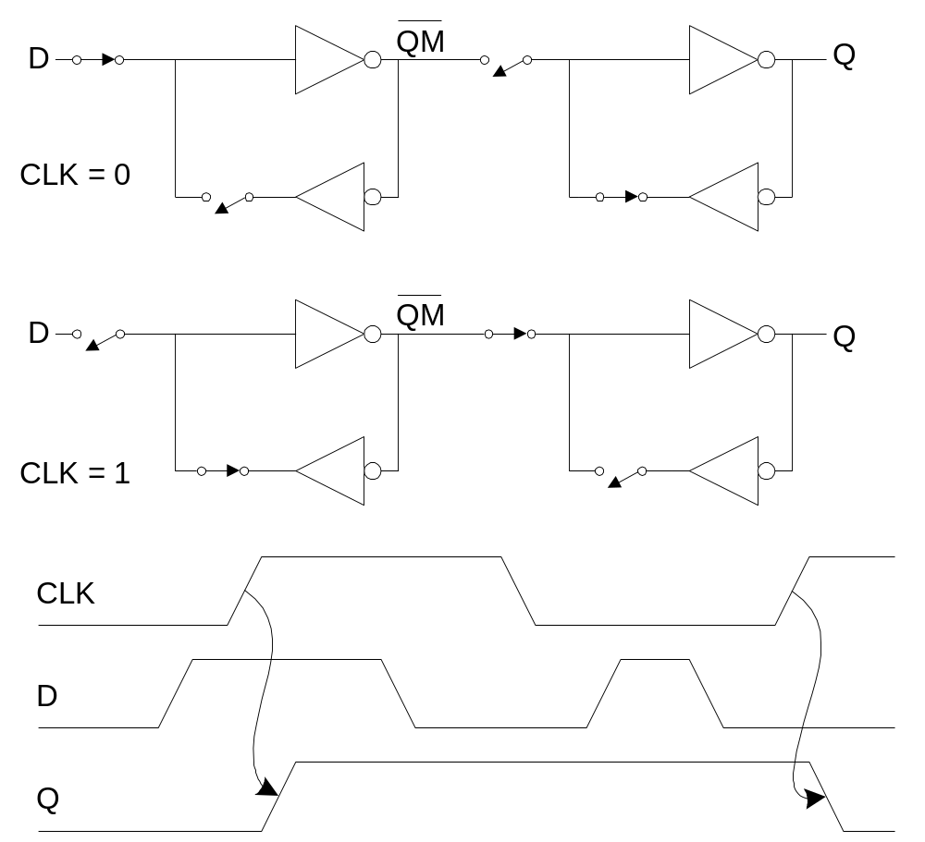
D Flip-flop Operation
1: Circuits & Layout

Slide 36
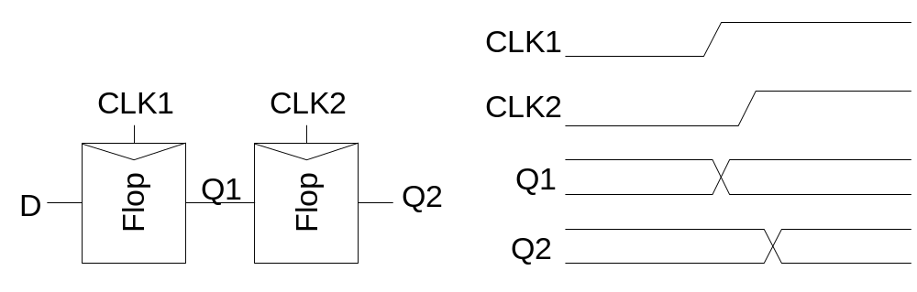
Race Condition
Back-to-back flops can malfunction from clock skew
  Second flip-flop fires late
  Sees first flip-flop change and captures its result
  Called hold-time failure or race condition
1: Circuits & Layout

Slide 37
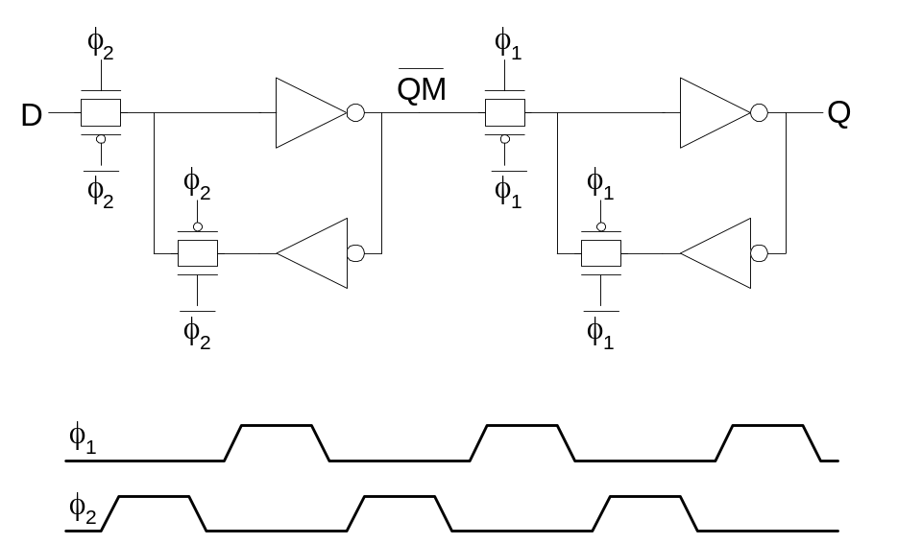
Nonoverlapping Clocks
Nonoverlapping clocks can prevent races
  As long as nonoverlap exceeds clock skew
We will use them in this class for safe design
  Industry manages skew more carefully instead
1: Circuits & Layout

Slide 38
Gate Layout
Layout can be very time consuming
  Design gates to fit together nicely
  Build a library of standard cells
Standard cell design methodology
  V_{DD} and GND should abut (standard height)
  Adjacent gates should satisfy design rules
  nMOS at bottom and pMOS at top
  All gates include well and substrate contacts
1: Circuits & Layout

Slide 39
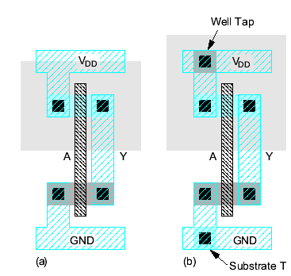
Example: Inverter
1: Circuits & Layout

Slide 40
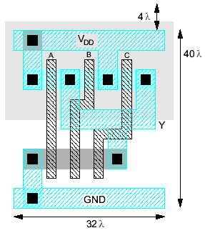
Example: NAND3
Horizontal N-diffusion and p-diffusion strips
Vertical polysilicon gates
Metal1 V_{DD} rail at top
Metal1 GND rail at bottom
32 λ by 40 λ
1: Circuits & Layout
Notes:
Chiều ngang từ trên xuống: 10(space||line)*4 lamda = 40 lamda = 5 lines * 8 lamda
Chiều đứng từ trái qua: 8(space||line)*4 lamda = 32 lamda = 4 lines * 8 lamda

Slide 41
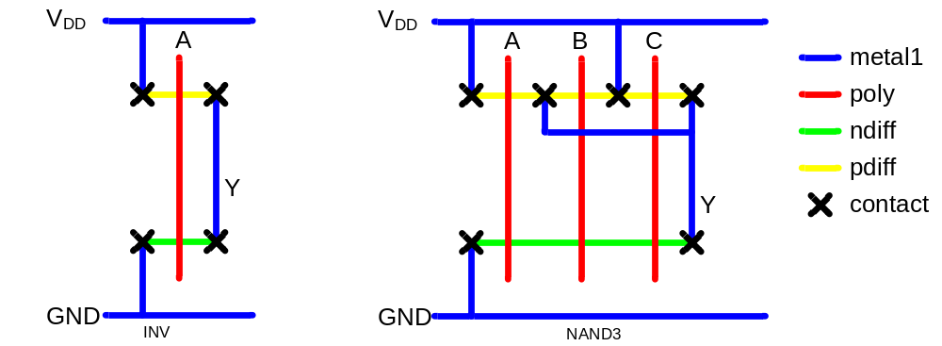
Stick Diagrams
Stick diagrams help plan layout quickly
  Need not be to scale
  Draw with color pencils or dry-erase markers
1: Circuits & Layout

Slide 42
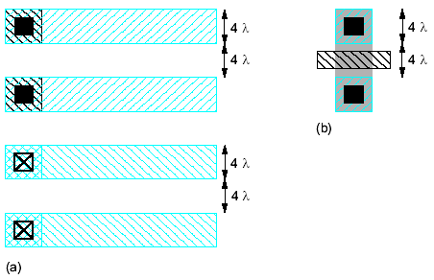
Wiring Tracks
A wiring track is the space required for a wire
  4 λ width, 4 λ spacing from neighbor = 8 λ pitch
Transistors also consume one wiring track
1: Circuits & Layout

Slide 43
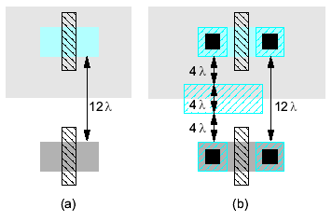
Well spacing
Wells must surround transistors by 6 λ
  Implies 12 λ between opposite transistor flavors
  Leaves room for one wire track
1: Circuits & Layout

Slide 44
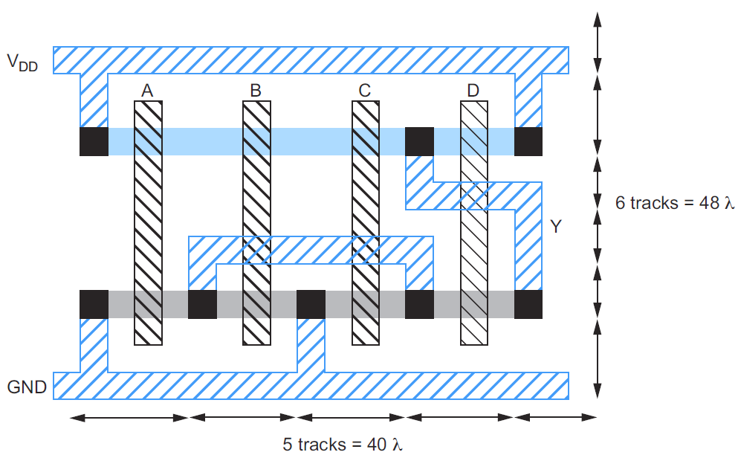
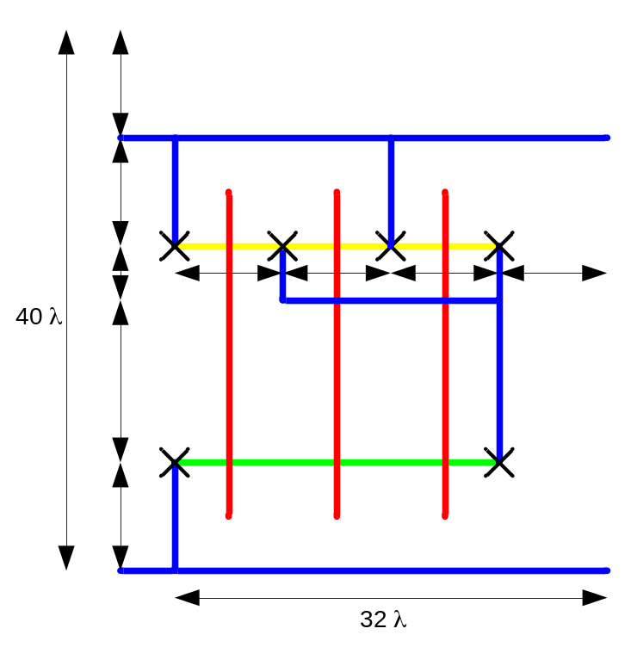
Area Estimation
Estimate area by counting wiring tracks
  Multiply by 8 to express in λ
1: Circuits & Layout

Slide 45
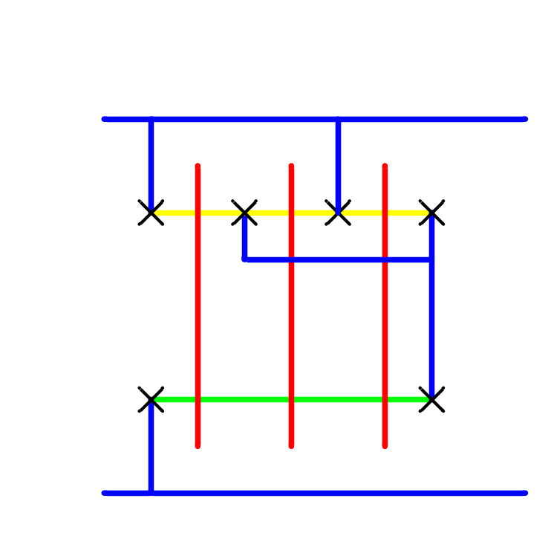
Area Estimation
Estimate area by counting wiring tracks
  Multiply by 8 to express in λ
1: Circuits & Layout

Slide 46
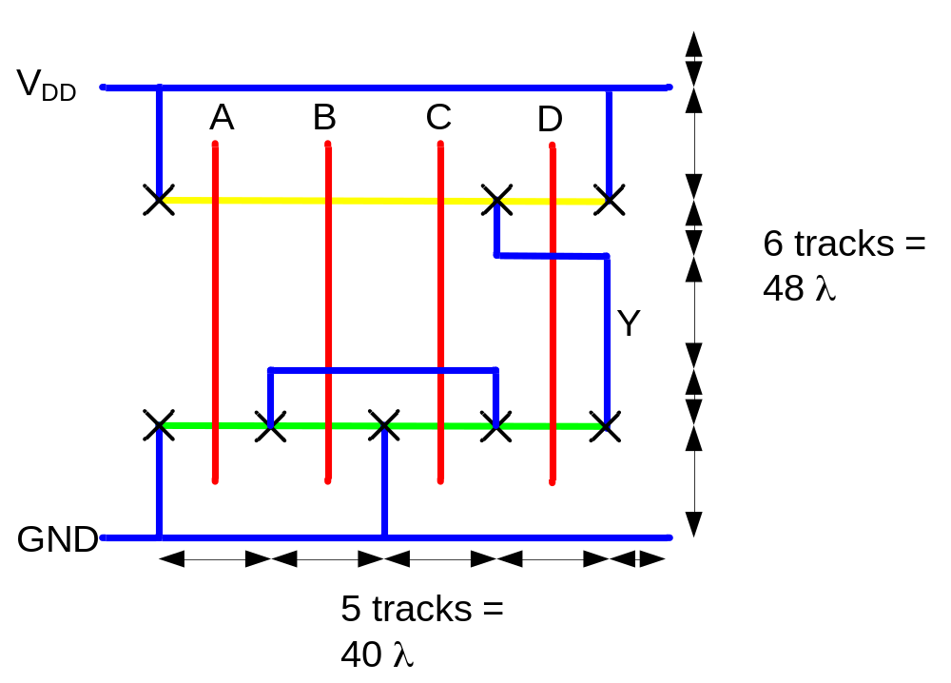
Example: O3AI
Sketch a stick diagram for O3AI and estimate area
1: Circuits & Layout

