Slide 1
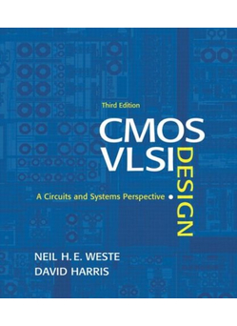
Lecture 4:
Nonideal Transistor Theory

Slide 2
Outline
Nonideal Transistor Behavior
  High Field Effects
    Mobility Degradation
    Velocity Saturation
  Channel Length Modulation
  Threshold Voltage Effects
    Body Effect
    Drain-Induced Barrier Lowering
    Short Channel Effect
  Leakage
    Subthreshold Leakage
    Gate Leakage
    Junction Leakage
Process and Environmental Variations
4: Nonideal Transistor Theory

Slide 3
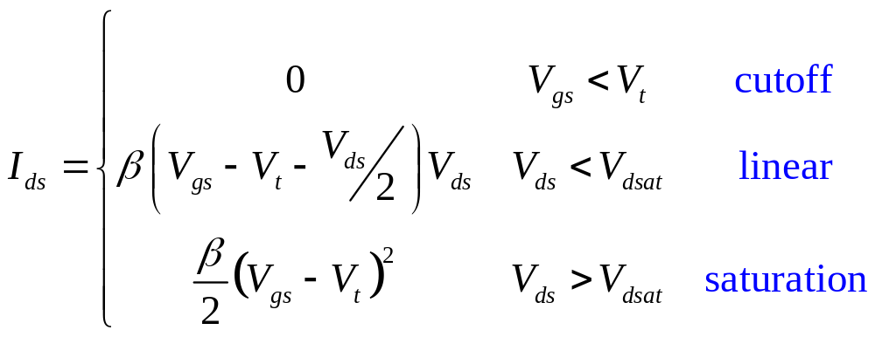
Ideal Transistor I-V
Shockley long-channel transistor models
4: Nonideal Transistor Theory

Slide 4
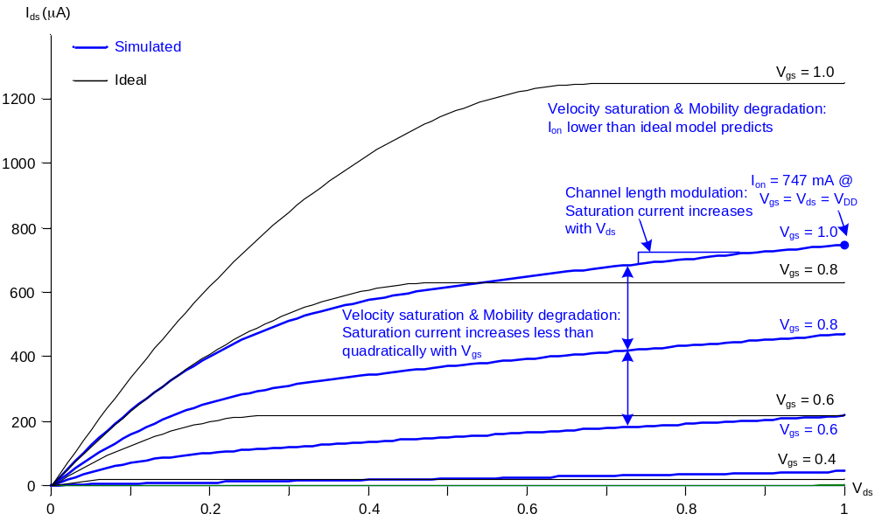
Ideal vs. Simulated nMOS I-V Plot
65 nm IBM process, V_{DD} = 1.0 V
4: Nonideal Transistor Theory
Notes:
Ion (defined in the next slide): = I_{ds} @ V_{gs} = V_{ds} = V_{DD} (=Isat @ V_{gs} = V_{ds} = V_{DD} ). Eg: Vgs = Vds = Vdd=1.0 V, Ids at this point is called Ion
Velocity saturation & Mobility degradation:
1. Ion: By the same Vgs, Ion of simulated plot (non-ideal) is lower than ideal model predicted (calculated by equations in last lecture)
2. Isat: By the equation in last lecture, Isat increases quadratically with Vgs, but in simulated plot (non-ideal) Isat increases less than quadratically with Vgs
Channel length modulation:
By the equation in last lecture, I sat does not increase with Vds, but in simulated plot (non-ideal) Isat increases with Vds

Slide 5
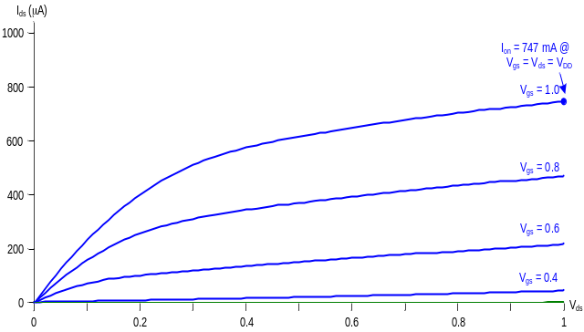
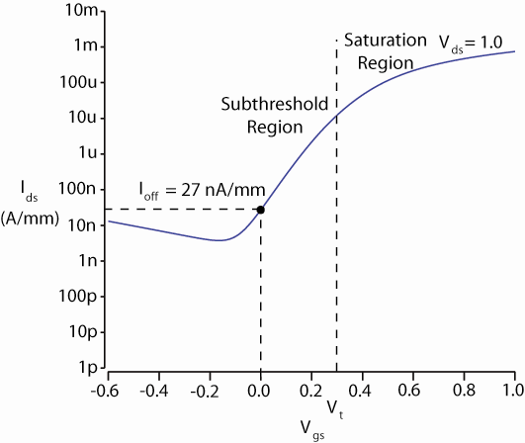
ON and OFF Current
I_{on} = I_{ds} @ V_{gs} = V_{ds} = V_{DD}
  Saturation
I_{off} = I_{ds} @ V_{gs} = 0, V_{ds} = V_{DD}
  Cutoff
4: Nonideal Transistor Theory
Notes:
Ion (defined in the next slide): = I_{ds} @ V_{gs} = V_{ds} = V_{DD} (=Isat @ V_{gs} = V_{ds} = V_{DD} ). Eg: Vgs = Vds = Vdd=1.0 V, Ids at this point is called Ion

Slide 6
Electric Fields Effects
Vertical electric field: E_{vert} = V_{gc} / t_{ox} = (V_{gs} - V_{ds} /2)/ t_{ox}
  Attracts carriers into channel
  Long channel: Q_{channel} ∝ E_{vert}
Lateral electric field: E_{lat} = V_{ds} / L
  Accelerates carriers from drain to source
  Long channel: v = μE_{lat}
4: Nonideal Transistor Theory
Notes:
Vgc = Vg – Vc = Vg – (Vs+Vds/2) = Vgs – Vds/2
v = Muy*Elat: For Elat small => Ids increase linearly with the Elat
But, for Elat large, v = Slide 9

Slide 7
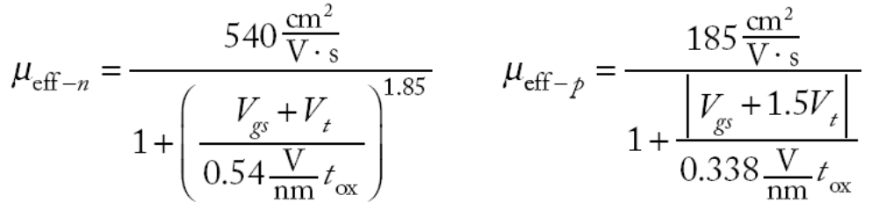
Mobility Degradation
High E_{vert} effectively reduces mobility
  Collisions with oxide interface
4: Nonideal Transistor Theory
Notes:
Ideality, Muy is independent from Vgs and Vt
Reality, Muy is decreased when Vgs increases

Slide 8
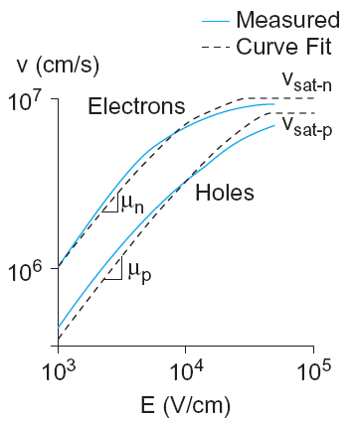
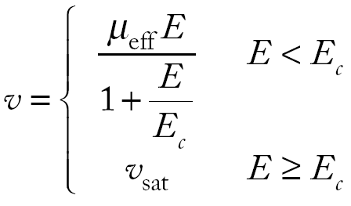
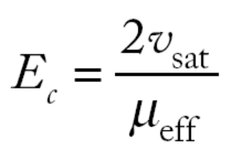
Velocity Saturation
At high E_{lat}, carrier velocity rolls off
  Carriers scatter off atoms in silicon lattice
  Velocity reaches v_{sat}
    Electrons: 10⁷ cm/s
    Holes: 8 x 10⁶ cm/s
  Better model
4: Nonideal Transistor Theory
Notes:
Ideality, v = Muy*Elat => Ids increase linearly with the Elat
Reality, v = Muy*Elat/(1+Elat/Esat), where Esat is determined empirically => v in reality is smaller than v in ideality => Ids in reality is smaller than Ids in ideality

Slide 9
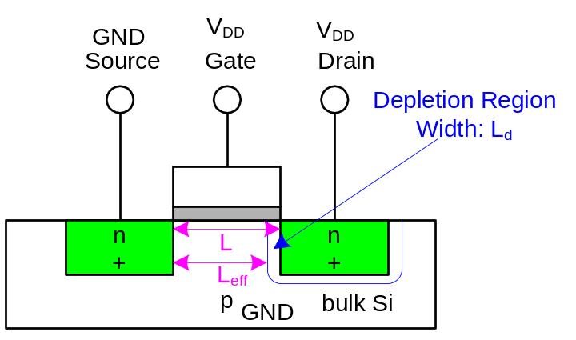
Channel Length Modulation
Reverse-biased p-n junctions form a depletion region
  Region between n and p with no carriers
  Width of depletion L_{d} region grows with reverse bias
  L_{eff} = L – L_{d}
Shorter L_{eff} gives more current
  I_{ds} increases with V_{ds}
  Even in saturation
4: Nonideal Transistor Theory
Notes:
Increase Vds => Vdb increase => reverse-biased p-n junction with Depletion region width Ld increase => Leff decrease => Ids increases
Ids vẫn tăng theo Vds ngay cả khi bão hòa

Slide 10
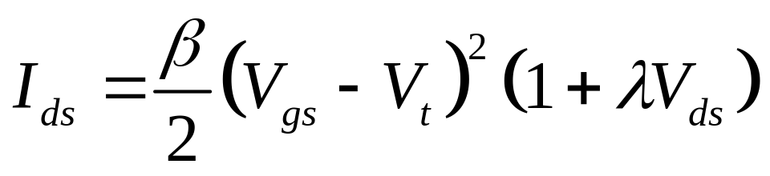
Chan Length Mod I-V
λ = channel length modulation coefficient
  not feature size
  Empirically fit to I-V characteristics
4: Nonideal Transistor Theory
Notes:
Ids van tang theo Vds

Slide 11
Threshold Voltage Effects
V_{t} is V_{gs} for which the channel starts to invert
Ideal models assumed V_{t} is constant
Really depends (weakly) on almost everything else:
  Body voltage: Body Effect
  Drain voltage: Drain-Induced Barrier Lowering
  Channel length: Short Channel Effect
4: Nonideal Transistor Theory
Notes:
Ideality, Vt is constant
Reality, Vt is not constant, it is changed by Vsb, Vd

Slide 12

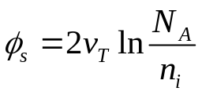
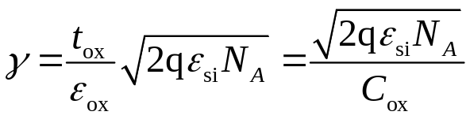
Body Effect
Body is a fourth transistor terminal
V_{sb} affects the charge required to invert the channel
  Increasing V_{s} or decreasing V_{b} increases V_{t}
φ_{s} = surface potential at threshold
  Depends on doping level N_{A}
  And intrinsic carrier concentration n_{i}
γ = body effect coefficient
4: Nonideal Transistor Theory
Notes:
Đối với trường hợp tổng quát Vsb:
Vt0: threshold voltage when Vs = Vb
Vt: threshold voltage when Vs # Vb
Vt: thermal voltage (kt/q)
Epsilon si = 11.7 x epsilon 0
Epsilon 0 = 8.85x10^(-14)

Slide 13
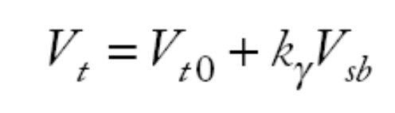
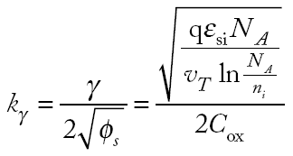
Body Effect Cont.
For small source-to-body voltage, treat as linear
4: Nonideal Transistor Theory
Notes:
Đối với trường hợp Vsb nhỏ

Slide 14
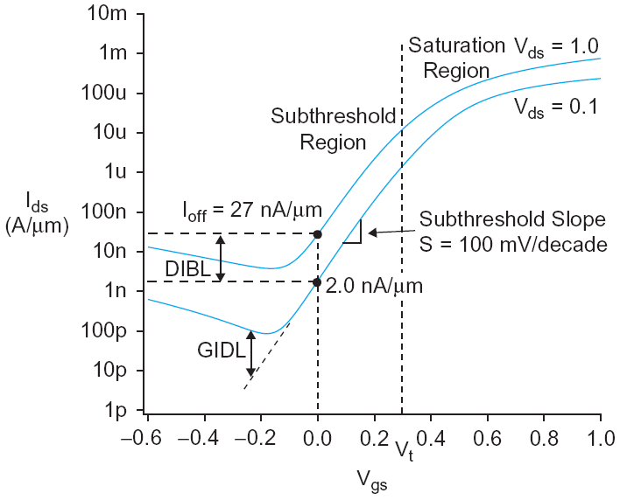

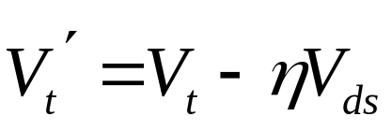
DIBL
Electric field from drain affects channel
More pronounced in small transistors where the drain is closer to the channel
Drain-Induced Barrier Lowering
  Drain voltage also affect V_{t}
High drain voltage causes current to increase.
4: Nonideal Transistor Theory
Notes:
Sự ảnh hưởng của Vds lên Vt càng lớn đối với transitors có kích thước nhỏ (độ dài kênh dẫn ngắn)
Nuy: Hệ số DIBL, 0.02 – 0.1

Slide 15
Short Channel Effect
In small transistors, source/drain depletion regions extend into the channel
  Impacts the amount of charge required to invert the channel
  And thus makes V_{t} a function of channel length
Short channel effect: V_{t} increases with L
  Some processes exhibit a reverse short channel effect in which V_{t} decreases with L
4: Nonideal Transistor Theory
Notes:
L tăng thì cần lượng điện tích lớn hơn để hình thành kênh dẫn => Vt lớn hơn

Slide 16
Leakage
What about current in cutoff?
Simulated results
What differs?
  Current doesn’t
  go to 0 in cutoff
4: Nonideal Transistor Theory

Slide 17
Leakage Sources
Subthreshold conduction
  Transistors can’t abruptly turn ON or OFF
Gate leakage
  Tunneling through ultrathin gate dielectric
Junction leakage
  Reverse-biased PN junction diode current
4: Nonideal Transistor Theory

Slide 18
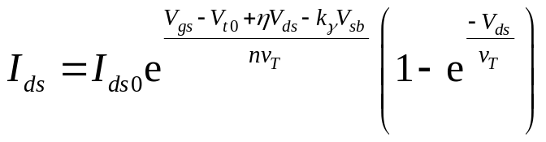
Subthreshold Leakage
Subthreshold leakage exponential with V_{gs}
n is process dependent
  typically 1.3-1.7
4: Nonideal Transistor Theory
Notes:
Ids0 = Beta*vT^2*e^(1.8): The current at threshold and is dependent on process and device geometry
vT: Thermal voltage

Slide 19
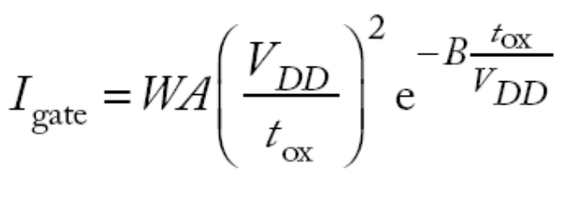
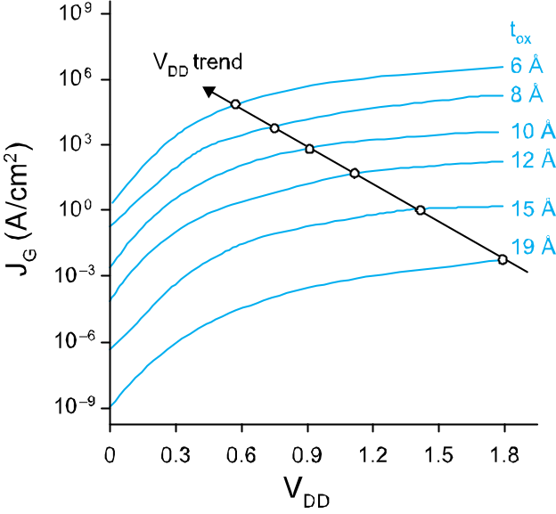
Gate Leakage
Carriers tunnel thorough very thin gate oxides
Exponentially sensitive to t_{ox} and V_{DD}
  A and B are tech constants
  Greater for electrons
    So nMOS gates leak more
Negligible for older processes (t_{ox} > 20 Å)
Critically important at 65 nm and below (t_{ox} ≈ 10.5 Å)
_{From [Song01]}
4: Nonideal Transistor Theory

Slide 20
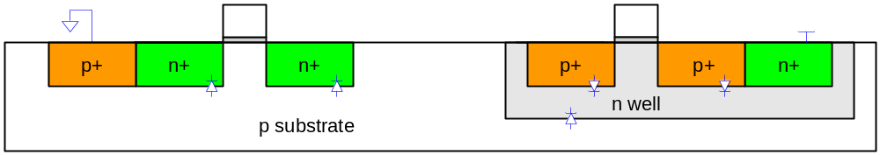
Junction Leakage
Reverse-biased p-n junctions have some leakage
  Ordinary diode leakage
4: Nonideal Transistor Theory

Slide 21
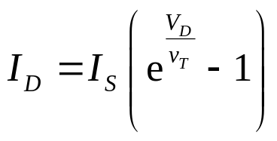
Diode Leakage
Reverse-biased p-n junctions have some leakage
At any significant negative diode voltage, I_{D} = -I_{s}
I_{s} depends on doping levels
  And area and perimeter of diffusion regions
  Typically < 1 fA/μm² (negligible)
4: Nonideal Transistor Theory
Notes:
VD: is the diode voltage (Vsb or Vdb)
ID: Diode current
IS: Diode reverse biased saturation current
When VD <0 and |VD| >> VT => ID = -IS

Slide 22
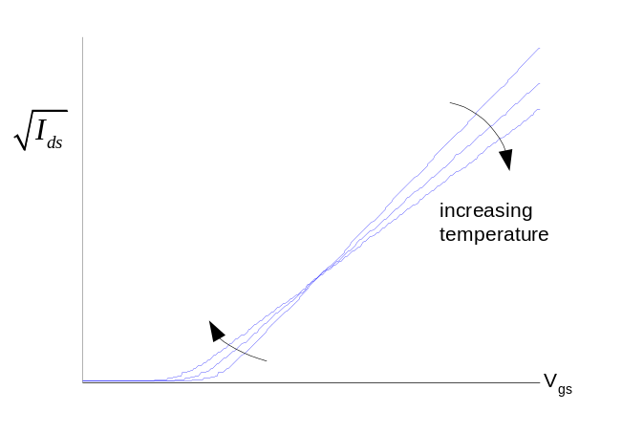
Temperature Sensitivity
Increasing temperature
  Reduces mobility
  Reduces V_{t}
I_{ON} decreases with temperature
I_{OFF} increases with temperature
4: Nonideal Transistor Theory

Slide 23
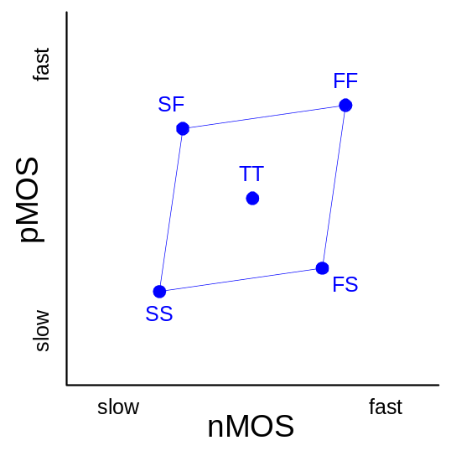
Parameter Variation
Transistors have uncertainty in parameters
  Process: L_{eff}, V_{t}, t_{ox} of nMOS and pMOS
  Vary around typical (T) values
Fast (F)
  L_{eff}: short
  V_{t}: low
  t_{ox}: thin
Slow (S): opposite
Not all parameters are independent
for nMOS and pMOS
4: Nonideal Transistor Theory

Slide 24
Environmental Variation
V_{DD} and T also vary in time and space
Fast:
  V_{DD}: high
  T: low
Corner | Voltage | Temperature
F | 1.98 | 0 C
T | 1.8 | 70 C
S | 1.62 | 125 C
4: Nonideal Transistor Theory

Slide 25
Process Corners
Process corners describe worst case variations
  If a design works in all corners, it will probably work for any variation.
Describe corner with four letters (T, F, S)
  nMOS speed
  pMOS speed
  Voltage
  Temperature
4: Nonideal Transistor Theory

Slide 26
Important Corners
Some critical simulation corners include
Purpose | nMOS | pMOS | VDD | Temp
Cycle time | S | S | S | S
Power | F | F | F | F
Subthreshold leakage | F | F | F | S
4: Nonideal Transistor Theory

