Slide 1
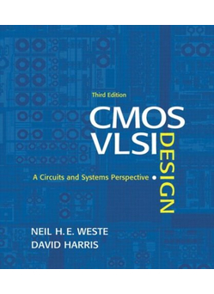
Lecture 5:
DC & Transient Response

Slide 2
Outline
Pass Transistors
DC Response
Logic Levels and Noise Margins
Transient Response
RC Delay Models
Delay Estimation
5: DC and Transient Response

Slide 3
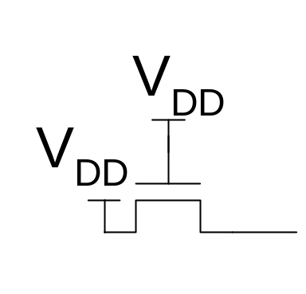
Pass Transistors
We have assumed source is grounded
What if source > 0?
  e.g. pass transistor passing V_{DD}
V_{g} = V_{DD}
  If V_{s} > V_{DD}-V_{t}, V_{gs} < V_{t}
  Hence transistor would turn itself off
nMOS pass transistors pull no higher than V_{DD}-V_{tn}
  Called a degraded “1”
  Approach degraded value slowly (low I_{ds})
pMOS pass transistors pull no lower than V_{tp}
Transmission gates are needed to pass both 0 and 1
5: DC and Transient Response
Notes:
An example for DC analysis

Slide 4
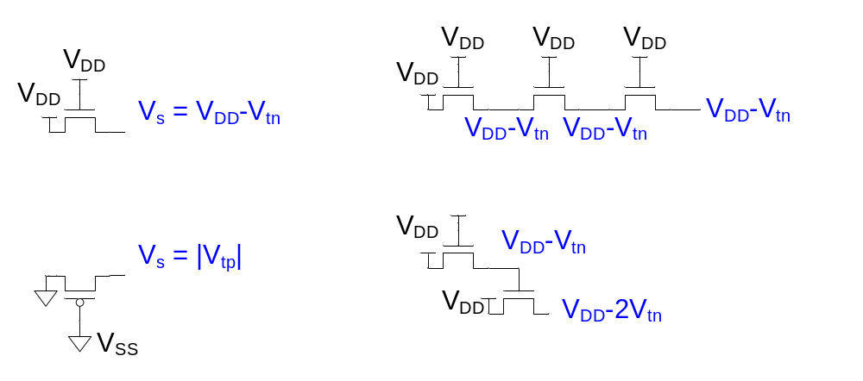
Pass Transistor Ckts
5: DC and Transient Response
Notes:
An example for DC analysis

Slide 5
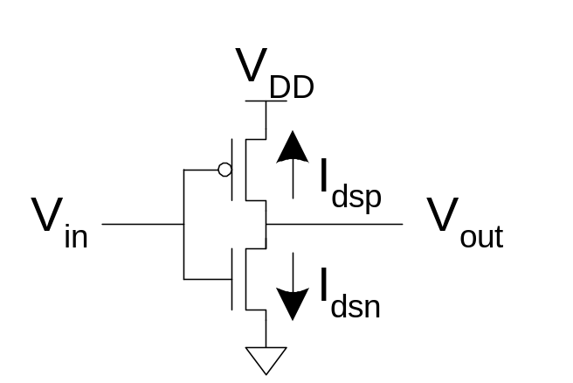
DC Response
DC Response: V_{out} vs. V_{in} for a gate
Ex: Inverter
  When V_{in} = 0 -> V_{out} = V_{DD}
  When V_{in} = V_{DD} -> V_{out} = 0
  In between, V_{out} depends on
  transistor size and current
  By KCL, must settle such that
  I_{dsn} = |I_{dsp}|
  We could solve equations
  But graphical solution gives more insight
5: DC and Transient Response
Notes:
DC response: Đáp ứng giữa tín hiệu ngõ vào và tín hiệu ngõ ra khi tín hiệu ngõ vào ổn định (không thay đổi theo thời gian)
DC Analysis tells you what would happen if you simply turned the circuit on and applied no signal to it.
Transient analysis, we can determine the charging and discharging time of capacitor and inductor

Slide 6
Transistor Operation
Current depends on region of transistor behavior
For what V_{in} and V_{out} are nMOS and pMOS in
  Cutoff?
  Linear?
  Saturation?
5: DC and Transient Response

Slide 7
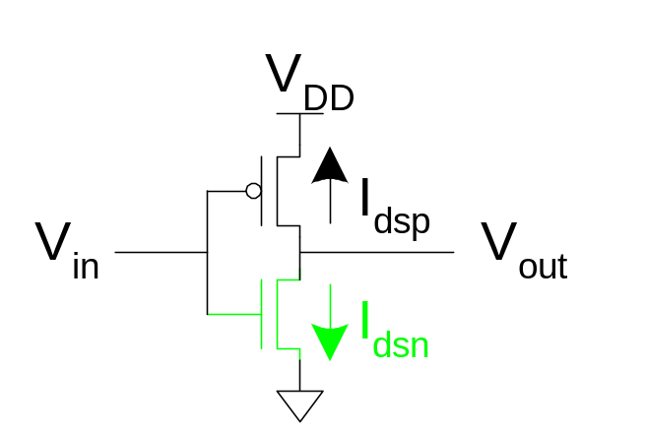
nMOS Operation
Cutoff | Linear | Saturated
V_{gsn} < V_{tn} V_{in} < V_{tn} | V_{gsn} > V_{tn} V_{in} > V_{tn} V_{dsn} < V_{gsn} – V_{tn} V_{out} < V_{in} - V_{tn} | V_{gsn} > V_{tn} V_{in} > V_{tn} V_{dsn} > V_{gsn} – V_{tn} V_{out} > V_{in} - V_{tn}
V_{gsn} = V_{in}
V_{dsn} = V_{out}
5: DC and Transient Response

Slide 8
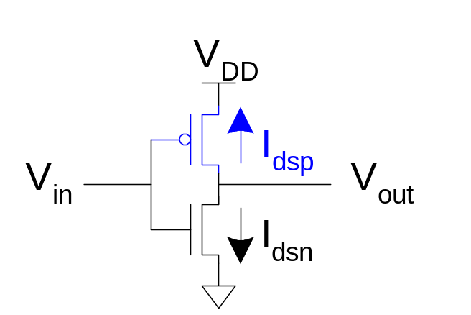
pMOS Operation
Cutoff | Linear | Saturated
V_{gsp} > V_{tp} V_{in} > V_{DD} + V_{tp} | V_{gsp} < V_{tp} V_{in} < V_{DD} + V_{tp} V_{dsp} > V_{gsp} – V_{tp} V_{out} > V_{in} - V_{tp} | V_{gsp} < V_{tp} V_{in} < V_{DD} + V_{tp} V_{dsp} < V_{gsp} – V_{tp} V_{out} < V_{in} - V_{tp}
V_{gsp} = V_{in} - V_{DD}
V_{dsp} = V_{out} - V_{DD}
V_{tp} < 0
5: DC and Transient Response
Notes:
Chú ý: Vtp < 0. Vd: Vtp = -0.4 volt
Vgs > Vtp
-> Vg – Vs > Vtp
-> Vg > Vs + Vtp
-> Vg > Vdd + Vtp

Slide 9
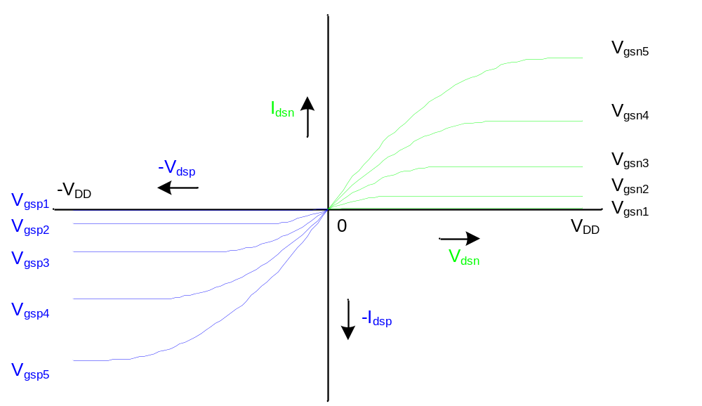
I-V Characteristics
Make pMOS is wider than nMOS such that β_{n} = β_{p}
5: DC and Transient Response

Slide 10
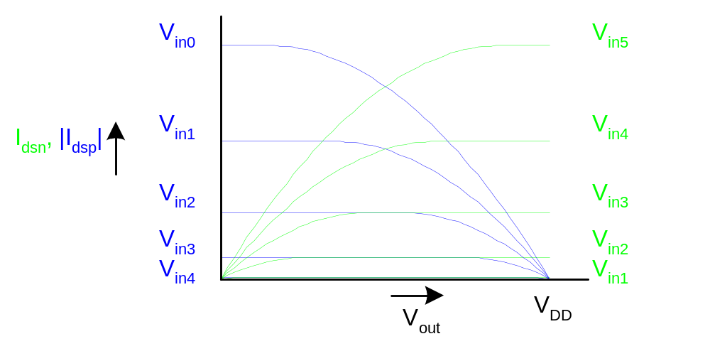
Current vs. V_{out}, V_{in}
0v
2v
0.5v
1.5v
1v
1v
1.5
0.5
2v
0v
5: DC and Transient Response
Notes:
Khi giảng bài, nên vẽ độc lập hai hình Idsn và Idsp riêng, sau đó gộp lại sau cho dễ hiểu
NMOS: Vin1 < Vin2 < Vin3 < Vin4 < Vin5 (tăng dần theo chiều từ dưới đi lên). Vs = 0 (ground) => Vds = Vout, then Vout increases => Vds increases => Idsn increases
PMOS: Vin0 < Vin1 < Vin2 < Vin3 < Vin4 (tăng dần theo chiều từ trên đi xuống). Vs = Vdd (Vsupply), Vout = Vd => Vds = Vout – Vdd, then Vout increases => |Vds| decreases => |Idsp| decreases

Slide 11
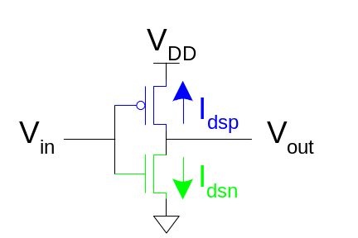
Load Line Analysis
For a given V_{in}:
  Plot I_{dsn}, I_{dsp} vs. V_{out}
  V_{out} must be where |currents| are equal in
5: DC and Transient Response
Notes:
Khi điện áp Vin và Vout ổn định thì lúc đó Idsn = Idsp

Slide 12
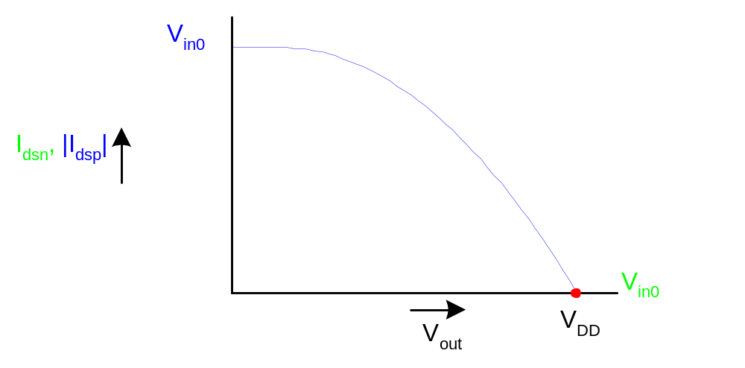
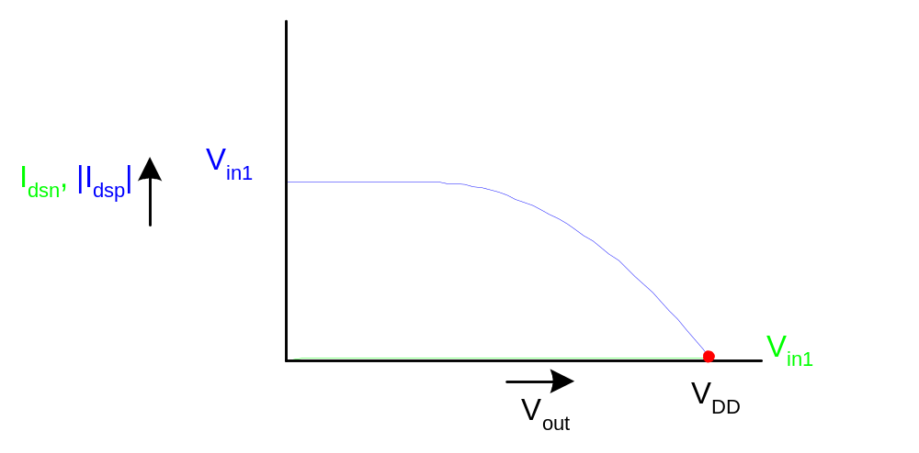
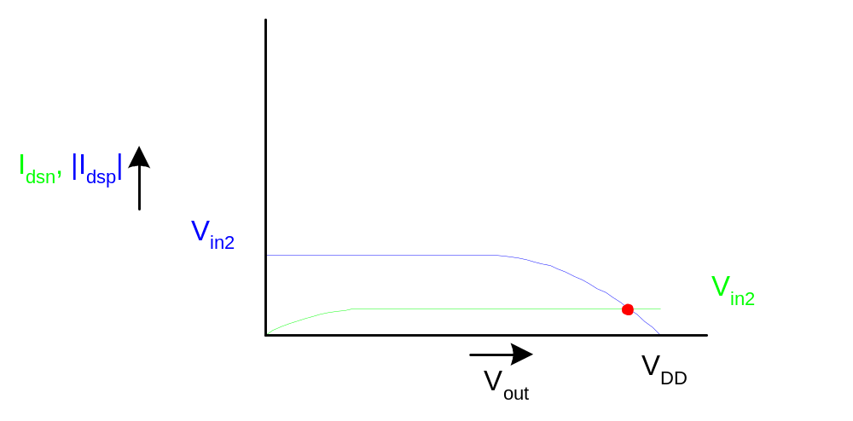
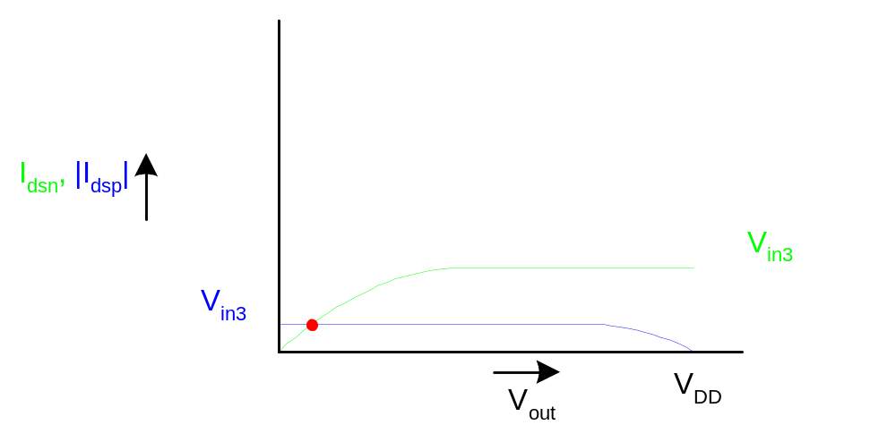
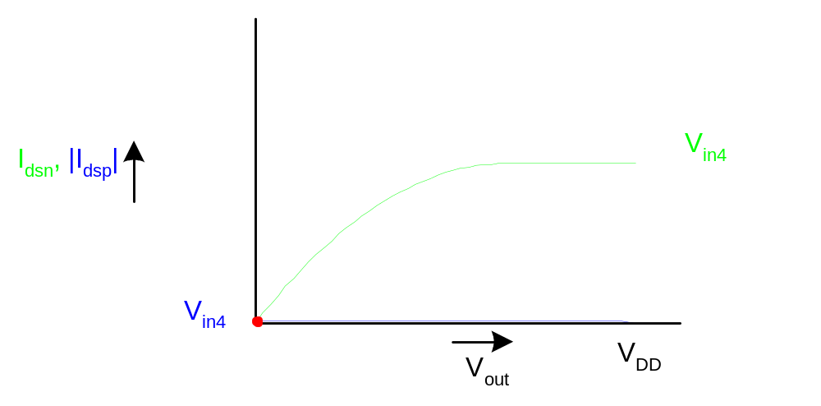
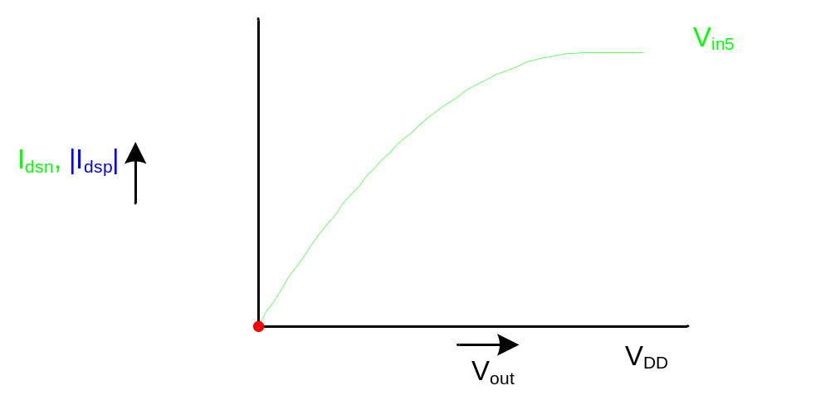
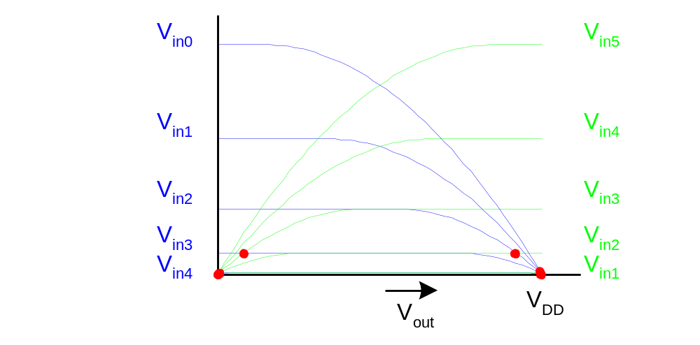
Load Line Analysis
V_{in0} = 0
V_{in1}=0.2V_{DD}
V_{in2}=0.4V_{DD}
V_{in3}=0.6V_{DD}
V_{in4}=0.8V_{DD}
V_{in5} =V_{DD}
5: DC and Transient Response
Notes:
Tại những dấu chấm đỏ là vị trí mà Idsn = Idsp
Từ vị trí những dấu chấm đỏ này ta suy ra giá trị Vin và Vout tương ứng

Slide 13
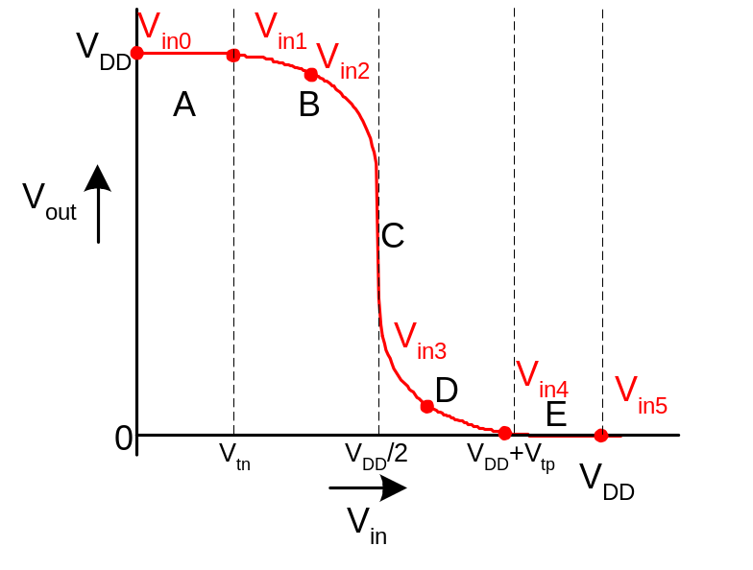
DC Transfer Curve
Transcribe points onto V_{in} vs. V_{out} plot
5: DC and Transient Response
Notes:
Tại những dấu chấm đỏ là vị trí mà Idsn = Idsp
Từ vị trí những dấu chấm đỏ này ta suy ra giá trị Vin và Vout tương ứng

Slide 14
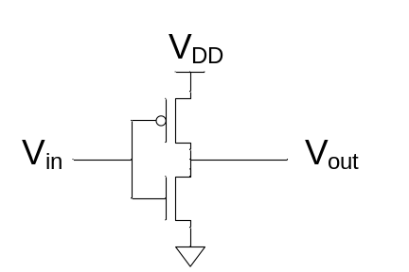
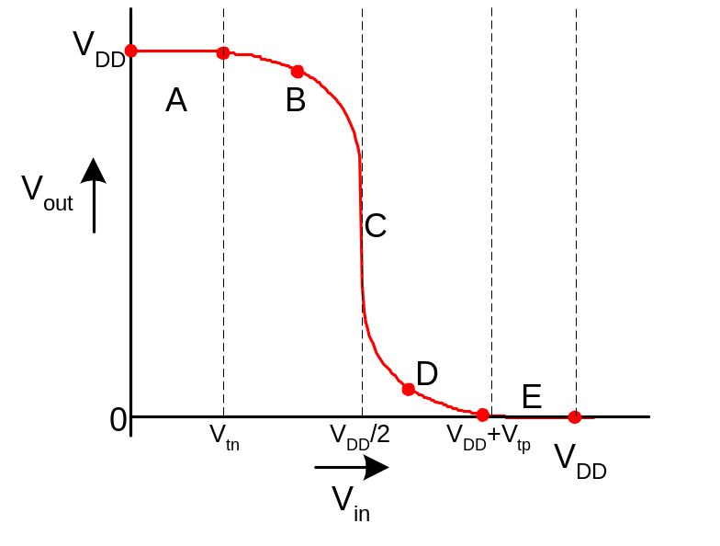
Operating Regions
Revisit transistor operating regions
Region | nMOS | pMOS
A | Cutoff | Linear
B | Saturation | Linear
C | Saturation | Saturation
D | Linear | Saturation
E | Linear | Cutoff
5: DC and Transient Response
Notes:
Vùng A: nMOS cutoff (do Vin < Vtn) , pMOS: linear (do Vds nhỏ 0, then Idsp sẽ nhỏ)
Vùng B: nMOS: saturation (do Vin > Vtn, Vds lớn nên Idsn sẽ lớn); pMOS: linear (do Vds nhỏ 0, then Idsp sẽ nhỏ)
Vùng C: nMOS: saturation (do Vin > Vtn, Vds lớn nên Idsn sẽ lớn) ;pMOS: saturation (do Vds lớn dần, Idps sẽ lớn)
Vùng D: nMOS: linear (do Vin > Vtn, Vds nhỏ nên dòng nhỏ); pMOS: saturation (do Vds lớn dần, Idps sẽ lớn)
Vùng E: nMOS linear; pMOS: cutoff

Slide 15
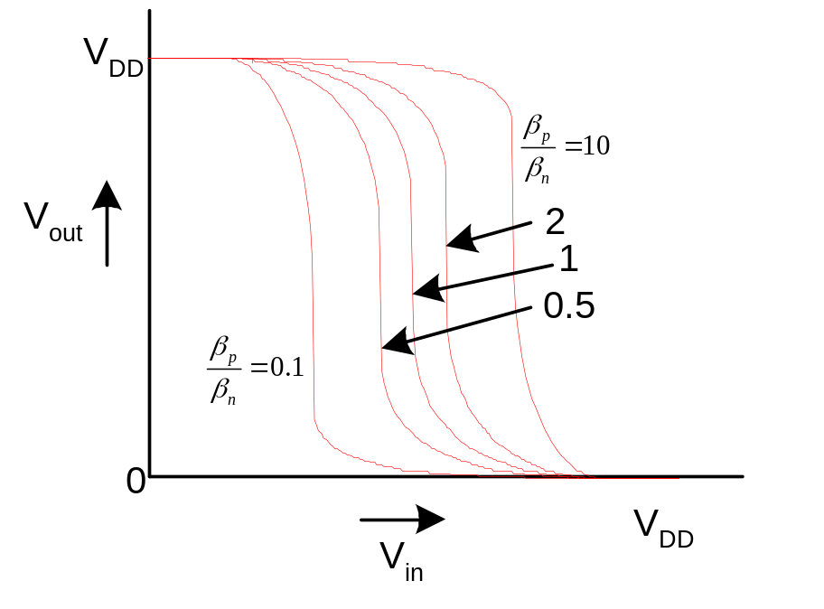
Beta Ratio
If β_{p} / β_{n} ≠ 1, switching point will move from V_{DD}/2
Called skewed gate
Other gates: collapse into equivalent inverter
5: DC and Transient Response

Slide 16
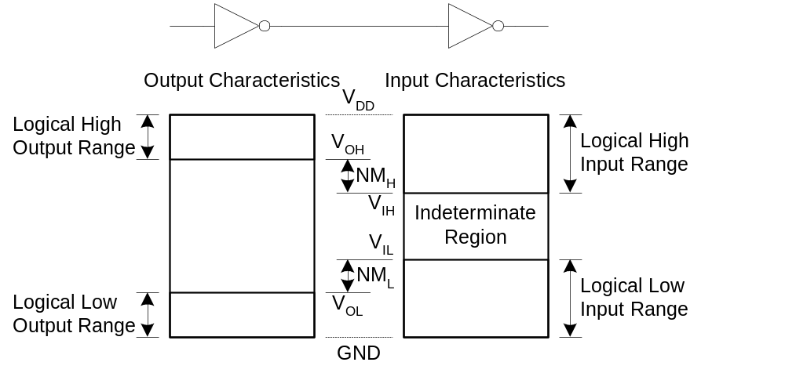
Noise Margins
How much noise can a gate input see before it does not recognize the input?
5: DC and Transient Response

Slide 17
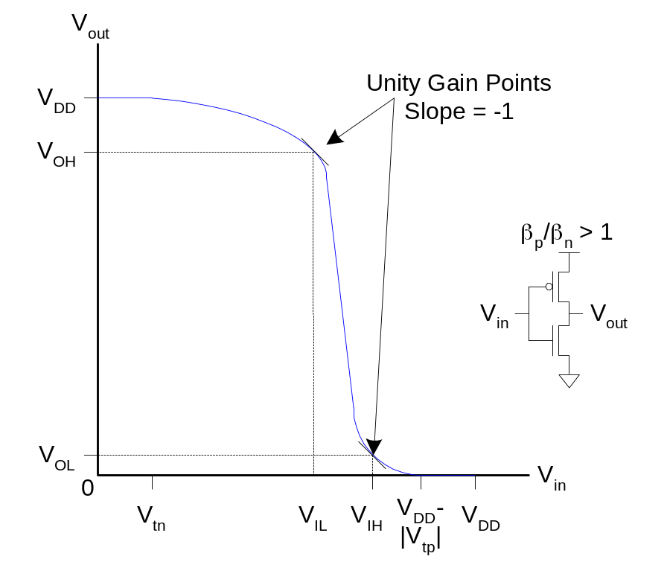
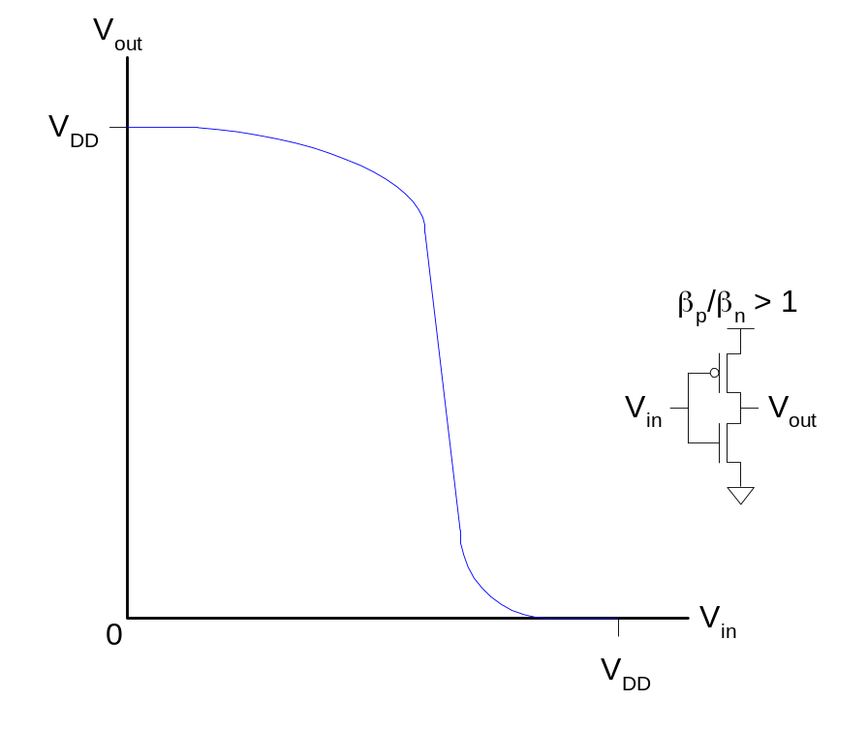
Logic Levels
To maximize noise margins, select logic levels at
  unity gain point of DC transfer characteristic
5: DC and Transient Response

Slide 18
Transient Response
DC analysis tells us V_{out} if V_{in} is constant
Transient analysis tells us V_{out}(t) if V_{in}(t) changes
  Requires solving differential equations
Input is usually considered to be a step or ramp
  From 0 to V_{DD} or vice versa
5: DC and Transient Response
Notes:
Transient analysis, we can determine the charging and discharging time of capacitor and inductor to measure the rise/fall times, slew rate

Slide 19
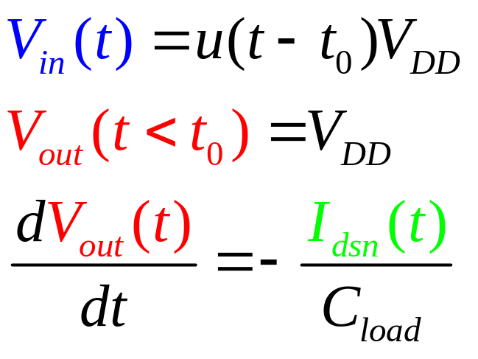
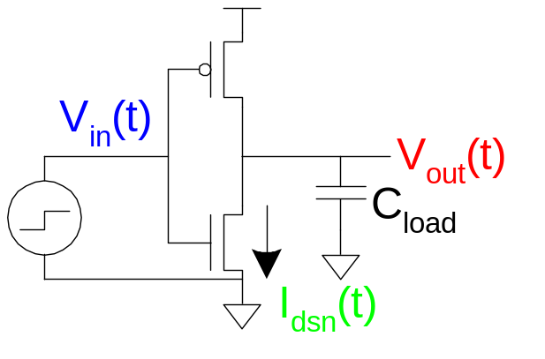
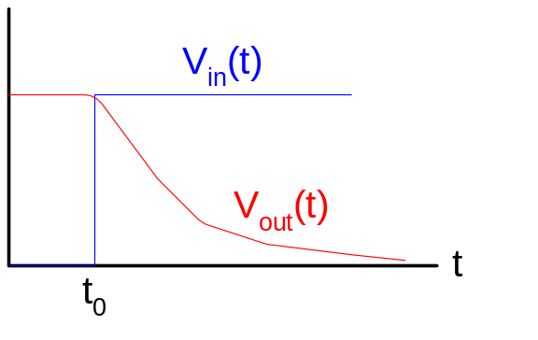
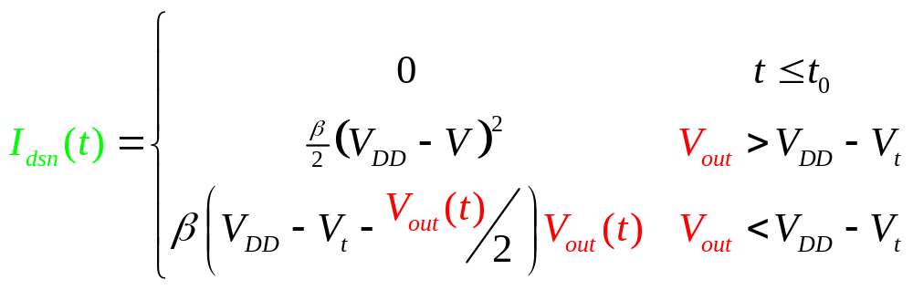
Inverter Step Response
Ex: find step response of inverter driving load cap
t
5: DC and Transient Response

Slide 20
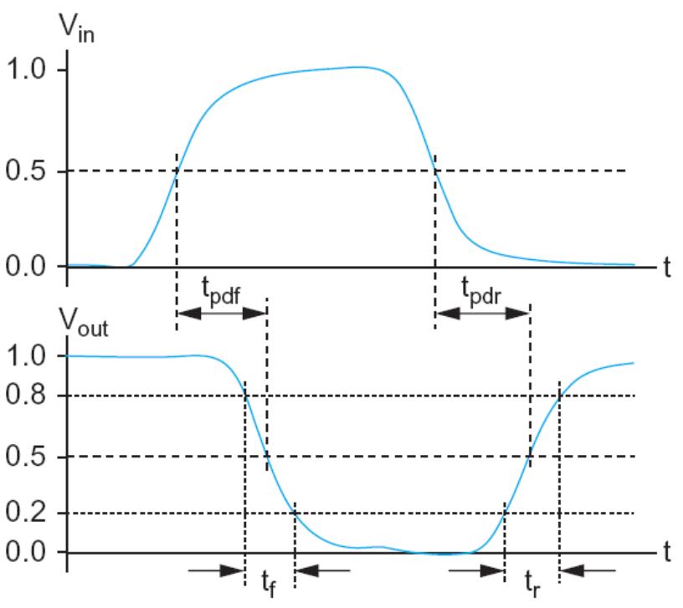
Delay Definitions
t_{pdr}: rising propagation delay
  From input to rising output crossing V_{DD}/2
t_{pdf}: falling propagation delay
  From input to falling output crossing V_{DD}/2
t_{pd}: average propagation delay
  t_{pd} = (t_{pdr} + t_{pdf})/2
t_{r}: rise time
  From output crossing 0.2 V_{DD} to 0.8 V_{DD}
t_{f}: fall time
  From output crossing 0.8 V_{DD} to 0.2 V_{DD}
5: DC and Transient Response

Slide 21
Delay Definitions
t_{cdr}: rising contamination delay
  From input to rising output crossing V_{DD}/2
t_{cdf}: falling contamination delay
  From input to falling output crossing V_{DD}/2
t_{cd}: average contamination delay
  t_{pd} = (t_{cdr} + t_{cdf})/2
5: DC and Transient Response
Notes:
In digital circuits, the contamination delay (denoted as tcd) is the minimum amount of time from when an input changes until any output starts to change its value. This change in value does not imply that the value has reached a stable condition.

Slide 22
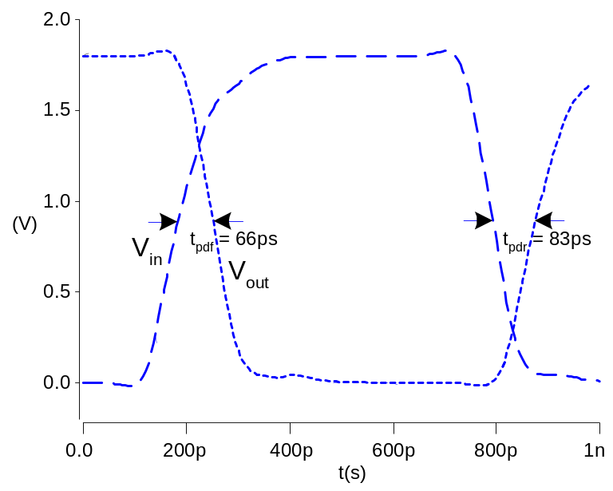
Simulated Inverter Delay
Solving differential equations by hand is too hard
SPICE simulator solves the equations numerically
  Uses more accurate I-V models too!
But simulations take time to write, may hide insight
5: DC and Transient Response

Slide 23
Delay Estimation
We would like to be able to easily estimate delay
  Not as accurate as simulation
  But easier to ask “What if?”
The step response usually looks like a 1st order RC response with a decaying exponential.
Use RC delay models to estimate delay
  C = total capacitance on output node
  Use effective resistance R
  So that t_{pd} = RC
Characterize transistors by finding their effective R
  Depends on average current as gate switches
5: DC and Transient Response

Slide 24
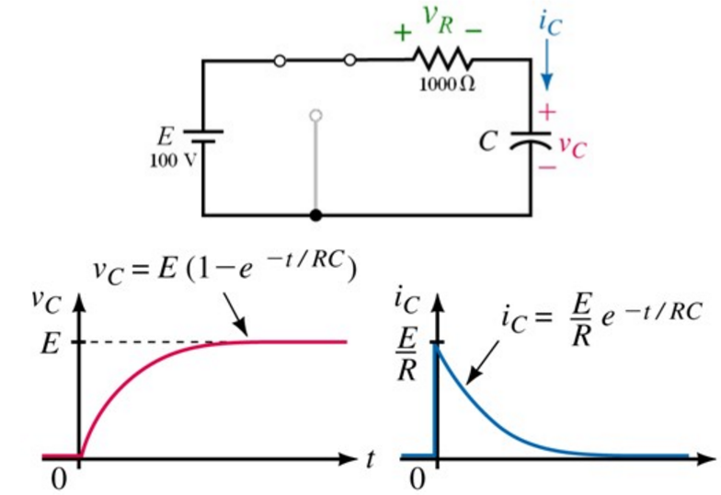
Capacitor Charging Equations
Voltages and currents in a charging circuit change exponentially over time
5: DC and Transient Response

Slide 25
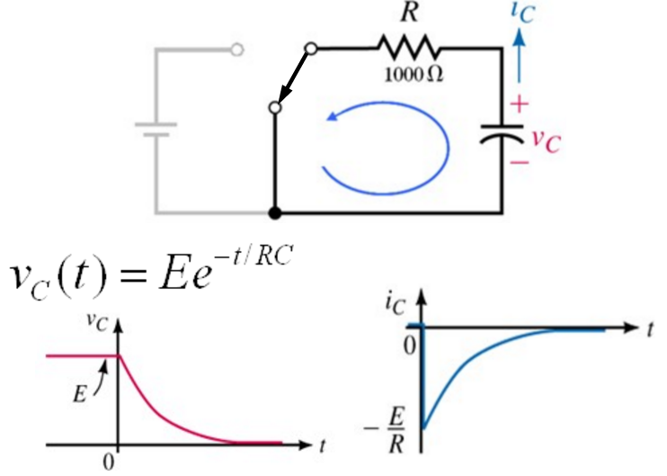
Capacitor Discharging Equations
Voltages and currents in a discharging circuit change exponentially over time
5: DC and Transient Response

Slide 26
Effective Resistance
Shockley models have limited value
  Not accurate enough for modern transistors
  Too complicated for much hand analysis
Simplification: treat transistor as resistor
  Replace I_{ds}(V_{ds}, V_{gs}) with effective resistance R
    I_{ds} = V_{ds}/R
  R averaged across switching of digital gate
Too inaccurate to predict current at any given time
  But good enough to predict RC delay
5: DC and Transient Response

Slide 27
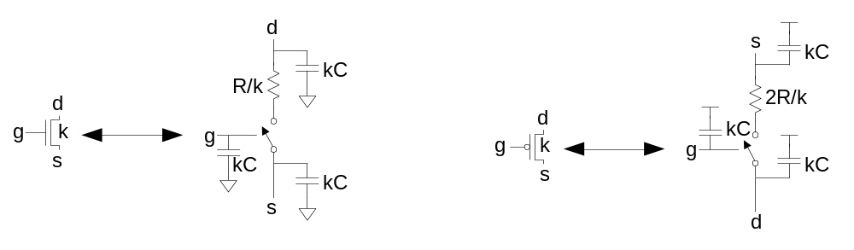
RC Delay Model
Use equivalent circuits for MOS transistors
  Ideal switch + capacitance and ON resistance
  Unit nMOS has resistance R, capacitance C
  Unit pMOS has resistance 2R, capacitance C
Capacitance proportional to width
Resistance inversely proportional to width
5: DC and Transient Response

Slide 28
RC Values
Capacitance
  C = C_{g} = C_{s} = C_{d} = 2 fF/μm of gate width in 0.6 μm
  Gradually decline to 1 fF/μm in nanometer techs.
Resistance
  R ≈ 6 KΩ*μm in 0.6 μm process
  Improves with shorter channel lengths
Unit transistors
  May refer to minimum contacted device (4/2 λ)
  Or maybe 1 μm wide device
  Doesn’t matter as long as you are consistent
5: DC and Transient Response

Slide 29
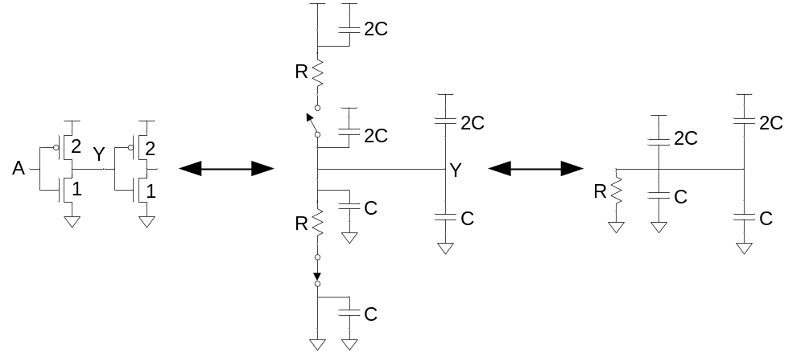
Inverter Delay Estimate
Estimate the delay of a fanout-of-1 inverter
d = 6RC
5: DC and Transient Response

Slide 30
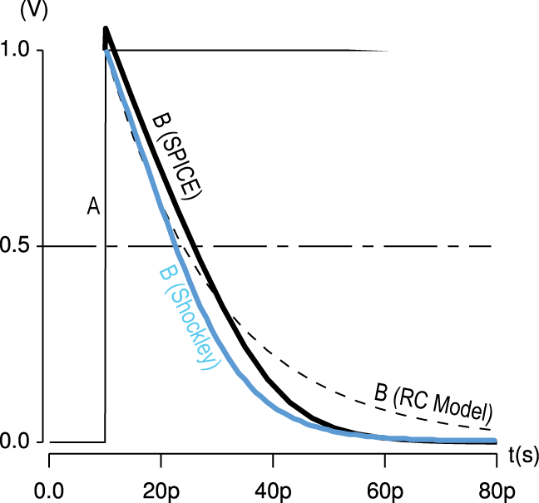
Delay Model Comparison
5: DC and Transient Response

Slide 31
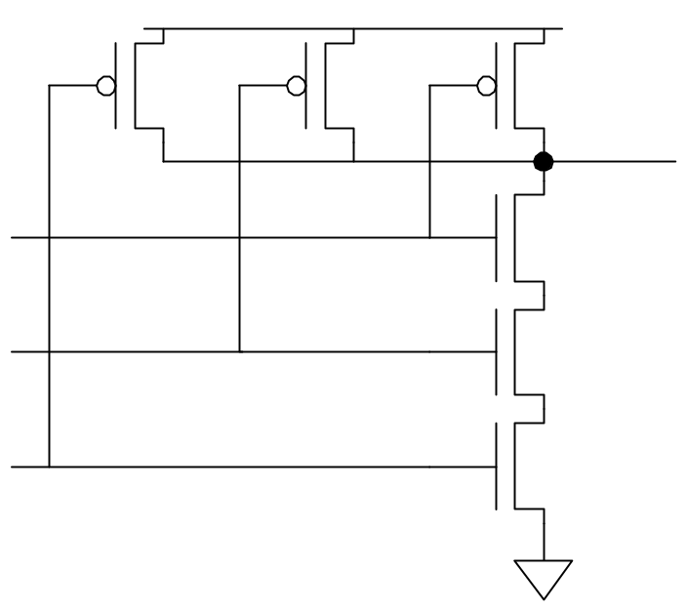
Example: 3-input NAND
Sketch a 3-input NAND with transistor widths chosen to achieve effective rise and fall resistances equal to a unit inverter (R).
2
2
2
3
3
3
5: DC and Transient Response

Slide 32
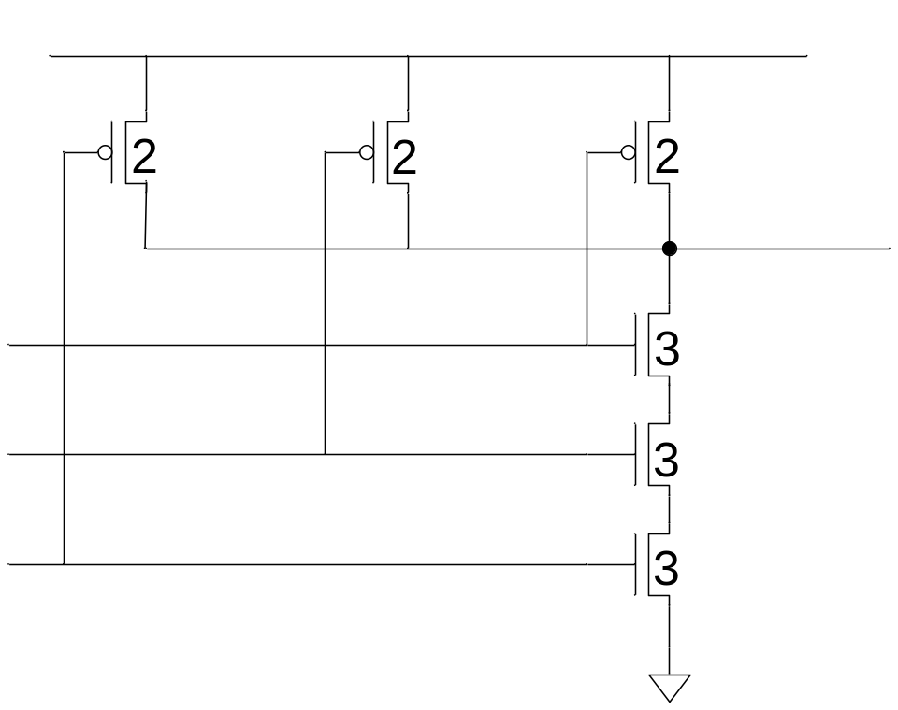
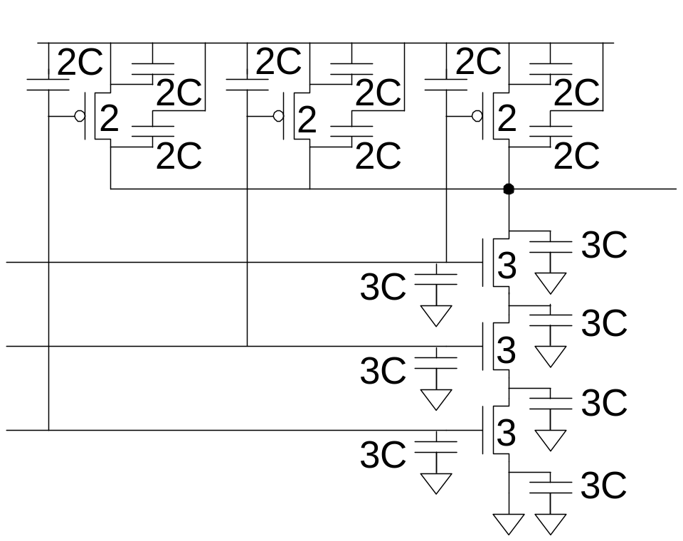
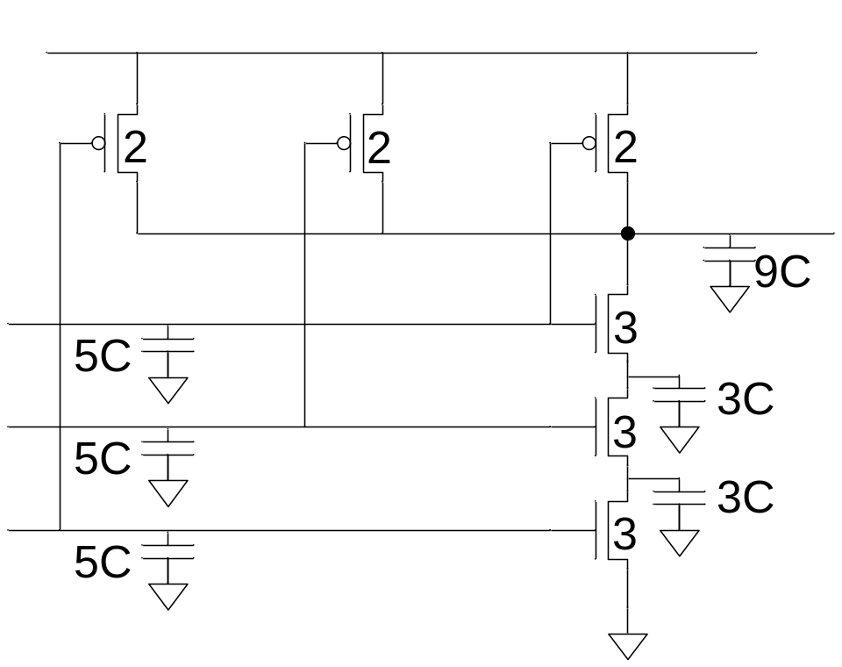
3-input NAND Caps
Annotate the 3-input NAND gate with gate and diffusion capacitance.
5: DC and Transient Response
Notes:
Note that:
The node between NMOS 3 and NMOS 2 should be 6C, but they use share diffusion, then they cost only 3C.
The node between NMOS 2 and NMOS 1 should be 6C, but they use share diffusion, then they cost only 3C.

Slide 33
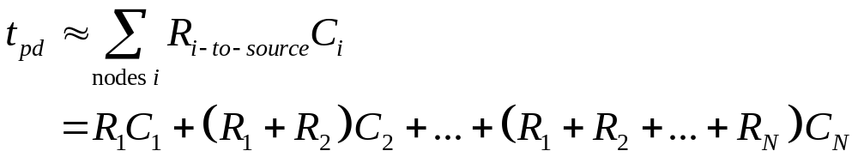
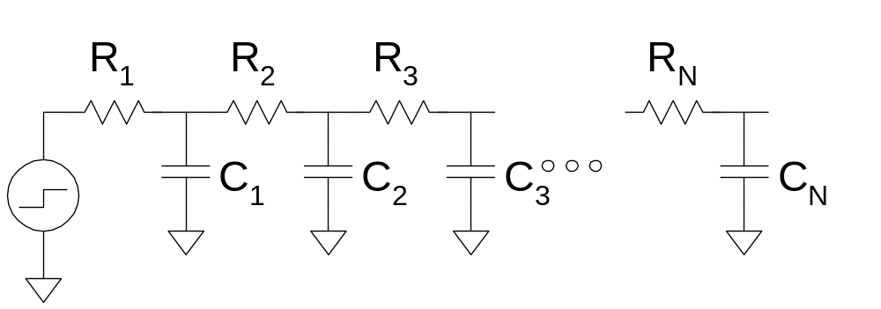
Elmore Delay
ON transistors look like resistors
Pullup or pulldown network modeled as RC ladder
Elmore delay of RC ladder
5: DC and Transient Response

Slide 34
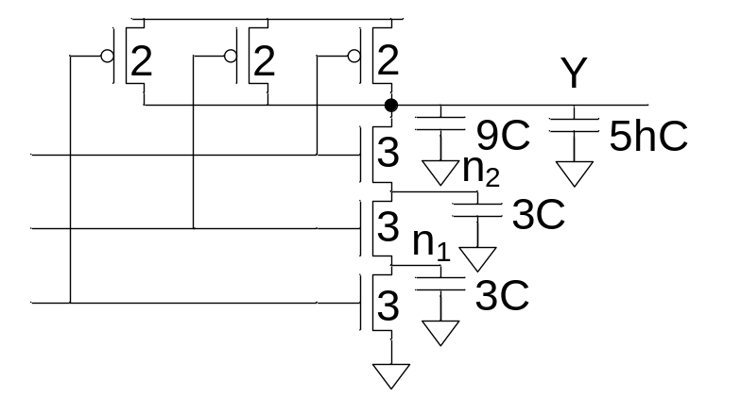
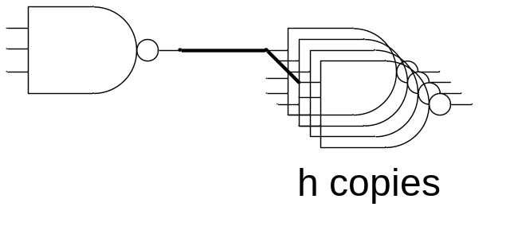
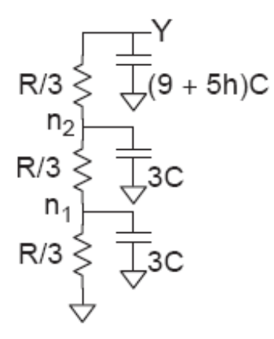
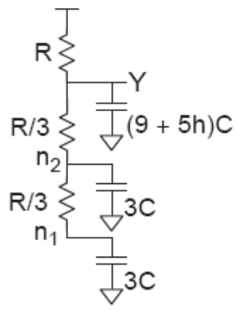
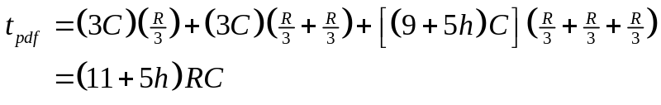

Example: 3-input NAND
Estimate worst-case rising and falling delay of 3-input NAND driving h identical gates.
5: DC and Transient Response
Notes:
Worst case rising: Chỉ một PMOS ON
Worst case falling: All NMOS ON

Slide 35
Delay Components
Delay has two parts
  Parasitic delay
    9 or 11 RC
    Independent of load
  Effort delay
    5h RC
    Proportional to load capacitance
5: DC and Transient Response

Slide 36
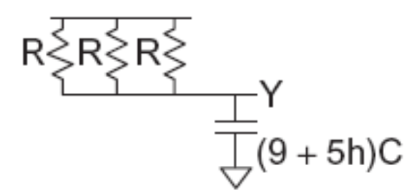
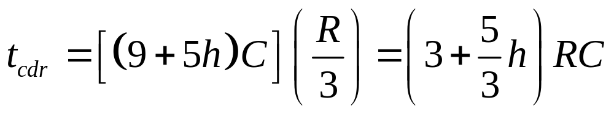
Contamination Delay
Best-case (contamination) delay can be substantially less than propagation delay.
Ex: If all three inputs fall simultaneously
5: DC and Transient Response

Slide 37
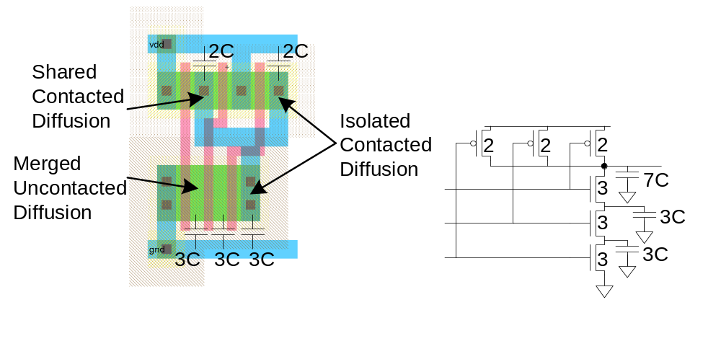
Diffusion Capacitance
We assumed contacted diffusion on every s / d.
Good layout minimizes diffusion area
Ex: NAND3 layout shares one diffusion contact
  Reduces output capacitance by 2C
  Merged uncontacted diffusion might help too
5: DC and Transient Response

Slide 38
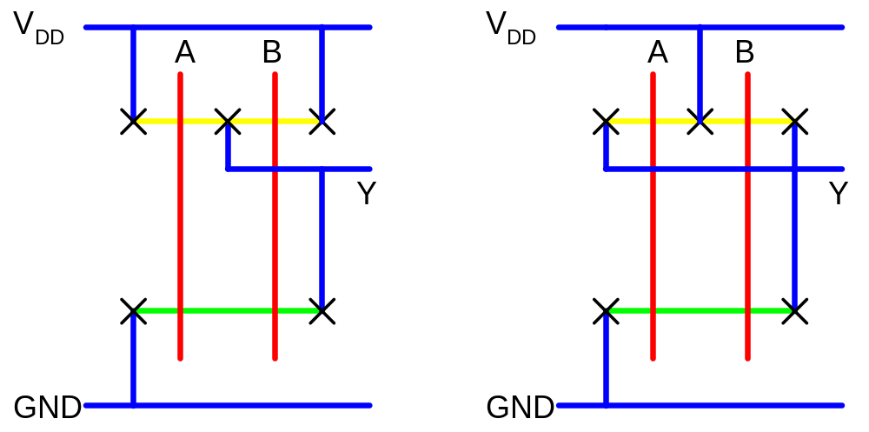
Layout Comparison
Which layout is better?
5: DC and Transient Response
Notes:
Layout (left handside) is better because the capacitance at node Y is smaller. (The capacitances at node connected to the Vdd are shorted, then ignored)

