Slide 1

JAVA Fresher Program - Project Assignments
Team: 2 - Mentor: Châu Hớn Cường
1
Project name:
Library Management System (LMS)
Hoàng Quốc Tuân
Đào Ngọc Lưu
Nguyên Văn Bách
Đặng Quốc Ân
Ma Kiên Hữu
Vũ Thị Thùy Dung

Slide 2
Description
Team: 2 - Mentor: Châu Hớn Cường
2
We will propose a web-based system to help a library in their management operations. In general, each book borrower will have to register his/her account in order to borrow book from the system. LMS will manage all books through their ISBN. There’s a limitation number of books which are allowed a user to borrow at the same time, this number could be changed by admin.

Slide 3
Technical
Team: 2 - Mentor: Châu Hớn Cường
3
Spring Boot
Spring Security
Hibernate
Thymeleaf Spring Boot
Spring Data JPA
Jquery, boostrap

Slide 4

Spring Boot
Team: 2 - Mentor: Châu Hớn Cường
4

Slide 5
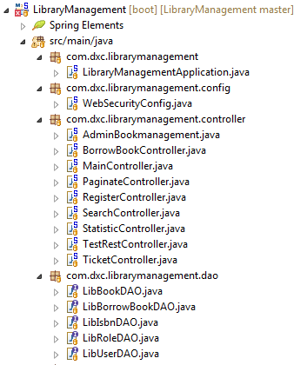
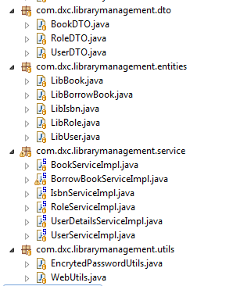
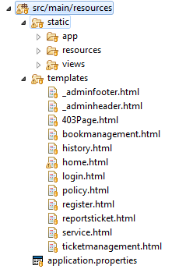
Design Code
Team: 2 - Mentor: Châu Hớn Cường
5

Slide 6
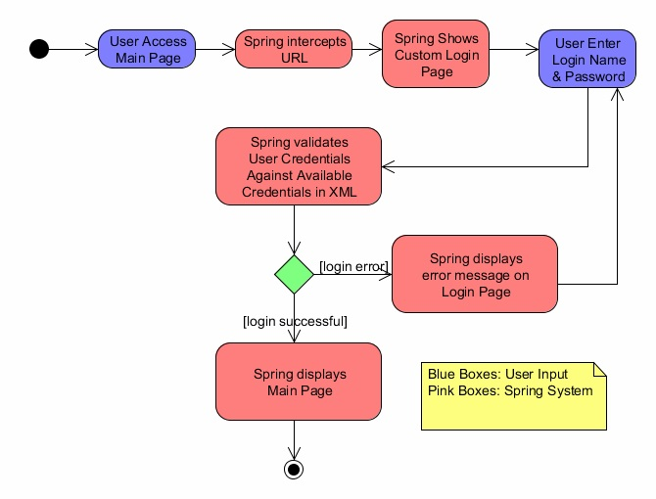
Spring Secutity
Team: 2 - Mentor: Châu Hớn Cường
6

Slide 7
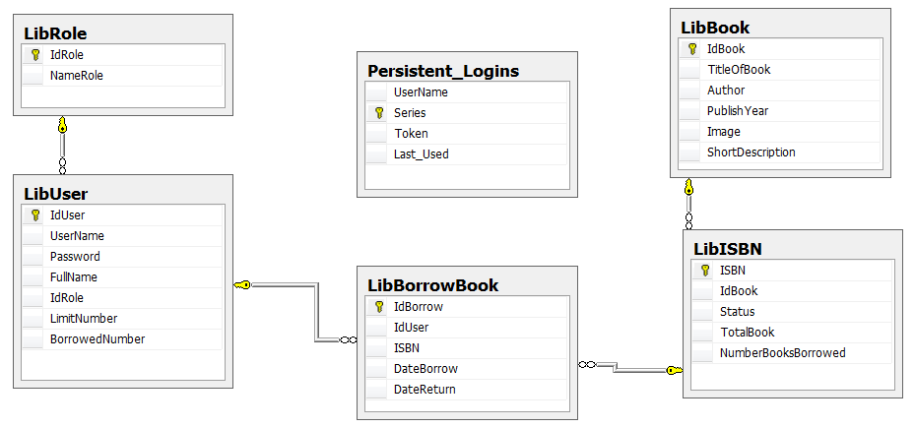
Database Diagram
Team: 2 - Mentor: Châu Hớn Cường
7

Slide 8
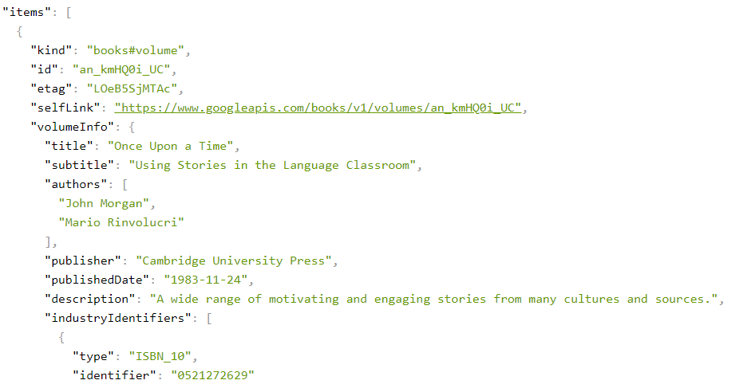
Google Books APIs
Team: 2 - Mentor: Châu Hớn Cường
8
url : https://www.googleapis.com/books/v1/volumes?q=isbn: + search

Slide 9
Task assignment
Team: 2 - Mentor: Châu Hớn Cường
9
TuanHoang: Configspring boot, config spring security, login, logout, register, create database, search autocomplete, sent and receive data with ajax, trigger in sql…
LuuDao: Paginate book, paginate user, edit book, delete book, borrow book, sent and receive data with ajax, add book.
BachNguyen: Validate ISBN with service Google, Report weekly/monthly/yearly, insert database
DungThuy: Save Ticket in admin page, Unit Test case, jquery validate
HuuMa: Html + CSS + Bootstrap
AnDang: Html + CSS + Bootstrap

Slide 10

Thanks you
Team: 2 - Mentor: Châu Hớn Cường
10

