Slide 1
Presentation title
Presented by Name
IoT, Power, Actuation & Control (iPAC) Laboratory
Department of Automation Engineering
School of Electronics and Electrical Engineering, HUST
Email: abc.xyz@hust.edu.vn

Slide 2
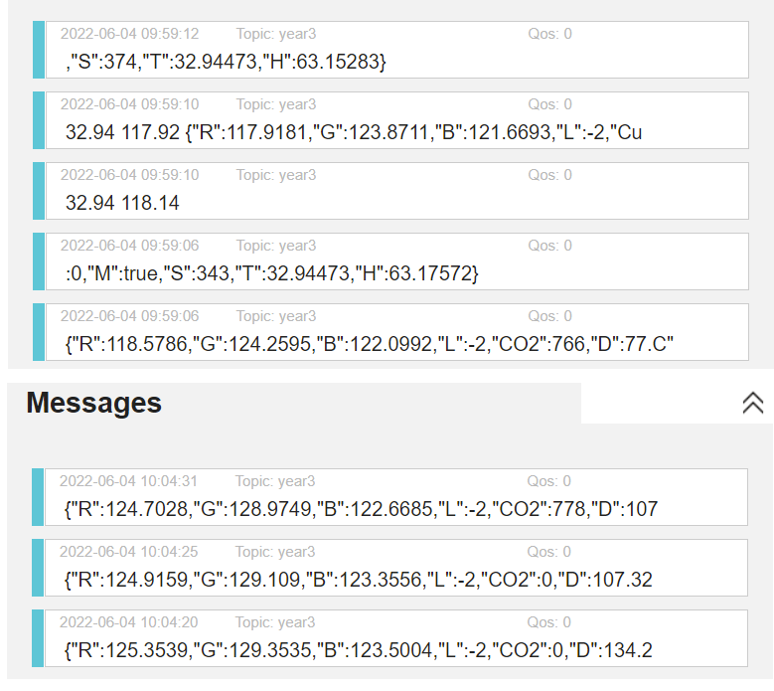
ESP → MQTT Broker

Slide 3
UART: Atmega → ESP
{"R":125.3679,"G":129.4189,"B":122.7028,"L":2,"CO2":767,"D":93.844,"TVOC":0,"M":true,"S":356,"T":32.85892,"H":63.94629}
{"R":114.0131,"G":124.5802,"B":120.8724,"L":2,"CO2":767,"D":76.14521,"TVOC":0,"M":true,"S":296,"T":32.86965,"H":63.99969}
{"R":114.0251,"G":124.6192,"B":120.902,"L":2,"CO2":767,"D":51.70401,"TVOC":0,"M":true,"S":537,"T":32.85892,"H":64.02258}
{"R":112.6415,"G":124.5283,"B":120.3774,"L":2,"CO2":772,"D":94.68681,"TVOC":0,"M":true,"S":627,"T":32.85892,"H":64.0531}

Slide 4
Thank You

