Slide 1
SCHOOL MANAGEMENT
Vũ Tuấn Anh – 17110004
Trương Minh Quân - 17110069
Phạm Vũ Thiện - 17110075

Slide 2
DESCRIPTION
The website has three kinds of users:
Admin: manage the whole system.
Teacher: manage all the courses that they are assigned to teach and give grade to students enroll those course.
Student: enroll courses, get document uploaded by teachers, view mark they get from those courses.

Slide 3
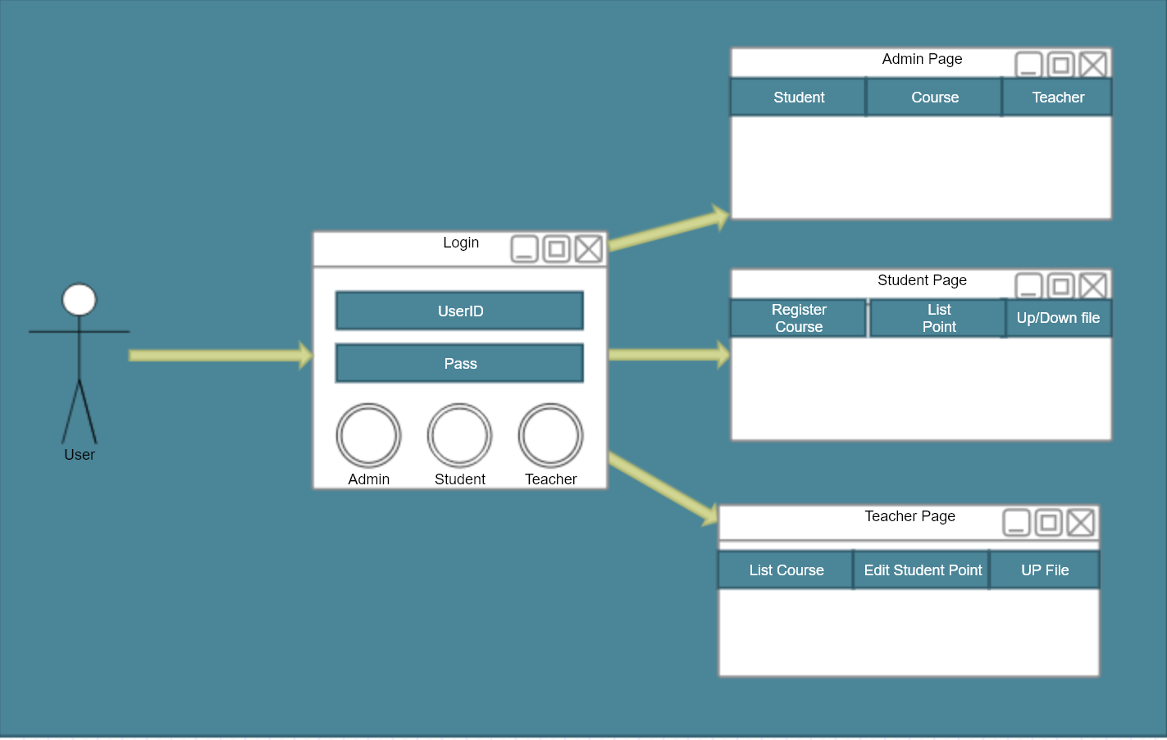
Use Case

Slide 4
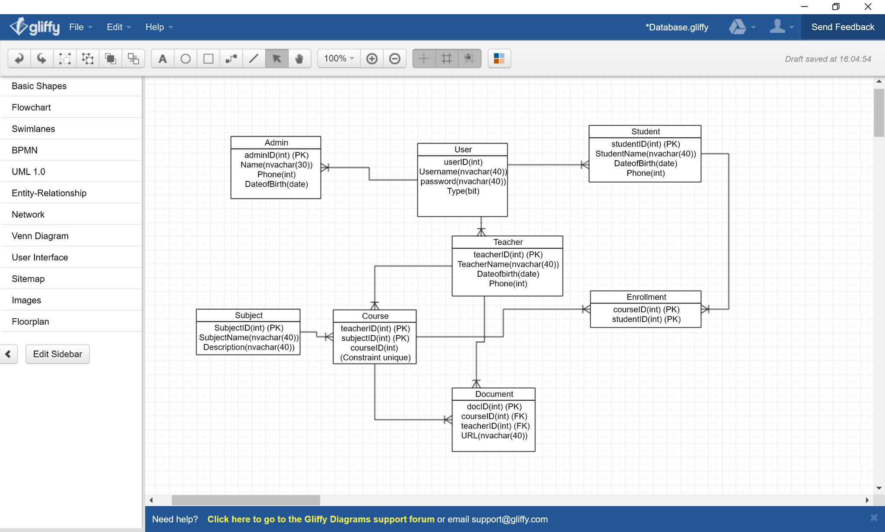
Database Diagram

Slide 5
ASSIGNMENT
Trương Minh Quân: login, functions belong to Teacher.
Vũ Tuấn Anh: functions belong to Student.
Phạm Vũ Thiện: functions belong to Admin.

Slide 6
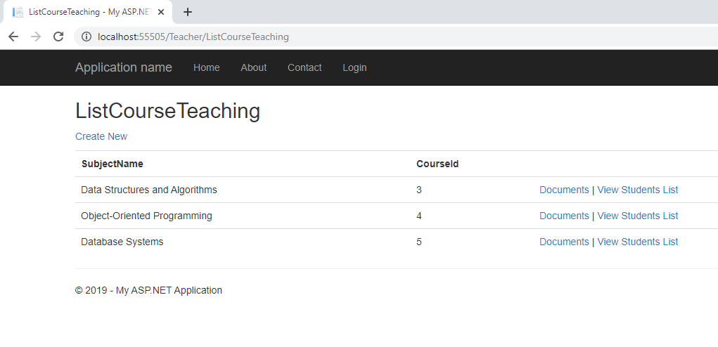
TEACHER
View Teaching Courses

Slide 7
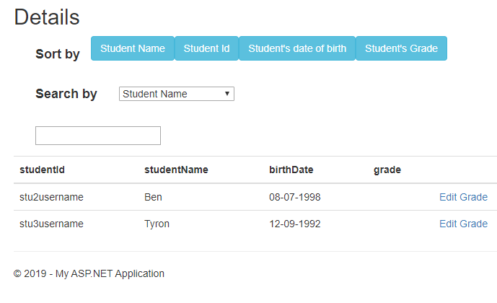
TEACHER
View List of Students belong to one course

Slide 8
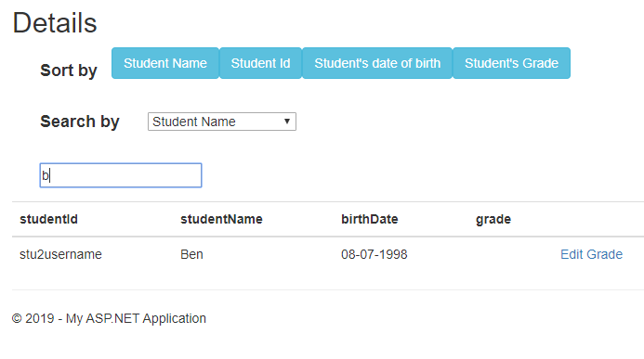
TEACHER
Searching Students ( by StudentName )

Slide 9
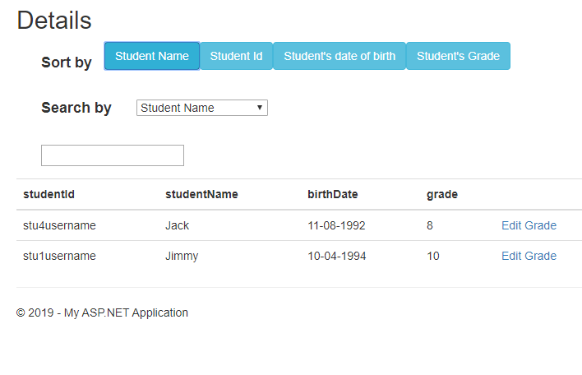
TEACHER
Sorting Students ( by StudentName )

Slide 10
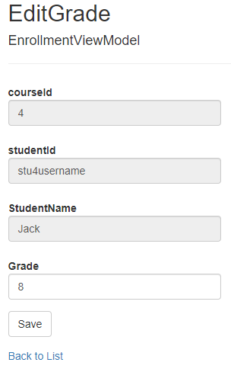
TEACHER
Give mark to a student

Slide 11
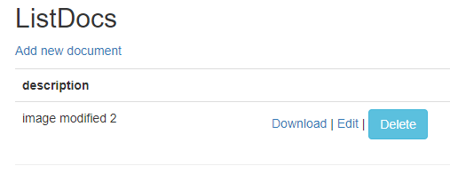
TEACHER
List of documents that have been uploaded

Slide 12
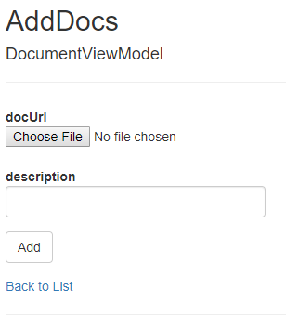
TEACHER
Add a new document to the course

Slide 13
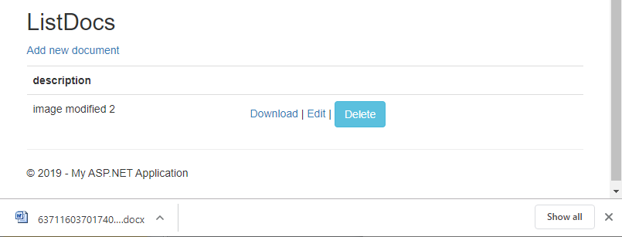
TEACHER
Download document

Slide 14
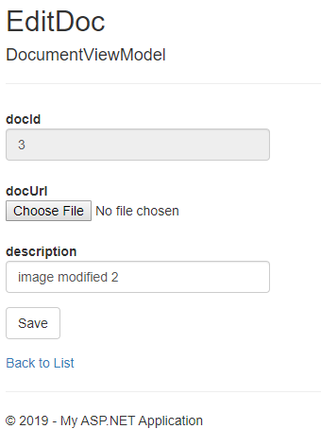
TEACHER
Edit document

Slide 15
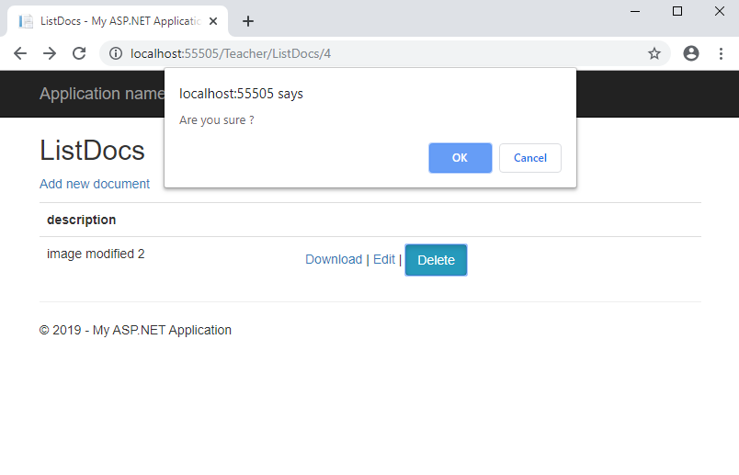
TEACHER
Delete document

Slide 16
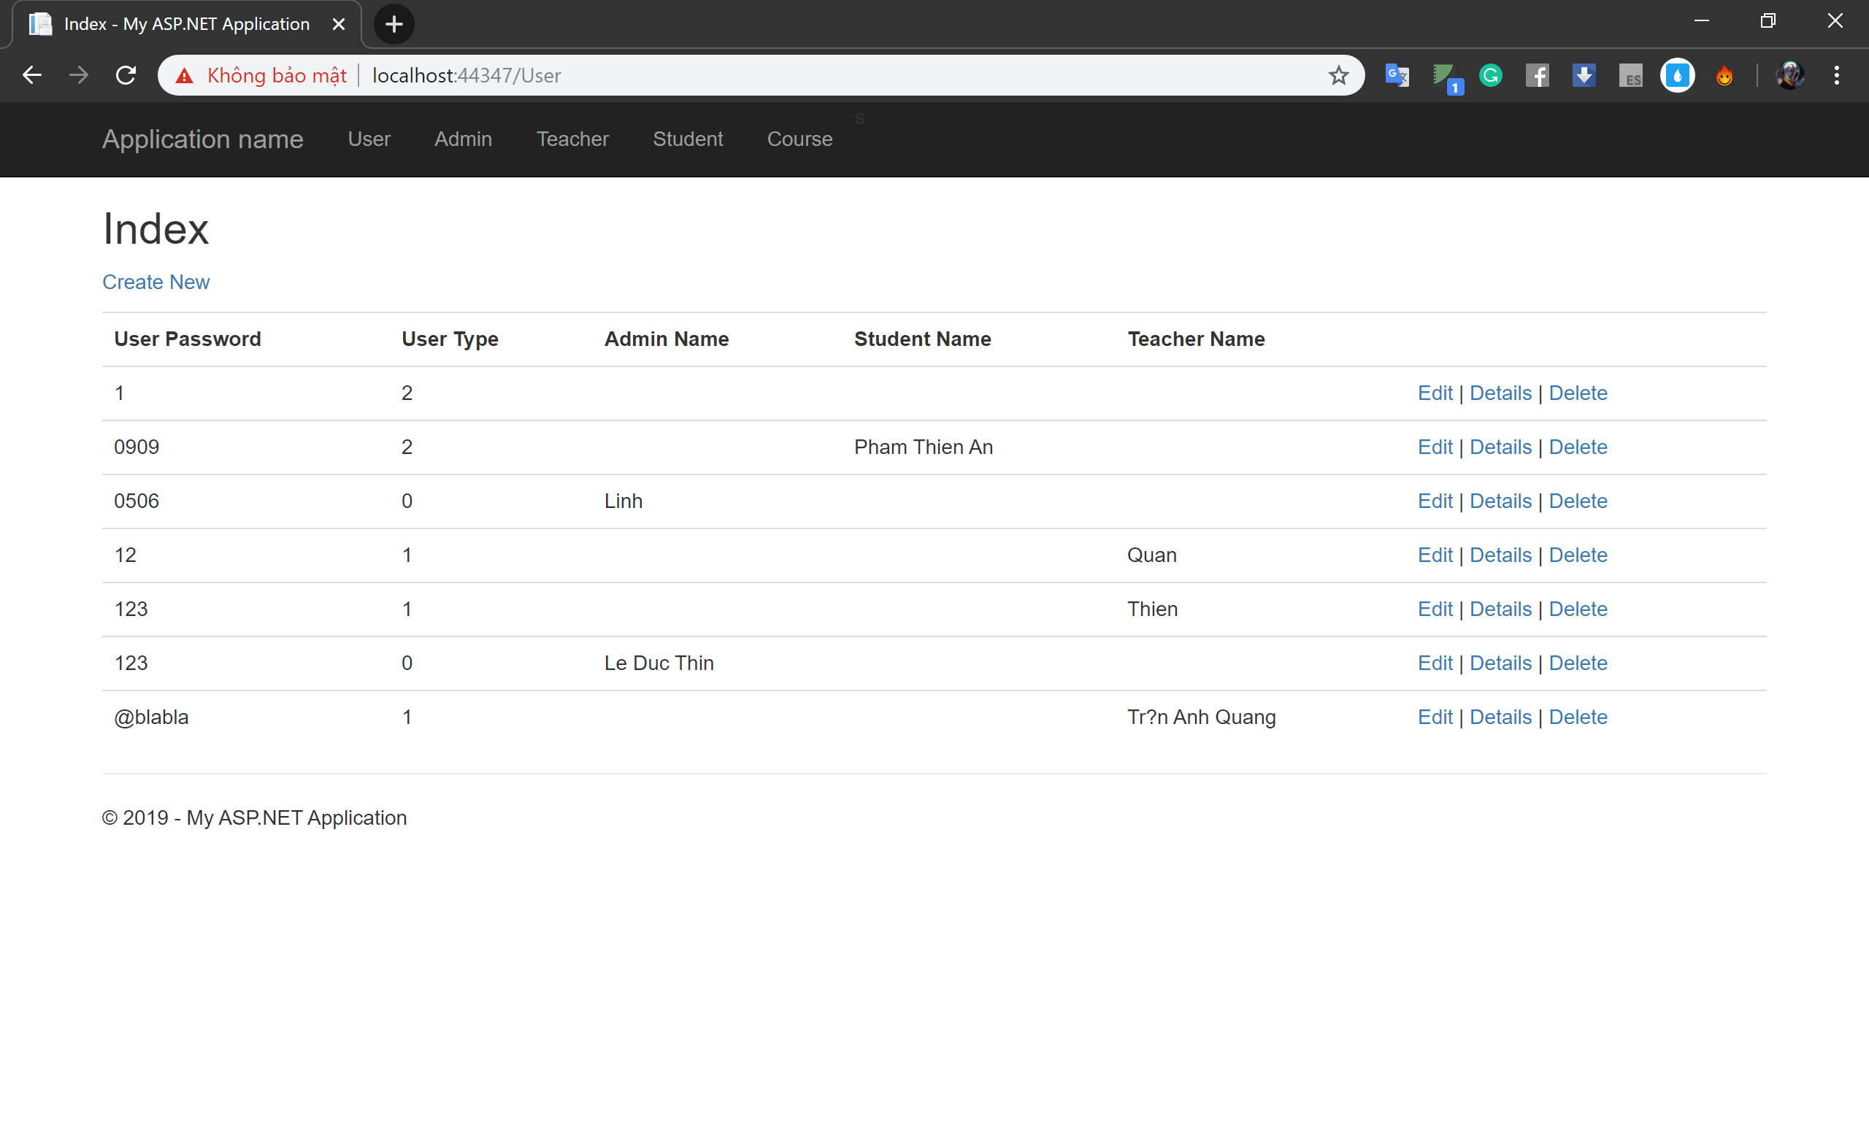
User Page
Function: - Use to create admins, teachers ,students account and courses. - User type is used to define which is admin, teacher and student account. - List type:
Admin = 0
Teacher = 1
Student = 2

Slide 17
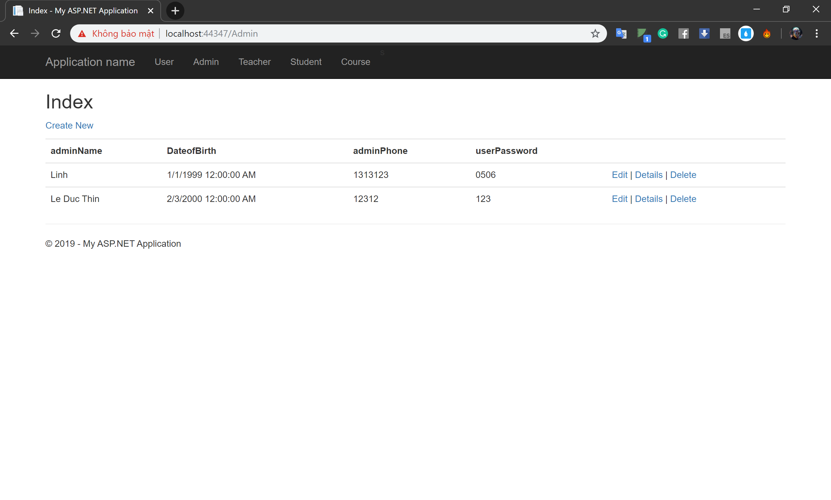
Admin Page
Function: - Use to create Admin account.
- Admin account have some basic information about admin.
- There is only one user but we have a lot of admin. - Admin can create teacher, student, and course.

Slide 18
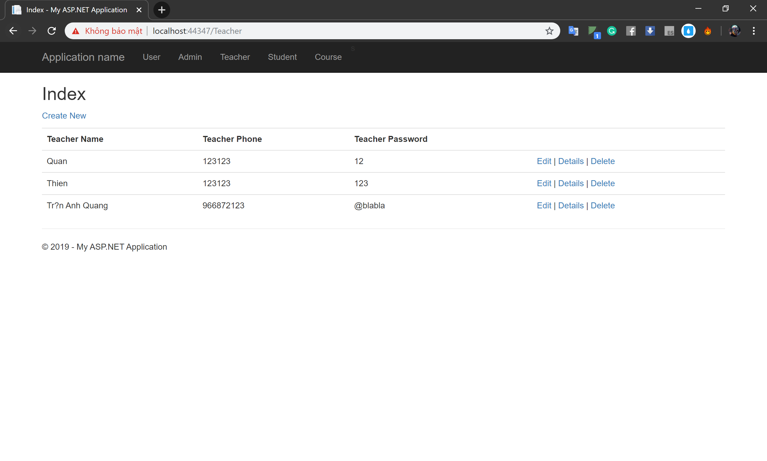
Teacher Page
Function: - Management teacher account.
- Teacher page have some basic information about teacher.

Slide 19
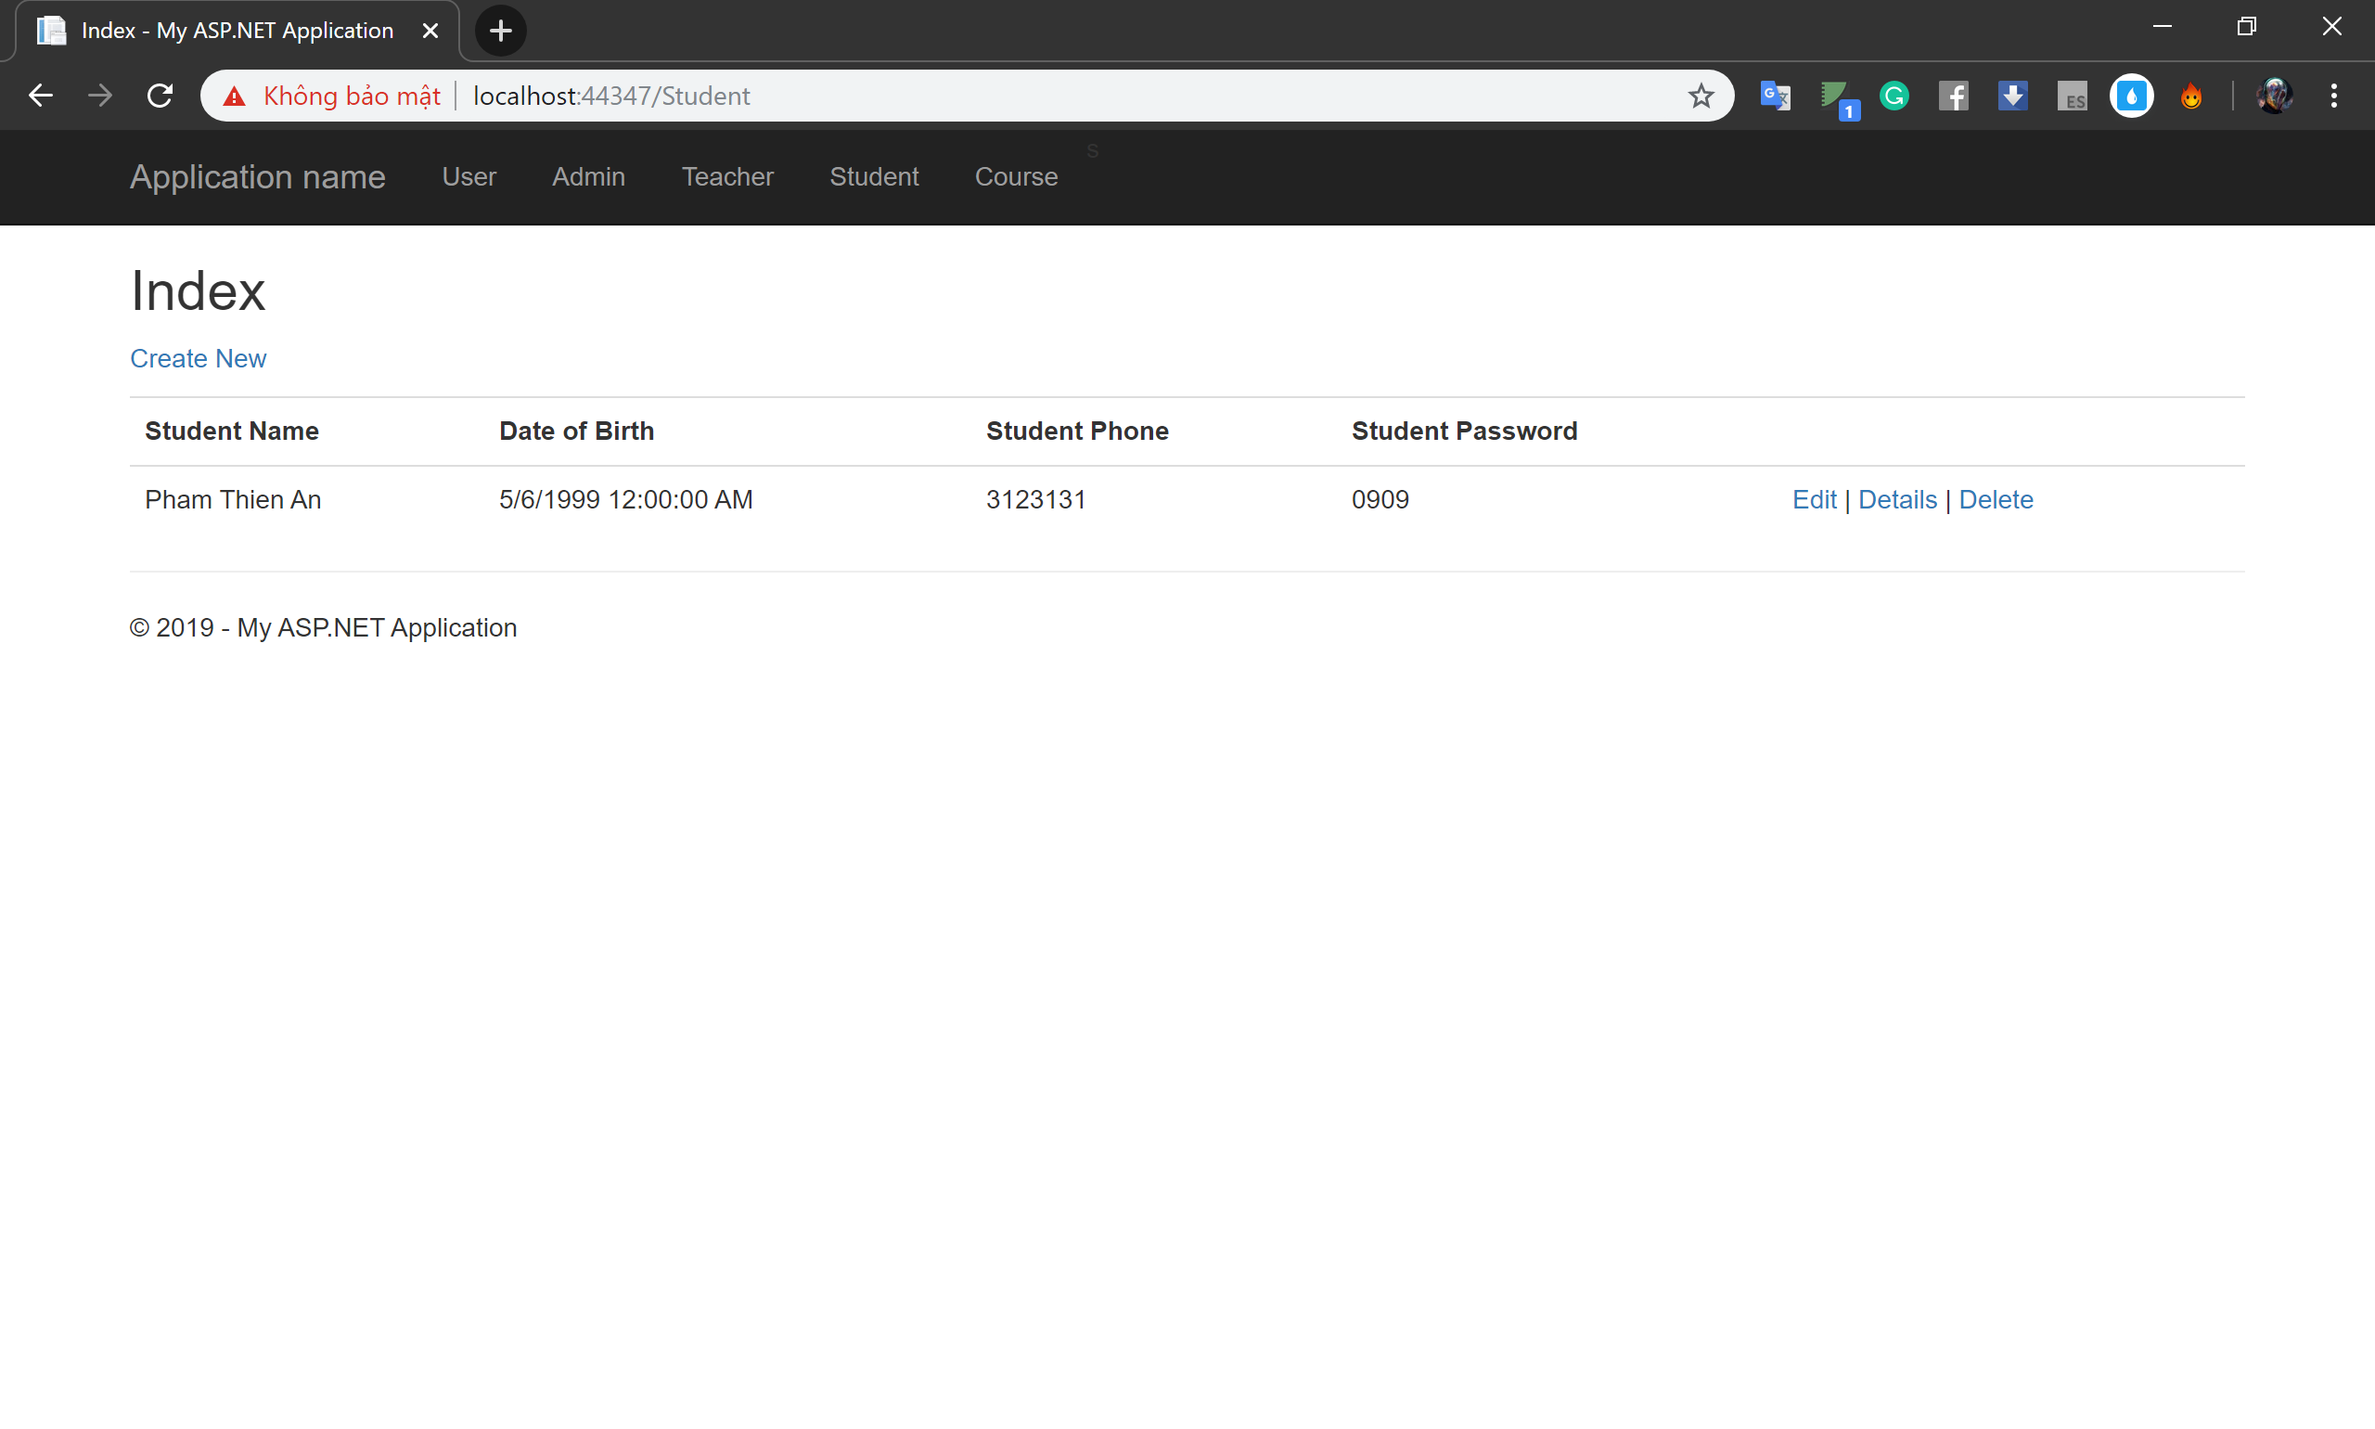
Student Page
Function: - Management student account.
- Student page have some basic information about student.

Slide 20
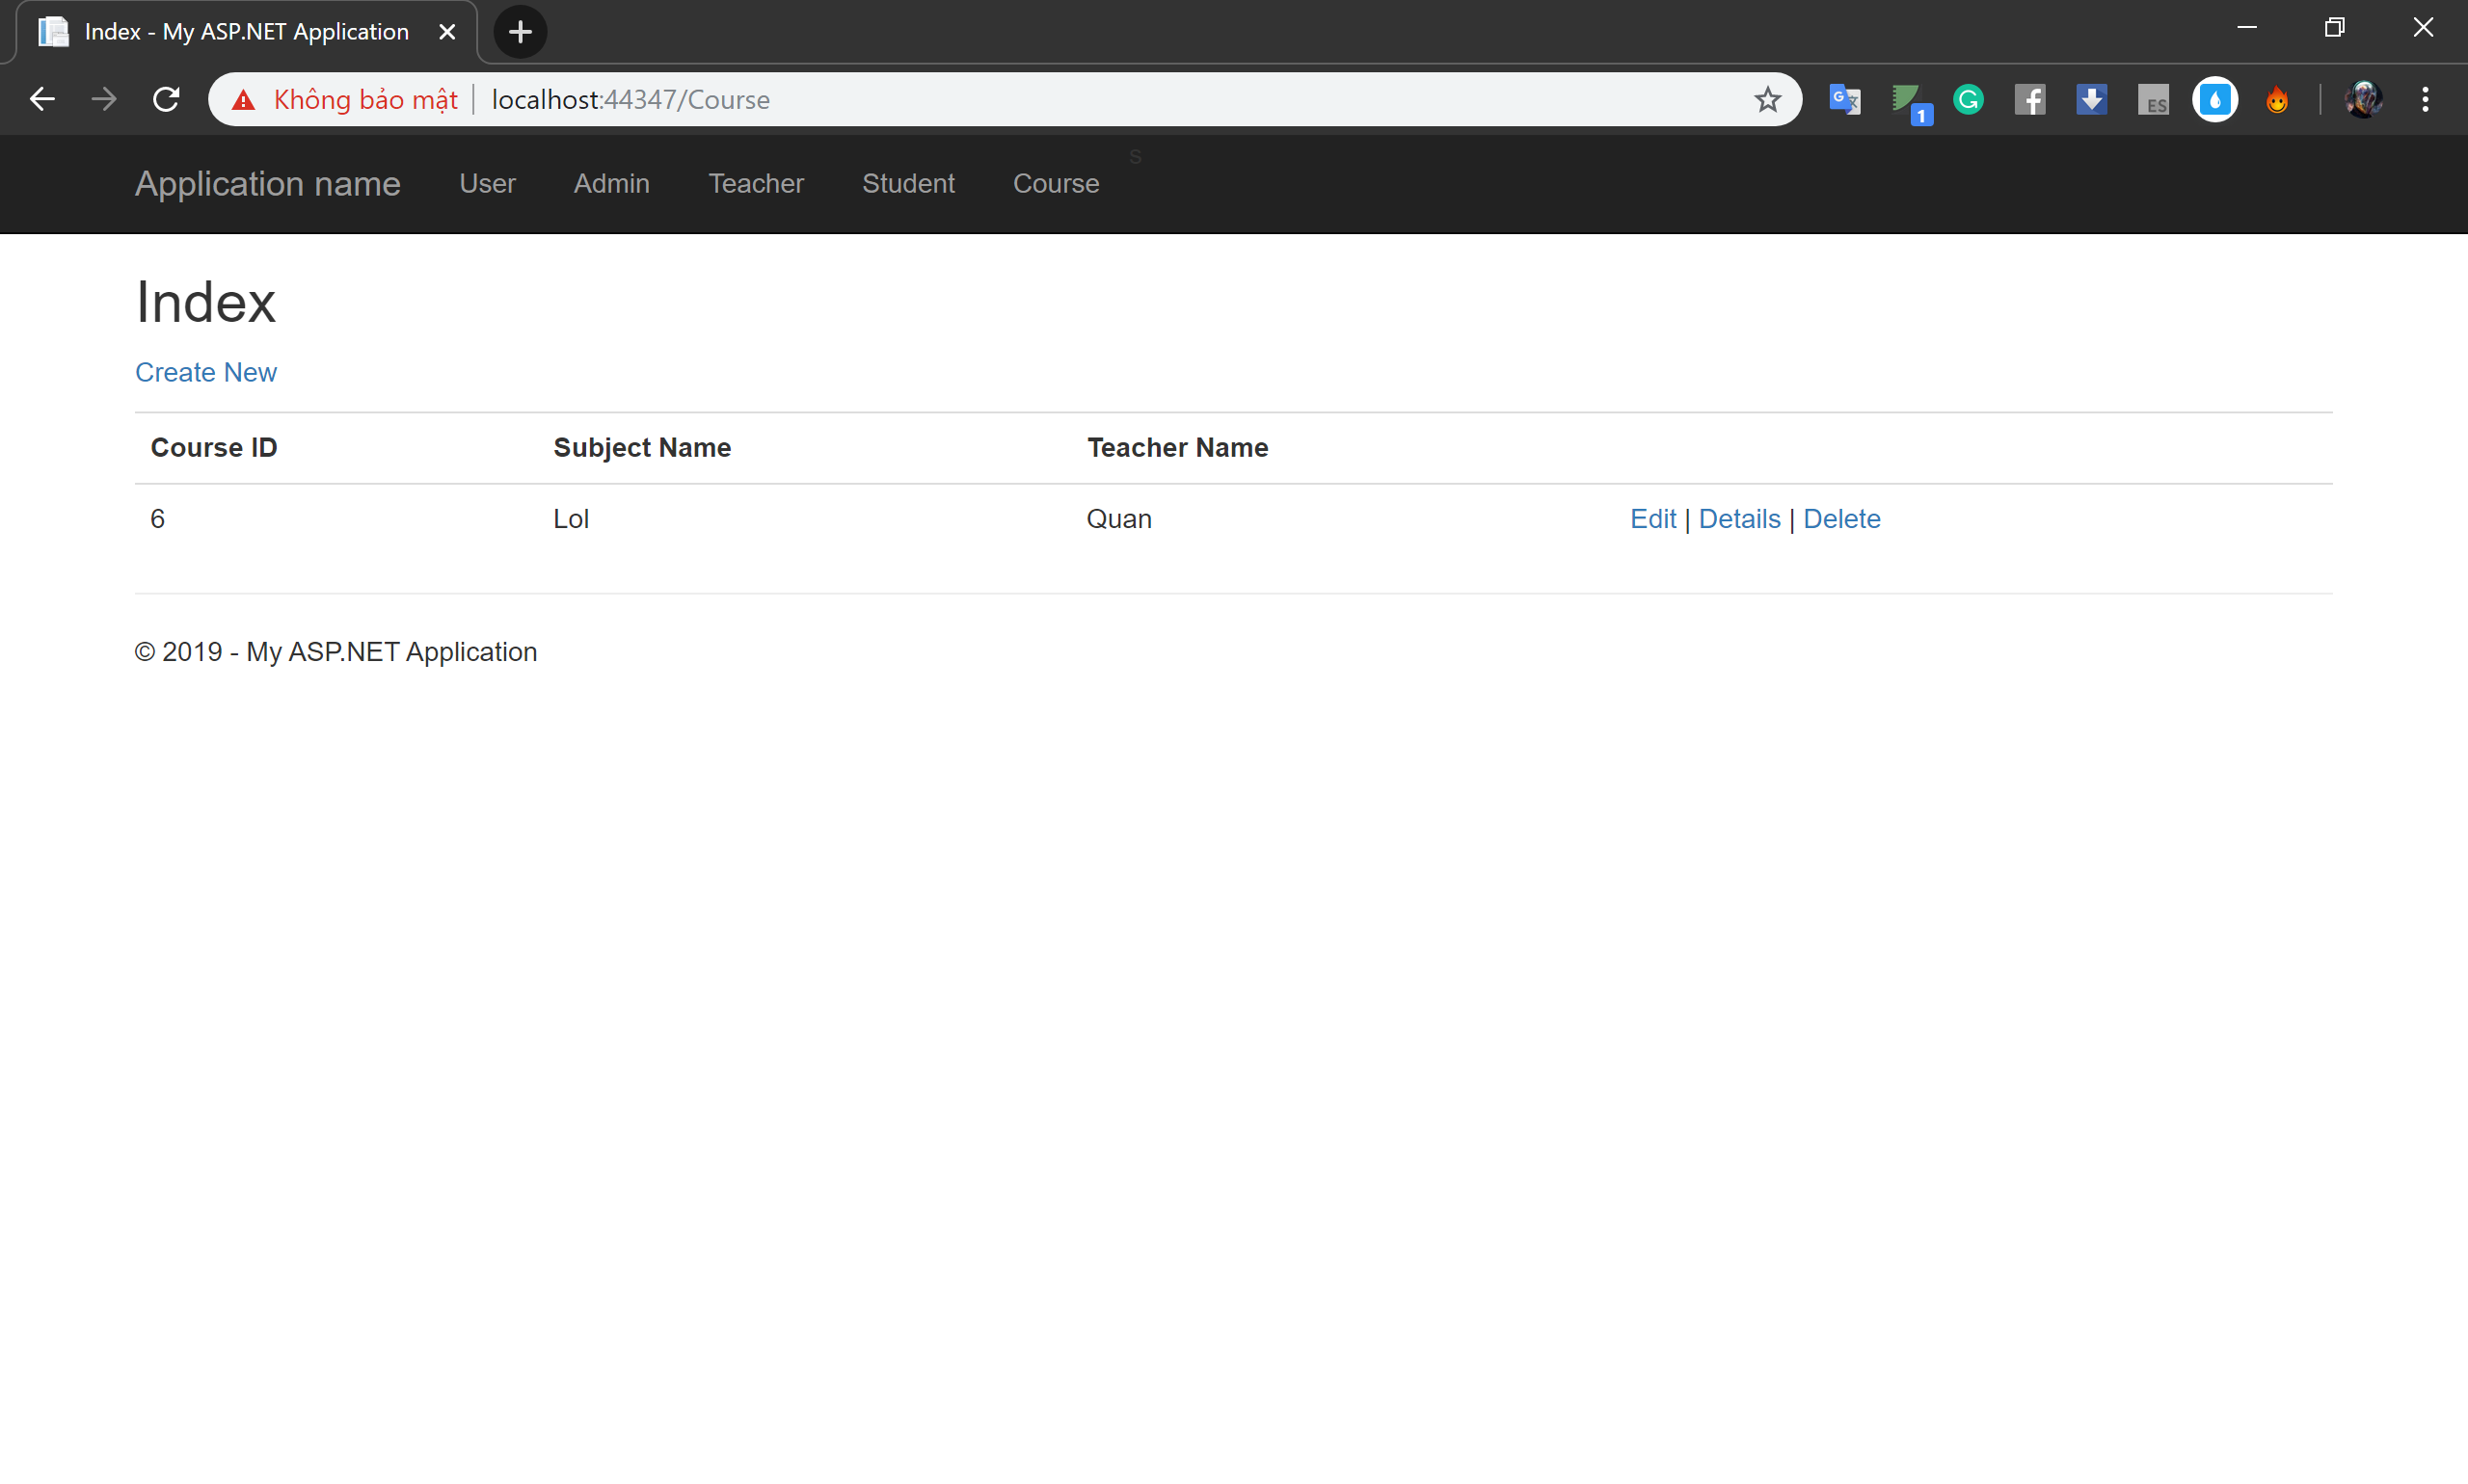
Course Page
Function: - Management course
- Course content: Teacher name, ID and Subject name.

Slide 21
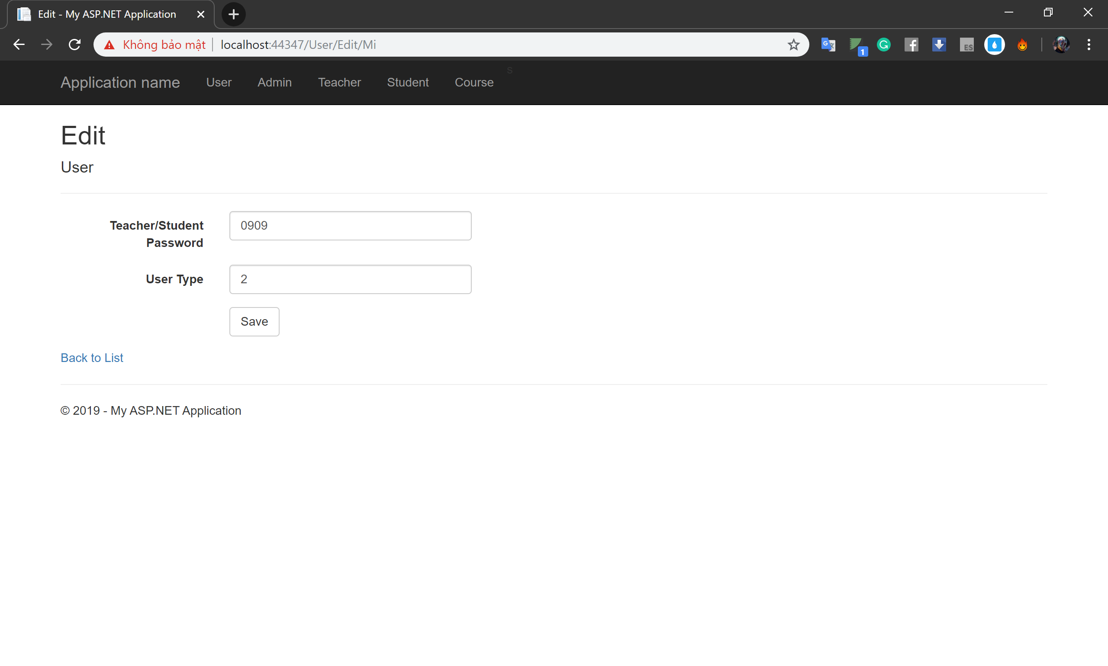
Edit Page

Slide 22
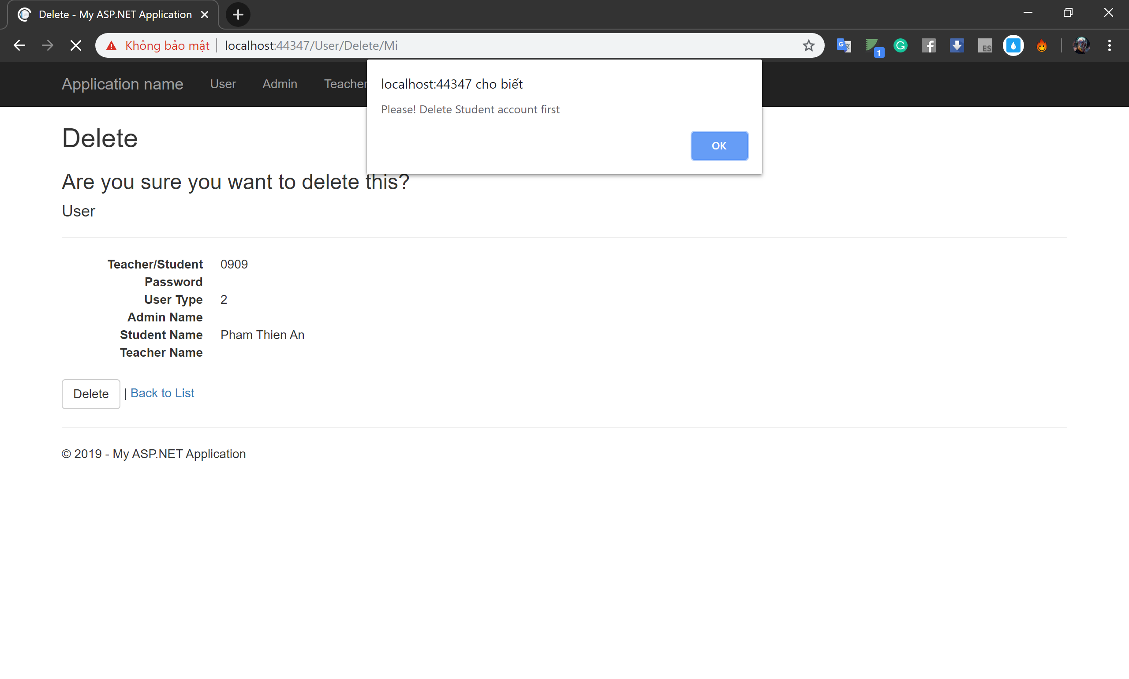
Delete

Slide 23
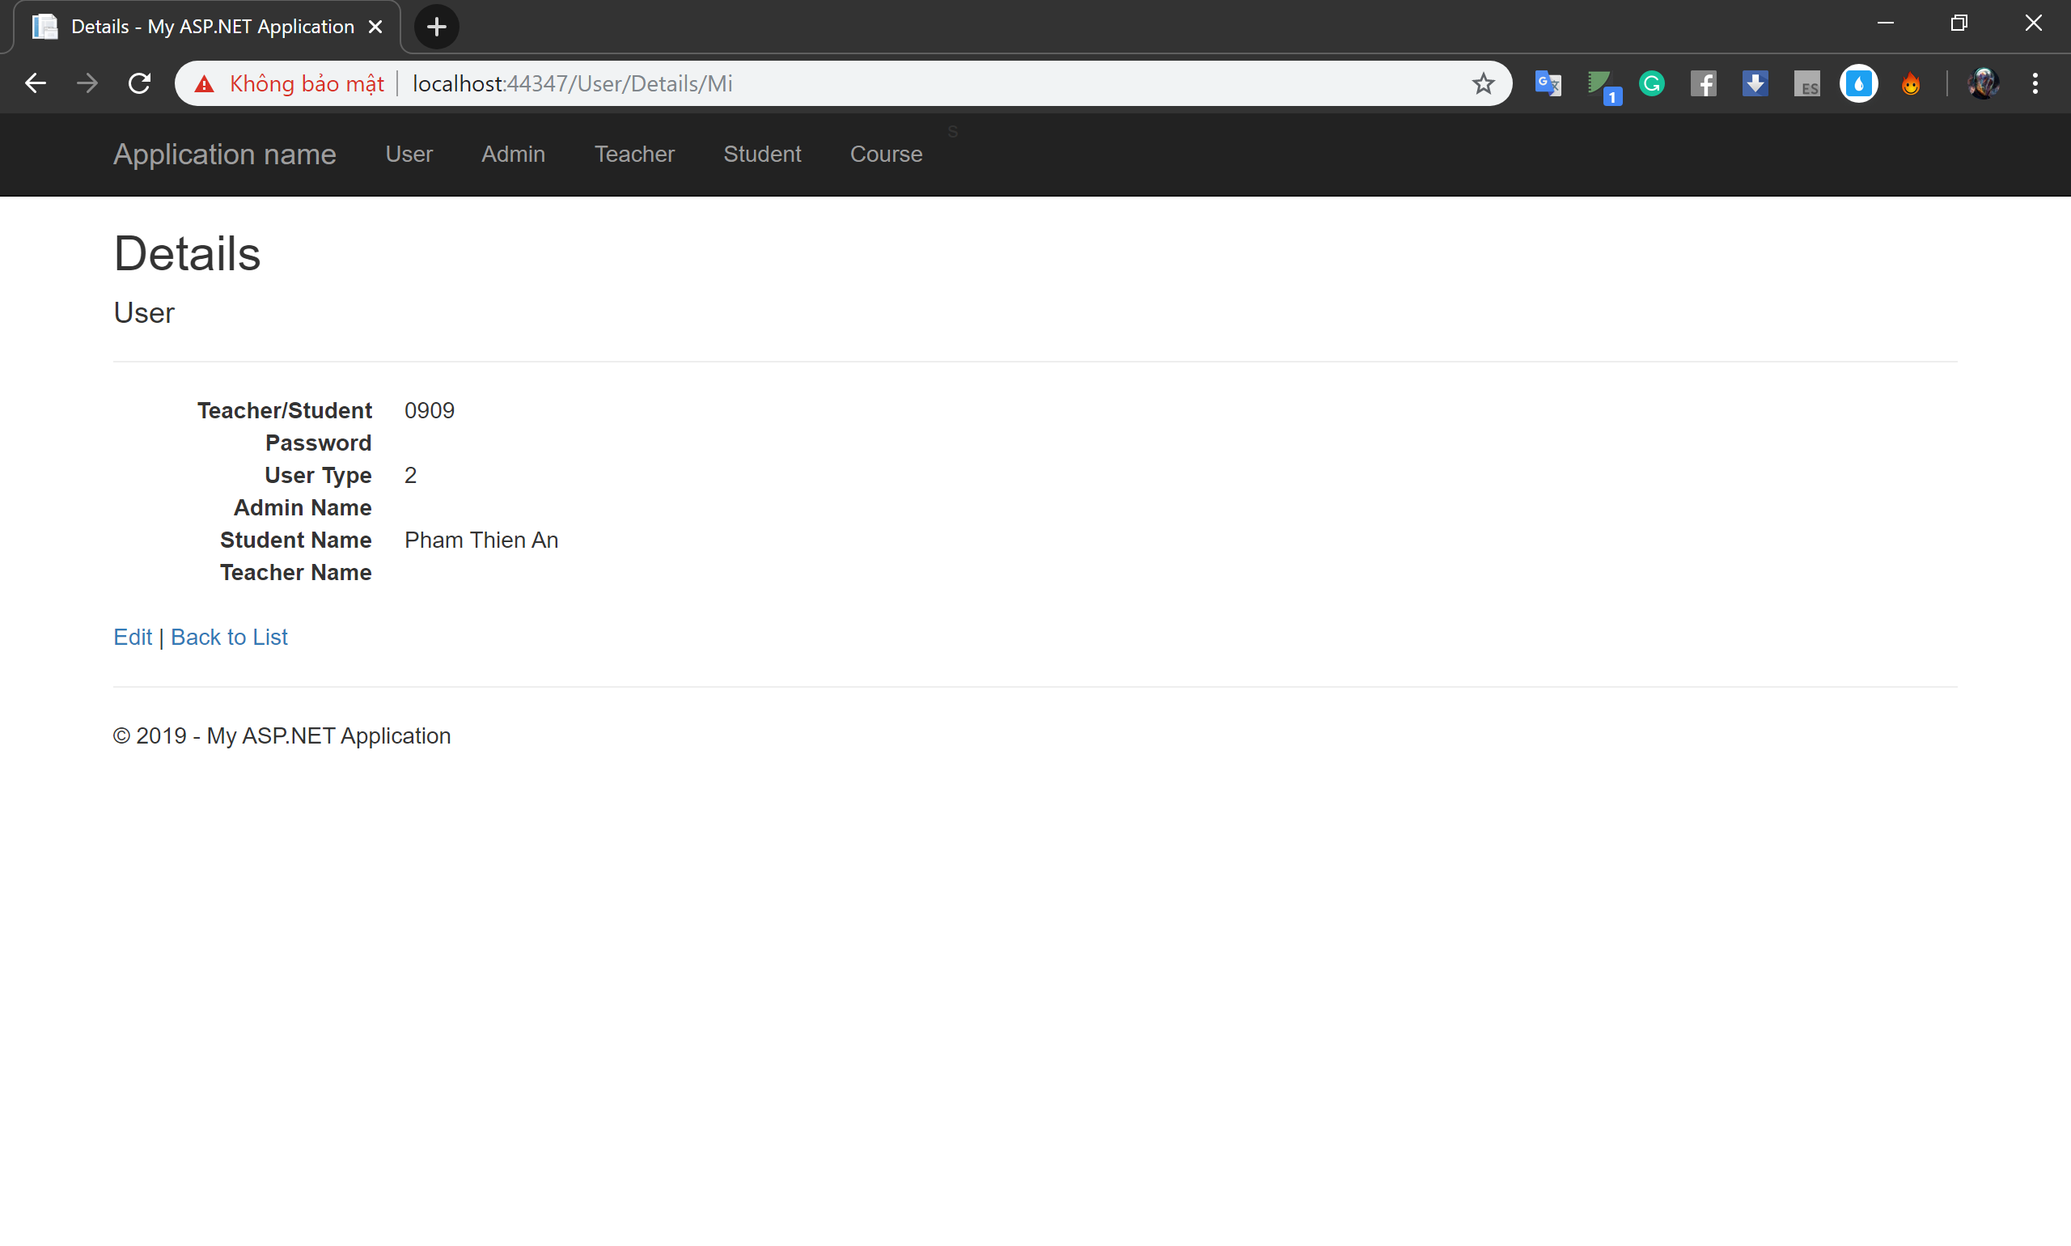
Details

Slide 24
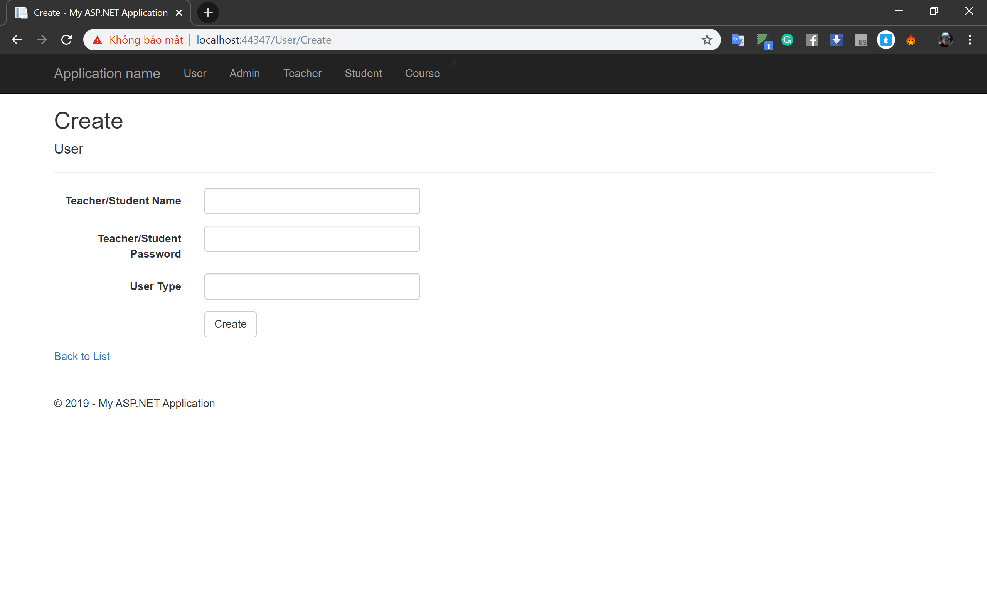
Create

Slide 25
Chart of student and its functions
Index
Create
Edit
Delete
List Grade
Register
File
Details

Slide 26
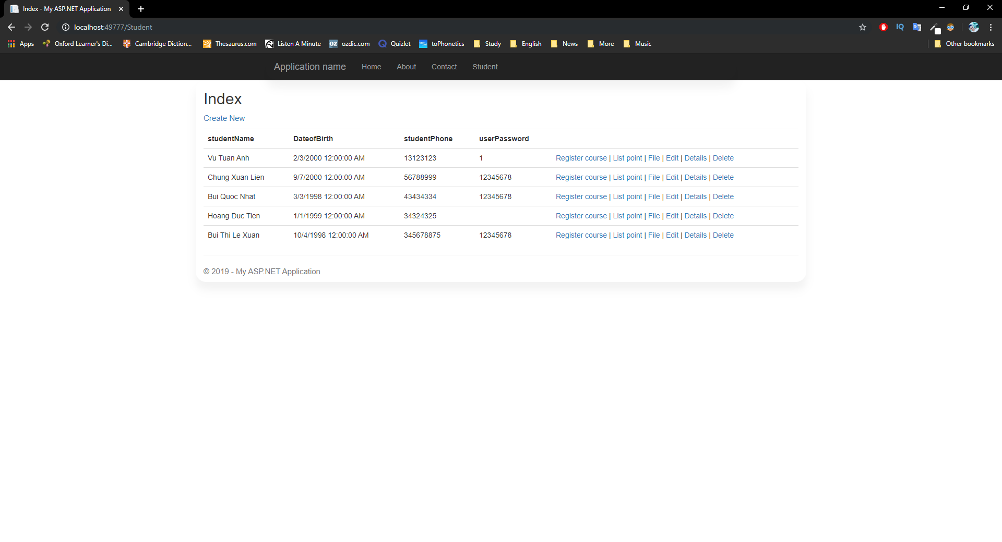
Index page

Slide 27
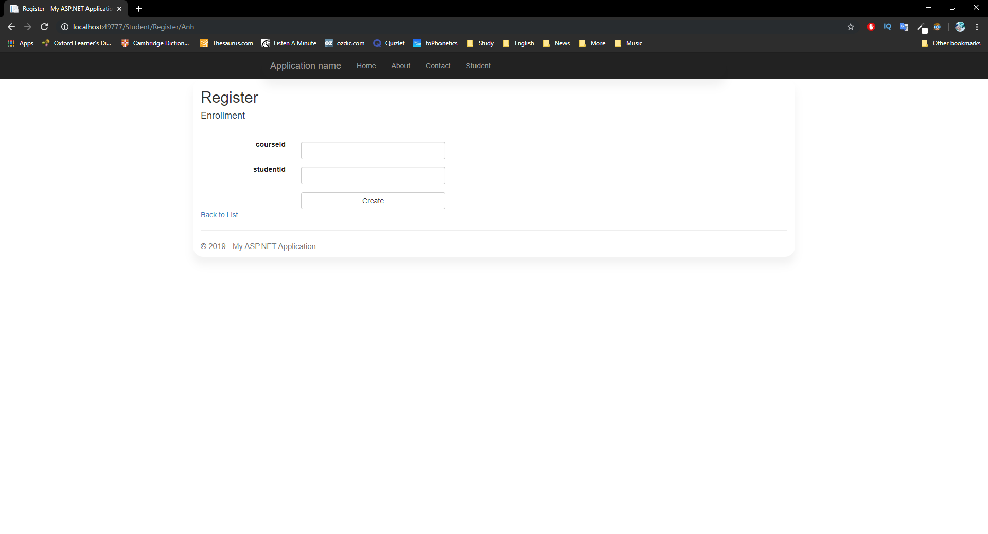
Register page

Slide 28
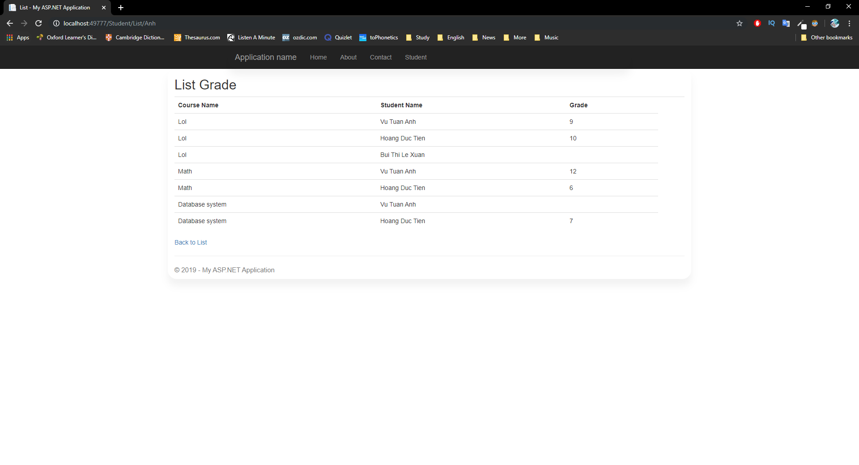
List grade page

Slide 29
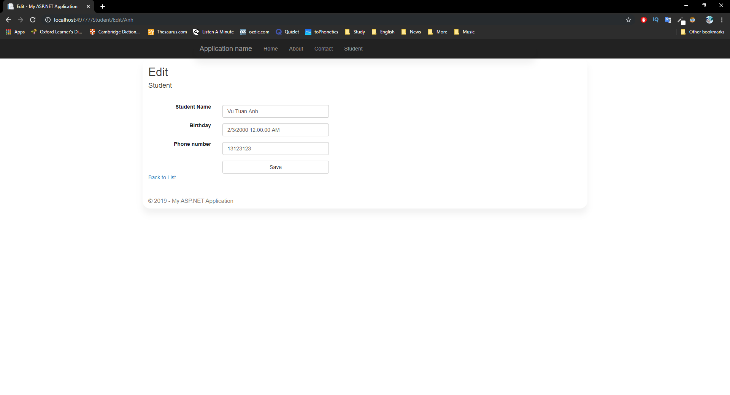
Edit page

Slide 30
Edit page

Slide 31
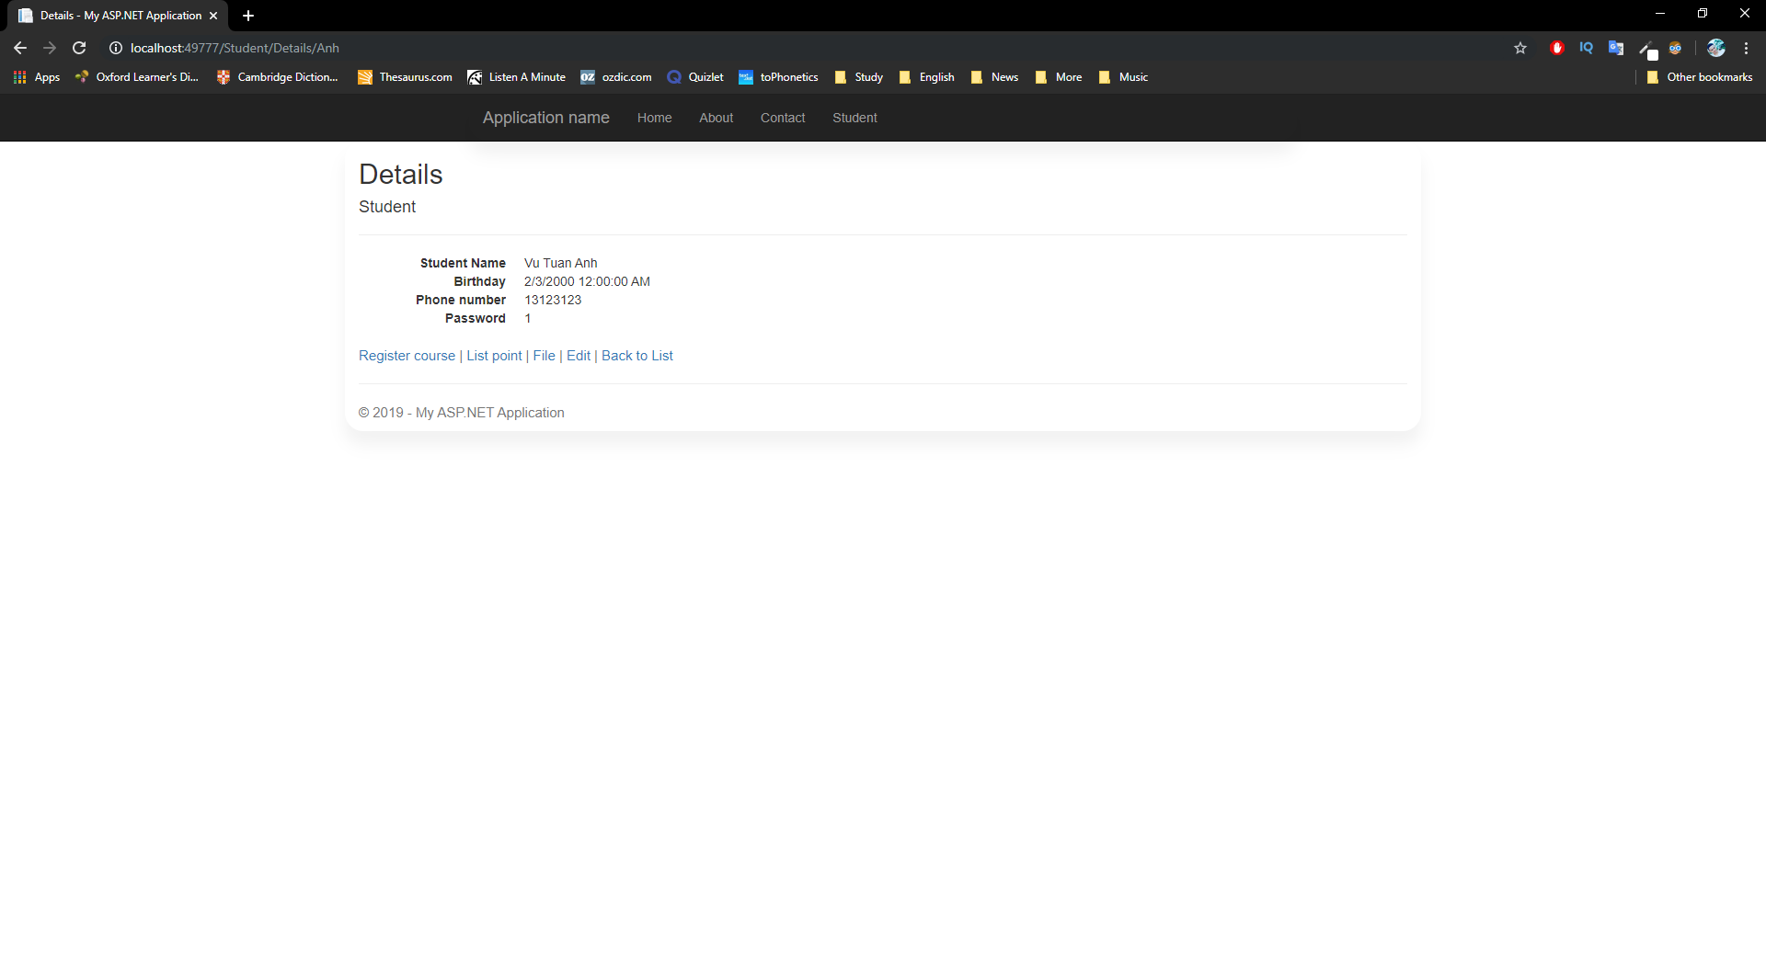
Details page

Slide 32
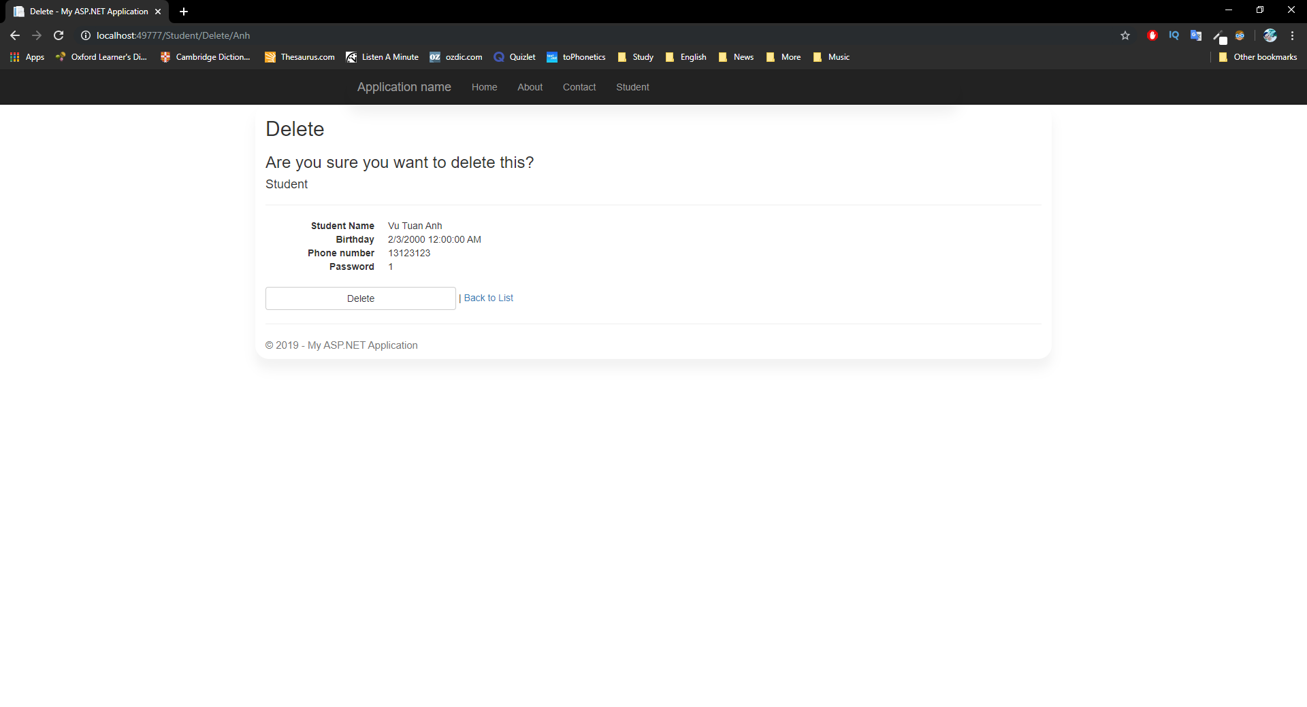
Delete page

