Slide 1
Chapter 3: Relational Algebra

Slide 2
Relational Algebra
Six basic operators
  select: σ
  project: ∏
  union: ∪
  set difference: –
  Cartesian product: x
  rename: ρ
The operators take one or two relations as inputs and produce a new relation as a result.

Slide 3

Select Operation – Example
Relation r
σ_{A=B ^ D > 5} (r)

Slide 4
Select Operation
Notation: σ _{p}(r)
p is called the selection predicate/condition
Defined as:
σ_{p}(r) = {t | t ∈ r and p(t)}
Where p is a formula in propositional calculus consisting of terms connected by : ∧ (and), ∨ (or), ¬ (not)
Each term is one of:
<attribute> op <attribute> or <constant>
where op is one of: =, ≠, >, ≥, <, ≤
Example of selection:
σ _{dept_name=“Physics”}(instructor)

Slide 5

Project Operation – Example
Relation r:
∏_{A,C} (r)

Slide 6

Project Operation
Notation:
where A₁, A₂ are attribute names and r is a relation name.
The result is defined as the relation of k columns obtained by erasing the columns that are not listed
Duplicate rows removed from result, since relations are sets
Example: given instructor(ID, name, dept_name, salary) To eliminate the dept_name attribute of instructor.
∏_{ID, name, salary} (instructor)

Slide 7

Union Operation – Example
Relations r, s:
r ∪ s:

Slide 8
Union Operation
Notation: r ∪ s
Defined as:
r ∪ s = {t | t ∈ r or t ∈ s}
For r ∪ s to be valid.
1. r, s must have the same arity (same number of attributes)
2. The attribute domains must be compatible (example: 2nd column of r deals with the same type of values as does the 2nd
column of s)
Example: to find all courses taught in the Fall 2009 semester, or in the Spring 2010 semester, or in both
∏_{course_id} (σ _{semester=“Fall” Λ year=2009} (section)) ∪
∏_{course_id} (σ _{semester=“Spring” Λ year=2010} (section))

Slide 9

Set difference of two relations
Relations r, s:
r – s:

Slide 10
Set Difference Operation
Notation r – s
Defined as:
r – s = {t | t ∈ r and t ∉ s}
Set differences must be taken between compatible relations.
  r and s must have the same arity
  attribute domains of r and s must be compatible
Example: Given
Section(courseID, secID, semester, year, building, roomNo, timeSlotID).
Find all courses taught in the Fall 2009 semester, but not in the Spring 2010 semester
∏_{course_id} (σ _{semester=“Fall” Λ year=2009} (section)) −
∏_{course_id} (σ _{semester=“Spring” Λ year=2010} (section))

Slide 11

Cartesian-Product Operation – Example
Relations r, s:
r x s:

Slide 12
Cartesian-Product Operation
Notation r x s
Defined as:
r x s = {t q | t ∈ r and q ∈ s}
Assume that attributes of r(R) and s(S) are disjoint. (That is, R ∩ S = ∅).
If attributes of r(R) and s(S) are not disjoint, then renaming must be used.

Slide 13

Composition of Operations
Can build expressions using multiple operations
Example: σ_{A=C}(r x s)
r x s
σ_{A=C}(r x s)

Slide 14

Rename Operation
Allows us to rename, and therefore to refer to, the results of relational-algebra expressions.
Allows us to refer to a relation by more than one name.
Denote by ρ _{x} (E )
returns the expression E under the name X
If a relational-algebra expression E has arity n, then
returns the result of expression E under the name X, and with the attributes renamed to A₁ , A₂ , …., A_{n} .
Ex. Instructor(ID, name, depat_name, salary)
∏_{instructor.salary} (σ_{instructor.salary < d.salary} (instructor x ρ_{d} (instructor)))

Slide 15
Additional Operations
We define additional operations that do not add any power to the relational algebra, but that simplify common queries.
Set intersection
Natural join
Assignment
Outer join

Slide 16
Set-Intersection Operation
Notation: r ∩ s
Defined as:
r ∩ s = { t | t ∈ r and t ∈ s }
Assume:
  r, s have the same arity
  attributes of r and s are compatible
Note: r ∩ s = r – (r – s)

Slide 17

Set-Intersection Operation – Example
Relation r, s:
r ∩ s

Slide 18
Natural-Join Operation
Notation: r s
Let r and s be relations on schemas R and S respectively.
Then, r s is a relation on schema R ∪ S obtained as follows:
  Consider each pair of tuples t_{r} from r and t_{s} from s.
  If t_{r} and t_{s} have the same value on each of the attributes in R ∩ S, add a tuple t to the result, where
    t has the same value as t_{r} on r
    t has the same value as t_{s} on s
Example:
  R = (A, B, C, D)
  S = (E, B, D)
  Result schema = (A, B, C, D, E)
  r s is defined as:
  ∏_{r.A, r.B, r.C, r.D, s.E} (σ_{r.B = s.B ∧ r.D = s.D} (r x s))

Slide 19

Natural Join Example
Relations r, s:
r s
Note: r s = r _{θ}s
where θ: r.D = s.D

Slide 20
Natural Join and Theta Join
Find the names of all instructors in the Comp. Sci. department together with the course titles of all the courses that the instructors teach
  ∏ _{name, title} (σ _{dept_name=“Comp. Sci.”} (instructor teaches course))
Natural join is associative
  (instructor teaches) course is equivalent to
  instructor (teaches course)
Natural join is commutative
  instructor teaches is equivalent to
  teaches instructor
The theta join operation: r _{θ} s or r s is defined as
  r _{θ} s = σ_{θ} (r x s)
θ
Notes:
Commutative tính giao hoán

Slide 21
Theta Join Example
F
G
Relations r, s:
θ
r s
F
G
where,θ: B= F and D=G

Slide 22
Assignment Operation
The assignment operation (←) provides a convenient way to express complex queries.
  Write query as a sequential program consisting of
    a series of assignments
    followed by an expression whose value is displayed as a result of the query.
  Assignment must always be made to a temporary relation variable.
  Ex. ∏ _{name, title} (σ _{dept_name=“Comp. Sci.”} (instructor teaches course))
  Can express:
  buf ← instructor teaches course
  ∏ _{name, title} (σ _{dept_name=“Comp. Sci.”} (buf))

Slide 23
Outer Join
An extension of the join operation that avoids loss of information.
Computes the join and then adds tuples form one relation that does not match tuples in the other relation to the result of the join.
Uses null values:
  null signifies that the value is unknown or does not exist

Slide 24
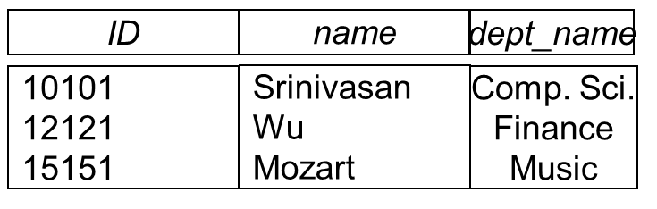
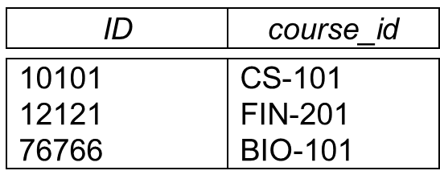
Outer Join – Example
instructor
teaches
Join (inner join)
instructor teaches
ID
name
dept_name
course_id
10101
12121
Srinivasan
Wu
Comp. Sci.
Finance
CS-101
FIN-201
Left Outer Join
instructor teaches
ID
name
dept_name
course_id
10101
12121
15151
Srinivasan
Wu
Mozart
Comp. Sci.
Finance
Music
CS-101
FIN-201
null

Slide 25
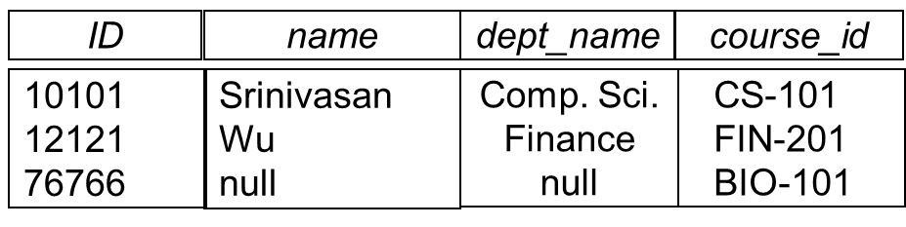
Outer Join – Example
Right Outer Join
instructor teaches
Full Outer Join
instructor teaches
ID
name
dept_name
course_id
10101
12121
15151
76766
Srinivasan
Wu
Mozart
null
Comp. Sci.
Finance
Music
null
CS-101
FIN-201
null
BIO-101

Slide 26
Extended Relational-Algebra-Operations
Generalized Projection
Aggregate Functions

Slide 27
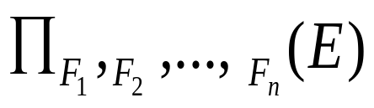
Generalized Projection
Extends the projection operation by allowing arithmetic functions to be used in the projection list.
F is any relational-algebra expression
Each of F₁, F₂, …, F_{n} are arithmetic expressions involving constants and attributes in the schema of E.
Ex.
Given relation instructor(ID, name, dept_name, salary) where salary is annual salary, get the same information but with monthly salary
∏_{ID, name, dept_name, salary/12} (instructor)

Slide 28
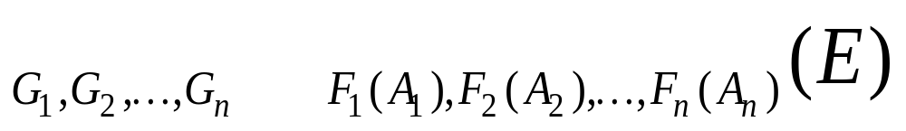

Aggregate Functions and Operations
Aggregation function takes a collection of values and returns a single value as a result.
avg, min, max, sum, count
Aggregate operation in relational algebra
E is any relational-algebra expression
  G₁, G₂ …, G_{n} is a list of attributes on which to group (can be empty)
  Each F_{i} is an aggregate function
  Each A_{i} is an attribute name
Note: Some books/articles use γ or (Calligraphic G)
: pronounced script F
F
F

Slide 29
Aggregate Operation – Example
Relation r:
A
B
C
α
α
β
β
α
β
β
β
7
7
3
10
F
_{sum(c)} (r)
sum(c )
27

Slide 30


Aggregate Operation – Example
Find the average salary in each department
_{dept_name} _{avg(salary)} (instructor)
F
No col name

Slide 31

Aggregate Functions (Cont.)
Result of aggregation does not have a name
  Can use rename operation to give it a name
  For convenience, we permit renaming as part of aggregate operation
_{dept_name} _{avg(salary) as avg_sal} (instructor)
F
avg_salary

Slide 32
Modification of the Database
The content of the database may be modified using the following operations:
  Deletion
  Insertion
  Updating
All these operations can be expressed using the assignment operator

Slide 33
Given a banking database:
BRANCH(branch name, branch city, assets)
CUSTOMER (customer name, customer street, customer city)
LOAN (loan number, branch name, amount)
BORROWER (customer name, loan number)
ACCOUNT (account number, branch name, balance)
DEPOSITOR (customer name, account number)

Slide 34
Deletion
A delete request is expressed similarly to a query, except instead of displaying tuples to the user, the selected tuples are removed from the database.
Can delete only whole tuples; cannot delete values on only particular attributes
A deletion is expressed in relational algebra by:
r ← r – E
where r is a relation and E is a relational algebra query.

Slide 35
Deletion Examples
ACCOUNT (account number, branch name, balance)
LOAN (loan number, branch name, amount)
BRANCH(branch name, branch city, assets)
DEPOSITOR (customer name, account number)
Delete all account records in the Perryridge branch.
account ← account – σ _{branch_name = “Perryridge”} (account )
Delete all loan records with amount in the range of 0 to 50
loan ← loan – σ _{amount ≥ 0 and amount ≤ 50} (loan)
Delete all accounts at branches located in Needham city.
r₁ ← σ _{branch_city = “Needham”} (account branch )
r₂ ← ∏ _{account_number,} _{branch_name, balance} (r₁)
r₃ ← ∏ _{customer_name, account_number} (r₂ depositor)
account ← account – r₂
depositor ← depositor – r₃

Slide 36
Insertion
To insert data into a relation, we either:
  specify a tuple to be inserted or
  write a query whose result is a set of tuples to be inserted
in relational algebra, an insertion is expressed by:
r ← r ∪ E
where r is a relation and E is a relational algebra expression.
The insertion of a single tuple is expressed by letting E be a constant relation containing one tuple.

Slide 37
Insertion Examples
ACCOUNT (account number, branch name, balance)
DEPOSITOR (customer name, account number)
LOAN (loan number, branch name, amount)
BORROWER(customer name, loan number)
Insert information in the database specifying that Smith has $1200 in account A-973 at the Perryridge branch.
account ← account ∪ {(“A-973”, “Perryridge”, 1200)}
depositor ← depositor ∪ {(“Smith”, “A-973”)}
Provide as a gift for all loan customers in the Perryridge
branch, a $200 savings account. Let the loan number serve
as the account number for the new savings account.
r₁ ← (σ_{branch_name = “Perryridge”} (borrower loan))
account ← account ∪ ∏_{loan_number, branch_name, 200} (r₁)
depositor ← depositor ∪ ∏_{customer_name, loan_number} (r₁)

Slide 38
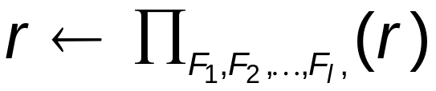
Updating
A mechanism to change a value in a tuple without charging all values in the tuple
Use the generalized projection operator to do this task

Slide 39
Update Examples
ACCOUNT (account number, branch name, balance)
Make interest payments by increasing all balances by 5 percent.
account ← ∏ account_number, branch_name, balance * 1.05 (account)
Pay all accounts with balances over $10,000 6 percent interest and pay all others 5 percent
account ← ∏ account_number, branch_name, balance * 1.06 (σ _{BAL > 10000} (account ))
∪ ∏ account_number, branch_name, balance * 1.05 (σ_{BAL ≤ 10000} (account))

Slide 40
End of Chapter 3

Slide 41

Schema Diagram for University Database

Slide 42
Example Queries
LOAN (loan number, branch name, amount)
BORROWER (customer name, loan number)
DEPOSITOR (customer name, account number)
Find the names of all customers who have a loan and an account at bank.
  ∏_{customer_name} (borrower) ∩ ∏_{customer_name} (depositor)
Find the name of all customers who have a loan at the bank and the loan amount
  ∏customer_name, loan_number, amount (borrower loan)

Slide 43
Example Queries
DEPOSITOR (customer name, account number)
ACCOUNT (account number, branch name, balance)
Find all customers who have an account from at least the “Downtown” and the Uptown” branches.
  Query 1
    ∏_{customer_name} (σ_{branch_name = “Downtown”} (depositor account )) ∩
    ∏_{customer_name} (σ_{branch_name = “Uptown”} (depositor account))
  Query 2
  ∏_{customer_name, branch_name} (depositor account)
  ÷ ρ_{temp(branch_name)} ({(“Downtown” ), (“Uptown” )})
  Note that Query 2 uses a constant relation.

Slide 44
Multiset Relational Algebra
Pure relational algebra removes all duplicates
  e.g. after projection
Multiset relational algebra retains duplicates, to match SQL semantics
  SQL duplicate retention was initially for efficiency, but is now a feature
Multiset relational algebra defined as follows
  selection: has as many duplicates of a tuple as in the input, if the tuple satisfies the selection
  projection: one tuple per input tuple, even if it is a duplicate
  cross product: If there are m copies of t1 in r, and n copies of t2 in s, there are m x n copies of t1.t2 in r x s
  Other operators similarly defined
    E.g. union: m + n copies, intersection: min(m, n) copies
    difference: min(0, m – n) copies

Slide 45
Division Operator
Given relations r(R) and s(S), such that S ⊂ R, r ÷ s is the largest relation t(R-S) such that
t x s ⊆ r
E.g. let r(ID, course_id) = ∏_{ID, course_id} (takes ) and
s(course_id) = ∏_{course_id} (σ_{dept_name=“Biology”}(course )
then r ÷ s gives us students who have taken all courses in the Biology department
Can write r ÷ s as
temp1 ← ∏_{R-S} (r )
temp2 ← ∏_{R-S} ((temp1 x s ) – ∏_{R-S,S} (r ))
result = temp1 – temp2
  The result to the right of the ← is assigned to the relation variable on the left of the ←.
  May use variable in subsequent expressions.

Slide 46
Bank Example Queries
Find all customers who have an account at all branches located in Brooklyn city.
∏_{customer_name, branch_name} (depositor account)
÷ ∏_{branch_name} (σ_{branch_city = “Brooklyn”} (branch))

Slide 47
Example Query
given instructor(ID, name, dept_name, salary). Find the largest salary in the university
  Step 1: find instructor salaries that are less than some other instructor salary (i.e. not maximum)
      using a copy of instructor under a new name d
    ∏_{instructor.salary} (σ _{instructor.salary < d.salary} (instructor x ρ_{d} (instructor)))
  Step 2: Find the largest salary
    ∏_{salary} (instructor) –
    ∏_{instructor.salary} (σ _{instructor.salary < d.salary} (instructor x ρ_{d} (instructor)))

Slide 48
Example Queries
Given instructor(ID, name, dept_name, salary) and
teaches(ID, courseID, sec_ID, semester, year)
Find the names of all instructors in the Physics department, along with the course_id of all courses they have taught
  Query 1
  ∏_{instructor.ID,course_id} (σ_{dept_name=“Physics”} (
  σ _{instructor.ID=teaches.ID} (instructor x teaches)))
  Query 2
  ∏_{instructor.ID,course_id} (σ_{instructor.ID=teaches.ID} (
  σ _{dept_name=“Physics”} (instructor) x teaches))

Slide 49
Formal Definition
A basic expression in the relational algebra consists of either one of the following:
  A relation in the database
  A constant relation
Let E₁ and E₂ be relational-algebra expressions; the following are all relational-algebra expressions:
  E₁ ∪ E₂
  E₁ – E₂
  E₁ x E₂
  σ_{p} (E₁), P is a predicate on attributes in E₁
  ∏_{s}(E₁), S is a list consisting of some of the attributes in E₁
  ρ _{x} (E₁), x is the new name for the result of E₁

Slide 50
Null Values
It is possible for tuples to have a null value, denoted by null, for some of their attributes.
null signifies an unknown value or that a value does not exist.
The result of any arithmetic expression involving null is null.
Aggregate functions simply ignore null values (as in SQL)
For duplicate elimination and grouping, null is treated like any other value, and two nulls are assumed to be the same (as in SQL)

