Slide 1
Conservative Road-Scene Risk Assessment via Fail-Aware Multi-Model Fusion
CLEAR
MONITOR
SLOW
BRAKE
STOP
Pham Hoang Bach · Vu Gia Tien · Trinh Quang Tien · Cao Van Mai
Faculty of Artificial Intelligence, FPT University, Hanoi, Vietnam
ICoCSETI 2026 · Jakarta, Indonesia
Notes:
Good morning. Our paper is about deciding when a single road image justifies a clear-path advisory. We combine three frozen pretrained models and add a fail-aware fusion layer whose job is to stay conservative when the evidence is weak. The five colored labels on top are the advisory levels the system outputs, from CLEAR to STOP.

Slide 2



One image, three kinds of uncertainty
OPENING
Detector misses
Depth has no scale
Path is ambiguous
A missed vehicle or pedestrian silently turns into an empty road, especially at night and in rain.
Monocular depth orders the scene near to far, but gives no meters and becomes unstable on dark, blurred or occluded objects.
A box does not say whether the object is in the ego lane, at its edge, or parked beside the road.
Goal: weak or conflicting evidence may add caution, but must never produce a confident CLEAR or an unsupported STOP.
Notes:
A single front image hides three problems. The detector can miss objects, monocular depth has no metric scale, and a box alone does not tell us whether the object is in our lane. Collapsing all of this into one precise-looking warning hides the uncertainty. Our goal is asymmetric: weak evidence may add caution, but it must never create a confident CLEAR or an unsupported STOP.

Slide 3




What this work contributes
OPENING
Interpretable fusion
Multi-region depth reliability
YOLO11 objects related to a HybridNets ego corridor and Depth Anything V2 relative depth; weak evidence can add caution but cannot justify a severe advisory.
Each object is labeled STABLE, CHECK or UNCERTAIN from the agreement of three mask regions, and validated against annotations.
Severity gates and fallback
Reproducible evaluation
Caps on unsupported BRAKE/STOP and a depth-only fallback for detector-empty images, measured with ground-truth lane occupancy.
9,500 BDD100K validation images, released image IDs, cached-replay ablations, confidence intervals and exact McNemar tests.
Notes:
We make four contributions: an interpretable fusion architecture in which weak evidence can only add caution; a multi-region depth reliability estimator whose states we validate against annotations; severity gates and a depth-only fallback that we measure with ground-truth lane occupancy; and a reproducible evaluation on 9,500 BDD100K images with released IDs.

Slide 4
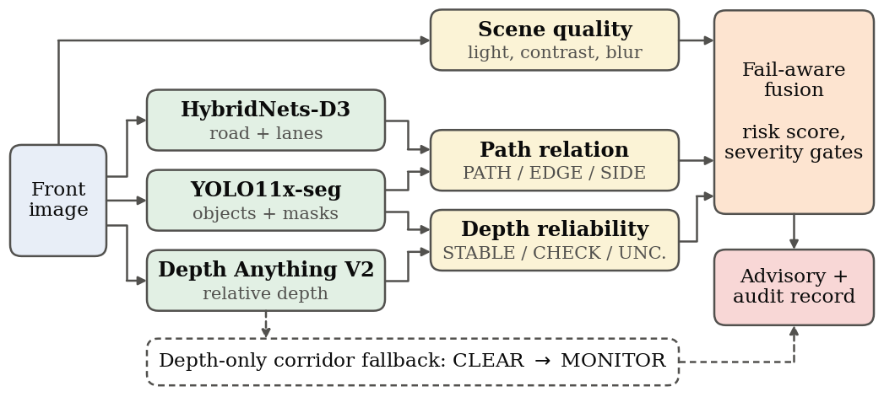



Three frozen models, one fail-aware fusion layer
METHOD
No training
All three networks are used as released; only the fusion layer is ours.
Relative depth only
Depth orders objects within one image; it is never read as meters.
Audit record
Every object keeps its confidences, depth state, path relation and advisory.
YOLO11x-seg 960 px, 4-pass TTA · HybridNets-D3 640 px · Depth Anything V2 ViT-L 518 px
Notes:
The pipeline. YOLO11x-seg gives objects and masks, HybridNets gives road and lane masks, Depth Anything V2 gives a relative depth field. Scene quality is computed from the image itself. The path relation combines the detector with HybridNets; the depth reliability combines the detector masks with the depth field. The fusion layer computes a risk score, applies severity gates, and outputs one advisory plus an audit record per object. If no object is detected, a depth-only check along the corridor can still raise CLEAR to MONITOR. Nothing is trained.

Slide 5
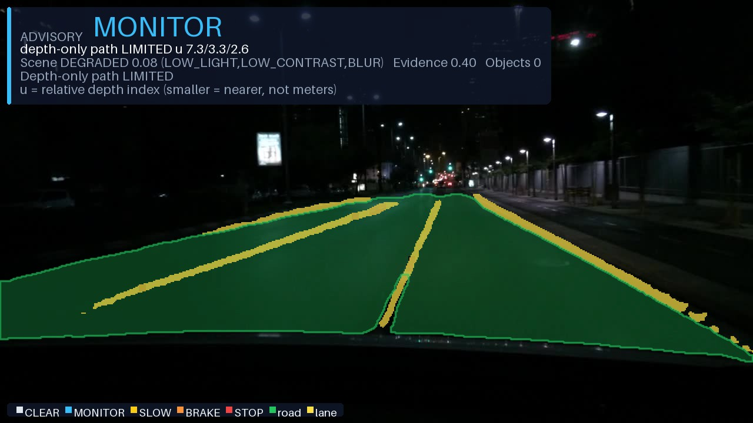
Scene quality and a relative depth index
METHOD
Scene quality q_s (from the gray image)
q_s = 0.40 q_illum + 0.30 q_contrast + 0.30 q_sharp
median brightness m, 10–90 percentile range R, Laplacian variance v
Flags: low light m < 45, low contrast R < 55, blur v < 60, glare
DEGRADED if q_s < 0.35 or dark and blurred; LIMITED if q_s < 0.58 or any flag
Relative depth index u (from Depth Anything V2)
u = clip(1000 / d, 0.1, 999)
smaller u = nearer surface; the network output d has unknown scale and shift
used only to order objects within one image, never as meters
DEGRADED night scene, no object detected. Scene quality 0.08 (low light, low contrast, blur); the depth-only corridor check is LIMITED, so CLEAR is raised to MONITOR.
Notes:
Two signals feed every decision. Scene quality is computed from the image itself: brightness, contrast and sharpness, with separate flags. Depth Anything gives an inverse-depth response with unknown scale; we turn it into a relative index u where smaller means nearer, and we never read it as meters. On the right, a degraded night image with no detection: the depth-only check cannot confirm a clear corridor, so the advisory is MONITOR, not CLEAR.

Slide 6
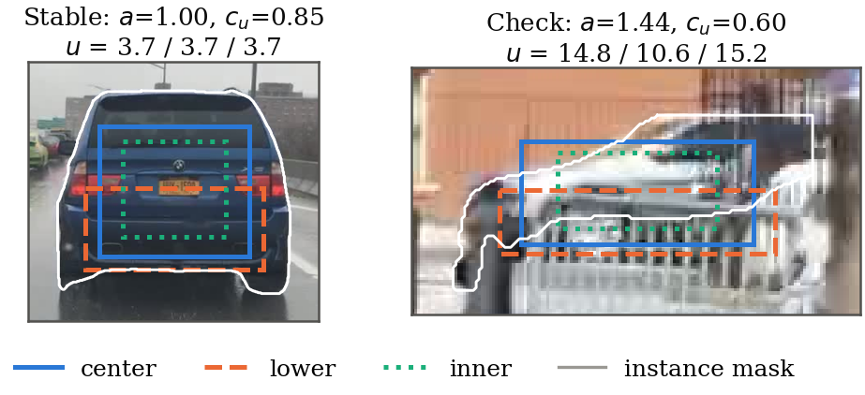
Do the parts of an object agree on its depth?
METHOD
How the state is set
Relative depth u is sampled in the center, lower-body and inner-core regions of the mask
Disagreement ratio a = max u_r / min u_r
Reliability c_u combines a, the spread of the samples and the support
STABLE
c_u ≥ 0.68 and a ≤ 1.35
Left: the three regions agree (a = 1.00) → STABLE. Right: the mask leaks into the background (a = 1.44) → CHECK.
CHECK
c_u ≥ 0.35 and a ≤ 1.80
UNCERTAIN
otherwise
Notes:
For each object we sample the relative depth in three regions of its instance mask. If they agree, the estimate is STABLE. On the right the mask leaks into the background, so the regions disagree and the object is kept at CHECK. The thresholds were fixed before the evaluation; we report their sensitivity later. A STABLE state means agreement, not ground-truth accuracy.

Slide 7



From evidence to a conservative advisory
METHOD
CLEAR
MONITOR
SLOW
BRAKE
STOP
risk < 24
risk ≥ 24
risk ≥ 40
risk ≥ 60
risk ≥ 78
Path relation
Severity gates
Depth-only fallback
PATH adds +32 and EDGE +15 to the risk score. A SIDE object can raise at most MONITOR (SLOW for a close vulnerable road user).
STOP needs a close, STABLE, in-path object with detector ≥ 0.55 and evidence ≥ 0.48. Weak evidence caps BRAKE and SLOW.
No object detected? If the depth along the corridor is not consistent, CLEAR is raised to MONITOR. It never creates an object.
Notes:
A risk score from relative depth, size, position and the path relation is mapped to five levels at fixed cut-offs. Severity gates then cap unsupported outputs: a side object cannot trigger a brake, and STOP needs a close, stable, in-path object with strong evidence. When nothing is detected, the depth-only fallback can raise CLEAR to MONITOR, but it never invents an object or a distance.

Slide 8
Evaluated against BDD100K ground truth
EVALUATION
Split | Images | Use
Test | 9,500 | every headline number
Dev | 500 | priors, sensitivity, operating curve only
Hard set | 100 | dark, low contrast, blur, glare, complex
1k subset | 1,000 | perturbation stability
val_rest | 8,400 | held-out operating-point check
Train | 69,863 | supplementary (HybridNets saw it)
Definitions, fixed before any result
Occupied image
a relevant road user (≥ 5% of image height) stands in the annotated ego lane
Unsafe CLEAR
CLEAR advisory on an occupied image
Over-caution
SLOW or higher while no road user is in the ego lane
Statistics
Wilson intervals, image-cluster bootstrap (10,000), exact McNemar
Image IDs and SHA-256 hashes of every split are released.
Notes:
Reviewer two asked for ground-truth validation and a reproducible set, so every headline number now comes from 9,500 BDD100K validation images. A 500-image dev subset is used only for priors, sensitivity and the operating curve. The hard set is a deterministic stress subset, and all image IDs are released. An unsafe CLEAR is a CLEAR advisory while a relevant road user is in the ego lane; over-caution is SLOW or higher on a free lane. These definitions were fixed before we looked at any result.

Slide 9
Reliability states carry real signal
RESULTS
84.9%
of the 75,819 accepted test detections are STABLE
1.8×
non-STABLE estimates are false positives 1.8 times as often (17.4% vs 9.7%)
69%
of CHECK objects are truncated by the image border, against 2.5% of STABLE ones
Notes:
Do the states mean anything? Yes. On the test split 84.9 percent of detections are STABLE. Non-stable estimates are false positives 1.8 times as often, and UNCERTAIN ones 44 percent of the time. CHECK mostly marks objects cut by the image border, exactly where regional samples cannot agree. A STABLE state is still agreement, not a guarantee.

Slide 10
All headline numbers at a glance
RESULTS
Measure | Hard set (100) | Test split (9,500)
Accepted detections | 505 | 75,819
STABLE / CHECK / UNCERTAIN | 437 / 67 / 1 | 64,334 / 11,104 / 354
Stable ratio [95% CI] | 86.5 [83.3, 89.2] | 84.9 [84.6, 85.1]
Detection precision (GT) | 86.3 | 89.1
Recall of relevant road users | 72.2 | 78.9
PATH precision / recall | 15.8 / 56.8 | 9.2 / 53.8
Corridor IoU with GT ego lane | 0.242 | 0.240
Unsafe CLEAR (fallback on) | 0 / 30 | 11 / 3,250 (0.3%)
Unsafe CLEAR (fallback off) | 1 / 30 | 15 / 3,250 (0.5%)
Over-caution (free ego lane) | 34 / 67 (50.7%) | 4,799 / 5,844 (82.1%)
Unsupported BRAKE / STOP | 31 / 47 | 4,179 / 6,188
Detector-empty / fallback fired | 15 / 15 | 295 / 236
How to read it
Percentages unless counts are shown; brackets are 95% confidence intervals.
The hard set is a stress test of 100 dark, low-contrast, blurred, glare and complex images.
Over-caution is an upper bound: an adjacent-lane hazard can justify some of these advisories.
Notes:
This table collects every headline number of the paper for the hard set and the 9,500-image test split. The fusion layer reaches 89 percent precision and 79 percent recall of relevant road users. Unsafe CLEAR is 11 of 3,250 with the fallback and 15 without it. The cost is over-caution: 82 percent of free-lane images still receive SLOW or higher.

Slide 11
Safe, at a measured cost
RESULTS
The price
Safety
82.1%
2.1%
9.2%
11 / 3,250
over-caution on free-lane images
of test images receive CLEAR
PATH precision against the ego lane
occupied test images received an unsafe CLEAR (0.34%, upper bound 0.6%); 0 of 30 on the hard set
Cause: the ego corridor. The fixed perspective band overlaps the annotated ego lane with IoU 0.24, while HybridNets' own road mask reaches 0.83. Roadside and distant objects are labeled PATH.
6 of the 11: object detected but placed beside the corridor. 5: missed by the detector (4 at night).
Notes:
The main safety result: only 11 of 3,250 occupied test images received an unsafe CLEAR. In six of them the object was detected but placed beside the corridor; in five the detector missed it, four at night. But this safety has a price. Over-caution reaches 82 percent, and only 2 percent of images get CLEAR. The cause is the fixed perspective corridor: it matches the ego lane with IoU 0.24, while HybridNets' road mask itself reaches 0.83. We report this openly.

Slide 12
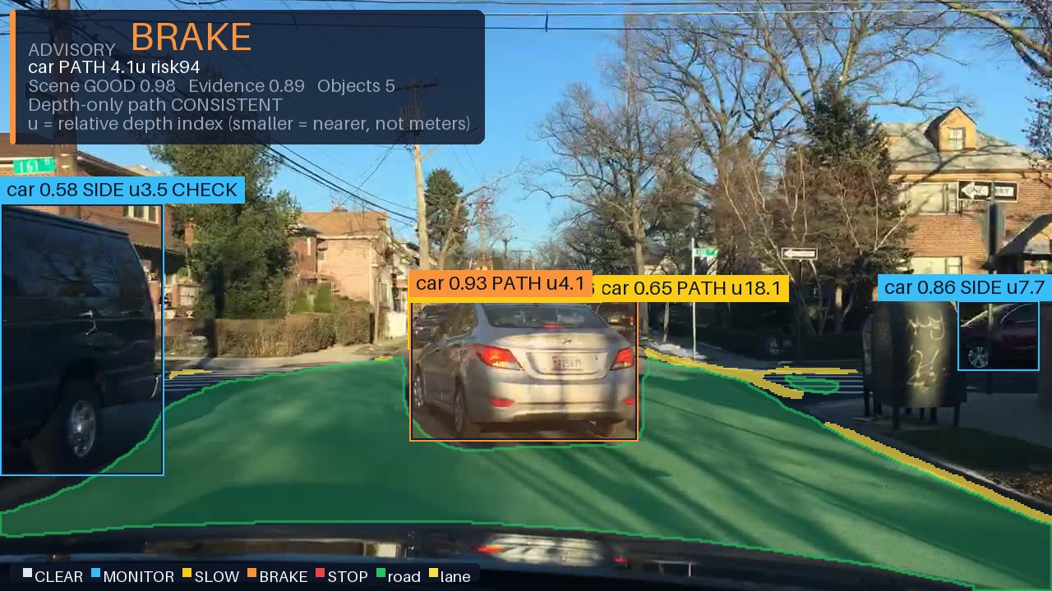
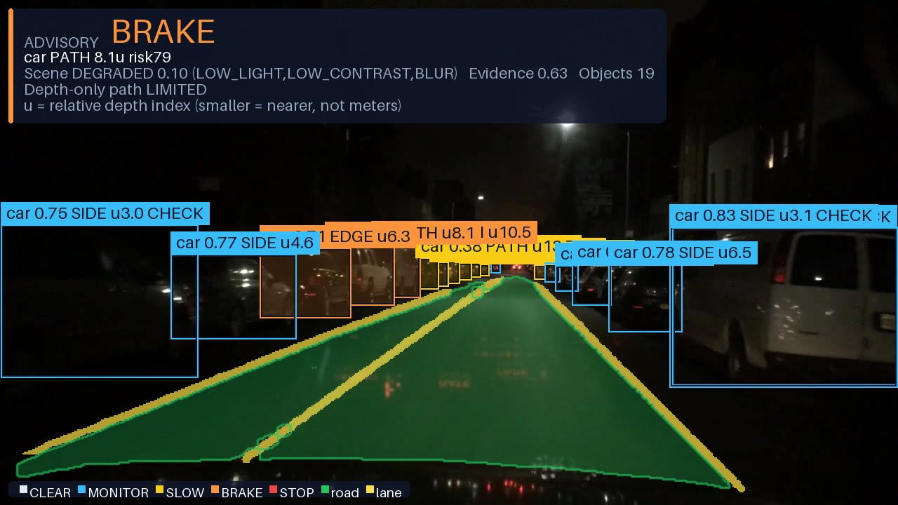
What the system shows
RESULTS
Daytime. The car ahead is PATH and raises BRAKE; parked cars are SIDE and stay at MONITOR.
Night, degraded scene. The gates keep the advisory at BRAKE; depth that is not STABLE is labeled CHECK.
Every box: class · confidence · PATH/EDGE/SIDE · u (relative depth, smaller = nearer, not meters) · CHECK if depth not STABLE
Notes:
Two real outputs. Each box takes the color of the advisory that object raised. In daytime, the car ahead is in the path and raises BRAKE, while parked cars are side objects. At night the scene is degraded; the gates keep the advisory at BRAKE, and CHECK flags depth that is not stable. Every label comes from the audit record.

Slide 13
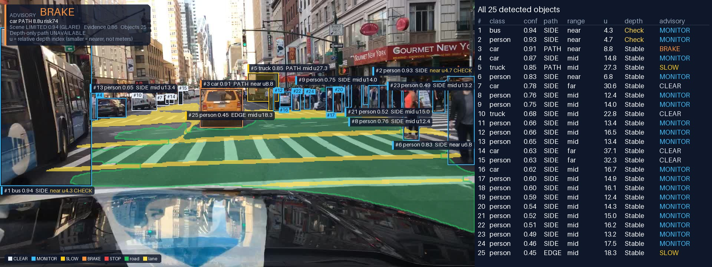
Every detection, with its numbers
RESULTS
Each box carries its number; the table lists all 25 objects. Detected here: 21 of the 34 relevant road users in the annotations. The others have no box because the detector missed them (recall 78.9% on the test split), not because the display hides them.
Notes:
This view shows every detection: each box is numbered and the table on the right lists class, confidence, path relation, relative depth index, depth state and the advisory it raised. Vehicles without a box were not detected; the detector finds about 79 percent of relevant road users, 21 of 34 in this crowded street.

Slide 14
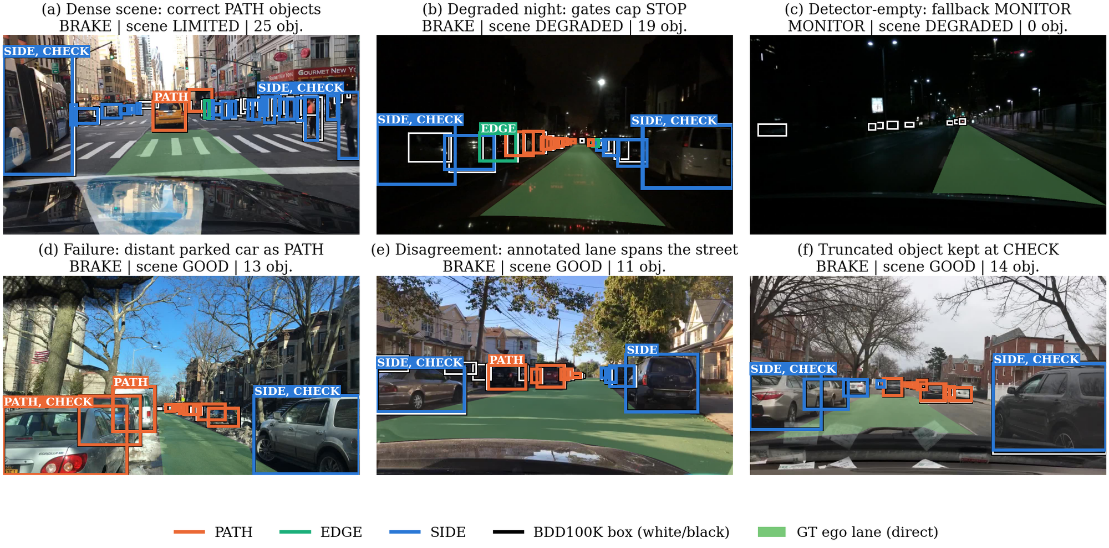
Six hard-set cases, compared with the annotations
RESULTS
(a–c) intended behaviour
correct PATH objects; gates cap STOP at night; fallback raises MONITOR
(d) failure
a distant parked car falls inside the corridor and is labeled PATH
(e) disagreement
the annotated ego lane spans the whole street
(f) truncation
an object cut by the image border is kept at CHECK
Colored boxes: system output by path relation (PATH, EDGE, SIDE; CHECK = depth not STABLE) · white boxes: BDD100K annotations · green: annotated ego lane
Notes:
Here the outputs are compared with the annotations. White boxes are ground truth, the green tint is the annotated ego lane. The first three cases show intended behaviour. Case d is the typical failure: a parked car far ahead falls inside the perspective corridor. Case e is an annotation disagreement, and case f shows a truncated object kept at CHECK.

Slide 15
Each component, replayed on identical network outputs
RESULTS
Severity gates
STOP 3,893 → 1,166 and over-caution 5,157 → 4,799 images (p < 0.001); flips 12.2% → 8.3%
Full vs. YOLO-only B0
unsafe CLEAR 17 → 11 and over-caution 86.7% → 82.1%
Depth Anything V2
replacing it changes 3,631 advisories: per-image depth drives severity
Fallback
fires on 236 of 295 empty images; unsafe CLEAR 15 → 11 (p = 0.12, few events)
Notes:
Every ablation re-runs only the fusion stage on the same cached network outputs, so the comparisons are paired. Adding the gates and the fallback is what brings over-caution down and unsafe CLEAR from 17 to 11 relative to YOLO alone. The gates are the strongest component: without them STOP triples. Depth Anything drives the severity. The fallback effect points the right way but is not significant with so few events, p equals 0.12, and we say so.

Slide 16
Removing one component at a time
RESULTS
Variant (test split) | Unsafe CLEAR | Over-caution % | BRAKE/STOP % | Advisories changed | McNemar p
Full system | 11 | 82.1 | 65.1 | – | –
without HybridNets (road prior) | 13 | 80.3 | 65.6 | 364 | 0.62
without Depth Anything V2 (depth prior) | 12 | 83.0 | 55.8 | 3,631 | 1.00
without multi-region (center only) | 11 | 82.0 | 65.0 | 47 | 1.00
without scene quality | 14 | 82.4 | 65.7 | 232 | 0.25
without severity gates | 11 | 88.2 | 74.5 | 4,024 | 1.00
without depth-only fallback | 15 | 82.1 | 65.1 | 236 | 0.12
Reading: the p-values test unsafe CLEAR, which has only about ten events, so none of these differences is significant on its own. The gates have the largest effect on the outputs (over-caution 5,157 vs 4,799 images, p < 0.001); depth drives the severity; HybridNets is under-used, since only 9.8% of corridor rows follow the detected lanes.
Notes:
Leave-one-out replays on the same cached network outputs. The p-values are exact McNemar tests on unsafe CLEAR, which has about ten events, so individually none is significant; we say so in the paper. The gates change the most advisories, Depth Anything drives the severity, and HybridNets matters little because the corridor rarely follows its lanes.

Slide 17
A margin chosen on the dev set does not transfer
RESULTS
0 → 0
unsafe CLEAR on the dev set at ×1.4, while over-caution falls 85.0% → 72.4%
9 → 28
on 8,400 held-out images: unsafe CLEAR triples (0.31% → 0.98%)
The dev set has only 162 occupied images, too few to see a 0.3% event rate. The published cut-offs are kept.
Notes:
Could we simply relax the thresholds? On the dev set, scaling all cut-offs by 1.4 removes 12 points of over-caution without a single unsafe CLEAR. But on 8,400 held-out images the same change triples unsafe CLEAR, and the 70-thousand-image train split confirms it. The dev set is too small to see such rare events, so we keep the published, conservative cut-offs.

Slide 18



Night, weather, perturbations and hardware
RESULTS
Night is the weak spot
Recall 70.4% vs 83.3% by day. Rain costs 3.2 points by day and 4.4 at night; snow almost none; fog: only 13 test images.
Mild perturbations
The advisory changes in 5.2% of image pairs (6.6% without gates).
Different GPU
RTX 3050 vs T4: 0 of 1,000 and 1 of 5,130 advisories differ.
Notes:
Weather is confounded with time of day, so we compare within each time of day. Rain lowers recall by about three points by day and four at night, snow hardly matters, and fog is too rare to judge. Night is the real weak spot. The same pattern holds on the 70-thousand-image train split. Under six mild perturbations the advisory changes for about 5 percent of images, less with the gates, and changing the GPU changes almost nothing.

Slide 19
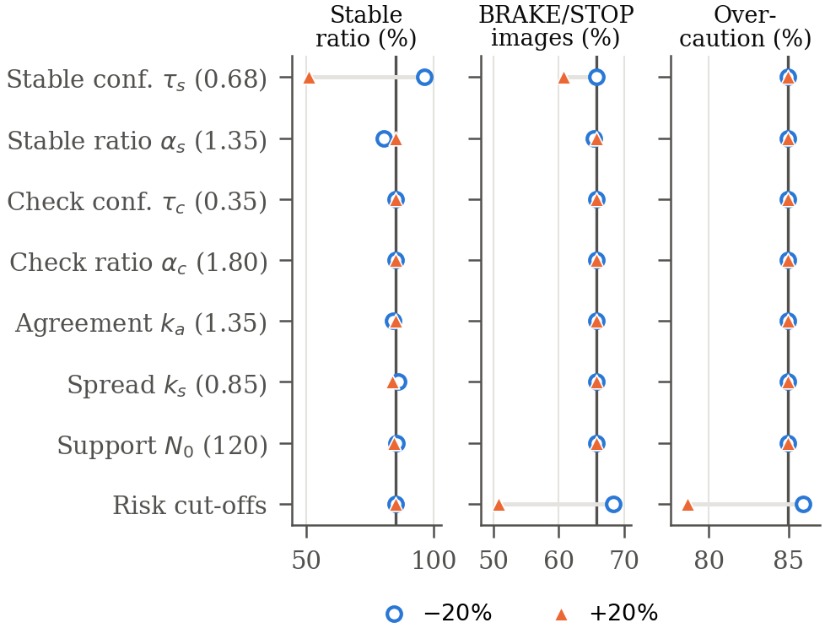
Sensitivity of the fixed constants
RESULTS
≤ 34 points
change of the stable ratio when a reliability constant moves by ±20%, almost entirely through the STABLE threshold
≤ 5 points
change of the BRAKE/STOP rate; over-caution does not change
0 / 162
unsafe CLEAR on the occupied dev images, for every sensitivity setting
Notes:
All constants were fixed during development. Changing each reliability constant by plus or minus 20 percent on the dev subset moves the stable ratio a lot, as expected by its definition, but the advisories barely move and no setting creates an unsafe CLEAR. The advisory trade-off is governed by the risk cut-offs, which the operating curve sweeps.

Slide 20
Supplementary check on 69,863 train images
RESULTS
Measure | Test, full | Test, no HybridNets | Train, full | Train, no HybridNets
Detection precision (%) | 89.1 | 91.3 | 88.9 | 91.2
Recall, relevant road users (%) | 78.9 | 76.0 | 79.4 | 76.6
PATH precision / recall (%) | 9.2 / 53.8 | 9.9 / 54.4 | 9.1 / 53.3 | 9.8 / 54.0
Road IoU (HybridNets vs GT) | 0.828 | – | 0.854 | –
Unsafe CLEAR (% occupied) | 0.34 | 0.40 | 0.26 | 0.40
Over-caution (% free lane) | 82.1 | 80.3 | 80.8 | 79.1
BRAKE / STOP (% images) | 65.1 | 65.6 | 64.9 | 65.4
Same picture on 7× more images. HybridNets was trained on these images, so its road output is slightly optimistic there (IoU 0.854 vs 0.828); the COCO-pretrained detector was not, and Depth Anything saw BDD100K images only without labels. Labels come from public copies that reproduce all 10,000 validation labels and masks exactly.
Notes:
As a supplementary check we ran the same protocol on all 69,863 annotated BDD100K train images. The numbers are almost identical to the test split, so the headline results are not an accident of the split. HybridNets saw these images in training, which is why they are reported separately.

Slide 21
Limitations and next steps
CLOSING
Limitations
Next steps
Static images: no speed, time-to-collision or tracking
Over-inclusive corridor: frequent over-caution
Night recall and rare fog
Lane relation approximated from drivable-area maps
2.3 s per image: an offline analysis tool
Drivable-mask corridor: in a replay, over-caution falls 4,799 → 3,843 images with the same 11 unsafe CLEAR
Video: temporal consistency, speed and time-to-collision
Calibrated distance targets and human rating of the advisories
Notes:
The study uses static images only and the corridor is over-inclusive. Night recall is the second weak spot, and fog is untested. The clearest next step comes from our own ablations: intersecting the corridor with the HybridNets drivable mask cut over-caution from 4,799 to 3,843 images with the same 11 unsafe CLEAR. This is exploratory and not part of the evaluated method.

Slide 22



Every number can be regenerated
CLOSING
Released splits
Byte-identical replay
Image-ID lists of every split with SHA-256 hashes (test prefix af51f530c5d9b3c5).
Replaying the published constants on cached network outputs reproduces the original reports exactly.
Two GPUs agree
Public code
RTX 3050 and T4 with pinned library versions: 0 of 1,000 and 1 of 5,130 advisories differ.
Evaluation, tables and figures are generated by scripts; no number is typed by hand.
python scripts/download_weights.py
python run_paper.py input --output-dir outputs/paper
Notes:
Reproducibility was a reviewer request. All splits are released with hashes, replays are byte-identical, and two different GPUs give the same advisories. Two commands download the official weights, verify their checksums, and run the pipeline.

Slide 23
Takeaways
Conservative by design
Reliability states are informative
The cost is measured and explained
11 unsafe CLEAR in 3,250 occupied test images
non-STABLE estimates: 1.8× more false positives
over-caution comes from the corridor, with a tested remedy
Code, image-ID manifests and evaluation scripts
github.com/VuTien1311/roadsense-risk-assessment
Thank you · Questions?
Notes:
To summarize: the fusion layer is conservative by design, its reliability states carry real information about correctness, and its cost is measured and explained, with a tested remedy. Code, image IDs and evaluation scripts are public. Thank you, we are happy to take questions.

