Slide 1


Airline Reservation System
Group - 8
Instructor:
Prof. Payman Salek

Slide 2
AGENDA
Introduction
Install and config
Class Diagram
ERD
Security JWT
implemented features
Microservice and other optional

Slide 3
Team Members
Student ID | Full name | Note
610601 | Robel Teferi
 | Chi Cuong Nguyen
 | Andrew Qolta
610769 | The Yen Pham
610505 | Yafet Andeberhan

Slide 4
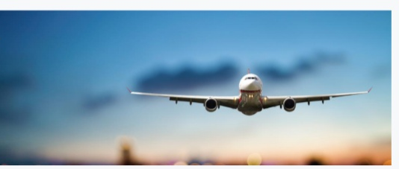
Introduction
We are trying to create a RESTful application (the backend part of an “Airline Reservation System”).

Slide 5
Installation and Configuration
Download the source code from https://github.com/VuaYen/EA-Project-Airline-Reservation-System
Open, compile and start it by IntelliJ
Browse the system by http://localhost:8080/user/authenticate, if necessary, login admin by the account admin/123456
If needed, browse the database by jdbc:mysql://localhost:3306/cs544g8?serverTimezone=America/Chicago
Username: eagroup8
Password: eagroup8

Slide 6
Installation and Configuration
4. Other configurations:
Field labels can be customized at \src\main\resources\messages.properties
Error messages can be changed at \src\main\resources\errorMessages.properties
Config sendmail: and others at: \src\main\resources\application.yml

Slide 7
Master data
Application should have pre-populated data such as admin account, list of Flights , list of Airports and some resource to have a better initial view. All of them are put at :
\src\main\resources\data.sql

Slide 8
Github links
Source code:
Master branch :
https://github.com/VuaYen/EA-Project-Airline-Reservation-System
Branches:
Robel Teferi, Chi Cuong Nguyen, Andrew Qolta,
The Yen Pham, Yafet Andeberhan
2. Documents (class diagram, entity mapping, …)
https://github.com/VuaYen/EA-Project-Airline-Reservation-System/master/documents

Slide 9
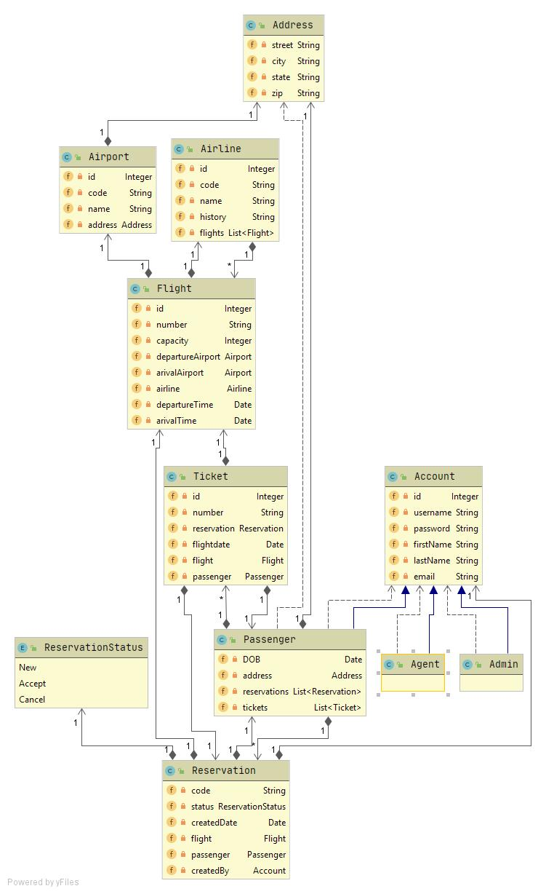
Class Diagram

Slide 10
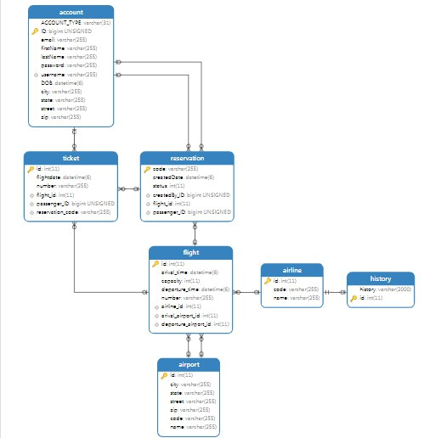
ER Diagram

Slide 11
New Airline Reservation System
We want to separate to many service
Core service with core Entity.
Services about security (account and Role is on another services.
Other services

Slide 12
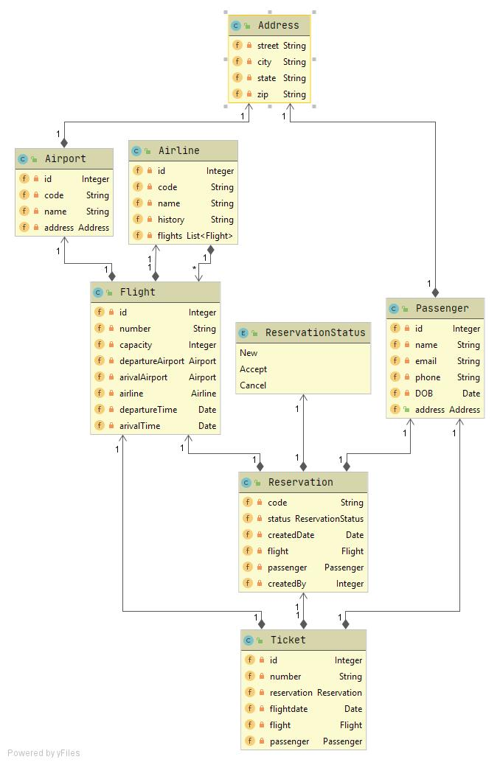
Class Diagram Core

Slide 13
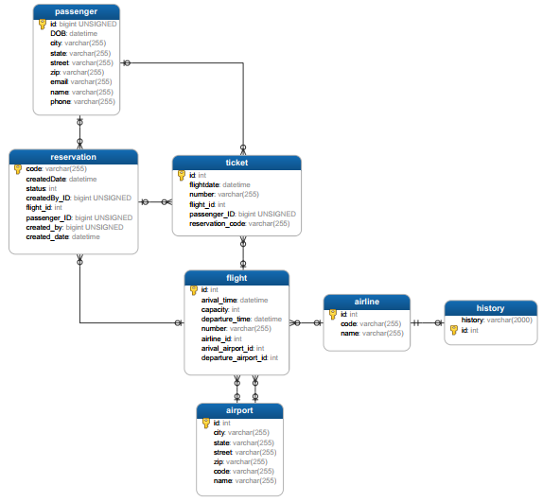
ER Diagram Core

Slide 14
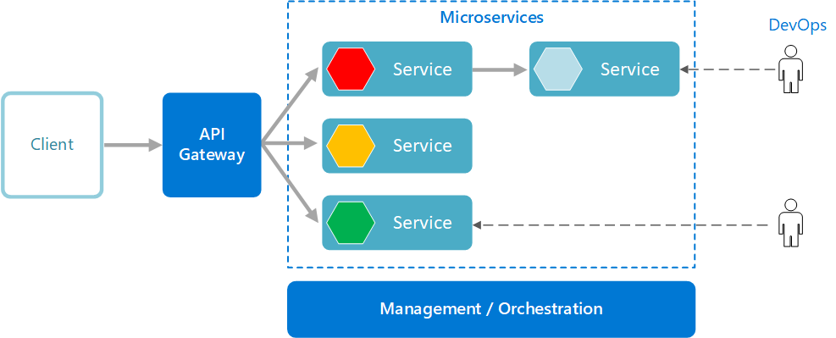
How this work?
We built this system with 4 virtual server.

Slide 15
Security in system
This system has 3 roles
Role Admin: can do CRUD many resources.
Role Passenger: can cancel Reservation, view list of airport,..
Role Agent: can do the same thing as Passenger..

Slide 16
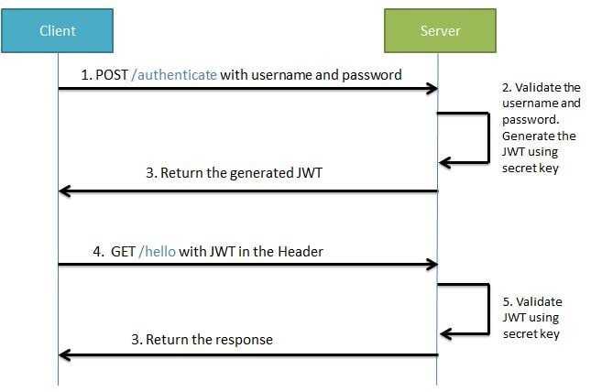
Security in system using JWT
Configure Spring Security for JWT. Expose REST POST API with mapping/authenticate using which User will get a valid JSON Web Token. And then, allow the user access to the API only if it has a valid token

Slide 17
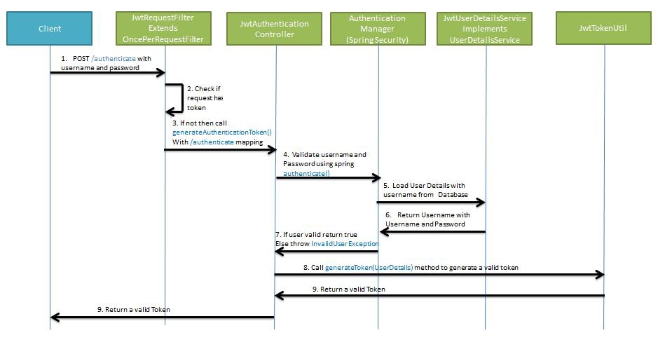
Security in system using JWT

Slide 18
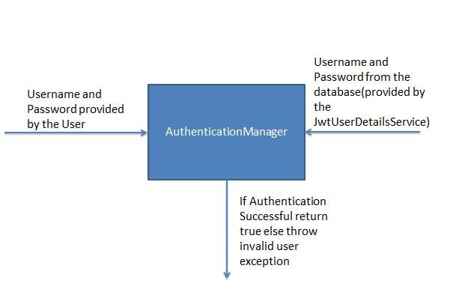
Security in system using JWT

Slide 19
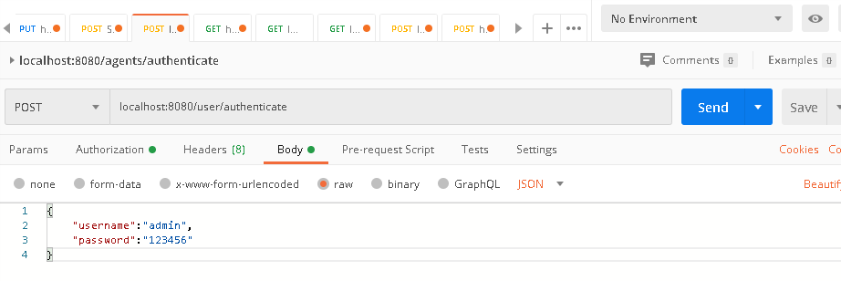
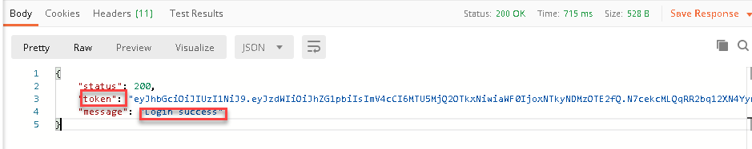
Security in system using JWT
Login

Slide 20
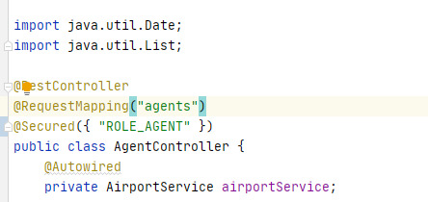

Security in system using JWT
Demo use the role agents to view list of Airports (Question Passengers and Agent can: View list of airports )

Slide 21

Presented by Andrew
Passenger wants to:
View list of airlines flying out of an airport (search by airport three letter code).
View list of flights between a departure and destination for a date.
View list of own reservations.
Agent wants to:
View list of passengers and reservations made for them “by this agent”.
Can perform CRUD operations on all resources.

Slide 22

6. Presented by Yafet
Passenger wants to:
Cancel a reservation
Agent wants to:
View list of airlines flying out of an airport (search by airport three letter code)
Cancel a reservation
Other:
…
…
…

Slide 23

6. Presented by Robel
Passenger wants to:
View details of a reservation (flights, departure times, etc.)
Agent wants to:
View details of a reservation (flights, departure times, etc.) – only if done by this agent
View list of flights between a departure and destination for a date.
Other:
…
…
…

Slide 24
6. Presented by Cuong Nguyen
Passenger wants to:
Make a reservation (note: payload will be a list of flights)
Confirm and purchase a reservation. This will result in multiple tickets (one for each flight in the reservation)
Agent wants to:
Make a reservation (note: payload will be a list of flights)
Confirm and purchase a reservation. This will result in multiple tickets (one for each flight in the reservation)
Other:
Master Data …
…
…

Slide 25

Presented by ThePham
Passenger wants to:
View list of Airports
Agent wants to:
View list of airports.
Other:
Master Data
Create Project Structure and Git hub
…
…
…

Slide 26

Admin make a CRUD operation on all resources
Administrator has full rights for this system. So he can create a Reservation, update status and view information from Reservations or even he can delete (don’t do this in real system)

Slide 27

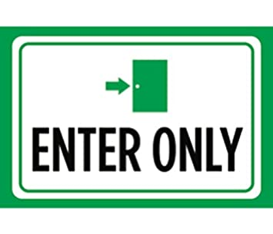



Using Microservice
I want to view a reservation status.
Sorry, do you have a
corrected password?
Notes:
We don’t want not user in this system to login. Because they need an account to login. So we use an anothers system uses services from this system just provide a code ( he is a guest) and view information of a reservation.

Slide 28
Using Microservice
Demo
Notes:
We don’t want not user in this system to login. Because they need an account to login. So we use an anothers system uses services from this system just provide a code ( he is a guest) and view information of a reservation.

Slide 29
Integration Testing

Slide 30
More option.
Config to send mail.
Make a schedule to send mail 24-hour reminder 24 hours prior to the first flight in a reservation
Use asynchronous.

Slide 31
Thanks you!

