Slide 1

Software development market
Challenge & Opportunity

Slide 2
Content
Introduce
Software development market
Strategy to take on your opportunity

Slide 3

Introduction
Graduated from University of Science, class of 2010
More 10 years working in software development
9 years at Restaff
Developer → Development team leader
Work with team of 16 members
Our customer is the biggest oil & gas company in the world
Strong as communication, technical vision (.NET/JS), agile/scrum
Nguyen Hoang - Development team leader
Wellbarrier – A Schlumberger Technology

Slide 4

Why do you choose IT?

Slide 5


Slide 6
Software development model
Production
In-house team
Outsourcing
Dedicated team
Project-based outsourcing

Slide 7


Slide 8



Slide 9

Where IS YOUR OPPORTUNITY ?

Slide 10



Where IS YOUR OPPORTUNITY ?

Slide 11

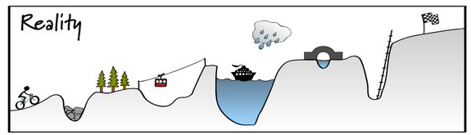
Plan vs Reality

Slide 12
Who do you want to become?
Who are you?
What is your opportunities?
CAREER PLANNING
What is your plan to take on those opportunities?
Notes:
Link your major and your career
Collect require skill set for each position in your major from recruitment chanel

Slide 13
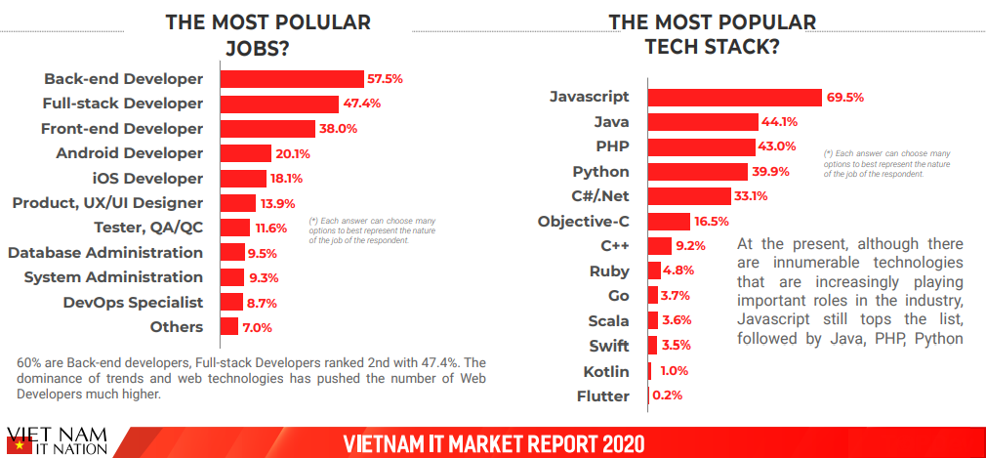

Slide 14
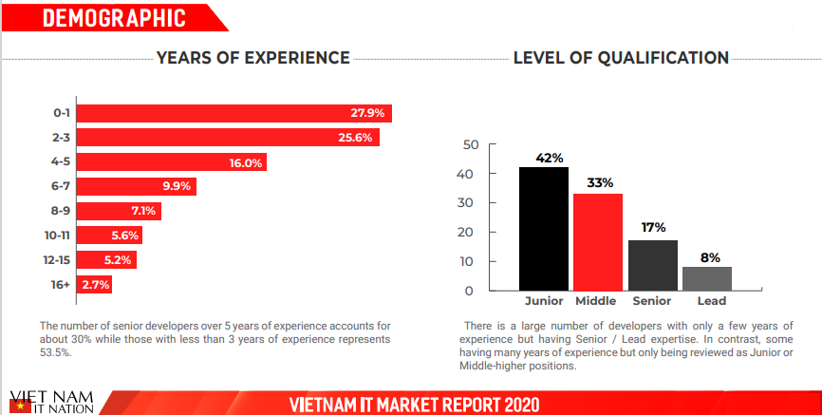

Slide 15

Make decision
Fail fast , recover quickly

Slide 16
Smart Goal
S
Specific
State exactly WHAT/WHERE/WHY/WHO you want to accomplish
Don’t set something being general
M
Measurable
Make sure your goal is trackable
A
Achievable
Work towards a goal that is challenging but POSSIBLE
Don’t try to take over the world in one night
R
Realistic
Be honest with yourself, you know what you are capable of
Don’t forget any hurdles you may have to overcome
T
Time-bound
Give yourself a deadline
Don’t keep pushing towards a goal you might hit, “SOME DAY”

Slide 17
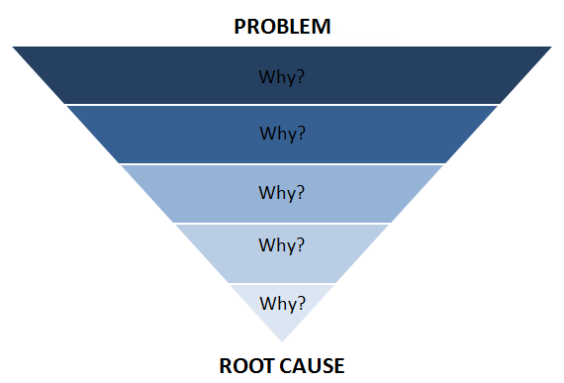
Problem solving with 5 whys
Notes:
You drill down to its root cause

Slide 18
Keys to success
Understand your-self
Listen to other, open-mind
Proactive in work/life/communicate
Having a smart plan for anything you do
Fail early to recover fast

Slide 19


Slide 20


Junior
Senior
Leader
4 years
1 years
1 years
7+ years

