Slide 1

Animations
SoftUni Team
Technical Trainers
Software University
http://softuni.bg

Slide 2
Table of Contents
Transitioning Single Elements/Components
Transitioning Between Elements
Transitioning Between Components
List Transitions

Slide 3
Have a Question?
sli.do #Vue.js

Slide 4
Transitioning Single Elements/Components

Slide 5
Transitioning Single Elements/Components
Vue provides a transition wrapper component, allowing you to add entering/leaving transitions for any element or component in the following contexts:
Conditional rendering (using v-if)
Conditional display (using v-show)
Dynamic components
Component root nodes

Slide 6
Transition Classes
There are six classes applied for enter/leave transitions.
v-enter
v-enter-active
v-enter-to
v-leave
v-leave-active
v-leave-to

Slide 7
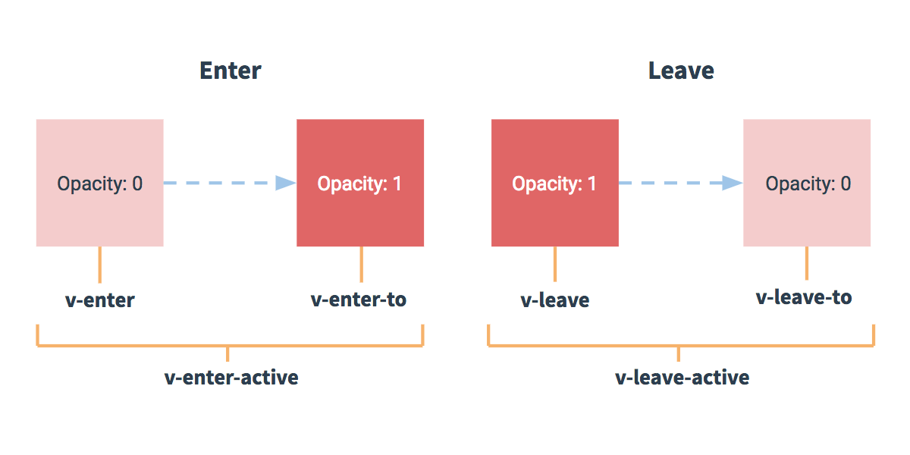
Transition Classes
Here is a schematic, showing when each transition class starts and ends:

Slide 8
CSS Transitions - Example
One of the most common transition types uses CSS transitions. Here’s an example:
HTML:
<div id="example-1">
<button @click="show = !show">
Toggle render
</button>
<transition name="slide-fade">
<p v-if="show">hello</p>
</transition>
</div>

Slide 9
CSS Transitions - Example
JS:
new Vue({
el: '#example-1',
data: {
show: true
}
})

Slide 10
CSS Transitions - Example
CSS:
.slide-fade-enter-active {
transition: all .3s ease;
}
.slide-fade-leave-active {
transition: all .8s cubic-bezier(1.0, 0.5, 0.8, 1.0);
}
.slide-fade-enter, .slide-fade-leave-to {
transform: translateX(10px);
opacity: 0;
}

Slide 11
CSS Animations
CSS animations are applied in the same way as CSS transitions, the difference being that v-enter is not removed immediately after the element is inserted, but on an animationend event.

Slide 12
CSS Animations - Example
HTML:
<div id="example-2">
<button @click="show = !show">Toggle show</button>
<transition name="bounce">
<p v-if="show">hello</p>
</transition>
</div>

Slide 13
CSS Animations - Example
JS:
new Vue({
el: '#example-2',
data: {
show: true
}
})

Slide 14
CSS Animations - Example
CSS:
.bounce-enter-active { animation: bounce-in .5s; } .bounce-leave-active { animation: bounce-in .5s reverse; } @keyframes bounce-in { 0% { transform: scale(0); } 50% { transform: scale(1.5); } 100% { transform: scale(1); } }

Slide 15
Custom Transition Classes
You can also specify custom transition classes by providing the following attributes:
enter-class
enter-active-class
enter-to-class
leave-class
leave-active-class
leave-to-class

Slide 16
Custom Transition Classes - Example
HTML:
<link href="https://cdn.jsdelivr.net/npm/animate.css@3.5.1" rel="stylesheet" type="text/css"> <div id="example-3"> <button @click="show = !show"> Toggle render </button> <transition name="custom-classes-transition" enter-active-class="animated tada" leave-active-class="animated bounceOutRight" > <p v-if="show">hello</p> </transition> </div>

Slide 17
Custom Transition Classes - Example
JS:
new Vue({
el: '#example-3',
data: {
show: true
}
})

Slide 18
A
B
Transitioning Between Elements

Slide 19
Transitioning Between Elements
You can transition between raw elements using v-if/v-else. One of the most common two-element transitions is between a list container and a message describing an empty list:
<transition>
<table v-if="items.length > 0">
<!-- ... -->
</table>
<p v-else>Sorry, no items found.</p>
</transition>

Slide 20
Transitioning Between Elements
When toggling between elements that have the same tag name, you must tell Vue that they are distinct elements by giving them unique key attributes. Otherwise, Vue’s compiler will only replace the content of the element for efficiency. Even when technically unnecessary though, it’s considered good practice to always key multiple items within a <transition> component.
<transition>
<button v-if="isOn" key="off">
Off
</button>
<button v-else key="on">
On
</button>
</transition>

Slide 21
Transition Modes
Because the default behavior of <transition> is to make entering and leaving simultaneously, sometimes the animations do not get the desired effect.
This is why Vue offers some alternative transition modes:
in-out: New element transitions in first, then when complete, the current element transitions out.
out-in: Current element transitions out first, then when complete, the new element transitions in.

Slide 22
Transition Modes - Example
<transition name="fade" mode="out-in">
<!-- ... the buttons ... -->
</transition>

Slide 23
click
A
B
Transitioning Between Components

Slide 24
Transitioning Between Components - Example
Transitioning between components is even simpler - we don’t even need the key attribute. Instead, we wrap a dynamic component.
HTML:
<transition name="component-fade" mode="out-in">
<component v-bind:is="view"></component>
</transition>

Slide 25
Transitioning Between Components - Example
JS:
new Vue({ el: '#transition-components-demo', data: { view: 'v-a' }, components: { 'v-a': { template: '<div>Component A</div>' }, 'v-b': { template: '<div>Component B</div>' } } })

Slide 26
Transitioning Between Components - Example
CSS:
.component-fade-enter-active, .component-fade-leave-active {
transition: opacity .3s ease;
}
.component-fade-enter, .component-fade-leave-to {
opacity: 0;
}

Slide 27

List Transitions

Slide 28
List Transitions
We can also make transitions in a list of components, using v-for and instead of <transition>, we will use <transition-group>.
Unlike <transition>, it renders an actual element: a <span> by default. You can change the element that’s rendered with the tag attribute.
Transition modes are not available, because we are no longer alternating between mutually exclusive elements.
Elements inside are always required to have a unique key attribute.

Slide 29
Entering/Leaving Transitions - Example
HTML:
<div id="list-demo">
<button v-on:click="add">Add</button>
<button v-on:click="remove">Remove</button>
<transition-group name="list" tag="p">
<span v-for="item in items" v-bind:key="item" class="list-item">
{{ item }}
</span>
</transition-group>
</div>

Slide 30
Entering/Leaving Transitions - Example
JS:
new Vue({ el: '#list-demo', data: { items: [1,2,3,4,5,6,7,8,9], nextNum: 10 }, methods: { randomIndex: function () { return Math.floor(Math.random() * this.items.length) }, add: function () { this.items.splice(this.randomIndex(), 0, this.nextNum++) }, remove: function () { this.items.splice(this.randomIndex(), 1) }, } })

Slide 31
Entering/Leaving Transitions - Example
.list-item {
transition: all 1s;
display: inline-block;
margin-right: 10px;
}
.list-enter-active, .list-leave-active {
transition: all 1s;
}
.list-enter, .list-leave-to {
opacity: 0;
transform: translateY(30px);
}
CSS:

Slide 32
List Move Transitions
The <transition-group> can also manage changes in position.
This is done with the v-move class. Like the other classes, its prefix will match the value of a provided name attribute and you can also manually specify a class with the move-class attribute.

Slide 33
List Move Transitions - Example
HTML:
<script src="https://cdnjs.cloudflare.com/ajax/libs/lodash.js/4.14.1/lodash.min.js"></script>
<div id="flip-list-demo" class="demo">
<button v-on:click="shuffle">Shuffle</button>
<transition-group name="flip-list" tag="ul">
<li v-for="item in items" v-bind:key="item">
{{ item }}
</li>
</transition-group>
</div>

Slide 34
List Move Transitions - Example
JS:
new Vue({
el: '#flip-list-demo',
data: {
items: [1,2,3,4,5,6,7,8,9]
},
methods: {
shuffle: function () {
this.items = _.shuffle(this.items)
}
}
})

Slide 35
List Move Transitions - Example
CSS:
.flip-list-move {
transition: transform 1s;
}

Slide 36

Summary
…
…
…
We can show/hide different elements or components using animations
We can transit from one element/component to another
We can animate adding items to lists
We can animate shuffling all the items in a list

Slide 37
https://softuni.bg/trainings/courses

Slide 38













SoftUni Diamond Partners

Slide 39





SoftUni Organizational Partners

Slide 40




Trainings @ Software University (SoftUni)
Software University – High-Quality Education and Employment Opportunities
softuni.bg
Software University Foundation
http://softuni.foundation/
Software University @ Facebook
facebook.com/SoftwareUniversity
Software University Forums
forum.softuni.bg

Slide 41

License
This course (slides, examples, demos, videos, homework, etc.) is licensed under the "Creative Commons Attribution-NonCommercial-ShareAlike 4.0 International" license

