Slide 1
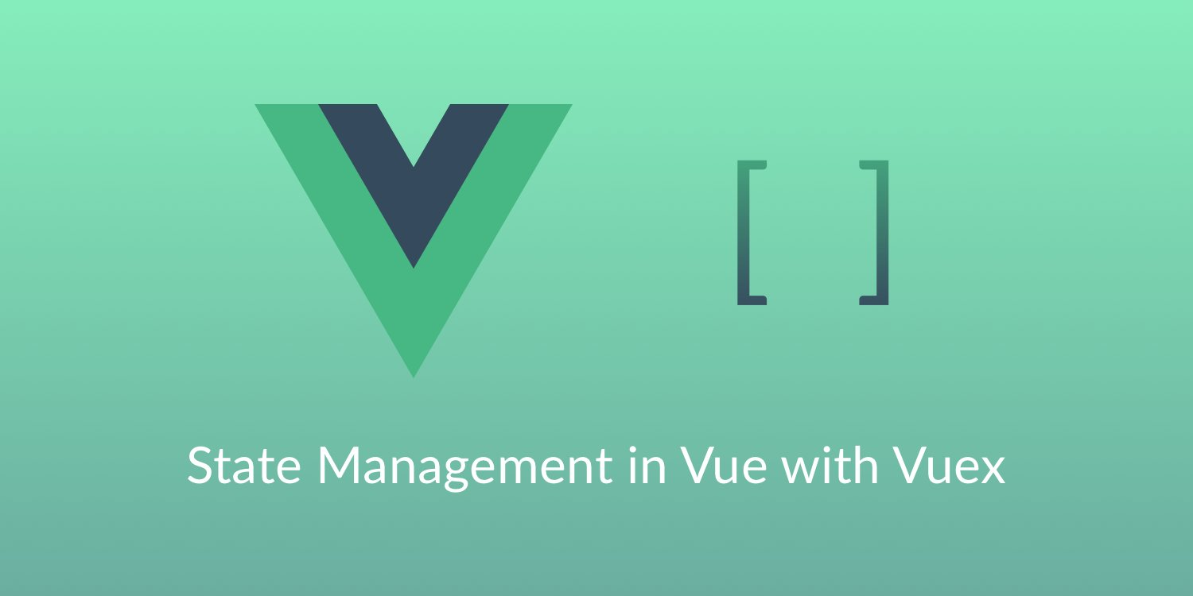
Vuex
SoftUni Team
Technical Trainers
Software University
http://softuni.bg

Slide 2
Table of Content
Installation
Introduction to Vuex
State Management Pattern
Vuex Components
Mutations
Actions
Getters
Modules

Slide 3
Have a Question?
sli.do #Vue.js

Slide 4

Installation
CDN, NPM, Dev Build

Slide 5
Installing Vuex
Direct Download / CDN
NPM
Dev Build (if you want to use the latest dev build).
<script src="https://unpkg.com/vuex@3.0.1/dist/vuex.js"></script>
npm install vuex --save
git clone https://github.com/vuejs/vuex.git node_modules/vuex
cd node_modules/vuex
npm install
npm run build

Slide 6

Vuex
State Management Pattern

Slide 7
What is Vuex?
Vuex is the official state management library for Vue.js.
It allows creating a centralized data store which can be accessed by all components in an app.
It helps provide a better structure and maintainability to our code.
The store is known as a “single source of truth” and every component has direct access to this global State.
Usually, only one store is used for an app as it contains the current state of the entire application.

Slide 8
State Management Pattern
Vuex store is created with new Vuex.Store. It has:
A reactive state.
Mutations.
Actions.
Getters.
const store = new Vuex.Store({
state: {…},
mutations: {…},
actions: {…},
getters: {…} })

Slide 9
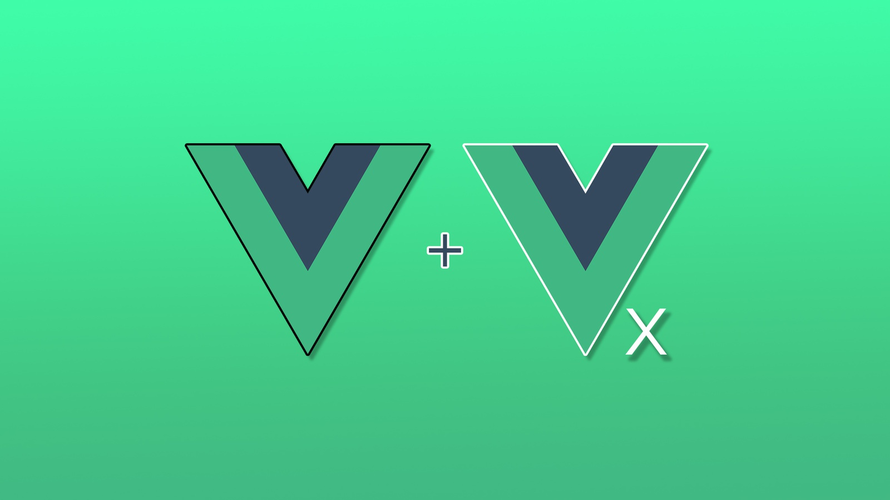
Vuex Components
State, Mutations, Actions, Getters…

Slide 10
Store State
The State is where you define the data structure of your app. You have to initialize the properties of the state when declaring the store.
The State is reactive (when one component updates the State, other components that are using that data get notified and automatically receive the new value).
In order to change the store state, you can either commit mutations or dispatch actions.
state: { count: 0 }

Slide 11
Store Mutations
The State can be changed by committing a mutation.
Mutations are synchronous.
Mutations are very similar to events:
Each mutation has a string type and a handler.
The handler function is where we perform actual state modifications. It receives the state as the first argument.
mutations: {
increment (state) {
state.count++ }
}

Slide 12
Mutation Handlers / Payload
You cannot directly call a mutation handler!
To invoke a mutation handler, you need to call store.commit with its type.
You can pass an additional argument to store.commit, which is called the payload for the mutation.
store.commit('increment')
mutations: { increment (state, n) {
state.count += n
} }
store.commit('increment', 10)

Slide 13
Mutation Handlers / Payload
In most cases, the payload should be an object so that it can contain multiple fields, and the recorded mutation will also be more descriptive.
mutations: {
increment (state, payload) {
state.count += payload.amount
} }
store.commit('increment', {
amount: 10
})

Slide 14
Store Actions
Actions are similar to mutations:
However, they don’t change the state directly.
Instead of mutating the state, actions commit mutations.
Actions can contain arbitrary asynchronous operations.
State and getters can be accessed via context.state and context.getters.
actions: {
increment (context) {
context.commit('increment') } }

Slide 15
Store Actions
In practice, argument destructing is often used.
Especially when we need to call commit multiple times.
Actions are triggered with the store.dispatch method.
We can perform asynchronous operations inside an action.
actions: {
increment ({ commit }) {
commit('increment') } }
store.dispatch('increment')

Slide 16
Store Getters
Vuex allows us to define "getters" in the store.
Getters will receive the state as their first argument.
They are like computed properties for your store.
Getter’s result is cached based on its store state. dependencies, and will only re-evaluate when some of its dependencies have changed.

Slide 17
Store Getters
We may need to compute derived state based on store state. For example:
Filtering through a list of items and counting them.
computed: {
doneTodosCount () {
return
this.$store.state.todos.filter(todo=>todo.done).length
}
}

Slide 18
Store Modules
The modules object provides a way to split the store in multiple stores, but allows them to all remain part of the store tree.
const moduleA = {
state: { ... },
mutations: { ... },
actions: { ... },
}
const moduleB = {
state: { ... },
mutations: { ... },
actions: { ... }
}
const store = new Vuex.Store({
modules: {
a: moduleA, b: moduleB } })

Slide 19
Vuex Examples
Initialization, State, Getters…

Slide 20
Vuex State Example
Initialization
The first thing we need to do is to instantiate our store using Vuex Store.
In the state, we declare and initialize the properties of our state.
const store = new Vuex.Store({
state: count: 0,
username: “The”,
userLastName: “Rock”
})

Slide 21
Vuex Getters Example
This is our computed getter to obtain the reversed version of username state property. These functions receive the state as the first parameter.
getters: {
reverseName(state) {
return !state.username ? state.username:
state.username.split(‘’).reverse().join(‘’);
}
}

Slide 22
Vuex Mutations Example
These are the two mutations that we are going to provide in order to change our state. They also receive the state as the first parameter.
mutations: {
increment(state) { state.count++ },
changeName (state, payload) {
state.username = payload.username;
}
}

Slide 23
Vuex Actions Example
We are going to provide only one async action that returns a promise. Actions receive a context that is a representation of the state. They always end up calling a mutation with the store “commit” function to change the state.
actions: {
increment (context) {
return new Promise(function (resolve)){
setTimeout(function(){
context.commit(‘increment’);
resolve(context.rootState.count);
}, 1000) }) } } }

Slide 24


Simple Workshop
Live Exercises in Class (Lab)

Slide 25

Summary
Arrow functions ≈ short function syntax
Vuex is a state management pattern + library.
It is a self-contained app with the following parts:
The state, which is the source of truth that drives our app.
The view, which is just a declarative mapping of the state.
The actions, which are the possible ways the state could change in reaction to user inputs from the view.
The modules object provides a way to split the store in multiple stores.

Slide 26
//TODO

Slide 27











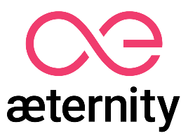

SoftUni Diamond Partners

Slide 28





SoftUni Organizational Partners

Slide 29




Trainings @ Software University (SoftUni)
Software University – High-Quality Education and Employment Opportunities
softuni.bg
Software University Foundation
http://softuni.foundation/
Software University @ Facebook
facebook.com/SoftwareUniversity
Software University Forums
forum.softuni.bg

Slide 30

License
This course (slides, examples, demos, videos, homework, etc.) is licensed under the "Creative Commons Attribution-NonCommercial-ShareAlike 4.0 International" license

