Slide 1

Animations
SoftUni Team
Technical Trainers
Software University
http://softuni.bg

Slide 2
Table of Contents
Transitioning Single Elements/Components
Transitioning Between Elements
Transitioning Between Components
List Transitions

Slide 3
Have a Question?
sli.do #Vue.js

Slide 4
Transitioning Single Elements/Components

Slide 5
Transitioning Single Elements/Components
Vue provides a transition wrapper component, allowing you to add entering/leaving transitions for any element or component in the following contexts:
Conditional rendering (using v-if)
Conditional display (using v-show)
Dynamic components
Component root nodes

Slide 6
Transition Classes
There are six classes applied for enter/leave transitions.
v-enter
v-enter-active
v-enter-to
v-leave
v-leave-active
v-leave-to

Slide 7
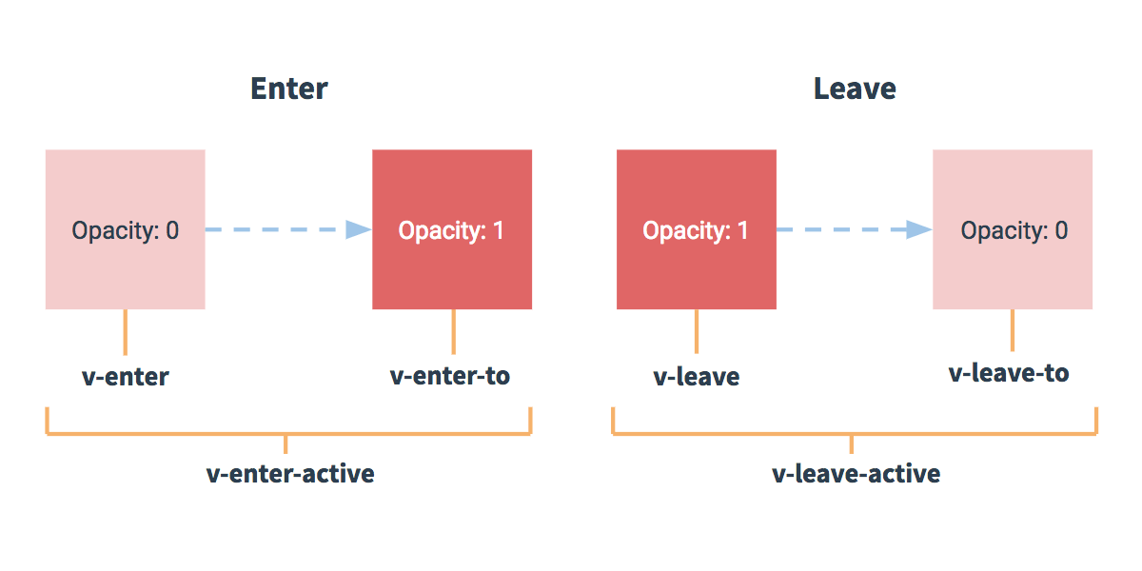
Transition Classes
Here is a schematic, showing when each transition class starts and ends:

Slide 8

CSS Transitions - Example
One of the most common transition types uses CSS transitions. Here’s an example:
When the button is clicked, show reverses value
<div id="example-1">
<button @click="show = !show">
Toggle render
</button>
<transition name="slide-fade">
<p v-if="show">hello</p>
</transition>
</div>
Using the Vue transition wrapper
If show is true, the text will be shown

Slide 9

CSS Transitions - Example
new Vue({
el: '#example-1',
data: {
show: true
}
})
Calling the div in which the transition will happen
The element starts off as being shown

Slide 10

CSS Transitions - Example
.slide-fade-enter-active {
transition: all .3s ease;
}
.slide-fade-leave-active {
transition: all .8s cubic-bezier(1.0, 0.5, 0.8, 1.0);
}
.slide-fade-enter, .slide-fade-leave-to {
transform: translateX(10px);
opacity: 0;
}
Assigning how the transition will work

Slide 11
CSS Animations
CSS animations are applied in the same way as CSS transitions, the difference being that v-enter is not removed immediately after the element is inserted, but on an animationend event.

Slide 12
CSS Animations - Example
<div id="example-2">
<button @click="show = !show">Toggle show</button>
<transition name="bounce">
<p v-if="show">hello</p>
</transition>
</div>

Slide 13
CSS Animations - Example
.bounce-enter-active { animation: bounce-in .5s; } .bounce-leave-active { animation: bounce-in .5s reverse; } @keyframes bounce-in { 0% { transform: scale(0); } 50% { transform: scale(1.5); } 100% { transform: scale(1); } }
Choose the scale of the element at key parts of the animation

Slide 14
Custom Transition Classes
You can also specify custom transition classes by providing the following attributes:
enter-class
enter-active-class
enter-to-class
leave-class
leave-active-class
leave-to-class

Slide 15
Custom Transition Classes - Example
<link href="https://cdn.jsdelivr.net/npm/animate.css@3.5.1" rel="stylesheet" type="text/css"> <div id="example-3"> <button @click="show = !show"> Toggle render </button> <transition name="custom-classes-transition" enter-active-class="animated tada" leave-active-class="animated bounceOutRight" > <p v-if="show">hello</p> </transition> </div>
The custom transition class
Calling animations from the custom class

Slide 16
A
B
Transitioning Between Elements

Slide 17
Transitioning Between Elements
You can transition between raw elements using v-if/v-else. One of the most common two-element transitions is between a list container and a message describing an empty list:
<transition>
<table v-if="items.length > 0">
<!-- ... -->
</table>
<p v-else>Sorry, no items found.</p>
</transition>

Slide 18
Transitioning Between Elements
When toggling between elements that have the same tag name, you must tell Vue that they are distinct elements by giving them unique key attributes. Otherwise, Vue’s compiler will only replace the content of the element for efficiency. Even when technically unnecessary though, it’s considered good practice to always key multiple items within a <transition> component.
<transition>
<button v-if="isOn" key="off">
Off
</button>
<button v-else key="on">
On
</button>
</transition>

Slide 19
Transition Modes
Because the default behavior of <transition> is to make entering and leaving simultaneously, sometimes the animations do not get the desired effect.
This is why Vue offers some alternative transition modes:
in-out: New element transitions in first, then when complete, the current element transitions out.
out-in: Current element transitions out first, then when complete, the new element transitions in.

Slide 20
Transition Modes - Example
<transition name="fade" mode="out-in">
<!-- ... the buttons ... -->
</transition>
<transition name="slide-fade" mode="in-out">
<!-- ... the buttons ... -->
</transition>

Slide 21
click
A
B
Transitioning Between Components

Slide 22
Transitioning Between Components - Example
Transitioning between components is even simpler - we don’t even need the key attribute. Instead, we wrap a dynamic component.
<transition name="component-fade" mode="out-in">
<component v-bind:is="view"></component>
</transition>

Slide 23
Transitioning Between Components - Example
new Vue({ el: '#transition-components-demo', data: { view: 'v-a' }, components: { 'v-a': { template: '<div>Component A</div>' }, 'v-b': { template: '<div>Component B</div>' } } })

Slide 24
Transitioning Between Components - Example
.component-fade-enter-active, .component-fade-leave-active {
transition: opacity .3s ease;
}
.component-fade-enter, .component-fade-leave-to {
opacity: 0;
}

Slide 25

List Transitions

Slide 26
List Transitions
We can also make transitions in a list of components, using v-for and instead of <transition>, we will use <transition-group>.
Unlike <transition>, it renders an actual element: a <span> by default. You can change the element that’s rendered with the tag attribute.
Transition modes are not available, because we are no longer alternating between mutually exclusive elements.
Elements inside are always required to have a unique key attribute.

Slide 27
Entering/Leaving Transitions - Example
<div id="list-demo">
<button v-on:click="add">Add</button>
<button v-on:click="remove">Remove</button>
<transition-group name="list" tag="p">
<span v-for="item in items" v-bind:key="item" class="list-item">
{{ item }}
</span>
</transition-group>
</div>

Slide 28
Entering/Leaving Transitions - Example
new Vue({ el: '#list-demo', data: { items: [1,2,3,4,5,6,7,8,9], nextNum: 10 }, methods: { randomIndex: function () { return Math.floor(Math.random() * this.items.length) }, add: function () { this.items.splice(this.randomIndex(), 0, this.nextNum++) }, remove: function () { this.items.splice(this.randomIndex(), 1) }, } })

Slide 29
Entering/Leaving Transitions - Example
.list-item {
transition: all 1s;
display: inline-block;
margin-right: 10px;
}
.list-enter-active, .list-leave-active {
transition: all 1s;
}
.list-enter, .list-leave-to {
opacity: 0;
transform: translateY(30px);
}

Slide 30
List Move Transitions
The <transition-group> can also manage changes in position.
This is done with the v-move class. Like the other classes, its prefix will match the value of a provided name attribute and you can also manually specify a class with the move-class attribute.

Slide 31
List Move Transitions - Example
<script src="https://cdnjs.cloudflare.com/ajax/libs/lodash.js/4.14.1/lodash.min.js"></script>
<div id="flip-list-demo" class="demo">
<button v-on:click="shuffle">Shuffle</button>
<transition-group name="flip-list" tag="ul">
<li v-for="item in items" v-bind:key="item">
{{ item }}
</li>
</transition-group>
</div>

Slide 32
List Move Transitions - Example
new Vue({
el: '#flip-list-demo',
data: {
items: [1,2,3,4,5,6,7,8,9]
},
methods: {
shuffle: function () {
this.items = _.shuffle(this.items)
}
}
})

Slide 33
List Move Transitions - Example
.flip-list-move {
transition: transform 1s;
}

Slide 34

Summary
…
…
…
We can show/hide different elements or components using animations
We can transit from one element/component to another
We can animate adding items to lists
We can animate shuffling all the items in a list

Slide 35
https://softuni.bg/trainings/courses

Slide 36













SoftUni Diamond Partners

Slide 37





SoftUni Organizational Partners

Slide 38




Trainings @ Software University (SoftUni)
Software University – High-Quality Education and Employment Opportunities
softuni.bg
Software University Foundation
http://softuni.foundation/
Software University @ Facebook
facebook.com/SoftwareUniversity
Software University Forums
forum.softuni.bg

Slide 39

License
This course (slides, examples, demos, videos, homework, etc.) is licensed under the "Creative Commons Attribution-NonCommercial-ShareAlike 4.0 International" license

