Slide 1

Components Basics
SoftUni Team
Technical Trainers
Software University
http://softuni.bg

Slide 2
Table of Content
Components Basics
Passing Data with Props
Sending Messages with Events
Content Distribution
DOM Templating Parsing Caveats

Slide 3
Have a Question?
sli.do #Vue.js

Slide 4
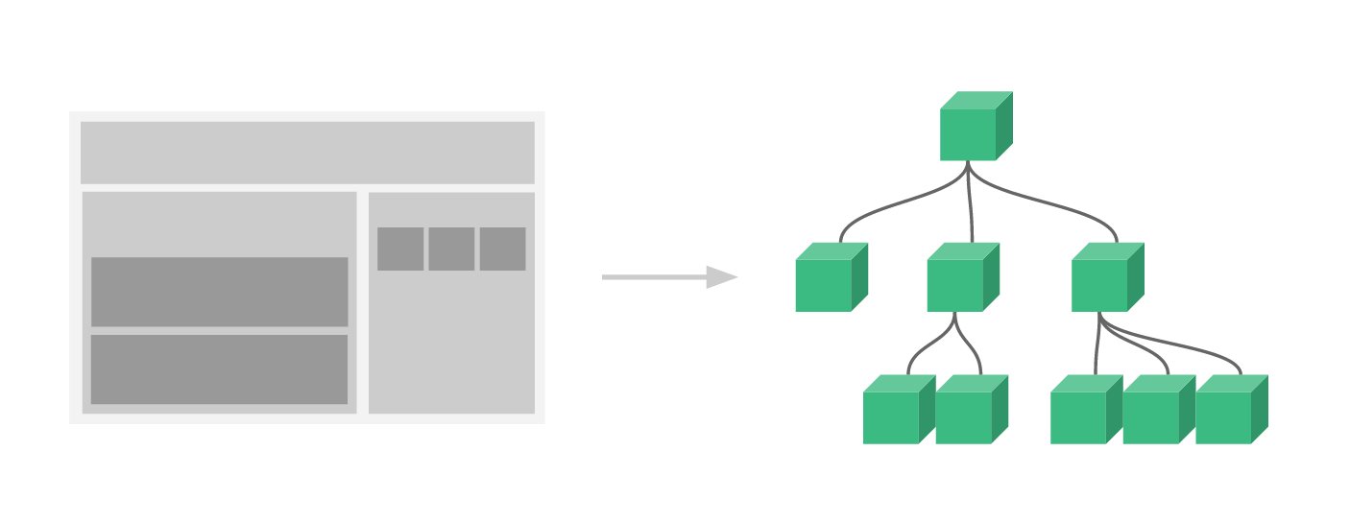
Components Basics

Slide 5
What are Components?
Components are one of the most powerful features of Vue.js.
They help you extend basic HTML elements to encapsulate reusable code.
At a high level, Components are custom elements that Vue.js’ compiler would attach specified behavior to.
In some cases, they may also appear as a native HTML element extended with the special is attribute.

Slide 6
Components
They can accept the same options as new Vue, data, computed, watch, methods, lifecycle hooks
The only exceptions are a few root-specific options like el.

Slide 7


Components
Components are reusable Vue instances with a name.
We can use this component as a custom element inside a root Vue instance created with new Vue:
<div id="components-demo">
<button-counter></button-counter>
</div>
Vue insance
new Vue({ el: '#components-demo' })

Slide 8

A Simple Example
// Define a new component called button-counter
Vue.component('button-counter', {
data: function () {
return {
count: 0
}
},
template:'
<button v-on:click="count++">You clicked me {{ count }} times.</button>'
})

Slide 9
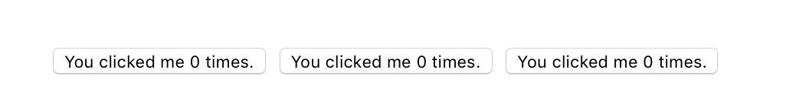
Reusing Components
Components can be reused as many times as you want:
Notice that when clicking on the buttons, each one maintains its own, separate count. That’s because each time you use a component, a new instance of it is created.
<div id="components-demo">
<button-counter></button-counter>
<button-counter></button-counter>
<button-counter></button-counter>
</div>

Slide 10
data - Must Be a Function
A component’s data option must be a function, so that each instance can maintain an independent copy of the returned data object:
data: function () {
return {
count: 0
}
}

Slide 11
Organizing Components
It’s common for an app to be organized into a tree of nested components.
You might have components for a header, sidebar, and content area, each typically containing other components for navigation links, blog posts, etc.
Globally registered components can be used in the template of any root Vue instance (new Vue) created afterwards – and even inside all subcomponents of that Vue instance’s component tree.

Slide 12
Organizing Components
To use these components in templates, they must be registered so that Vue knows about them.
There are two types of component registration:
Global
Local
Vue.component('my-component-name', {
// ... options ...
})

Slide 13
Problem 1:
Write program where each instance can maintain an independent copy of the returned data object:

Slide 14
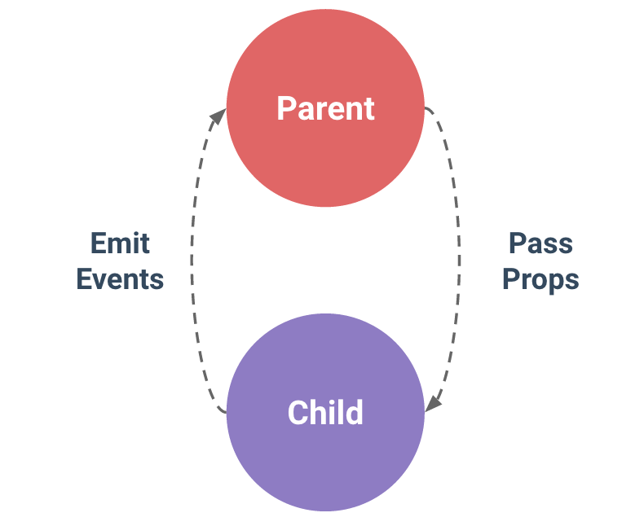
Props
Passing Data to Child Components with Props

Slide 15
Props
Props are custom attributes you can register on a component.
When a value is passed to a prop attribute, it becomes a property on that component instance.
Vue.component('blog-post', {
props: ['title'],
template: '<h3>{{ title }}</h3>'
})

Slide 16
Props
A component can have as many props as you’d like and by default, any value can be passed to any prop.
Once a prop is registered, you can pass data to it as a custom attribute, like this:
<blog-post title="My journey with Vue"></blog-post>
<blog-post title="Blogging with Vue"></blog-post>
<blog-post title="Why Vue is so fun"></blog-post>

Slide 17
Props
new Vue({
el: '#blog-post-demo',
data: {
posts: [
{ id: 1, title: 'My journey with Vue' },
{ id: 2, title: 'Blogging with Vue' },
{ id: 3, title: 'Why Vue is so fun' }
]
}
})
use v-bind to dynamically pass props.
<blog-post
v-for="post in posts"
v-bind:key="post.id"
v-bind:title="post.title"
></blog-post>

Slide 18
A Single Root Element
Whenever a new property is added to post objects, it will automatically be available inside <blog-post>.
Vue.component('blog-post', {
props: ['post'],
template: `
<div class="blog-post">
<h3>{{ post.title }}</h3>
<div v-html="post.content"></div>
</div>
`})
<blog-post
v-for="post in posts"
v-bind:key="post.id"
v-bind:post="post"
></blog-post>

Slide 19
Events
Sending Messages to Parents with Events

Slide 20
Sending Messages to Parents with Events
Include an accessibility feature to enlarge the text of blog posts while leaving the rest of the page its default size:
This can be used in the template to control the font size of all blog posts.
new Vue({
el: '#blog-posts-events-demo',
data: {
posts: [/* ... */],
postFontSize: 1
}
})

Slide 21
Sending Messages to Parents with Events
Add a button to enlarge the text right before the content of every post:
Then we can listen for this event with v-on, just as we would with a native DOM event:
<button v-on:click="$emit('enlarge-text')">
Enlarge text
</button>
<blog-post
...
v-on:enlarge-text="postFontSize += 0.1"
></blog-post>

Slide 22
Emitting a Value With an Event
It’s sometimes useful to emit a specific value with an event.
Use $emit‘s 2nd parameter to provide this value:
Then when we listen to the event in the parent, we can access the emitted event’s value with $event:
<button v-on:click="$emit('enlarge-text', 0.1)">
Enlarge text
</button>
<blog-post
...
v-on:enlarge-text="postFontSize += $event"
></blog-post>

Slide 23
Emitting a Value With an Event
If the event handler is a method:
Then the value will be passed as the first parameter of that method:
<blog-post
...
v-on:enlarge-text="onEnlargeText"
></blog-post>
methods: {
onEnlargeText: function (enlargeAmount) {
this.postFontSize += enlargeAmount
}
}

Slide 24
v-model
Custom events can also be used to create custom inputs that work with v-model:
The <input> inside the component must:
Bind the value attribute to a value prop
On input, emit its own custom input event with the new value
<custom-input v-model="searchText"></custom-input>
Vue.component('custom-input', {
props: ['value'],
template: `
<input
v-bind:value="value"
v-on:input="$emit('input', $event.target.value)”>`})

Slide 25
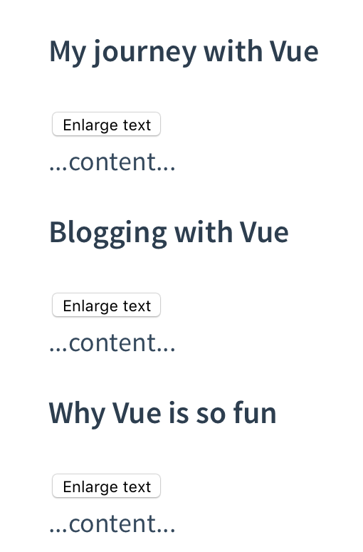
Problem 2:
Write a program which has an accessibility feature to enlarge the text of blog posts, while leaving the rest of the page its default size:

Slide 26
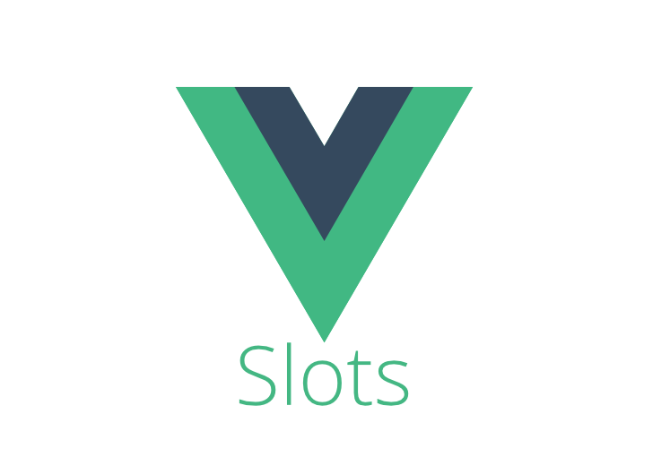
Slots
Content Distribution with Slots

Slide 27
Slots
Use Vue’s custom <slot> element to pass content to a component:
Vue.component('custom-input', {
props: ['value'],
template: `
<input
v-bind:value="value"
v-on:input="$emit('input', $event.target.value)”>`})

Slide 28
Dynamic Components
We can dynamically switch between components by using Vue’s <component> element with the is special attribute:
<!-- Component changes when currentTabComponent changes -->
<component v-bind:is="currentTabComponent"></component>

Slide 29
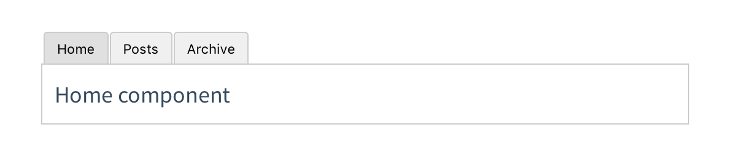
Problem 3:
Write program that dynamically switch between components:

Slide 30
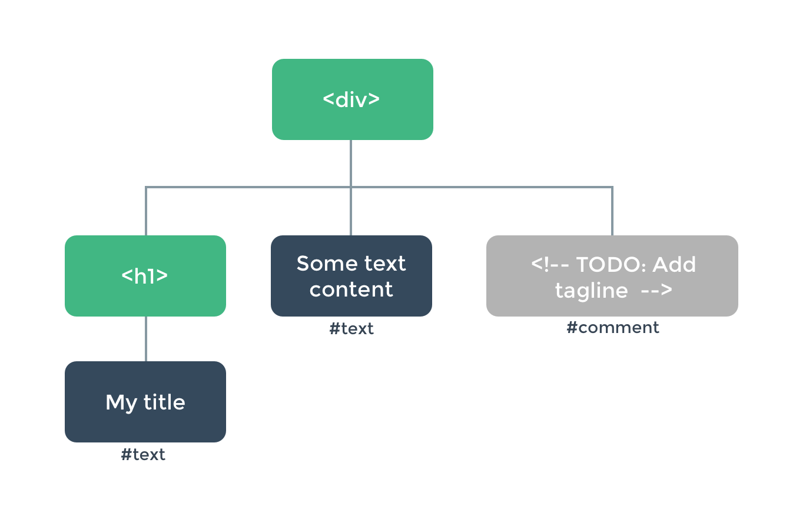
DOM
Template Parsing Caveats

Slide 31
DOM Template Parsing Caveats
Some HTML elements, such as <ul>, <ol>, <table> and <select> have restrictions on what elements can appear inside them
Some elements such as <li>, <tr>, and <option> can only appear inside certain other elements.

Slide 32
is
We use the is special attribute to the custom component <blog-post-row> so it won’t be hoisted out as invalid content and causing errors in the eventual rendered output:
<table>
<tr is="blog-post-row"></tr>
</table>

Slide 33
DOM Template Parsing Caveats
It should be noted that the limitation does not apply if you are using string templates from one of the following sources:
String templates (e.g. template: '...')
Single-file (.vue) components
<script type="text/x-template">

Slide 34

Summary
…
…
…
Components are reusable Vue instances with a name
Props are custom attributes you can register on a component.
use v-bind to dynamically pass props
To emit an event to the parent use the built-in $emit method
Use Vue’s custom <slot> element to pass content to a component
<component> element helps you to dynamically switch between components

Slide 35
https://softuni.bg/trainings/courses

Slide 36













SoftUni Diamond Partners

Slide 37





SoftUni Organizational Partners

Slide 38




Trainings @ Software University (SoftUni)
Software University – High-Quality Education and Employment Opportunities
softuni.bg
Software University Foundation
http://softuni.foundation/
Software University @ Facebook
facebook.com/SoftwareUniversity
Software University Forums
forum.softuni.bg

Slide 39

License
This course (slides, examples, demos, videos, homework, etc.) is licensed under the "Creative Commons Attribution-NonCommercial-ShareAlike 4.0 International" license

