Slide 1

Validators
SoftUni Team
Technical Trainers
Software University
http://softuni.bg

Slide 2
Table of Content
Data Validation
Client Side Validation
Custom Validation
Vuelidate

Slide 3
Have a Question?
sli.do #Vue.js

Slide 4

Data Validation

Slide 5
Why we do Data Validation?
The most common web application security weakness
Ensure that the application is robust against all forms of input
Ensure that the data is strongly typed
Ensure that data is not only validated, but business rule correct
Data from the client should never be trusted

Slide 6
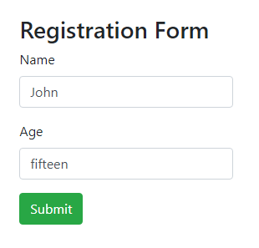
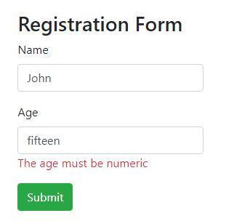
Base Example
Using validation we can:
Validate syntax
Validate length boundaries
Validate if input contains only permitted characters

Slide 7

Client Side Validation

Slide 8
Client Side Validation
Fast form of validation
Form validation is natively supported by the browser
Error messages are shown upon filling the form
Gives better feedback to the average user
Saves time and bandwidth
Not secure, can be easily disabled by the user
Shouldn’t be used independently

Slide 9
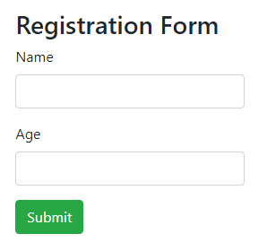
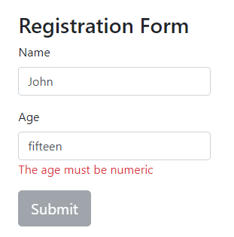
Base Example
Error message is displayed immediately
You can disable the submit button as well

Slide 10

Custom Validation

Slide 11
Custom Validation
Relying on browser validation could be tricky
Different browsers will handle things differently
You have better control over the feedback
You can match any kind of case
Data can be easily validated to match business logic

Slide 12

Form Validation on Submit
Using @submit will invoke submitForm method
So the validation is fired up on submit
<form @submit ="submitForm" autocomplete="off">
<div class="form-group">
<label for="name">Name:</label>
<input v-model="form.name" id="name">
</div>
</form>

Slide 13

Form Validation on Submit
The function will check if the input field is filled
methods:{
submitForm () {
if (this.form.name) {
return true;
}
// You can decide how to handle the error
}
}

Slide 14
Form Validation on selected
Using @blur on input tag will invoke isNameValid method
The validation is fired up when the text box is selected
The paragraph will be rendered when the input is empty
<form @submit ="submitForm " autocomplete="off">
<div class="form-group">
<label for="name">Name:</label>
<input @blur="isNameValid" v-model="form.name" id="name">
<p v-if="form.error">Name is required</p>
</div>
</form>

Slide 15
Form Validation on selected
The method will check if the input is filled
If it’s not, error property will be set to true and the paragraph will be displayed
isNameValid () {
if (this.form.name) {
this.form.error = true
return
}
this.form.error = false
}

Slide 16


Validating email address
Email address input field
If you use type="email" you must include novalidate="true"
This will prevent browser to validate field of type email
<input id="email" v-model="email" type="email" name="email">
<form @submit ="submitForm "
novalidate="true"
autocomplete="off">

Slide 17
Validating email address function
This is the function that our validation method will use
validEmail: function (email) {
let re = /^(([^<>()\[\]\\.,;:\s@"]+(\.[^<>()\[\]\\.,;:\s@"]+)*)|(".+"))@((\[[0-9]{1,3}\.[0-9]{1,3}\.[0-9]{1,3}\.[0-9]{1,3}\])|(([a-zA-Z\-0-9]+\.)+[a-zA-Z]{2,}))$/;
return re.test(email);
}

Slide 18
Validating email address function
This is the actual method which will check:
That email is required
The email is valid
if (!this.email) {
this.errors.push('Email required.');
} else if (!this.validEmail(this.email)) {
this.errors.push('Valid email required.');
}
if(!this.errors.length) return true;
return false;

Slide 19

Vuelidate

Slide 20

Vuelidate
Simple, lightweight model-based validation plugin
Flexible, decoupled from templates
Dependency free, minimalistic library
Many built-in validators
Easy to use with custom validators
High test coverage

Slide 21
Api $v values
$invalid - Indicates the state of validation for given model
$dirty – A flag representing if the field under validation was touched
$model - A reference to the original validated model
$error - Convenience flag to easily decide if a message should be displayed
if (!this.$v.$invalid) console.log('Form Submitted')
if (!$v.$dirty && $v.$invalid) console.log('The form is invalid')
if (!$v.$dirty && $v.$model) console.log('The field is required')
<p v-if="$v.$error" class="error">The form is invalid</p>

Slide 22
Api $v methods
$touch - Sets the $dirty flag of the model to true
$reset – Sets the $dirty flag of the model to false
setName(value) {
this.name = value
this.$v.name.$touch()
}
<button class="button" @click="$v.$reset">Reset</button>

Slide 23
Builtin validators
numeric - Accepts only numerics
aplhaNum - Accepts only alphanumerics
integer - Accepts positive and negative integers
decimal - Accepts positive and negative decimal numbers.
sameAs - Checks for equality with a given property
maxLength - Requires the input to have a max specified length
minLength - Requires the input to have a min specified length

Slide 24
Vuelidate Installation
Available on npm
Import the library and use as a Vue plugin to enable the functionality globally
npm install vuelidate --save
import Vue from 'vue'
import Vuelidate from 'vuelidate'
Vue.use(Vuelidate)

Slide 25

Summary
…
…
…
Data validation is a must client and server side
Client side validation gives better user experience and better feedback, but lack of security
Creating own validation with own rules using Vue methods and directives
Creating validation using Vulidate Api

Slide 26
https://softuni.bg/trainings/courses

Slide 27













SoftUni Diamond Partners

Slide 28





SoftUni Organizational Partners

Slide 29




Trainings @ Software University (SoftUni)
Software University – High-Quality Education and Employment Opportunities
softuni.bg
Software University Foundation
http://softuni.foundation/
Software University @ Facebook
facebook.com/SoftwareUniversity
Software University Forums
forum.softuni.bg

Slide 30

License
This course (slides, examples, demos, videos, homework, etc.) is licensed under the "Creative Commons Attribution-NonCommercial-ShareAlike 4.0 International" license

