Slide 1







Analysis of programming languages ​​and databases that are widely used now and in the future
Vu Thi Hau
12/8/2024

Slide 2



OUTLINE
Executive Summary
Introduction
Methodology
Results
Visualization – Charts
Dashboard
Discussion
Findings & Implications
Conclusion
Appendix

Slide 3

EXECUTIVE SUMMARY
Current Technology Usage
Top 10 LanguageWorkedWith (Bar chart)
Top 10 DatabaseWorkedWith (Column chart)
PlatformWorkedWith (Word cloud chart)
Top 10 WebFrameWorkedWith (Hierarchy bubble chart)
Future Technology Trend
Top 10 LanguageDesireNextYear (Bar chart)
Top 10 DatabaseDesireNextYear (Column chart)
PlatformDesireNextYear (Tree map chart)
Top 10 WebFrameDesireNextYear (Hierarchy bubble chart)
Demographics
Respondent classified by Gender (Pie chart)
Respondent Count for Countries (Map chart)
Respondent Count by Age (Line chart)
Respondent Count by Gender, classified by Formal Education Level (Stacked bar chart

Slide 4

INTRODUCTION
Current Technology Usage
Future Technology Trend
Demographics

Slide 5

METHODOLOGY
Point1
Point2
Point3
Point4
Sub Point1
Sub Point2

Slide 6
RESULTS

Slide 7
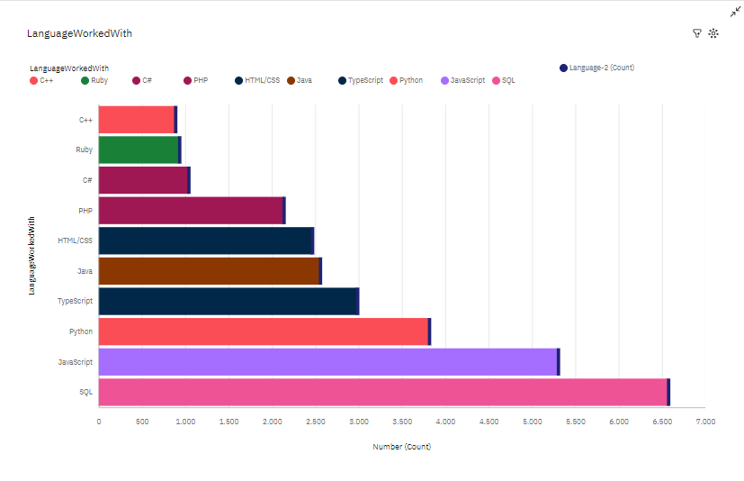
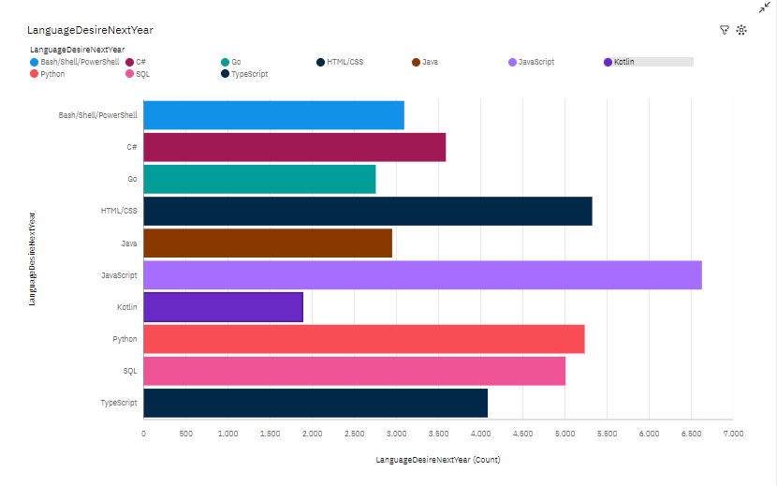
PROGRAMMING LANGUAGE TRENDS
Current Year
Next Year
Bar chart of top 10 programming languages for the current year
Bar chart of top 10 programming languages for the next

Slide 8
PROGRAMMING LANGUAGE TRENDS - FINDINGS & IMPLICATIONS
Findings
Finding 1
Finding 2
Finding 3
Implications
Implication 1
Implication 2
Implication 3

Slide 9
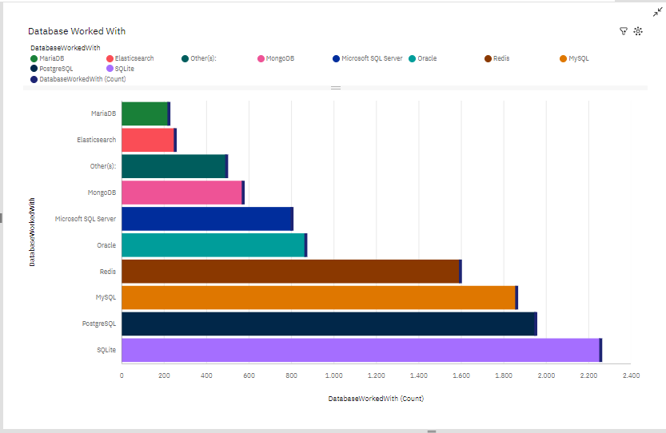
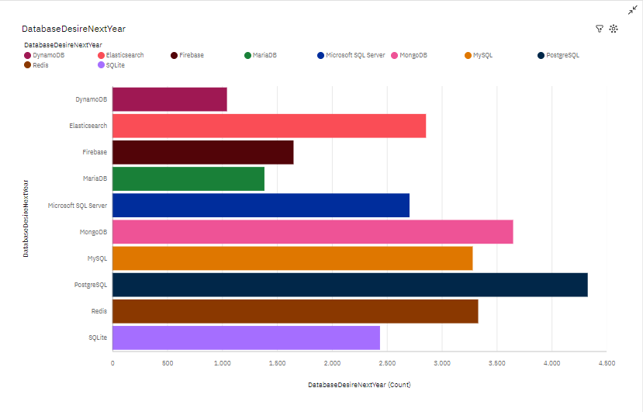
DATABASE TRENDS
Current Year
Next Year
Bar chart of top 10 databases for the current year
Bar chart of top 10 databases for the next year

Slide 10
DATABASE TRENDS - FINDINGS & IMPLICATIONS
Findings
Finding 1
Finding 2
Finding 3
Implications
Implication 1
Implication 2
Implication 3

Slide 11

DASHBOARD
https://github.com/Vuhau1012/Dasboards

Slide 12
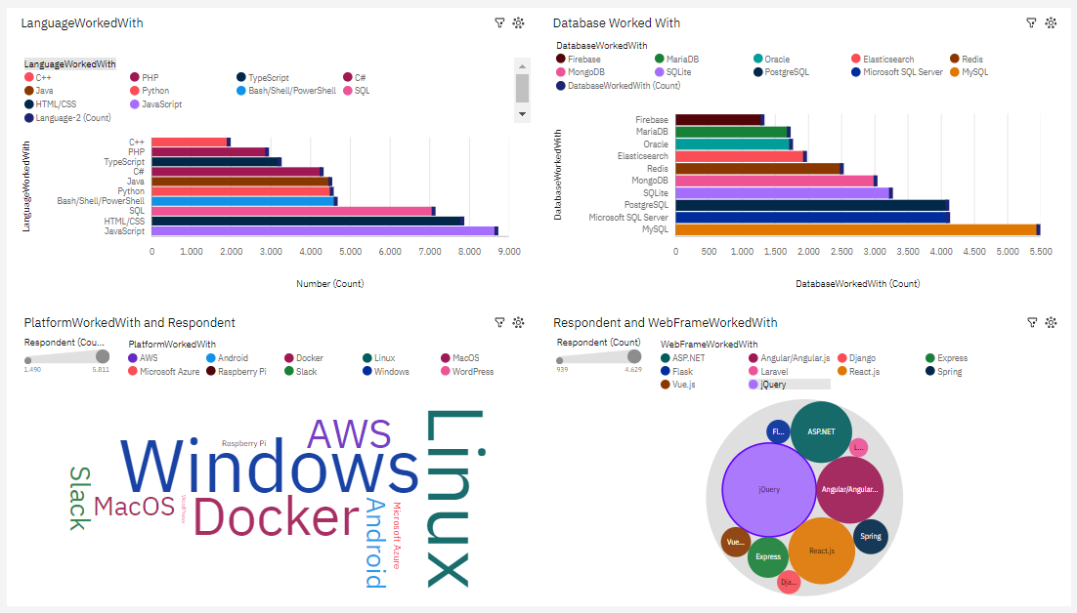
DASHBOARD TAB 1

Slide 13
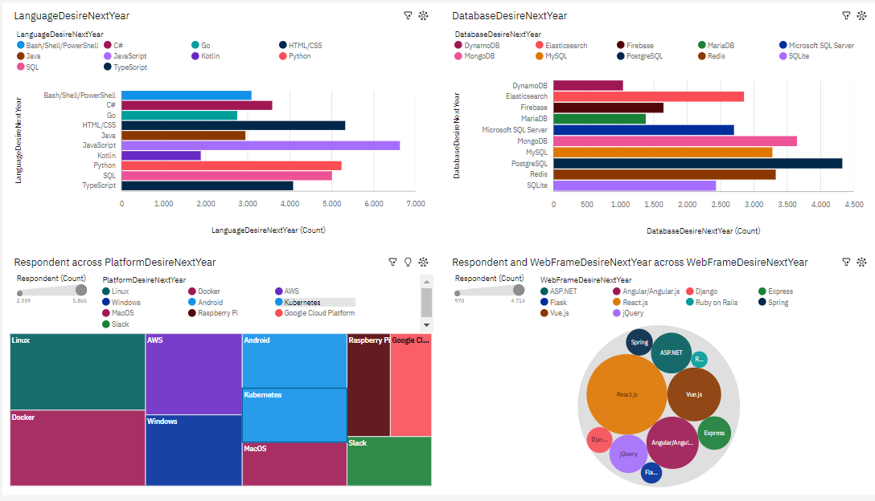
DASHBOARD TAB 2

Slide 14
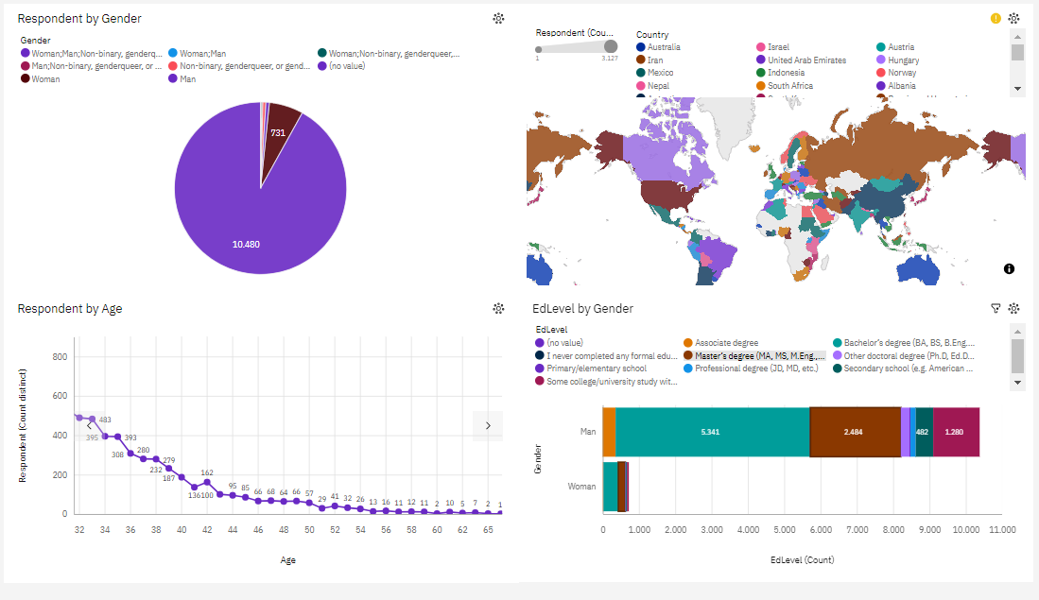
DASHBOARD TAB 3

Slide 15
DISCUSSION

Slide 16
OVERALL FINDINGS & IMPLICATIONS
Findings
Finding 1
Finding 2
Finding 3
Implications
Implication 1
Implication 2
Implication 3

Slide 17

CONCLUSION
Point 1
Point 2
Point 3
Point 4

Slide 18

APPENDIX
Include any relevant additional charts, or tables that you may have created during the analysis phase.

Slide 19
JOB POSTINGS
In Module 1 you have collected the job posting data using Job API in a file named “job-postings.xlsx”. Present that data using a bar chart here. Order the bar chart in the descending order of the number of job postings.

Slide 20
POPULAR LANGUAGES
In Module 1 you have collected the job postings data using web scraping in a file named “popular-languages.csv”. Present that data using a bar chart here. Order the bar chart in the descending order of salary.

