Slide 1
A31M223
Duong

Slide 2
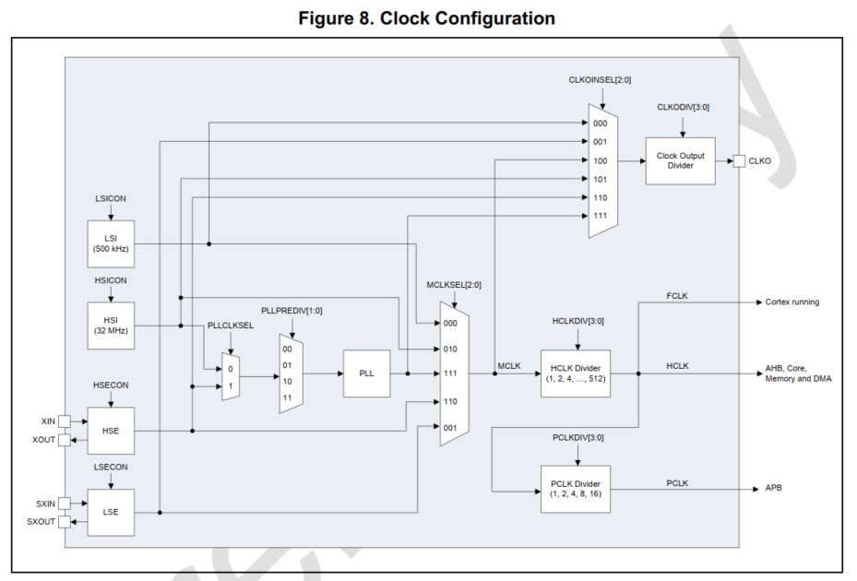
SCU

Slide 3
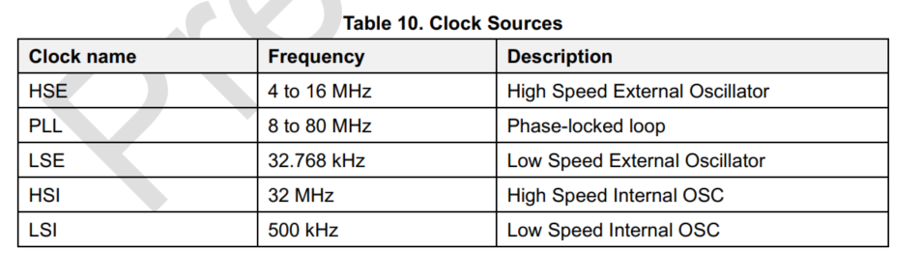
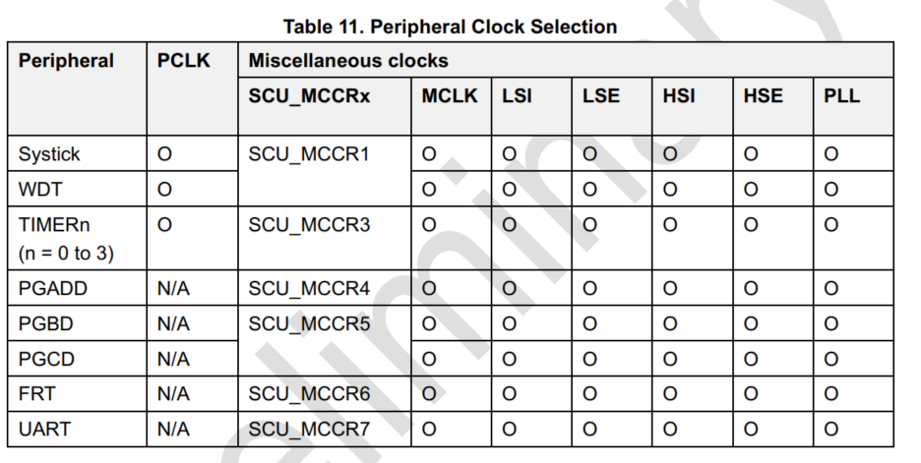

Slide 4
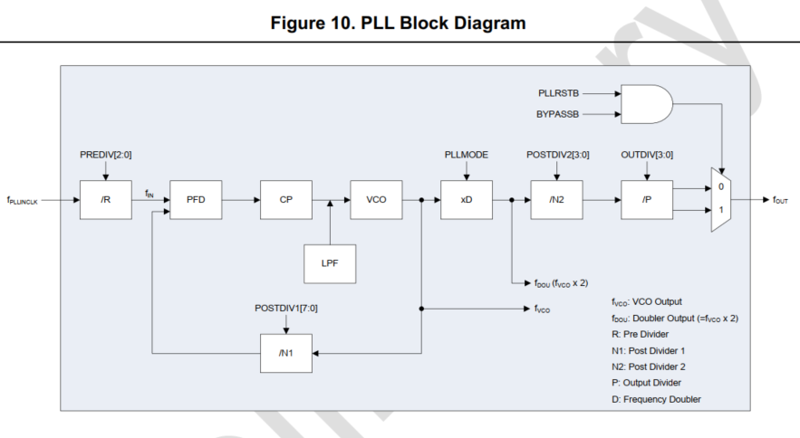
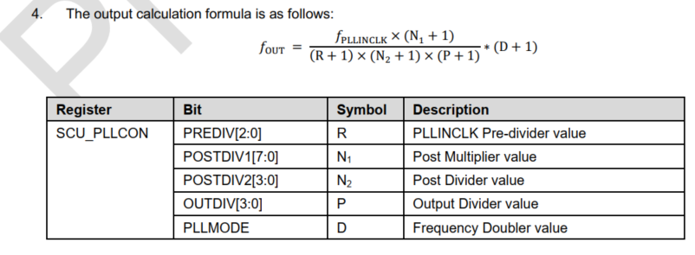

Slide 5
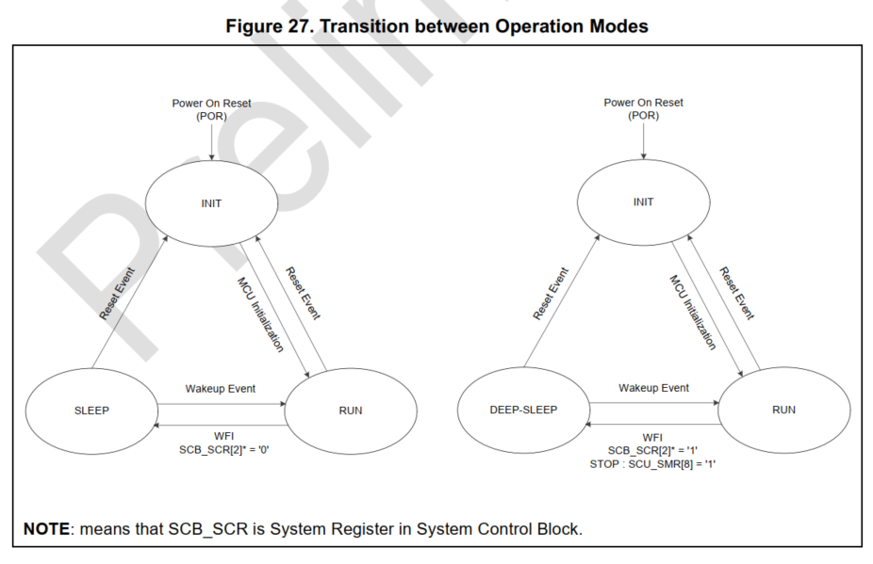

Slide 6
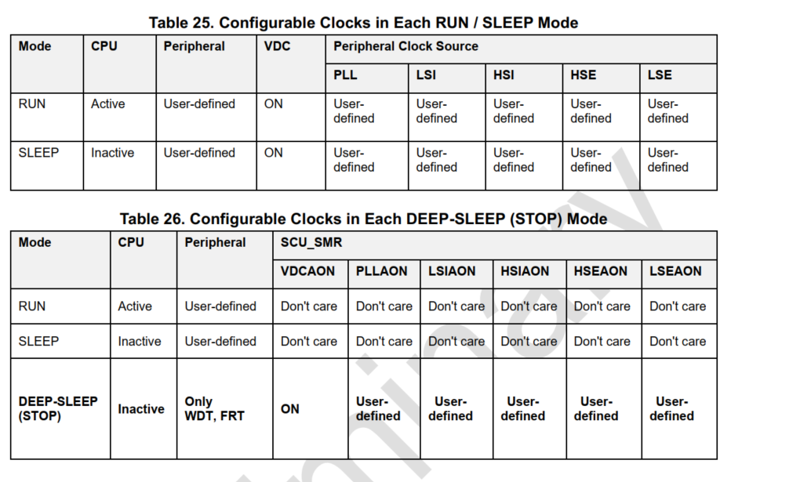

Slide 7
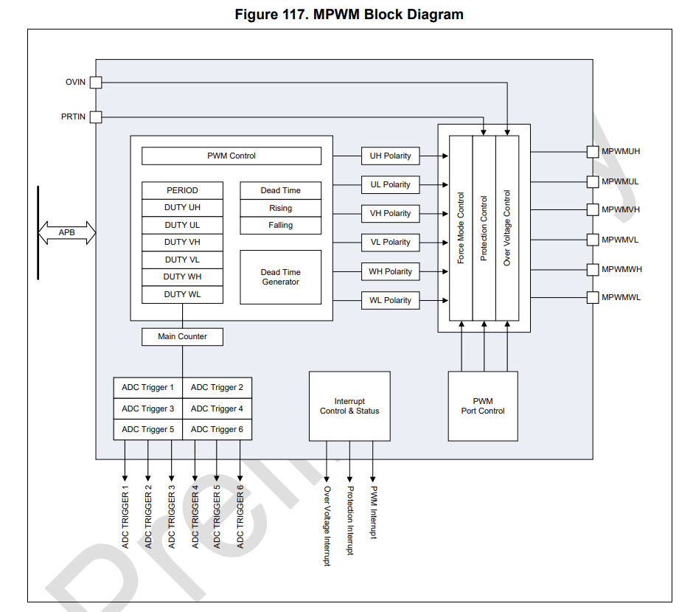
MPWM

Slide 8
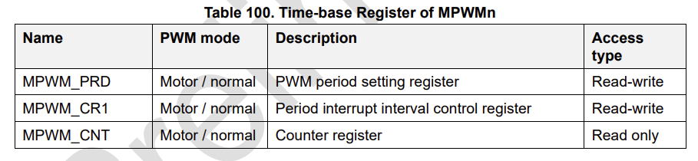
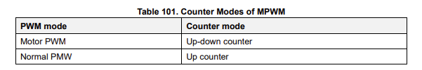



Slide 9
Normal mode
Motor PWM mode
symmetrically mode
symmetrically mode
asymmetrically mode
2-ch symmetric mode
1-ch symmetric mode
2-ch symmetric mode
1-ch symmetric mode
1-ch asymmetric mode

Slide 10
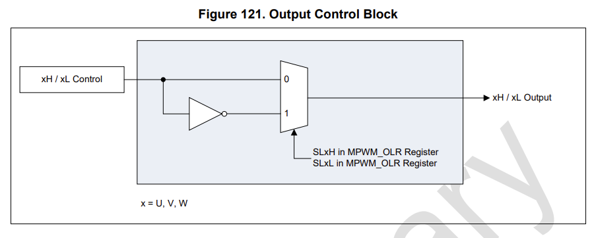
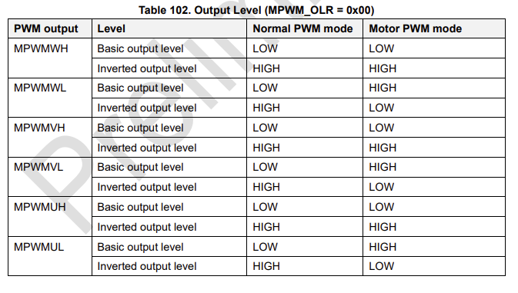

Slide 11
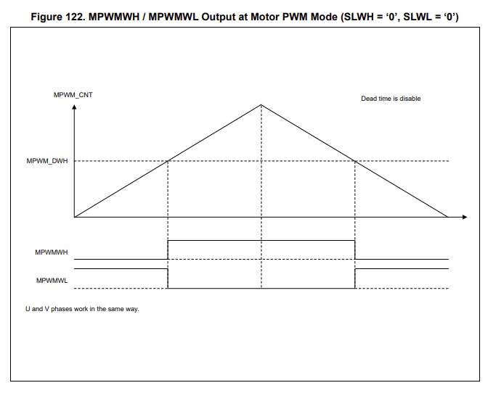
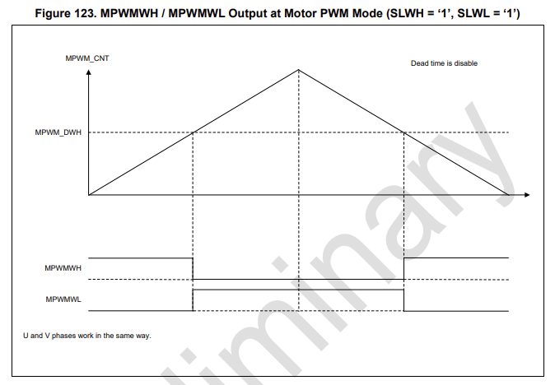

Slide 12
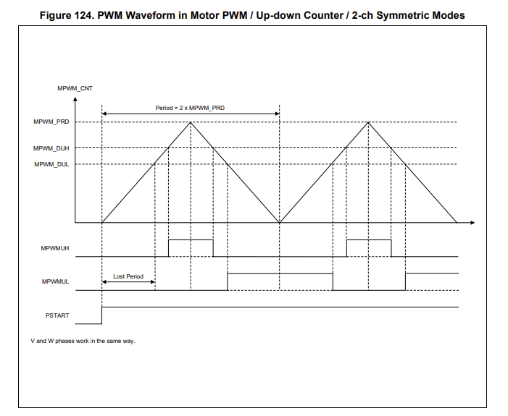

Slide 13
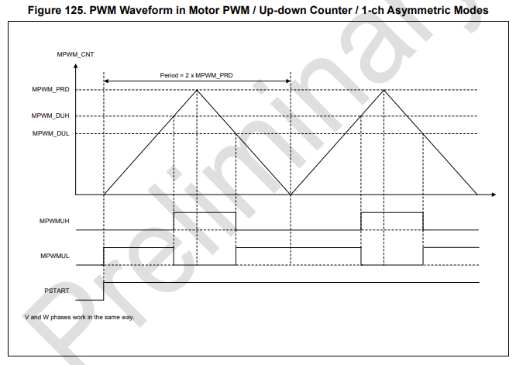

Slide 14
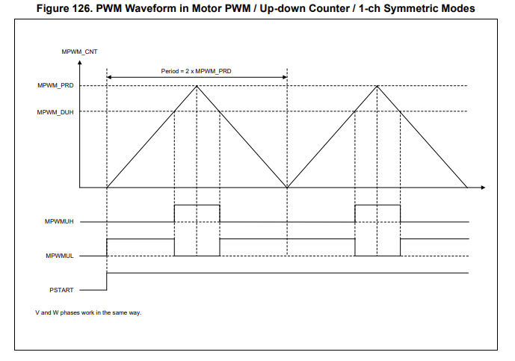

Slide 15
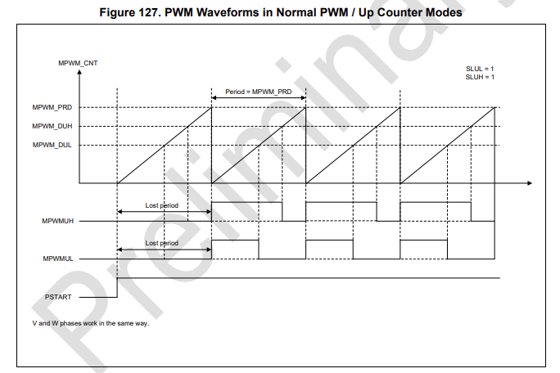

Slide 16
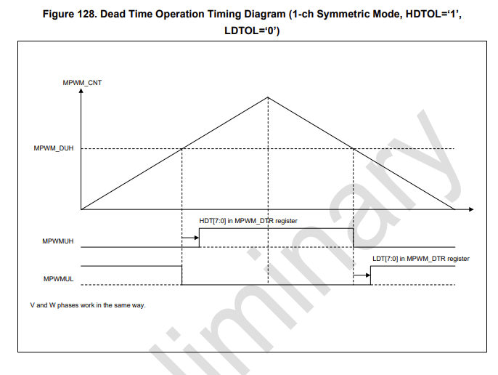
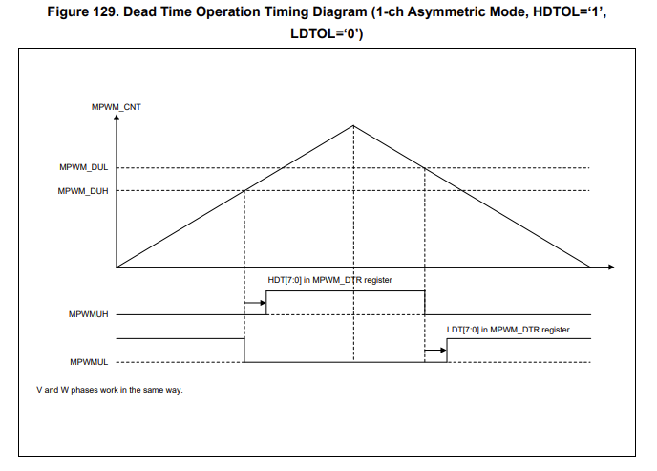
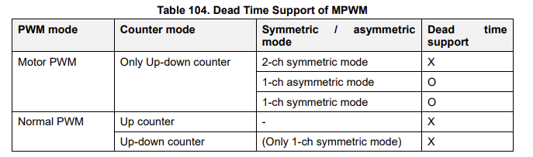
DEADTIME

Slide 17
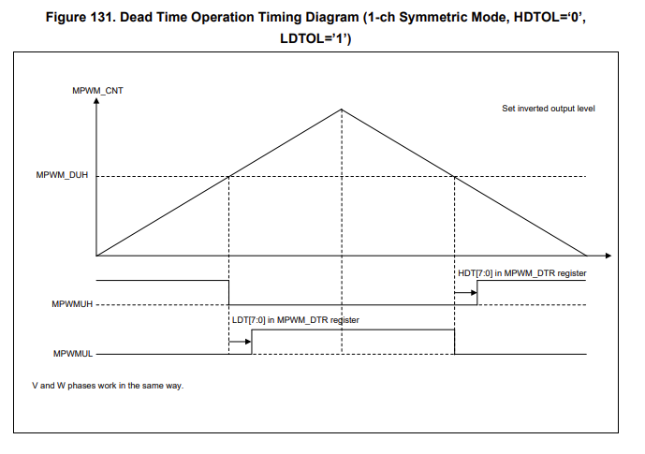
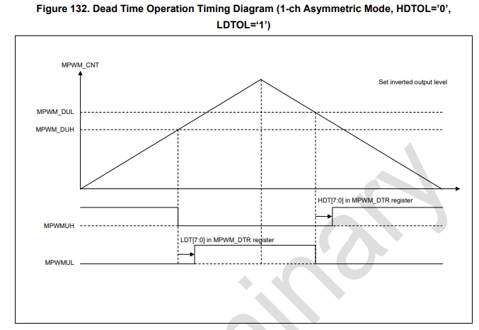

Slide 18
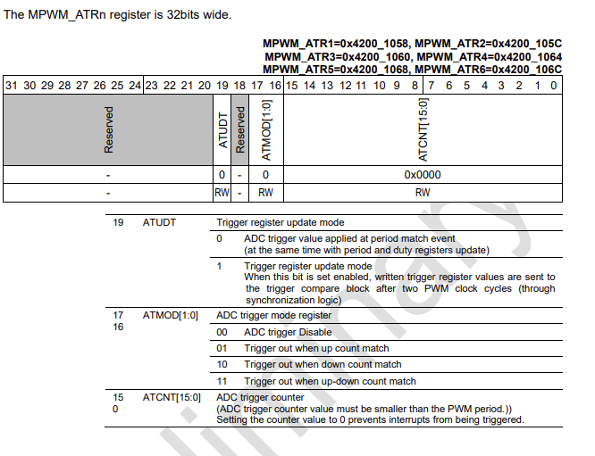
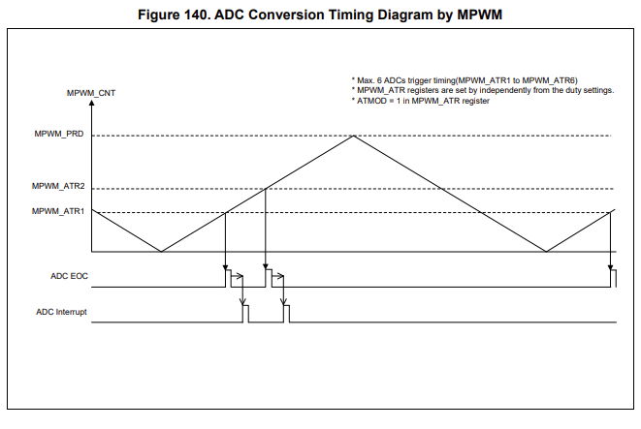
MPWM TRIGGERS ADC

Slide 19
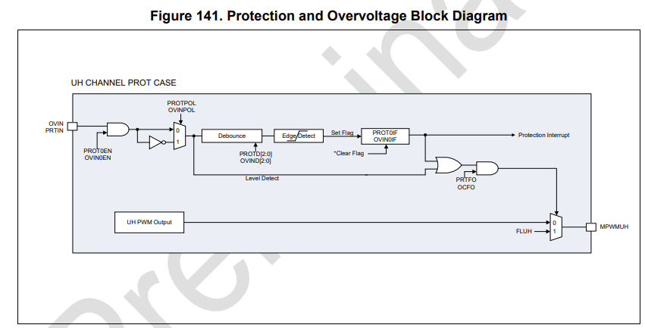
PROTECTION AND OVERVOLTAGE

Slide 20
COMPARE A31M223 With XMC1400
Features | A31M223 | XMC1400
Channels output | 6 | 16 ( 4 timer ( 1 timer has 2 channels, 1 channel has 2 output pin)
Deadtime generator | 1 | 2 ( 2 dead time for 2 channel independently)
Count mode | Up-down | Up Up-down
Period | 6 channels have 1 period | 16 channels have 4 periods (4 timers)
mode | 2-ch symmetric, 1-ch symmetric, 1-ch asymmetric ( 2 compare value: H and L) | Symmetric, asymmetric ( 1 compare value), but it still works 1-ch asymmetric by using update compare value
Protection and overvoltage | PRIN, OVIN | None
External modulation | None | Modify output of each timer

Slide 21
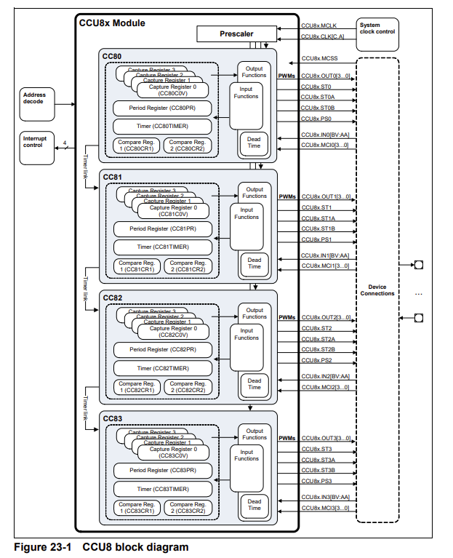
Block diagram of MPWM - XMC1400

Slide 22
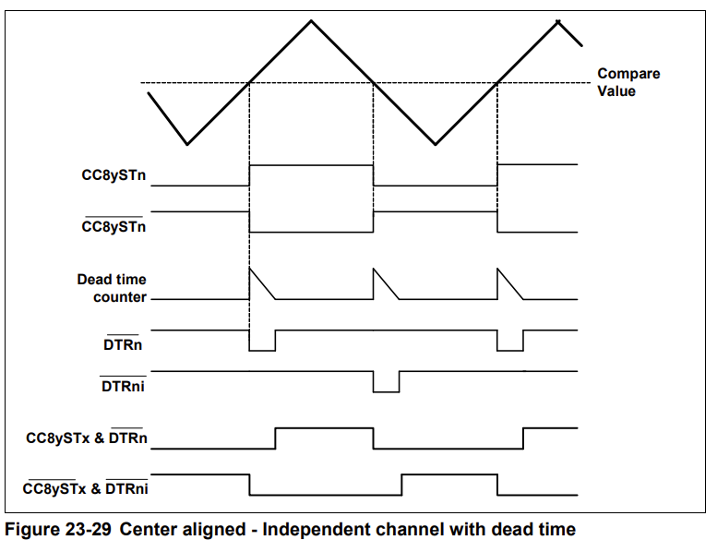
Deadtime of MPWM - XMC1400

Slide 23
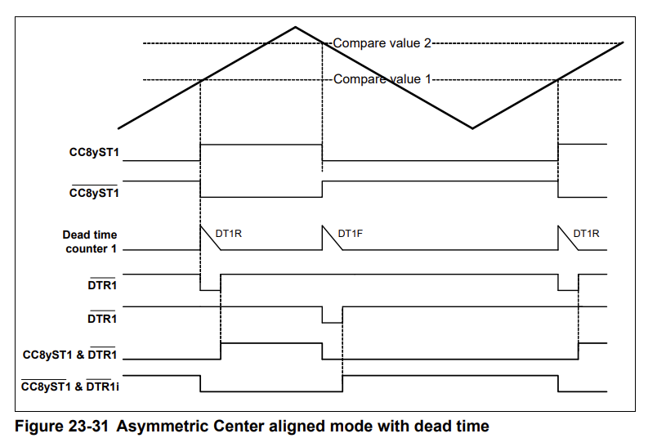

Slide 24
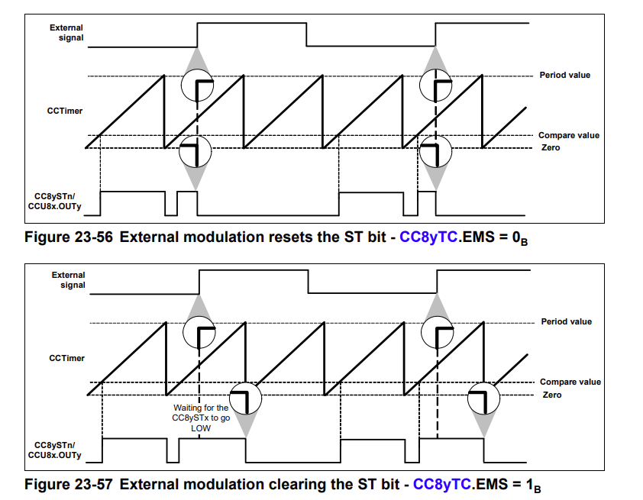

Slide 25


