Slide 1
Developing Data Products Course Project Presentation
Dominik Vuksan

Slide 2
Reading in the data
data= datasets::cars # reading the data in

Slide 3
Making a model
model= lm(dist~speed, data) # linear model

Slide 4
Prediction
speed1= 80 # hypothetical value pred= predict(model, new.data= speed1)

Slide 5
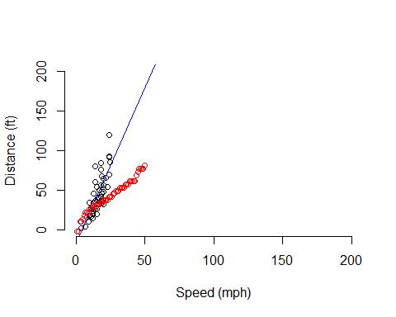
Plot
plot(cars, xlab = "Speed (mph)", ylab = "Distance (ft)", bty = "n", xlim = c(0,200), ylim = c(0,200)) abline(model, col= "blue", lwd= 1) points(pred, col= "red")

