Slide 1

Unveiling the Power of Big Data
Transforming Insights through Data Science on Big Data Platforms
Zhanbo Hua
Xiangrui Zhao Haozhe Zhou
School of Computer Science & Technology China University of Mining and Technology
Haopo Zhang
September 20, 2023
Authors (CUMT)
Big Data
September 20, 2023
1 / 13

Slide 2




Table of Contents
Introduction
Data Science in Big Data Case Studies
3
4 Challenges and Limitations
5
Future Trends
Conclusion References
6
7

Slide 3
Introduction
Big Data is transforming industries worldwide.
In this presentation, we explore its significance and applications. Let’s begin our journey into the world of Big Data.

Slide 4
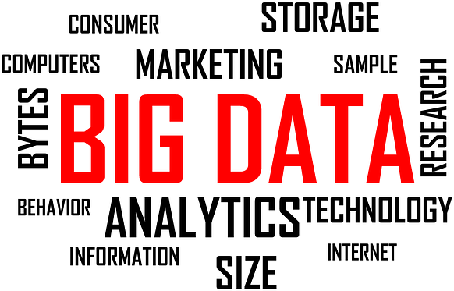
Introduction
Definition
Big Data Definition:
Big Data refers to extremely large and complex datasets that cannot be easily managed, processed, or analyzed using traditional data processing tools.
It is characterized by the four Vs: Volume, Velocity, Variety, and Veracity.
Figure: Big Data

Slide 5

Introduction
Big Data is all around us
Data is generated all the time:
The Internet of Things, cloud computing, mobile Internet, mobile phones and tablets, PCs, and various sensors everywhere are all sources or carriers of big data.
It can be said that big data is all around us, producing and carrying large amounts of data every day.
Figure: Data Generation

Slide 6

Data Science in Big Data
Data Science is the key to unlocking insights from Big Data.
It involves data collection, analysis, and interpretation.
Data Science helps organizations make data-driven decisions.
Figure: Data Science

Slide 7
Case Studies
Let’s explore real-world examples to understand the impact of Big Data and Data Science.
Case Study 1: E-commerce Personalization Case Study 2: Healthcare Analytics

Slide 8
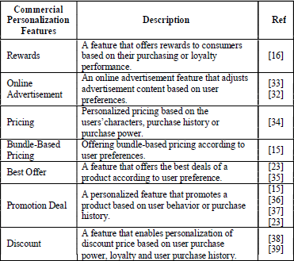
Case Studies
E-commerce Personalization
Personalization features on business-to-consumer
e-commerce:
The rapid growth of technology and social media enables easy real-time information exchange and interaction among users, impacting online personalized advertising performance.
However, it also poses challenges in terms of consumer trust and privacy concerns for researchers.
Figure: Commercial personalization features

Slide 9
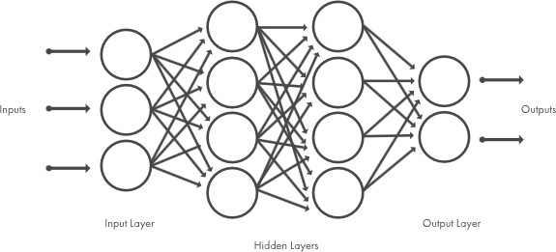
Case Studies
Healthcare Analytics
Applying data science to healthcare data:
Coronavirus disease 2019 (COVID-19) data are notable healthcare data. The disease broke out in 2019, was declared as a pandemic on 11 March 2020, and is still prevailing more than two years later (in 2022). Healthcare informatics on COVID-19 data helps get a better understanding of the disease and find ways to prevent or combat it.
Figure: Neural networks

Slide 10
Challenges and Limitations
While Big Data offers immense potential, it comes with challenges and limitations:
Challenge 1: Data Privacy and Security Challenge 2: Scalability
Limitation 1: Representativeness: a complete sample is never possible Limitation 2: Timeliness: Second-level value exists
We must address these challenges to harness the full power of Big Data.

Slide 11

Future Trends
The world of Big Data is constantly evolving.
Future trends include: Trend 1: Edge Computing
Trend 2: AI and Machine Learning Integration
Trend 3: Advancements in Big Data Platforms
Stay updated to stay competitive in the era of Big Data.
Figure: Future Trends

Slide 12

Conclusion
Big Data, Data Science, and Data Mining are revolutionizing industries.
With the right strategies, organizations can harness Big Data’s power. Embrace the future of data for informed decision-making.

Slide 13
References
Chen, J., Song, L., Liu, X., & Wang, L. (2014). Big Data Deep Learning: Challenges and Perspectives. IEEE Access, 2, 514-525.
Provost, F., & Fawcett, T. (2013). Data Science for Business: What You Need to Know about Data Mining and Data-Analytic Thinking. O’Reilly Media.
Zikopoulos, P., Eaton, C., deRoos, D., Deutsch, T., Lapis, G., & Deroos, D. (2012). Understanding Big Data: Analytics for Enterprise Class Hadoop and Streaming Data. McGraw-Hill Osborne Media.
Ghemawat, S., Gobioff, H., & Leung, S. T. (2003). The Google file system. ACM SIGOPS Operating Systems Review, 37(5), 29-43.
White, T. (2015). Hadoop: The Definitive Guide. O’Reilly Media.
Manyika, J., Chui, M., Brown, B., Bughin, J., Dobbs, R., Roxburgh, C., & Byers, A. H. (2011). Big Data: The Next Frontier for Innovation, Competition, and Productivity. McKinsey Global Institute.

