Slide 1


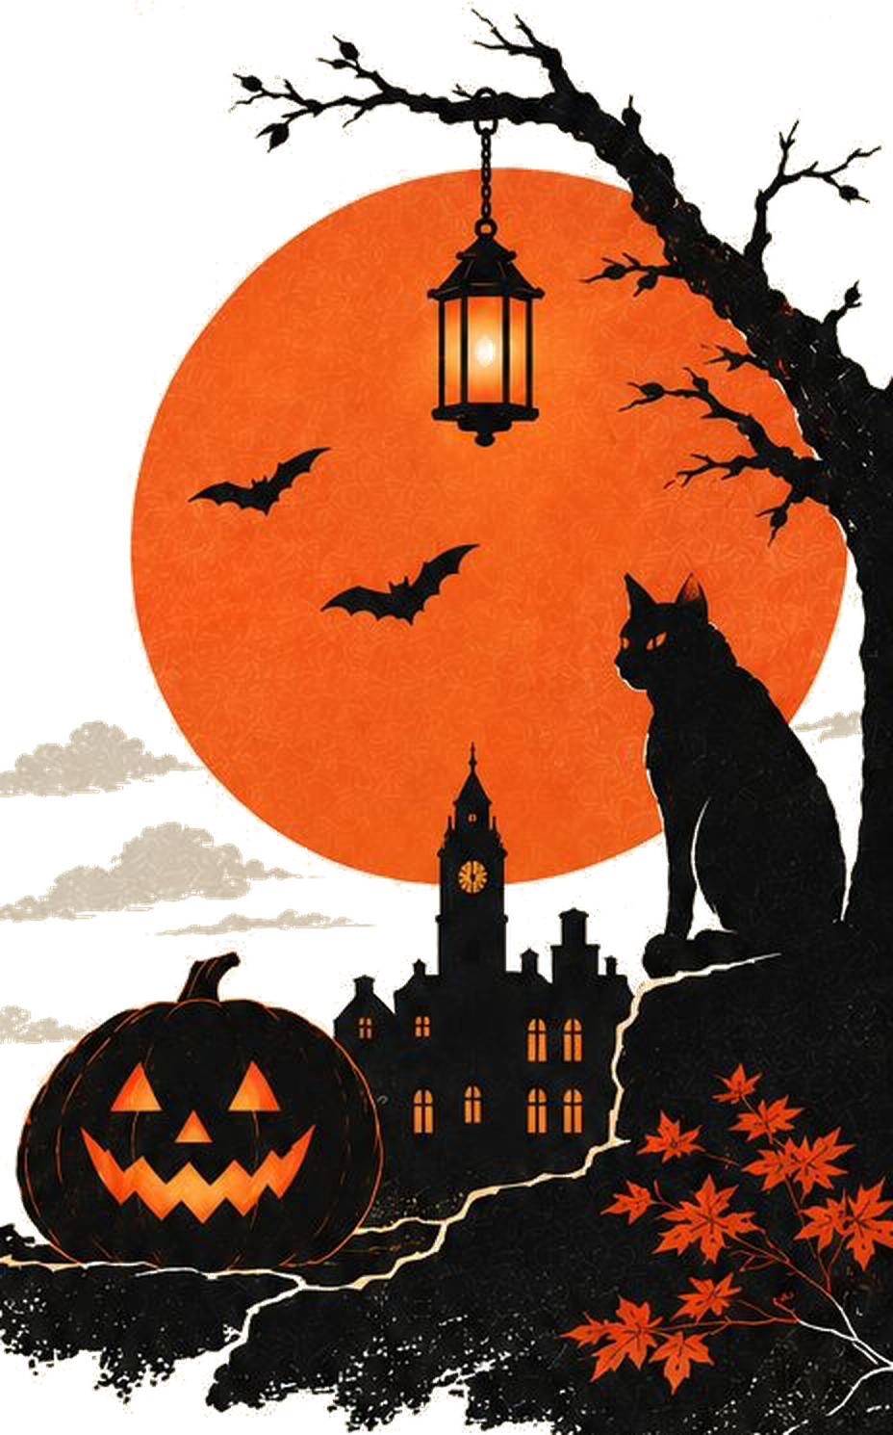

HACK-
-
LANTERN
A HALLOWEEN OVERNIGHT HACKATHON
CODE / CREATE / CELEBRATE
OPENING CEREMONY
31 October 2026 · 7:00 PM · Mirai Floor, Mirai School of Technology
Notes:
Welcome everyone to Hack-O-Lantern, Vulcan Club's Halloween overnight hackathon, powered by Boom Pizza. Tonight the challenges are revealed.

Slide 2






Twelve hours. Five cursed problems.
THE NIGHT AT A GLANCE
31 OCT & 1 NOV
7:00 PM – 7:00 AM
PRIZE POOL
MIRAI FLOOR
Mirai School of Technology
₹9,000
TEAM OF 3
Every member present at each evaluation
₹300 per team entry · awards decided by the judges
HACKING ENDS AT DAWN
Code freeze at 6:45 AM

Slide 3


Powered by Boom Pizza
OUR SPONSOR
The fuel for tonight's hackers
Boom Pizza is sponsoring the pizzas for Hack-O-Lantern, so every team can build through the night on a full stomach. A huge thank you to the Boom Pizza team for backing student builders at Mirai School of Technology.
Notes:
Thank Boom Pizza. Mention when the pizza will be served tonight.

Slide 4






Five tracks. Pick one curse
THE CHALLENGE, REVEALED
TRACK 01
TRACK 02
TRACK 03
TRACK 04
TRACK 05
The Witch's Potion Pantry
The Midnight Phantom Hotline
The Possessed Butler
The Midnight Crossroads
The Coven of Five Hospitals
Smart inventory & demand prediction
Hinglish voice agent under 800 ms
Prompt-injection-proof AI agent
Indian traffic signal optimizer
Federated learning with privacy
1st years only
AI + Systems
AI Security
CV + RL
Privacy + ML

Slide 5




The Witch's Potion Pantry
TRACK 01 · AI + FULL STACK + WEB + ANDROID
Madam Hexley's potion shop runs out of bat wings and mandrake root every Halloween, and angry customers turn into frogs. Build her a smart pantry.
Forecast accuracy on hidden future sales, planted anomalies caught, a working web + Android app, and UX.
YOUR QUEST
Track stock: add, update and record what was sold
Prophecy: predict which ingredients run out, and when
Restock spell: recommend how much to reorder
Strange happenings: flag unusual consumption
Crystal ball: demand charts for every product
Web dashboard + Android app on one shared backend
YOUR DATA
Retail Store Inventory & Demand Forecasting (Kaggle), re-skinned as potion ingredients.
Sealed until 12:00 AM.
A twist to this track drops at midnight. Build to adapt.

Slide 6

The Midnight Phantom Hotline
TRACK 02 · AI + SYSTEMS
Ghosts keep calling the clinic and the haunted railway station in Hinglish, with chains rattling and a signal weaker than a dying candle.
Task completion rate on hidden test calls, and latency.
YOUR QUEST
Book doctor appointments or answer railway queries in code-mixed Hinglish
Handle interruptions and background noise
Survive a 3G-level connection
Reply within 800 ms end to end
Streaming speech-to-text, turn-taking and the latency budget pull against each other.
Sealed until 12:00 AM.
A twist to this track drops at midnight. Build to adapt.

Slide 7
The Possessed Butler
TRACK 03 · AI SECURITY
Count Byteula's AI butler reads letters, browses the cursed web and acts for his master. Dark spirits hide curses everywhere, waiting to possess him.
Tasks completed minus successful possessions.
YOUR QUEST
Build an LLM agent that reads email, browses web pages and takes actions
Defend it against prompt injections hidden in emails, web pages and PDFs
Keep it useful: refusing everything loses points
There is no single known fix, so you must design an architecture, not apply a patch.
Sealed until 12:00 AM.
A twist to this track drops at midnight. Build to adapt.

Slide 8
The Midnight Crossroads
TRACK 04 · COMPUTER VISION + REINFORCEMENT LEARNING
Autos, bikes, buses, cattle and the odd zombie crawl through the cursed crossroads with no lane discipline. Free the souls stuck at red lights.
Reduction in average wait time on unseen junction scenarios.
YOUR QUEST
The All-Seeing Eye: count queued vehicles per approach from CCTV-style video
The Signal Spell: control the lights in the SUMO simulator to cut average wait time
Real-world vision feeds a control loop, and test junctions differ from training.
Sealed until 12:00 AM.
A twist to this track drops at midnight. Build to adapt.

Slide 9
The Coven of Five Hospitals
TRACK 05 · PRIVACY + MACHINE LEARNING
Five haunted hospitals must diagnose a plague together, but their oath forbids sharing records. The Soul Thief lurks, hunting whose records trained the model.
Model accuracy, how much the attacks reveal, and communication cost.
YOUR QUEST
Train across 5 hospitals with differently skewed data
Federated learning: no raw data leaves a hospital
Stay within a differential-privacy budget
Survive membership-inference attacks
Privacy noise, skewed hospitals and attack resistance all cost accuracy.
Sealed until 12:00 AM.
A twist to this track drops at midnight. Build to adapt.

Slide 10
From dusk till the Grand Séance
SCHEDULE OF THE DAMNED
7:00 PM
12:00 AM
1:00 AM
3:00 AM
4:00 AM
Opening ceremony
Challenge reveal, check-in, costumes
The Midnight Curse
Every track gets its twist
Round 1
The First Haunting
Witching-hour break
Pizza courtesy of Boom Pizza
Round 2
The Witching Hour Trial
6:45 AM
7:00 AM
~8:30 AM
9:30 AM
~11:30 AM
Code freeze
The graves are sealed
Round 3
The Graveyard Cut: top 10 chosen
Top 10 announced
The survivors are named
Final
The Grand Séance: top 10 present
Awards ceremony
The night ends
Evaluation round
Twist or deadline

Slide 11




Three rounds, one cut, one séance
JUDGEMENT
1:00 AM
4:00 AM
7:00 AM
9:30 AM
The First Haunting
The Witching Hour Trial
The Graveyard Cut
The Grand Séance
NO ELIMINATION
NO ELIMINATION
ELIMINATION
TOP 10 ONLY
Architecture and the basic flow working end to end.
Core metrics on public test data, and progress on the curse. Live leaderboard after.
Hidden test sets, live attacks and curse handling. Top 10 advance.
8 min presentation and live demo, then 4 min judge Q&A.
SCORE WEIGHTS
15%
Round 1
25%
Round 2
60%
Round 3

Slide 12
What the judges want to see first
ROUND 1 · 1:00 AM
Potion Pantry
Database and CRUD working; web and Android app connected to the backend
Phantom Hotline
End-to-end voice pipeline answers at least one query
Possessed Butler
Agent completes basic email, browsing and file tasks
Midnight Crossroads
Vehicle detection running on the sample video
Coven of Hospitals
Federated training loop running across all 5 hospitals
Round 1 has no elimination. It is your chance to get early feedback.

Slide 13
Rules of the night
THE COVEN'S LAWS
01
Teams of 3
All code is written tonight. Open-source libraries, pretrained models and public APIs are allowed; list them in your README.
02
Hidden tests
You get sample data now. Final scores use hidden test sets no team sees in advance.
03
The curse counts
The Midnight Curse drops at 12:00 AM and is scored in Rounds 2 and 3.
04
Show up
Be at your table with a working build for every round. A missed round scores zero.
05
Code freeze 6:45 AM
Only your last commit before the freeze is judged.
06
Fair play
Attacking other teams is allowed only in the official Track 3 Possession Round. The judges' decision is final.

Slide 14






Awards of the night
GLORY
Grand Sorcerer
Overall winner
Rising Witch
Best first-year team
PRIZE POOL
₹9,000
Exorcist
Best defence in the Possession Round
Speed Demon
Lowest latency on the Phantom Hotline
Split across the awards, announced at the ceremony.
Necromancer
Best comeback after the Midnight Curse
Best Costume
Voted at the opening ceremony

Slide 15





7993521335
vulcan.techclub@gmail.com
Survey No. 137, South, Doddakammanahalli, Phase 2, Begur Hobli, Bengaluru, Karnataka 560083

Slide 16
The Midnight Curse has fallen
SHOW AT 12:00 AM ONLY
Potion Pantry
A full moon festival is announced for next week. Demand for 3 ingredients triples.
Phantom Hotline
The latency limit drops to 600 ms, and callers switch language mid-sentence.
Possessed Butler
The Possession Round: write curses to attack other teams' butlers. Points for attack and defence.
Midnight Crossroads
A funeral procession (emergency-vehicle priority) and a fog curse on night footage.
Coven of Hospitals
One hospital is corrupted and sends poisoned updates. Detect it and stay accurate.
Keep this slide hidden until midnight.
Notes:
Reveal at 12:00 AM. Hide this slide during the opening ceremony.

