Slide 1
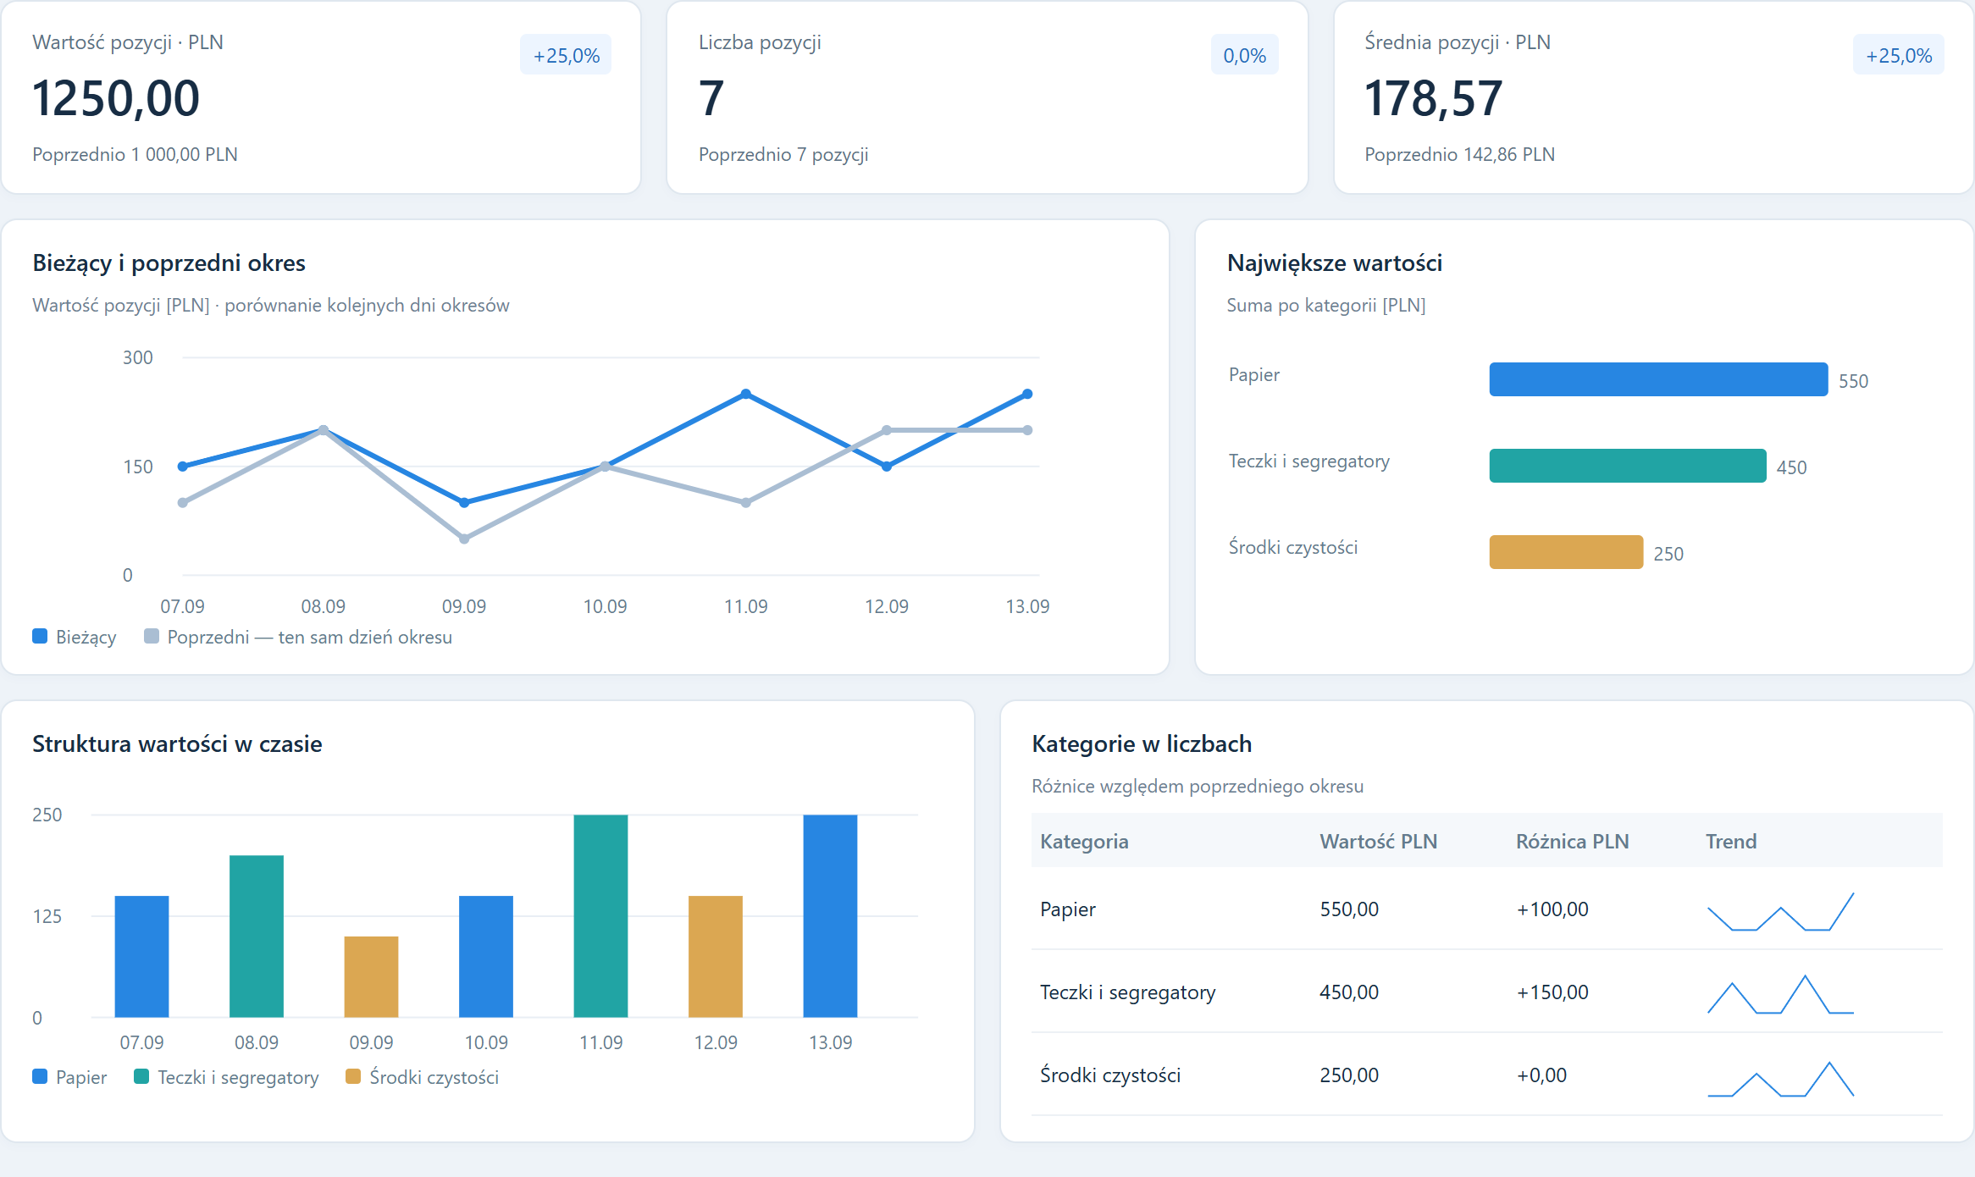
{{TITLE}}
{{SUBTITLE}}
{{FOOTER}}
Notes:
{{NOTES}}

Slide 2
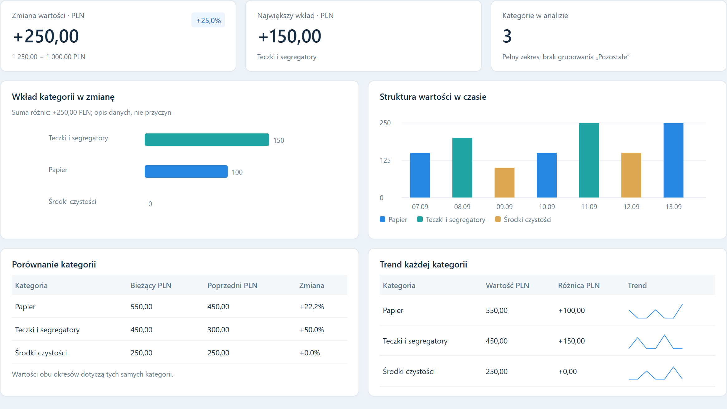
{{TITLE}}
{{SUBTITLE}}
{{FOOTER}}
Notes:
{{NOTES}}

Slide 3
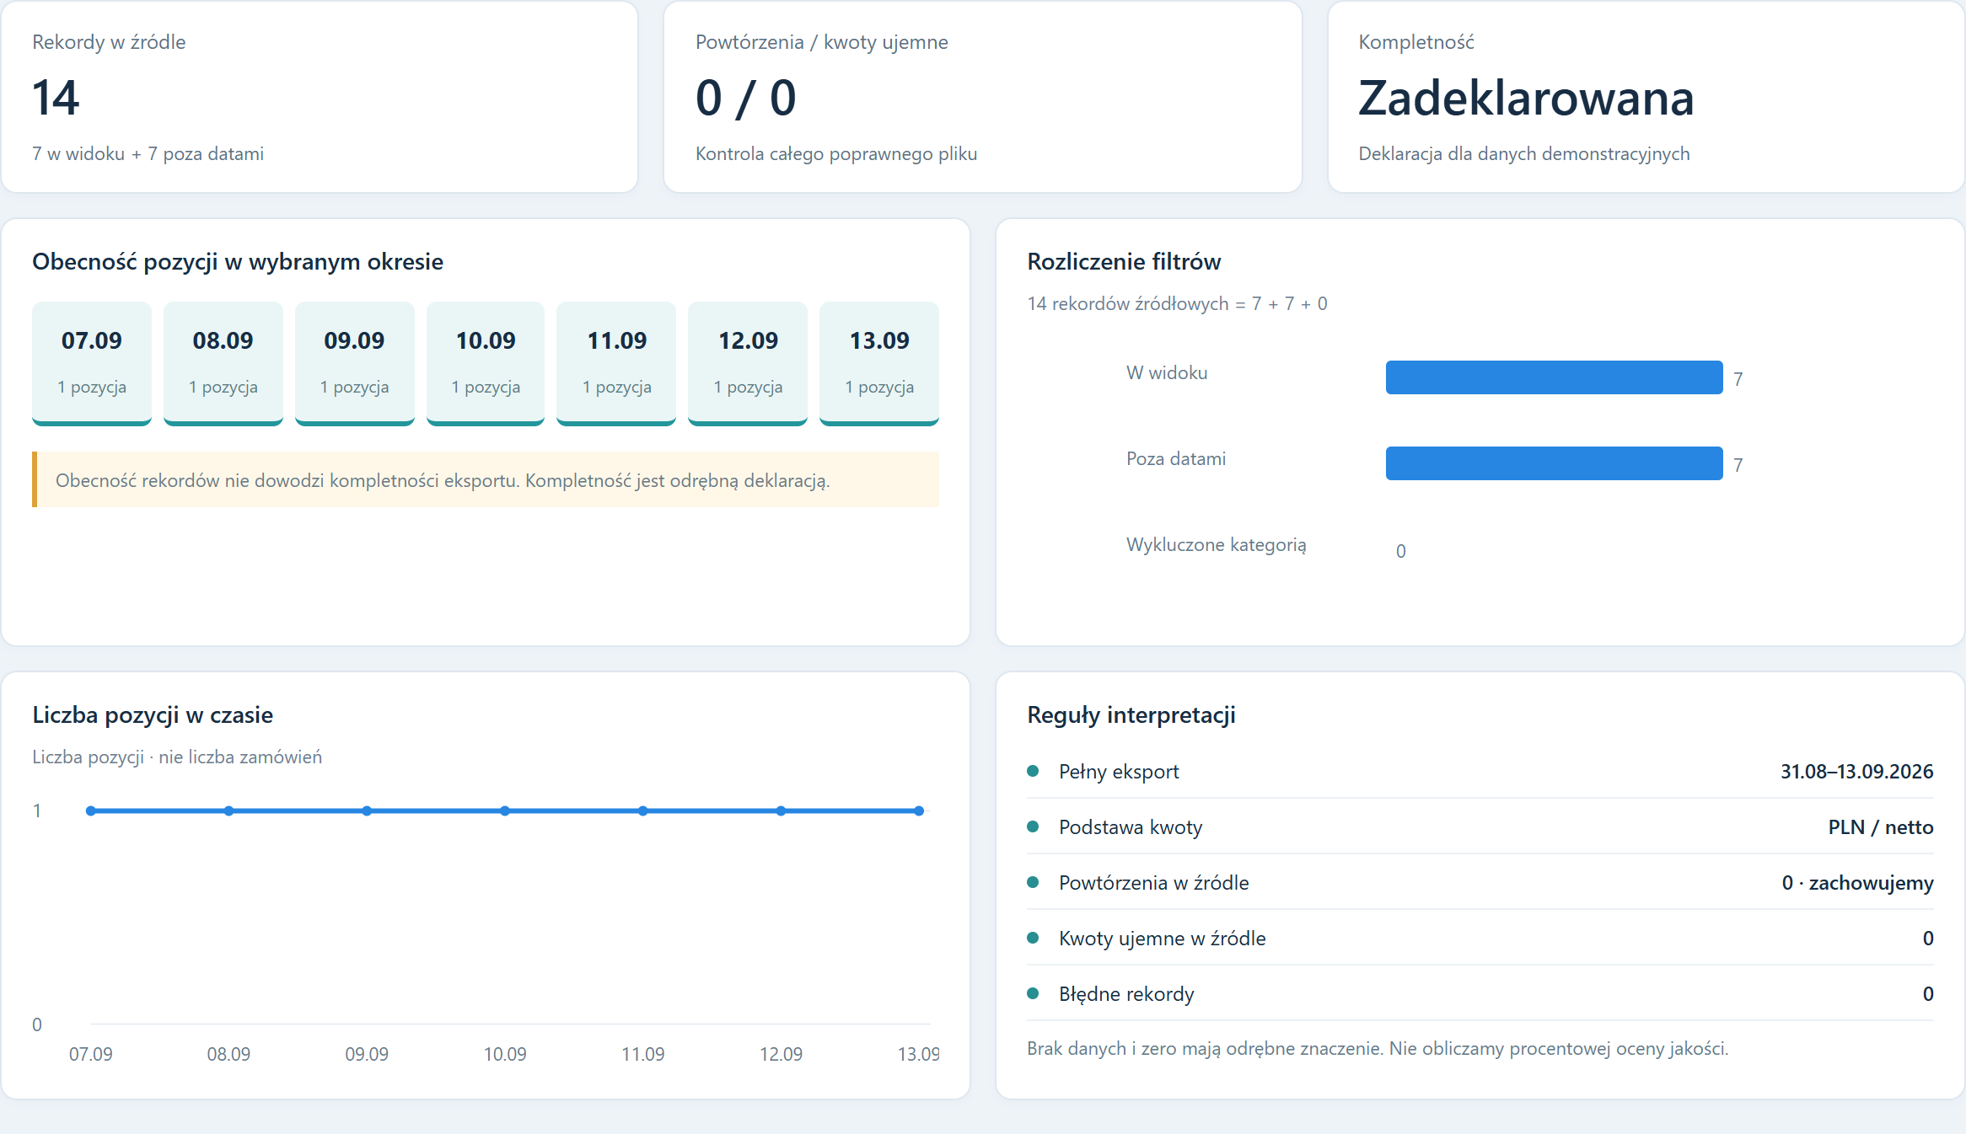
{{TITLE}}
{{SUBTITLE}}
{{FOOTER}}
Notes:
{{NOTES}}

