Slide 1

Performance/ Network Monitor
Group 2 – Abubaker Egeh, Harsh Dhanwani, Martin Kukura, Niral Mehta, Romina Gnanavel, Tulga Sukhdorj

Slide 2
Introduction
Our aims:
Stable program
Efficient interface
Multiple users
Security management

Slide 3
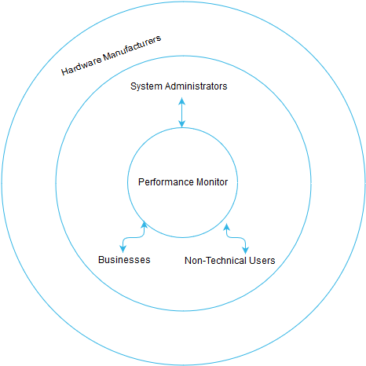
The Scope
Represents who the program affects directly and indirectly.
Directly – users
Indirectly – hardware manufacturers

Slide 4
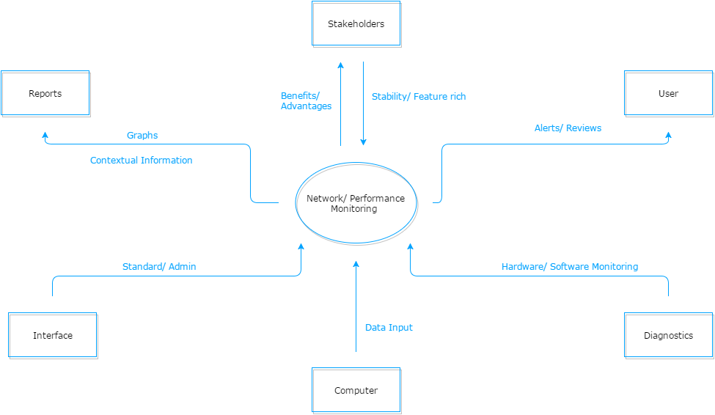
Context
How our program will interact with it’s environment.
Arrows going towards centre – environment to program
Arrows going away from centre – program outputting specific requirements

Slide 5
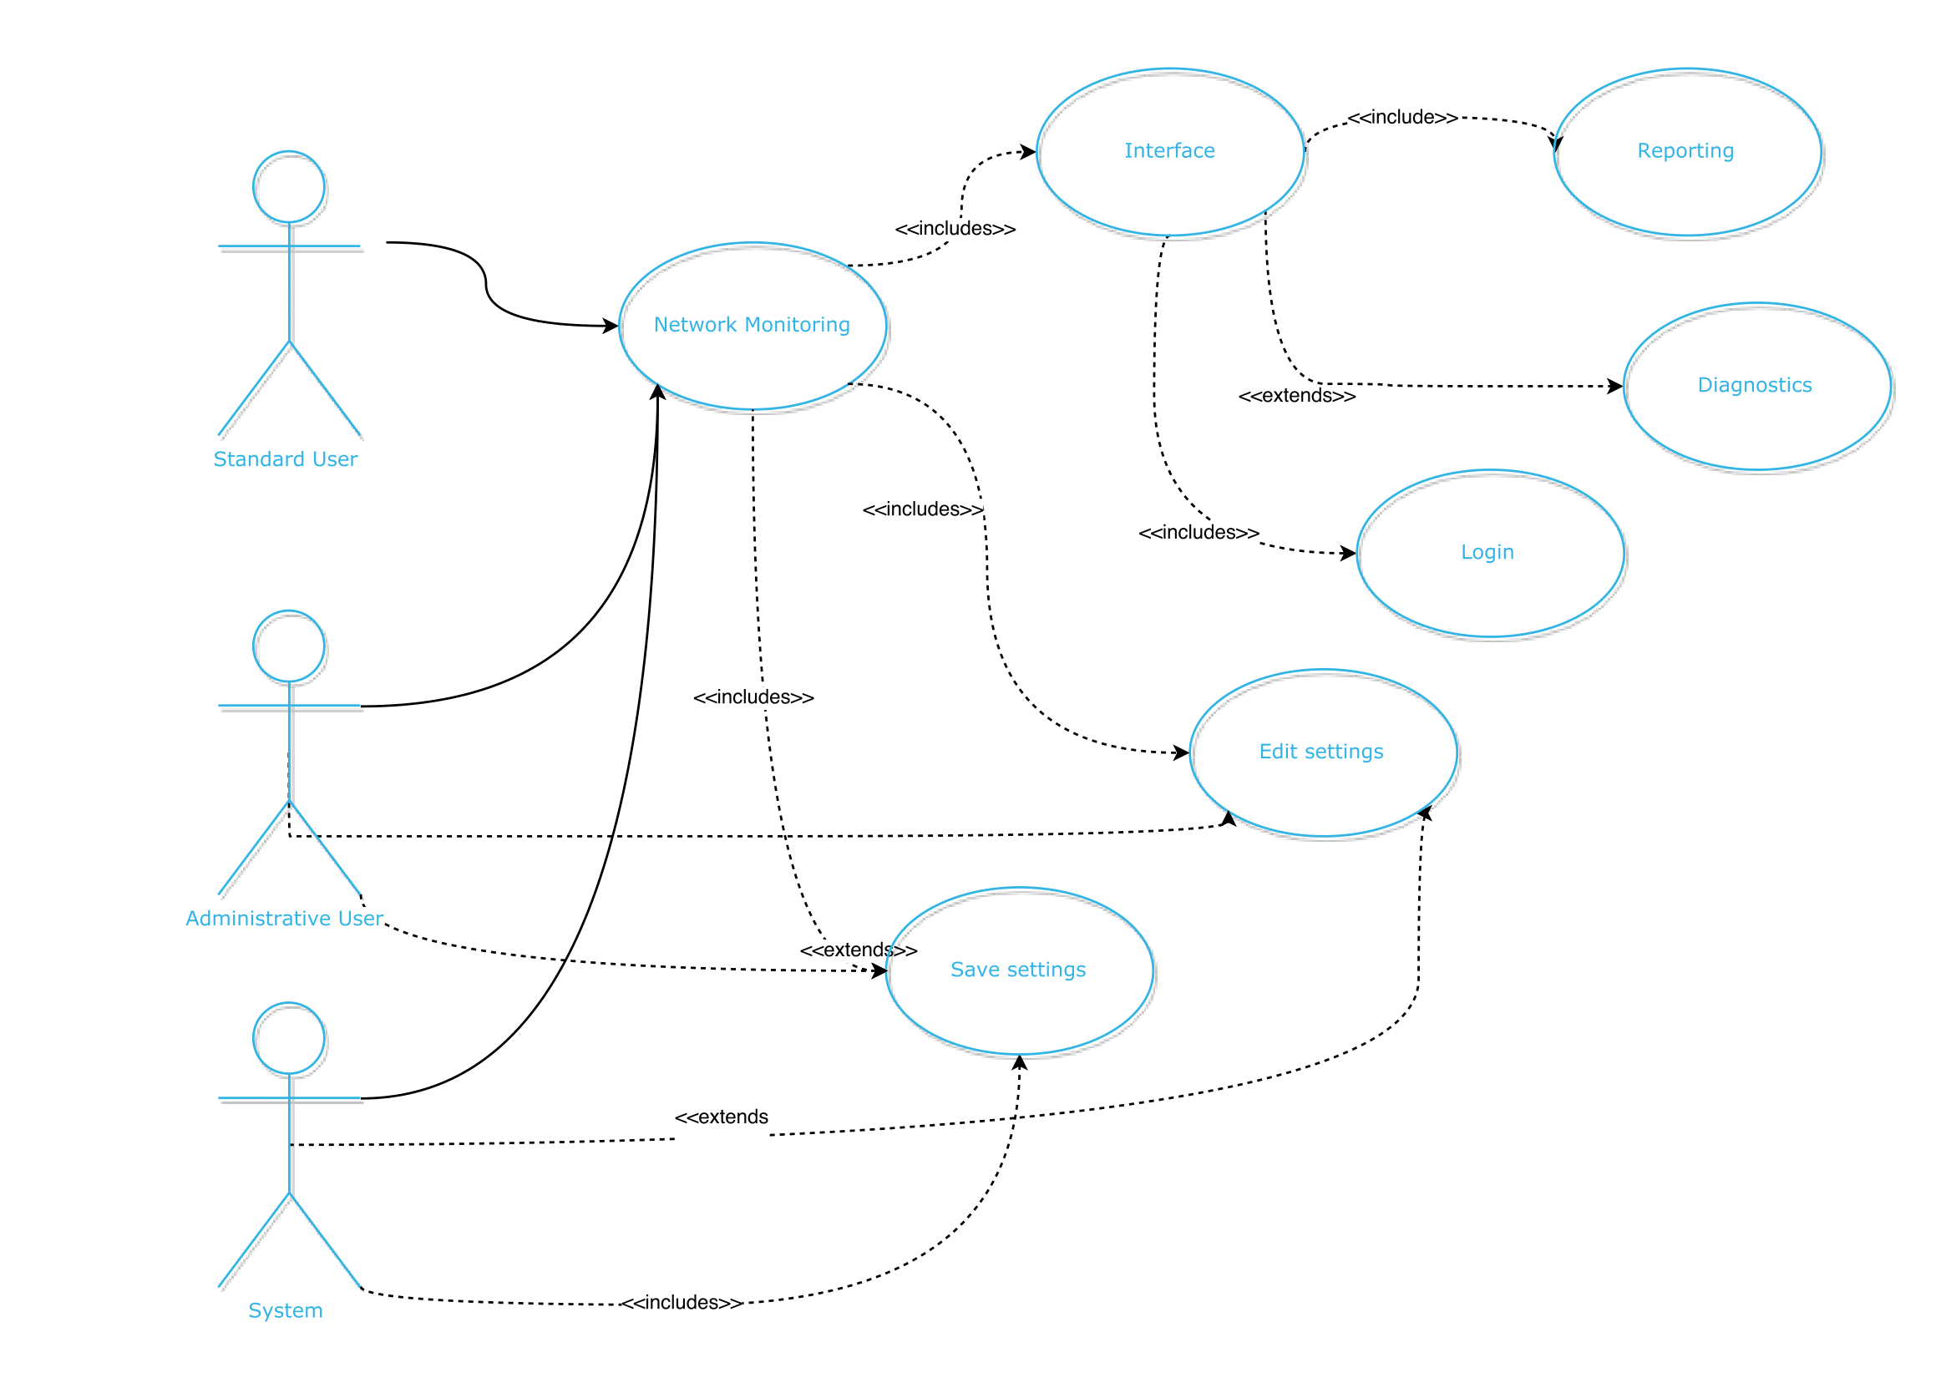
Use Case
How the actors and the system interact with one another
Admin/System can perform all functions including edit/save settings
User is limited to core functions. Excludes save/ edit settings

Slide 6
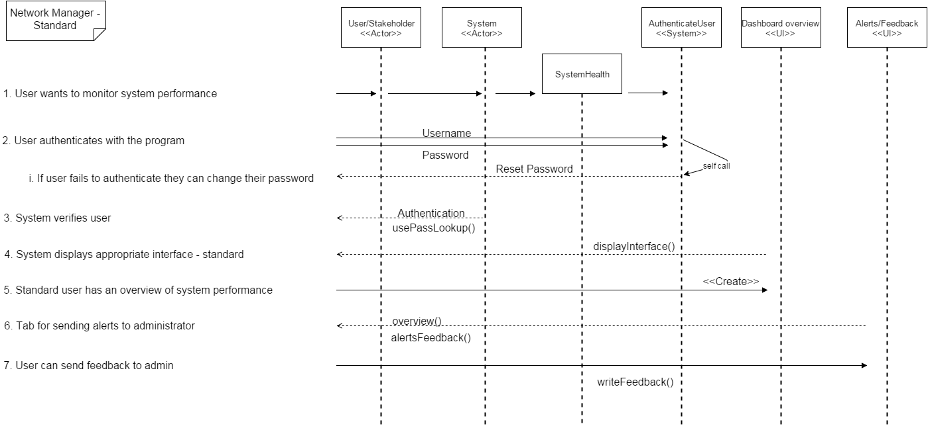
Sequence Diagram User
Standard user objects and their interactions
Objects message other objects to perform functions

Slide 7
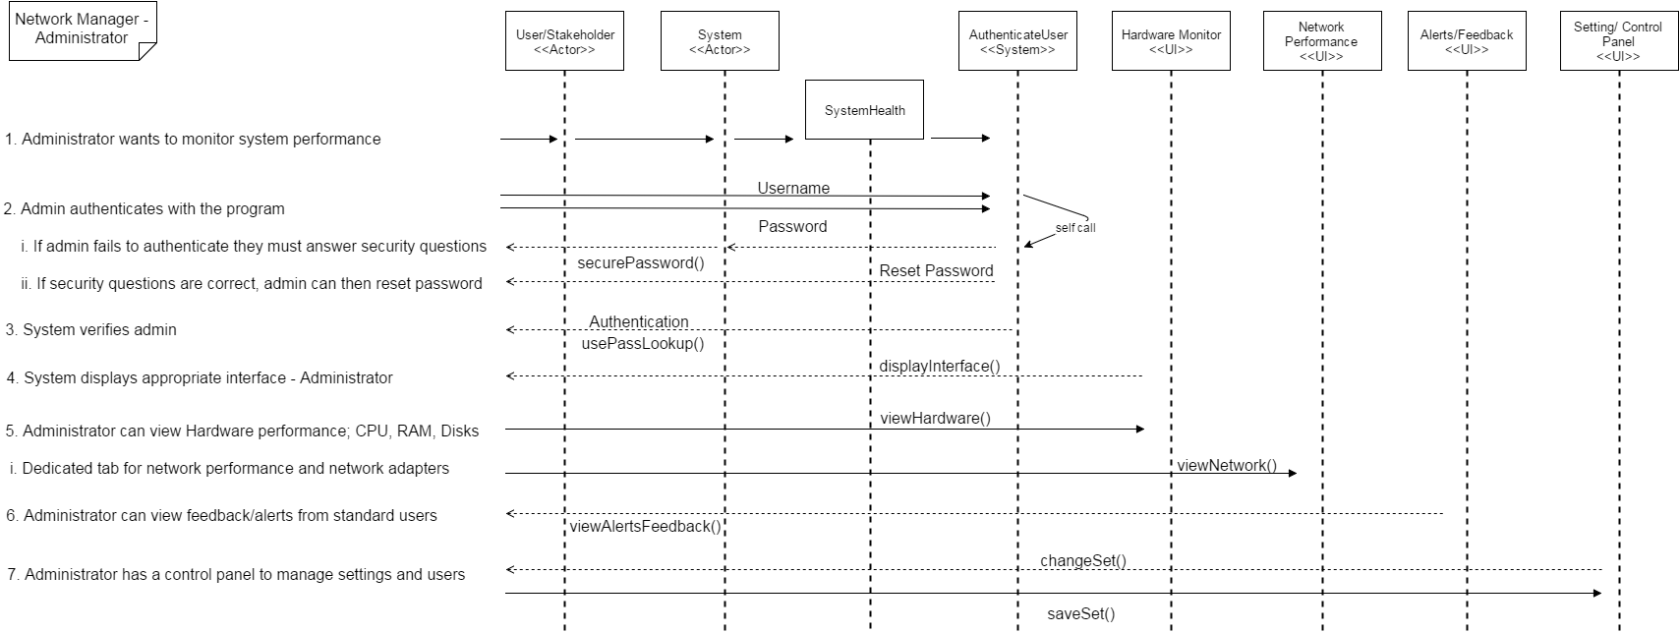
Sequence Diagram Administrator
Administrator user objects and their interactions
More class/objects as they have more control

Slide 8
Architecture
Getter and Setters
Agent and GUI split
OS-Specific agent implementation
Database abstraction
Helper classes
Tabular GUI
Minimal but contextual

Slide 9
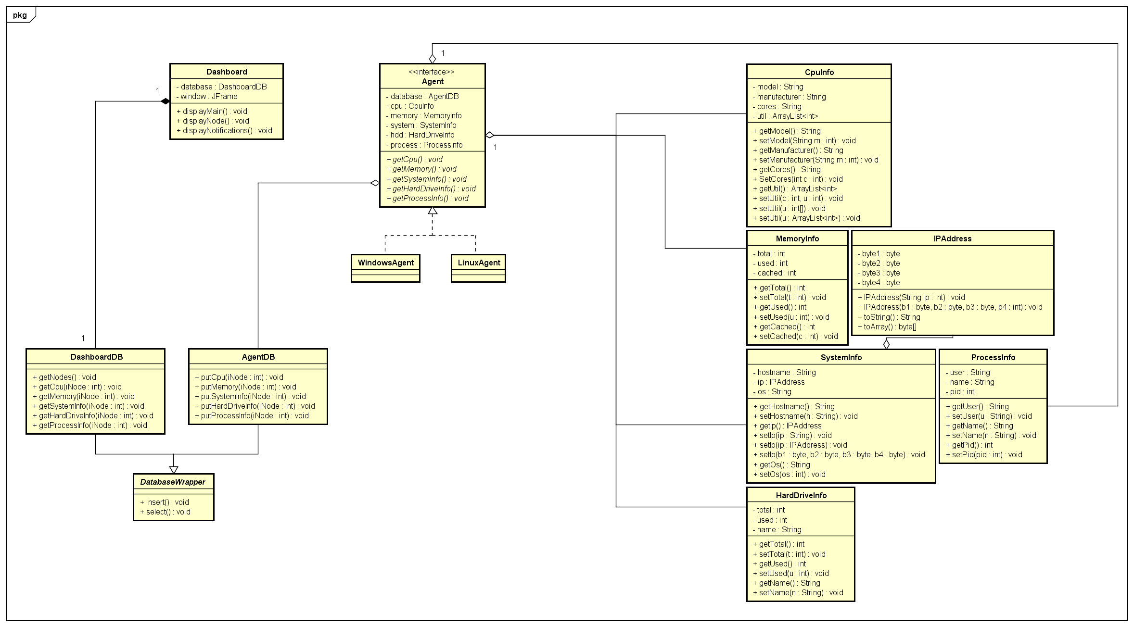
Class Diagram

Slide 10
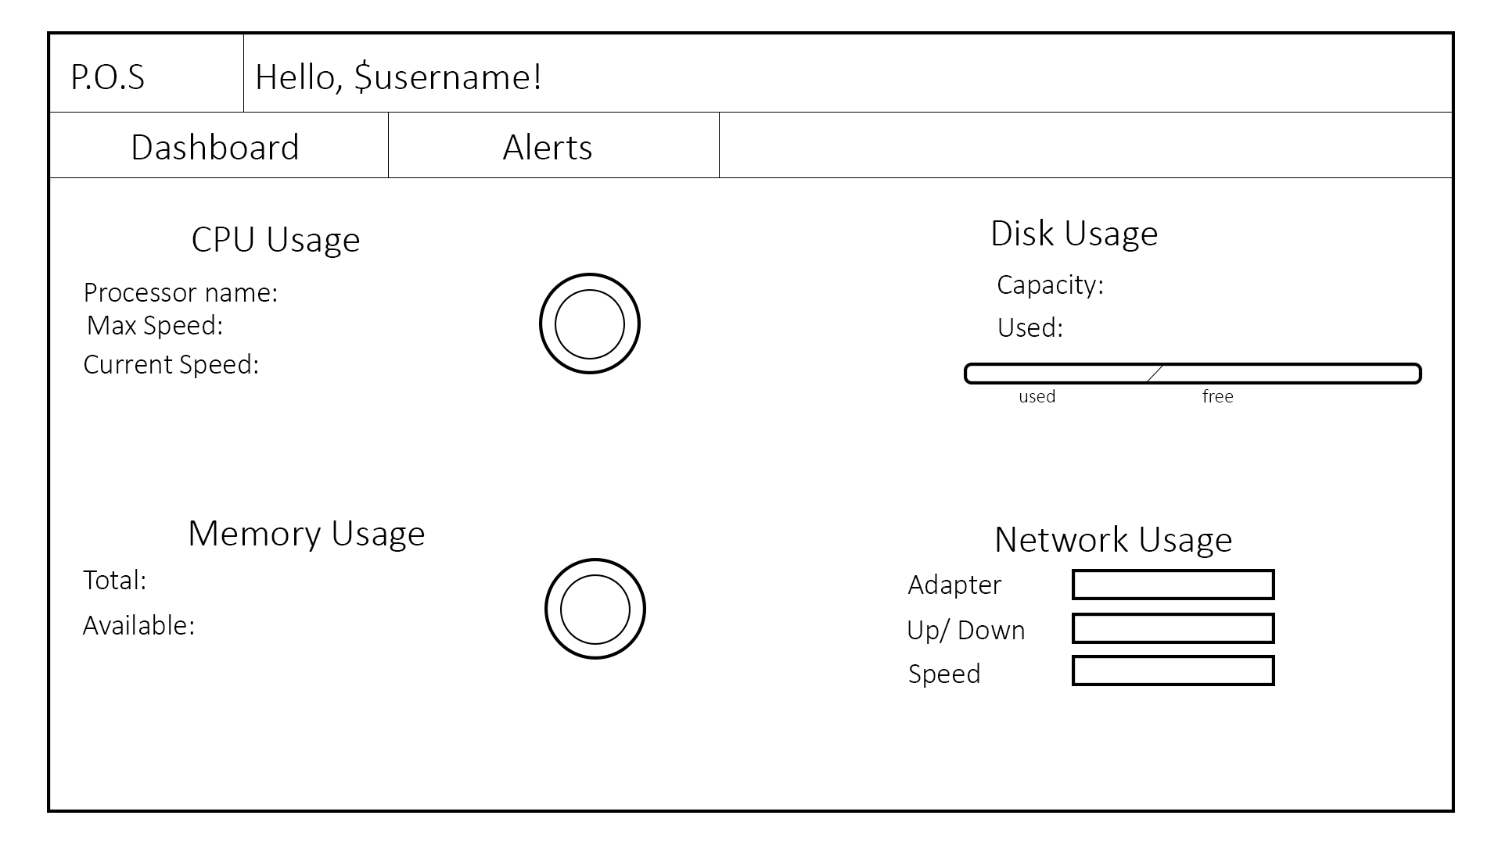
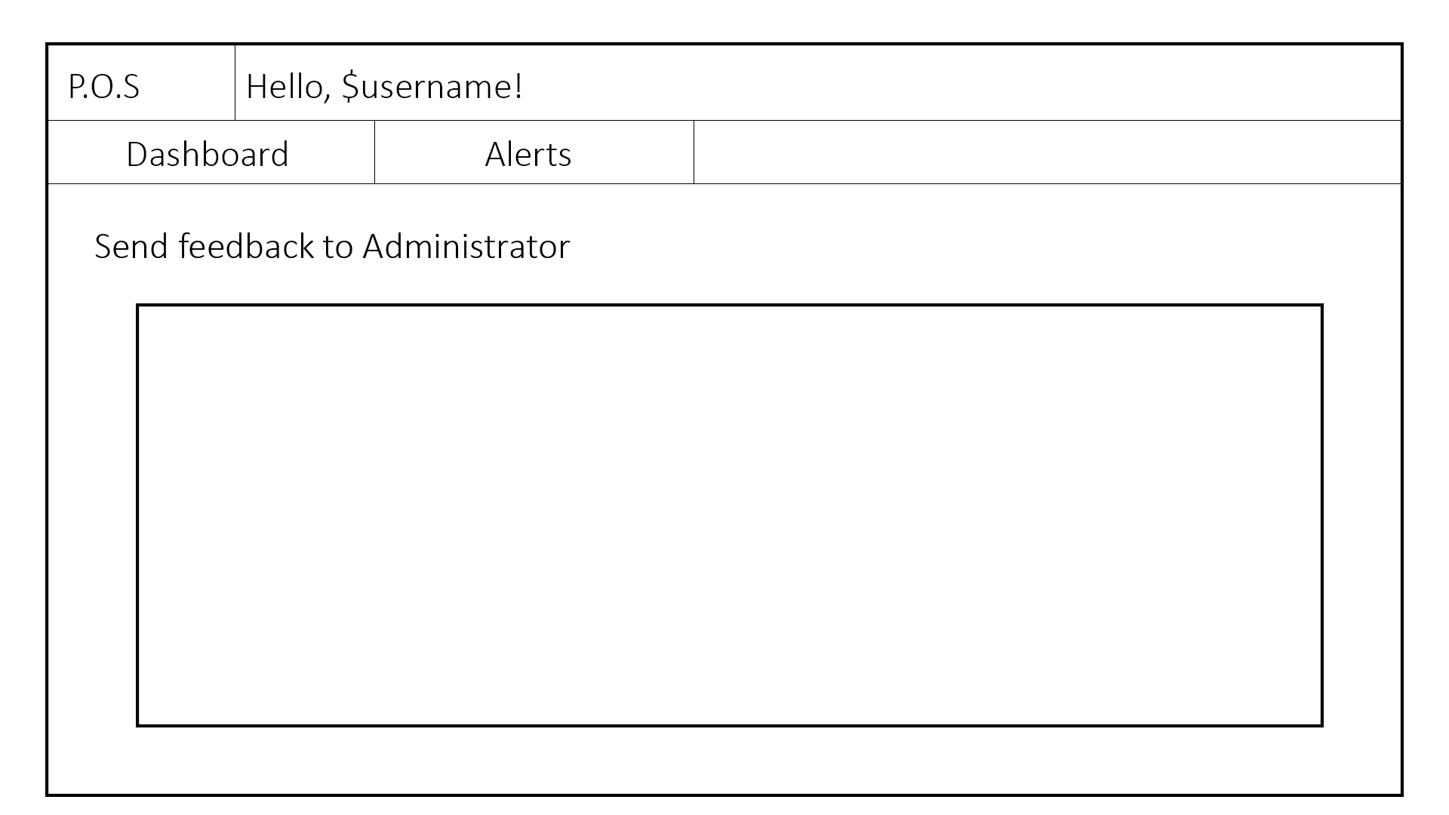
Design – Standard Users
System overview
Contact Administrator

Slide 11
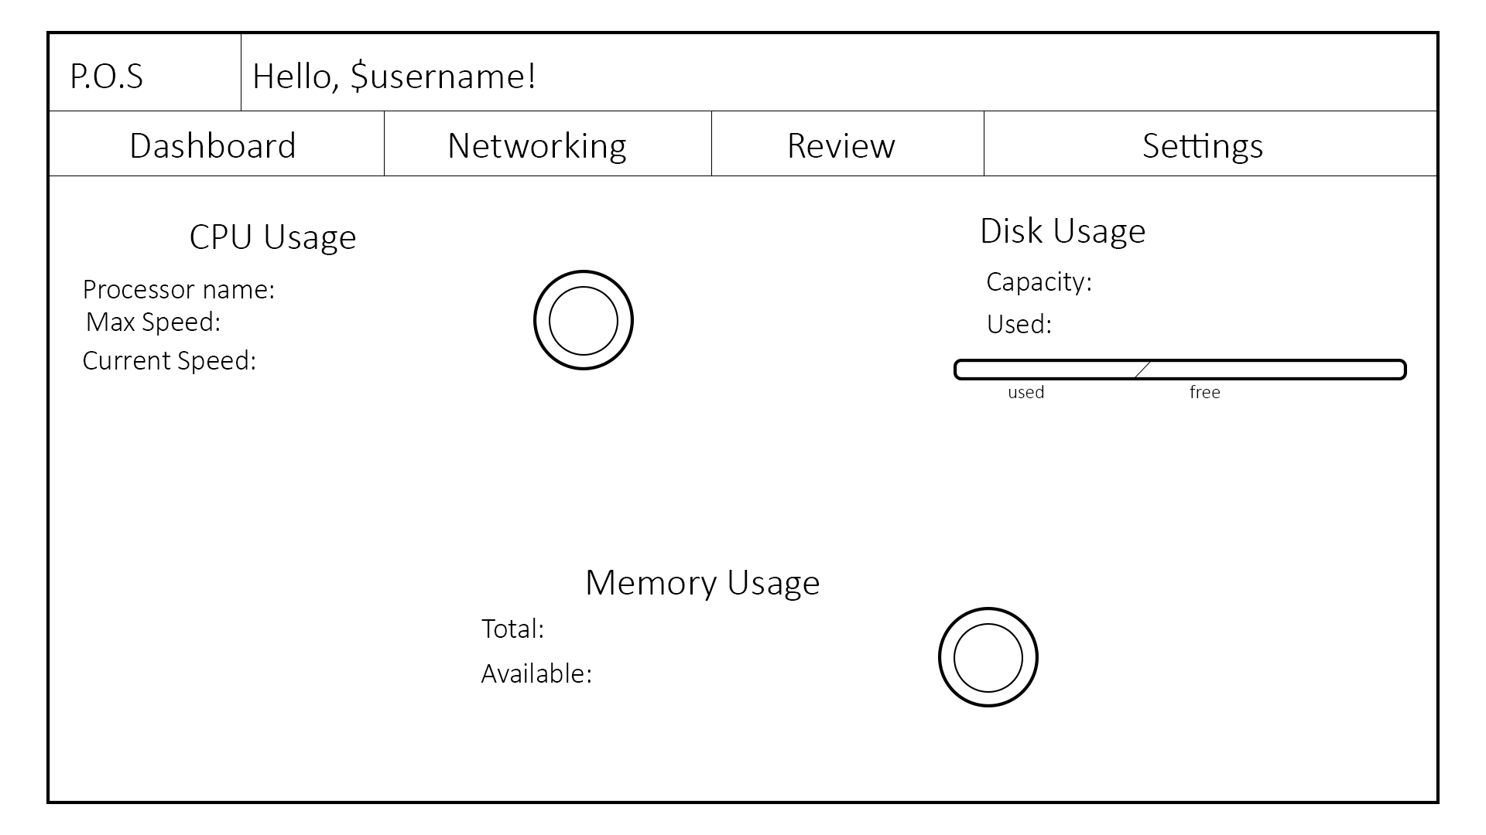
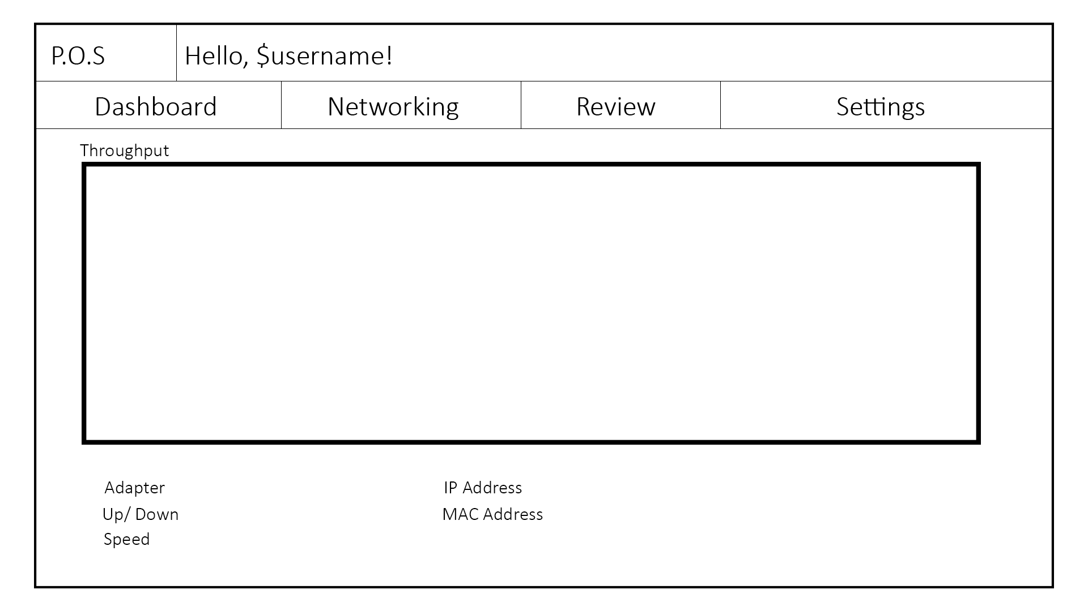
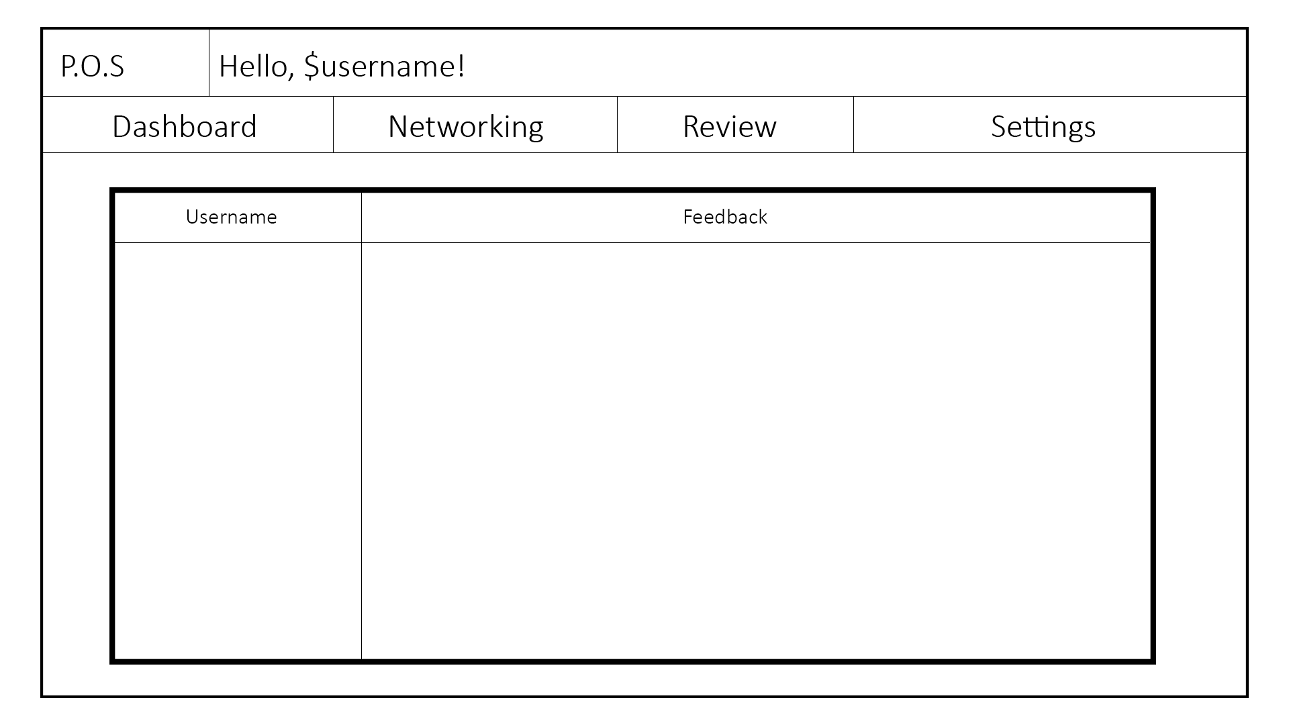
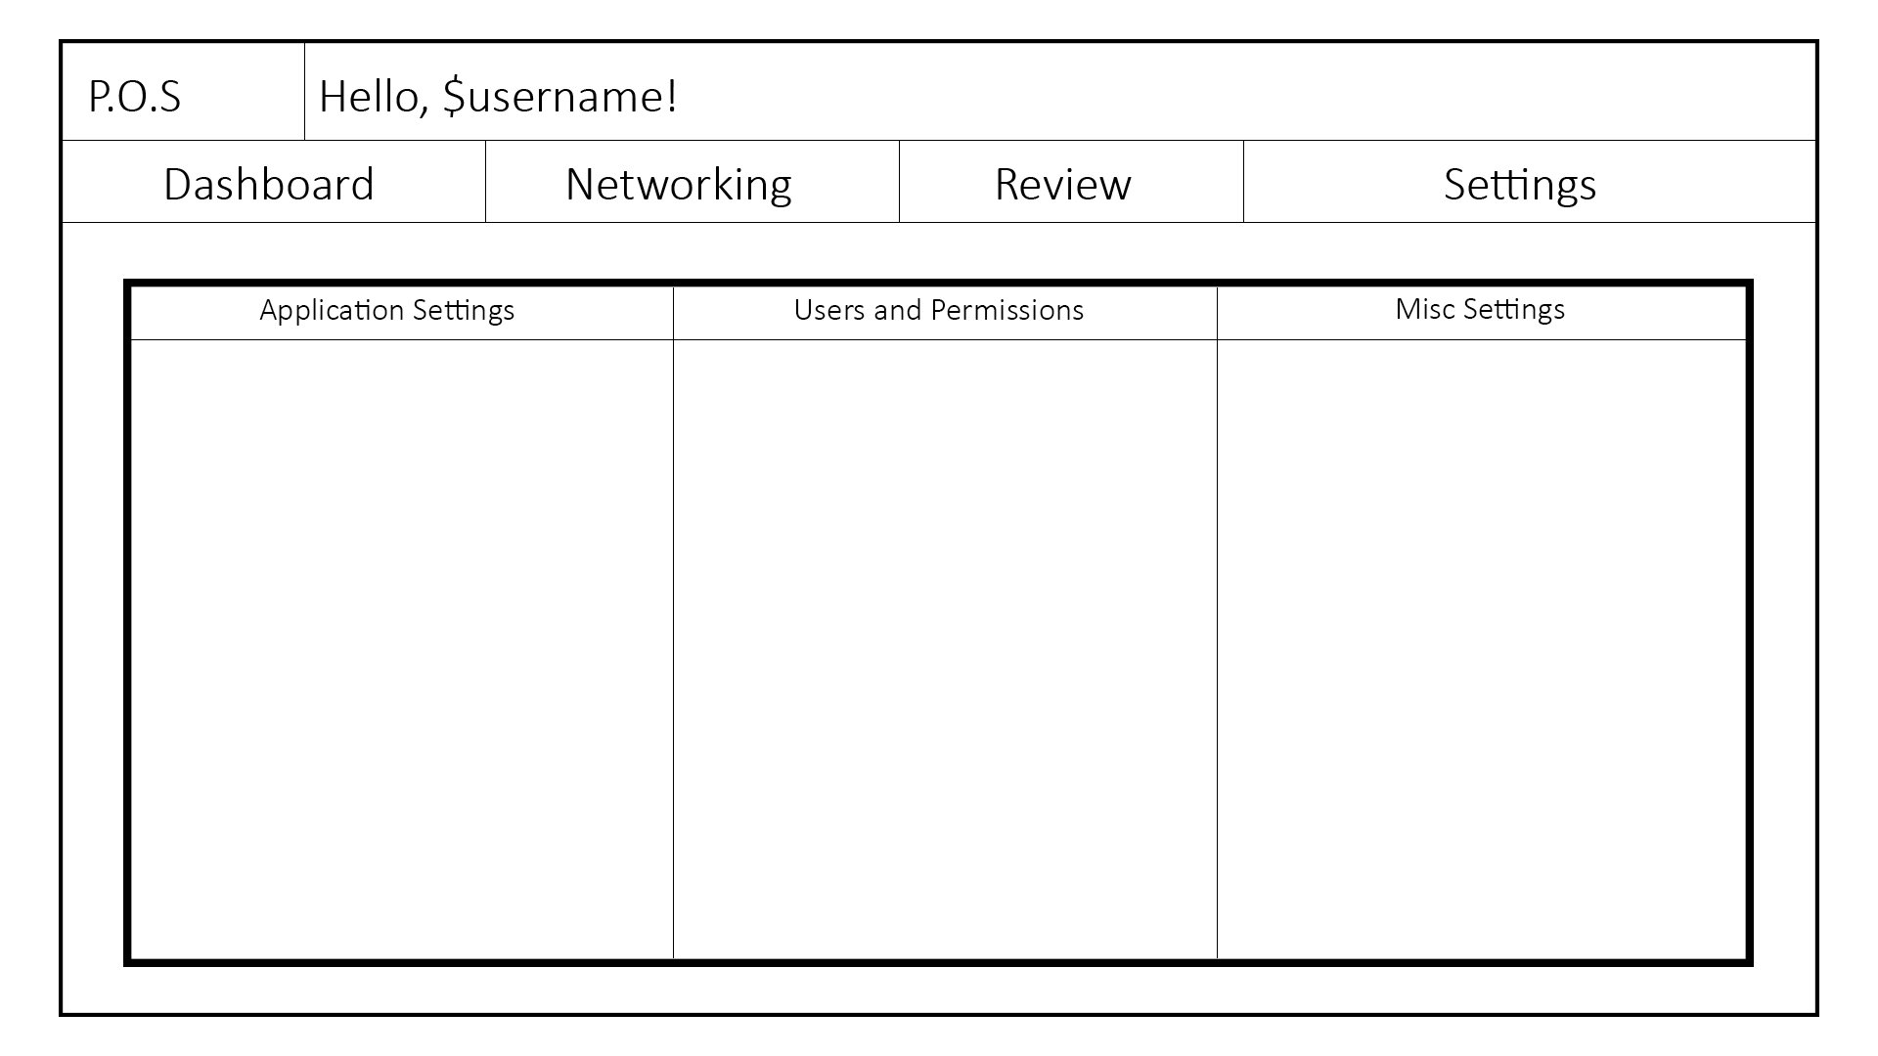
Design – Administrative Users
Administrator Dashboard Overview
Network Tab
Review Tab
Settings Tab

Slide 12
Conclusion
We have proved
Efficient
Easily managed
Secure
Accurate statistics
To lighten your mood:
I was going to tell you guys a joke about UDP, but you might not get it!

Slide 13
References
Inspiration:
Nagios Enterprises, LLC (2015) Nagios core. Nagios open source project. Available at: https://www.nagios.org/ (Accessed: 24 November 2015).
Use Case
Use case (2015) in Wikipedia. Available at: https://en.wikipedia.org/wiki/Use_case (Accessed: 27 November 2015).
Conclusion - Joke
I Was Gonna Tell You Guys A Joke About UDP (2012) Available at: https://www.reddit.com/r/ProgrammerHumor/comments/14wv9p/i_was_gonna_tell_you_guys_a_joke_about_udp/ (Accessed: 30 November 2015)

