Slide 1
VAXPLAN
A multitenant GIS microplanning platform for national immunisation programmes.
Stakeholder briefing · 2026
Plan vaccination sessions where they're needed — even offline.

Slide 2
VaxPlan
Executive summary
2 / 28
Microplanning, finally on a single map.
VaxPlan replaces the paper-and-spreadsheet stack that national EPIs use to plan, deliver and account for every vaccination session — from the national office to the last village.
10
5
100%
1
guided steps from blank slate to an approved microplan
role tiers from facility clerk to national administrator
offline-capable: every screen continues to work without a signal
tenant per Ministry — full data isolation and own SSO
Why this matters now
• Coverage gaps and zero-dose children remain concentrated in places no spreadsheet ever named.
• Donors and governments are pushing for accountable, georeferenced delivery — not aggregate forms.
• Connectivity is improving but is still uneven; tools built only for online dashboards exclude the field.
VaxPlan · Multitenant GIS Microplanning for National Immunisation Programmes

Slide 3
VaxPlan
01 · The problem
3 / 28
Microplanning today is invisible work on top of broken data.
Four compounding failures cost EPIs accuracy, time and coverage at every quarterly cycle.
Stale denominators
No spatial picture
Catchment populations are recopied each quarter from census tables that are 10+ years old. Targets and dropout rates drift further from reality every cycle.
Plans live in Excel rows. Health workers can't see which villages sit beyond 5 km, which were missed last round, or where zero-dose clusters concentrate.
Broken reporting loops
Offline-blind tools
Submissions move by photo, email and WhatsApp. District review rarely closes inside the quarter, and provincial roll-ups are reconstructed weeks after the fact.
Generic BI dashboards assume connectivity. The facilities that need them most — rural, low-bandwidth, intermittent power — are the ones they fail in.
VaxPlan · Multitenant GIS Microplanning for National Immunisation Programmes

Slide 4
VaxPlan
02 · Vision
4 / 28
One platform. Every facility. Every quarter.
VaxPlan gives Ministries of Health a shared, map-first workspace for routine immunisation and campaign planning — designed for the realities of the last mile.
01
02
03
04
Map-driven
Offline-first
Multitenant
Accountable
GRID3 settlement footprints, WorldPop rasters and drawn catchments on one interactive map. Click a village to plan a session there.
Dexie/IndexedDB replicates facility, village, client and planning data. A mutation outbox flushes when the device sees a signal again.
Each Ministry runs its own tenant with its own users, schedule, boundaries and identity provider. Cross-tenant writes are blocked at the API.
Draft → Pending → Approved → Locked, with an immutable audit log on every sensitive change. RED checklists seed automatically on approval.
VaxPlan · Multitenant GIS Microplanning for National Immunisation Programmes

Slide 5
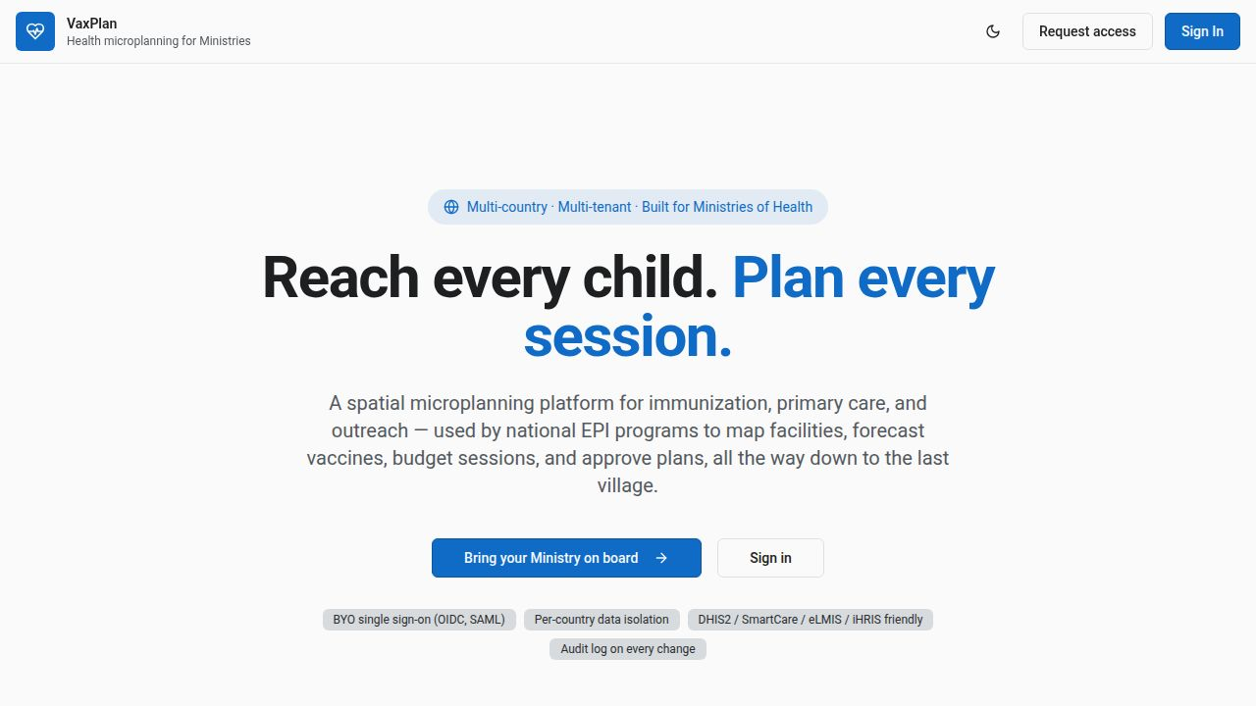
VaxPlan
03 · Product
5 / 28
Branded for the Ministry, recognisable to the field.
Every tenant gets its own home page, identity provider and country styling — VaxPlan is the platform, the Ministry is the brand.
What stakeholders see first
• Plain promise — no jargon, no acronyms above the fold.
• Two paths: existing users sign in, new Ministries request access.
• Trust badges call out SSO, data isolation, HIS-friendliness, audit.
• Country switcher appears once you're in — the same login lets a regional officer cross approved borders.
• Light and dark themes follow OS preferences.
VaxPlan public landing — recognisable promise: "Reach every child. Plan every session."
VaxPlan · Multitenant GIS Microplanning for National Immunisation Programmes

Slide 6
VaxPlan
04 · Stakeholders
6 / 28
Built around the five people who run immunisation.
Each role sees only what it needs. Permissions and visibility are scoped to its level in the health system.
Facility clerk
Author microplans, log sessions, capture per-antigen doses and defaulters, work fully offline.
Facility in-charge
Submit the microplan for approval, sign off on supervisory visits, manage stock at the facility.
District manager
Review and approve facility microplans, monitor coverage by catchment, reconcile unmapped antigens.
Provincial coordinator
Aggregate district performance, escalate gaps, allocate supervisory visits across the province.
National administrator / GIS specialist
Configure schedules, tenants, SSO and boundaries; approve national plans; full tenant-wide visibility.
Donors & partners (read-only)
Audit-grade visibility into approved plans, coverage and supply needs without write access.
VaxPlan · Multitenant GIS Microplanning for National Immunisation Programmes

Slide 7
VaxPlan
05 · Capabilities
7 / 28
Twelve modules. One coherent workspace.
Each module solves a real Ministry workflow — not a generic BI tab.
Facility & village registry
Microplan wizard
Vaccine requirements
Session execution
Geo-coordinates, drawn catchments, refrigerator and power status.
Ten guided steps for routine and campaigns. Drafts auto-save and resume.
Per-antigen forecasts against the tenant schedule, with wastage factors.
Mark-done with per-antigen counts, defaulter capture, offline outbox.
Map workspace
Settlement intelligence
Client logbook
Defaulter tracking
GRID3 footprints, WorldPop rasters, catchment polygons, defaulter dots.
Detect unmapped communities by comparing satellite footprints to the registry.
Digital immunisation register; track dose histories per child.
Auto-identify missed children, one-click outreach session creation.
Stock ledger
Approvals hub
Supervision workspace
HIS integrations
Facility-level inventory with consumption tracking and stock-out alerts.
Draft → Pending → Approved → Locked, with comments and reason codes.
WHO RED checklists auto-seeded for every facility on approval.
Bi-directional adapters for DHIS2 and FHIR R4 (Patient/Immunization).
VaxPlan · Multitenant GIS Microplanning for National Immunisation Programmes

Slide 8
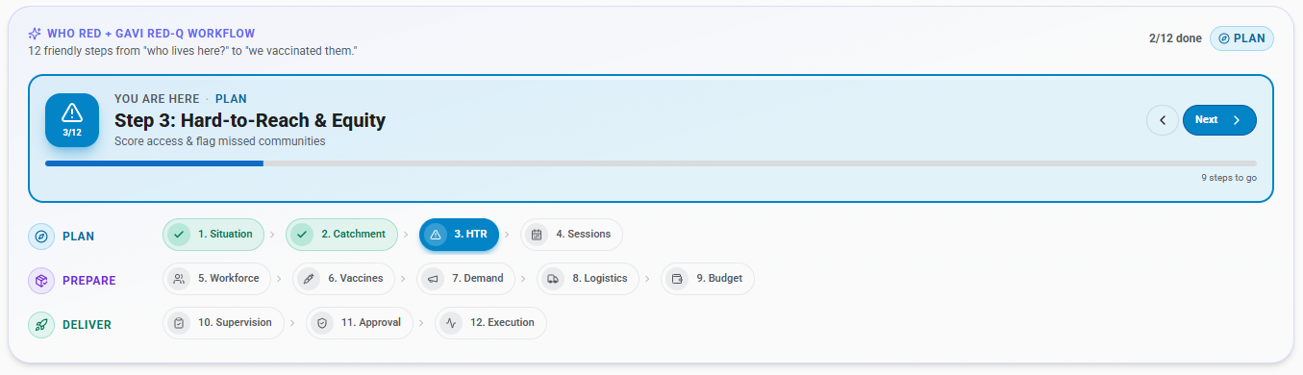
VaxPlan
05a · Product tour · Wizard
8 / 28
From "who lives here?" to "we vaccinated them" — in twelve plain-language steps.
VaxPlan's microplan wizard walks the facility clerk through the WHO RED and GAVI RED-Q workflow without ever using the word "microplan".
Three phases — PLAN · PREPARE · DELIVER — with twelve friendly steps end-to-end.
PLAN
Who lives here, who is hard to reach, who missed last round, and who is due this round. The map answers all four.
PREPARE
How many doses, how many session days, where and when, who runs each one, how much it costs, who tells the community.
DELIVER
Mark sessions done with per-antigen counts, sweep defaulters, supervise with the RED checklist, sign off the quarter.
VaxPlan · Multitenant GIS Microplanning for National Immunisation Programmes

Slide 9
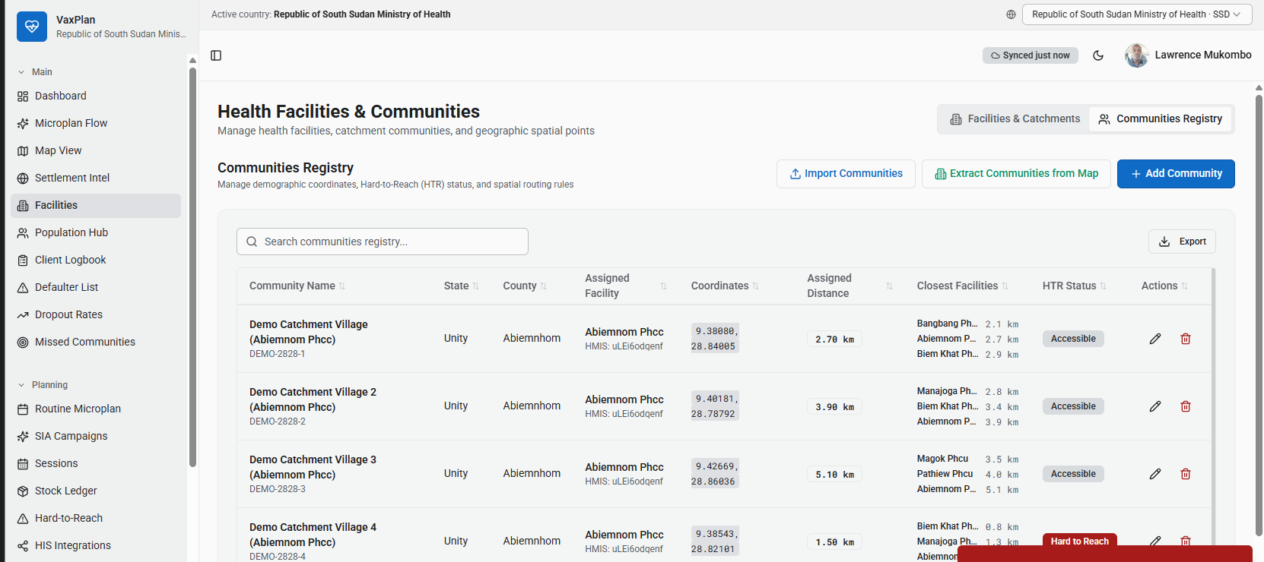
VaxPlan
05b · Product tour · Registry
9 / 28
Every facility, every community, every coordinate — one searchable table.
The Communities Registry is the source of truth for catchment, distance and Hard-to-Reach status.
What's captured per row
• Province / district / county / state
• HMIS / DHIS2 facility code
• GPS coordinates
• Assigned facility & distance (km)
• Three closest facilities (fallback)
• Hard-to-Reach status badge
• In-line edit + delete with audit
• Bulk import from CSV or extract from map
Communities Registry in the South Sudan tenant — note the live country indicator and the per-community HTR flag.
VaxPlan · Multitenant GIS Microplanning for National Immunisation Programmes

Slide 10
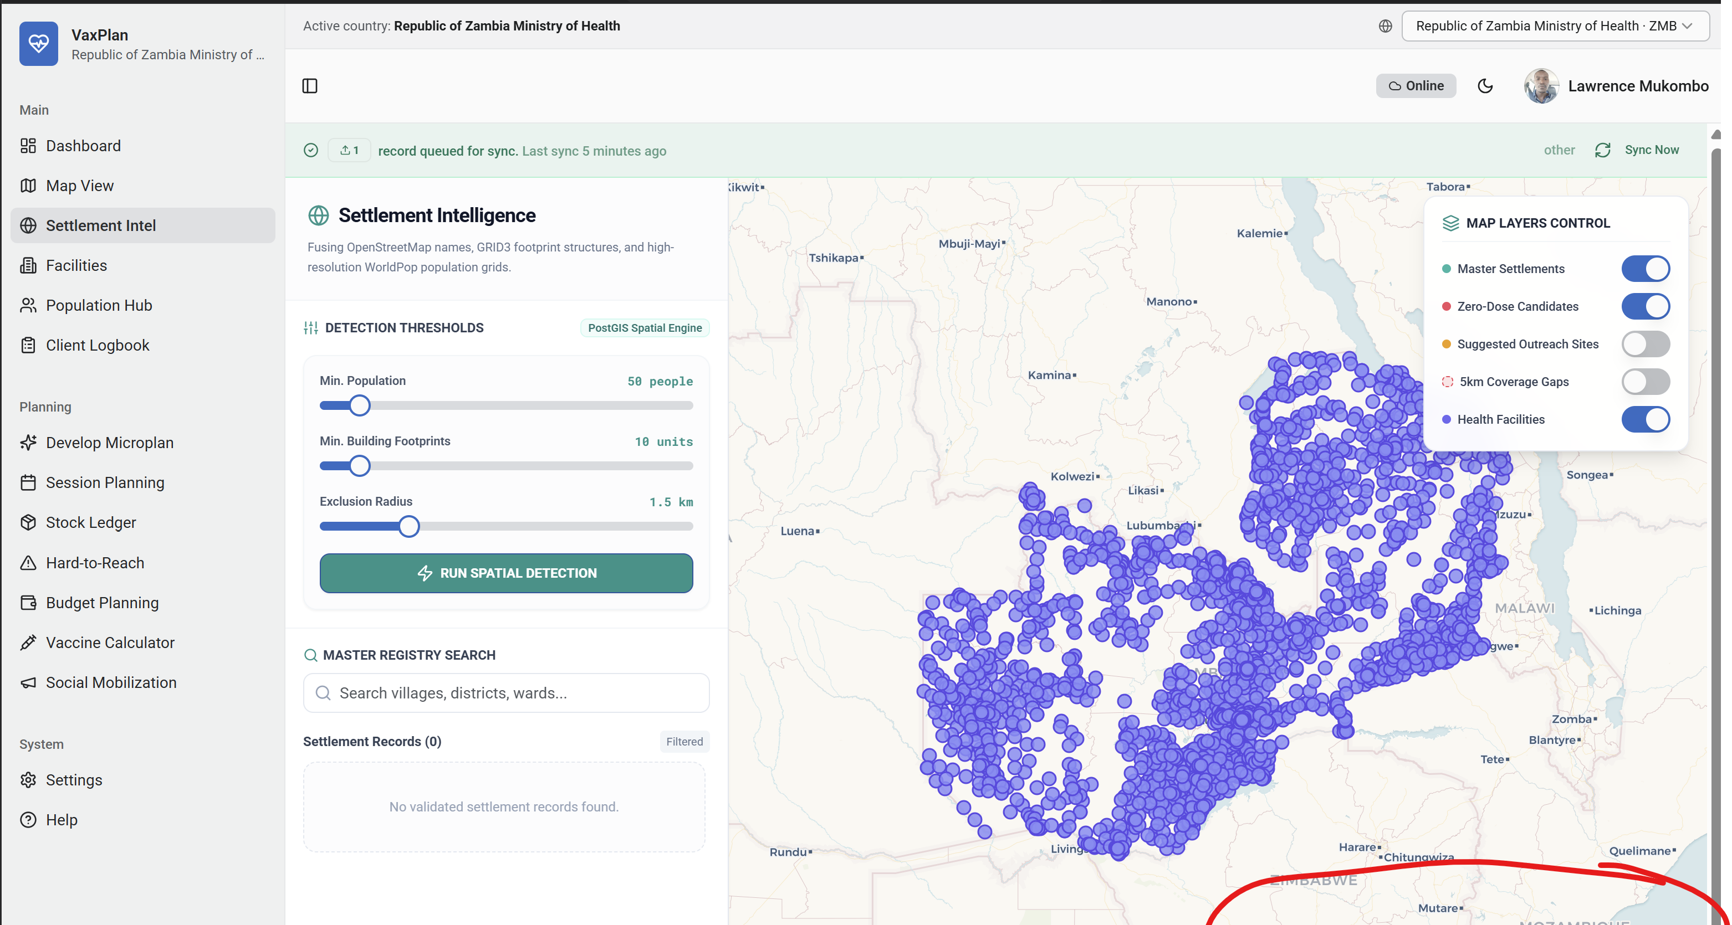
VaxPlan
05c · Product tour · Settlement intel
10 / 28
Find the communities your registry never knew existed.
Settlement Intelligence fuses OpenStreetMap names, GRID3 building footprints and WorldPop population grids on a PostGIS spatial engine.
Zambia — thousands of detected master settlements overlaid against the registry. Toggle zero-dose candidates, suggested outreach sites, 5 km coverage gaps and health facilities.
VaxPlan · Multitenant GIS Microplanning for National Immunisation Programmes

Slide 11
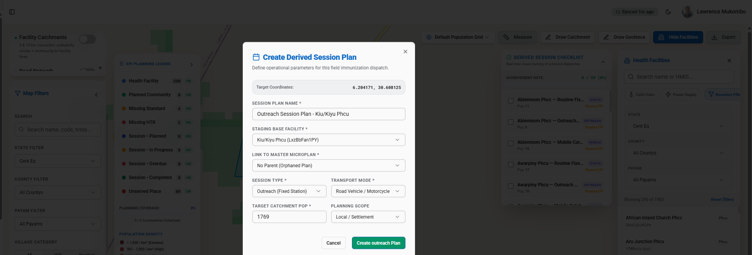
VaxPlan
05d · Product tour · Outreach
11 / 28
Click an unserved settlement. Plan a session right there.
The map IS the planning form. Click any household or settlement and VaxPlan opens a Derived Session Plan with the coordinates, staging facility and transport mode prefilled.
Create Derived Session Plan dialog — target coordinates, staging base, transport mode (motorcycle / boat / foot), planning scope and link to master microplan.
EPI Planning Legend (left panel)
Derived Session Checklist (right panel)
Health Facility · Planned Community · Missing Standard · Missing HTR · Session Planned / In-Progress / Overdue / Completed · Unserved Place.
Routine / Outreach / Mobile sessions auto-listed against the staging facility with a one-tap dispatch ready for the field team.
VaxPlan · Multitenant GIS Microplanning for National Immunisation Programmes

Slide 12
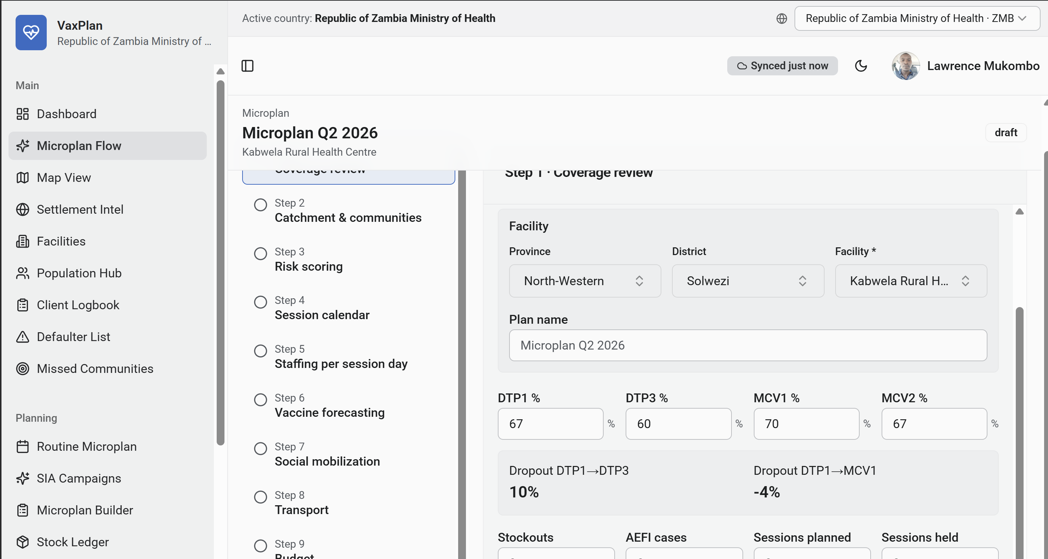
VaxPlan
05e · Product tour · Coverage
12 / 28
Last quarter's reality, baked into next quarter's plan.
The wizard's first step shows the facility's own DTP1, DTP3, MCV1, MCV2 and dropout rates — so plans are anchored to performance, not aspirations.
Why this step matters
• Plans grounded in real performance, not last year's targets copy-pasted.
• A 10% DTP1→DTP3 dropout becomes a visible problem, not a buried row.
• Negative dropout (−4% here) flags data quality issues for the district reviewer.
• Stockouts, AEFI cases and sessions planned vs held are captured in the same step.
• The 11 remaining wizard steps build on this baseline — catchment, risk, calendar, staffing, forecasting, mobilisation, transport, budget, supervision, submission, approval.
Microplan Q2 2026 · Kabwela Rural Health Centre — Step 1 Coverage review with live DTP1 / DTP3 / MCV1 / MCV2, dropout DTP1→DTP3 and DTP1→MCV1.
VaxPlan · Multitenant GIS Microplanning for National Immunisation Programmes

Slide 13
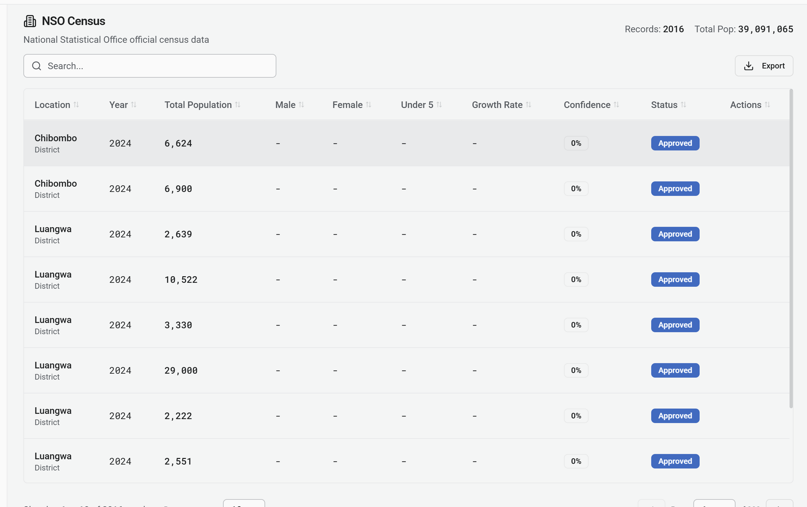
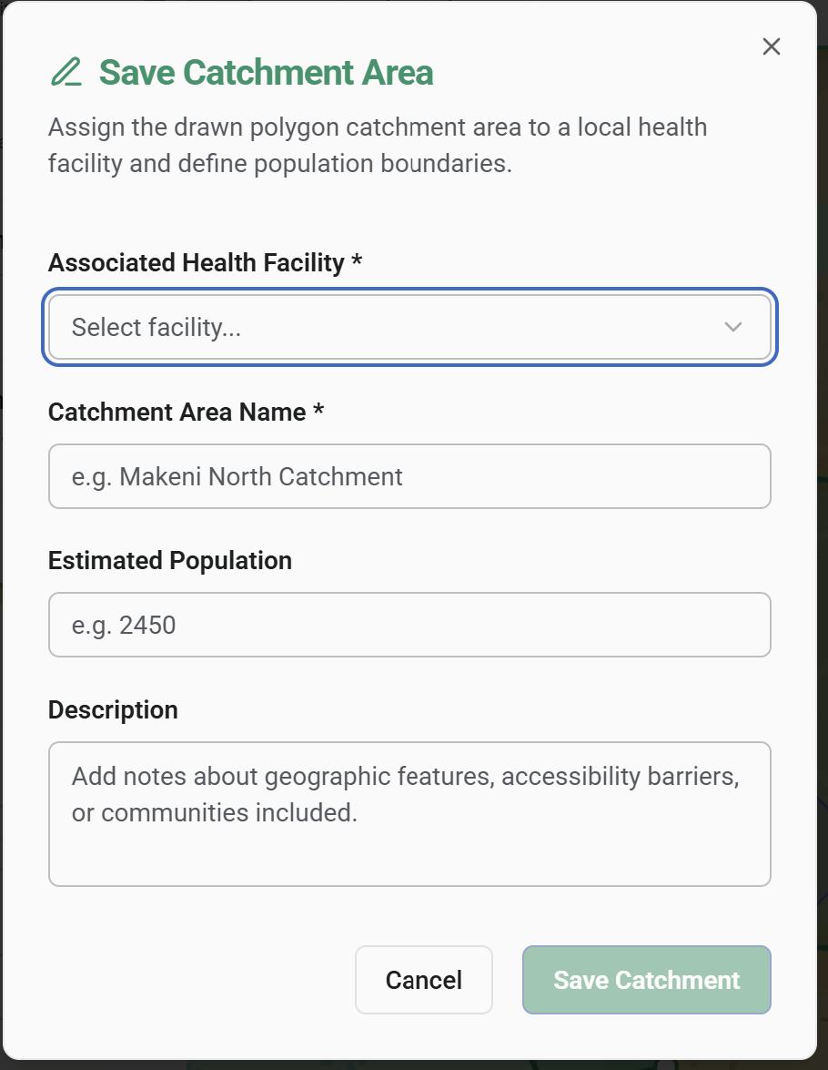
VaxPlan
05f · Product tour · Denominator
13 / 28
A living denominator, not a fossilised one.
VaxPlan ingests the National Statistical Office census, lets GIS specialists draw real catchment polygons, and the targets recompute themselves.
NSO Census table — 2,016 records, 39.09 million total population, with approval workflow per row.
Draw a polygon on the map → save as a named catchment.
VaxPlan · Multitenant GIS Microplanning for National Immunisation Programmes

Slide 14
VaxPlan
06 · Day in the life
14 / 28
Tuesday morning at a Health Post, 90 minutes from the road.
A facility clerk's whole day — from prep to submission — without ever leaving VaxPlan.
06:30
Plan the day on the calendar
Open the Sessions Hub calendar, pick today's date, hit "Plan a session on this day". The form opens with the date already filled.
07:15
Drive the bike to the outreach village
App is fully offline. Catchment polygons, household list and last-quarter coverage are already cached on the phone.
09:00
Vaccinate
Mark-done captures per-antigen counts (OPV-1, PENTA-2, MR-1...). Defaulters from previous rounds appear automatically as a checklist.
12:30
Catch unserved households
Click any unmapped house on the map: VaxPlan offers "Plan a session here" and prefills the outreach form with the right village link.
16:00
Sync on return
Back in 4G range, the outbox flushes. The in-charge receives the day's session ready to review and submit upward.
VaxPlan · Multitenant GIS Microplanning for National Immunisation Programmes

Slide 15
VaxPlan
07 · Quarter in the life
15 / 28
One quarter, three altitudes, one chain of accountability.
Approval flows up. Visibility flows down. Both happen inside VaxPlan, in the same week.
Facility
District / Province
National EPI
1. Author or copy-forward last quarter's microplan in the wizard.
2. Forecast vaccine requirements against the tenant schedule.
3. Submit to district for review with one tap.
1. Approvals Hub queues every pending plan by facility.
2. Reviewer compares targets, sessions and supply to last quarter on the map.
3. Approve, request changes with a reason, or escalate to province.
1. National dashboard shows DTP1, DTP1→DTP3 dropout, zero-dose by district.
2. Supervisory visits with WHO RED checklists are auto-seeded for every approved facility.
3. Sign off the quarter and push aggregate indicators upstream (DHIS2).
VaxPlan · Multitenant GIS Microplanning for National Immunisation Programmes

Slide 16
VaxPlan
08 · Map-driven planning
16 / 28
The map is the plan.
Health workers see catchments, settlements, defaulters and last-quarter coverage on one canvas — and act from it.
What's on the canvas
What you do from it
• Facility points sized by catchment population.
• Catchment polygons, drawn by the facility or by GIS specialists.
• GRID3 settlement footprints overlaid on OpenStreetMap.
• WorldPop population rasters (binary tiles cached for offline).
• Defaulter dots — children who missed their last scheduled dose.
• Hard-to-reach flags, terrain difficulty, distance-to-facility.
• Live coverage shading recomputed as sessions are reported.
• Click any village → "Plan a session here" with the form prefilled.
• Click a household icon → reach an unserved family with a single tap.
• Draw or redraw a catchment polygon and the recompute pushes targets, schedule and supply in real time.
• Pin a calendar day → open the New Session dialog with the date already set.
• Filter by quarter, province, district, facility, hard-to-reach status.
VaxPlan · Multitenant GIS Microplanning for National Immunisation Programmes

Slide 17
VaxPlan
09 · Offline-first
17 / 28
Works in airplane mode. Works on a motorbike. Works in the rainforest.
The last mile is built in from day one, not bolted on after launch.
Local replica
Mutation outbox
Two-way sync
Dexie / IndexedDB stores facilities, villages, clients, microplans and sessions on the device. Every screen reads from local cache first.
Every offline action is queued in an outbox table. The user keeps working; the platform doesn't lose the write if the network drops mid-save.
syncEngine flushes outbox via POST /api/sync/batch and pulls server updates via /api/sync/pull. Conflicts resolve by tenant + audit timestamp.
GIS cache v2 & v3
Unmapped antigen handling
Resumable wizard
GeoJSON and binary GeoTIFF map tiles cache locally, so the map keeps drawing population and settlements without a connection.
Old offline clients can still report unknown vaccine codes. Server stores them under perAntigenUnmapped, audits each occurrence, and surfaces a reconcile screen.
The microplan wizard auto-saves draft state. Close the tab, lose power, switch device — pick up exactly where you left off.
VaxPlan · Multitenant GIS Microplanning for National Immunisation Programmes

Slide 18
VaxPlan
10 · Schedule integrity
18 / 28
Tenant-owned schedule, no data ever silently dropped.
Every Ministry runs the antigens it actually uses — and the platform refuses to lose a count, even from an out-of-date client.
Per-tenant vaccine schedule
Mark-done with safety net
• Each tenant declares its own antigens, doses and intervals.
• expandVaccineSchedule(...) auto-generates per-dose records (OPV-1, OPV-2, PENTA-1...).
• Codes are canonicalised case- and whitespace-insensitively ("opv-1" → "OPV-1").
• Schedule changes flow to every facility in the tenant without a redeploy.
• Wastage factors and target ages travel with the antigen, not the spreadsheet.
• Known antigens land under vaccinatedCounts.perAntigen at the canonical code.
• Unknown codes (stale clients, mid-flight migrations) go to perAntigenUnmapped.
• Both still count toward totals — no field worker's day disappears because their app was a build behind.
• Every occurrence writes an audit entry: mark_done_unmapped_antigens.
• Response carries an unmappedAntigenCodes array so offline clients warn the user instead of failing silently.
• A reconcile screen lets district managers map stragglers back into the canonical schedule.
VaxPlan · Multitenant GIS Microplanning for National Immunisation Programmes

Slide 19
VaxPlan
11 · Multitenant & security
19 / 28
One platform, many Ministries — strictly isolated.
Every byte is tagged with a tenant. Every cross-tenant write is refused. Every approval is auditable.
Tenant-scoped data
Cross-tenant write guard
Bring-your-own SSO
Every domain table carries a tenantId. requireTenant middleware filters all reads to the active tenant.
crossTenantWriteGuard rejects writes to any tenant other than the user's home tenant with HTTP 403 — even for superusers exploring another country.
Per-tenant identity provider configurations support OIDC and SAML. The Ministry's IT team owns the directory; we never see passwords.
Self-service onboarding with approval
Immutable audit log
Country switcher, scoped writes
Hierarchical signup workflow: a new request lands with the national administrator for the country, not in a global support queue.
logAudit records userId, action, entityType, entityId, oldValue, newValue, IP. Approvals, reassignments and reconciliations are all replayable.
Regional officers can browse other countries (read-only) without leaving their session. Writing requires being in your home tenant.
VaxPlan · Multitenant GIS Microplanning for National Immunisation Programmes

Slide 20
VaxPlan
12 · Interoperability
20 / 28
Plays well with the HIS the Ministry already runs.
VaxPlan is the planning and field layer. It doesn't replace the national HIS — it feeds and consumes it.
Field
VaxPlan
HIS estate
Facility clerks
In-charges
Outreach teams
Defaulter sweeps
• Microplans, sessions, supervisory visits
• Per-antigen counts and defaulters
• Catchment polygons and zero-dose layers
• Offline outbox + bi-directional sync
• Approvals, comments, audit
DHIS2 (aggregates, org units)
FHIR R4 (Patient, Immunization)
SmartCare / eLMIS / iHRIS via adapter
National data warehouse
›
›
VaxPlan · Multitenant GIS Microplanning for National Immunisation Programmes

Slide 21
VaxPlan
13 · Accountability
21 / 28
Every plan signed. Every visit logged. Every change replayable.
Approvals and supervision are first-class workflows, not PDFs in shared folders.
Draft
›
Pending
›
Approved
›
Locked
Hierarchical review chain
Auto-seeded supervision (RED)
• Facility clerks/in-charges author; district approves routine; province approves campaigns.
• Reviewers can request changes with a reason code that travels back to the author's queue.
• Locked plans cannot be edited — only superseded by a new revision with full audit trail.
• Approving a microplan automatically seeds a quarterly supervisory visit for every facility in scope.
• Each visit is prepopulated with a 12-point WHO Reaching Every District (RED) checklist.
• Supervisor scores feed the district dashboard so weak facilities surface in the next cycle.
VaxPlan · Multitenant GIS Microplanning for National Immunisation Programmes

Slide 22
VaxPlan
14 · Reporting & analytics
22 / 28
The indicators EPI managers are actually asked about.
Computed live off the operational data — not exported, retyped and reconciled a week later.
DTP1
DTP1→3
Zero-dose
MCV1 / MCV2
First-contact coverage — proxy for access to immunisation.
Drop-out rate — proxy for system retention quality.
Children with no DTP1 by 12 months — the equity headline.
Measles coverage and second-dose follow-through.
District scorecards
Missed communities
Supply realism
Supervision coverage, DTP3 by facility, missed-community count, sessions held vs planned.
Automated report cross-references GRID3 settlements against held sessions to surface populations the plan missed.
Forecast vs consumption vs wastage per antigen — flags facilities with persistent stock-out risk.
VaxPlan · Multitenant GIS Microplanning for National Immunisation Programmes

Slide 23
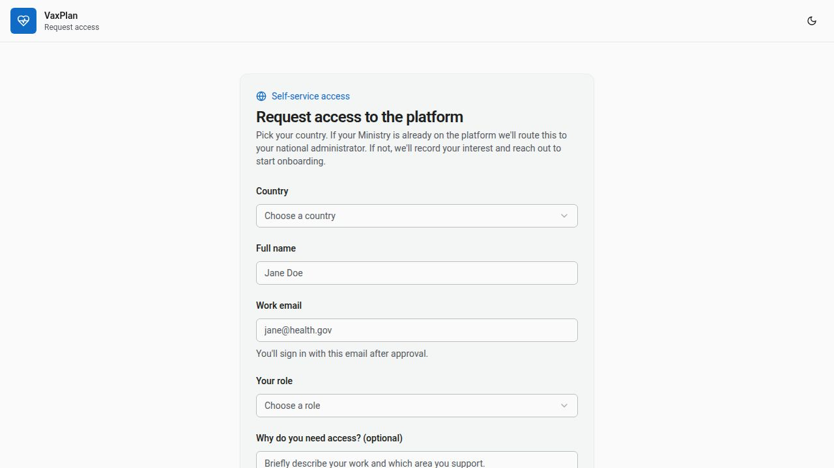
VaxPlan
15 · Onboarding
23 / 28
A Ministry can request access in under two minutes.
Self-service signup with hierarchical approval — no sales gate, no email chain, no spreadsheet of access requests.
How approval works
• If the Ministry already runs a tenant, the request lands with the country's national administrator.
• If not, VaxPlan logs the interest and reaches out about onboarding.
• Approvals propagate down — district managers approve facility staff, not headquarters.
• Onboarded users sign in via the tenant's chosen identity provider (OIDC / SAML).
• Email domains map to tenants, so the country switcher routes them home automatically.
Self-service request form — country, role, and an optional note to the national admin.
VaxPlan · Multitenant GIS Microplanning for National Immunisation Programmes

Slide 24
VaxPlan
16 · Where VaxPlan fits
24 / 28
Not another dashboard — the missing planning layer.
VaxPlan complements DHIS2 and the national HIS; it doesn't compete with them.
Capability
Paper / register
Spreadsheet
DHIS2 only
VaxPlan
Map-driven catchments
—
—
Some
Yes — drawn & GRID3
Offline session capture
Manual
Manual
Limited
First-class outbox
Per-antigen forecasting
—
Yes (fragile)
Aggregated
Tenant schedule
Hierarchical approvals
Signatures
—
Workflow plugin
Built-in chain
Auto supervisory visits
—
—
—
RED checklist seeded
Multitenant SSO
—
—
Per instance
BYO IdP per tenant
Audit on every write
—
—
Partial
Immutable log
VaxPlan · Multitenant GIS Microplanning for National Immunisation Programmes

Slide 25
VaxPlan
17 · Deployment
25 / 28
Deployed in the region. Owned by the Ministry.
Three deployment shapes, the same product, the same data model.
Managed cloud
Fastest
Sovereign cloud
Most common
On-premise
Highest control
VaxPlan hosts a dedicated tenant. The Ministry's data lives in a region of its choice (EU, US, Africa). SLA managed by us.
Deployed into the Ministry's own cloud account (AWS / Azure / GCP) or a national data centre. Same image, Ministry holds keys.
Air-gapped national EPI servers. Releases delivered on signed media. Ideal for sensitive deployments and offline pilots.
• Up in days
• We patch & upgrade
• Pay per facility per month
• Data residency in-country
• Ministry IT keeps root
• Quarterly upgrade cadence
• Zero external dependencies
• Field devices sync locally
• Slower upgrade cycle
VaxPlan · Multitenant GIS Microplanning for National Immunisation Programmes

Slide 26
VaxPlan
18 · Pilot roadmap
26 / 28
A six-month pilot to a province-wide rollout.
Concrete, measurable milestones — not a multi-year transformation.
M0 – M1
Tenant set-up & data load
Spin up the Ministry's tenant. Load national boundaries, facility registry, GRID3 settlements, WorldPop rasters. Configure SSO and the vaccine schedule.
M1 – M2
Train two pilot districts
Train ~40 facility clerks and 6 district managers. Activate offline devices. Co-author the first quarterly microplan in the wizard.
M2 – M4
Run one full quarter
Plan, deliver and review one quarter on VaxPlan. Compare coverage, dropout and zero-dose with the previous baseline.
M4 – M5
Independent evaluation
M&E team reviews coverage, missed communities, supervisory visit completion and user adoption. Publish dashboard to national EPI.
M5 – M6
Province-wide rollout decision
Sign-off by the National EPI Manager. Expand to remaining districts in the pilot province; plan national scale-out for the next fiscal year.
VaxPlan · Multitenant GIS Microplanning for National Immunisation Programmes

Slide 27
VaxPlan
19 · Investment
27 / 28
Predictable cost. Proportional to the system, not the licences.
Pricing follows the number of facilities served, not seat counts — so adding a clerk never costs a Ministry money.
Pilot
Province
National
Up to 2 districts · 6 months
Up to 200 facilities · annual
Country-wide · multi-year
Fixed
$
$$
fee-for-service
per facility / month
per facility / month, tiered
• Tenant set-up and data load
• Training for 40 users
• One quarterly cycle supported
• Independent evaluation included
• Unlimited users in tenant
• Managed or sovereign cloud
• 9 × 5 support, 1 business day SLA
• Quarterly product upgrades
• On-prem option, signed releases
• 24 × 7 critical-incident support
• Custom HIS adapters (DHIS2, eLMIS)
• Joint roadmap with EPI manager
VaxPlan · Multitenant GIS Microplanning for National Immunisation Programmes

Slide 28
Reach every child.
Plan every session.
Next step: a 60-minute working session with your national EPI lead and GIS focal point to scope a pilot province.
contact@vaxplan.health · vaxplan.health

