Slide 1
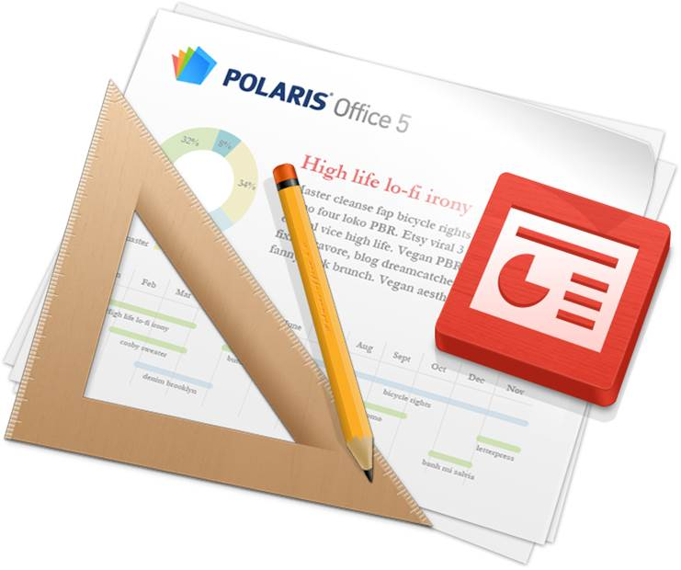
Editing Slides
With Polaris Office, you can create new .ppt and .pptx presentations or edit your presentation with ease.
However, new documents can only be saved as .pptx files.

Slide 2

Title bar
‘Slide show’
You can start slide show.
‘Free draw’
You can draw a shape/table with a pen.
‘Insert’
You can insert an object.
‘Properties’
You can adjust the properties of an object.
‘Menu’
You can call up the menu.
(This menu icon disappears in the device supporting ‘Hardware menu button’.)

Slide 3
Adding Slides
To add a slide, click the ‘Menu’ icon in the Title bar and
select ‘Insert Slide’. Select the slide layout, and the new
slide with corresponding layout will be added after current
slide.
Managing Slides
Click the ‘Menu’ icon in the Title bar and select ‘Managing
Slide’. The entire list of slides will appear, and then you
can copy, move or delete the slides you want.
Hold the slide and drag it to a new position.

Slide 4
Slide Show
To execute a slide show, click the ‘Menu’ icon in the Title
bar and select ‘Slide Show’, and you can move to
previous/next slide and see the animation effects between slides. Also, you can place the pointer and draw a line on
the slide.
Slide Note
To see a slide note, click the ‘Menu’ icon and select ‘Slide
Note’, and the slide note appears at the bottom of the slide. When you move to the slide you want to see, the applicable slide note is displayed. To edit the content, tap the note.

Slide 5
Object Insert
Tap the Insert icon in the Title bar and select the icon for the type of object you want to insert, such as image, shape, table, or chart. You can insert images, shapes, tables, or charts by selecting them in the Gallery, or insert images by taking a picture using the camera on your device.
Object Format
Select the object for which you want to change the format and then tap the Properties icon in the Title bar to bring up the Properties Panel for each object. You can set the Brightness, Contrast, Transparency, and Shadow of images, the Color, Border, 3D Rotation, and Alignment of shapes, and the Shape, Layout, and Style of tables and charts.

Slide 6
Screen Conversion Effect
Tap the Menu icon in the Title bar and then select Screen Conversion to display the Properties panel. You can set the area, transition time, and other effects of the animation here.
Select Multiple Objects
Select an object, such as an image, shape, or chart, to display the pop-up menu. Tap the Multi Select icon in the pop-up menu and then tap multiple objects to select multiple objects at once. You can adjust the size or move the selected objects. After selecting the objects, tap the Properties icon in the Title bar to align the selected objects.

Slide 7
Draw Shape/Table with Pen
Tap the My Notes icon in the Title bar and then select the Shape icon to draw a shape with the pen. Select the Table icon to draw a table with the pen. Select the Erase Table icon to delete rows/columns or merge cells in the table.
Multi Select with Pen
Tap the My Notes icon in the Title bar and then tap the Lasso icon to select multiple objects with the Lasso tool.
Smart Guide
Tap the Menu icon in the Title bar and then tap the View Settings to bring up the pop-up menu. When you check the Display Smart Guide option in the menu, the proper position of the shape or image will be displayed as a Smart Guide, showing reference lines as you move the shape or image.

