Slide 1
EMAIL SPAM CLASSIFICATION BY FASTTEXT
FUNIX EDU
Graduation thesis Data Science DSP305
STUDENT: VŨ QUỐC VƯƠNG
MENTOR: NGUYỄN HUY THÀNH

Slide 2
CONTENT
Business Understanding
Data Understanding
Data Description
EDA report
Data Preparation
Modelling
Model Evaluation
Model Improvement

Slide 3

BUSINESS UNDERSTANDING
What is email spam ?
Spam emails are illegal or unsolicited messages sent through to a large number of users.
Their primary goal is to lure the user into clicking a malicious link or downloading an attachment that is harmful to the user's machine.
Why classification email spam?
To protect user from malicious email
Reduce user distractions when receiving unsolicited emails
Goal:
Build a usable spam classification model
The classification is based on the metrics, which is more than 0.95

Slide 4
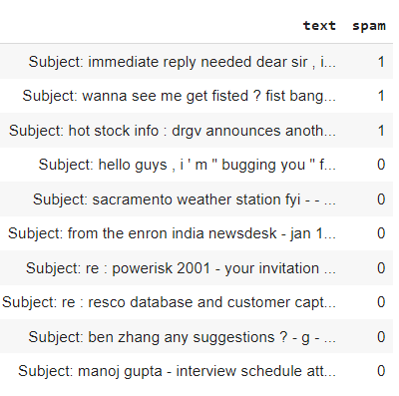
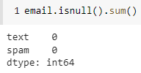

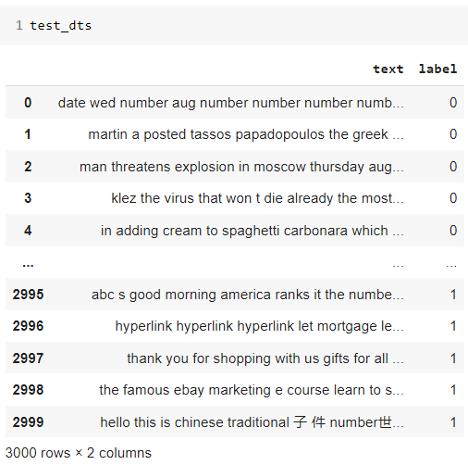
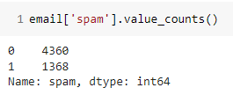
DATA UNDERSTANDING
Data Description
Main dataset
Test dataset

Slide 5
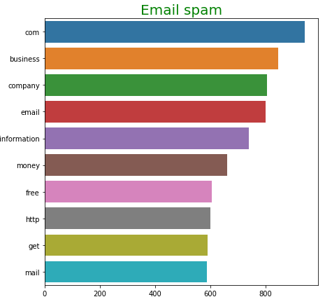
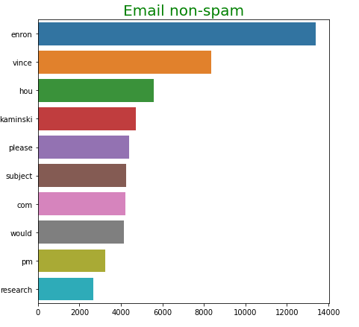
DATA UNDERSTANDING
Exploratory Data Analysis - EDA
Top 10 words appear in each field

Slide 6
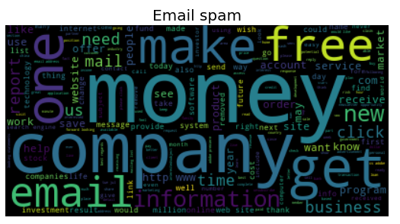
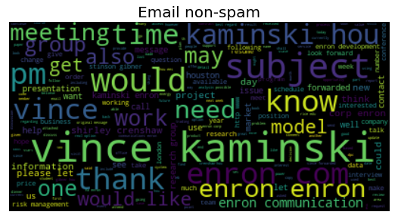
DATA UNDERSTANDING
Exploratory Data Analysis - EDA
Top words appear in each field visualize by wordcloud

Slide 7
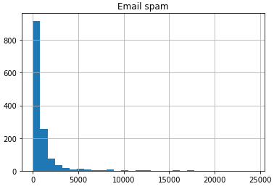
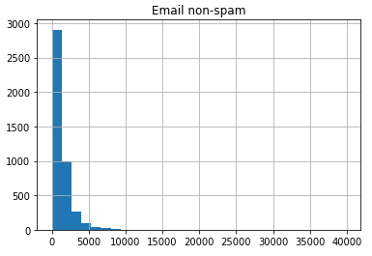
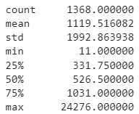
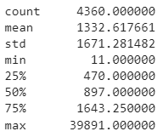
DATA UNDERSTANDING
Exploratory Data Analysis - EDA
Words distribution

Slide 8
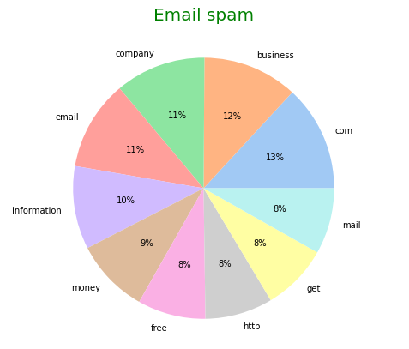
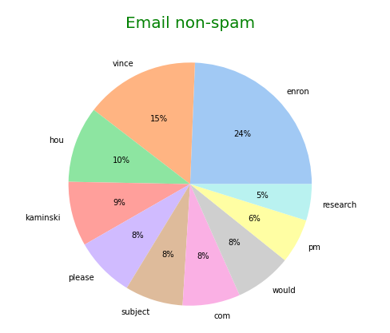
DATA UNDERSTANDING
Exploratory Data Analysis - EDA
Top 10 words appear in each field

Slide 9
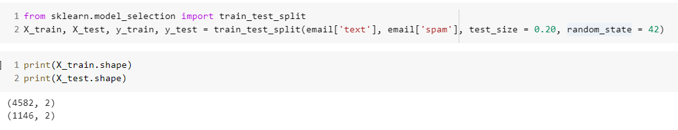
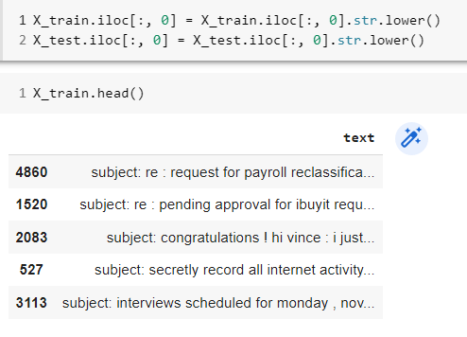
DATA PREPARATION

Slide 10
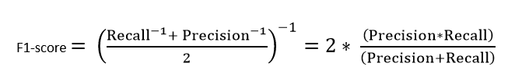
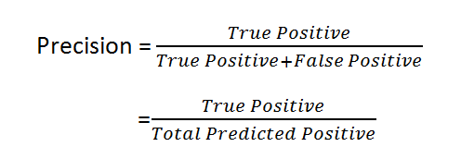
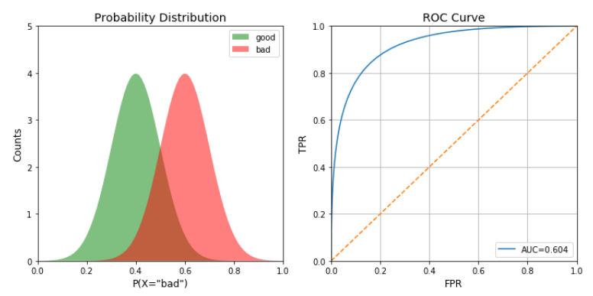
MODEL EVALUATION
Evaluate model by F1 score
F1-score is used when the False Negatives and False Positives are crucial
F1-score is a better metric when there are imbalanced classes as in the above case

Slide 11

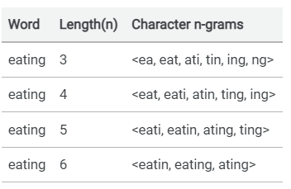
MODELLING
FastText
FastText is a lightweight library designed to help build scalable solutions for text representation and classification.
Advantages:
It is helpful to find the vector representation for rare words.
It can give the vector representations for the words not present in the dictionary (OOV words) since these can also be broken down into character n-grams.
character n-grams embeddings tend to perform superior to word2vec and glove on smaller datasets.

Slide 12
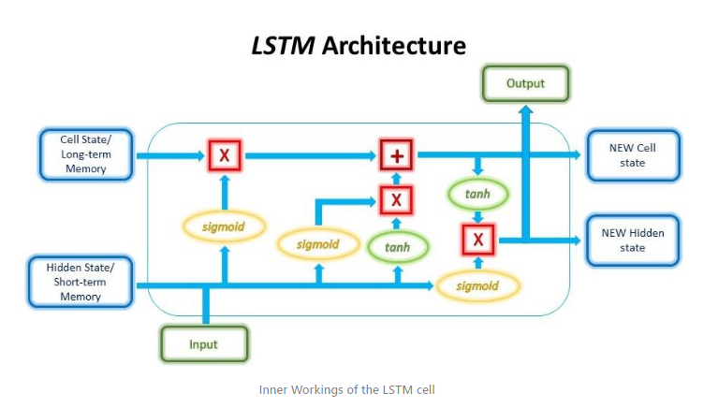
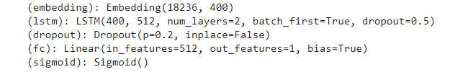
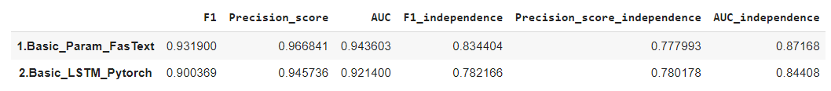
MODELLING
LSTM Pytorch
Pytorch used for applications such as natural language processing.
Advantages:
LSTM have long-term memory.
Simple model LSTM with two layer

Slide 13
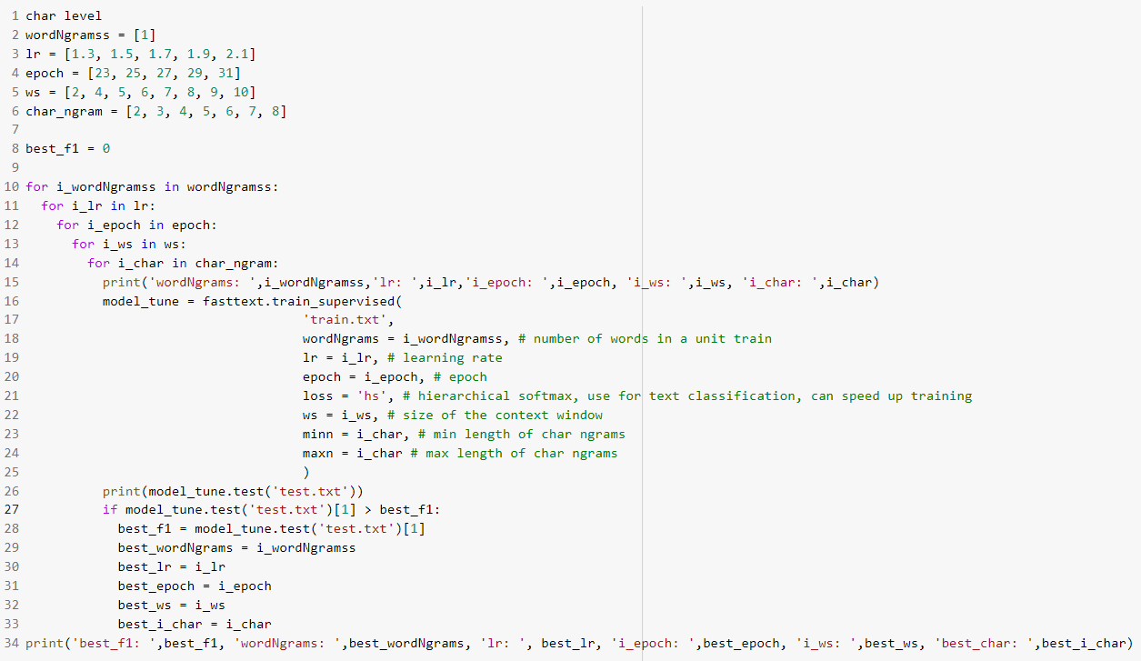
MODEL IMPROVEMENT
FastText – Tuning parameter

Slide 14
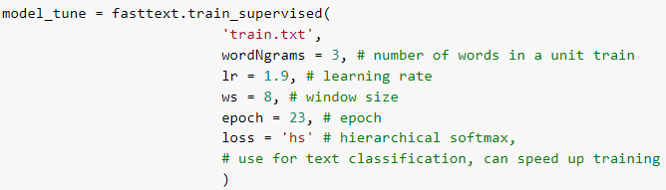
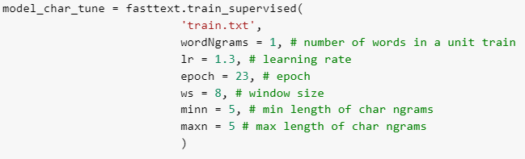
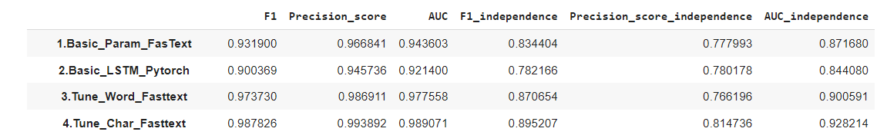
MODEL IMPROVEMENT
FastText – Tuning parameter
Best param with word level
Best param with character level

Slide 15
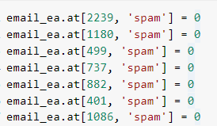
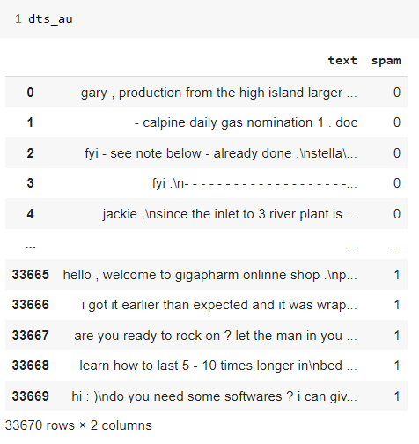
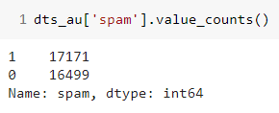
ERROR ANALYSIS and DATA AUGMENTATION
Replace incorrect label
Data augmentation for email has little data

Slide 16
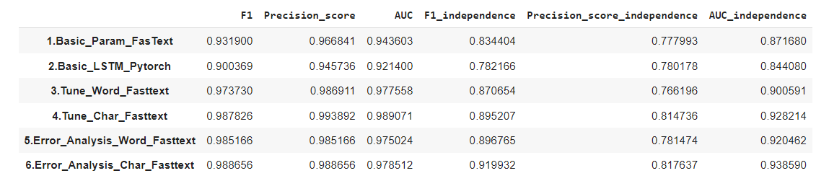
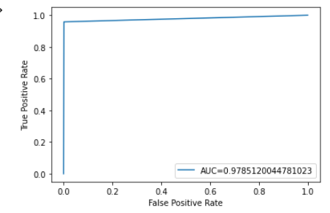
RESULT
After error analysis, fasttext model by character level give the best result
Timeline of results

Slide 17

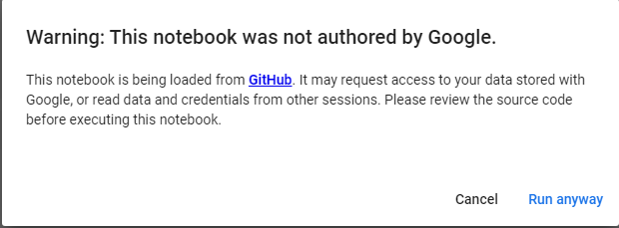
GUIDELINE DOCUMENT
Access notebook by click this below link:
https://github.com/VuongDS/305/blob/main/Classification.ipynb
Click ‘Open in Colab’:
Click ‘Ctrl + F9’ to Run
Click ‘Run anyway’:

Slide 18
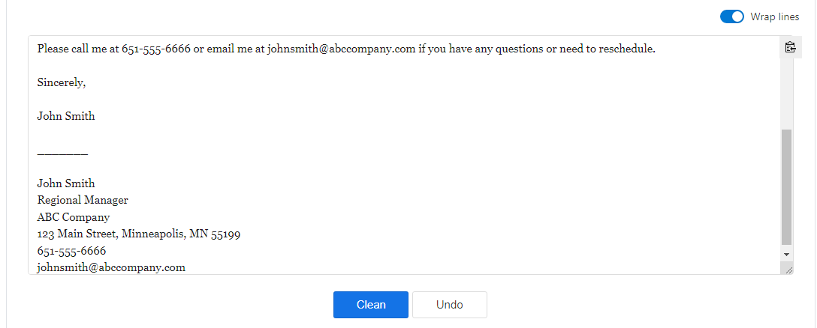
GUIDELINE DOCUMENT
Preprocessing text by click this link: https://textcleaner.net/
Copy and paste email under classify to this box

Slide 19

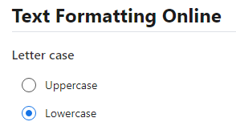
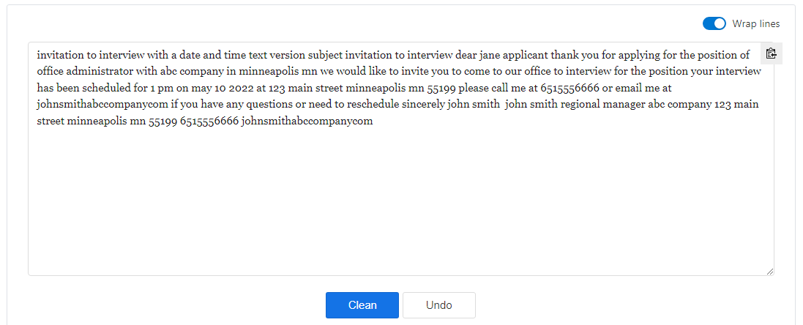
GUIDELINE DOCUMENT
Choose option:
Then, click ‘clean’

Slide 20

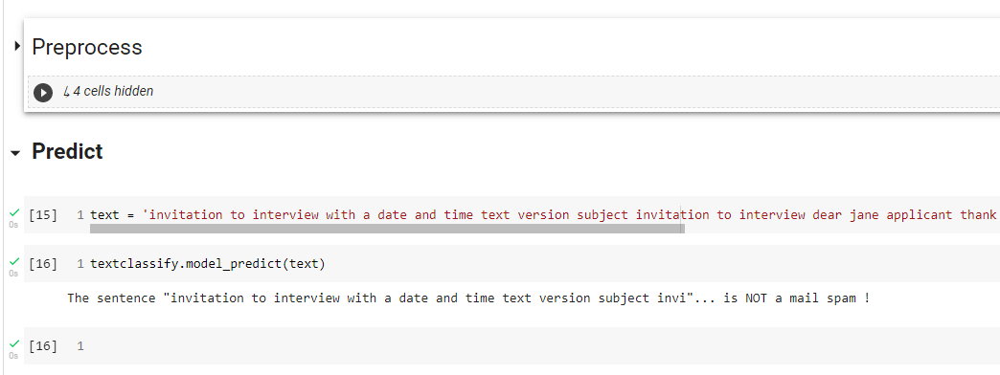
GUIDELINE DOCUMENT
Copy text to notebook by following this command:
Then, run notebook to classify email:

Slide 21
THANK YOU !

